Slide 1
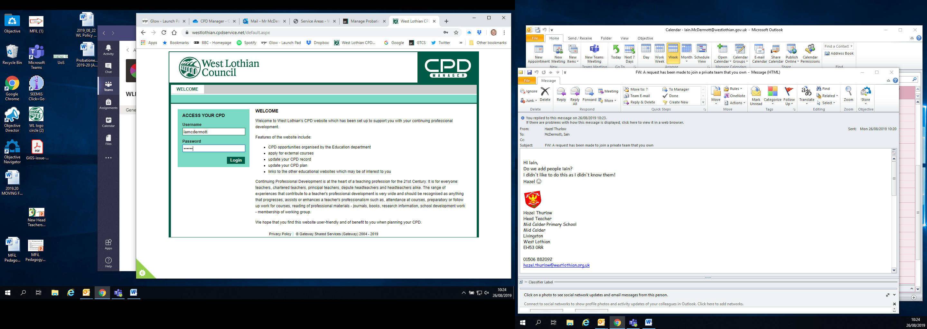
Staff can: | Coordinators can:
Create and maintain a their CLPL linked to the HGIOS framework Search, apply and manage CLPL opportunities Manage their annual CLPL requirement Manage the Professional Update process and electronic submission to GTCS within MyPL | View and manage staff applications View staff CLPL records and contact history Manage school and staff details Manage and promote local CLPL opportunities

Slide 2
Staff walkthrough:
Login
and
Booking a Course

Slide 4
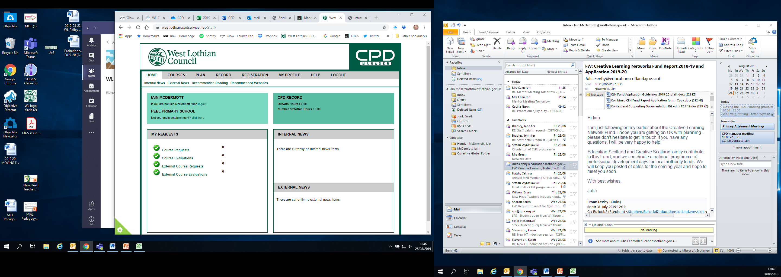

Slide 5
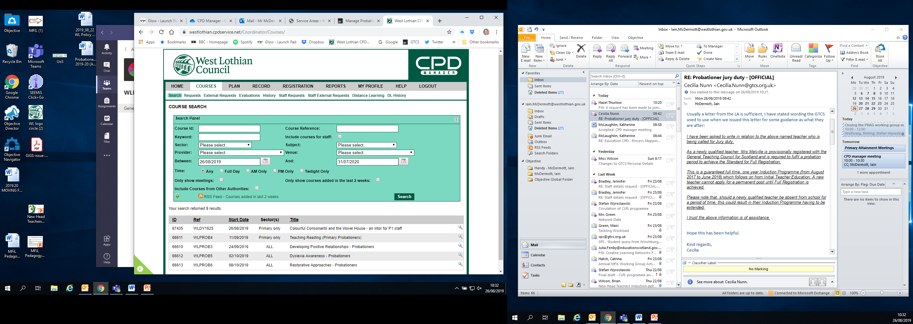

Slide 6
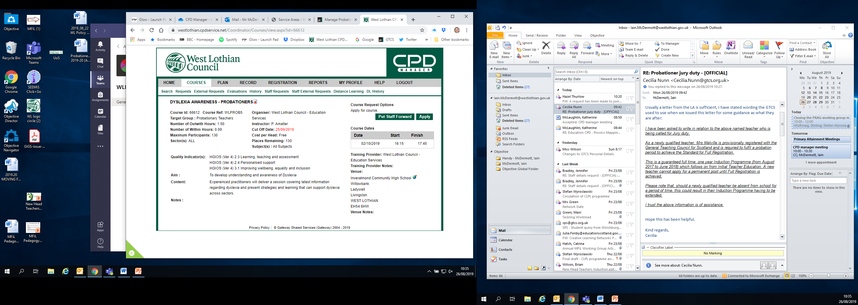

Slide 7
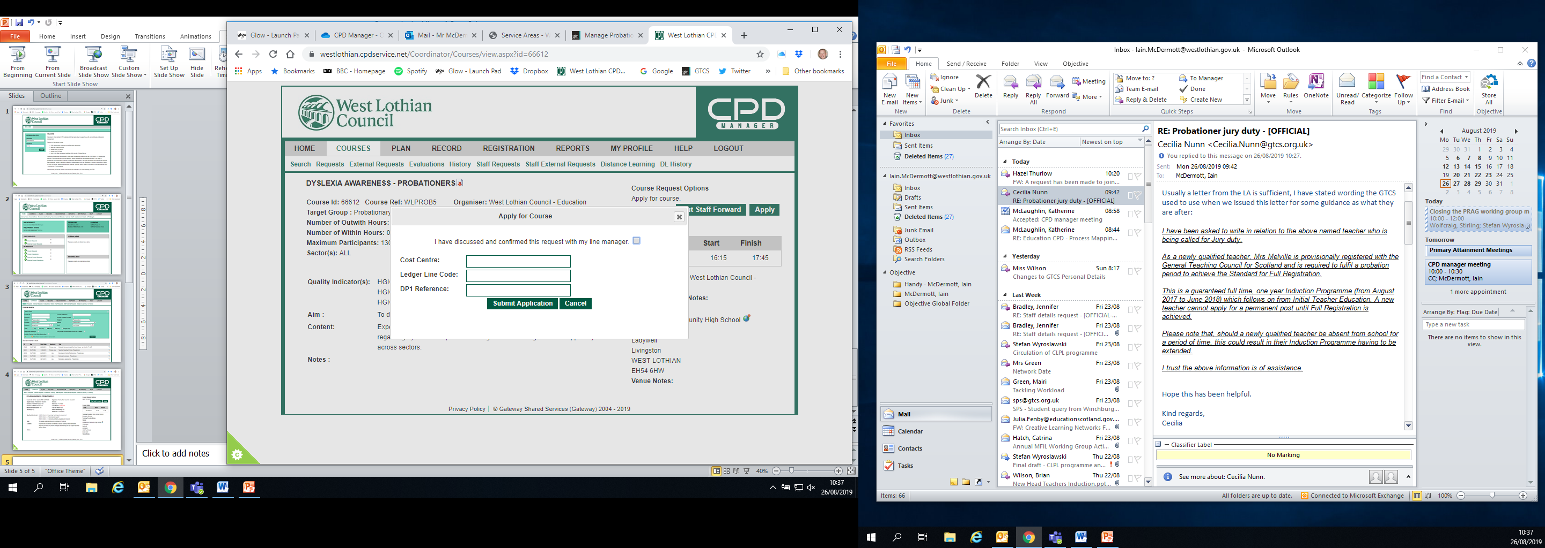
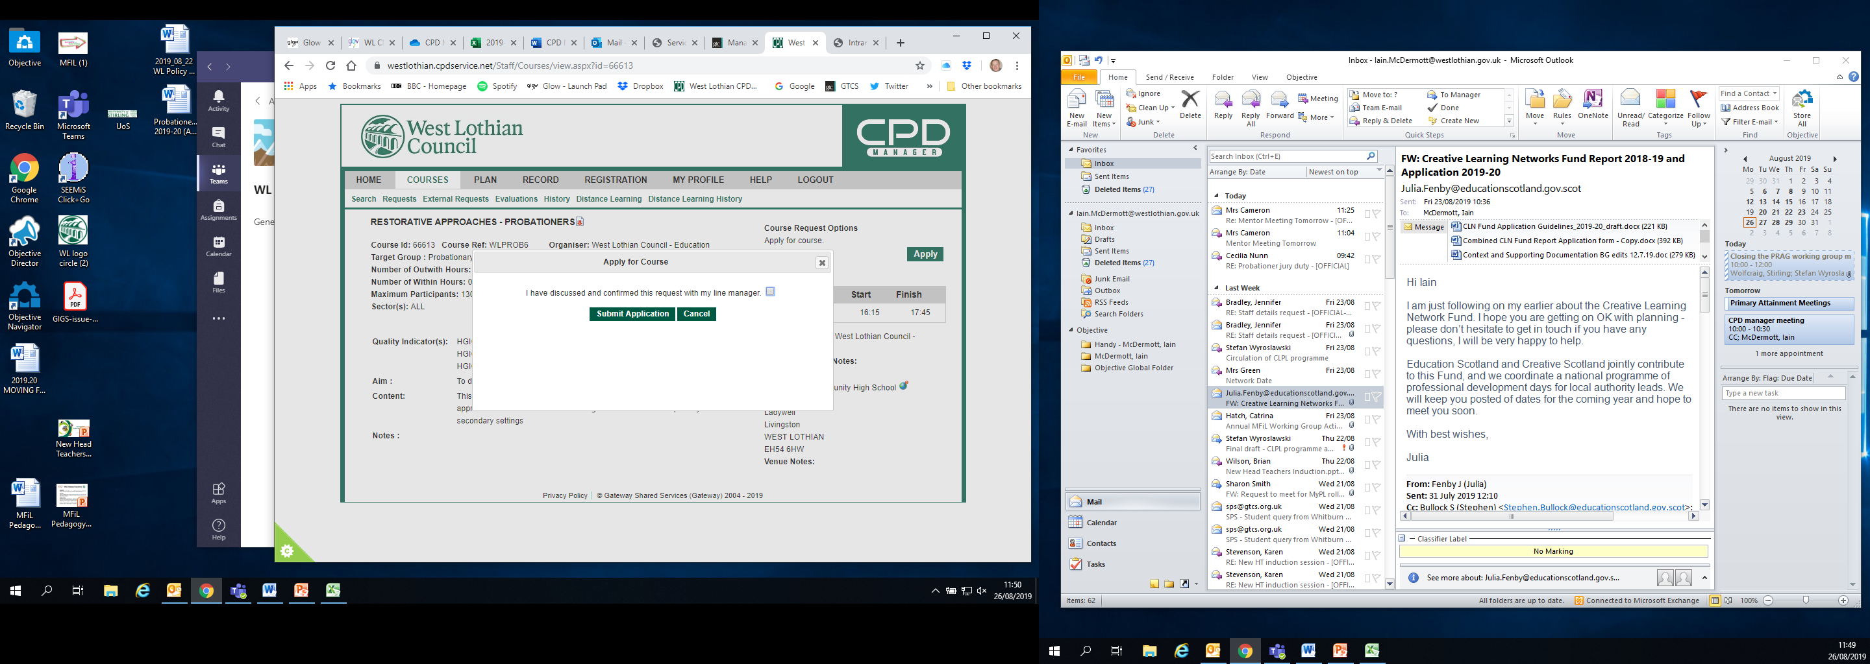

Slide 8
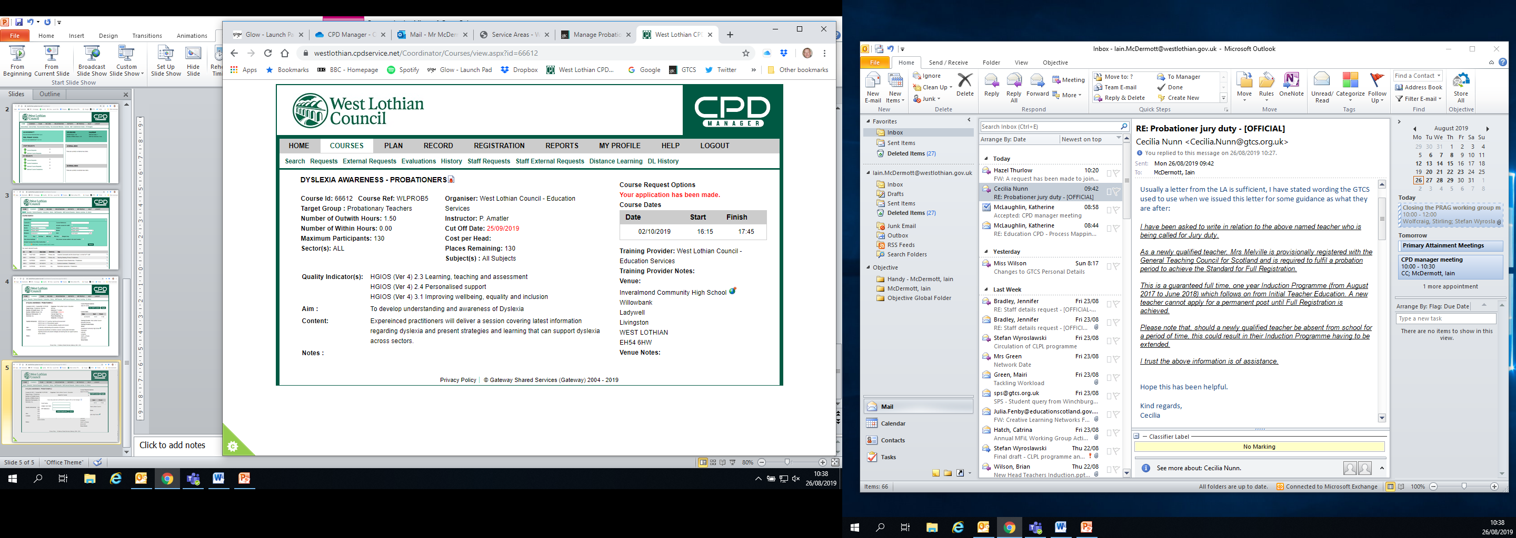

Slide 9
Coordinators walkthrough:
Approving courses

Slide 10
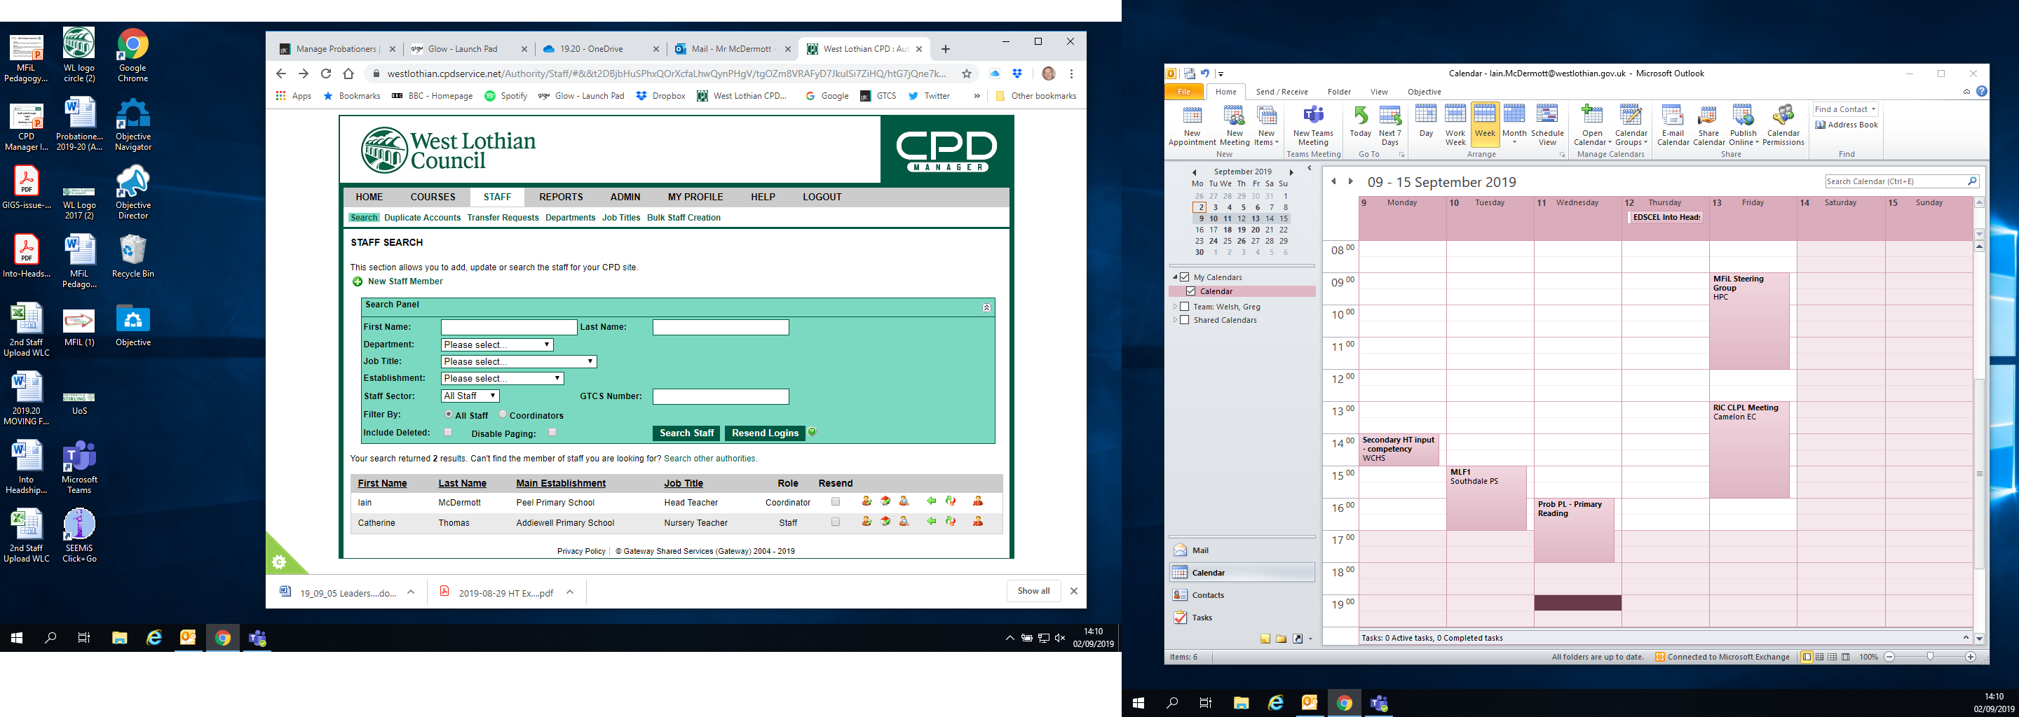

Slide 11
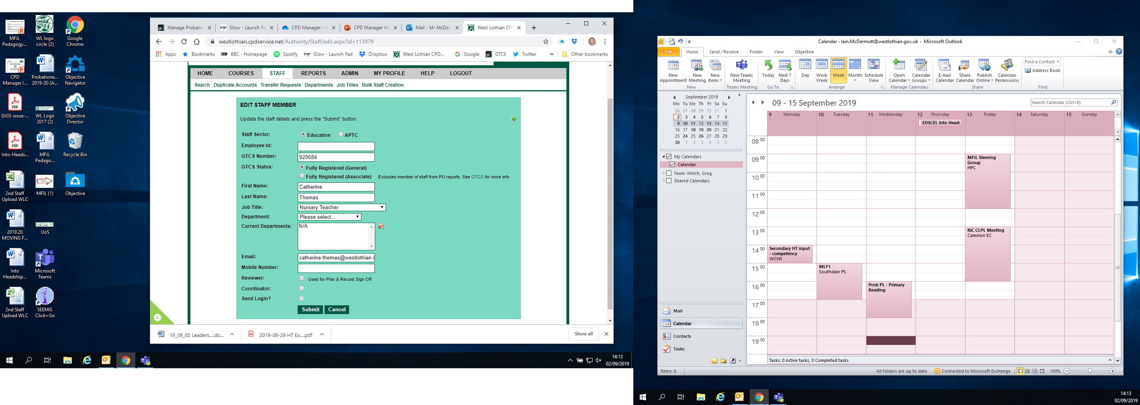

Slide 12


Slide 13
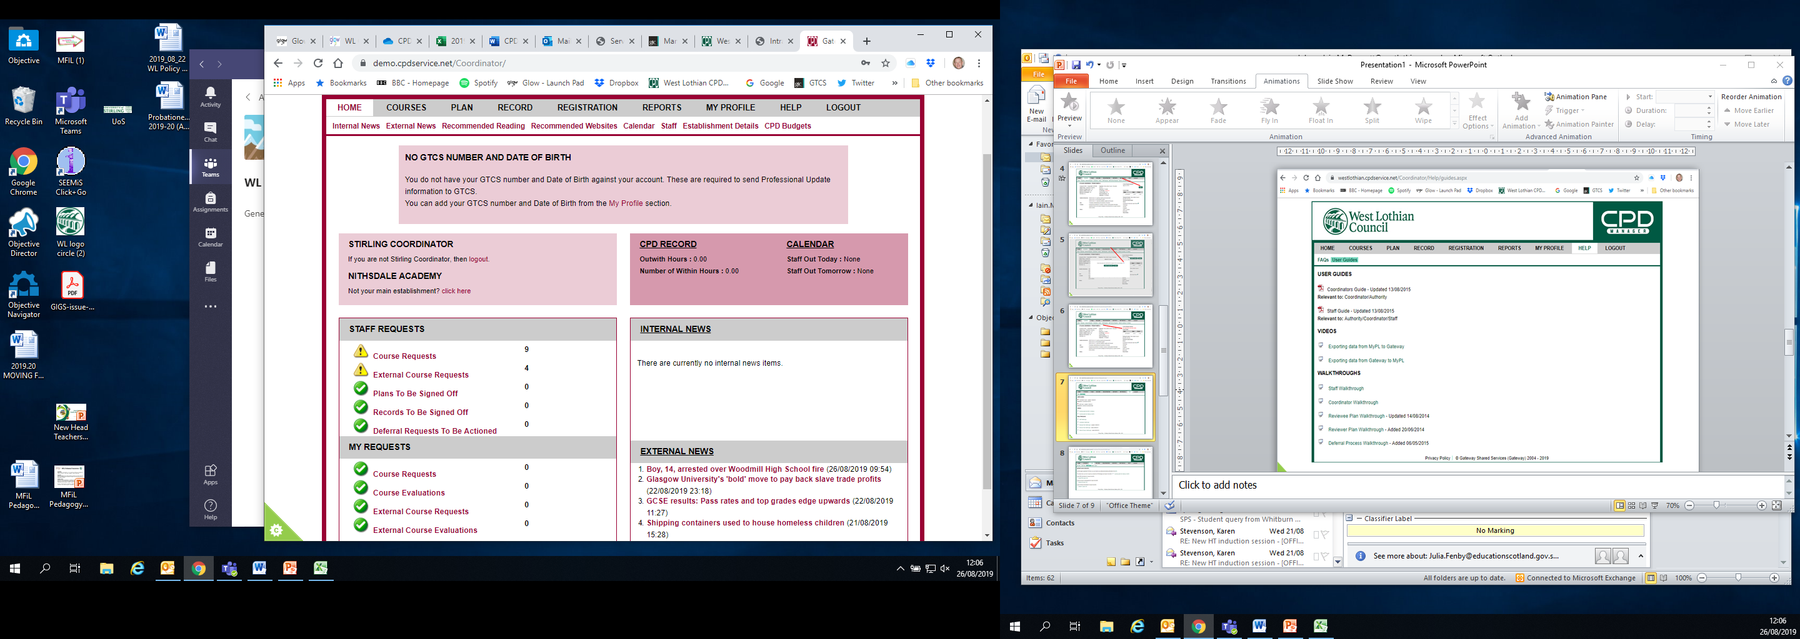

Slide 14
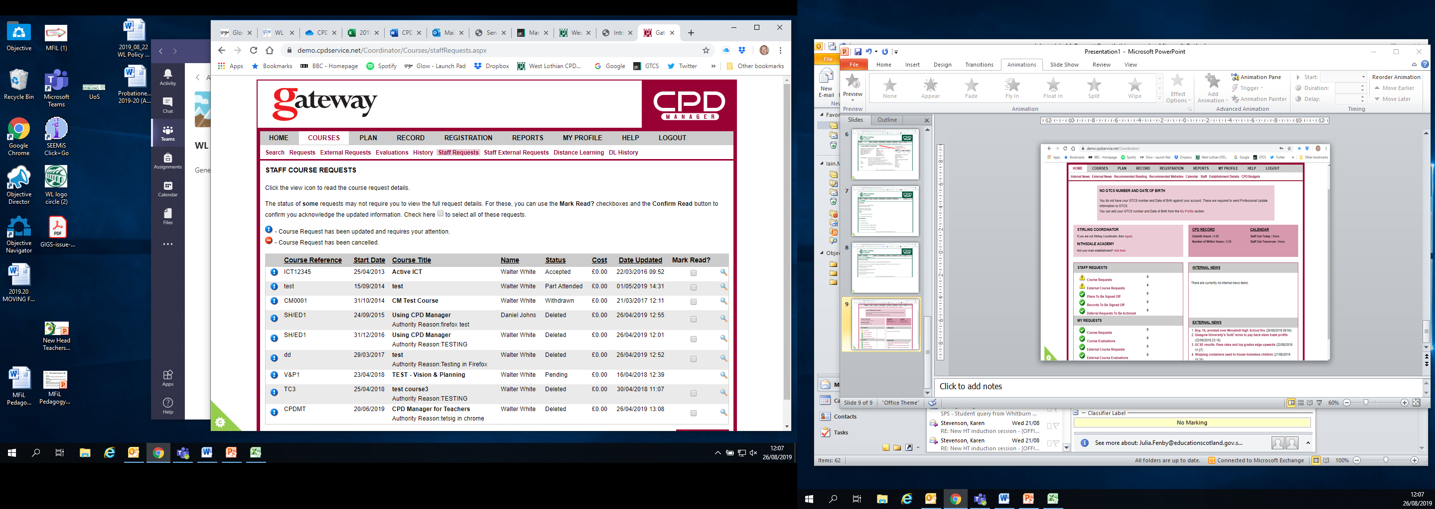

Slide 15
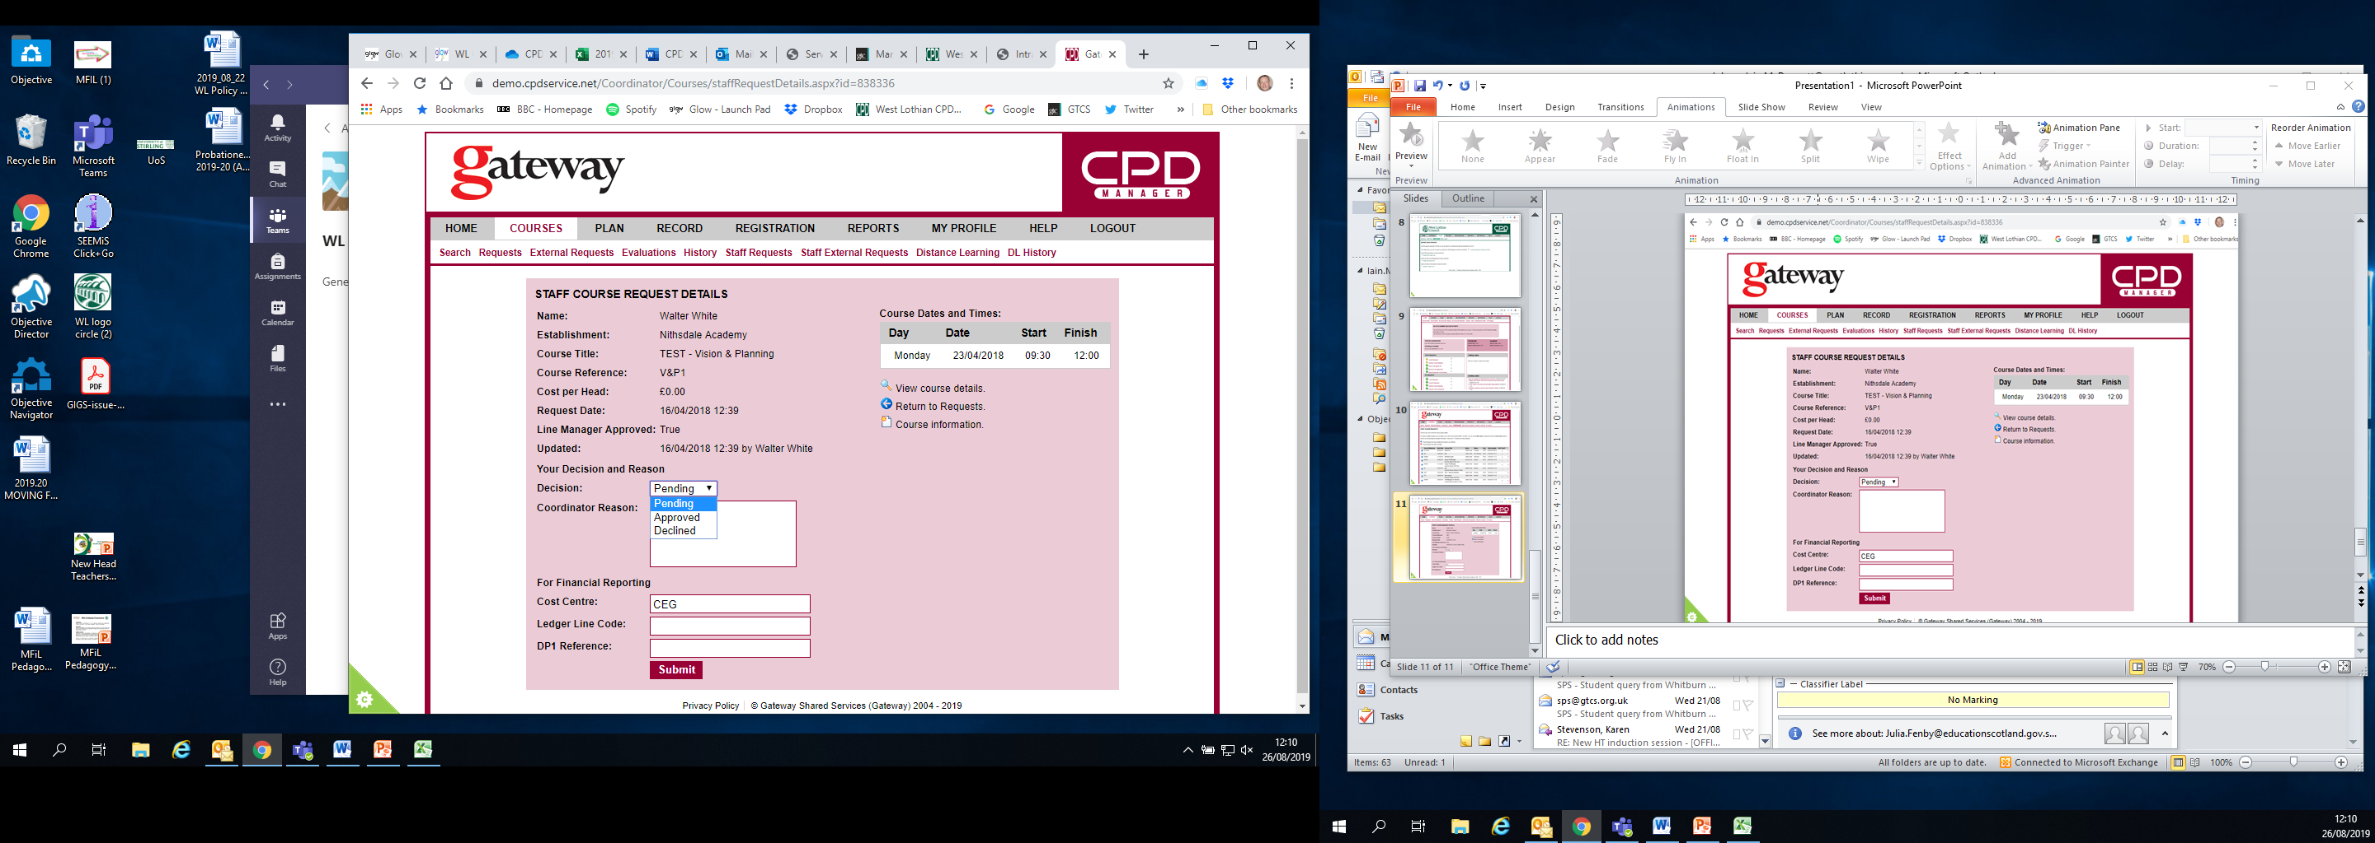

Slide 16
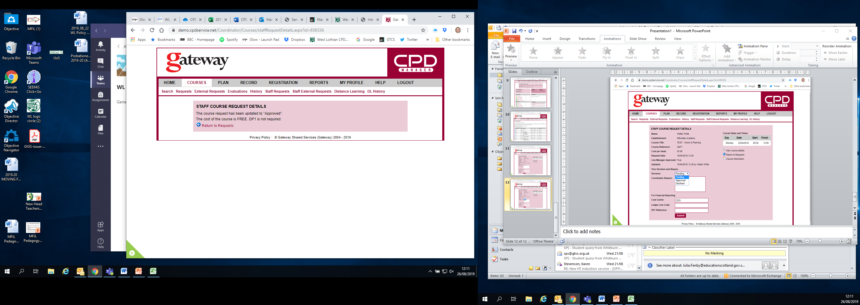

Slide 18
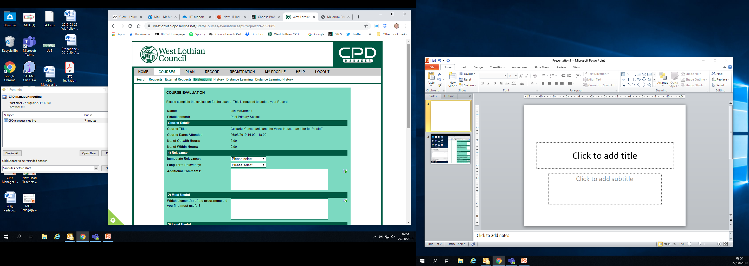

Slide 19
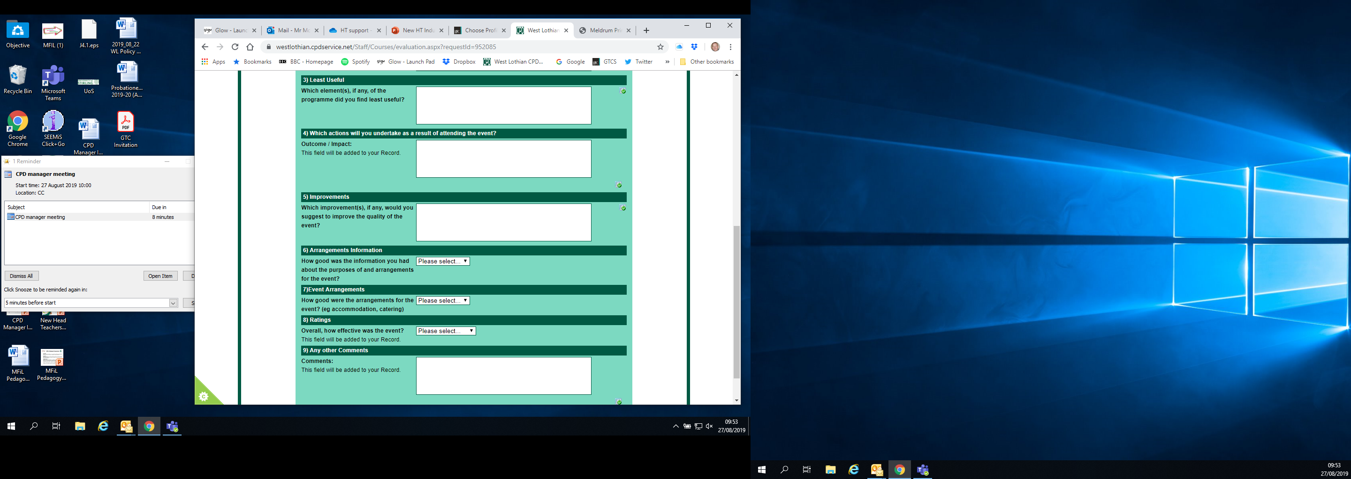

Slide 20
