Slide 1
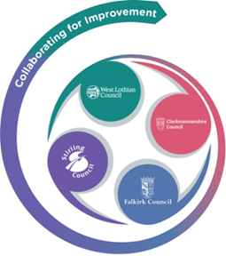
Forth Valley & West Lothian Regional Improvement Collaborative
ELC Workshop
May 2019

Slide 2
ELC
AIM -
By the end of 2020, 100% of 2-3 year old children will experience good or very good quality ELC in establishments in the RIC.
The aim supports the overarching aim of the RIC as our belief is that high quality early learning and childcare is key to raising attainment and achieving equity. The Blueprint for the Expansion of Early Learning and Childcare puts quality at the heart of delivery and each authority in the Forth Valley and West Lothian Collaborative is currently undertaking work to improve practitioner professionalism and to raise standards across ELC settings.

Slide 3
For an establishments to have good or very quality childcare they should demonstrate 3 out of 4 key quality indicators (or process measures) at 90% or above -
Each establishment will have an improvement plan with key relevant priorities visible in their setting, using data over time, to inform progress on changes and evidence improvements.
100% of practitioners will report a high degree of confidence and knowledge in national practice guidelines.
Practitioners will have a quality and meaningful conversation about 100% of children, with their parents, on a monthly basis around their child’s progress. Quality examples to be included as an appendix.
100% of children will be happy, engaged and achieving as evidenced by 4 or 5 on both the wellbeing and involvement on the Leuven Scale.

Slide 4
A range of example change ideas have also been identified which may be helpful to support the main drivers, these are -
Regular training in national practice guidance for ELC
Access to leadership and coaching support
Support settings in revisiting self-evaluation
Establish links with regional training providers
Share CLPL activities across the RIC
Parental engagement opportunities
Access to multi-agency partner knowledge to support children's progress
Promote use of outdoor areas for a variety of activities
Opportunities for children's voice in all aspects of provision
Develop a localised Q&A framework
Use agreed and consistent tracking tools across key aspects of development

Slide 5
Sharing Good Practice
CENTRE OF INNOVATION - Building the Ambition at Bowhouse Early Learning and Childcare Centre in Falkirk
CENTRE OF INNOVATION - 'Wee Scones Cafe' at Menstrie Nursery Class in Clackmannanshire Literacy - led by Stirling Council
Language is fun Together (LIFT) and the development of a self-evaluation tool to support this work
Bedtime Story initiative at Croftamie Nursery
Phonological Awareness Programme
It’s a Good Time to be Two - led by West Lothian Council

Slide 6
Forth Valley & West Lothian RIC

