Slide 1
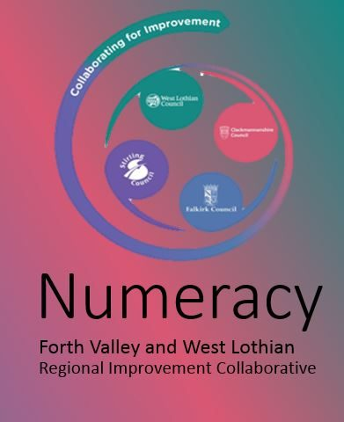
It’s A Good Time To Collaborate
Wednesday 29th May

Slide 2
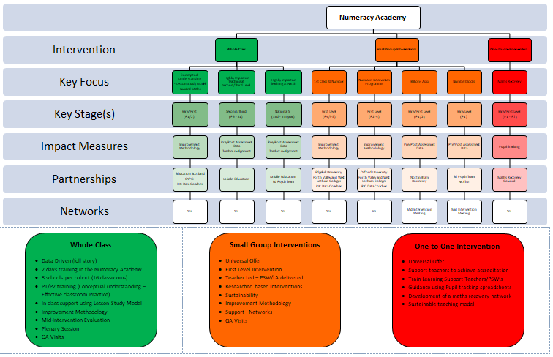
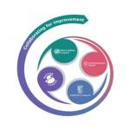
Numeracy Plan
Notes:
A RIC improvement plan in Numeracy that demonstrates aims, progress, evidence of impact and next steps.
Aim
To create a programme of CLPL to enhance pedagogical practice to raise attainment and close the poverty related attainment gap. The core purpose of the Numeracy Academy is to help schools lead improvement in Numeracy and Mathematics through enhanced pedagogical practice. Across the Regional Collaborative we aim to develop and spread excellent practice, for the benefit of all pupils and students.

Slide 3
Contact Details
Lynne McBain
CLlmcbain@glowmail.org.uk
Peter Valentine
peter.valentine@westlothian.org.uk
@FVWLric

