Slide 1
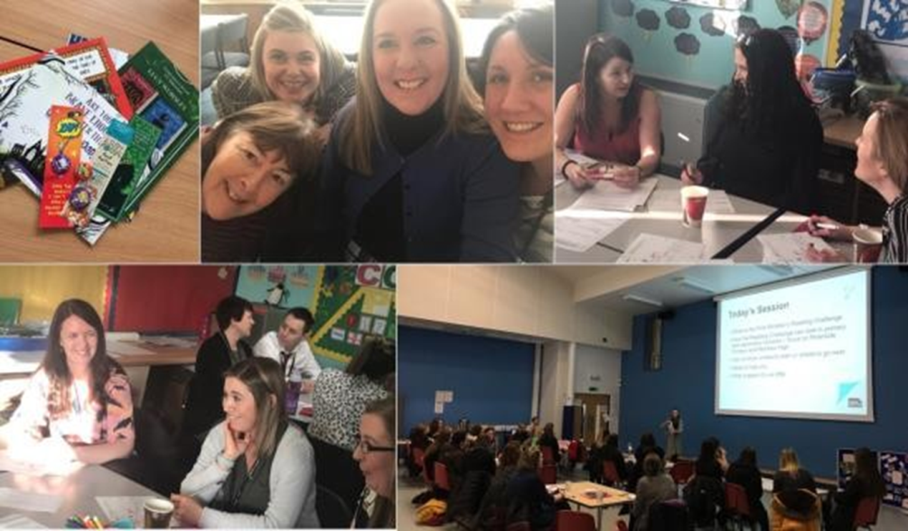
Forth Valley & West Lothian Regional Improvement Collaborative
‘It’s a Good Time to Collaborate’

Slide 2
Welcome
Opening Address
Forth Valley & West Lothian Lead
Dr Elaine Cook
Depute Chief Executive Officer, West Lothian

Slide 3
Let’s Collaborate
@FVWLric
RIC blog (FV&WLRIC blog)

Slide 4
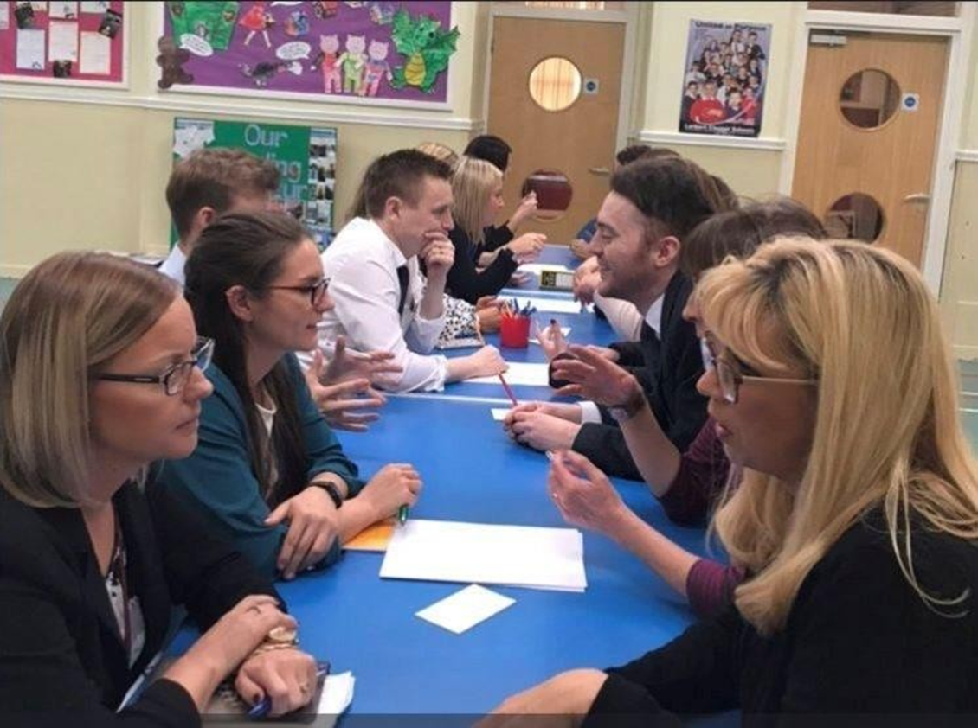
Workshop Session A
Numeracy (Earl)
Literacy (Grange)
Performance Analysis (Inchyra)
CLPL (Foyer)

Slide 5
Tea/Coffee on the Move

Slide 6
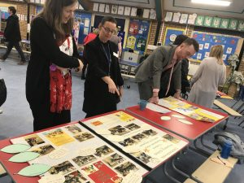
Workshop Session B
Numeracy (Earl)
Literacy (Foyer)
Early Learning & Childcare (Grange)
Developing the Curriculum (Inchyra)

Slide 7
Keynote
Teacher agency: what is it…and [importantly] how do we develop it?
Professor Mark Priestley
Professor of Education
University of Stirling

Slide 8
Network Lunch

Slide 9
Keynote
Collaborative Professionalism
and the future of RICs
Professor Andy Hargreaves
Research Professor, Boston College
Member of International
Council of Education Advisers

Slide 10
Panel Forum
Mr John Swinney, Deputy First Minister of Scotland; Cabinet Secretary for Education & Skills
Gayle Gorman, HM Chief Inspector and Chief Executive Education Scotland

Slide 11
Reflections
Dr Elaine Cook

