Slide 1
Provide the following information to participants prior to the session taking place
You may wish to make staff aware of the following information prior to holding your session either verbally or by email:
The Scottish Government’s ambition is for Scotland to have a trauma informed and responsive workforce, that is capable of recognising where people are affected by trauma and adversity, that is able to respond in ways that prevent further harm and support recovery, and can address inequalities and improve life chances. Trauma is 'everyone's business' and every member of the Scottish workforce has a role to play in understanding and responding to people affected by trauma.
This session is suitable for all members of the workforce and after attending people will be trained to the Trauma Informed Practice Level. The session will cover what is meant by psychological trauma, and the prevalence of trauma across Scotland. We will consider the different ways in which trauma can affect people. We will also spend time considering our roles and our teams, how we interact with those impacted by trauma and any changes we may be able to make to become more trauma informed. There will be consideration given to staff wellbeing and how staff can be supported in relation to this work.
We realise that this can be an emotive and potentially triggering subject. You will not be asked to share any details of your own traumatic experiences. Think about whether now is the right time for you to undertake this training. If you’d like to have a discussion or gain more information about the training prior to attending, please discuss with your line manager or you can contact:
Cheryl Aitken
Trauma Informed Development Officer
Email: cheryl.aitken@falkirk.gov.uk

Slide 2
General Considerations
To make the most of this session we suggest at least 3 hours. You may wish to split this into three sessions to allow time for proper discussion.
You should think about how best to have discussion – it may be best to split your team into smaller groups to feedback into a larger group or it might suit better to have a whole group discussion
There are links to relevant websites within the notes section of the PowerPoints

Slide 3
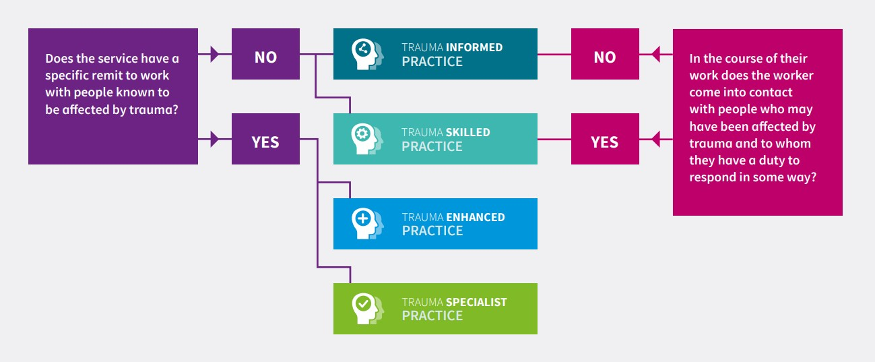
Information for facilitator
This session is a suitable starting point for all staff. Completing this will mean that your staff are trained to the trauma informed level. This session is also suitable for staff who have completed training at the higher levels to help them embed their learning. Therefore, you may deliver this to a staff group who have a mix of training and experience.
The flow chart shows what level training your staff require. You can also use the online tool here:
Knowledge and Skills - National Trauma Transformation Programme
Notes:
Knowledge and Skills - National Trauma Transformation Programme
If the link doesn’t work copy and paste this into your browser - https://www.traumatransformation.scot/knowledge-skills/

Slide 4
Information for Facilitator
You might want to check the videos play ok before starting your session. Make sure and click “Enable content” underneath the task bar at the top to ensure you can play the videos. If you have any problems playing the videos the links to play the videos on the Vimeo website are included in the notes section of the two video slides .
At the end you will be asked to undertake an evaluation – whether via the QR code or by a link in the slide. Please take time for you and your staff to do so. It provides a record of who in the council has undertaken the training. It also provides valuable feedback about the great work already taking place, the changes that are being made and the barriers we need to be aware of in your area.

Slide 5


Trauma Informed Level: Workshop
Any Queries:
cheryl Aitken, Trauma informed policy officer
Cheryl.Aitken@falkirk.gov.uk

Slide 6
Welcome, Introductions and Housekeeping
This is a reflective session and we are going to be talking about our experiences of working alongside people who may have experienced trauma.
YOU WILL NOT BE ASKED TO SHARE ANY DETAILS OF YOUR OWN TRAUMATIC EXPERIENCES.
If you find this session challenging it is important to know:
It’s ok to take a break
It’s ok to asked to be excused completely

Slide 7
Suggested Group Agreement
Respect confidentiality
Take a non-judgmental approach.
Allow space for everyone to get a chance to express their views/experience
Safety Choice Empowerment Trust Collaboration

Slide 8
Aims of the session
Reflect on/expand upon strategies used to support staff wellbeing
Reflect on the five trauma informed principles and how you can implement these in your own practice/setting
Consider to what extent trauma informed practice is embedded within your workplace/organisation
Make a trauma informed action plan for your service

Slide 9
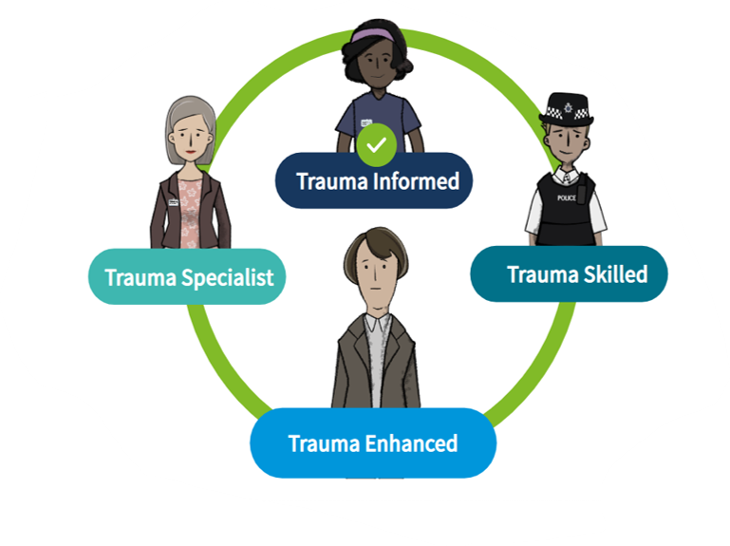

This initial reflective session is suitable for all practice types
This session is an ideal starting place for your trauma informed journey. Once you have completed this session you will be trained to the trauma informed level.
You can also use it to help embed any learning you have had at the other levels

Slide 10
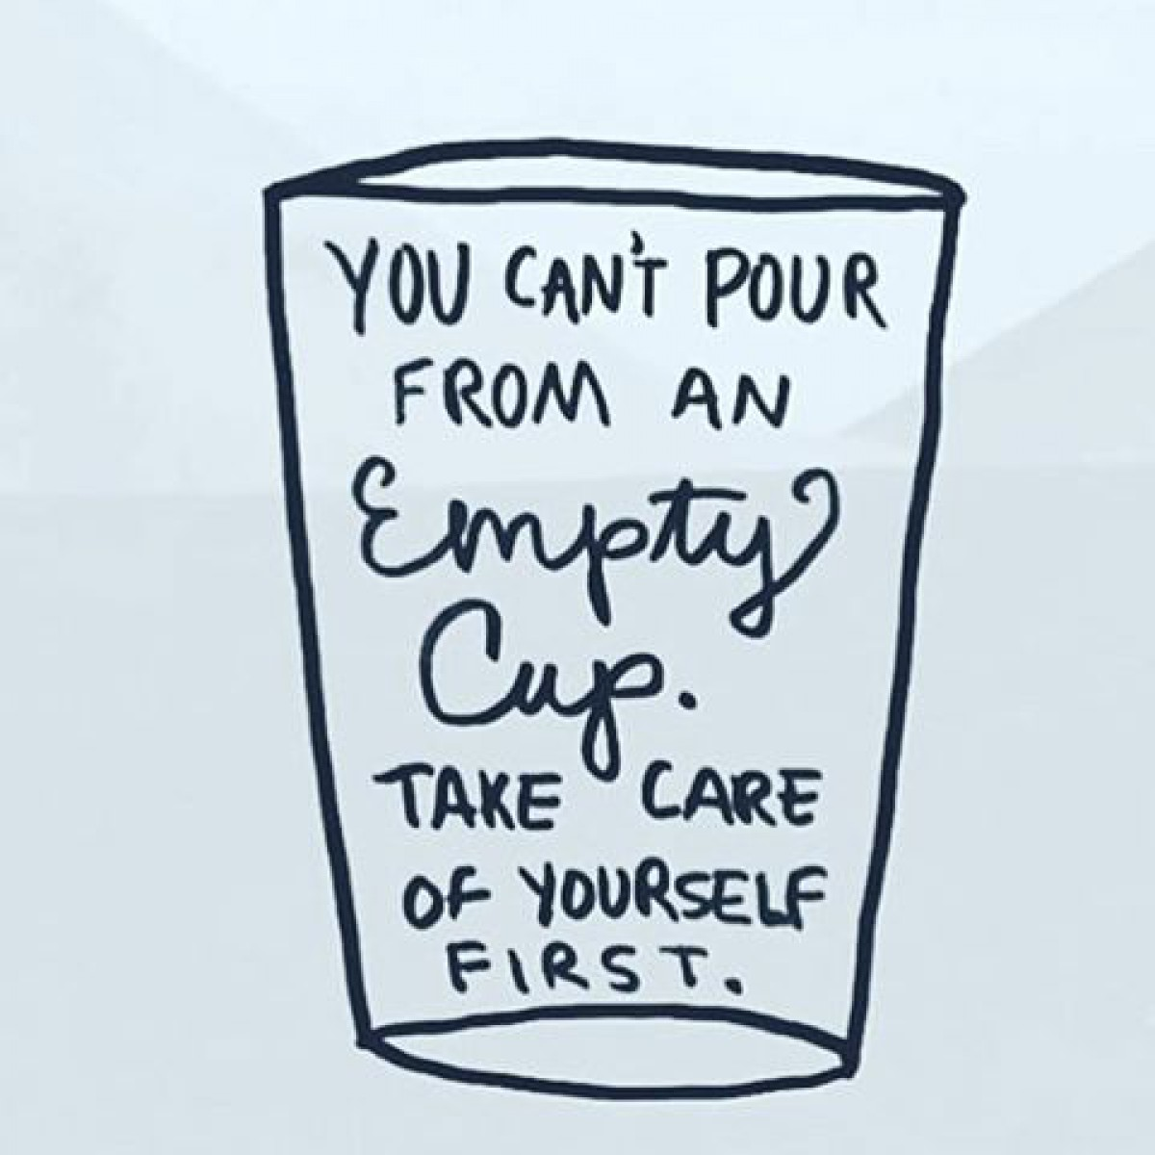
Staff Wellbeing

Slide 11
Workforce Care and Support
When things are tough in work what helps you feel ok?
Discuss (5 mins)

Slide 12
Workforce Care and Support 2
Do you have formal/informal processes in place for debriefing after something difficult has happened?
Does your 1 to 1 time with your manager meet the needs of you and your service?
Is there anything that used to take place but no longer does which would be helpful to restart? Or anything new that could be introduced?
Discuss (10 mins)

Slide 13
Where to look if YOU need support
Falkirk Council staff can find info about wellbeing supports here www.Falkirk.gov.uk/employees/wellbeing
(Falkirk Council staff - you can also contact Cheryl Aitken for Slides with more specific info on the supports that the Council offers)
All other organisations should provide info on the organisational supports available to your staff e.g. any employee assistance programmes
Safety Choice Empowerment Trust Collaboration
Notes:
Navigate to this page via intranet …

Slide 14

Other available supports…
Safety Choice Empowerment Trust Collaboration

Slide 15
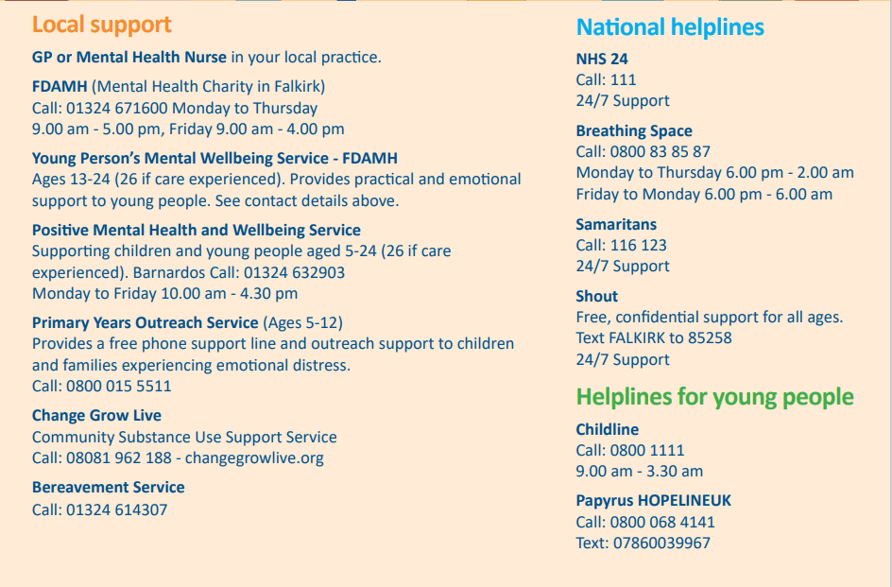
Local Resources in Falkirk
Safety Choice Empowerment Trust Collaboration
Notes:
GP/Mental Health nurse point of contact for NHS trauma therapies
FDAMH – Falkirk’s Mental Health Association offer range of supports for mild to moderate MH issues: Groupwork (positive wellbeing, CBT for anxiety); support for carers; 1-1 short term counselling not for (usually 9 sessions); social sparks (loneliness and isolation); social prescribing1-1 service (practical strategies for low mood/anxiety)
Phone and the initial assessment team would discuss and see if any of the services meet your needs.
Appointments can be phone or face to face.

Slide 16
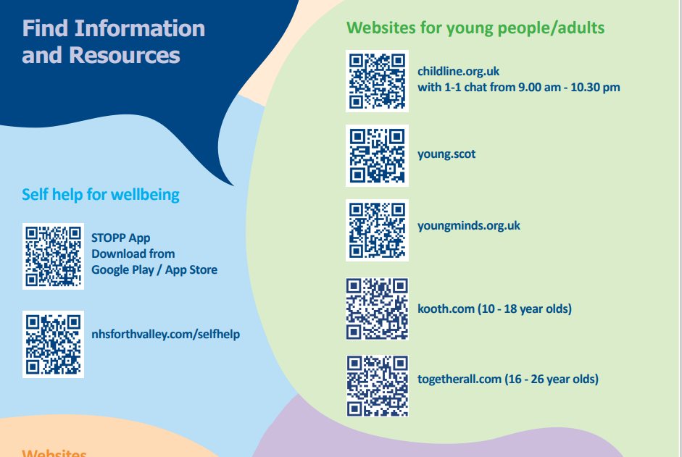
QR codes for online info
Safety Choice Empowerment Trust Collaboration

Slide 17
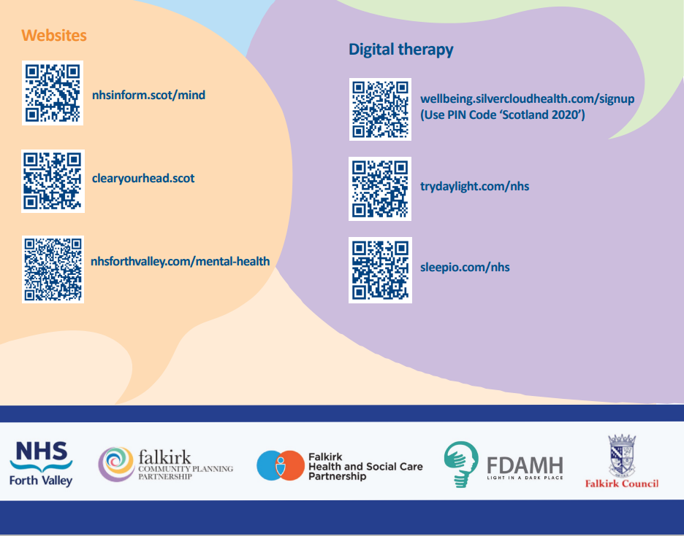
QR codes for online info 2
Safety Choice Empowerment Trust Collaboration

Slide 18


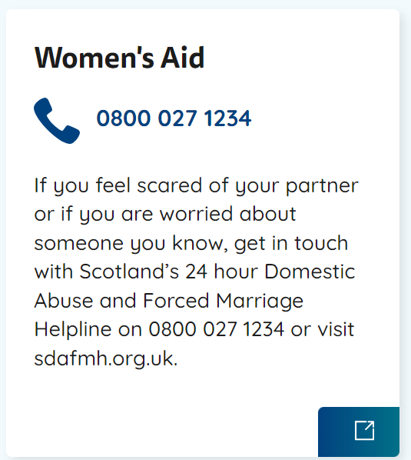
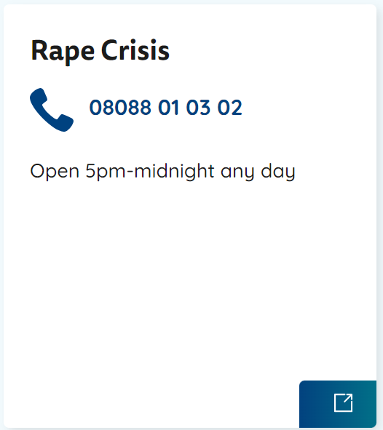
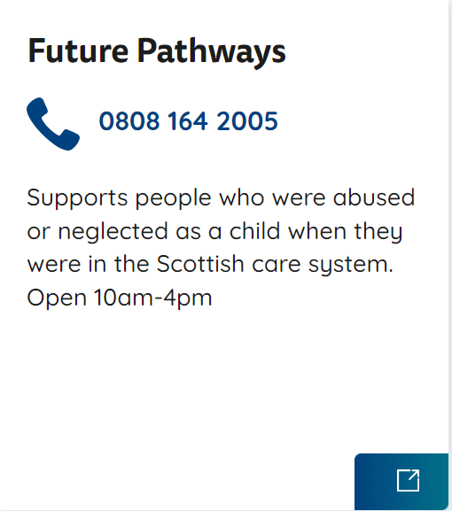
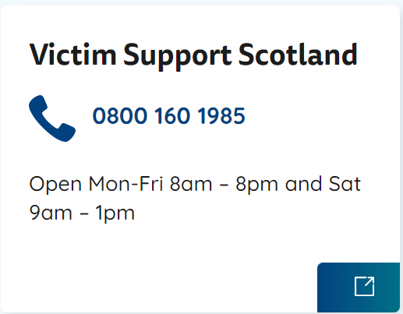
Support for Recovery from Trauma
Notes:
Help - National Trauma Transformation Programme – web address for for support services and further info
Or copy and paste this into your browser - https://www.traumatransformation.scot/get-help/

Slide 19
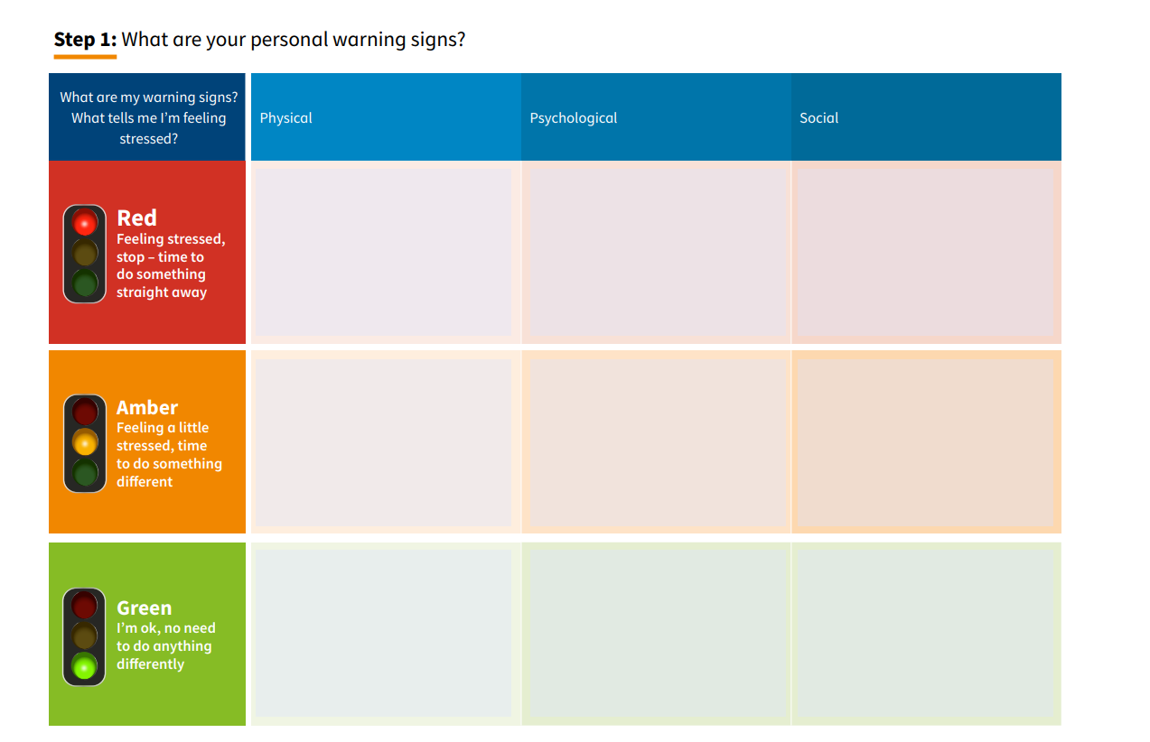
Staff Wellbeing Planning tool… Click on this link to access - Wellbeing planning tool | Turas | Learn

Slide 20
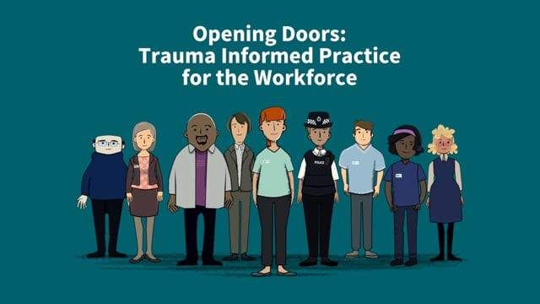
Watch video – opening doors, captions available
Notes:
Opening Doors: Trauma Informed Practice for the Workforce on Vimeo
Or if play button on slide doesn’t work, copy and paste the following into your browser - https://vimeo.com/274703693?msockid=2f2bc2d215a4600f07edd6d514de6194

Slide 21
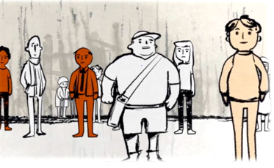
Discussion 1: Recognising the prevalence of trauma in your work setting...
Individual trauma results from an event, a series of events or a set of circumstances that is experienced by an individual as physically or emotionally harmful or life threatening and that has long lasting effects on the individual’s functioning and mental, physical, social, emotional or spiritual wellbeing.” Substance Abuse and Mental Health Administration (SAMSA, 2014)
How many of the people you work with do you think have been affected by trauma?
Discuss (5 mins)

Slide 22
Discussion 1: Did you consider?
Were you surprised by how common trauma is? Some additional statistics to consider…
The 2019 Scottish Health Survey found that 28% of the Scottish adult population had suffered physical abuse in their childhoods, whilst 7% had suffered sexual abuse.
31% of a sample of 2000 Young People surveyed In UK had been exposed to at least 1 traumatic event by the time they reached 18. And 7.8% of them met the criteria for a diagnosis of Post Traumatic Stress Disorder.
Did you think about your colleagues? Their own experiences of trauma and how this might impact upon them?
There is no need to ask people about their experiences of trauma if you don’t know. We should be working in a trauma informed way with everyone.

Slide 23
If you work with Children, watch the Children & Trauma Video. Otherwise, you can head straight to the next question.

Slide 24
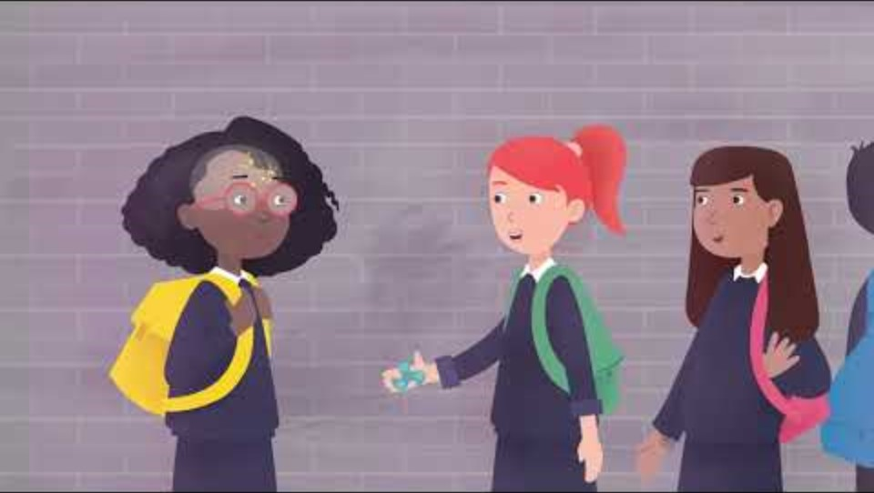
Watch Video trauma and children’s brains
Notes:
Childhood Trauma and the Brain - UK Trauma Council
Or if the play button in the slide doesn’t work, copy and paste the following into your browser - https://uktraumacouncil.org/resources/childhood-trauma-and-the-brain

Slide 25
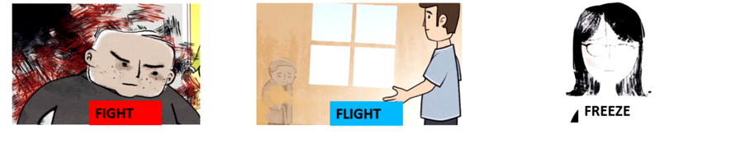
Discussion 2: Recognising the impact of trauma…
How might someone’s experience of trauma affect how a person interacts with your service?
Discuss (5 mins)

Slide 26
Discussion 2: Did you consider these points?
Research shows the main way that trauma impacts upon people is through difficulty managing strong emotions; difficulties with relationships with others and engaging in risky strategies to manage feelings of distress. These can lead to a range of adverse outcomes and particular difficulty accessing universal and specialist services.
Experiencing adversity doesn’t necessarily mean someone will experience negative consequences. There are a range of buffers which help mediate the impact of trauma - such as how many traumatic experiences they have had; supportive relationships; financial security etc.
Think about “what’s happened to you” rather than “what’s wrong with you”

Slide 27
Discussion 3: What do you think the benefits of your service being trauma informed could be? (Discuss 5 mins)

Slide 28
Discussion 3: What the research says…
Workforce Benefits:
Improved wellbeing and satisfaction
Improved communication and collaboration
Increased confidence, skills and knowledge in relation to responding to psychological trauma.
Benefits for people who use services:
Improvement in accessibility and quality of services being accessed
Improved wellbeing
Evidence of less distressed presentation
Improved outcomes
Notes:
The above is drawn from the Scottish Governments’ Rapid Evidence Review

Slide 29
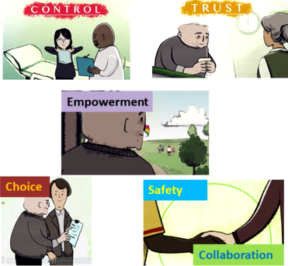
Taking a Trauma Informed Lens…
Start thinking about your service from the perspective of someone using it who has experienced trauma.
The main principles of being trauma informed are:
Trust
Empowerment
Choice
Safety
Collaboration

Slide 30

Start where you are, do what you can, with what you have…
Try and use your time together to consider the things that you can change and make an impact on.
(Feedback on barriers is very much welcomed in the evaluation to help us better understand the difficulties)

Slide 31

Discussion 4a: What do you want to keep/do more of that is trauma informed?
What are you already doing that is trauma informed - where the impact of trauma is recognised, and you offer safety, choice, collaboration, empowerment and trust?
(Take 10 mins to discuss)

Slide 32
Discussion 4b: What do you want to stop doing or change or add?
Are there any experiences that may be disempowering, coercive or lacking collaboration? Or where a person affected by trauma may feel unsafe or that their trust is breached?
What new things would you like to do to make your service more trauma informed?
(Take 10 mins to discuss)

Slide 33
Your next steps
Check out OLLE for the SKILLED level e-modules…
check out what face to face training is available in Falkirk
Trauma skilled practice 1: understanding the impact of trauma and responding in a trauma-informed way
Trauma skilled practice 2: trauma in children and young people
Trauma skilled practice 3: understanding the impact on mental health and evidenced based pathways to recovery
Trauma skilled practice 4: understating the use of substances to cope with the impact of trauma
FALKIRK Children and Adult Services Multiagency Training – Forth Valley Practitioner Pages
Search “Forth Valley Practitioner Pages” and look in the learning and development section (or follow the link above)
Notes:
If the hyperlink to the training calendar above doesn’t work, copy and paste the following into your browser - https://blogs.glowscotland.org.uk/glowblogs/fvpp/learning-development/childrens-services-training/

Slide 34
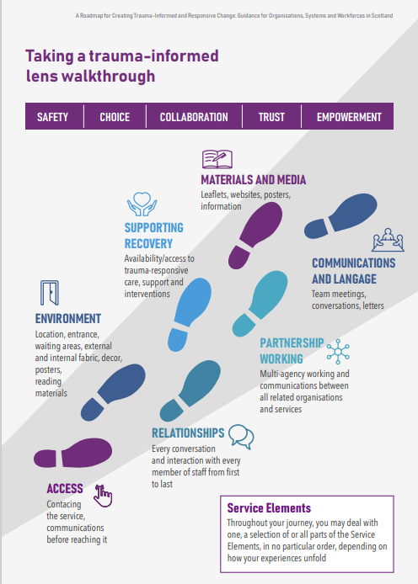
Possible next steps…use the lens tool walkthrough… Click here to access - Roadmap-for-Trauma-Informed-Change-Appendix-A (17).pdf You can contact Cheryl Aitken, Trauma Informed Development Officer, for support undertaking the walkthrough: cheryl.aitken@falkirk.gov.uk
Notes:
Copy and paste the following into your web browser for more info -https://www.traumatransformation.scot/implementation/

Slide 35
Discussion 5: Making a Plan…
When are you going to review your proposed changes?
How will you keep track of these?
How can you ensure the voice of the people who use your service who have experienced trauma can be involved in the changes you are considering?
Take 5 mins

Slide 36
Key points from today
Psychological Trauma is common
Growing body of evidence around the risks of psychological trauma on mental and physical wellbeing over the lifespan
Adversity is not destiny, it’s important to realise people’s strengths and resilience
Trauma happens in relationships and is healed in relationships
Trauma is everyone’s business, but not everyone has to be a trauma expert.
The small things we do really can have a big impact

Slide 37
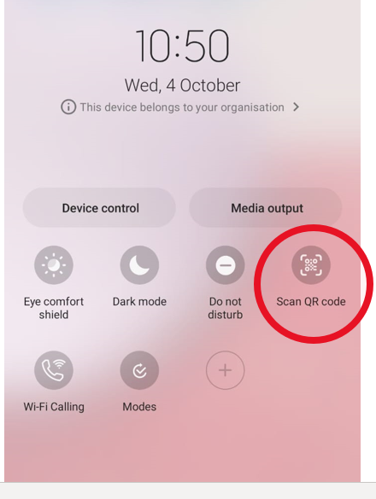
Please complete the evaluation
If you could use your smart device to scan the QR code in the next slide to help us better understand the progress being made in Falkirk’s trauma informed journey, and any barriers we should be aware of. Your feedback is so appreciated!
If opening your camera app and trying to scan the QR code doesn’t work, try using the pull down menu on your phone and clicking on the Scan QR code button.

Slide 38
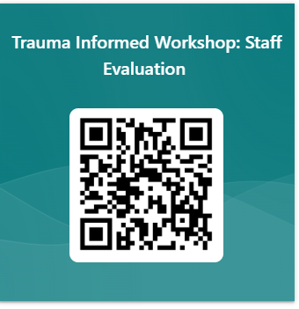
Evaluation
Or via the link: https://forms.office.com/e/waHX3arXVg
Any issues contact :
Cheryl Aitken
Trauma Informed Development Officer
cheryl.aitken@falkirk.gov.uk
Please complete so we know who has engaged in the sessions, areas of good practice and issues which are arising.
Many thanks!
Notes:
Stress the importance of staff completing this – it really helps feed into the planning around the trauma informed stuff AND helps us to see who the training is reaching.

