Slide 1
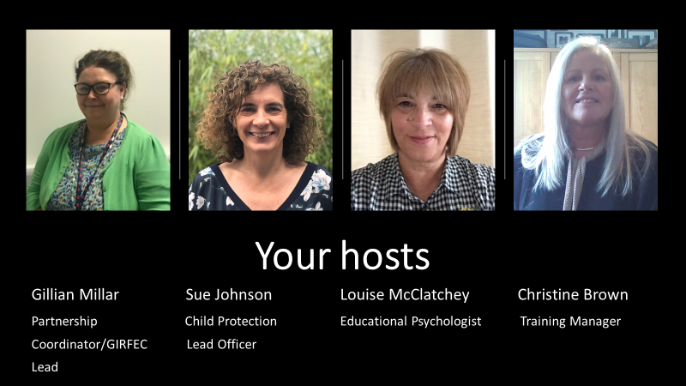
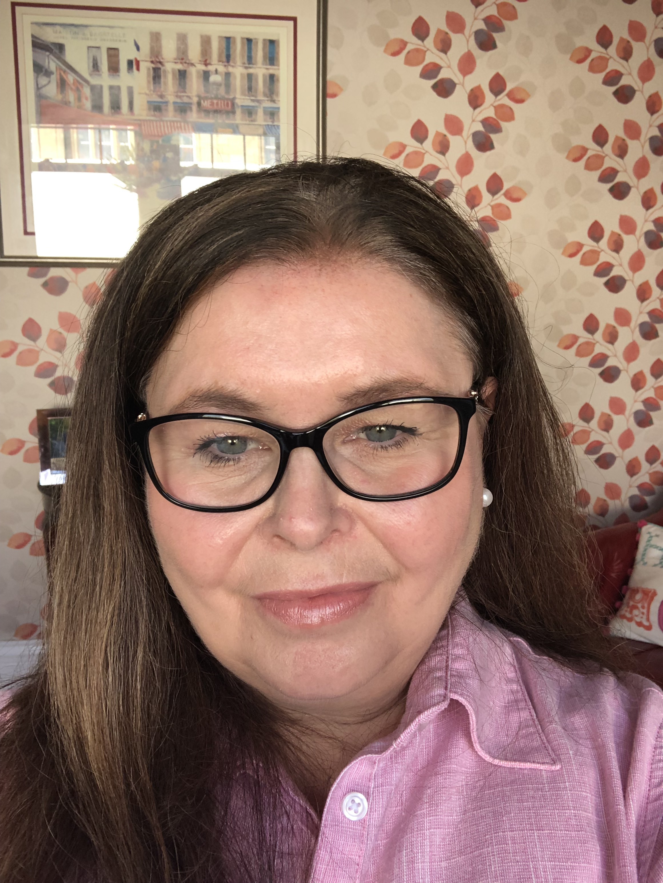

Slide 2
Use the Chat
Function

Slide 3
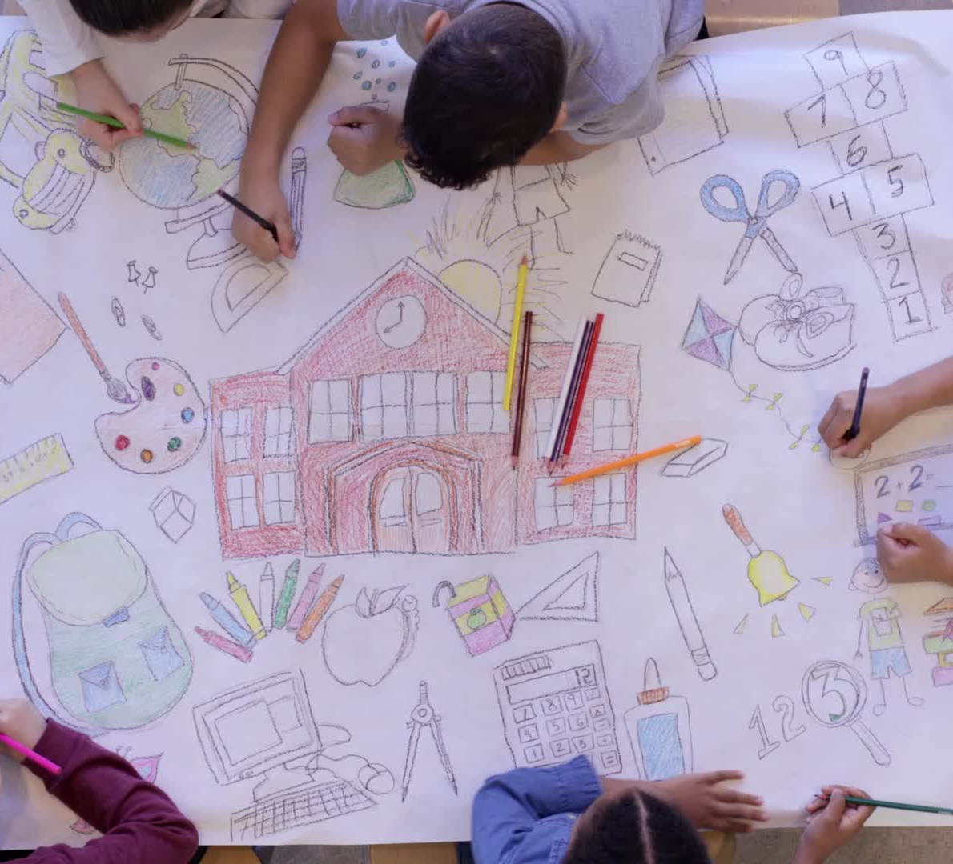
Falkirk’s vision for Children and Young People
For all children and young people in Falkirk to grow up to be loved, safe and respected so that they realise their full potential

Slide 4
GIRFEC – Getting It Right For Every Child
putting the child and family at the centre, by promoting choice, with full participation of children and families in decision-making;
working in partnership with families to enable a rights-respecting, strengths-based, inclusive approach; Underpinned by the principles of UNCRC and The Promise
understanding wellbeing as holistic and interconnected, with a child's developmental experiences understood within the wider context and influences of family, community and society;
valuing diversity and ensuring non-discrimination;
tackling multiple and intersecting forms of inequality;
shifting resources and support towards providing an early offer of support to improve outcomes for children, young people and families
joint working in a culture of co-operation and communication between practitioners and services
Scottish Government

Slide 5
working together to achieve better outcomes

Slide 6
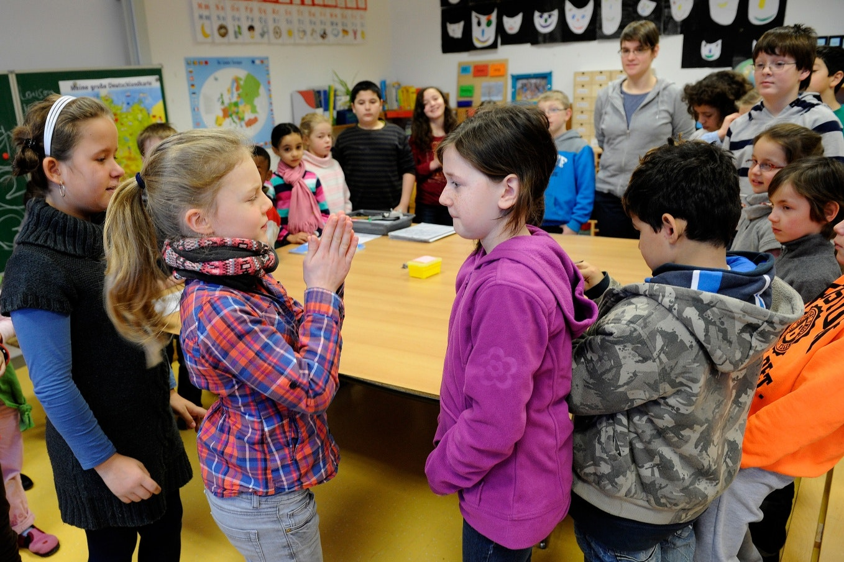
Identifying our strengths and areas for improvement
Involving children and families
Having multi-agency guidance, policies, procedures
Effectively resourcing our multi-agency system
Having one multi-agency, timely assessment
Developing our multi-agency workforce
The plan to make a difference and improve safety for all children who may be at risk of harm
This Photo by Unknown Author is licensed under CC BY-NC-ND

Slide 7
Effective Practice found in Falkirk’s Learning Review
Services being as flexible as possible
Persistence and commitment of all the professionals
Good communication between the professionals

Slide 8
What everyone can do to make sure children are alright.
Embed our culture of learning - we are the first area in Scotland to complete a learning review.
Help us evaluate how our services are doing – we are refining our child protection dataset and feedback from children, parents and families always helps. Our focus is on multi-agency working and training and reflecting together.
Support our implementation of revised national guidance for child protection -we have priority areas for change across Forth Valley to comply with the guidance.

Slide 9
Promoting positive relationships through collaboration and mutual understanding Using an Appreciative Inquiry approach to consider the best practice we want to take forward in our multi-agency working
Notes:
(Louise) In this part of the session we are going to be using an appreciative inquiry (AI) approach to consider the best practice we want to take forward in our multi-agency working.

Slide 10
What is Appreciative Inquiry? (AI)
Appreciate – valuing, the act of recognising the best in people or the world around us; affirming past and present strengths, successes and potential; to perceive those things that give life (health, vitality, excellence to living systems).
Inquire – The act of exploration and discovery. To ask questions; to be open to seeing new potentials and possibilities.
It was developed by David Cooperrider as a way of looking at what works in an organisation and doing more of it.
Notes:
(Louise) Appreciative Inquiry (AI)
What is it?
In a nutshell – it’s a positive, strengths based approach to organisational development and change. And here you can see a definition……………………
It suggests that you look for what already works in an organisation.
The aim is to produce statements that describe where an organisation or service wants to be, based on the high moments or positives of where they have been. Because statements are grounded in real experience people know how to repeat their success.
We’ve been through two years of working in a different way – we’ve had to adapt and change. Coming together like this gives us a really good opportunity to reflect individually and with each other what’s worked best and how we want to take things forward.

Slide 11
Problem solving
Appreciative Inquiry
Felt need – Identification of problem
↓
Analysis of causes
↓
Analysis and possible solutions
↓
Action Planning (treatment)
↓
Basic Assumption: An organisation is a problem to be solved.
Appreciating and valuing the best of what is
↓
Envisioning what might be
↓
Dialoguing what should be
↓
Basic Assumption: An organisation is a mystery to be embraced.
Adapted from Cooperrider and Srivastva (1987) ‘Appreciative Inquiry into Organisational Life’ in Research in
Organizational Change & development. (Passmore and Woodman (eds) Vol 1,JAI Press
Notes:
(Louise) Sometimes it seems we are really good at talking about what hasn’t worked, what went wrong, who to blame and so forth. Indeed, we’ve had years of practice in the art of problem-focused, problem solving. Okay, that works if we are investigating a plane crash but our work is mainly about relationships and building those relationships.
We’ve had far less practice in looking at what works and in doing more of it.
Rather than being obsessed with learning from our mistakes. It rarely occurs to us that we can ‘fix’ an organisation by doing more of what works.
Contrast the two ways of working. Which one appears more positive and future orientated? Which one makes us value the people we work with, boost morale and help wellbeing?

Slide 12
Assumptions of Appreciative Inquiry
1. In every society, organisation, or group, something works.
2. What we focus on becomes our reality.
3. Reality is created in the moment and there are multiple realities.
4. The act of asking questions of an organisation/group influences the group in some way.
5. People have more confidence and comfort to journey to the future (the unknown) when they carry forward parts of the past (known).
6. If we carry parts of the past forward, they should be what is best about the past.
7. It is important to value differences.
8. The language we use creates our reality.
From the ‘Thin Book Of Appreciative Inquiry’ Sue Annis Hammond
Notes:
(Louise)These are a set of beliefs shared by a group that causes the group to think and act in certain ways. They can become a shorthand – when faced with similar situations a group just acts and doesn’t re-evaluate every time, for example following the GIRFEC principles. The downside can be if the group fail to act on new information they may miss an opportunity to improve their effectiveness. That is why it is important to bring to the surface group assumptions and experiences every so often to see if they are still valid.
Take a moment to read through and think about these assumptions
Do you agree with them?
Which ones may have greater resonance for you?
For me number 8 is important in this approach. Aiming for neutral or positive language and avoiding language which may have an emotional overload or negative connotation - the ‘language of deficit’. (Ken Gergen). I am sure you can think of examples. (Could ask other presenters which ones resonate with them?)

Slide 13
4 D cycle – Leading to Affirmative Topics
Discovering
Identifying
“The best of what has been and what is.” Appreciating
Dream
What might be (What is the world calling for) Envisioning Results.
Design
What should be the ideal?
Co-constructing.
Destiny
How to empower, learn and adjust/improvise? Sustaining
Notes:
(Louise) This 4D cycle is similar to how elite sportspeople visualise their events with their coaches and sports psychologists.
So this is how we’re going to frame our discussion around multi-agency working our best practice.
We’re going to Discover and Appreciate - the best of what has been
We’re going to Dream and Envision – what the ideal may look like
And we’re going to Design and Co-construct statements to take us forward
When we’ve done this we have what is known in AI as ‘The Positive Core’

Slide 14
The Positive Core collective wisdom; energy and resilience.
Human systems grow in the direction of what they persistently ask questions about.
The single most important action a group can take to liberate the human spirit and construct a better future is to make the positive core the common and explicit property of all.
So go with the flow… allow yourself to dream and you will discover that destiny is yours to design.
Notes:
(Louise) Read slide. Moving on now to our discussions…

Slide 15
The Activity – Stage 1 – housekeeping
In your breakout rooms please carry out the following actions:
Please make introductions
Move on to discussing and noting down responses to the questions…
Facilitators have been identified in each group

Slide 16
6579 2139

Slide 17
1929 9669

Slide 18
Write a short Provocative Proposition of what the group wants to see more of. For example:- ‘Two years on and we have developed our core strengths and we have moved forward successfully with regard to multi-agency working. Everything is as you wished it would be.’
How would you describe our Children’s service and its relationships? What are people doing? How is this different? How did we get here? What would you like to see more of?
e2
Go to www.menti.com and use the code 9741 2285
123
123ww

Slide 20
Next Steps
7 minute briefing with the themes/ highlights from today will be circulated
GIRFEC refresh due late summer
Further multi agency learning sessions planned in September
Feedback – Teams Questionnaire to help to inform future sessions
https://forms.office.com/r/SyjvT3fsJC
gillian.millar@falkirk.gov.uk
christine.brown@falkirk.gov.uk

