Slide 1
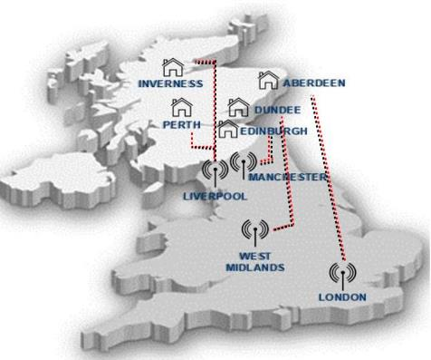
County Lines in Scotland
A Presentation for Partners

Slide 2
What is County Lines? Isn’t it just drug dealing?
County Lines is a method of dealing drugs, but it relies heavily on the criminal exploitation of children and vulnerable adults. It involves importing drugs to another area from major cities in England and can result in increased community tensions and violence in areas affected.

Slide 3
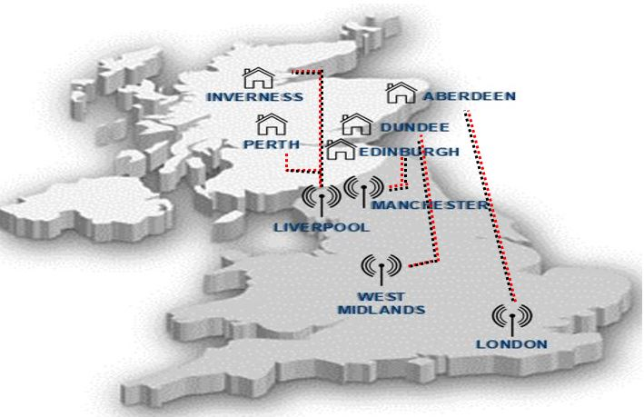
How does it work?
Notes:
Gangs from cities in England are travelling to Scotland to deliver drugs and collect cash.
Selling heroin, cocaine and crack cocaine, they use vulnerable young people to deliver drugs. These young or vulnerable people often travel from those cities to Scotland, sometimes referred to as ‘Going Country’. Often this involves some degree of intimidation, violence, debt bondage, and/or grooming.
We are now seeing an increase in ‘local’ young people becoming involved in this kind of activity.
This is called ‘County Lines’ because the gangs use one phone number ‘Line’ to run their business in when dealing in any area.
Generally this has involved rural/coastal locations in Scotland but, whilst these outlying areas are still affected there is also activity in major Scottish cities such as Aberdeen, Dundee, Edinburgh, Inverness and Perth. In County Lines, the person transporting the drugs will attempt to set up a base in these Scottish locations often by taking over/cuckooing an address through violence or intimidation. We have also seen the use of short term holiday lets such as AirBnB’s.

Slide 4
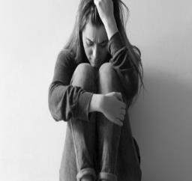
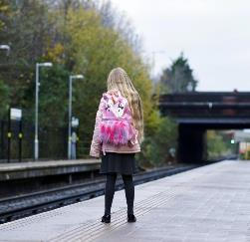
English Crime Group coordinates drugs/money/people from afar Use children to transport, store and deal the drugs
Criminal Exploitation, Human Trafficking & Modern Slavery
Notes:
To summarise the method used by these drug dealing gangs: County Lines Drug Dealing can lead to – Criminal Exploitation of Children and Adults, Child Sexual Exploitation, HT and MS.

Slide 5
What is Child Criminal Exploitation (CCE)?
Where an individual or group uses their position of power to take advantage of a child or young person under the age of 18 and coerces, controls, manipulates or deceives them into criminal activity.
Can be in exchange for something the victim needs or wants such as money, clothing, electrical goods, OR can be through violence or threats of violence
Activity may appear consensual however exploitation may still be a major contributing factor
Notes:
CCE involves children with many vulnerabilities being exposed to, and/or being a victim of: physical and emotional violence, neglect, going missing, sexual abuse, sexual grooming and exploitation, modern day slavery, human trafficking and domestic abuse.
Even if the criminal activity appears to be consensual, the child may have been criminally exploited, or intimidated/threatened? CCE does not always involve physical contact, it can also happen through use of technology. This could include making contact through social media and chat forums such as on gaming platforms.

Slide 6
Knowing the Signs of Child Exploitation
Change in behaviour (Angry, Anxious, Withdrawn)
Access to numerous phones
Unexplained gifts (Clothes, Trainers, Electrical items, Cash)
School truancy / Going Missing
Travelling alone (particularly during school hours, late at night, or frequently)
Increased use of bus or rail network
Notes:
Young people who are being exploited Don’t Always Look Vulnerable, Don’t Always Act Like Victims, May Not Understand that they are being exploited.

Slide 7
County Lines : UK* *National Crime Agency, 2019
2700 phone numbers linked to 1200 groups
Most originate from London, Liverpool and West Midlands
More than 30 other force areas in England and Wales have at least 1 group using County Lines Model
Social media increasingly used for recruitment and promotion
Exploitation of children and young people and vulnerable adults on the rise
Notes:
The National Crime Agency (NCA) collate figures for the UK. A National County Lines Coordination Centre report provided updated figures from later 2018 until Autumn 2019.
Over 2,700 deal line numbers linked to about 1200 groups.
Most “lines” originate from London, then Liverpool (Merseyside) and West Midlands – with a notable increase in activity from West Midlands during this period.
More than 30 other police force in the UK have at least 1 group operating a County Lines model.
These drug dealing gangs predominantly deal Heroin and Crack Cocaine – with Crack Cocaine becoming more prevalent.
The national (UK) turnover is estimated at between £500M-700M per annum with couriers/those who transport and deal the drugs on behalf of the gangs earning up to £2000 per day in some areas. There will however be people making much less than this and carry out tasks through drug debt bondage and fear and intimidation. The lure of these financial rewards will remain attractive to people with no other source of income.
Exploitation is the key element of CL drug dealing – high risk factors include poverty, family breakdown, social care intervention, being a looked after child, behavioural and developmental disorders and exclusion from mainstream education.

Slide 8
Scotland
Approx 29 county lines groups
8/13 local policing divisions impacted
Most activity in North East Division
Merseyside largest exporting area
Heroin and Crack Cocaine
Evidence of violence
More local children and young people being identified
Notes:
There are now over 29 active county line groups impacting on Scotland.
There is County Line activity in 8 out of 13 Police Scotland divisions with most activity in the North of Scotland; Aberdeen City/Aberdeenshire, Highlands and Islands, Tayside
Merseyside remains the largest exporter of these county line gangs into Scotland, however London, Birmingham, Wolverhampton, Bradford and a few others have a footprint in Scotland too.
Heroin and Crack cocaine remains the biggest imported drug by these groups.
No consistent serious violence has been noted in Scotland, unlike the position down south, however individual cases have been highlighted where extreme violence has been used by County Lines operators.
Whilst children and young people from elsewhere in the UK have been found in Scottish addresses, more local children have been found to be involved in county lines in recent months – both male and female.

Slide 9
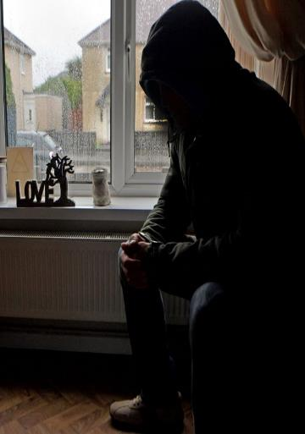
What is Cuckooing?
Exploitation of vulnerable people; mental health, learning difficulties, substance abuse
Act of taking over a person's home; often by exploitation, intimidation, or violence.
Victims may initially be paid or given drugs to use their home
Home becomes a safe-house and/or accommodation for the drug courier Gives the gang a base in your area.
Notes:
‘Cuckooing’ creates a secure base in a new area within the homes of vulnerable people.
Those most commonly exploited are drug users, however other vulnerabilities can be preyed upon.
Some group members have entered into relationships with vulnerable females in order to access their homes.
Those being cuckooed don’t always see themselves as victims as they are being groomed.
Sometimes taking payment/drugs etc can blur the lines between being a victim or offender.

Slide 10
Knowing the signs of Cuckooing
Unknown persons in area/address
Increase in reports of violence/antisocial behaviour
Usual occupant no longer at address or is less visible
Increase in drug dealing activity at the address ; visitors/vehicles
Occupant appears anxious or distressed
Bags of clothing or bedding around their property
Barricades within the address, including weapons.
Notes:
Look for these signs…

Slide 11
Multi-Agency Response
Social Work
Addiction Services
Education
3rd Sector
Housing
New Approach
Notes:
Communities in the North East of Scotland – Aberdeenshire – were really the first to be impacted by County Line activity.
In 2017 a process began in the Buchan area for those who had been cuckooed.
Over time this matured into a well developed multi agency approach to the challenges of County Lines and Cuckooing in that area.
In places affected by similar problems, this multi agency, victim based response was identified as best practice and more effective than traditional police action. This has been adopted across Scotland. The approach focuses on helping to find people routes out of their situation, and to deal with the issues that made them vulnerable to exploitation in the first instance.
Across Scotland police and partners continue to meet with partners to deliver awareness sessions.

Slide 12
Case Studies
Notes:
County Lines relies heavily on the criminal exploitation of children, teenagers and adults.
On the following slides we will look at two scenarios that are based upon real lived experiences.
The first will look at an adult, vulnerable through addiction, who quickly loses control of his property and becomes embroiled in a County Line operation.
The second will look at a young Scottish teen, coerced into a County Line operation, and transported from his home town.

Slide 13
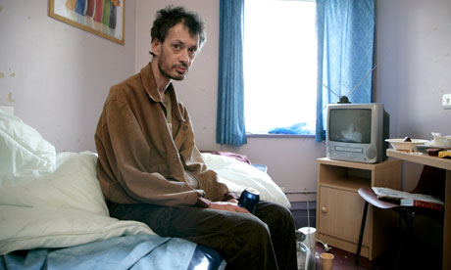
Case Study: Cuckooing Vulnerable Adults
Notes:
Central Belt, Scotland
Day 1: An adult male (John) who is a drug user is introduced to a London based drug dealer by a friend down at the local town centre. John him to cut drugs in his flat for a small amount of heroin. The dealer stays overnight. He is not invited but John doesn’t object.
Day 2: John told to hire a car for a week to drive now three dealers around the local area, he is now actively involved. Several dealers stay in his house overnight.
Day 3: John told to drive to bigger cities (Glasgow, Edinburgh, Dundee) and asked to identify other vulnerable drug users he my know in these areas whose homes they could use to deal drugs.
Day 4: John is now fully at the disposal of this drugs gang. He realises he is being used however feels intimidated, unable to refuse, and is frightened.
Day4/5: John realises things have gone too far and makes an excuse to leave his house alone. He contacts his support worker who in turn tells police. Police speak to John and are able to take action against the drug dealers and they are arrested. John’s support worker, police and housing work together to provide a support package for John including temporary housing to ensure his immediate safety and continued substance use support and guidance.

Slide 14
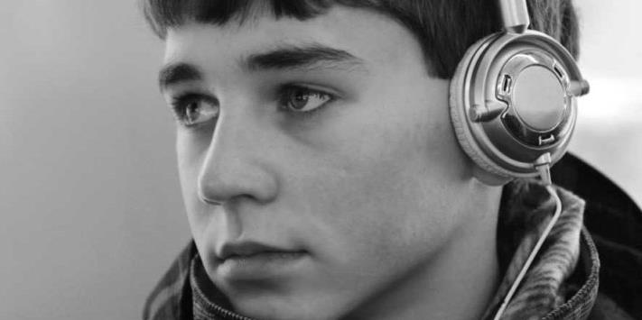
Case Study: Recruiting Scottish Children and Young People
Notes:
Tom is 16 years old and stays in a deprived area in the Central Belt of Scotland.
Tom was hanging around the streets in his local area with a few friends when they were approached by an older male within a London accent. They were asked if they wanted to make some money, all they had to do was to sell a small amount of cannabis. Tom thought this was a good way to make some quick money.
After gaining Toms trust, they ask him to sell larger amounts of cannabis locally before asking him if he wanted to make more money.
This all happened quickly – within the space of a couple of weeks. With the promise of making significantly more money, Tom was taken to Glasgow where the male who first approached him, and several other older males with similar London accents collected drugs.
They thereafter travelled to the North of Scotland where Tom was put up in a rented flat and introduced to an associate of the older London males.
Tom was used to move the drugs and cash to and from the rented flat. He remained away from home for lengthy periods and was moved around by train, bus, and private car.
Tom was provided with a regular ‘wage’ for selling the drugs. He was instructed not to spend his money in his own local area to avoid bringing any attention to himself.
Tom was reported as a missing person by his family and eventually traced in the North of Scotland by the Police following a missing person investigation, he was provided with wrap around support to address his vulnerabilities and give him alternative options.
How the group identified Tom, other than the area he resides, is unknown, however we are seeing this rise in local youths becoming entangled in county lines operations.

Slide 15
What can you do? National Referral Mechanism (NRM)
The National Referral Mechanism (NRM) is a framework for identifying and referring potential victims of modern slavery and ensuring they receive the appropriate support.
Modern slavery is a complex crime and may involve multiple forms of exploitation. It encompasses human trafficking, slavery, servitude, and forced or compulsory labour.
Victims may not be aware that they are being trafficked or exploited, and may have consented to elements of their exploitation, or accepted their situation.
Notes:
The NRM process is applicable when dealing with both children/young people and vulnerable adults who have been exploited into taking part in County Line activities, may have been moved around (trafficked) in order to run drugs in a different area, or may have had their properties cuckooed.
The NRM form is now online

Slide 16
How & When to submit?
If you think you have encountered a person (adult or child) who has been a victim of modern slavery, you should complete a referral via the new online process.
The new online process for NRM referrals is now a single online form which can be completed whether the victim is an adult or child. The form has been designed to be responsive and will change depending on the options selected. You can access the new form and guidance here: Online NRM Form
Notes:
Individuals who are recognised as a potential victim of modern slavery through the NRM have access to specialist tailored support for a period of at least 45 days while their case is considered, which may include: access to relevant legal advice, accommodation, protection, independent emotional and practical help.
You must explain this process to the potential victim and seek their consent before completing the online referral. If they consent to being referred you should indicate on the form the type of referral being made and you will be asked to confirm that the potential victim provided you with consent.

Slide 17
What can you do?
If someone is in immediate danger - Call 999
If you are suspicious about something you have seen or heard, call your local police on 101
Information can be given anonymously:
Crimestoppers 0800 555 111 or online, crimestoppers-uk.org,
We need information about County Lines drug dealing and Cuckooing in Scotland.
If you have any information please contact Police Scotland or report anonymously to Crimestoppers.

Slide 18
Thank you
Questions or Comments can be directed to me via the following:
Email: martyn.paterson@scotland.pnn.police.uk
Thank you.
Martyn

