Slide 1
Notes:
As part of introducing yourself, explain that you are a member of collaborative project developing and implementing the new Standards. The Care Inspectorate and Healthcare Improvement Scotland are leading the project on behalf of Scottish Government in partnership with organisations representing people experiencing, providing and planning care.
Perhaps the first thing to highlight is the title of the Standards. They are not just a replacement for the previous National Care Standards, as the new Health and Social Care Standards apply to all parts of our care system, right across health care, social care, early learning and childcare and social work. They are a vehicle for Scotland’s journey to integrate health and social care and to create a more joined-up service for the public.
Looking at the new Standards, they are very different to the ones from what we had before. Scotland’s first National Care Standards were introduced in 2002 and applied only to registered social care services, such as care homes and nurseries. The new Health and Social Care Standards will have a far wider impact and will apply to many more people’s experiences of care, including non-registered care provided by the NHS and local authority social work.
Another key difference is that the new Standards focus on people rather than policies, paperwork and property. Instead of setting out a list of inputs that all providers must meet, these Standards are much more outcome-based and will help everyone focus on what really matters – the experience of the person who uses care. The consistent message from people experiencing care, as well as organisations inspecting care, is that it is the quality of human relationships, kindness and compassion, that really affects the quality of care, rather than all those traditional measures, the tangible inputs such as records, procedures and of course health and safety. That’s why these new Standards focus much more on the softer side of care. They focus more on people’s outcomes than provider inputs. They also reflect our increasing expectations of people’s human rights. So for the first time, we have tried to set out in some detail what it looks and feels like to experience wellbeing and human rights in all types of care setting.
When you’re thinking about these Standards and how they apply to you or your organisation, it is important to see tem in the context of the aims and objectives of the organisation. Not all statements will apply to everyone, or to all settings. For example, someone attending an outpatient department for routine screening should look through these with that lens, which will be a very different lens from that of someone who perhaps has more complex needs and is engaging with a range of services, on a more planned or frequent basis.

Slide 2
From compliance…
Notes:
These Standards bring with them a change of regulatory culture, moving away from policing all services to comply with a minimum baseline to a more collaborative approach in order to help each service to improve as much as possible. While we’re not saying that technical and tangible inputs are not important, they are not in themselves always the most reliable indicator of quality. For example, care services that need to improve record keeping, policies or health and safety, can at the same time provide compassionate care, involve people and uphold their rights.

Slide 3
… to collaboration
Notes:
Moving away from the traditional prescriptive standards to a more holistic model looking at an individual’s overall experience needs a different kind of inspection. Most of the Statements contained in the Standards are not black-and-white judgements that can be easily measured, but they need inspectors (and others engaged in Quality assuring services) to get alongside and collaborate with providers, staff and more importantly people experiencing care. They need inspectors (and others engaged in Quality assuring services) to observe the quality of relationships and to discuss how care is being provided and experienced before reaching a professional assessment. For example, Statements like 3.7, 3.8, 3.9 or 3.16 need a more person-centred and nuanced approach to regulation and inspection.
Other Statements are consciously aspirational and are the responsibility of everyone involved in planning and providing care, such as 1.17, 1.19, 1.20 and 4.17. This means that inspectorates (and others engaged in Quality assuring services) need to consult a range of people, as well as a single service provider, in order to assess progress in achieving these ambitious national aims for individuals.
So inspectorates and other Quality assurance agencies are evolving from inspections and QA activities based mainly on compliance with rules to an approach that helps services improve quality.
The Standards are designed to ensure that the assessment of quality is not whether a minimum standard is met but whether the experience and outcomes for people are positive. We want service providers to creatively solve problems and innovate to improve. The new Standards are designed to help managers and care staff to plan, do, study and act. Increasingly inspection and quality assurance is moving from seeing whether something is done ‘correctly’, to asking ‘how successful is this in improving experiences and outcomes for people?’ The new Standards reinforce the new approach completely.

Slide 4
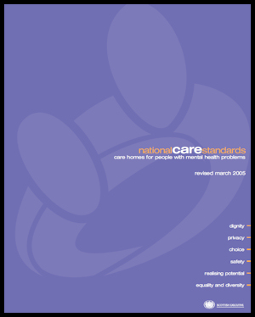
First standards in 2002
23 separate standards for settings
2,042 mostly input statements
Only regulated health & care
Used primarily for inspection
Notes:
The new Standards consist of one slim booklet, which replaces the previous 23 sets of Standards that we had for different registered care settings. They also no longer just apply to registered settings. They are relevant across all the whole care system – a kind of passport you can take with you, whether you’re spending time in hospital, attending outpatients having your needs assessed by a professional, Live in a care home, go to nursery or childminder or receiving a social work service. These Standards apply to non-regulated provision, which after all makes up the majority of care, as well as an individually registered social care service.
Think just how many times you and your family will engage with our care system in some shape or form. We know that understanding and navigating a way through the maze of different structures and services is complex for a consumer. These Standards will help us assess someone’s journey through the care system so we can collectively become more joined up.
So the new Standards are more than just a tool for inspection and quality assurance, whether that is at a service or strategic level. They have been produced for everyone and should be owned by everyone. Increasingly organisations run a combination of registered and non-registered services and the Standards can equally be used for internal quality assurance as external scrutiny.
Some of the Statements will be familiar to many of you and we have tried to take the best aspects of the different previous standards and good practice guidelines. For example, dignity, respect, human rights and empowerment are not new concepts, but we have tried to take into account society’s increasing expectations and recent developments, such as the Human Rights Act, Self Directed Support and the Community Empowerment Act. The new Standards have not been produced in isolation, they have taken into account the knowledge gained from inspections and investigating complaints, but perhaps more importantly they were directly influenced by representatives of people experiencing care and by extensive public consultation.

Slide 5
The task in 2015
Single set of standards across health & social care
Designed around a set of overarching principles
Developed by people experiencing & providing care
Designed to be future-proof
Notes:
In 2014 the Scottish Government announced that the National Care Standards would be reviewed in line with current expectations of compassionate, high quality, safe and effective care. The Care Inspectorate and Healthcare Improvement Scotland were asked to produce these alongside people using services, providers and other agencies.
How care services are provided has changed since 2002, with more of us being supported and cared for in our own home and as part of the local community. If we had adopted the same approach, we would have developed different sets of Standards that reflected the most common settings we have today. Having one integrated Standards document is more accessible and meaningful for consumers. But we also wanted the new Standards to be more flexible to support choice and innovation as care services continue to evolve in the future.

Slide 6
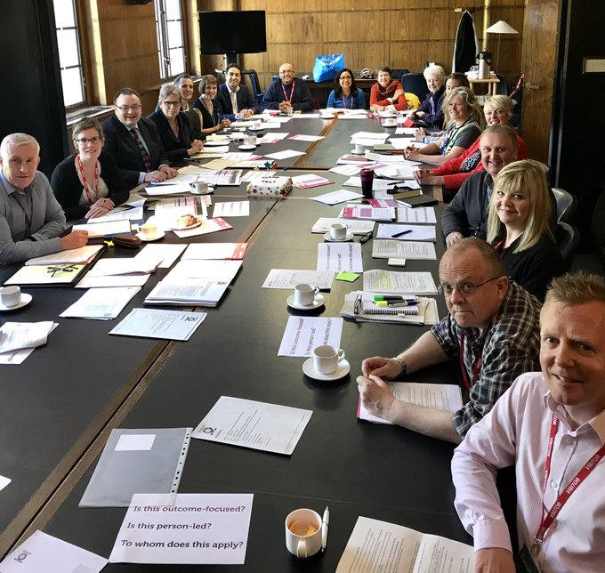
Notes:
The Scottish Government carried out 3 public consultations, with a very high level of response, including from individuals and organisations with experience of using care. The first consultation related to the whole review process, the second consulted on the underlying principles and the third on the draft Standards.
This is a photograph of a meeting of the Development Group responsible for drafting the Standards. The way they were produced is an example of genuine partnership working. As well as bringing together professionals from across the different silos, including public, private and voluntary sector providers, organisations representing people experiencing care were fully involved. Organisations such as Who Cares Scotland and the Scottish Older People’s Assembly, helped us get the tone of the language as well as the content.
The same collaborative approach is now being taken by the inspectorates with regard to implementing the Standards.

Slide 7
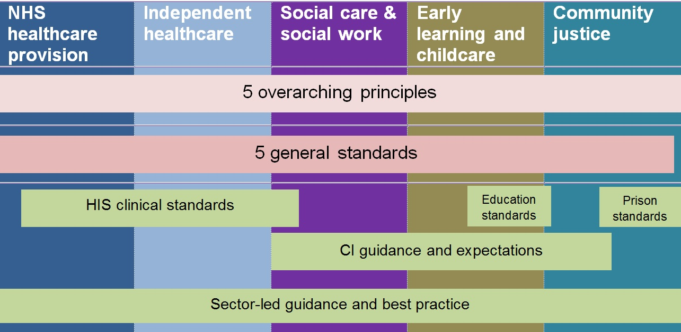
Notes:
This slide illustrates the scope of the new Standards and that they apply right across the NHS, independent health, social care, social work, early learning and childcare, and community justice.
The Standards are aligned with and complement sector specific standards and guidance, such as Healthcare Improvement Scotland’s clinical standards or guidance issued by the Care Inspectorate. Some of you may be looking for more detail to be available, such as the minimum size of a care home bedroom or condition specific treatment times in hospital, and these will continue to be specified by the relevant body. Increasingly we will also look to issue integrated guidance where this is relevant. For instance, Healthcare Improvement Scotland’s recent guidance on good practice regarding pressure ulcers was jointly produced with the Care Inspectorate. Adopting the same model as the Standards, producing one set of guidance across different settings within the wider care system when this is applicable, makes sense for practitioners and consumers alike. The Development Group drafting the Standards found that, once differences in jargon between health and social care had been overcome, there was often more in common across professional divides than not.

Slide 8
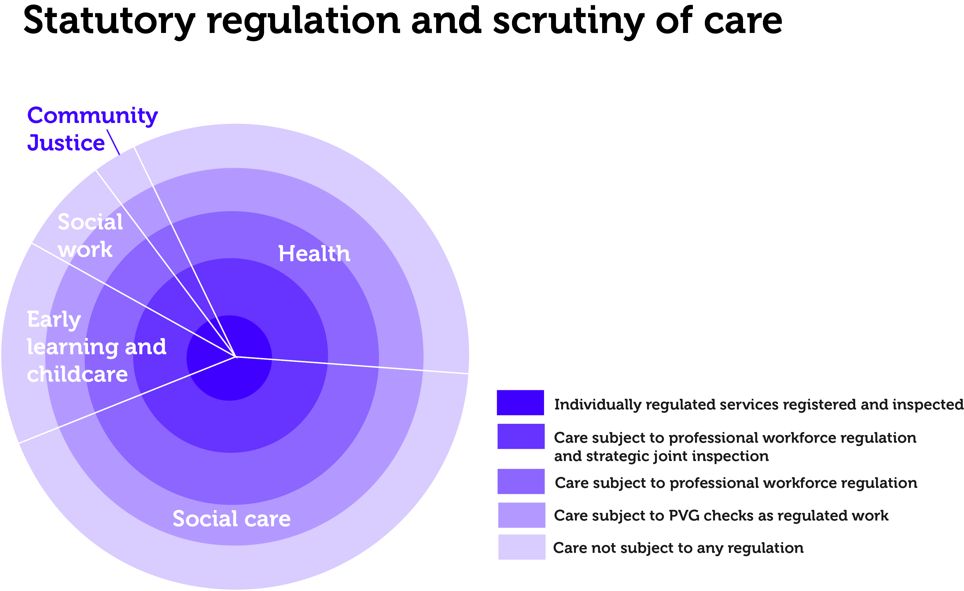
Notes:
This chart shows that our care system is made up of a blend of non-registered and registered provision across different professional disciplines and structures. The dark circle in the middle shows the minority of services that are individually regulated and inspected, while the majority of provision is not regulated or inspected. Staff may of course be individually registered with their professional workforce regulator whether or not the service they work in is registered. Within health for instance, only independent health services are regulated and within social work only some social care services such as care homes run by the social work are regulated. This means that formal external regulation and inspection is only one part of implementing the Standards – they have been designed as much for internal quality assurance and improvement purposes. Indeed many organisations are already using the Standards as an accessible tool with staff, volunteers and people using their services in order to improve care and plan service development.

Slide 9
5 principles
Compassion
Be included
Dignity and respect
Responsive care & support
Wellbeing
Notes:
The Standards are underpinned by these 5 principles.
Some people might be surprised to see ‘Compassion’ alongside more a familiar principle such as ‘Dignity and respect’. And we think this is the first time that ‘Compassion’ has featured as part of official national standards in this way. This reflects the feedback from people experiencing care and was strongly supported by the 2015 public consultation. We’ve put arrows around the circle here to show that the principles do not have a hierarchy of importance.
‘Safety’ was originally considered as a principle and, while of course safety is fundamental to all good quality, it was agreed that concerns regarding safety should not dominate, as has traditionally featured in many frameworks for standards. People experiencing care felt that a more balanced approach to safety and risk should be adopted, with people being actively supported to take risks in some circumstances, as set out in Statements 2.24 and 2.25.

Slide 10
Five general standards
I experience high quality care and support that is right for me.
I am fully involved in all decisions about my care and support.
I have confidence in the people who support and care for me.
I have confidence in the organisation providing my care and support.
I experience a high quality environment if the organisation provides the premises.
Notes:
And these are the headings of the 5 general Standards.
All starting with ‘I’, being written in the first person locates quality firmly through the lens of the person experiencing care, rather than by specifically describing or prescribing what care professionals should do to make this happen. This is empowering for people who may be in unfamiliar or distressing environments and is designed to ensure care professionals reflect on their practice from the perspective of the person. This person-led approach is designed to help people and organisations to work together to support people to direct their own care. So the first Standard talks about experiencing high quality care and support ‘that is right for me’.
The 2nd Standard focusses on the importance of people being fully involved in their care and support. This is more than just being consulted or having a say, with 2.1 stating that ‘I can control my own care and support if this is what I want.’
Standard 3 reflects that the quality of relationships you have with staff and volunteers is at the heart of high quality care. Statement 3.1 states: ‘I experience people speaking and listening to me in a way that is courteous and respectful, with my care and support being the main focus of people’s attention.’ 3.3 highlights that relationships need to be a 2 way dialogue and negotiation, while 3.7 also talks about the importance of relationships between staff and volunteers: ‘I experience a warm atmosphere because people have good working relationships.’
Standard 4 addresses the need for all organisations responsible for providing care to work together, as set out in 4.17 and 4.18, as it is often the ‘messy joins’ between different services and different sectors that can result in problems. The increasing expectation that leaders and managers actively involve people in how an organisation provides care is also articulated.
While Standards 1 to 4 apply to all care settings, Standard 5 only applies where the organisation proving care is also responsible for the premises.

Slide 11
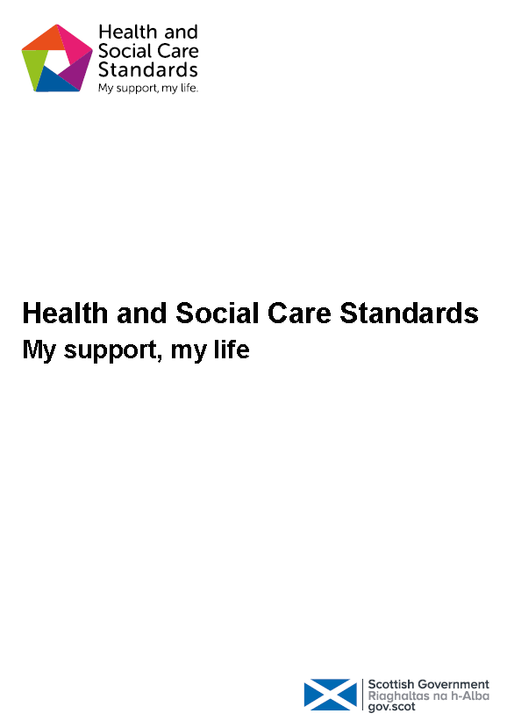
What’s launched now?
One set of standards across all health and social services
5 standards - 146 statements
Relevant across planning,
assessment, commissioning,
delivery
No big bang in the roll-out
Notes:
The consultation on the draft Standards supported having one set of standards rather than separate sets, say for different service types or for children or restricted care. Although some Statements are specific only for children and young people or only covering adults living in care homes, for example, the majority apply to everyone. This has brought the previous diverse sets of standards into one streamlined document which is hopefully written in a way that is accessible to all.
Being relevant across planning, assessment, commissioning as well as delivery, we also bring the quality indicators used for strategic joint inspections of local authorities, health boards and Integrated Joint Boards together with the more familiar standards used to inspect an individual care service.
With regard to inspection and quality assurance, the Care Inspectorate and Healthcare Improvement Scotland are not adopting a big bang approach. These Scottish Government Standards are new for those organisations with responsibility for scrutiny and quality assurance, as well as everyone else. For example, the Care Inspectorate is phasing in full implementation across different service types and is currently testing out new inspection methods with care homes for older people as part of a collaborative approach.

Slide 12
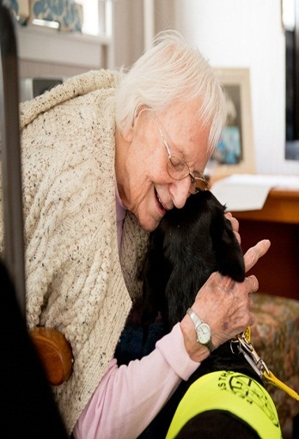
How are the new standards different?
Human rights and wellbeing
Person-led
Outcome focused
Decoupled
from settings
Outcome focused
Notes:
Lets look in more detail at how these Standards are different from previous versions.

Slide 13
1
Human rights and wellbeing
Describes what a care service needs to do to meet the minimum.
Describes the quality which I am entitled to experience.
Notes:
In many ways we are turning traditional standards on their head by describing what I am entitled to rather than what a service needs to do. The new Standards articulate what human rights should actually mean in practice for someone experiencing care, irrespective of which part of the health and social care system they happen to be experiencing. They describe what the consequence of good care should be, not how it should be delivered.
So the first Statements 1.1, 1.2 and 1.3 articulate people’s rights from the outset, while Standards 3 and 4 highlight the need for staff and organisations to proactively take steps to uphold people’s rights and tackle inequality.

Slide 14
2
Being person-led
Staff will treat you politely at all times.
Staff call you by your preferred name or title at all times.
If you need help, your request will be dealt with politely and as soon as possible.
I get the most out of life because the people and organisation who support and care for me have an enabling attitude and believe in my potential.
I experience warmth, kindness and compassion in how I am supported and cared for, including physical comfort when appropriate for me and the person supporting and caring for me.
I experience care and support where all people are respected and valued.
Notes:
Compared to the wording of old standards, the new Standards are based on human rights and are more person-led. If we compare the wording of the previous National Care Standards on the left with the new Standards on the right, we can see just how much we’ve all moved on regarding human rights, compassion and wellbeing. For example, looking at the wording used to describe kind and compassionate care, we can see that the old standards had fairly minimal expectations in this regard, so we have tried to be more explicit about what people should expect. The old standards didn’t say anything about physical touch, and historically there has been some risk averse attitudes and assumptions to this in many care settings, so we have deliberately stated that this is expected while at the same time respecting the need for mutual negotiation.
Everyone being valued and feeling cared for in a service, including staff and volunteers, is a key element of quality, so this is also included.

Slide 15
3
Outcome focused
You have full information on your legal position about your occupancy rights in the care home. You are confident that the home is run in line with legal requirements for health and safety, fire safety and food hygiene.
I am accepted and valued whatever my needs, ability, gender, age, faith, mental health status, race, background or sexual orientation.
My human rights are protected and promoted and I experience no discrimination.
If my independence, control and choice are restricted, this complies with relevant legislation and any restrictions are justified, kept to a minimum and carried out sensitively.
Notes:
The old wording seems very distant, passive and formal now. With the new Standards, we have tried to be explicit about how people’s rights should be actively promoted.

Slide 16
3
Outcome focused
You can ask for copies of the care home’s policies and procedures.
You can ask for confirmation that the home meets with all the relevant legislation and guidance relating to fire, health and safety procedures, anti-discriminatory practice and risk management.
I am empowered and enabled to be as independent and as in control of my life as I want and can be.
I am supported to understand and uphold my rights.
My human rights are central to the organisations that support and care for me.
I receive an apology if things go wrong with my care and support or my human rights are not respected, and the organisation takes responsibility for its actions.
Notes:
For example, rather than just saying you can ask for copies of policies and procedures, the new Standards ask the ‘so what?’ question and says what we expect people to experience. This is an outcome focused rather than an input focused approach.

Slide 17
4
Decoupled from settings
I am fully involved in assessing my emotional, psychological, social, and physical needs at an early stage, regularly, and when my needs change.
If I have a carer, their needs are assessed and support provided.
I am enabled to live in my own home if I want this and it is possible.
If I am supported and cared for by a team or more than one organisation, this is well co-ordinated so that I experience consistency and continuity.
Notes:
The Standards are also decoupled from settings. Instead of separate standards for all the different types of care homes, hospitals, children’s services, for example, there is now one common set of outcomes across all care. But now the Standards cover the planning and commissioning of care services as well the what is expected of an individual services. The Standards here therefore relate to the assessment of an individual’s needs and whether there are sufficient services available for people in a local area. It also covers whether people can choose a suitable service and be fully involved in making this decision.
The limitations under the previous Standards are illustrated by how care at home has been inspected. Until now a care at home inspection could only look at how a commissioned service performed in terms of its contract. However this is of course only part of the picture and you need to take into account the local authority’s contract. in order to fully assess the extent to which people’s needs and wishes are being met.
The Care Inspectorate inherited different scrutiny models, with service level regulation of social care from the Care Commission and strategic level inspection of local authorities and health boards from Social Work Inspection Agency and HMIE’s child protection unit. The new Standards provide an integrated model and an opportunity to blend the best aspects of the different models. One of the weaknesses of the previous standards is that they just covered what happened after you’d started attending a service rather than how you got there and the choices available.

Slide 18
Care Inspectorate’s response
1
No big bang approach
Is this a good regulated care service?
2
We will set out our expectations clearly
3
New model of inspections from April 2018 - gradually
4
Scrutiny of strategic commissioning
Outcome focused
Notes:
As mentioned, there will be no ‘big bang’ and we want to bring providers with us as part of a phased approach. All organisations have things to learn and improve, including inspectorates. We want to emphasise that although inspectorates have led on producing these Standards, they are for everyone, and we don’t want to adopt a ‘done unto’ approach.
We will also use these Standards for strategic inspections of how public bodies are planning and commissioning care in their area.

Slide 19
New inspections model - April 2018 onwards
Quality indicators with Self Evaluation at core
May well change themes / grades
Proportionate, intelligence-led, risk-based
Recognise that care services are not being asked to meet all standards alone
Commitment to work together during 2018
Commitment to work together during 2018
Notes:
In changing how services are inspected, taking into account these radically different Standards, Self Evaluation will be at its core. We are considering whether changes are needed to the previous themes and grades used for inspection and will consult before introducing a different model. We are committed to the new methodology being proportionate, intelligence-led and risk-based. We also recognise that responsibility for meeting the Standards is shared and now goes wider than individually registered services.

Slide 20
Healthcare Improvement Scotland’s response
1
Supports Quality of Care approach
Is this a good regulated care service?
2
Development of standards
3
Supporting stakeholders
4
Joint working, joint inspections
Outcome focused
Notes:
QoC approach next slide
Going forward Evidence and Standards will be reflecting on the structure and wording of new standards when developing new standards. A pilot will be undertaken on the
Care Inspectorate and Healthcare Improvement Scotland will be discussing how to intergrade the standards into their inspection methodology.

Slide 21
Quality of Care model - 2018 onwards
Quality of Care Approach
Consistency and supports improvement
Existing inspections
Proportionate, intelligence-led, risk-based
Commitment to work together during 2018
Notes:
Quality of care approach
The quality of care approach is how we design HIS inspection and review frameworks and provide external assurance of the quality of healthcare provided in Scotland. The approach is designed to deliver quality assurance activity that drives improvement.
Until now, our approach to external quality assurance of services has largely been on a case-by-case basis with bespoke tools and methodologies developed and used depending on the service, topic or sector being reviewed. The new approach will use a consistent core methodology, based on an overarching Quality Framework and a set of tools that can adapt to the scale and topic of a review. The approach places a much stronger emphasis on supporting continuous quality improvement and building supportive improvement-focused relationships with service providers. We will also assess factors such as service sustainability, organisational culture and leadership.
Using the same framework for all of our inspection and review work will ensure consistency and coherence of assessment and help to identify possible variation in care provision across Scotland.
The quality of care approach and the Quality Framework will guide and inform all of our quality assurance activity. Inspections, such as care of older people in acute hospitals and the safety and cleanliness of hospitals, are an important part of this activity and will continue. We will be aligning the self-evaluations for these inspections to the domains of the Quality Framework and streamlining the self-evaluation completion process where we can. Likewise, our work with independent healthcare services will be underpinned by the quality of care approach and the Quality Framework.
The Quality Framework is a tool to support improvement within health services and provide public assurance that appropriate systems and structures are in place to deliver safe, high quality, person-centred care that delivers positive outcomes for people.
Part of this assurance function will include assessment of whether healthcare providers have robust processes for implementing national standards and guidance and for self-evaluating local care provision against these.
The five overarching principles of the Health and Social Care Standards are reflected in the Quality Framework and relevant aspects of the standards have been incorporated into the ‘Impact on patients, service users, carers and families’ domain and quality indicators.
We are in the process of translating the framework into a self-assessment tool with supporting measures, and developing a proportionate, sustainable operational methodology. We have tested elements of the new approach and more testing is planned in early 2018 which will further inform and shape the final self-evaluation tool and methodology. The aim is to start a phased roll-out of the new approach in 2018. The framework will initially be introduced within secondary healthcare settings and independent hospitals. This will allow us to begin to establish the new methodology and gain experience within these sectors while continuing to reflect, learn and adjust the approach as we expand into other healthcare sectors.

Slide 22
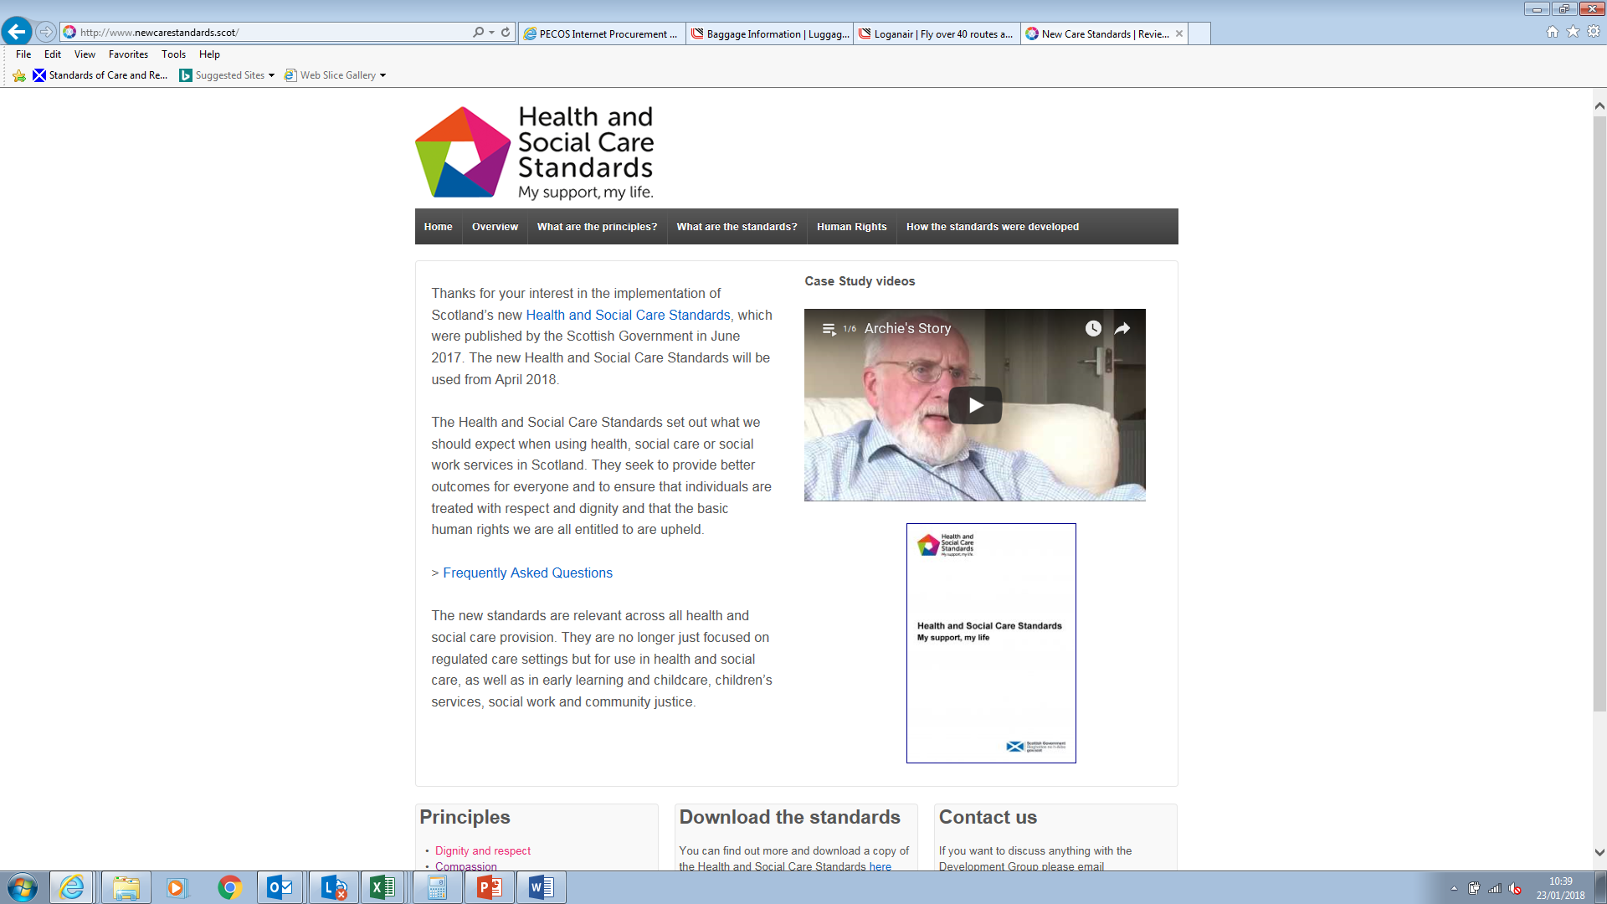
Where can I find out more?
Link to our Videos:
https://www.youtube.com/watch?list=PLbGUgyQIJfFi43x2bOJyToKPYjgSr8oHC&v=wLgBR7eJwz4
www.newcarestandards.scot
Notes:
Where can I find more
What other tools are there
Highlighting
Films
FAQs
Leaflets
Copies of Standards

Slide 23
Notes:
We hope that you and your organisation can sign up to these Standards. They are owned by all of us. Ultimately it will take all parts of our currently fragmented care system to pull together behind the Standards to make these aspirations a reality. And it will take time. We therefore ask you, whatever your particular role in care, to look at the relevance of the Standards for you and your setting and use them to improve the experience of people using your service.
We think that having one set of person-led Standards covering the whole care system, with a focus on wellbeing and human rights, is the first time this has been done anywhere in the world. Indeed the level of interest internationally in the unique scrutiny model we are collectively developing in Scotland has been heartening. Just in the last few months since the Standards were published, for example, we have received delegations from Japan, Malta, Sweden and have presented at conferences in Norway and Iceland.

