Slide 1
Leading Improvement Evidencing Impact : Children’s Services in Falkirk
Workshop 3
February 11th 2020
Wendy Toner
CYPIC Improvement Advisor
&
Falkirk CYPIC QI Faculty

Slide 3
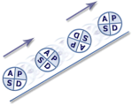
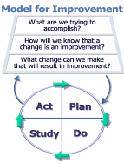
Programme design and key dates
Action Period 2
Action Period 3
Action Period 4
Action Period 5
Welcome Overview
Workshop 1
Workshop 2
Workshop 3
Workshop 4
Showcase
October
10^{THdDec}
21ST JAN
Feb 11th
Mar 31st
Support
National IA Leadership Team/s Q.I. Faculty
QI Zone (TURAS) (Falkirk) GIRFEC Practitioner pages
All teach ,all learn

Slide 4
By the end of this session you will…….
Measurement for improvement
Change Ideas and testing your way to Improvement
Leave with an action plan for Action Period 3.

Slide 5
If you want to go fast, go alone.
If you want to go far, go together.
African Proverb
Notes:
Adam
Bill Alexander’s challenge from last year
Big Idea’ – you need coaches and leaders at all levels to create the conditions that support improvement and enable systems to change
SCLIP message – Slow down to speed up

Slide 6
Notes:
Empathy map to be distributed.
Who’s going to be in the audience? Stand in their shoes.
What will they need to know?

Slide 7
Technical Tools: Understanding a System
Process Mapping
Pareto chart
Force field Analysis
Cause + Effect
Surveys

Slide 8
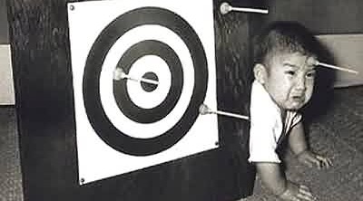
Creating an Aim

Slide 9
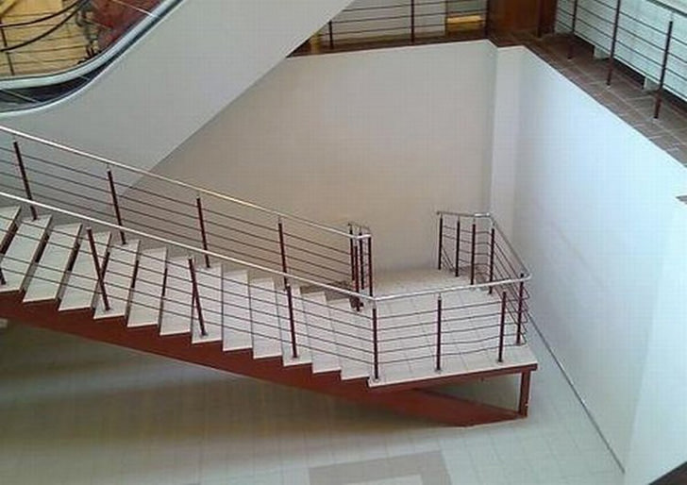
Improvement Planning

Slide 10
Notes:
If you don’t create a measurement plan you will fly blind. Things may get better or worse but you won’t be able to say if it was because of something you did.

Slide 11
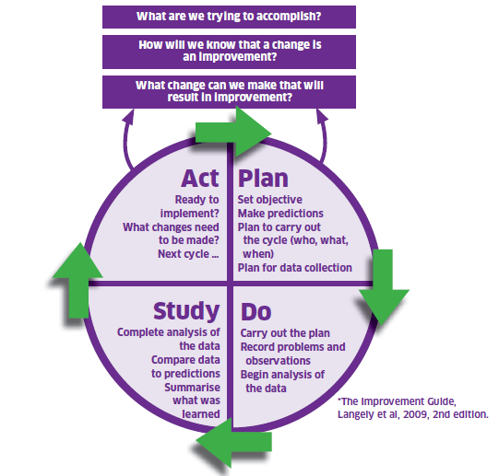
The Model For Improvement
The Thinking Part
The Doing Part
Notes:
The model is split into two parts. The first being the thinking part and the second being the doing part. We will now take you through the two distinct parts in some detail with practical exercises to get everyone used to using the model and be able to describe and direct others in terms of our support function as a Unit.
.

Slide 12
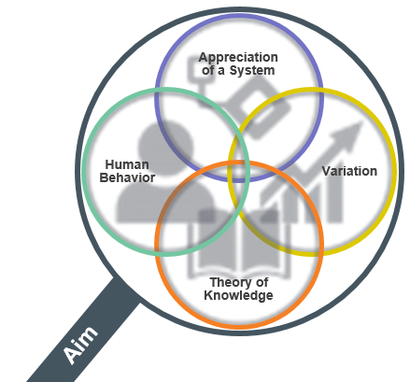
Appreciation of a System
Common Aim
Understand how things link together
People, process and items
Simple, Complicated or Complex
Profound
Knowledge
Psychology
Relationships between people
Motivation, intrinsic /extrinsic
Beliefs, assumptions
Will to change
Theory of Knowledge
1. Develop a theory
2. Use PDSA to test
3.Bring knowledge into the system
Develop a theory
Use PDSA to test
Bring knowledge into the system
Understanding Variation
The world is not deterministic
Variation is expected
Understand when to improve
Understand when not to tamper
Notes:
Appreciation for a System
Interdependence, dynamism
World is not deterministic
Optimization, interactions
System must have an aim
Whole is greater than sum of the parts
Theory of Knowledge
Prediction
Learning from theory, experience
Operational definitions
PDSA for learning and improvement
Understanding Variation
Variation is to be expected
Common or special causes
Ranking, tampering
Potential mistakes
Psychology
Interaction between people
Intrinsic motivation, movement
Beliefs, assumptions
Will to change

Slide 13
Improvement Journey
Understand current system
Develop aim and change theory
Identify specific change ideas, test and refine in context
Implement locally, using PDSA cycles to build in sustainability
Scale up / spread where relevant
Build will and conditions for change
Coaching
Leadership

Slide 14
Practical Exercise
In teams:
STAN Aim
Driver Diagram
Measures
Notes:
60 mins
15 Buzz every 15 mins
Then 5
15
5
15
5
Prompt movement from C to L to E to A to R
to coach plus 5 to feedback

Slide 15
Notes:
Amanda
Reflections & Day Ahead
Welcome
Refresh catch-up

Slide 16
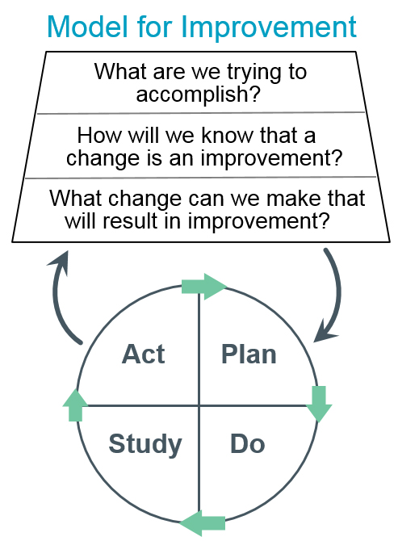
The Model for Improvement was developed by Associates in Process Improvement. [Source: Langley GL, Moen R, Nolan KM, Nolan TW, Norman CL, Provost LP. The Improvement Guide: A Practical Approach to Enhancing Organizational Performance (2nd edition). San Francisco: Jossey-Bass Publishers; 2009.]

Slide 17
Driver Diagram
Primary Drivers
Broadly what needs to be in place
Secondary Drivers
Specifically what needs to be in place
Aim
How much,
by when
http://www.ihi.org/resources/Pages/Tools/Driver-Diagram.aspx

Slide 18
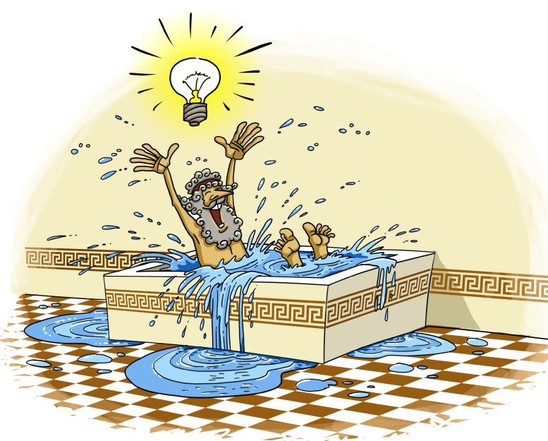
Where do change Ideas come from?
Eureka!
Archimedes 250BC
Active thinking

Slide 19
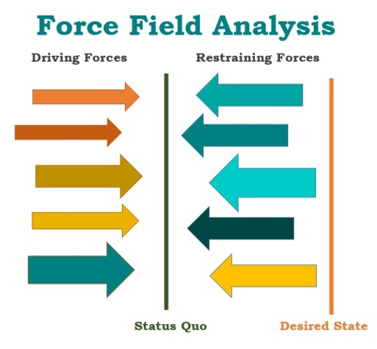
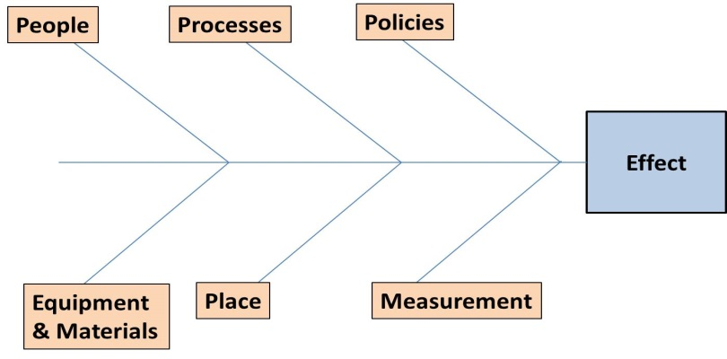
Where do change Ideas come from?
Critical thinking about the current system
Benchmarking
Use technology
Creative thinking
Change concepts

Slide 20
De Bono’s 6 Thinking Hats
Discuss your theory of change so far including
Aim
Drivers
Change Ideas
For each part, consider it from the following perspectives

Slide 21
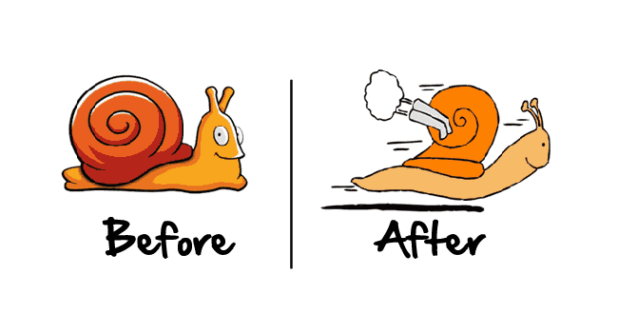
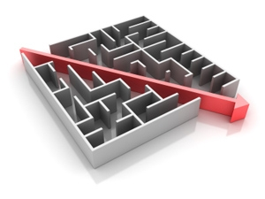
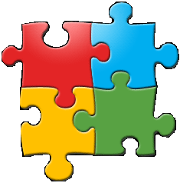
ONE: Take on the big problems
Over the last few years, most of the technology we’ve seen has been produced by a small group: largely wealthy, male, and living in a small number of big cities. Naturally, they have been building solutions to the problems that they face on a daily basis: “Where can I find the perfect cup of coffee quickly?”, “How can I share my photos with my friends the moment I’ve taken them?”, “How can I publish my thoughts on a minute by minute basis?”
And the solutions they’ve developed have been lovely. But what about problems like: how do we provide for a rapidly ageing and increasingly isolated population? How do we support the one in 10 of us who will suffer from mental health issues? How can we give everyone equal opportunities to education and employment? If just some of the brilliant people building technology right now turned their minds to these problems we might have some slightly more impressive technological advances than the Yo App.
TWO: Accept that social problems are wicked problems
Wikipedia describes a wicked problem as: "A problem that is difficult or impossible to solve because of incomplete, contradictory, and changing requirements that are often difficult to recognise. The term "wicked" is used to denote resistance to resolution, rather than evil. Moreover, because of complex interdependencies, the effort to solve one aspect of a wicked problem may reveal or create other problems."
Social problems, such as educational inequality or mental wellbeing, are actually a collection of smaller (but still massive) problems, and you’ll often need to tackle several of them before you can get to the one you were actually interested in. This can be disheartening, especially because people in technology are used to problems that can be solved intellectually. But, social problems often involve negotiations, bureaucracy and community building, and even then they may not work because too many obstacles remain. But this doesn’t mean you should lose hope! The trick is...
Image courtesy of Paul Miller via Flickr (CC)
THREE: Be focused
If you set out to solve world hunger, you’ll probably fail. Hunger is much bigger than technology – it concerns politics, economics, capitalism, corruption and all sorts of other factors over which you have no control. But sometimes you can create real world impact by solving a smaller problem.
For example, DrDoctor, which is one of the ventures we support, set out to transform access to healthcare, a huge problem. But they decided to start by rebuilding Hospital Appointment booking systems. Through working with hospitals to improve the way they booked outpatient appointments they learnt a huge amount about how to work with the NHS’s existing technology, how their security protocols worked, and identified the individuals who were interested in new ways of doing things. So when they tackle the next challenge in transforming access to healthcare, they start from a better place.
FOUR: Solve problems you really understand
Playlab’s founder suffered from severe panic attacks so he built a mobile game that would help people manage the effects of panic and anxiety in their lives. The founders of Andiamo are a husband and wife team whose child needed orthotics. After the harrowing experience of trying to get ones that actually fitted, they realised that orthotics could be made far more accurately and faster by using 3D printing and scanning technologies. By using your unique insights you can make technology that could really change things for the better.
FIVE: Prove it’s possible
When Fairphone approached us two years ago they were a campaigning organisation trying to persuade big phone manufacturers to stop using conflict minerals and child labour. They weren’t really getting anywhere; everyone they talked to said, “This is simply the way it’s done, there is no alternative.”
So they went ahead and designed, manufactured and sold a smartphone from fair trade minerals, put together in cooperative factories, and that could be completely recycled at the end of its lifecycle. They’ve sold almost 50,000 of them, and now the big phone companies are paying attention.
SIX: Don’t just put existing services online
One mistake people often make when building digital services is just putting the existing system online, where all the old problems are simply replicated. But because the web enables new ways of working and thinking these services can be completely rethought. Our alumni Open Utility are re-imagining the way that people can buy energy, and supporting small-scale energy generation.
SEVEN: Ask for help!
Finally, always make sure you talk to people about what you are doing, and ask them for help. Our programme is hugely enriched not just by the experience and knowledge of our mentors, but the peer-to-peer learning between teams and alumni. You never know when that casual conversation might result in the introduction to THE person who will get your idea of the ground, or will trigger THE idea that makes it work.
Can you use technology to…
Simplify
Quicken
Integrate
Accessibility
Increase Reach
Standardise

Slide 22
What do you need to do to bring about success?
What does success look like?
Secondary Driver
What you need to do to bring about success
Change Idea

Slide 23
Change ideas are theories
Written as a hypothesis
Change ideas could be
Old
New
Borrowed
Blue
State what you think you will improve

Slide 24
Driver Diagram
Primary Drivers
Broadly what needs to be in place
Secondary Drivers
Specifically what needs to be in place
Change Ideas
Theories about what might work
Aim
How much,
by when

Slide 25
Prioritisation of change ideas?
Effort
Impact

Slide 26
Driver Diagrams
Primary Drivers
Secondary Drivers
Change Ideas
Fully understand system?
User ideas
Changes or
interventions
that can be
tested out
Key factors
that drive the
aim/outcome
Secondary factors which
will influence delivery of
the primary drivers
Aim
Staff ideas
Research & evidence
Best practice?
Stakeholder expectations?
Drivers
Result
Cause
Notes:
Diver diagrams are used to visually present a team’s theory of how improvement goals will be achieved. They articulate which parts of the system need to change, and in what way, and include ideas to make this happen. Such theories should be derived from the team’s experience, knowledge, observation and evidence available.
Here’s a schematic view of a system – a ‘driver diagram’. On the left we depict the outcome in the yellow box. As we move right we drill down into the network of causes that drive the outcome, from ‘primary’ to ‘secondary’ drivers. On the right we depict the ideas for system changes that might ultimately impact the outcome.
This diagram represents our theory about how to modify the system to change the outcome.
Primary Drivers
Key factors which you need to influence in order to move towards the aim. These drivers may act independently or in concert to achieve the overall goal.
Secondary Drivers
Underpinning factors affecting the associated primary driver(s). They can be used to create projects or a change package that will affect the primary drivers.
Change Ideas
The ideas you will take forward to test with PDSAs that directly support delivery of the secondary drivers
Buckets
More and more recognising the work and key components of the system in terms of processes, resources, groups, policies…
Going to get right down to change ideas…things you can do differently, there must be change by time you reach this layer…that’s the point…and the quicker you can start testing in and around these change ideas, the better!

Slide 27
Practical Exercise
In teams:
Create some change ideas
Prioritise them
Notes:
60 mins
15 Buzz every 15 mins
Then 5
15
5
15
5
Prompt movement from C to L to E to A to R
to coach plus 5 to feedback

Slide 28
The Model for Improvement was developed by Associates in Process Improvement. [Source: Langley GL, Moen R, Nolan KM, Nolan TW, Norman CL, Provost LP. The Improvement Guide: A Practical Approach to Enhancing Organizational Performance (2nd edition). San Francisco: Jossey-Bass Publishers; 2009.]

Slide 29
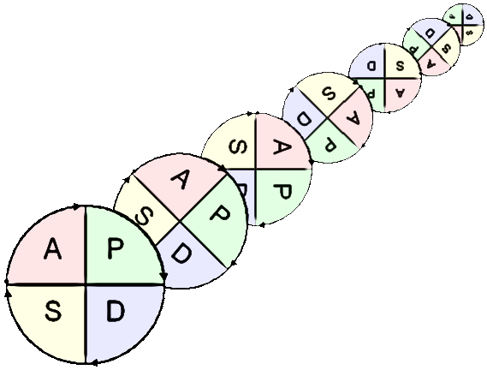
Why test changes?
To learn how to adapt the change to conditions in your setting
Increase the belief that the change will result in improvements in your setting
Minimise resistance when spreading the change throughout the organisation
Evaluate the costs and “side-effects” of changes
Notes:
If you roll out a fully formed plan and it doesn’t work it gets shelved.
Testing allows for tweaking and improvement so that good ideas aren’t abandoned before they’ve been given a real chance.
The more tests you do, the more evidence of you ability to adopt.
Adapt: taking preexisting knowledge but making it locally relevant
Minimise resistance – people buy in when you are able to offer them solutions and work arounds before implementation
Side effects – you will have balancing measures in place so that you are not at risk of missing the impact of your work on the nigger picture.

Slide 30
PDSA Cycles: Deciding on Scale
 |  | Current commitment within organisation
BELIEF | COST OF FAILURE | No commitment | Some commitment | Strong commitment
Low degree of belief that change idea will lead to improvement | Cost of failure large | Very small scale test | Very small scale test | Very small scale test
 | Cost of failure small | Very small scale test | Very small scale test | Small scale test
High degree of belief that change idea will lead to improvement | Cost of failure large | Very small scale test | Small scale test | Large scale test
 | Cost of failure small | Small scale test | Large scale test | Implement
Source: The Improvement Guide, page 146
Notes:
Objective: Matrix of size of test to implementation
Explanation: This slide is a matrix of the size of the test of change as it relates to readiness for, cost of failure and confidence in the change. For example, if the current situation contains high resistance to a change and there is very low confidence in or evidence of success related to the change and the cost of failure is high, then the test should be very small. Only in high readiness, low cost of failure and high confidence should the team move to implementation.
Note that small scale refers to the size of the test and not the size of the change… the thing you’re testing on a very small scale could be totally different from current practice.

Slide 31
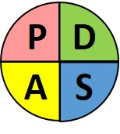
Outcome
Process
Primary Drivers
Broadly what needs to be in place
Secondary Drivers
Specifically what needs to be in place
Change Ideas
Theories about what might work
Aim
How much,
by when
Measure
Measure
Measure
Measure
Balancing

Slide 32
The Model for Improvement was developed by Associates in Process Improvement. [Source: Langley GL, Moen R, Nolan KM, Nolan TW, Norman CL, Provost LP. The Improvement Guide: A Practical Approach to Enhancing Organizational Performance (2nd edition). San Francisco: Jossey-Bass Publishers; 2009.]

Slide 33
What’s your experience of using data?
What is the purpose of your data?
What kinds of data do you look at?
What common issues, feeling and frustrations do you have with the data?
Notes:
Discussions at tables:
Experience of using data or collecting data at work…
What was the purpose?
Any common issues?
What kinds of data did you look at?

Slide 34
Why do we need data for improvement?
To understand what needs improved
To understand variation
For testing changes
For monitoring progress
To tell the story of your improvement journey
Notes:
ASK THEM TO DISCUSS THIS AND COME UP WITH REASONS BEFORE REVEALING ANSWERS
(5 mins)
To understand what needs improved – e.g. data, surveys, pareto, etc.
To understand and reduce variation – link back to profound knowledge
For testing changes – remember, you need to be able to measure whether the test has the predicted effect
For monitoring progress– these would be more global measures for your project
To tell the story of your improvement journey – very important especially if you want to scale up
The last two are where we’re focussing here – measures for your project…

Slide 36
Do you know where your gap is?
How will you bridge your gap?
Notes:
It’s only when you known where your gap is, that you can begin to plan effective improvement work.

Slide 37
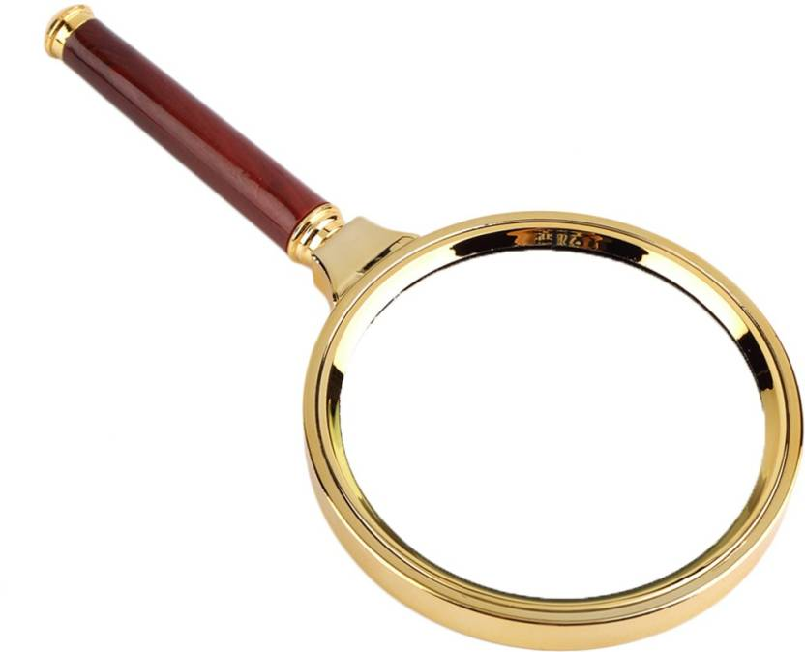
SIMD
National level data
Falkirk level data
Lens
Of
Equity &
Poverty
School legacy data
Notes:
Deming proposed that having a clearer understanding of how each aspect Lens of Profound Knowledge impacted upon your improvement project would increase the likelihood of success.

Slide 38
Notes:
Imagine your flying a plane. There’s loads of measurement going on here….

Slide 39
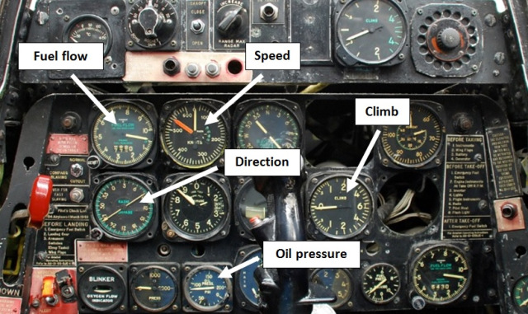
The right measures are the ones derived from purpose…
Simon Guilfoyle, 2013
Notes:
You can see that it’s pretty useful stuff – how fast the plane is flying, what direction it’s heading, how the oil pressure is doing, and so on. All linked to purpose – in this case to fly passengers safely to their destination. The method by which the information is relayed to the pilot is useful too – the dials are capable of indicating change in real time, enabling our pilot to respond accordingly and make adjustments if necessary.

Slide 40
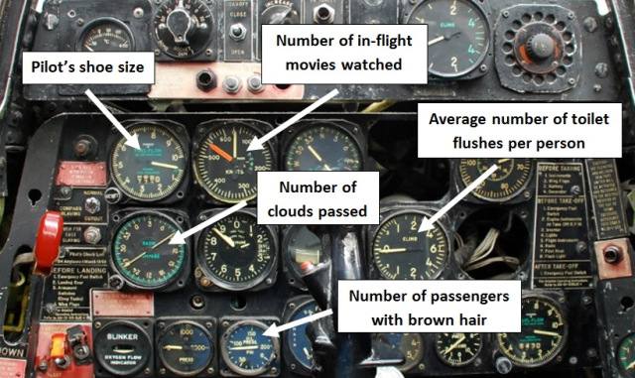
What if we use the wrong measures?
Simon Guilfoyle, 2013
Notes:
Well here’s the same set of dials, this time configured to measure the wrong things. Using the wrong measures means it’s impossible to establish if you’re achieving purpose. There’s no point counting the wrong things, just because they’re easy to count. Furthermore, if you’re using the wrong measures, don’t expect them to encourage the right behaviours.

Slide 41
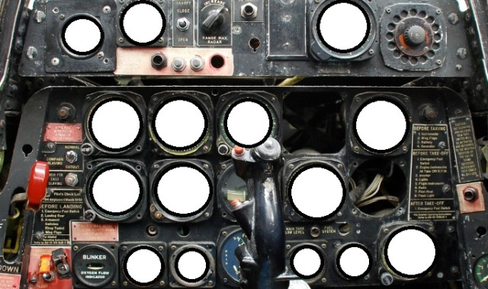
And if we didn’t measure anything?
Simon Guilfoyle, 2013
Notes:
If you don’t measure anything youre flying blind. How can you make strategic decisions like this??

Slide 42
“When you have two data points, it is very likely that one will be different from the other.”
W. Edwards Deming
Notes:
Aggregate measures alone do not lead to predictions about future performance or insights to explain past variations
Looking at data over time allows us to make informed predictions, and understand the impact of changes on our measures so we can take appropriate action

Slide 43
It’s important!
Data
Information
Insights
Action
Notes:
Visualisation of your data is vitally important to convey your message.
Our aim is that we want ACTION caused by COMMUNICATING insights gained from DATA.
Best way is to turn DATA into INSIGHT is then by using visual displays such as charts.
Charts can be complicated. We need to make them as easy
to understand without losing the insights

Slide 44
Change Made Between Weeks 7 & 8
Langley, G.J., Nolan, K.M., Nolan, T.W, Norman, C.L., & Provost, L.P. (2009). The improvement guide: A practical approach to enhancing organizational performance (2nd Ed.). San Francisco: Jossey-Bass.

Slide 45
Case 1
Change

Slide 46
Case 2

Slide 47
Case 3

Slide 48
Aggregated Data
Tells us very little
about the
improvement journey

Slide 49
Week beginning | Number of children
21-Jan | 5
25-Jan | 8
04-Feb | 7
11-Feb | 8
18-Feb | 9
25-Feb | 7
04-Mar | 10
11-Mar | 6
18-Mar | 9
25-Mar | 12
01-Apr | 4
08-Apr | 5
15-Apr | 9
22-Apr | 11
29-Apr | 18
06-May | 17
13-May | 19
20-May | 20
27-May | 19
Tells us very little
about the
improvement journey
Notes:
Even though it is over time – very little information

Slide 50
Notes:
Plot your data on a chart and use annotations to tell the story of what was tested and explain reasons for data activity - engages everyone in the improvement journey.

Slide 51
Notes:
Data+ Story = Learning

Slide 52
Team Time
In teams:
What do you need to know?
Notes:
60 mins
15 Buzz every 15 mins
Then 5
15
5
15
5
Prompt movement from C to L to E to A to R
to coach plus 5 to feedback

Slide 53
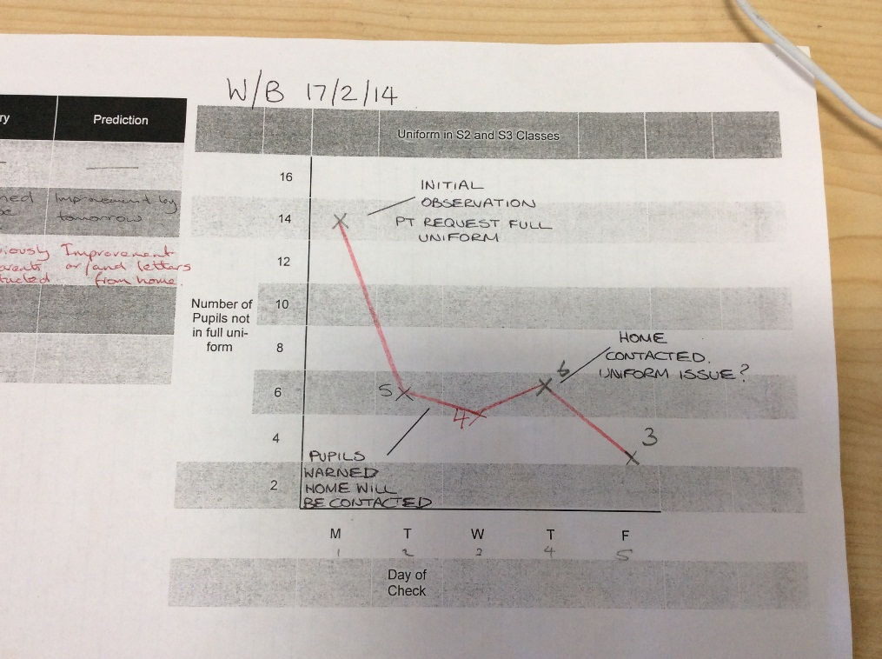
Start with a bit of paper!

Slide 54
RUN CHART EXAMPLE
Months | Percentage | Notes
Apr-14 | 48
May-14 | 46
Jun-14 | 48
Jul-14 | 5
Aug-14 | 50
Sep-14 | 63 | Event 1
Oct-14 | 65
Nov-14 | 25 | Event 2
Dec-14 | 48 | Event 3 & 4
Jan-15 | 58
Feb-15 | 60 | Event 5
Mar-15 | 65
Apr-15 | 72
May-15 | 75
Jun-15 | 78 | Implementation starts
Jul-15 | 80
Aug-15 | 65

Slide 56
Run chart rules to spot non-random variation
56
Notes:
HANDOUT contains these charts, and the table for numbers of runs.
Because they are simple to make and relatively straightforward to interpret, run charts are one of the most useful tools in quality improvement. They allow us to:
Display data to make process performance visible
Determine if a change resulted in improvement
Assess whether improved performance has been sustained
Run charts are line graphs where a measure is plotted over time, often with a median (the middle value of those plotted so that half are above and half are below) also shown.
Changes made to a process are also often marked on the graph so that they can be connected with the impact on the process. Often a change can be seen by visual inspection alone.
If we have at least 10-12 data points on our graph, run charts can also be used to distinguish between random and non-random variation using four simple rules. Different versions of these rules are used in different places so you may encounter different sets in other books or papers you read. However Improvement Guide and the Health Care Data Guide and by the Institute for Healthcare Improvement provide the following rules and the Non-random variation can be recognised by looking for:
A shift: six or more consecutive data points either all above or below the median. Points on the median do not count towards or break a shift.
A trend: five or more consecutive data points that are either all increasing or decreasing in value. If two points are the same value ignore one when counting.
Too many or too few runs: a run is a consecutive series of data points above or below the median. As for shifts, do not count points on the median: a shift is a sort of run. If there are too many or too few runs (i.e. the median is crossed too many or too few times) that's a sign of non-random variation. You need to look up a statistical table (see Perla et al, 2011) to see what an appropriate number of runs to expect would be. An easy way to count the number of runs is to count the number of times the line connecting all the data points crosses the median and add one.
An astronomical data point: a data point that is clearly different from all others. This relies on judgement. Every data set has a highest and lowest. They won't necessarily be an astronomical data point. Different people looking at the same graph would be expected to recognise the same data point as astronomical (or not).
Since using these rules requires you to have 10-12 data points at least on your run chart it is important to collect data as frequently as possible. If you collect data only once a month that would be 10 months, if weekly, 10 weeks (2½ months). However this needs to be balanced with keeping denominators (the number of values contributing to each data point) for percentages (or rates) above ten or so to minimise random variation due to small sample size.
Run charts are a powerful tool for detecting non-random variation and so sufficient for most improvement projects. However they are not so sensitive in detecting special causes as a second type of chart named after Walter Shewhart, who did early work in industry to develop the methods.

Slide 57
Shift

Slide 59
Astronomical
point

Slide 60
Run 1

Slide 61
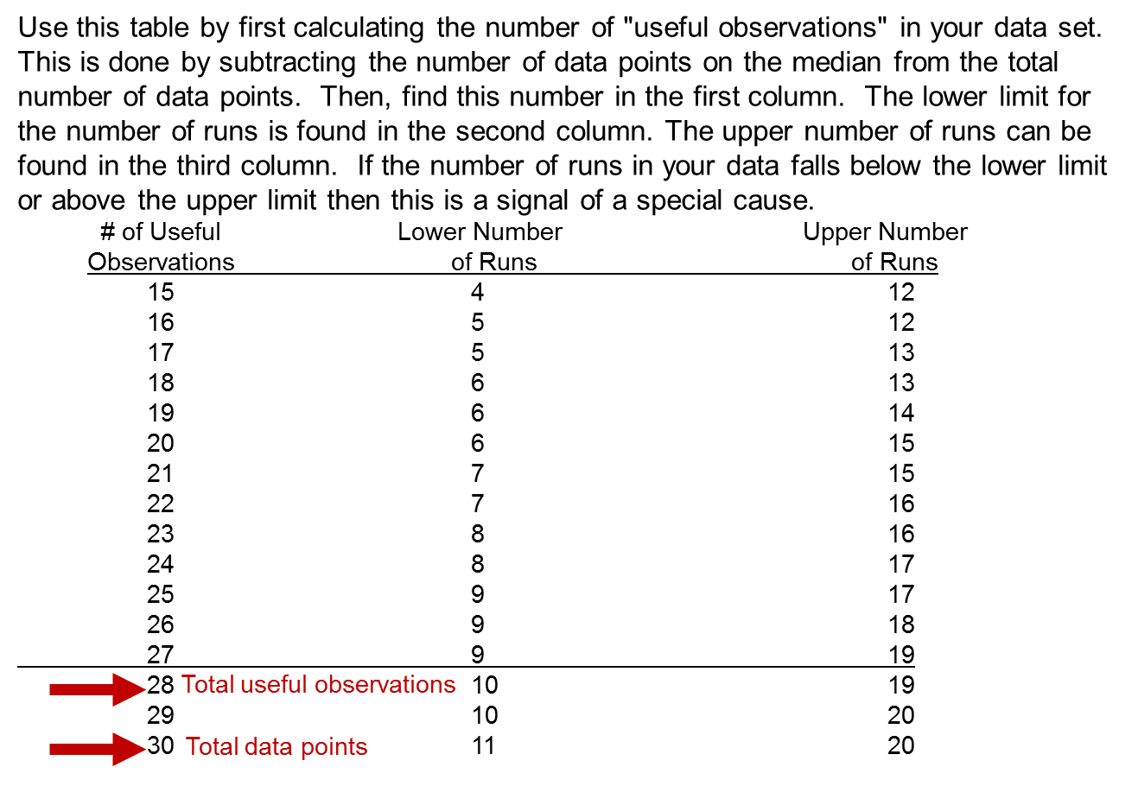
Too few or too many runs
Notes:
61

Slide 62
Run 1

Slide 63
Outcome
Process
Primary Drivers
Broadly what needs to be in place
Secondary Drivers
Specifically what needs to be in place
Change Ideas
Theories about what might work
Aim
How much,
by when
Measure
Measure
Measure
Measure
Balancing

Slide 64
Primary Drivers
Broadly what needs to be in place
Secondary Drivers
Specifically what needs to be in place
Change Ideas
Theories about what might work
Aim
How much,
by when
Measure
Measure
Measure

Slide 65
Measures - Things to consider
Who will be responsible for data collection?
What is the data source / how will the data be collected?
Frequency of data collection, and timings?
Equipment needed to measure?
How can data collection be integrated with work?
What factors might influence the measure?

Slide 66
Team Time
In teams:
Action Plan
Notes:
60 mins
15 Buzz every 15 mins
Then 5
15
5
15
5
Prompt movement from C to L to E to A to R
to coach plus 5 to feedback

Slide 67
Improvement Journey
Understand current system
Develop aim and change theory
Identify specific change ideas, test and refine in context
Implement locally, using PDSA cycles to build in sustainability
Scale up / spread where relevant
Build will and conditions for change
Leadership

Slide 68
Programme design and key dates
Action Period 2
Action Period 3
Action Period 4
Action Period 5
Welcome Overview
Workshop 1
Workshop 2
Workshop 3
Workshop 4
Showcase
October
10^{THdDec}
21ST JAN
Feb 11th
Mar 31st
Support
National IA Leadership Team/s Q.I. Faculty
QI Zone (TURAS) (Falkirk) GIRFEC Practitioner pages
All teach ,all learn

Slide 69
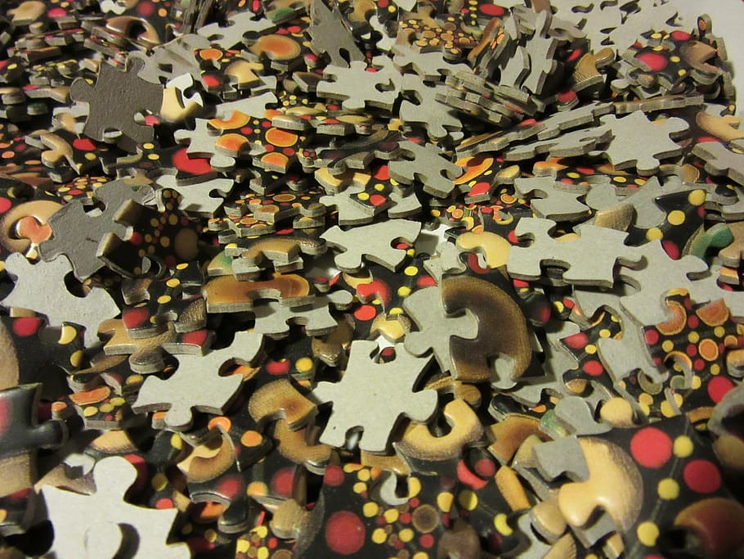

Slide 70
The Power Of A Story
Notes:
Data are stories but even the best chart cant tell the whole story as well as people,
Facts tell, stories sell
You can PUSH information out
You can PULL them in w/STORY
Could easy spend a day on this but we dont have time. Idea is change requires data but data is part of the story not the whole story.

Slide 71
By the end of this session you will…….
Measurement for improvement
Change Ideas and testing your way to Improvement
Leave with an action plan for Action Period 3.

