Slide 1

Leading Improvement Evidencing Impact - Session 1
Grangemouth High School – 10th December 2019
Wendy Toner
CYPIC Improvement Advisor
&
Falkirk CYPIC QI Faculty

Slide 2

Quality Improvement across
Children’s Services in Falkirk

Slide 3

Scottish Government National Performance Framework

Slide 4




Golden Thread
SG LOIP ICSP (and other CPP sub pans)
ALL AIM TO REDUCE INEQUALITY AND IMPROVE OUTCOMES

Slide 5


SG - Improvement
2 OFFERINGS SUPPORTED BY CYPIC:
1. LIEIP Sessions – to develop a common language across the CPP about improvement.
2. MH Project – Focussed support to improve an aim in relation to MHWB.
Following on from Wider Children’s Commission Dec
Will be bringing people together to work on this – your service will likely be involved.

Slide 6
Aim for these sessions
Apply quality improvement approaches to all of our plans – Chief Executive endorsing this approach
Develop a common language re improvement
Understand the planning systems we’re working in and how they can be better aligned.
Develop clear aims and measures in our plans
Apply QI approaches in all our work; service and CPP
Involve trained people in the MH project.

Slide 7

If you want to go fast, go alone.
If you want to go far, go together.
African Proverb
Notes:
Adam
Bill Alexander’s challenge from last year
Big Idea’ – you need coaches and leaders at all levels to create the conditions that support improvement and enable systems to change
SCLIP message – Slow down to speed up

Slide 8

Notes:
Empathy map to be distributed.
Who’s going to be in the audience? Stand in their shoes.
What will they need to know?

Slide 9

By the end of this session you will…….
Be able to explain the model for improvement and have knowledge of other QI tools.
Have a knowledge of some practical examples of how to use QI tools to support your work
Have enhanced knowledge of systems thinking
Know where to go for further information and support.

Slide 10
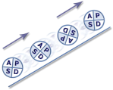
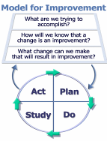
Programme design and key dates
Action Period 2
Action Period 3
Action Period 4
Action Period 5
Welcome Overview
Workshop 1
Workshop 2
Workshop 3
Sharing Workshop
Showcase
October
10^{THdDec}
21ST JAN
Feb
TBC
MAR
TBC
Support
National IA Leadership Team/s Q.I. Faculty
QI Zone (TURAS) (Falkirk) GIRFEC Practitioner pages
All teach ,all learn

Slide 11



Slide 12
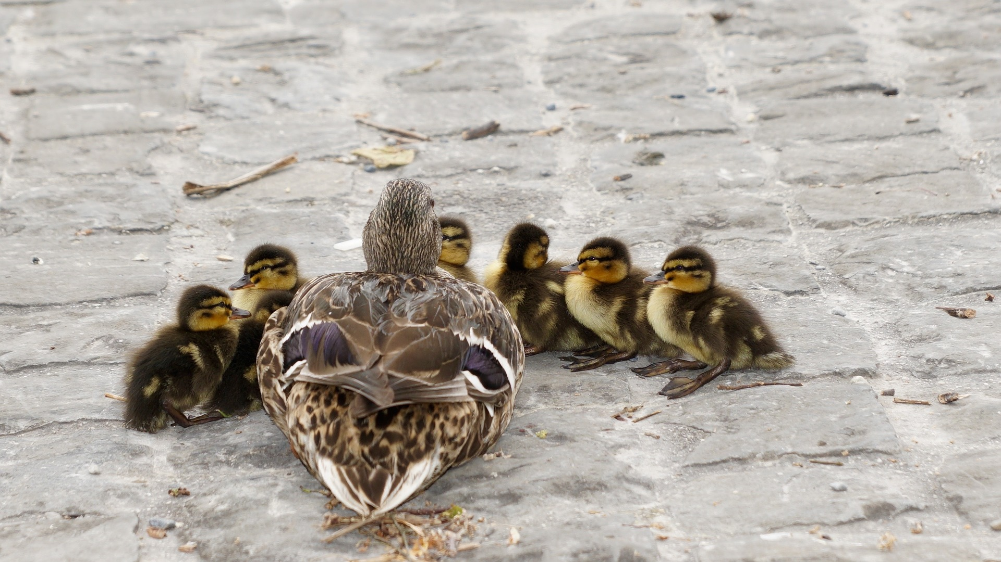
All teach and all learn…..

Slide 13
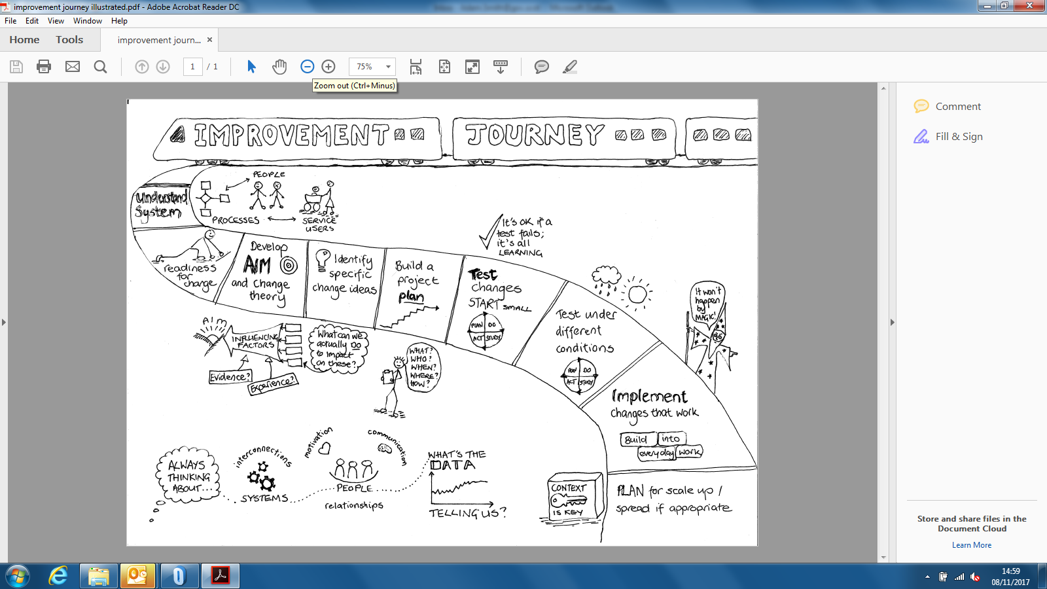

Slide 14
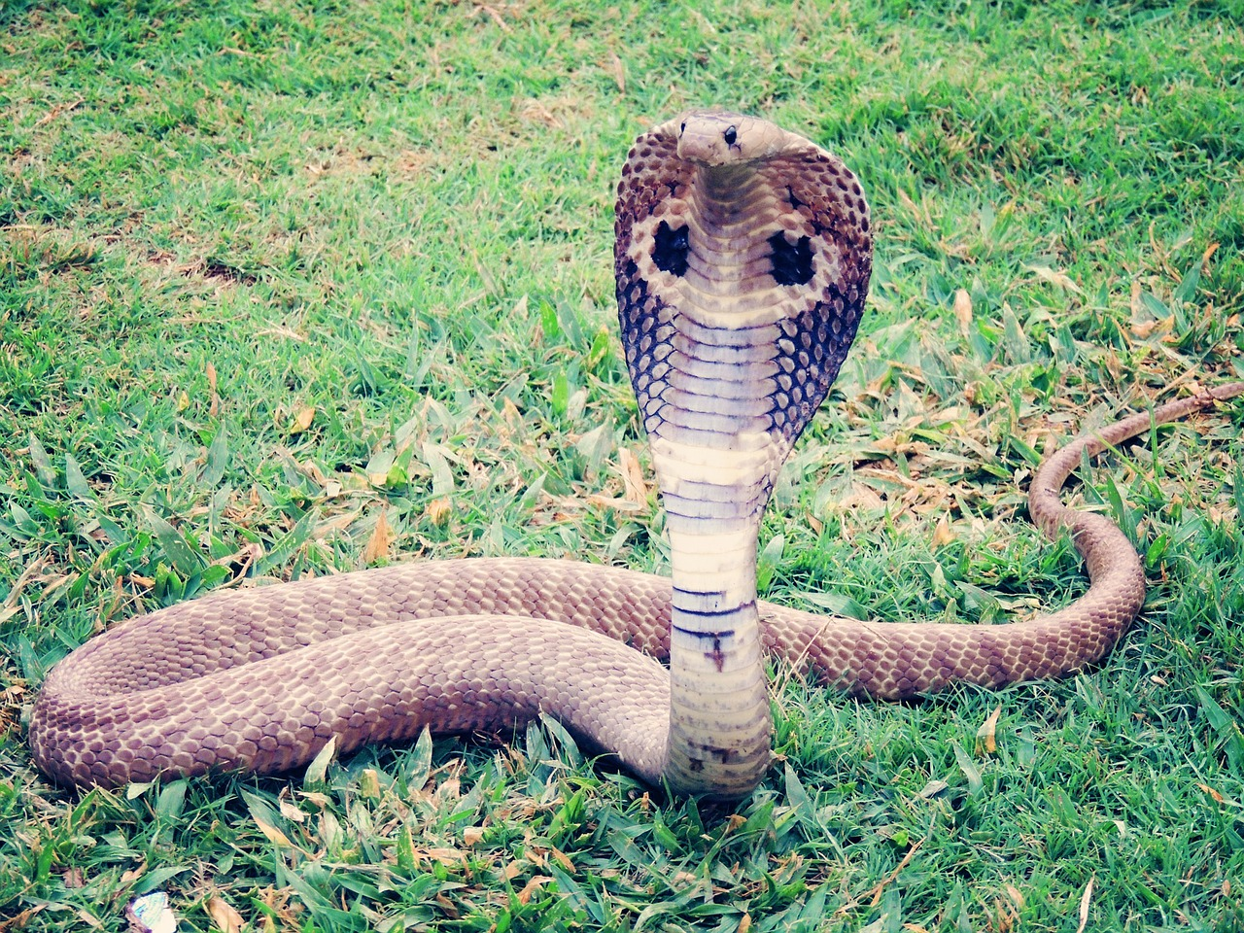
Adders

Slide 15
‘Not all change is improvement, but all improvement requires change’
Don Berwick
Notes:
Issue of change and improvement – link to story of adders and challenge of changes in a a manged way

Slide 16

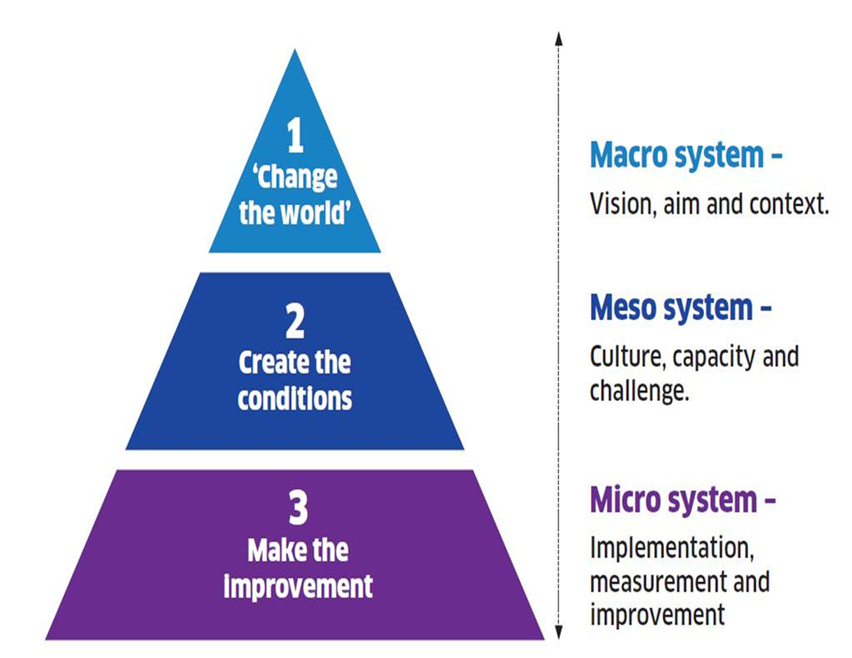
Notes:
Step 1: “Change the World”
A vision – capable of stirring the heart of the community and able to serve as
a constant reference and anchor point as the change moves forward.
A story – to enable people to recognise where they have been and where
they are going.
A set of actions – to take us to the next steps towards releasing the vision.
A clear framework for improvement.
A strategy to engage and empower the workforce - to provide the
Stimulation, development and opportunity our staff need to fully release their
deep commitment to public service.
An understanding of how change will work locally (everywhere) –
Recognising communities are different and creativity should be nurtured and
released at a local level.
A guiding coalition – a team of key people to drive the change when the
going gets tough, and to sustain support.

Slide 17
The six questions to be asked of EVERY change programme:
Step 2 –Creating the Conditions
1
Aim
Is there an agreed aim that is understood by everyone in the system?
2
Correct changes
Are we using our full knowledge to identify the right changes and priorities those that are likely to have the biggest impact on our aim?
3
Clear change method
Does everyone know and understand the method(s) we will use to improve?
4
Measurement
Can we measure and report progress on our improvement aim?
5
Capacity and capability
Are people and other resources deployed in the best way to enable improvement?
6
Spread plan
Have we set out our plans for innovating, testing, implementing and sharing new learning to spread the improvement everywhere it is needed?

Slide 18
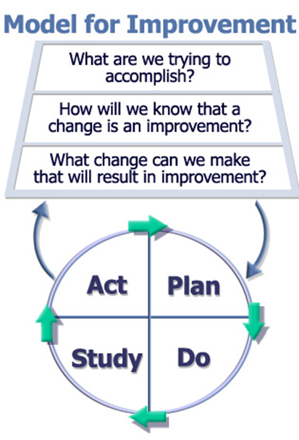
Thinking
Learning by doing
Notes:
The model for Improvement – a standardised approach across Public Service Improvement Programmes throughout Scotland
A simple but helpful starting point to develop thinking and consensus
Outline 2 distinct parts and how each of these is related to our 2 main themes – thinking – Project charter – shared mental model of the improvement project
PDSA – opportunity to learn through testing change ideas

Slide 19

Reflect
What is in your current improvement plan?
What are the priorities?
What will better look like?
By how much? By when?
How will we know if we’re improving?

Slide 20


The Typical Approach…
Conference Room
APPROVE
DESIGN
DESIGN
DESIGN
DESIGN
Real World
IMPLEMENT

Slide 21

The Quality Improvement Approach
Conference Room
DESIGN
APPROVE
IF NECESSARY
Real World
START TO IMPLEMENT
TEST & MODIFY
TEST & MODIFY
TEST & MODIFY

Slide 22
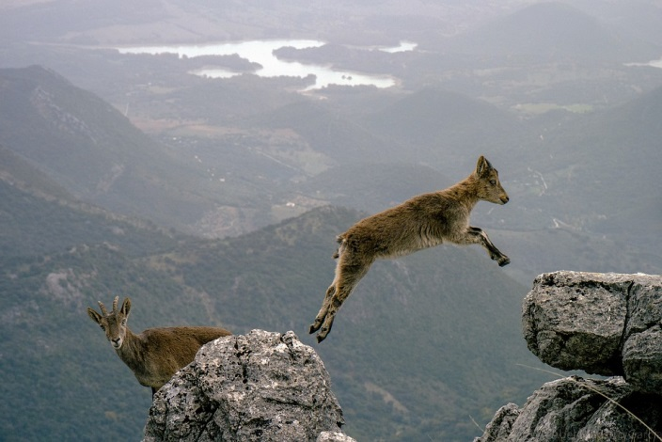
With challenge comes opportunity!
Notes:
Bridging slide ☺

Slide 23
What is Quality Improvement?
Quality Improvement is defined as the application of a systematic approach that uses specific techniques to improve quality.
Health Foundation 2014
Notes:
Improvement Science is NOT
Research
Designed to find out what is possible
Control context to reduce its impact as a variable
Audit
Designed to find out what is actual
Time between measurement may be long

Slide 24
Improvement Journey
Understand current system
Develop aim and change theory
Identify specific change ideas, test and refine in context
Implement locally, using PDSA cycles to build in sustainability
Scale up / spread where relevant
Build will and conditions for change
Measurement, project management and understanding people
Leadership

Slide 25
What is a system?
“An interdependent group of items, people, or processes working together toward a common aim”

Slide 26

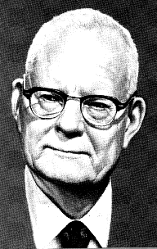
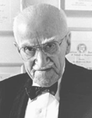
Pioneers of Improvement Science
Walter Shewhart
1891 - 1967
W. Edwards Deming
1900 - 1993
Joseph Juran
1904 - 2008
Notes:
To explain we are going to look a bit more at the Roots of improvement Science.

Slide 27
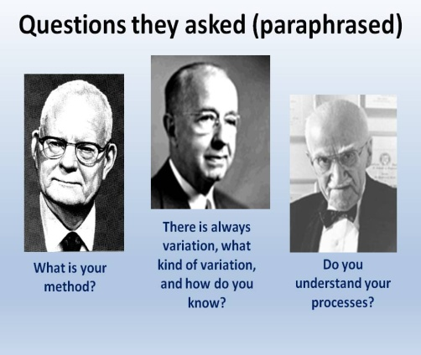

Slide 28
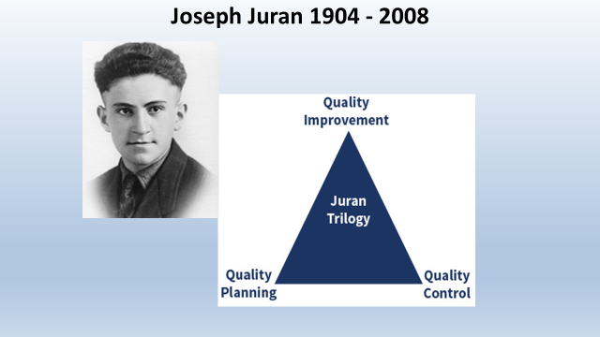

Slide 29
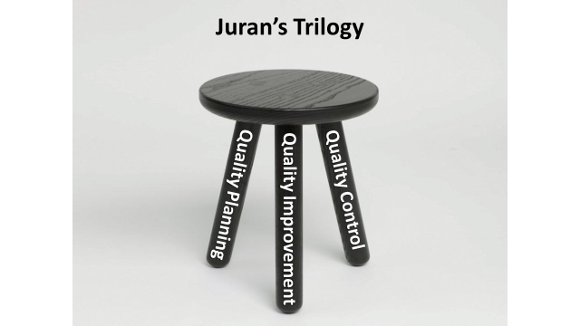

Slide 30
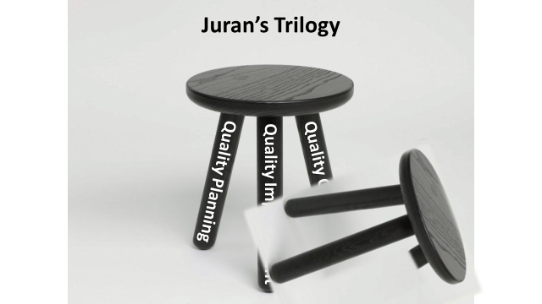

Slide 32

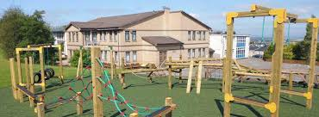


Slide 33

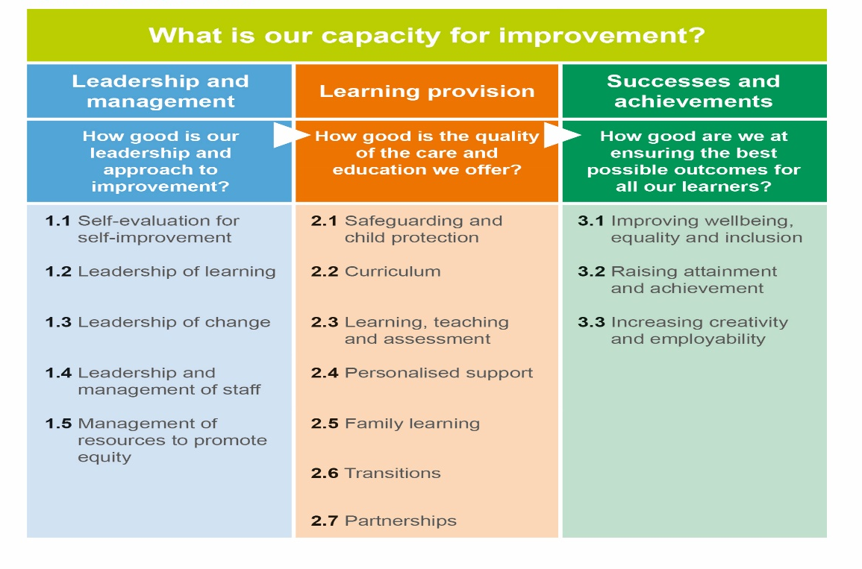


Slide 34
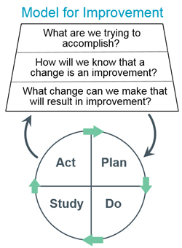
Source: Scoville R, Little K, Rakover J, Luther K, Mate K. Sustaining Improvement. IHI White Paper. Cambridge, Massachusetts: Institute for Healthcare Improvement; 2016.

Slide 35

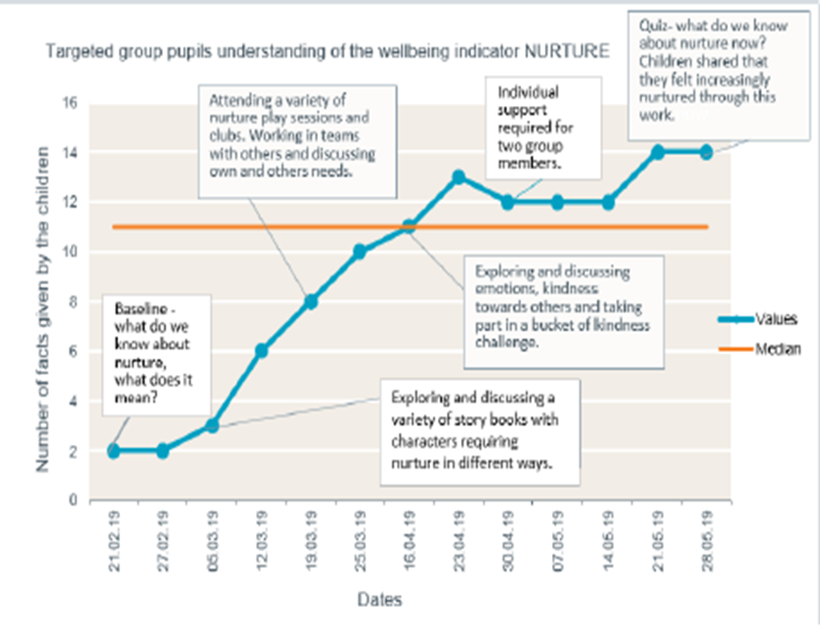
“Work on promoting healthy choices has certainly transferred to choices at home as well as a level of self-awareness”.
The talk from the police and work we did helped me to score myself from 3 to 5 at the end of the year.”

Slide 36
Improvement Journey
Understand current system
Develop aim and change theory
Develop change ideas
Test and refine ideas, building knowledge
Start to implement
Building will
Measurement, project management and understanding people
Notes:
We are going to structure the two days to take you through an improvement journey, introducing tools, ideas and approaches as we go. Much may be familiar as you have all been involved in various types of projects and change management.
Understand the system – look at data – listen to the people – use the available improvement tools. Might involve data analysis, comparisons, process mapping, cause and effect analysis etc., also understanding people and why things work as they do. Do the conditions exist for change? E.g. leadership buy-in, will to change,
This will help identify what to improve – prioritise what might have the most impact. Can refer to example on CPOs – make sure you’re solving the right problem
Might be obvious how to change it, or may need to think of creative solutions. Copy from others if they’ve done something that works.
Start testing on a small scale, and measure as you go along. It’s the people who do the work who need to own the change and test it.

Slide 37
Improvement Journey
Understand current system
Develop aim and change theory
Develop change ideas
Test and refine ideas, building knowledge
Start to implement
Building will
Measurement, project management and understanding people

Slide 38
What is a system?
“An interdependent group of items, people, or processes working together toward a common aim”
Notes:
3 minutes
Group interaction asking people to shout out to share definitions of what a system is
A really useful quote that keeps you grounded – but doesn’t really explain things.

Slide 39
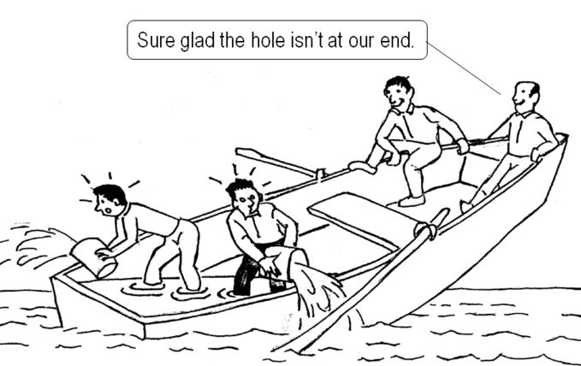
Shared effort understood by all

Slide 40

Find the root cause, avoid sticking plasters

Slide 41
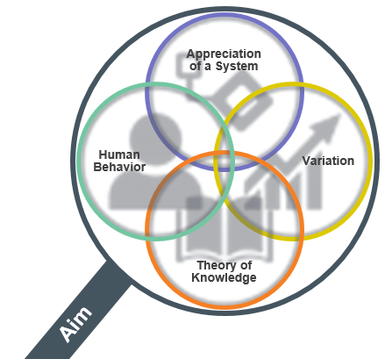
Appreciation of a System
Common Aim
Understand how things link together
People, process and items
Simple, Complicated or Complex
Profound
Knowledge
Psychology
Relationships between people
Motivation, intrinsic /extrinsic
Beliefs, assumptions
Will to change
Theory of Knowledge
Develop a theory
Use PDSA to test
Bring knowledge into the system
Understanding Variation
The world is not deterministic
Variation is expected
Understand when to improve
Understand when not to tamper

Slide 42
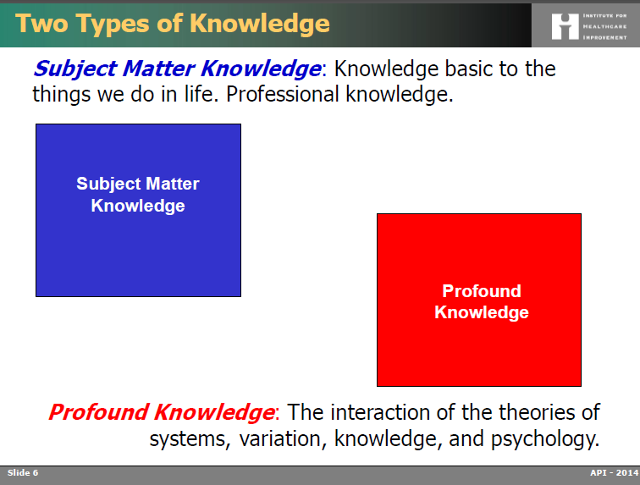

Slide 43
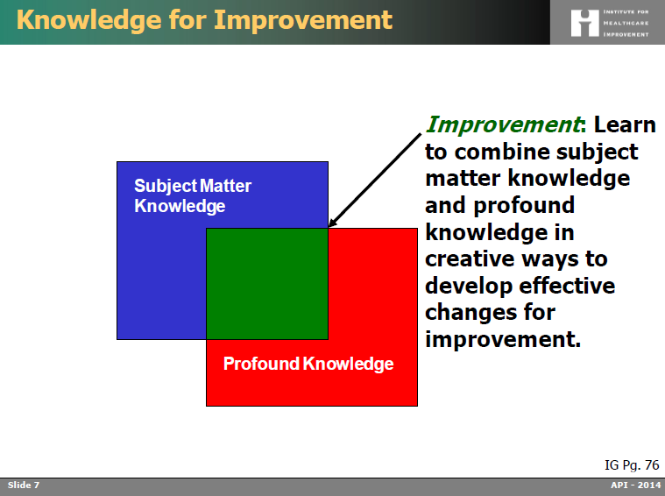

Slide 44

What insights might be obtained by looking through the Lens of Profound Knowledge at your project?
How well do you understand the system you are working in?
What steps have you taken to address the human reaction to change?
Are you confident you understand what may be affecting performance for your project?
Is your improvement project based on a sound theory?

Slide 45
Thinking
Learning by doing
Notes:
The model for Improvement – a standardised approach across Public Service Improvement Programmes throughout Scotland
A simple but helpful starting point to develop thinking and consensus
Outline 2 distinct parts and how each of these is related to our 2 main themes – thinking – Project charter – shared mental model of the improvement project
PDSA – opportunity to learn through testing change ideas
4minutes

Slide 46
Notes:
The model for Improvement – a standardised approach across Public Service Improvement Programmes throughout Scotland
A simple but helpful starting point to develop thinking and consensus
Outline 2 distinct parts and how each of these is related to our 2 main themes – thinking – Project charter – shared mental model of the improvement project
PDSA – opportunity to learn through testing change ideas
4minutes

Slide 47

First Define
Your Rationale and Scope
What’s the problem?
How do you know?
How big is the gap?
Who will be affected?
Strategic fit?
Expected impact?
Realistic timescale -why?

Slide 48
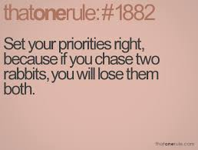

Slide 49
Driving Forces
1 (weak) to 5 (strong)
Restraining Forces
1 (weak) to 5 (strong)
5
4
3
2
1
1
2
3
4
5
Unpredictable work demands - FW
Communication
Timing of visit
Families engaging
Families moving in/out of area
First time pupils
English not 1st language
By September , 70% of “eligible” S1 learners at Seaview High School will receive a home visit from the family support worker at 2 – 4 weeks of starting first year
Domestic abuse
Adequate staffing levels
Content of visit – too prescriptive
Staff motivation
& commitment
Where concerns identified –
fosters a hostile environment
Geographical Model
Poor management communication –
especially around change
Total: 20
Total: 28

Slide 50
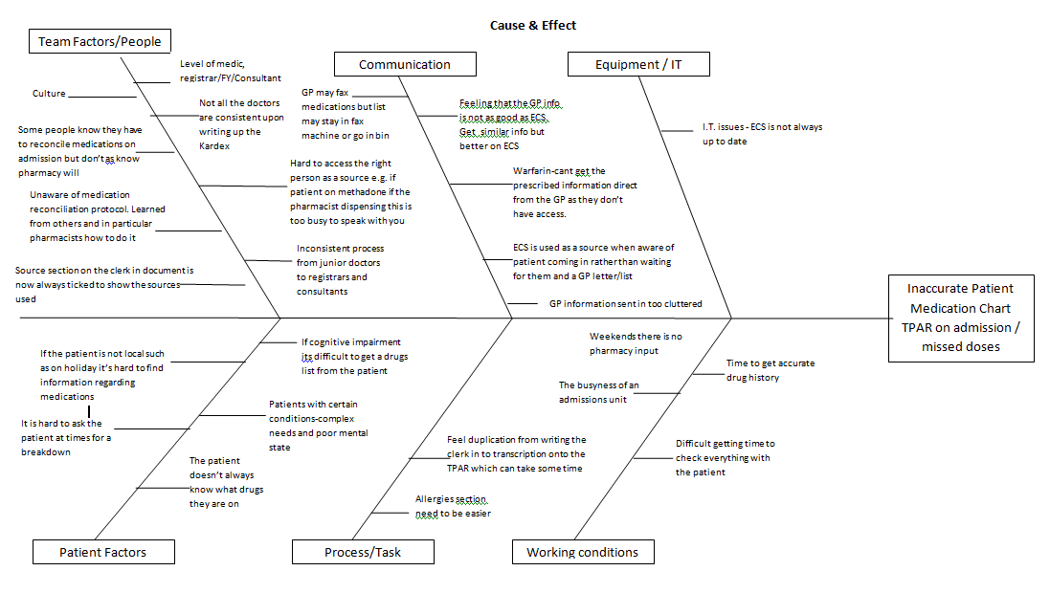
Cause & Effect – Non Accuracy TPAR
Notes:
This is my cause and effect diagram which was an eye opener and great method of capturing the problems, reasons why med rec isn't done correctly on admission and hence patients charts incorrect.
Some issues can be realities such as patients having cognitive impairments and not being able to clarify their meds, others can be passed down habits, failure to try to speak with patients and taking easy options of using an IT system/screen to find out info without thinking of the other sources that would make their medication list right. Some admit they know the pharmacist will pick up their work and they don't always do things consistently. In other words culture.
I was horrified to hear that whilst GPs send in a home visit by fax often it can sit there for days or be put in the bin as it takes time to pick it up, go to fax in the same room. They would rather use an It system for speed, even though its not always up to date.

Slide 51
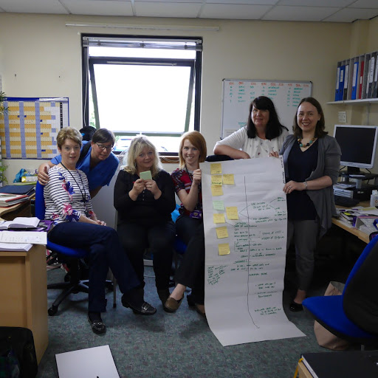
HV Admin Team forwards Antenatal Record to appropriate HV Team
MW completes Antenatal Record at FPOC
Based on EDD, HV Admin Team calculates date to send out introductory letter to HV service at 19 weeks gestation and date of 32 – 34 week HV antenatal visit
Phone call from pregnant woman to Midwife (MW) requesting First Point of Contact (FPOC)
Booking appointment with MW
MW emails Antenatal Record to Generic HV Mailbox
HV Admin Team receives Antenatal Record
HV Admin Team log Antenatal Record on Database
Is an Unborn Baby (UBB) Referral required?
Start
No agency
involvement
HV Admin Team log dates of 19 weeks and 32 – 34 weeks gestation on database
Joint visit to pregnant woman by HV & MW or HV/MW & SW
Yes
What is outcome of P&K UBB MASG?
Follow Child Protection
Protocol
Concern for Unborn Babies
Agency
involvement
MW & HV
to attend all agency meetings regarding woman
Has a non-continuing pregnancy been notified to the HV Admin Team?
Yes
HV Admin Team remove Antenatal Record from Database
Forward information to appropriate HV Team
No
HV records 32 – 34 week visit in maternal health record on emis Web
Introductory letter to HV service sent to woman at 19 weeks gestation
HV undertakes 32 – 34 week antenatal visit
HV contacts woman to arrange 32 – 34 antenatal visit
End

Slide 52
First Define
Your Rationale and Scope
What’s the problem?
How do you know?
How big is the gap?
Who will be affected?
Strategic fit?
Expected impact?
Realistic timescale -why?

Slide 53
Reflect
What is in your current improvement plan?
What are the priorities?
What will better look like?
By how much? By when?
How will we know if we’re improving?

Slide 54

What am I trying to accomplish?

Slide 55


Slide 56

Constructing an Aim
Statement
Specific
Timebound
Aligned
Numeric

Slide 57

Falkirk : Aim Statements
Attendance will improve
All children p.1 – 7 will achieve at least 85% attendance by June 2018. (Attainment)
There is a shared understanding of what a good lesson looks like.
By January 2019, 95% of children and 95% of teachers will rate lessons in Maths as good or very good. (Self-Evaluation)
More children will be read to at home
90% of children will receive a bedtime story 3 times a week by the end of the summer term (Family Support)

Slide 58
Reflect
What is in your current improvement plan?
What are the priorities?
What will better look like?
By how much? By when?
How will we know if we’re improving?

Slide 59
Programme design and key dates
Action Period 2
Action Period 3
Action Period 4
Action Period 5
Welcome Overview
Workshop 1
Workshop 2
Workshop 3
Sharing Workshop
Showcase
October
10^{THdDec}
21ST JAN
Feb
TBC
MAR
TBC
Support
National IA Leadership Team/s Q.I. Faculty
QI Zone (TURAS) (Falkirk) GIRFEC Practitioner pages
All teach ,all learn

Slide 60
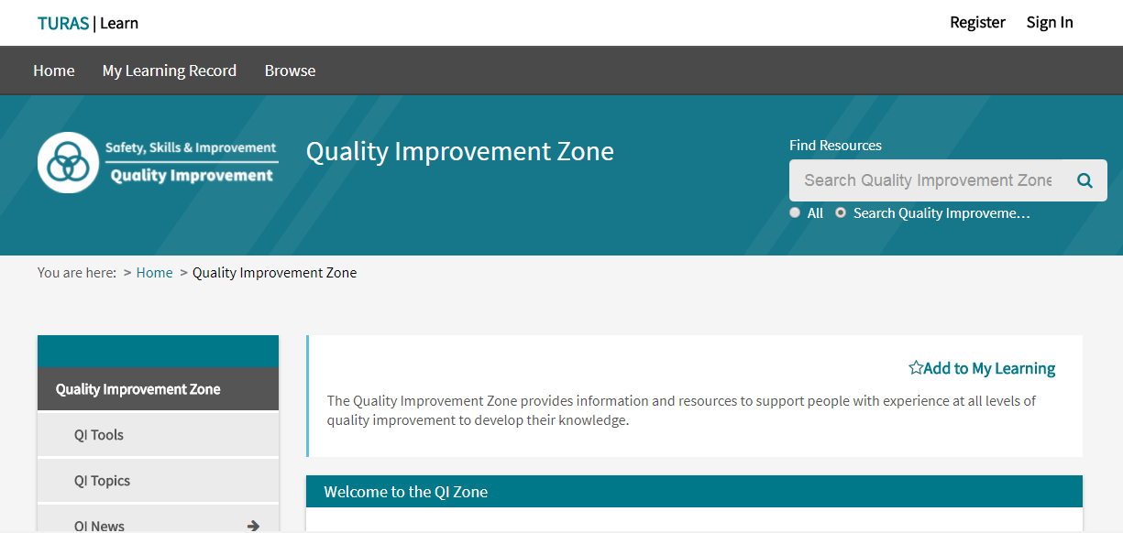
Baseline Knowledge - Resources Available
https://learn.nes.nhs.scot/741/quality-improvement-zone

Slide 61
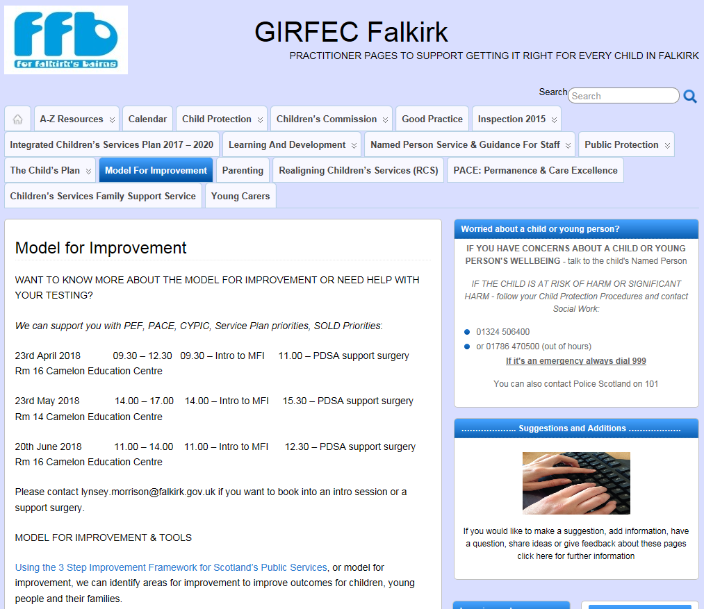
GIRFEC Falkirk Practitioner Pages

Slide 62

Session 3
Session 2
Location tbc, Falkirk
21st January 2020
9.00 pm – 12.00 pm

Slide 63
By the end of this session you will…….
Be able to explain the model for improvement and have knowledge of other QI tools.
Have a knowledge of some practical examples of how to use QI tools to support your work
Have enhanced knowledge of systems thinking
Know where to go for further information and support.

