Slide 1

It’s not rocket science!
Understanding brain development for better relationships
FACILITATOR SLIDES
Falkirk Children’s Commission

Slide 2
Pre course facilitator tasks
1. Identify families – 10 (link with TAC or other supporting agencies)
Agree weeks course will run
Allocate workers to each week; minimum 2 per week
Get Parent’s Pack ready, print SDQ and AWS
Print paperwork for home visit:
  START & FINISH - Adult wellbeing scale & Parenting Daily Hassles
  PDH - http://www.oscb.org.uk/wp-content/uploads/parenting_daily_hassles_scale.pdf
  AWS - http://lrsb.org.uk/uploads/adult-wellbeing-the-scale.pdf
  WEEKLY – Stress of parent 0-10, Behaviour of child 0-10.
5. Flipchart, pens, Blue Tac, post its, tissues.

Slide 3
1. Getting to know you
Week 1 – at home

Slide 4
Week 1: Getting to Know You & Your Family
How trauma affects people; brain development, stress, behaviour
What’s your story?
Sessions are about learning; why, how patterns can be changed, how the brain can change, how behaviour can change
Self care/ triggers; behaviours – run, cry, shout, drink
What do you want to get out of this course? For you and for your family.
The Three R’s
Measures – start and finish and weekly feedback sheets

Slide 5
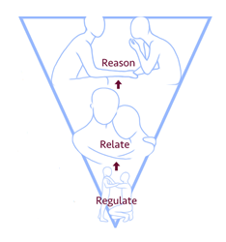
It’s not rocket science! THE 3 R’S
1. REGULATE
Get back to calm (you), get them back to calm and out of fight or flight.
2. RELATE
Understand what the behaviour is telling you. Love them (not always easy!) show you’re interested and care. What do they like to do; hug, play a game, watch tv with you next to them?
3. REASON
Now you can talk about what happened or the problem and try and solve it together when you’re both calm.
Kids won’t be able to learn any lessons until they’re calm.
They need you to help them get to CALM.
Adapted from Dr. Bruce Perry’s 3 R’s.

Slide 6
2. BEHAVIOUR (stress)
Week 2

Slide 7
Week 2 facilitator tasks
Slides
Feedback sheets – Stress of parent 0-10, Behaviour of child 0-10.

Slide 8
How do you behave when you’re stressed?
1. Lunch, Introductions and ice breakers
Group agreement
Keeping ourselves safe (Angela)
2. Three R’s – what is the behaviour telling us? (Angela)
3. Be curious about behaviour
4. We all experience stress (Slides) (Joyce)
What are the signs and causes of stress?
When stress goes wrong: chronic Stress, trauma and stress
5. Self awareness and coping strategies (Slides) (Joyce)
How do you respond?
How do you manage stress and get back to calm?
How can you relax?
Weekly scores/ feedback sheets
NHS Stress Booklet: http://www.selfhelpguides.ntw.nhs.uk/forthvalley/leaflets/selfhelp/Stress.pdf

Slide 9
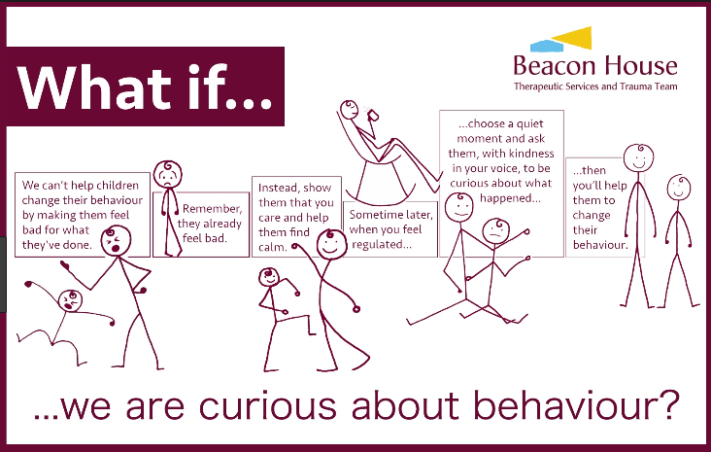

Slide 10
It’s not rocket science! THE 3 R’S
1. REGULATE
Get back to calm (you), get them back to calm and out of fight or flight.
2. RELATE
Understand what the behaviour is telling you. Love them (not always easy!) show you’re interested and care. What do they like to do; hug, play a game, watch tv with you next to them?
3. REASON
Now you can talk about what happened or the problem and try and solve it together when you’re both calm.
Kids won’t be able to learn any lessons until they’re calm.
They need you to help them get to CALM.
Adapted from Dr. Bruce Perry’s 3 R’s.

Slide 11
3. CALM
Week 3

Slide 12
Keep calm
Lunch, how did your week go, thoughts/ comments from last week?
Stress crisis & chronic stress - when stress gets stuck on.
Emotional skills & self awareness, non verbal communication(Joyce & Gail)
  4 questions
  Strategies (TCI)
Your child’s behaviour; what happens, what it means, how to react. (Angela)
Remember the 3 R’s (Angela)
Relaxation; exercise, body scan, guided imagery, breathing.
FEEDBACK SHEETS & RAIN/ SNACK POSTCARDS, FEELS FM

Slide 13
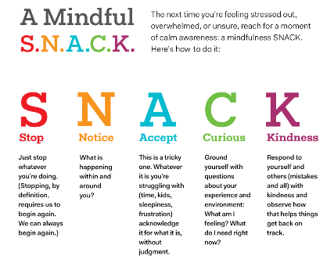

Slide 14
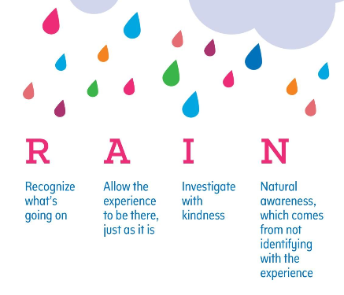

Slide 15
4. CONNECT
Week 4

Slide 16
Connect with your kids
Lunch, how did your week go, thoughts/ comments from last week?
Regulated people can connect - Understanding your brain (Angela)
The science, brain hand
Early brain development (baby it’s you video)
Teen brain development (video tbc)
3. The impact of ACEs or trauma on the brain (Joyce & Gail)
Types of trauma: impact and effect on development and behaviour
The brain can remodel itself
FEEDBACK SHEETS

Slide 17
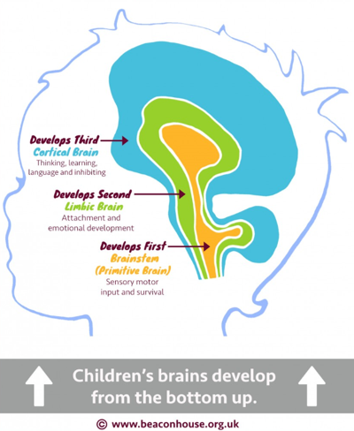

Slide 18
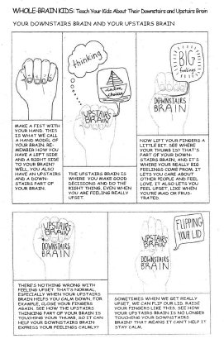

Slide 20
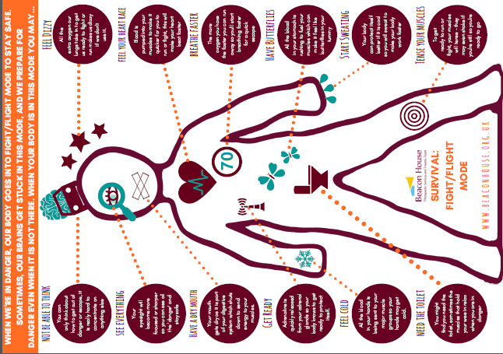

Slide 21
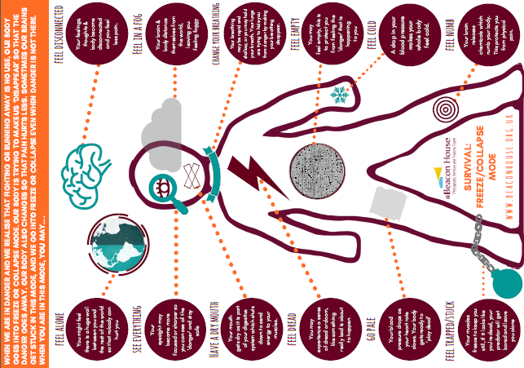

Slide 22
5. Blether
Week 5

Slide 23
Blether - Talk to each other
Lunch, how did your week go, thoughts/ comments from last week?
Teen Vs Toddler (Angela)
Conflict cycle exercise (remember the 3R’s)
Non verbal walk in/ act it out
4. Circle of influence. Positive statements (Angela)
Self talk – be your own best friend, be kind to yourself, control your brain
5. Magic 30 days – 30 days to change a habit
FEEDBACK SHEETS

Slide 24
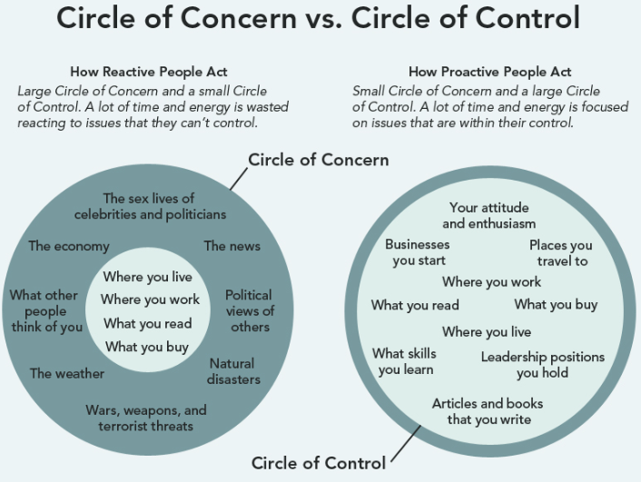

Slide 25
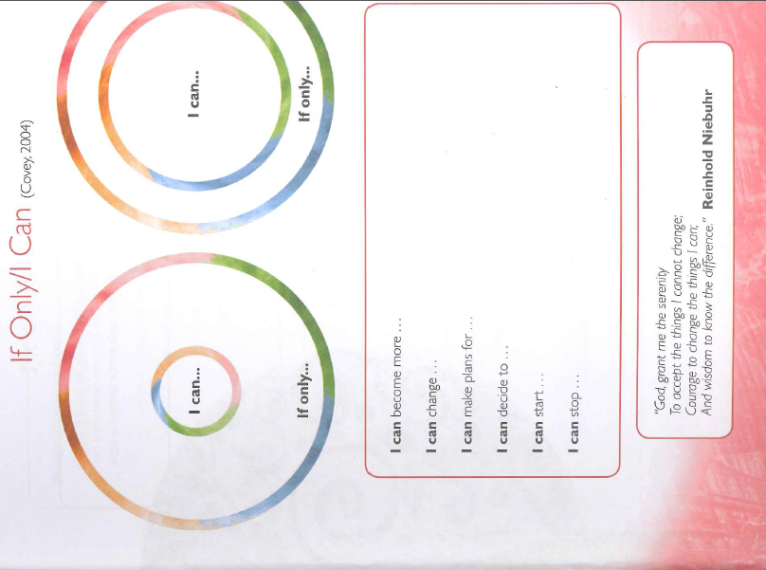

Slide 26
It’s not rocket science! THE 3 R’S
1. REGULATE
Get back to calm (you), get them back to calm and out of fight or flight.
2. RELATE
Understand what the behaviour is telling you. Love them (not always easy!) show you’re interested and care. What do they like to do; hug, play a game, watch tv with you next to them?
3. REASON
Now you can talk about what happened or the problem and try and solve it together when you’re both calm.
Kids won’t be able to learn any lessons until they’re calm.
They need you to help them get to CALM.
Adapted from Dr. Bruce Perry’s 3 R’s.

Slide 27
6. Have fun
Week 6

Slide 28
Have fun
Lunch, how did your week go, thoughts/ comments from last week?
Hot spots homework discussion
Relationships = most important thing
Game: don’t let anyone else burst your balloon (Gail & Joyce)
Tea bags
Card Games
FEEDBACK SHEETS

Slide 29
7. Home Visit
Week 7 Weekly Sheets & Start and finish qs.

Slide 30
Week 7 facilitator tasks
Feedback sheets – Stress of parent 0-10, Behaviour of child 0-10.
START & FINISH - Adult wellbeing scale & Parenting Daily Hassles

Slide 31
8. Celebration and feedback
Week 8
Parents Pack Feedback sheets

Slide 32
Week 9 facilitator tasks
Slides
WEEKLY – Stress of parent 0-10, Behaviour of child 0-10.
Parent’s Pack: cards, dominoes, smellies, chocolates, stress balls, postcards, candle, and certificate.

Slide 33
9. Phone call
Week 9 Do weekly score/ feedback sheets

Slide 34
Week 8 facilitator tasks
Feedback sheets – Stress of parent 0-10, Behaviour of child 0-10.

Slide 35
10. Telephone catch up
Week 10
Feedback sheets – Stress of parent 0-10, Behaviour of child 0-10.

