Slide 1
Using the Model for Improvement to support clear and measureable impact
Session 4
Wendy Toner
CYPIC Improvement Advisor
&
Falkirk CYPIC QI Faculty

Slide 3
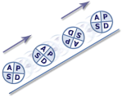
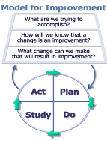
Programme design and key dates
Action Period 2
Action Period 3
Action Period 4
Action Period 5
Welcome Overview
Workshop 1
Workshop 2
Workshop 3
Sharing Workshop
Showcase
September
11th Oct
5th Nov
6th Dec
10th Jan
4th Feb
5th Feb
Spring
Support
National IA Leadership Team/s Q.I. Faculty
QI Zone (TURAS) (Falkirk) GIRFEC Practitioner pages
All teach ,all learn

Slide 4
By the end of this session you will…….
What are you going to continue to do and what are you going to change?
How are we using the MfI to create a learning system?
Leave with an action plan for Action Period 4.

Slide 5
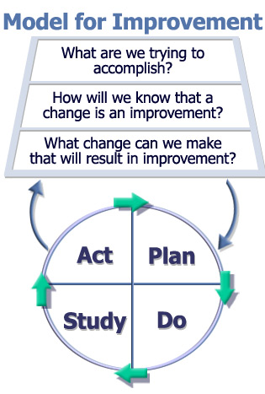
Specific aim
Clear measures
Ideas generated by staff
Testing ideas

Slide 6
Technical Tools: Understanding a System
Process Mapping
Pareto chart
Force field Analysis
Cause + Effect
Surveys

Slide 7
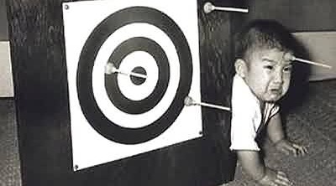
Creating an Aim

Slide 8
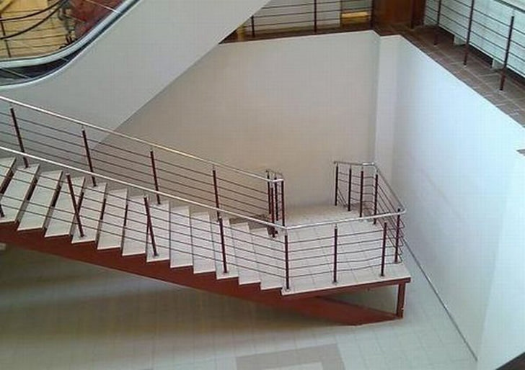
Improvement Planning

Slide 9
Notes:
If you don’t create a measurement plan you will fly blind. Things may get better or worse but you won’t be able to say if it was because of something you did.

Slide 10
Measures - Things to consider
Who will be responsible for data collection?
What is the data source / how will the data be collected?
Frequency of data collection, and timings?
Equipment needed to measure?
How can data collection be integrated with work?
What factors might influence the measure?

Slide 11
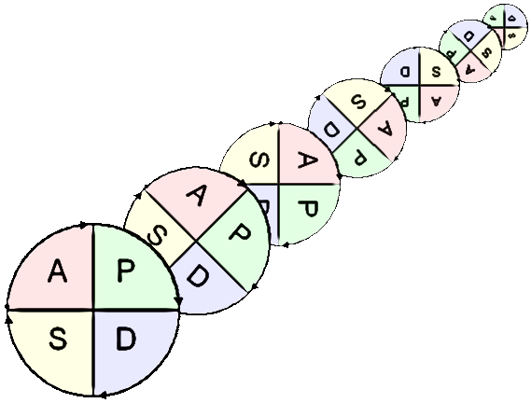
Why test changes?
To learn how to adapt the change to conditions in your setting
Increase the belief that the change will result in improvements in your setting
Minimise resistance when spreading the change throughout the organisation
Evaluate the costs and “side-effects” of changes
Notes:
If you roll out a fully formed plan and it doesn’t work it gets shelved.
Testing allows for tweaking and improvement so that good ideas aren’t abandoned before they’ve been given a real chance.
The more tests you do, the more evidence of you ability to adopt.
Adapt: taking preexisting knowledge but making it locally relevant
Minimise resistance – people buy in when you are able to offer them solutions and work arounds before implementation
Side effects – you will have balancing measures in place so that you are not at risk of missing the impact of your work on the nigger picture.

Slide 12
PDSA Cycles: Deciding on Scale
 |  | Current commitment within organisation
BELIEF | COST OF FAILURE | No commitment | Some commitment | Strong commitment
Low degree of belief that change idea will lead to improvement | Cost of failure large | Very small scale test | Very small scale test | Very small scale test
 | Cost of failure small | Very small scale test | Very small scale test | Small scale test
High degree of belief that change idea will lead to improvement | Cost of failure large | Very small scale test | Small scale test | Large scale test
 | Cost of failure small | Small scale test | Large scale test | Implement
Source: The Improvement Guide, page 146
Notes:
Objective: Matrix of size of test to implementation
Explanation: This slide is a matrix of the size of the test of change as it relates to readiness for, cost of failure and confidence in the change. For example, if the current situation contains high resistance to a change and there is very low confidence in or evidence of success related to the change and the cost of failure is high, then the test should be very small. Only in high readiness, low cost of failure and high confidence should the team move to implementation.
Note that small scale refers to the size of the test and not the size of the change… the thing you’re testing on a very small scale could be totally different from current practice.

Slide 13
Team Time : Improvement Planning?
What are you going to keep doing?
What are you going to change?
Notes:
60 mins
15 Buzz every 15 mins
Then 5
15
5
15
5
Prompt movement from C to L to E to A to R
to coach plus 5 to feedback

Slide 14
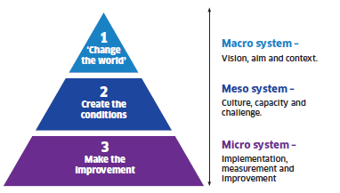
Notes:
A vision – capable of stirring the heart of the community and able to serve as a constant
reference and anchor point as the change moves forward.
A story – to enable people to recognise where they have been and where they are going.
A set of actions – to take us to the next steps towards releasing the vision.
A clear framework for improvement.
A strategy to engage and empower the workforce - to provide the stimulation,
development and opportunity our staff need to fully release their deep commitment to public
service.
An understanding of how change will work locally (everywhere) – recognising
communities are different and creativity should be nurtured and released at a local level.
A guiding coalition – a team of key people to drive the change when the going gets tough,
and to sustain support.
Aim- Is there an agreed aim that is understood by everyone in the system?
Correct changes - Are we using our full knowledge to identify the right changes and priorities those that are likely to have the biggest impact on our aim?
Clear change method- Does everyone know and understand the method(s) we will use to improve?
Measurement- Can we measure and report progress on our improvement aim?
Capacity and capability - Are people and other resources deployed in the best way to enable improvement?
Spread plan- Have we set out our plans for innovating, testing, implementing and sharing new learning to spread the improvement everywhere it is needed?

Slide 15
The 3-Step Improvement Framework
Step 2 –Creating the Conditions
1
Aim
Is there an agreed aim that is understood by everyone in the system?
2
Correct changes
Are we using our full knowledge to identify the right changes and priorities those that are likely to have the biggest impact on our aim?
3
Clear change method
Does everyone know and understand the method(s) we will use to improve?
4
Measurement
Can we measure and report progress on our improvement aim?
5
Capacity and capability
Are people and other resources deployed in the best way to enable improvement?
6
Spread plan
Have we set out our plans for innovating, testing, implementing and sharing new learning to spread the improvement everywhere it is needed?

Slide 16
Table top discussion:
Consider your context and your improvement work:
How are you going to share your improvement work/story?
Who are your audience?
What visuals would help?
What data/charts will support your story?
Notes:
How are you going to share your improvement work/story?
Who are your audience?
What visuals would help?
What data/charts will support your story?

Slide 17
Measures

Slide 18
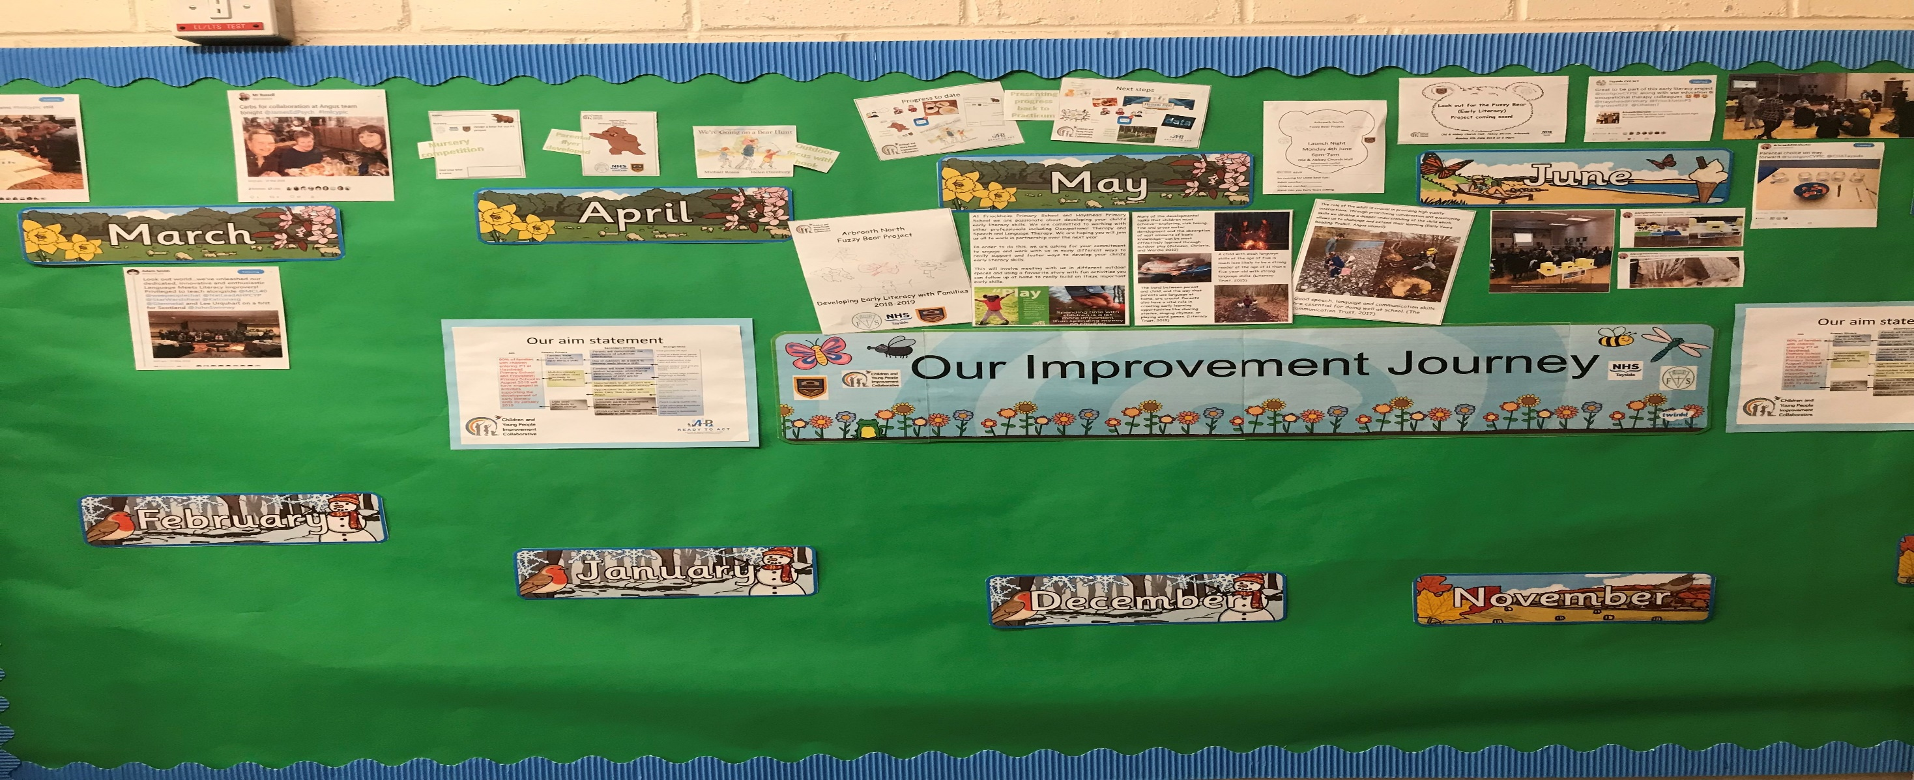
Visual Management Boards/Improvement Walls

Slide 19
Working Together to…
(Insert chosen theme)
Insert CPP / Health Board Logo
Project Lead Name; Job Title, CPP / Health Board
Rationale – Some background to your project – a brief statement about the issue you are trying to resolve. Who will benefit from this for and why is it important?
Aim: Include your aim.
Method
Results
A short summary about your methodology for analysis and testing. What data or sampling methods did you use? What Improvement tools? Who was involved?
What are the results of your project? Annotated run charts are a good way to document the story of your project. Add text, images, graphs, etc.
Process Change
What specifically were the key changes you made? You may also wish to insert your Driver Diagram here to provide an overview of your change theory.
Add text, images, graphs, etc.
Conclusions
A brief concluding statement from the results of your testing. Was the aim of your project met? How has the impact been felt? Qualitative data and quotes can be powerful here. Add text, images, graphs, etc.
Achievements
List some of your broader achievements which resulted out of completing the project. What new skills did you learn? What has made you proud?
Scale / Spread
Key Learning Points
Where is the project being spread to next? Is there a spread/scale up plan? Do you want this to be replicated across your CPP/Health Board and by when would you like this to happen?
What are your key learning points? Are there specific things that had to happen in order for your project to work successfully? Does this form a ‘bundle’ that you are going to spread? Think about what didn’t work and the reflections/changes it led you to make.
Further information contact: joebloggs@nhs.net

Slide 21
Team Time : Improvement Planning
What are you going to keep doing?
What are you going to change?
Notes:
60 mins
15 Buzz every 15 mins
Then 5
15
5
15
5
Prompt movement from C to L to E to A to R
to coach plus 5 to feedback

Slide 22
NEXT STEPS

Slide 23
Programme design and key dates
Action Period 2
Action Period 3
Action Period 4
Action Period 5
Welcome Overview
Workshop 1
Workshop 2
Workshop 3
Sharing Workshop
Showcase
September
11th Oct
5th Nov
6th Dec
10th Jan
4th Feb
5th Feb
Spring
Support
National IA Leadership Team/s Q.I. Faculty
QI Zone (TURAS) (Falkirk) GIRFEC Practitioner pages
All teach ,all learn

Slide 24
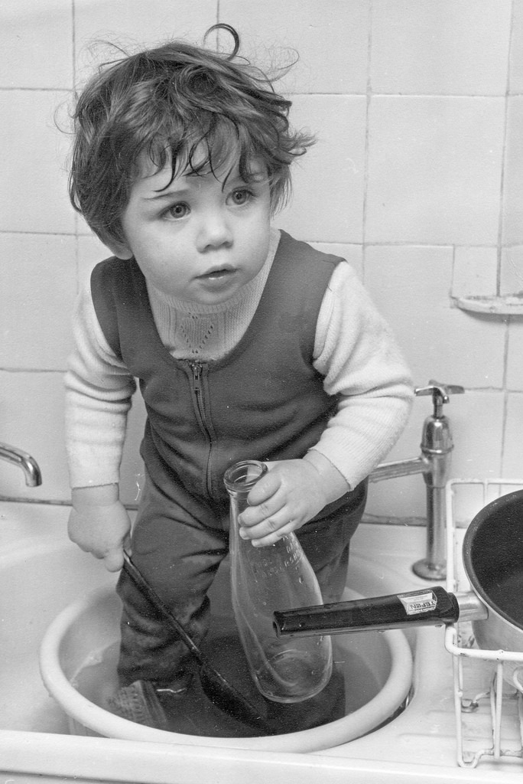
Session 4 - time to wash up…..
What went well…………..
Even better if……
Questions?

Slide 25
By the end of this session you will…….
What are you going to continue to do and what are you going to change?
How are we using the MfI to create a learning system?
Leave with an action plan for Action Period 4.

