Slide 1
Using the Model for Improvement to support clear and measureable impact
Session 3
Wendy Toner
CYPIC Improvement Advisor
&
Falkirk CYPIC QI Faculty

Slide 3
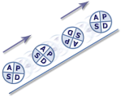
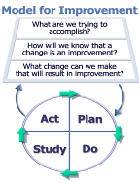
Programme design and key dates
Action Period 2
Action Period 3
Action Period 4
Action Period 5
Welcome Overview
Workshop 1
Workshop 2
Workshop 3
Sharing Workshop
Showcase
September
11th Oct
5th Nov
6th Dec
10th Jan
4th Feb
5th Feb
Spring
Support
National IA Leadership Team/s Q.I. Faculty
QI Zone (TURAS) (Falkirk) GIRFEC Practitioner pages
All teach ,all learn

Slide 4
By the end of this session you will…….
Started to plan some tests- Plan, Do, Study, Act (PDSA)
Create a measurement plan that matters
Leave with an action plan for Action Period 3.

Slide 5
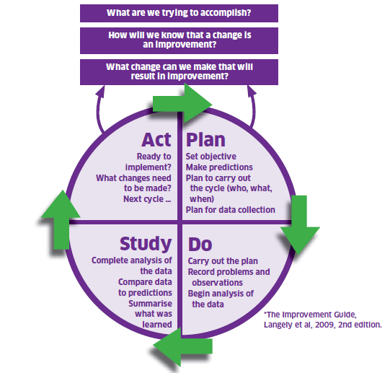
The Model For Improvement
The Thinking Part
The Doing Part
Notes:
The model is split into two parts. The first being the thinking part and the second being the doing part. We will now take you through the two distinct parts in some detail with practical exercises to get everyone used to using the model and be able to describe and direct others in terms of our support function as a Unit.
.

Slide 6
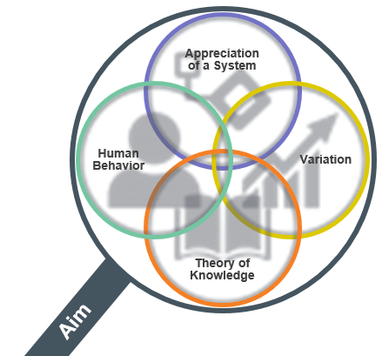
Appreciation of a System
Common Aim
Understand how things link together
People, process and items
Simple, Complicated or Complex
Profound
Knowledge
Psychology
Relationships between people
Motivation, intrinsic /extrinsic
Beliefs, assumptions
Will to change
Theory of Knowledge
1. Develop a theory
2. Use PDSA to test
3.Bring knowledge into the system
Develop a theory
Use PDSA to test
Bring knowledge into the system
Understanding Variation
The world is not deterministic
Variation is expected
Understand when to improve
Understand when not to tamper
Notes:
Appreciation for a System
Interdependence, dynamism
World is not deterministic
Optimization, interactions
System must have an aim
Whole is greater than sum of the parts
Theory of Knowledge
Prediction
Learning from theory, experience
Operational definitions
PDSA for learning and improvement
Understanding Variation
Variation is to be expected
Common or special causes
Ranking, tampering
Potential mistakes
Psychology
Interaction between people
Intrinsic motivation, movement
Beliefs, assumptions
Will to change

Slide 7
Improvement Journey
Understand current system
Develop aim and change theory
Develop change ideas
Test and refine ideas, building knowledge
Start to implement
Building will
Measurement, project management and understanding people
Notes:
We are going to structure the two days to take you through an improvement journey, introducing tools, ideas and approaches as we go. Much may be familiar as you have all been involved in various types of projects and change management.
Understand the system – look at data – listen to the people – use the available improvement tools. Might involve data analysis, comparisons, process mapping, cause and effect analysis etc., also understanding people and why things work as they do. Do the conditions exist for change? E.g. leadership buy-in, will to change,
This will help identify what to improve – prioritise what might have the most impact. Can refer to example on CPOs – make sure you’re solving the right problem
Might be obvious how to change it, or may need to think of creative solutions. Copy from others if they’ve done something that works.
Start testing on a small scale, and measure as you go along. It’s the people who do the work who need to own the change and test it.

Slide 8
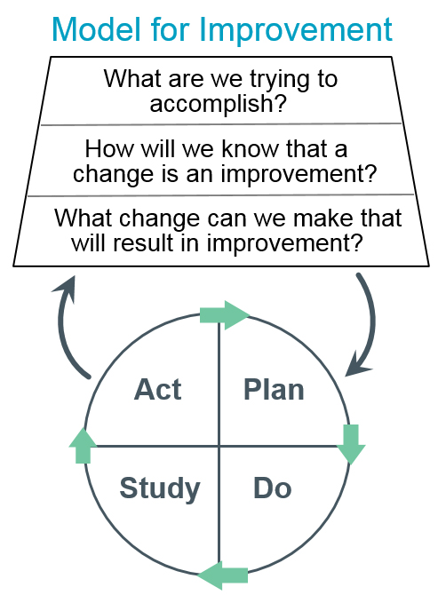
The Model for Improvement was developed by Associates in Process Improvement. [Source: Langley GL, Moen R, Nolan KM, Nolan TW, Norman CL, Provost LP. The Improvement Guide: A Practical Approach to Enhancing Organizational Performance (2nd edition). San Francisco: Jossey-Bass Publishers; 2009.]

Slide 9
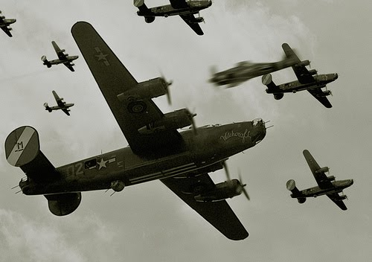
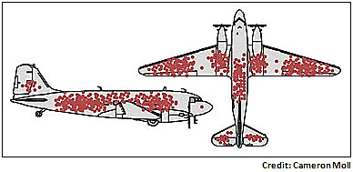
Notes:
This is the story of Abraham Wald, the grandson of a rabbi and son of a kosher baker and a genius at pure mathematics – set theory and metric spaces.
Wald spent much of World War II in Manhattan working for the Statistic Research Group -- the mathematical equivalent of The Manhattan Project – where the weapons were equations, not bombs.
According to Ellenberg, “The mathematical talent at hand was equal to the gravity of the task. In Wallis’s words, the SRG was “the most extraordinary group of statisticians ever organized, taking into account both number and quality.”
The task they were set was to add armour to the WW2 planes to protect them. But armour makes the plane heavier, and heavier planes are less manoeuvrable and use more fuel. So the generals came to SRG with mounds of data -- especially on where bullets were lodged in U.S. fighters.
So here’s the question. You don’t want your planes to get shot down by enemy fighters, so you armour them. But armour makes the plane heavier, and heavier planes are less manoeuvrable and use more fuel. Armouring the planes too much is a problem; armouring the planes too little is a problem. Somewhere in between there’s an optimum. The reason you have a team of mathematicians socked away in an apartment in New York City is to figure out where that optimum is.
CLICK The military came to the SRG with some data they thought might be useful. When American planes came back from engagements over Europe, they were covered in bullet holes. But the damage wasn’t uniformly distributed across the aircraft. There were more bullet holes in the fuselage, not so many in the engines.
The officers saw an opportunity for efficiency; you can get “the same protection with less armour if you concentrate the armour on the places with the greatest need, where the planes are getting hit the most. But exactly how much more armour belonged on those parts of the plane? That was the answer they came to Wald for. It wasn’t the answer they got.
The armour, said Wald, doesn’t go where the bullet holes are. It goes where the bullet holes aren’t: on the engines.
Wald’s insight was simply to ask: where are the missing holes? The ones that would have been all over the engine casing, if the damage had been spread equally all over the plane? Wald was pretty sure he knew. The missing bullet holes were on the missing planes. The reason planes were coming back with fewer hits to the engine is that planes that got hit in the engine weren’t coming back. Whereas the large number of planes returning to base with a thoroughly Swiss-cheesed fuselage is pretty strong evidence that hits to the fuselage can (and therefore should) be tolerated.
Wald saw what the officers, who had more experience and understanding of the particulars of aerial combat, couldn’t. It comes back to his math-trained habits of thought. A mathematician is always asking, “What assumptions are you making? And are they justified?”

Slide 10
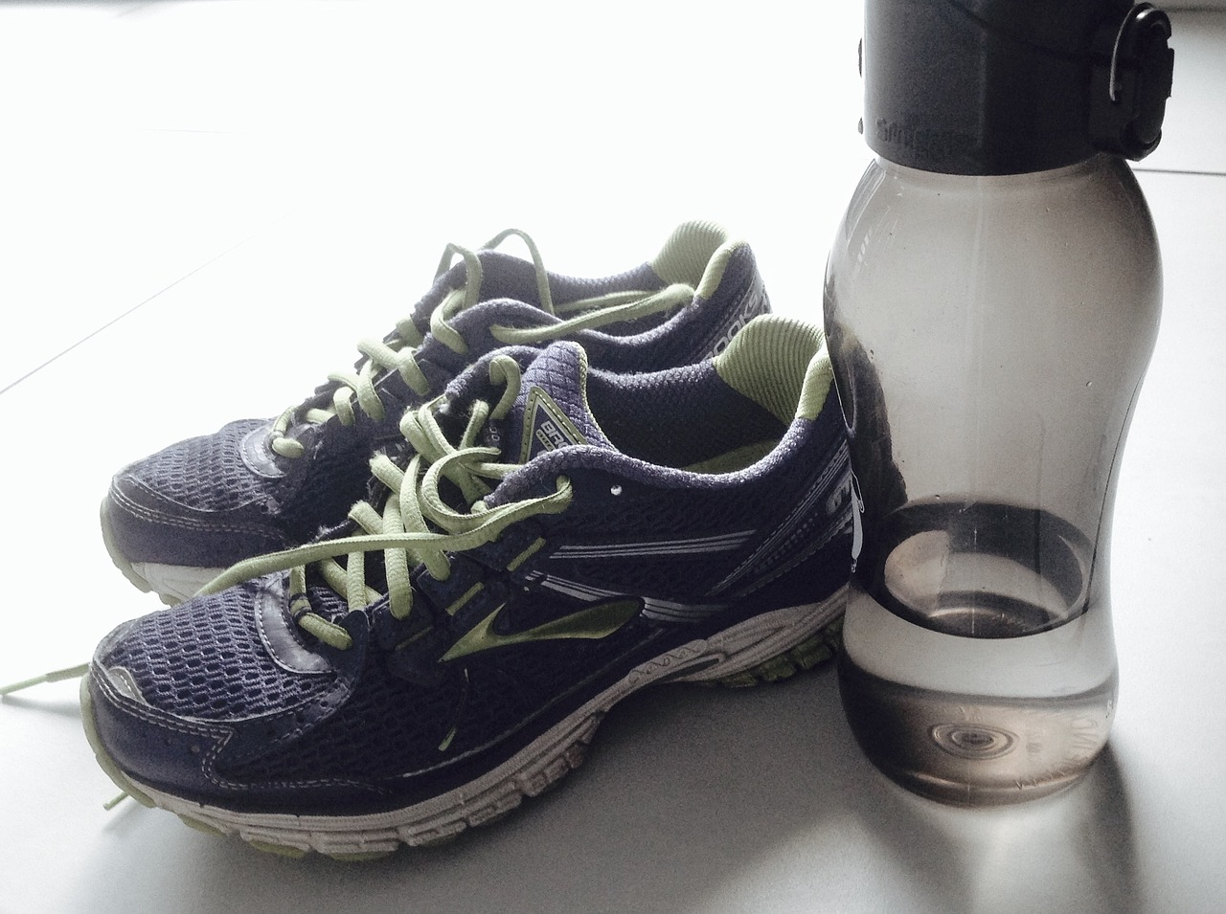
Sometimes…….
…….we know
Notes:
Improvement aim to get fitter - exercise
Sometimes…….
We know what change would make a difference………………
But lack the conditions, resources, inclination for it to happen
Often…….
It’s not obvious what change we should make……….
And we can resort to common ineffective ways to develop change……..

Slide 11
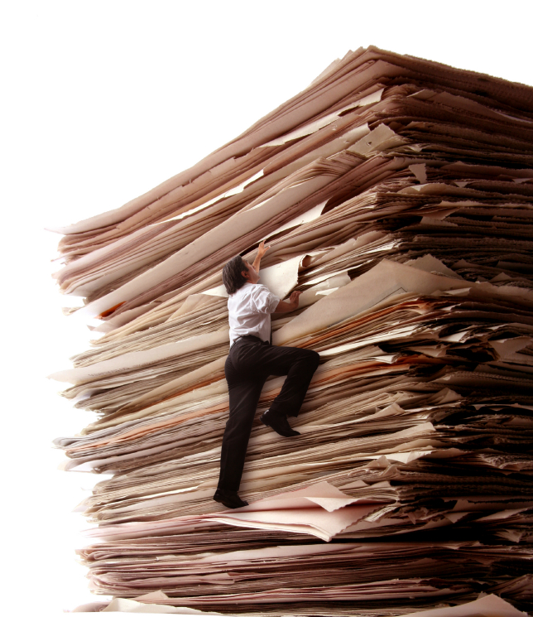
Often………..
We don’t know………..
Notes:
Presenter draws on their own experience – sometimes we don’t know what change ideas we are going to test. We just know things aren’t working the way we want them to work.
We focus on the problem rather than identifying/testing changes
Often…….
It’s not obvious what change we should make……….
And we can resort to common ineffective ways to develop change……..

Slide 12
There may be trouble ahead………………
Trouble with meeting “customer” requirements
Add more resources, more money more time!
Trouble with performance
Introduce/add more inspection!
Trouble with variation in the process
Make more adjustments!
Trouble with adherence to procedures
Add more procedures!
Trouble with discipline
Add more restrictions!
Notes:
Can resort to common traps of ineffective ways of thinking rather than lateral thinking
Often we jump to measure more or a technical solution!

Slide 13
The Model for Improvement - PDSA Cycles

Slide 14
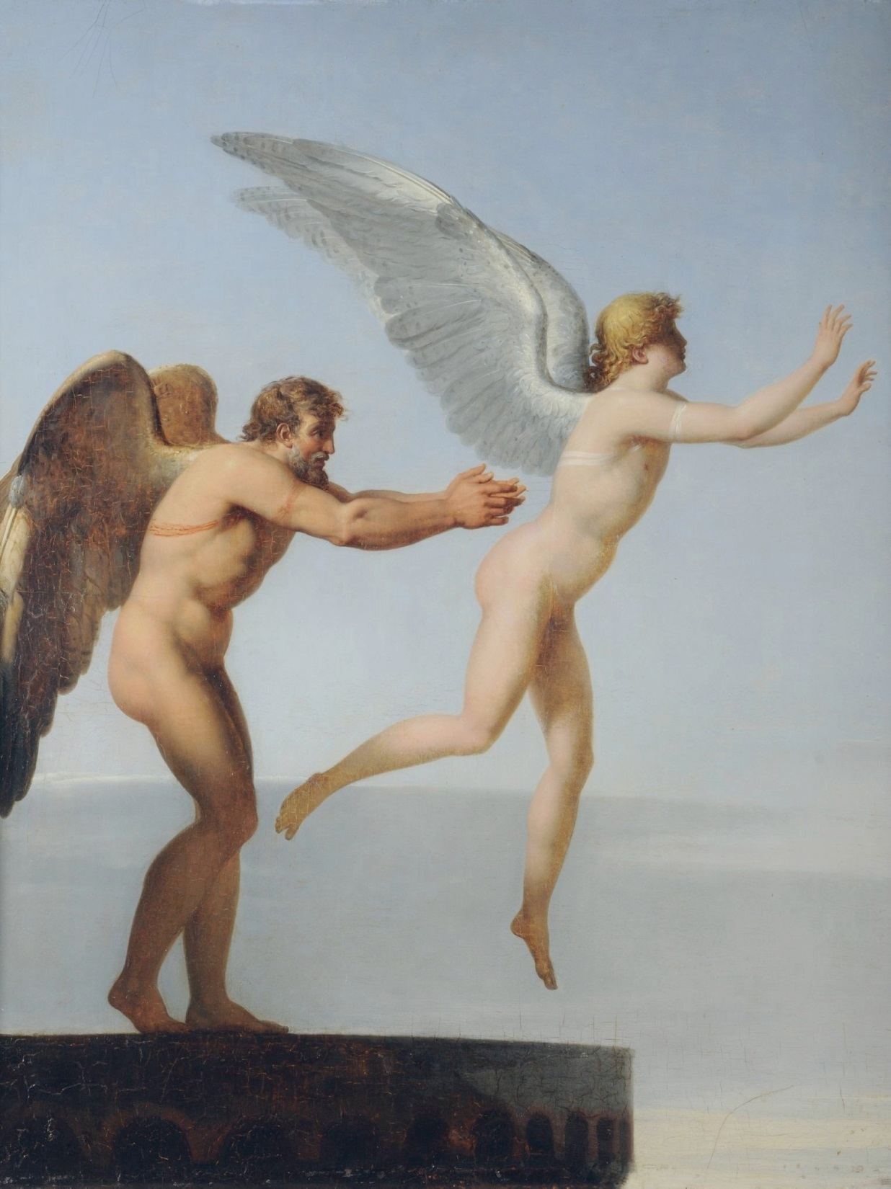
Degree of belief
in a change is
increased when
tests confirm predictions
under a wide range of conditions

Slide 15
PDSA Cycles: Deciding on Scale
 |  | Current commitment within organisation
BELIEF | COST OF FAILURE | No commitment | Some commitment | Strong commitment
Low degree of belief that change idea will lead to improvement | Cost of failure large | Very small scale test | Very small scale test | Very small scale test
 | Cost of failure small | Very small scale test | Very small scale test | Small scale test
High degree of belief that change idea will lead to improvement | Cost of failure large | Very small scale test | Small scale test | Large scale test
 | Cost of failure small | Small scale test | Large scale test | Implement
Source: The Improvement Guide, page 146
Notes:
Objective: Matrix of size of test to implementation
Explanation: This slide is a matrix of the size of the test of change as it relates to readiness for, cost of failure and confidence in the change. For example, if the current situation contains high resistance to a change and there is very low confidence in or evidence of success related to the change and the cost of failure is high, then the test should be very small. Only in high readiness, low cost of failure and high confidence should the team move to implementation.
Note that small scale refers to the size of the test and not the size of the change… the thing you’re testing on a very small scale could be totally different from current practice.

Slide 16
Driver Diagram - Visually presents a team’s theory of how an improvement goal will be achieved.
It articulates what parts of the system need to change, and in which way, and includes ideas to make this happen.
It is used to help plan improvement project activities and ensure team engagement.
In order to achieve this Aim…
We need to ensure…..
Which requires….
Ideas to ensure this happens
Aim
Primary driver
Secondary driver
Secondary driver
Primary driver
Secondary driver
Secondary driver
Secondary driver
Secondary driver
Primary driver
Secondary driver
Secondary driver
Primary driver
Change idea
Change idea
Theory based on:
Experience
Knowledge
Existing evidence
Change idea
Change idea
Change idea
Change idea
Change idea

Slide 17
Multiple change ideas for a project aim
AIM
Concept D
Concept C
Concept A
Concept B

Slide 18
Notes:
Just a note that they need to remember to record the pdsa’s…
Note to record the pdsa’s – v important. Luckily we have a handy template which we’ll come to later..

Slide 19
Do | Describe what happened when you carried out your plan.
Study | Describe the measured results and how they compared to the predictions.
Act | Describe what modifications in the plan will be made for the next cycle from what you learned.
Document what happens, including problems or anything unexpected
Learn by studying how your predictions matched your results using the PDSA measures
Abandon, adapt, adopt or expand?
Notes:
The information collected during the do stop should help you to understand why a test didn’t work…

Slide 20
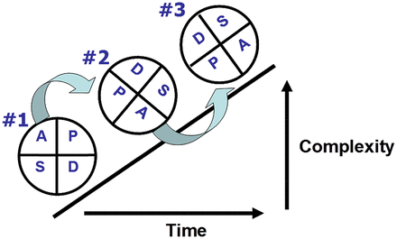
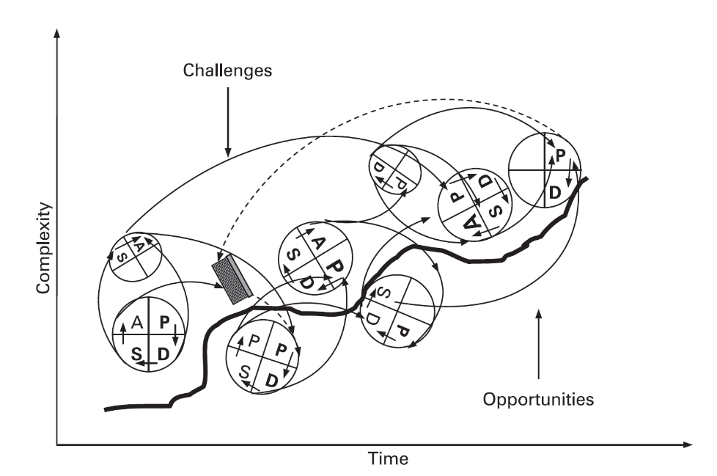
“Its simplicity belies its sophistication”
Berwick 1996
Ogrinc & Shojania BMJ Q&S 2014

Slide 21
Practical 1 Exercise : 15 Mins
In teams:
Plan a test of change
Who, when and why…..
ALL TEACH ALL LEARN
Notes:
60 mins
15 Buzz every 15 mins
Then 5
15
5
15
5
Prompt movement from C to L to E to A to R
to coach plus 5 to feedback

Slide 22
All Teach, All Learn
Questions?

Slide 23
Why do we need data for improvement?
To understand what needs improved
To understand variation
For testing changes
For monitoring progress
To tell the story of your improvement journey
Notes:
ASK THEM TO DISCUSS THIS AND COME UP WITH REASONS BEFORE REVEALING ANSWERS
(5 mins)
To understand what needs improved – e.g. data, surveys, pareto, etc.
To understand and reduce variation – link back to profound knowledge
For testing changes – remember, you need to be able to measure whether the test has the predicted effect
For monitoring progress– these would be more global measures for your project
To tell the story of your improvement journey – very important especially if you want to scale up
The last two are where we’re focussing here – measures for your project…

Slide 24
Driver Diagram - Visually presents a team’s theory of how an improvement goal will be achieved.
It articulates what parts of the system need to change, and in which way, and includes ideas to make this happen.
It is used to help plan improvement project activities and ensure team engagement.
In order to achieve this Aim…
We need to ensure…..
Which requires….
Ideas to ensure this happens
Aim
Primary driver
Secondary driver
Secondary driver
Primary driver
Secondary driver
Secondary driver
Secondary driver
Secondary driver
Primary driver
Secondary driver
Secondary driver
Primary driver
Change idea
Change idea
Theory based on:
Experience
Knowledge
Existing evidence
Change idea
Change idea
Change idea
Change idea
Change idea

Slide 25
Identifying Measures
Aim
Primary drivers
Secondary drivers
Secondary factors which
will influence delivery of
the primary drivers
Key factors
that drive the
outcome/aim
Outcome measures
Process measures
Aim statement:
(what, how much
by when)
Process measures
Process measures
Outcome measures
Balance measures

Slide 26
What might a ‘dashboard’ look like?

Slide 27
Potential Ideas
1 -5 Scale of Involvement
1 – 5 Scale of Wellbeing
RAG (Red, Amber, Green) Indicators for Learning Objectives
Attendance
Pupil Confidence
Staff Confidence
Notes:
Research Centre for Experiential Education at Leuven University (Belgium), under the supervision of Professor Ferre Laevers – an educationalist in the Experiential Education field.
We want learners to feel included, engaged and involved.
Scales could be modified for learner friendly language. Could support teacher professional judgements or learners themselves could track.
Engagement – 1 to 5 scoring – definitions available on table
Wellbeing – 1 to 5 scoring – definitions available on table
RAG – Red (50% or less of weekly learning objectives achieved) Amber (50% - 75% of weekly learning objectives achieved) and Green (Above 75% of weekly learning objectives achieved)
Attendance – Register or SEEMIS system
Pupil Confidence - Likert Scale

Slide 28
Notes:
How this might look in practice

Slide 29
RAG Indicators for Learning Objectives
Visual Timetable trialled
Notes:
Understanding the data

Slide 30
Dashboard?
Notes:
Pulling the data together in a dashboard format

Slide 31
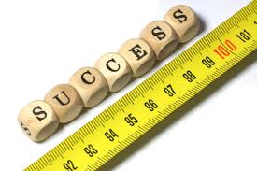
Create a measurement plan that matters
Notes:
If your aim was an increase in attainment of Pulling the data together in a dashboard format

Slide 32
Aim: 85% of pupils in class P7B, will know* their times tables by 22ndDecember 2017. Fluent recall of times tables are considered an essential prerequisite to success in multiplication and other mathematical concepts (Ofsted, 2010).

Slide 33
Practical 2 Exercise : 15 Mins
In teams:
Agree what to measure, who , when and how
Notes:
60 mins
15 Buzz every 15 mins
Then 5
15
5
15
5
Prompt movement from C to L to E to A to R
to coach plus 5 to feedback

Slide 34
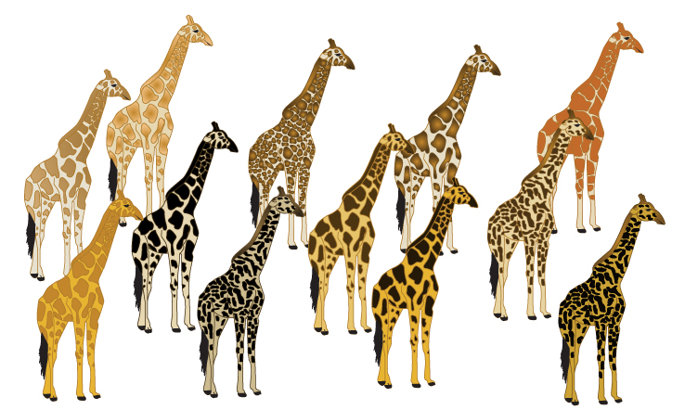
Variation: Common cause or special cause…………..

Slide 35
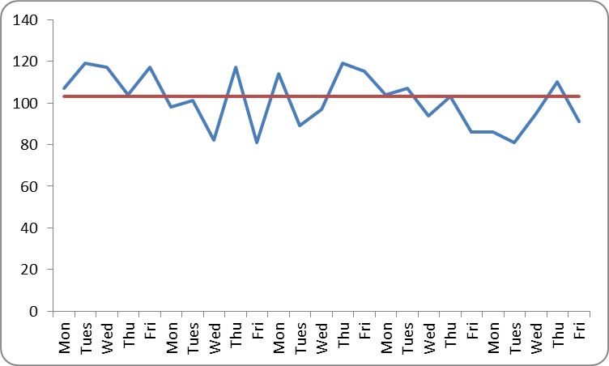
Run Charts
Display data to make process performance visible
Centre line is the median
Usually time is represented along the bottom
Notes:
Can be started as soon as you have data - to facilitate learning as soon as possible

Slide 36
Practical 3 Exercise : 15 Mins
In teams:
Build a run chart
ALL TEACH ALL LEARN
Notes:
60 mins
15 Buzz every 15 mins
Then 5
15
5
15
5
Prompt movement from C to L to E to A to R
to coach plus 5 to feedback

Slide 37
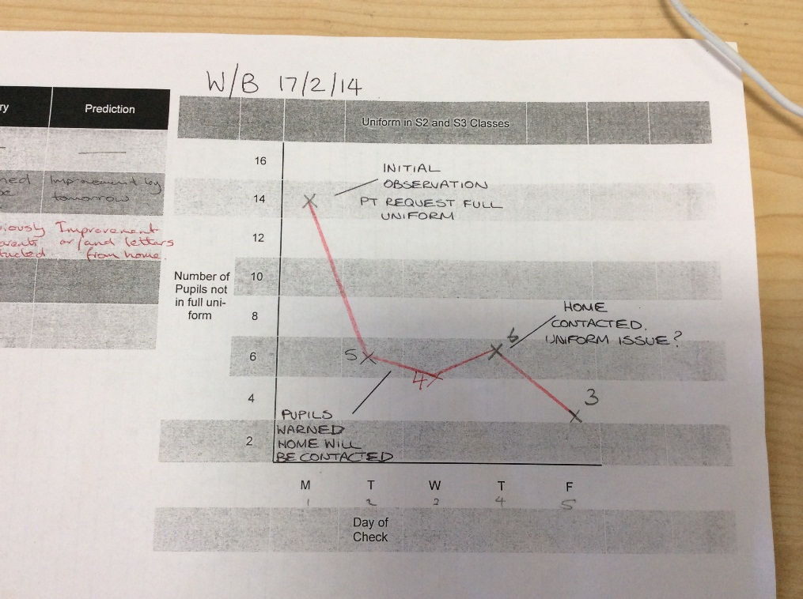
Start with a bit of paper!

Slide 38
RUN CHART EXAMPLE
Months | Percentage | Notes
Apr-14 | 48
May-14 | 46
Jun-14 | 48
Jul-14 | 5
Aug-14 | 50
Sep-14 | 63 | Event 1
Oct-14 | 65
Nov-14 | 25 | Event 2
Dec-14 | 48 | Event 3 & 4
Jan-15 | 58
Feb-15 | 60 | Event 5
Mar-15 | 65
Apr-15 | 72
May-15 | 75
Jun-15 | 78 | Implementation starts
Jul-15 | 80
Aug-15 | 65

Slide 40
Run chart rules to spot non-random variation
40
Notes:
HANDOUT contains these charts, and the table for numbers of runs.
Because they are simple to make and relatively straightforward to interpret, run charts are one of the most useful tools in quality improvement. They allow us to:
Display data to make process performance visible
Determine if a change resulted in improvement
Assess whether improved performance has been sustained
Run charts are line graphs where a measure is plotted over time, often with a median (the middle value of those plotted so that half are above and half are below) also shown.
Changes made to a process are also often marked on the graph so that they can be connected with the impact on the process. Often a change can be seen by visual inspection alone.
If we have at least 10-12 data points on our graph, run charts can also be used to distinguish between random and non-random variation using four simple rules. Different versions of these rules are used in different places so you may encounter different sets in other books or papers you read. However Improvement Guide and the Health Care Data Guide and by the Institute for Healthcare Improvement provide the following rules and the Non-random variation can be recognised by looking for:
A shift: six or more consecutive data points either all above or below the median. Points on the median do not count towards or break a shift.
A trend: five or more consecutive data points that are either all increasing or decreasing in value. If two points are the same value ignore one when counting.
Too many or too few runs: a run is a consecutive series of data points above or below the median. As for shifts, do not count points on the median: a shift is a sort of run. If there are too many or too few runs (i.e. the median is crossed too many or too few times) that's a sign of non-random variation. You need to look up a statistical table (see Perla et al, 2011) to see what an appropriate number of runs to expect would be. An easy way to count the number of runs is to count the number of times the line connecting all the data points crosses the median and add one.
An astronomical data point: a data point that is clearly different from all others. This relies on judgement. Every data set has a highest and lowest. They won't necessarily be an astronomical data point. Different people looking at the same graph would be expected to recognise the same data point as astronomical (or not).
Since using these rules requires you to have 10-12 data points at least on your run chart it is important to collect data as frequently as possible. If you collect data only once a month that would be 10 months, if weekly, 10 weeks (2½ months). However this needs to be balanced with keeping denominators (the number of values contributing to each data point) for percentages (or rates) above ten or so to minimise random variation due to small sample size.
Run charts are a powerful tool for detecting non-random variation and so sufficient for most improvement projects. However they are not so sensitive in detecting special causes as a second type of chart named after Walter Shewhart, who did early work in industry to develop the methods.

Slide 41
Shift

Slide 43
Astronomical
point

Slide 44
Run 1

Slide 45
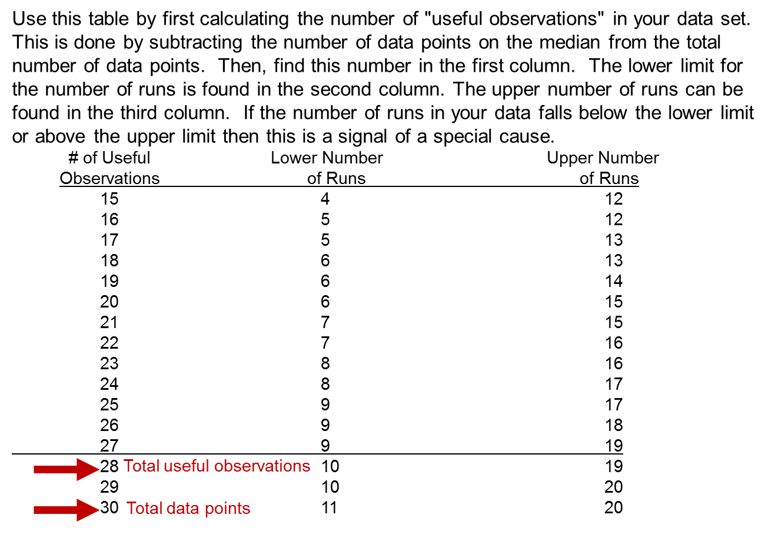
Too few or too many runs
Notes:
45

Slide 46
Run 1

Slide 47
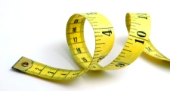
Measures - Things to consider
Who will be responsible for data collection?
What is the data source / how will the data be collected?
Frequency of data collection, and timings?
Equipment needed to measure?
How can data collection be integrated with work?
What factors might influence the measure?

Slide 48
Programme design and key dates
Action Period 2
Action Period 3
Action Period 4
Action Period 5
Welcome Overview
Workshop 1
Workshop 2
Workshop 3
Sharing Workshop
Showcase
September
11th Oct
5th Nov
6th Dec
10th Jan
4th Feb
5th Feb
TBC
Support
National IA Leadership Team Q.I. Faculty
QI Hub (TURAS) (Falkirk) GIRFEC Homepage
All teach all learn

Slide 49
Plan for Action Period 3:
Ongoing development of your measurement plan and continue to measure and plot over time.
What is your aim/s?
How do you know you’re on track?
Start testing and Learning
What tests are you doing to learn more about your system?
Regular Improvement Team meetings
How are you going to share?
Notes:
Next Webex focussed on project charters, using the knowledge network, evaluation

Slide 50
NEXT STEPS – 10 mins

Slide 51
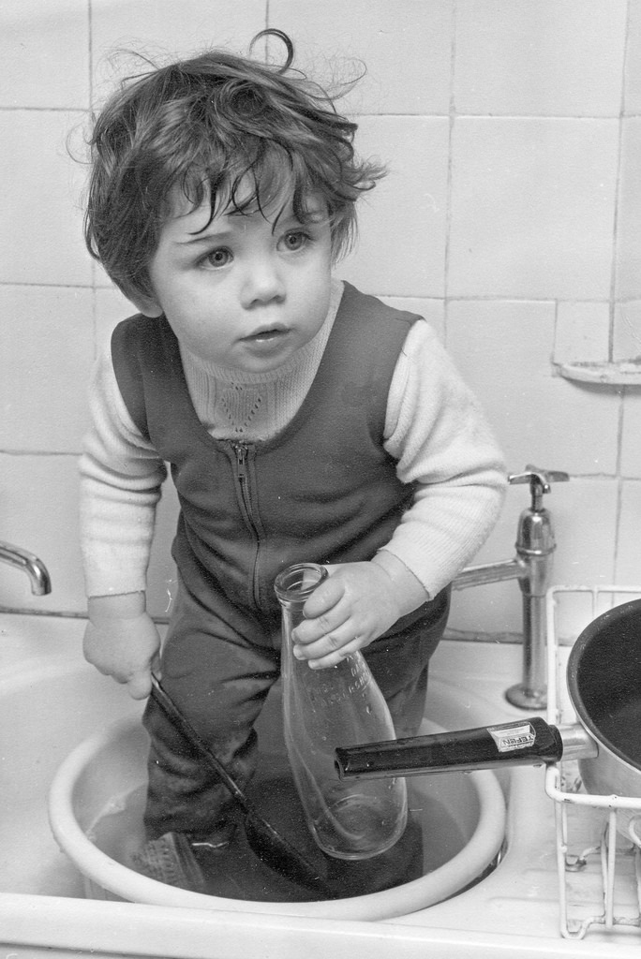
Session 3 - time to wash up…..
What went well…………..
Even better if……
Questions?

Slide 52
By the end of this session you will…….
Started to plan some tests- Plan, Do, Study, Act (PDSA)
Created a measurement plan that matters
Leave with an action plan for Action Period 3.

