Slide 1
Using the Model for Improvement to support clear and measureable impact
Workshop 2
Wendy Toner
CYPIC Improvement Advisor
&
Falkirk CYPIC QI Faculty

Slide 3
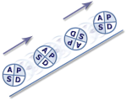
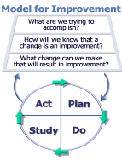
Programme design and key dates
Action Period 2
Action Period 3
Action Period 4
Action Period 5
Welcome Overview
Workshop 1
Workshop 2
Workshop 3
Sharing Workshop
Showcase
September
11th Oct
5th Nov
6th Dec
10th Jan
4th Feb
TBC
Spring
Support
National IA Leadership Team/s Q.I. Faculty
QI Zone (TURAS) (Falkirk) GIRFEC Practitioner pages
All teach ,all learn

Slide 4
By the end of this session you will…….
Have a STAN aim and strong Driver Diagram (theory of change)
Understand how your measurement plan is linked to your change theory
Enhance knowledge of run chart rules and measures
Leave with an action plan for Action Period 2.

Slide 5
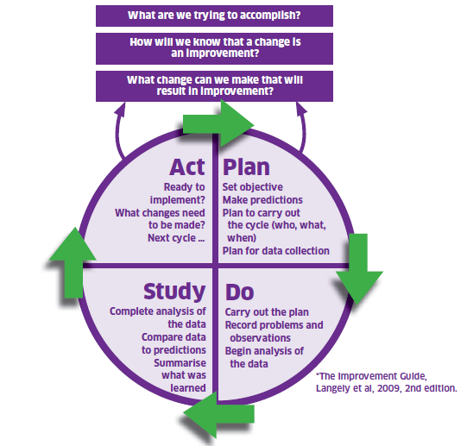
The Model For Improvement
The Thinking Part
The Doing Part
Notes:
The model is split into two parts. The first being the thinking part and the second being the doing part. We will now take you through the two distinct parts in some detail with practical exercises to get everyone used to using the model and be able to describe and direct others in terms of our support function as a Unit.
.

Slide 6
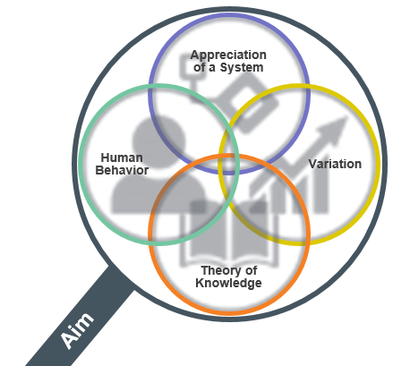
Appreciation of a System
Common Aim
Understand how things link together
People, process and items
Simple, Complicated or Complex
Profound
Knowledge
Psychology
Relationships between people
Motivation, intrinsic /extrinsic
Beliefs, assumptions
Will to change
Theory of Knowledge
1. Develop a theory
2. Use PDSA to test
3.Bring knowledge into the system
Develop a theory
Use PDSA to test
Bring knowledge into the system
Understanding Variation
The world is not deterministic
Variation is expected
Understand when to improve
Understand when not to tamper
Notes:
Appreciation for a System
Interdependence, dynamism
World is not deterministic
Optimization, interactions
System must have an aim
Whole is greater than sum of the parts
Theory of Knowledge
Prediction
Learning from theory, experience
Operational definitions
PDSA for learning and improvement
Understanding Variation
Variation is to be expected
Common or special causes
Ranking, tampering
Potential mistakes
Psychology
Interaction between people
Intrinsic motivation, movement
Beliefs, assumptions
Will to change

Slide 7
Improvement Journey
Understand current system
Develop aim and change theory
Develop change ideas
Test and refine ideas, building knowledge
Start to implement
Building will
Measurement, project management and understanding people
Notes:
We are going to structure the two days to take you through an improvement journey, introducing tools, ideas and approaches as we go. Much may be familiar as you have all been involved in various types of projects and change management.
Understand the system – look at data – listen to the people – use the available improvement tools. Might involve data analysis, comparisons, process mapping, cause and effect analysis etc., also understanding people and why things work as they do. Do the conditions exist for change? E.g. leadership buy-in, will to change,
This will help identify what to improve – prioritise what might have the most impact. Can refer to example on CPOs – make sure you’re solving the right problem
Might be obvious how to change it, or may need to think of creative solutions. Copy from others if they’ve done something that works.
Start testing on a small scale, and measure as you go along. It’s the people who do the work who need to own the change and test it.

Slide 8
Constructing an Aim Statement
Specific
Timebound
Aligned
Numeric

Slide 9
Falkirk : Aim Statements
Attendance will improve
All children p.1 – 7 will achieve at least 85% attendance by June 2018. (Attainment)
There is a shared understanding of what a good lesson looks like.
By January 2019, 95% of children and 95% of teachers will rate lessons in Maths as good or very good. (Self-Evaluation)
More children will be read to at home
90% of children will receive a bedtime story 3 times a week by the end of the summer term (Family Support)

Slide 10
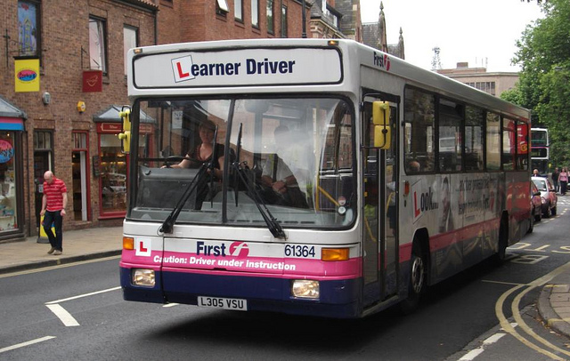
Why a Driver Diagram: What’s my theory?

Slide 11
Vision – each child lives in a stable, safe, secure and happy home, where they know they will stay until independent and where they can make lifelong connections.
Aim Primary Drivers Secondary Drivers
Worker confidence & skills
People
Parental engagement
By Jan 17 85% of children under 12 will be presented to Panel within 12 weeks of their Plan for Permanence being agreed
Worker capacity
Reduce duplication in paperwork
Assessment Process
Earlier completion of assessments/ reports
Well managed transitions
Child Focus
Joint early Planning
Clear agreed timescales aligned to planned outcome
Continuous focus on progress

Slide 12
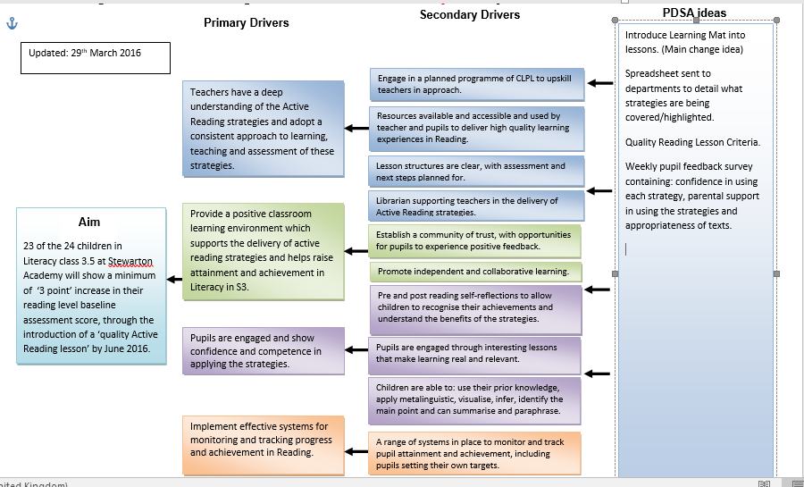

Slide 13
Driver Diagram: Tips on Facilitation
Gather together the subject matter experts.
Brainstorm “to achieve our aim the things we need to improve are...”
Cluster the ideas to see if groups represent a common driver.
Expand the groups (or single ideas) to see if new drivers come to mind.
Logically link together the groups into a driver diagram format.
Work backwards from ideas of change if that helps.
Notes:
Affinity Diagram
Driver diagrams should never be constructed in isolation

Slide 14
Practical Exercise : 15 Mins
In teams:
STAN Aim
Driver Diagram
ALL TEACH ALL LEARN
Notes:
60 mins
15 Buzz every 15 mins
Then 5
15
5
15
5
Prompt movement from C to L to E to A to R
to coach plus 5 to feedback

Slide 15
All Teach, All Learn
Questions?

Slide 16
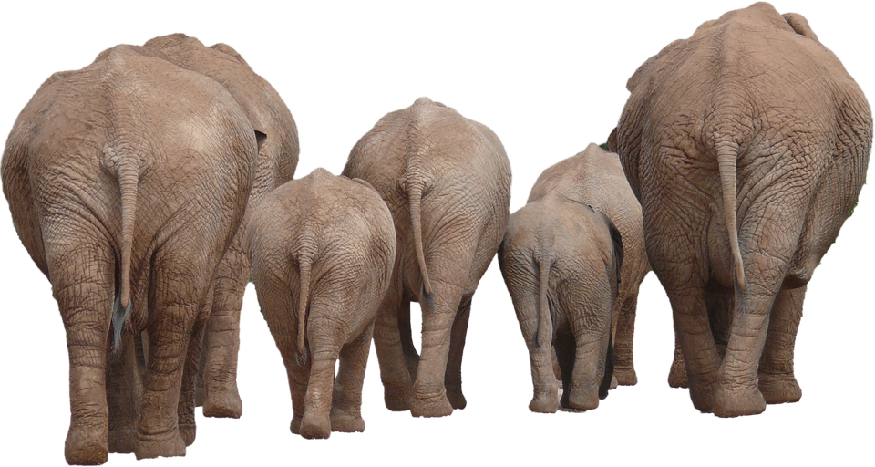
We need a wee family of measures…

Slide 17
Outcome Measures
Process Measures
Balancing Measures
Notes:
An improvement project should have a small FAMILY of measures. You should know these already.. Ask people to explain what these are.

Slide 18
Is the young person getting the right outcome?
Is the system working as planned?
What about the bigger picture?
Outcome Measures
Are we making things better?
Are we on track to achieve our Aim?
Process
Measures
Are we doing the right things at the right time, every time?
Is the process reliable?
Balancing Measures
Looking at the system from different dimensions.
Does improving one thing cause problems elsewhere?
Dave Williams, IHI
Notes:
Process measures are about the how
The outcomes measures are about the impact, the so what
The balancing measures are the unintended consequences and can be negative or positive

Slide 19
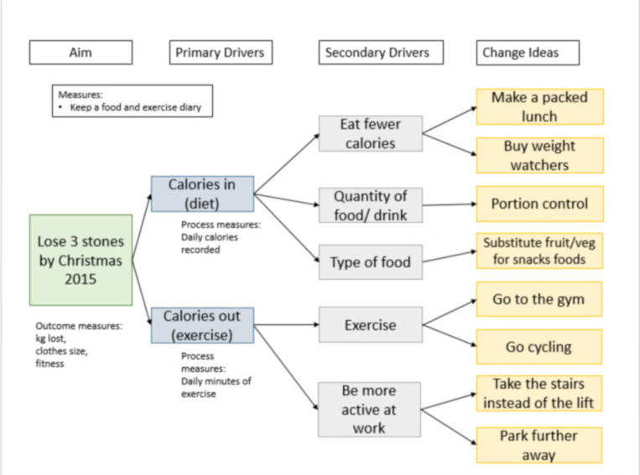
0
Healthier ‘New Me’ by August 2018
Less frequent
More frequent
Notes:
Key messages:
You will normally have one (maybe 2) outcome measures, several process measures, and one or two balancing measures.
Don’t become a data factory – only use the measures and collect the data that you really need.
The measures you choose will also depend on whether you have the tools/resources needed for that particular measure.
(If operational definitions crop up, cover briefly)

Slide 20
Vision – each child lives in a stable, safe, secure and happy home, where they know they will stay until independent and where they can make lifelong connections.
Aim Primary Drivers Secondary Drivers
Worker confidence & skills
Process :
% of cases with support meeting held within 2 weeks of allocation
People
Parental engagement
By Jan 17 85% of children under 12 will be presented to Panel within 12 weeks of their Plan for Permanence being agreed
Worker capacity
Reduce duplication in paperwork
Assessment Process
Earlier completion of assessments/ reports
Process :
% of transfers where workers report being fully informed on child’s plan and journey
Well managed transitions
% presented within 12 weeks
Time taken by individual child
Child Focus
Joint early Planning
Clear agreed timescales aligned to planned outcome
Process
% of children who have their Panel date set when plan agreed
Continuous focus on progress
Notes:
Reduce time taken from the child’s Permanence Plan being agreed at the Options Appraisal Meeting to the Panel ratifying the recommendation

Slide 21
Moving from a Concept to a Measure
Concept
Possible Measure
% of parents/carers invited to review meetings
Parental Engagement
Number of parents who attended monthly meeting about their child's development
% parents/carers who are more confident in understanding their child as a learner
Notes:
Different ways to think about the same concept – depending on what the purpose of the measure is and what will give you the best information.
NOTE THIS IS ANIMATED TO SHOW DIFFERENT POSSIBLE MEASURES

Slide 22
Moving from a Concept to a Measure
Concept
Possible Measure
Number of staff attending training sessions
Staff Confidence
% of staff completing self-evaluation paperwork
% of staff reporting they are more confident in identifying concerns
Number of staff reporting improved wellbeing
Notes:
ANIMATED TO SHOW POSSIBLE MEASURES. This should lead into conversation about different types of data and picking what’s appropriate

Slide 23
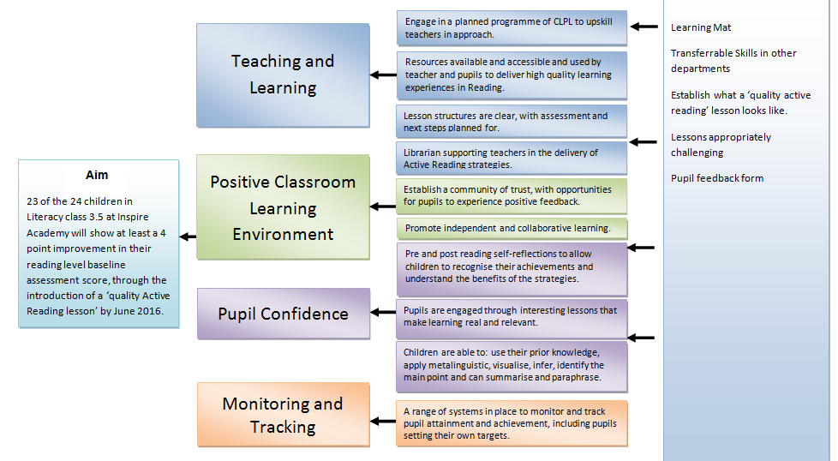

Slide 24
Concept
Measure
Learner Confidence
% of pupils reporting they are confident or very confident
Teaching & Learning
Number of lessons scored as ‘6’ or above
Teaching & Learning
% of learners reporting lessons were ‘appropriate’ or ‘quite challenging’

Slide 25
Create a measurement plan that matters
Notes:
If your aim was an increase in attainment of Pulling the data together in a dashboard format

Slide 26
Practical 2 Exercise : 15 Mins
In teams:
Start to identify your Outcome Measure and 1 process measure
ALL TEACH ALL LEARN
Notes:
60 mins
15 Buzz every 15 mins
Then 5
15
5
15
5
Prompt movement from C to L to E to A to R
to coach plus 5 to feedback

Slide 27
All Teach, All Learn
Questions?

Slide 28
Why do we need data for improvement?
To understand what needs improved
To understand variation
For testing changes
For monitoring progress
To tell the story of your improvement journey
Notes:
ASK THEM TO DISCUSS THIS AND COME UP WITH REASONS BEFORE REVEALING ANSWERS
(5 mins)
To understand what needs improved – e.g. data, surveys, pareto, etc.
To understand and reduce variation – link back to profound knowledge
For testing changes – remember, you need to be able to measure whether the test has the predicted effect
For monitoring progress– these would be more global measures for your project
To tell the story of your improvement journey – very important especially if you want to scale up
The last two are where we’re focussing here – measures for your project…

Slide 29
“When you have two data points, it is very likely that one will be different from the other.”
W. Edwards Deming
Notes:
Aggregate measures alone do not lead to predictions about future performance or insights to explain past variations
Looking at data over time allows us to make informed predictions, and understand the impact of changes on our measures so we can take appropriate action

Slide 30
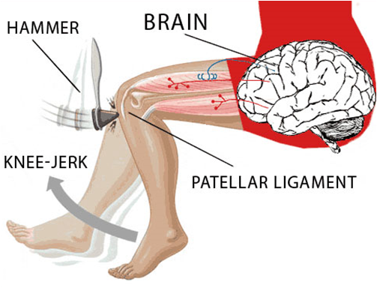
The mechanics of making decisions based on two data points………
Notes:
Data which varies randomly shows a pattern similar to that observed in the past – values are predictable within certain parameters
If we don’t understand the variation that lives in our data, we will be tempted to…
Deny the data as it doesn’t fit with our view of reality
See trends where there are none
Try to explain natural variation as special events
Blame and give credit to people for things over which they have no control
Distort the process that produced the data

Slide 31
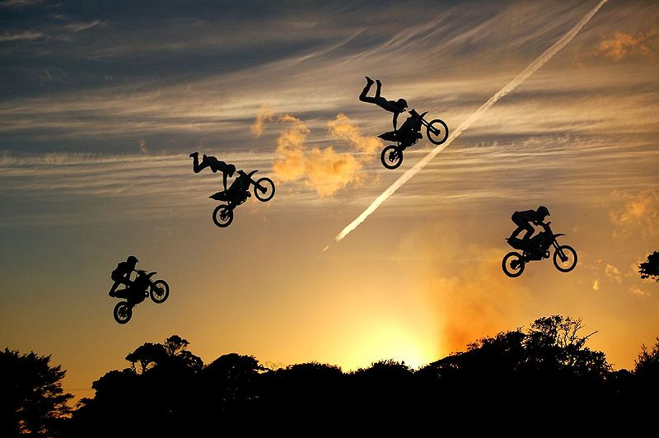
Importance of measurement over time
Notes:
So we’ve mentioned plotting our measures over time… why? Well, how would we know what was going on if we didn’t take all the time lapse pictures? Where might this motorbike have gone? It’s like that with numerical data too.
We’re thinking about understanding variation and we’ll go even more into it when you come back next time for res 2.
Recall that this is one of the 4 aspects of Deming’s Profound Knowledge

Slide 32
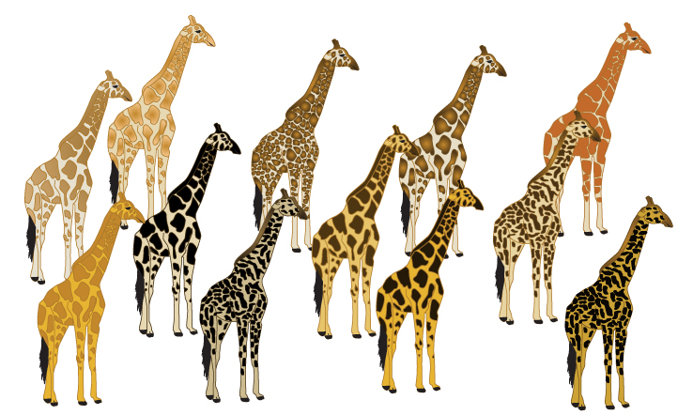
Understanding Variation

Slide 33
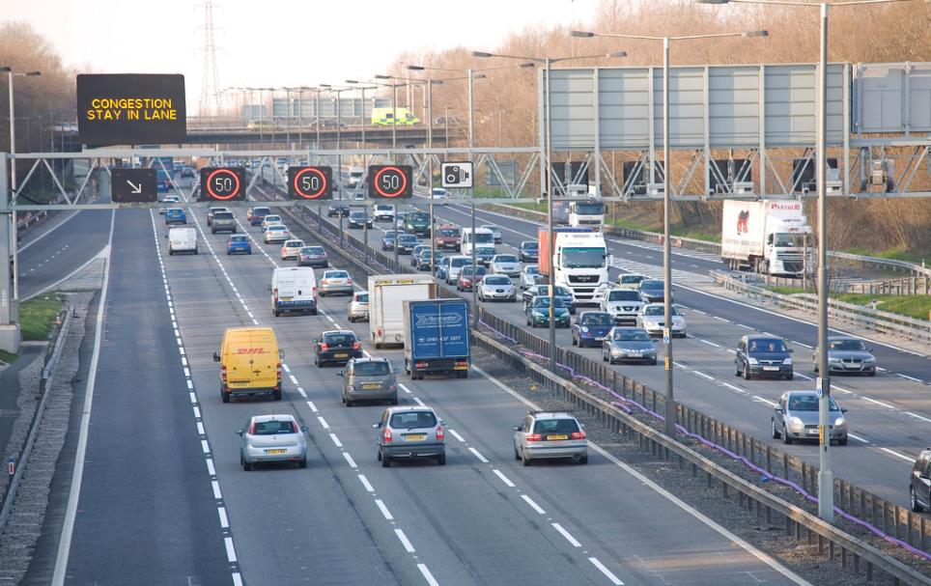
Common Cause Variation

Slide 35
Common Cause Variation
Inherent in the design
Due to regular, natural or ordinary causes
Affects all the outcomes of a process
Stable process that is predictable
Also known as random unassignable variation

Slide 36
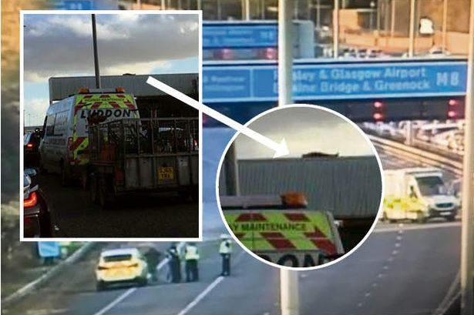
Special Cause Variation

Slide 38
Special Cause Variation
Due to irregular or unnatural causes
Affect some but not all aspects of the process
Results in an unstable process that is not predictable
Also known as non-random or assignable variation

Slide 39
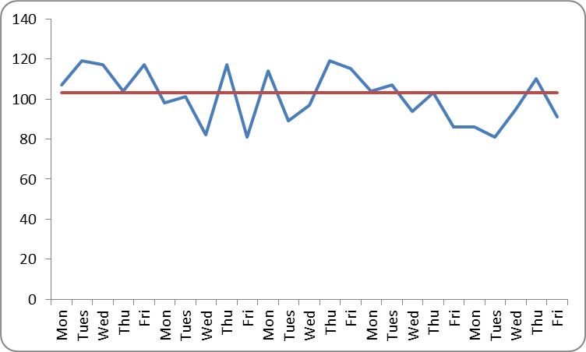
Run Charts
Display data to make process performance visible
Centre line is the median
Usually time is represented along the bottom
Notes:
Can be started as soon as you have data - to facilitate learning as soon as possible

Slide 40
Practical 3 Exercise : 15 Mins
In teams:
Build a run chart
ALL TEACH ALL LEARN
Notes:
60 mins
15 Buzz every 15 mins
Then 5
15
5
15
5
Prompt movement from C to L to E to A to R
to coach plus 5 to feedback

Slide 41
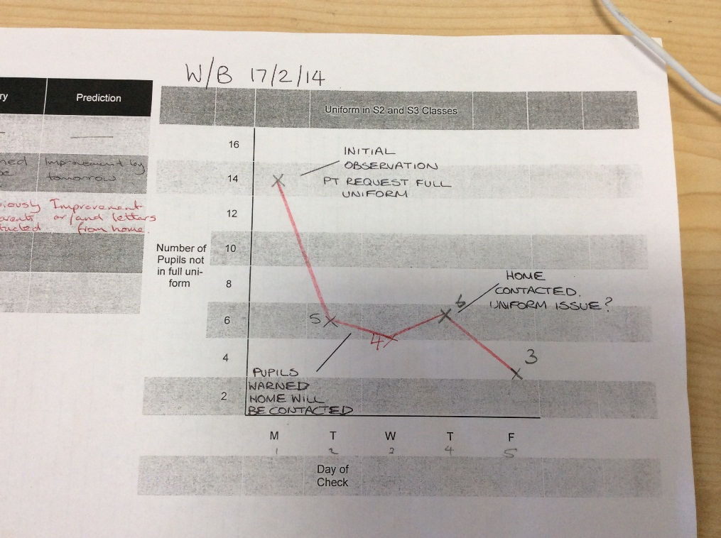
Start with a bit of paper!

Slide 42
RUN CHART EXAMPLE
Months | Percentage | Notes
Apr-14 | 48
May-14 | 46
Jun-14 | 48
Jul-14 | 5
Aug-14 | 50
Sep-14 | 63 | Event 1
Oct-14 | 65
Nov-14 | 25 | Event 2
Dec-14 | 48 | Event 3 & 4
Jan-15 | 58
Feb-15 | 60 | Event 5
Mar-15 | 65
Apr-15 | 72
May-15 | 75
Jun-15 | 78 | Implementation starts
Jul-15 | 80
Aug-15 | 65

Slide 44
Run chart rules to spot non-random variation
44
Notes:
HANDOUT contains these charts, and the table for numbers of runs.
Because they are simple to make and relatively straightforward to interpret, run charts are one of the most useful tools in quality improvement. They allow us to:
Display data to make process performance visible
Determine if a change resulted in improvement
Assess whether improved performance has been sustained
Run charts are line graphs where a measure is plotted over time, often with a median (the middle value of those plotted so that half are above and half are below) also shown.
Changes made to a process are also often marked on the graph so that they can be connected with the impact on the process. Often a change can be seen by visual inspection alone.
If we have at least 10-12 data points on our graph, run charts can also be used to distinguish between random and non-random variation using four simple rules. Different versions of these rules are used in different places so you may encounter different sets in other books or papers you read. However Improvement Guide and the Health Care Data Guide and by the Institute for Healthcare Improvement provide the following rules and the Non-random variation can be recognised by looking for:
A shift: six or more consecutive data points either all above or below the median. Points on the median do not count towards or break a shift.
A trend: five or more consecutive data points that are either all increasing or decreasing in value. If two points are the same value ignore one when counting.
Too many or too few runs: a run is a consecutive series of data points above or below the median. As for shifts, do not count points on the median: a shift is a sort of run. If there are too many or too few runs (i.e. the median is crossed too many or too few times) that's a sign of non-random variation. You need to look up a statistical table (see Perla et al, 2011) to see what an appropriate number of runs to expect would be. An easy way to count the number of runs is to count the number of times the line connecting all the data points crosses the median and add one.
An astronomical data point: a data point that is clearly different from all others. This relies on judgement. Every data set has a highest and lowest. They won't necessarily be an astronomical data point. Different people looking at the same graph would be expected to recognise the same data point as astronomical (or not).
Since using these rules requires you to have 10-12 data points at least on your run chart it is important to collect data as frequently as possible. If you collect data only once a month that would be 10 months, if weekly, 10 weeks (2½ months). However this needs to be balanced with keeping denominators (the number of values contributing to each data point) for percentages (or rates) above ten or so to minimise random variation due to small sample size.
Run charts are a powerful tool for detecting non-random variation and so sufficient for most improvement projects. However they are not so sensitive in detecting special causes as a second type of chart named after Walter Shewhart, who did early work in industry to develop the methods.

Slide 45
Shift

Slide 47
Astronomical
point

Slide 48
Run 1

Slide 49
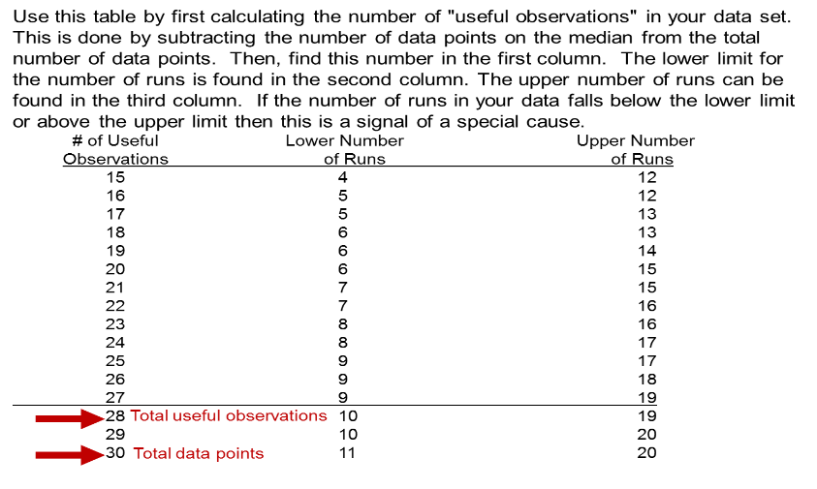
Too few or too many runs
Notes:
49

Slide 50
Run 1

Slide 51
Measures - Things to consider
Who will be responsible for data collection?
What is the data source / how will the data be collected?
Frequency of data collection, and timings?
Equipment needed to measure?
How can data collection be integrated with work?
What factors might influence the measure?

Slide 52
Practical 4 Exercise : 10 Mins
In teams:
Agree what measure, who , when and how
Notes:
60 mins
15 Buzz every 15 mins
Then 5
15
5
15
5
Prompt movement from C to L to E to A to R
to coach plus 5 to feedback

Slide 53
All Teach, All Learn
Questions?

Slide 54
Programme design and key dates
Action Period 2
Action Period 3
Action Period 4
Action Period 5
Welcome Overview
Workshop 1
Workshop 2
Workshop 3
Sharing Workshop
Showcase
September
11th Oct
5th Nov
6th Dec
10th Jan
4th Feb
TBC
TBC
Support
National IA Leadership Team Q.I. Faculty
QI Hub (TURAS) (Falkirk) GIRFEC Homepage
All teach all learn

Slide 55
Plan for Action Period 2:
Develop measurement plan and start to measure and plot over time. Continue to refine aims and look to develop Driver Diagram/s with other measures.
Regular Improvement Team meetings
Revise and review driver diagram
Read and learn
How are you going to share?
Notes:
Next Webex focussed on project charters, using the knowledge network, evaluation

Slide 56
NEXT STEPS – 10 mins

Slide 57
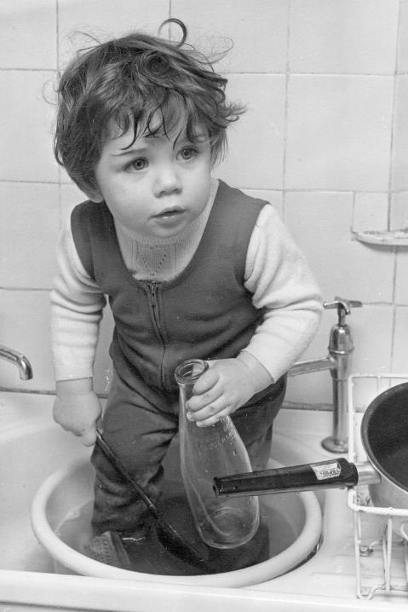
Session 2 - time to wash up…..
What went well…………..
Even better if……
Questions?

Slide 58
By the end of this session you will…….
Have a STAN aim and strong Driver Diagram (theory of change)
Understand how your measurement plan is linked to your change theory
Enhance knowledge of run chart rules and measures
Leave with an action plan for Action Period 2.

