Slide 1
Working with Violent Men
Jim McCormick & Jeanette Myles
CJSW Brockville

Slide 2
Why work with perpetrators?
Manage Risk
Effect change
Prevent further victims
Better outcomes for women and any children

Slide 3
Caledonian System
The Caledonian takes the form of an intervention system comprising:
1. A programme of intervention work with men lasting at least two years, comprising pre-group preparation and motivation sessions; a group-work programme of twenty-six sessions and post group maintenance work.
2. A service to women partners, ex-partners and children including personal contact from women’s and children’s services workers.
3. The development of interagency protocols coupled with training, designed to maximise women’s and children’s safety and thus reduce the opportunity for, or likelihood of, men re-offending.

Slide 4
Caledonian Men’s Programme
A Programme that addresses a mans abusive behaviour.
Run by the local authority and Scottish Government funded.
Delivered in Forth Valley to all men who receive the programme as a condition of a Community payback order (CPO) in court following a domestic charge.
2 year programme. A requirement of CPO or a Licence condition
The Man should be fully committed and motivated to complete the groupwork.
14 weeks pre group followed by 6 months group, them maintenance for remainder of order.

Slide 5
Role of Case manager
• Forging and sustaining a working alliance with each man.
• Liaison with women’s service workers through client liaison meetings.
• Risk assessment and risk management.
• Delivering pre-group sessions
• Supporting men joining the group and during the group.
• Managing attendance./compliance
• Dealing with violence and other critical incident reports.

Slide 6
Role of Men’s group worker
• Delivering the group-work elements of the programme
• Liaising with women’s service workers.
• Managing attendance and informing case managers of men’s absences.
• Reporting on each man after each session and at the end of the group.
• Meeting with women partners
• Dealing with critical incident reports/ Managing risk
• Contributing to CPO/licence reviews during and at the end of the programme.

Slide 7
Working with resistance
Shields
Denial
Minimisation
Blame

Slide 8
Women's service role
To identify risk and increase safety (using a risk assessment tool). Based on research of intimate partner violence
To Gather the woman's views on his behaviour
Voluntary service and women do not have to work with the IDDA
To be a advocate offering emotional and practical support
To refer any children to the children’s worker or relevant agency as local to the family and school

Slide 9
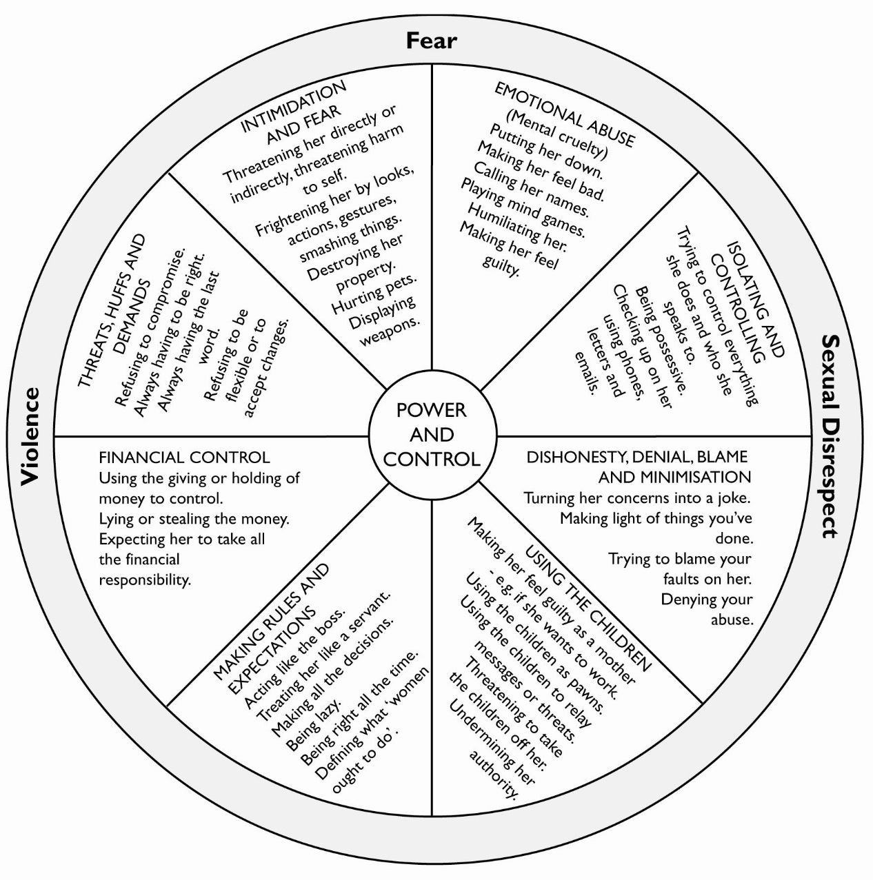
Power & Control Wheel

Slide 10
Context
In 2016-17 there were 58,810 incidents of domestic abuse recorded by the Police Scotland. Less than half of these incidents go on to be recorded as a crime or offence.
In 2015-16 there were 12,374 domestic abuse convictions (domestic abuse as main aggravator), 87% of which were against men.
Conviction levels are 44% higher than in 2010-11. This reflects an increase in breach of the peace convictions, particularly offences of threatening or abusive behaviour or stalking. 44% convictions were for BOP, 30% for assaults.
Domestic abuse is the third highest ground for referral to SCRA , and of all of the children on the Child Protection Register in July 2014, the most common concerns related to parental substance misuse, emotional abuse, and domestic abuse (Watson, 2017).
Estimated that one in four women will experience domestic abuse in her lifetime: Huge financial and social costs.

