Slide 1
Pupil Equity Fund: Falkirk

Slide 2
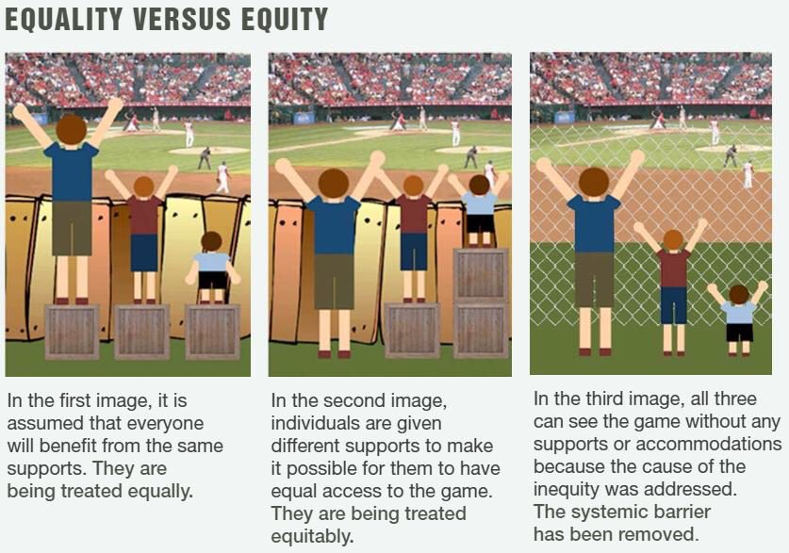
Notes:
Keep in mind the reason for the funding
Removing barriers to learning

Slide 3
Notes:
Impacts of are poverty is real:
ACE (adverse childhood experiences) study, impacts on mental health, workforce, citizenship

Slide 4
Poverty and Neglect
There is a strong correlation between poverty and neglect
Poor children are 44 times more likely to experience neglect (National incident study III, 1996)
It is important, however, to note that most poor families do not maltreat their children. (NIS-III)
www.dhs.state.mn.us

Slide 5
What is meant by the poverty related gap?
Poverty as a barrier to learning is not purely financially related.
We need to view this widely; examining all barriers to learning in a child’s life which is preventing them from thriving.

Slide 6
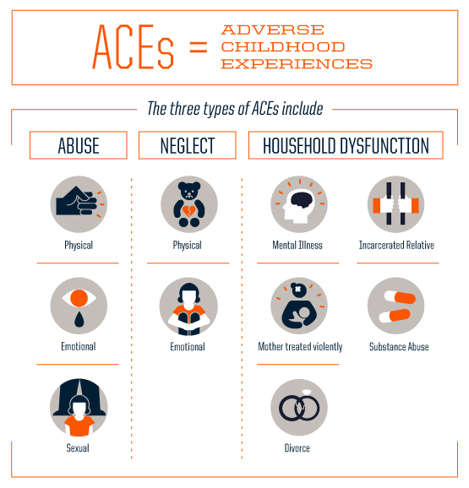
Notes:
Links between ACEs and poverty

Slide 7
Closing the Equity Gap
Providing high quality learning and teaching
Providing focus and support targeted to learning needs
Improving early learning
Promoting social and emotional wellbeing
Promoting healthy lifestyles and tackling health inequalities
Identifying and driving strategies to improve attainment in literacy and numeracy
Promoting use of evidence and data
Developing employability skills and improving positive and sustained destinations
Engaging families and communities
Working with partners to explore new and innovative approaches to tackling inequity
Developing professional learning and leadership at all levels
Conducting and using research
Notes:
Education Scotland's focus:

Slide 8
POVERTY RELATED GAP IN FALKIRK
17% of pupils Free School Meal Entitlement (FSME), ranging from 11% - 25%
61 out of 62 schools in receipt of funding, ranging from £1,200 to £152,400
98% of schools with funding, requiring support for data, financial management and tracking
£3,538,800 funds, 2,949 pupils
Two Scottish Attainment Challenge schools
Notes:
Impacts of poverty is real:
ACE (adverse childhood experiences) study, impacts on mental health, workforce, citizenship

Slide 9
FUNDING RANGE
Primary FSME
Lowest: 5% Kinnaird, £31,200
Highest: 48% Langlees, £132,000
Average: 21%, £55,680
Secondary FSME (S1-3)
Lowest: 9% Braes, £58,800
Highest: 21% Falkirk, £152,400
Average: 13%, £90,450
Notes:
Balance of funding and pressures on schools with significantly high FME numbers

Slide 10
‘Poverty is not an accident. Like slavery and apartheid, it is man-made and can be removed by the actions of human beings.’
Nelson Mandela
Notes:
We have the power to change

Slide 11
PLANNING & TRACKING SPEND
61 with PEF and approx. 250 interventions
Need to gather overview of all programmes
Categorise to monitor and report
Create a toolkit to support schools

Slide 12
DATA
Split programmes into three sections:
  Across all
  Literacy & Numeracy
  Health & Wellbeing
Compiled data to include:
  Spend
  Jobs
  Cluster allocations
  Partnerships

Slide 13
Health & Wellbeing Data
66% of programmes focusing on Inclusion and Family Engagement
30% of programmes focussing on Mental Health & Nurture
‘Young people living in poverty do not engage in wider achievement opportunities. 54% of our young people live in SIMD 1-3, we believe that the addition of a Wider Achievement Teacher will make a significantly positive impact to achievements of the majority of our young people.’
Falkirk High School, Scottish Attainment Challenge Secondary School

Slide 14
MONITORING & REPORTING
Areas of focus to monitor impact
  Attainment
  Attendance
  Inclusion/exclusion
  Participation (wider school life)
  Engagement (families)
Internal reports generated in January & June 2018

Slide 15

Collaboration
Notes:
To create change we need to collaborate

Slide 16
What does effective collaboration look like and what steps do we need to take to achieve it?
Notes:
In groups of 4 discuss and write answers on post its and then feedback. 10 mins?

Slide 17
Case Study Challenge
Forth Valley Primary School has received £136,800
80% of their pupils live in SIMD 1 &2
Numeracy stats are below. Create an aim and plan for partners who would be involved to reduce the poverty related gap.
 | 2014/15 | 2015/16 | 2016/17
Above expected level | 22% | 21% | 23%
Expected level | 45% | 49% | 50%
Below expected level | 33% | 30% | 27%
Notes:
Create and aim and a plan of who would be involved 15 mins then present.

Slide 18

Notes:
Schools can’t make the change on their own, collaboration is vital

Slide 19
ANY QUESTIONS ?
Contact details:
Gayle Martin-Brown
Education Support Officer
t). 01324 590654
e). gayle.martin@falkirk.gov.uk

