Slide 1


Slide 2



Falkirk Families Information Service launched March 2015 (previously Falkirk Childcare Information Service)
Falkirk Families Information Service is an online directory and telephone helpline providing free, impartial and useful information for families across the Falkirk Council area, including:-
organisations and services
childcare providers
activities
helplines
signposting to other useful websites
The online directory (website) is funded by the Scottish Government.
The service is part of Falkirk Council Children’s Services.

Slide 3
An early intervention universal access point to family information continues to be a priority
Scottish Government Early Years Framework (2009)
Falkirk Children’s Commission
Falkirk Parenting Partnerships
Falkirk Integrated Children’s Service Plan
The role of the Families Information Service also links with key priorities relating to engaging with parents, included in the Children and Young People Scotland Act (2014) and National Parenting Strategy (2012).

Slide 4

What we do
Publish information on a range of topics including family support, childcare, additional support needs, activities, helplines.
Take enquiries through telephone helpline, website and email and supplying information, advice, guidance and signposting to other services.
Regularly add, update and check all information published on the online directory.
Share information through additional methods including email and meetings.
Regularly research information which may be suitable for families, practitioners and services including checking websites, newsletters, e-bulletins and leaflets.
Network with services to promote the role of FIS and services and the area.

Slide 5
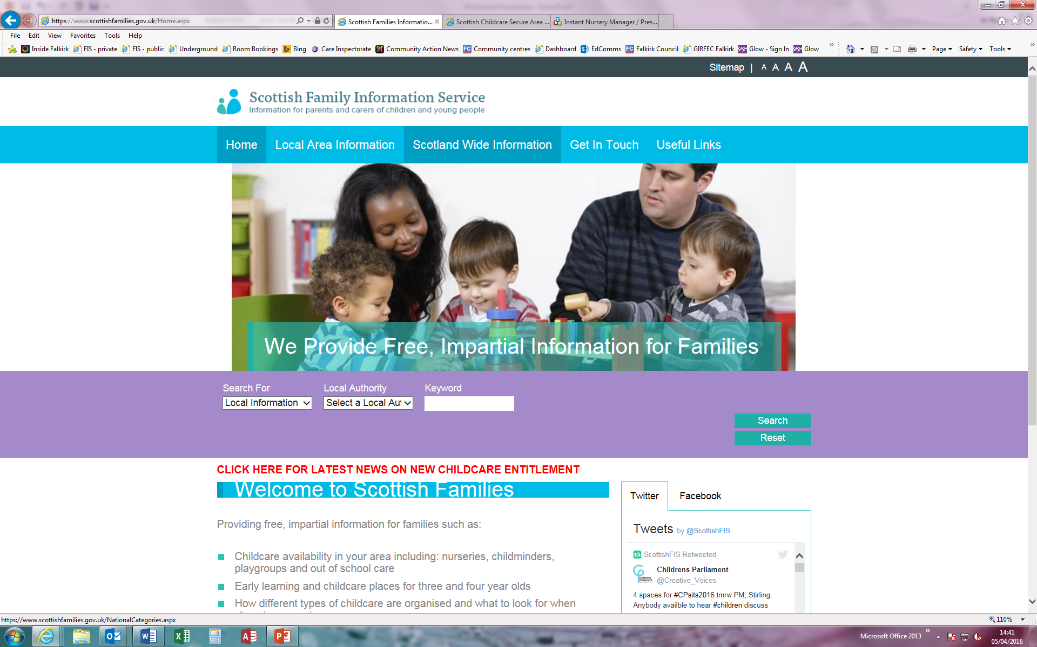
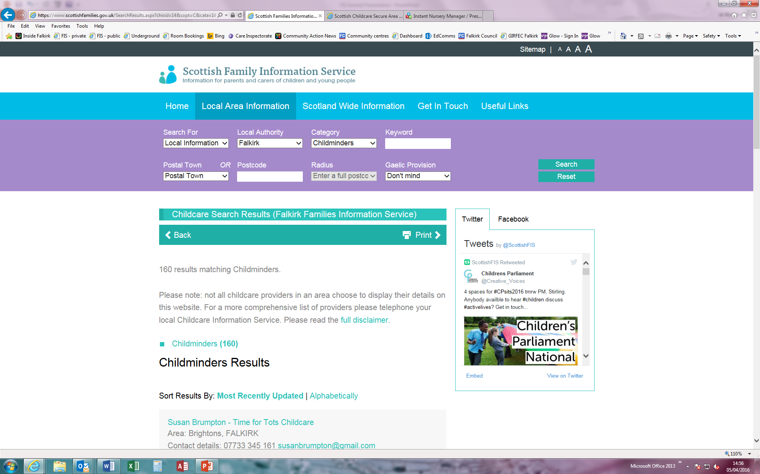
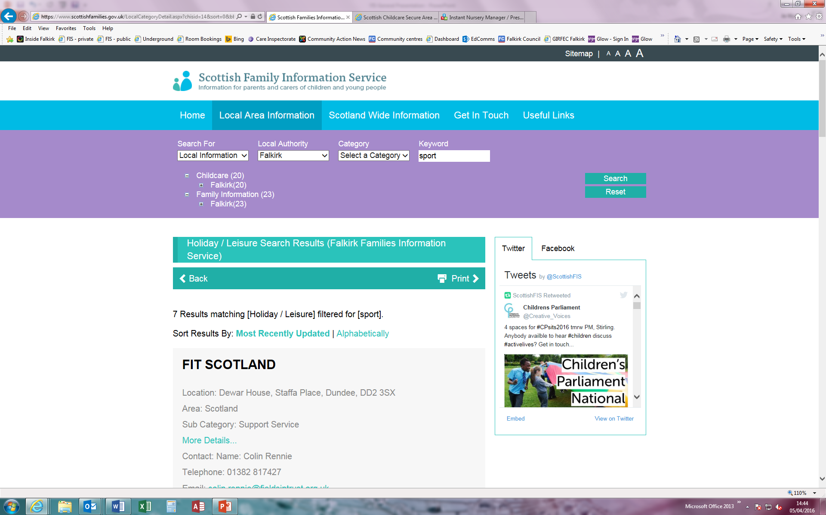
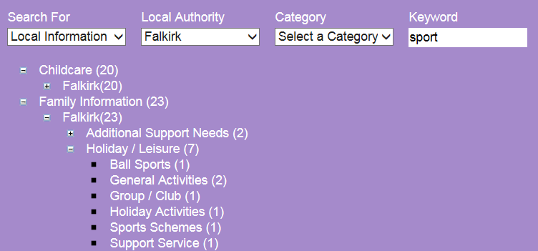
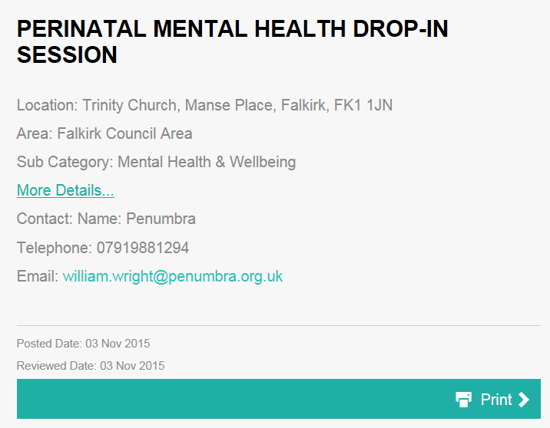
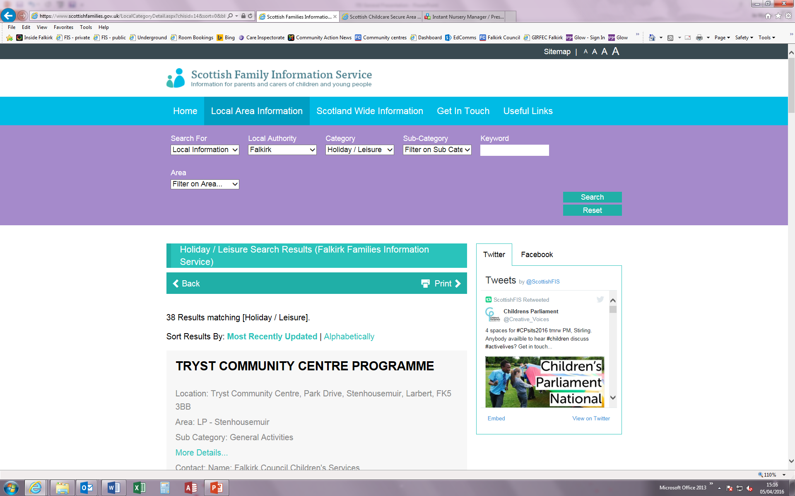
How to use the website
Searching for childcare offers a postcode or postal town search as well as type of care
Select Falkirk from the list
Type Keyword with no Category
Once you find the entry you are interested in, click the More Details button to view full details
Click on + to expand list(s)
Click on a heading to view entry
You can also include Sub-Category and Area as part of your search

Slide 6
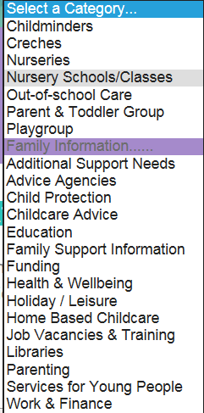
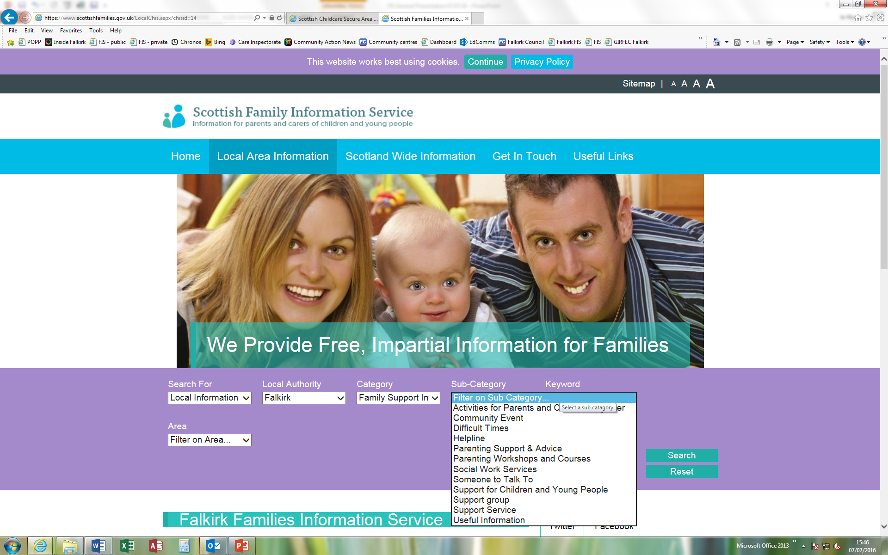
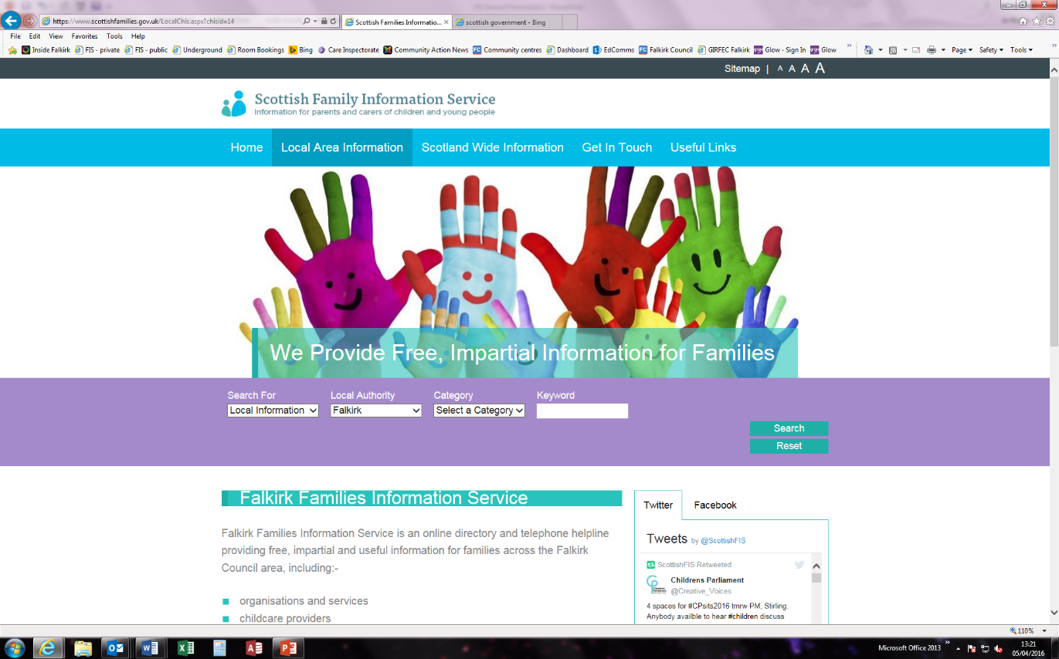
Using the website – www.scottishfamilies.gov.uk
There are different options for searching on the website –
Your search will depend on the type of query you have.
Choosing from the list will limit the search to only those
entries which match that particular category.
You can then search by a sub-category i.e. if you choose Family
Support Information as a category then click on Sub-Category
a further list will be shown.
Searching by keyword will show all entries that have the
keyword entered, no matter what category they are listed under.
>>> You can choose from the Category list and type a keyword to limit your search further.
Examples
If you choose Health & Wellbeing category the search results will show 100 items.
If you then choose Mental Health & Wellbeing sub-category, 5 results will be shown.
Typing stress in the keyword box will show you 2 results.
But if you only choose the category and keyword, 9 results will be shown.
If you only type stress in the keyword box, 19 results will be shown in 6 different categories.

Slide 7
How we publish
When publishing information we aim to have the main keywords for that entry added e.g. if a group offers benefits advice we might add the words finance, funding, benefits, advice, money.
Entries may also be added onto several categories e.g. a family support service who offer parenting sessions, healthy eating sessions and benefits advice may be added to four categories; Parenting, Health & Wellbeing, Family Support Information, Work & Finance. We can also allocate a sub-category (e.g. Category Parenting has sub-category option Course, Classes, Programmes).
What to search for?
The main thing to think about is WHAT you are looking for:-
What is the issue? – type of problem, family issue, concern.
What type of support is required? - group, session, advice, activity.
* * We would recommend that you do not search for a specific age or location e.g. 3 years, Bainsford as it is likely that services/groups have only indicated an age range and general area e.g. from birth to 5 years, primary 1 to primary 3, Falkirk Council area, Denny area, Braes area.

Slide 8
E x a m p l e s
You are working with a family who have a 4 year old child who is having behavioural issues.
  Do you feel the child should attend a group/session?
  Would mum/dad benefit from attending a group/session?
  Do mum/dad need a little advice as behaviour issues have only just started?
  Has the reason for child’s behavioural issues been identified therefore support is needed for this issue (finance, separation, unemployment) rather than the behaviour?
  Search Category – Family Support Information, Health & Wellbeing, Parenting.
  Search Keyword – behaviour, counselling, issue identified, session.
A young parent has moved into the area and has no family or friends and you feel he would benefit from attending a class to interact with others.
  Is he interested in sport?
  Would a computer class help?
  Is he a lone-parent?
  Search Category – Holiday/Leisure.
  Search Keyword – class, activity, sport, lone-parent, computer, dad, isolation.

Slide 9
WE NEED YOU!!!
Falkirk Families Information Service is your online directory
If there is something missing or you’d like to see more information, we need your help.
Do you have ideas or suggestions on what should be on FIS?
Let us know ☺
Do you know of any groups, services or events that is in your area?
Let us know ☺
Already have details on FIS but have new information?
Let us know ☺

Slide 10
WHAT WE NEED
Information for families in Falkirk
* Activities * * Groups * * Websites * * Tips * * Advice * * Guidance *
* Events * * Services * *Agencies * * Consultations *
* Training * *Local Information * * National Information * * Leaflets *
* Booklets * * Newsletters * * Bulletins *
~ ~ ~ ~ ~ ~ ~ ~ ~ ~ ~ ~ ~ ~ ~ ~ ~ ~ ~ ~ ~ ~ ~ ~ ~ ~ ~ ~ ~ ~ ~ ~ ~ ~ ~ ~ ~ ~ ~ ~ ~ ~ ~
* Additional Support Needs * * Advice Agencies * * Child Protection *
Childcare Advice * * Education * * Family Support Information *
* Funding * * Health & Wellbeing * * Holiday / Leisure *
* Job Vacancies & Training * * Libraries * * Parenting *
* Services for Young People * * Work & Finance *

Slide 11

* * T h a n k Y o u * *

