Slide 1
Five to Thrive
Falkirk Community Planning Partnership – SOLD Plan 2016-2020
Falkirk Children’s Commission – ICSP 2016-2019
VISION
We want every child and young person to have an enjoyable, fulfilling life in a nurturing, healthy and safe environment. We will encourage children and young people to achieve their potential and make a positive contribution to society.
OUTCOME
Our children, particularly those who are vulnerable, have:
* the best start in life
* achieve their potential
* develop into resilient, confident and successful adults.
Notes:
The Community Planning Partnership is the strategic multi agency group that leads on all we do in Falkirk.
The CPP produces the Strategic Outcome, Local Delivery (SOLD) (previously the SOA) Plan.
Falkirk Children’s Commission is a subgroup of the CPP (there are 6 subgroups). The Children’s Commission is tasked with the multi agency strategic leadership of what Scottish Government calls ‘children’s services’ across the Commission. We call this integrated Children’s Services because in Falkirk Children’s Services is known as social work and education.
The CPP and the Commission have one outcome for children. The ICSP is currently being finalised. We are waiting on the outcome of our recent inspection and for the SOLD to be signed off by the CPP.
The SOLD and ICSP are the 2 plans that should drive all of our work. Our other plans should sit underneath these 2 and should reflect the priorities in the SOLD and the ICSP:
ICSP Key Priorities:
• Improving mental health and wellbeing (SOLD)
• Maximising job creation and employability (SOLD)
• Substance misuse (SOLD)
• Address the impact of poverty on children and young people (SOLD)
• Inclusion
• Corporate Parenting
• Neglect.

Slide 2
Falkirk Attachment Definition
The emotional bond and care everyone needs to have healthy brain development and relationships.
Notes:
This simple definition was agreed upon by the Five to Thrive Steering group and the Children’s Commission Leadership Group in 2015.

Slide 3
Five to Thrive Falkirk – Why?
Children’s healthy development is dependent on healthy brain development and healthy relationships.
Poor attachment carries significant health and economic costs for children. Children who then become future parents.
Furnival et al, 2012, advises an attachment informed approach for all staff including universal services is the best way to ensure early intervention for children with various levels of need
Build on existing knowledge and good practise to formally develop a common language and embed tools that support attachment informed practise.
Build confidence in staff to discuss attachment with families.
Discuss attachment with parents during assessments.
Five to Thrive - framework to develop attachment informed practise with all staff across the Children’s Commission.
Notes:
It is well researched an documented how important positive attachment is to a child or young person.
We want to make sure every practitioner has the tools to help them pass on the knowledge about brain development and positive attachment to all parents.
By sharing the science we can empower parents to support their children. Feedback in Renfrewshire form parents was’ why did no one tell us this?’
We want to tell as many parents as possible that they have the skills to help their baby/ child/ young person’s brain develop and to build a bond with their child.

Slide 4
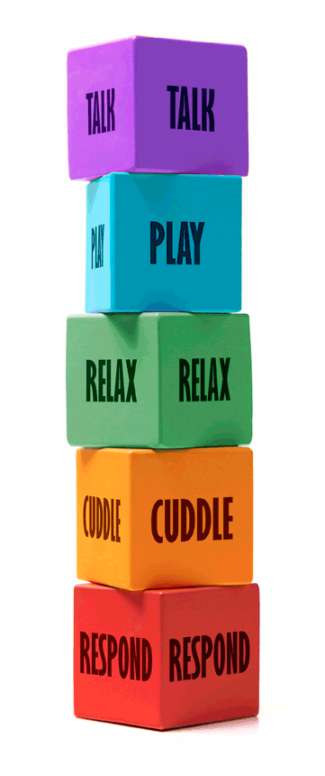
It’s GIRFEC
Notes:
Five to thrive isn’t new. It’s based on years of neuroscience and research. It’s a tool to put the science into practise.
It supports GIRFEC and the Children and Young People (Scotland) Act 2014 – it helps support, promote and safeguard wellbeing.

Slide 5
Five to Thrive – What is it?
A sequence of relational activities that build healthy brains in young children and maintain healthy brain function throughout life
A bridge between professional understanding of neuroscience and everyday experience. Gives us the ‘doing bits’ based on the science
Provide practitioners, parents and families with an accessible way of recognising how the quality of their engagement can make a huge difference to healthy brain development, particularly in the first years of life
Every interaction can become an opportunity to reinforce positive development, to share information, and to model behaviours that will help bring about positive change from one generation to the next.

Slide 6
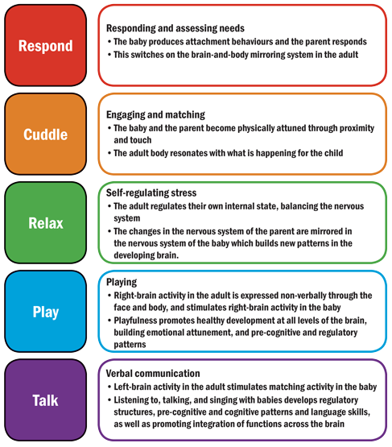
Five to Thrive
Start from the bottom block

Slide 7
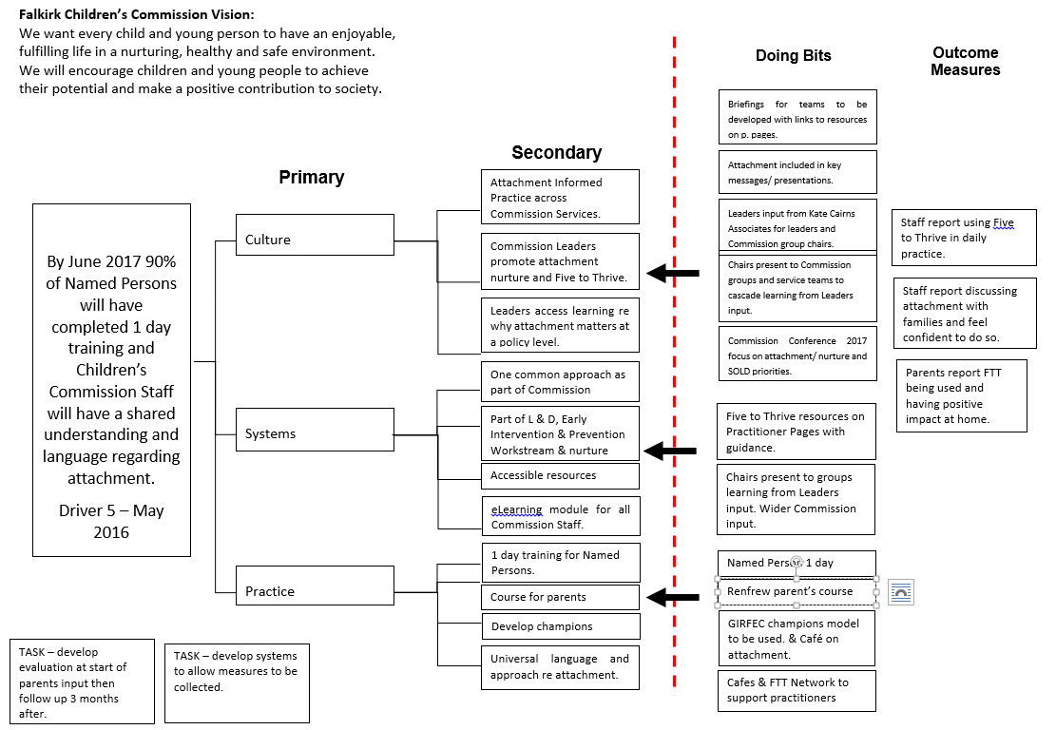
Notes:
This is the driver diagram developed by the Five to Thrive Steering Group.
This is the Five to Thrive work that will take place in picture form from the Aim to the doing bits and what we want to measure to know if we have made an improvement.

Slide 8
Five to Thrive: Overview of activity in Falkirk 2016
Core emodule
Brain Development & Positive Parenting
online and paper resources
Resources, Ideas and examples on practitioner pages
other modules
Share practice
Five to Thrive network.
(12 week
course)
parents
To be finalised but including: Adolescence and Trauma.
Presentations 30 mins, 1hr, 2hr - Five to Thrive Champions
Sign up for Falkirk FTT on website complete questionnaire
Emodule: Brain development & positive parenting completed & certificate
Open access to 5 emodules is unlocked

