Slide 1
Nurturing Principles
Educational Psychology Service
Nurture Steering Group
Susan Morrison, Gail Hendry, Educational Psychologists
Additional Development by Magda Olejniczak, Hannah Bertram and Rhoda Marshall, Educational Psychologists Nick Balchin, Principal Educational Psychologist

Slide 2
Course overview
Date and time | Content | Who will attend
24/2/2016 - 4:00-6:00pm Graham High School. | Attachment | Wave 2 Project Team
23/3/2016 - 4:00-6:00pm St Bernadette’s RC PS. | Assessment of Need for Nurture Boxall Profile | Wave 2 Project Team Wave 1 participants who missed Reconnect in November/December
20/4/2016 - 4:00-6:00pm St Bernadette’s RC PS. | Nurturing Principles | Wave 2 Project Team
18/5/2016 - 4:00-6:00pm St Bernadette’s RC PS. | Nurturing in Practice. Approaches for whole school: Nurture Classes, Groups, Spaces and Nooks, Nurture practices in mainstream classes | Wave 2 Project Team
TBC October 2016 | Reconnector Session | Wave 2 Project Team

Slide 3
Overview
Review of Attachment Theory
Introduction to the Six Nurturing Principles
Implications for practice and teaching style

Slide 4
Learning Intentions
By the end of the session participants should be able to:
Define the six nurture principles
Apply understanding of attachment theory and links this to nurturing principles
Identify ways in which nurture principles can be embedded into classroom practice
Identify evidence based strategies which link to nurture principles and can be implemented within the classroom context

Slide 5
Nurture…

Slide 6
Why focus on Nurture Principles in Education?
Highlights the importance of social environments
Nurture offers opportunity to learn the early nurturing experiences some children and young people lack
Models skills essential for the child to achieve success
Enhances confidence
Promotes skills to do well at school, make friends and deal more confidently and calmly with the trials and tribulations of life, for life.

Slide 7
The Nurturing Principles
Principle1
Children’s learning is understood developmentally
Principle 2 The classroom offers a safe base
Principle 3 Nurture is important for the development of self-esteem
Principle 4 Language is understood as a vital means of communication
Principle 5
All behaviour is communication
Principle 6 Transitions are significant in the lives of children

Slide 8
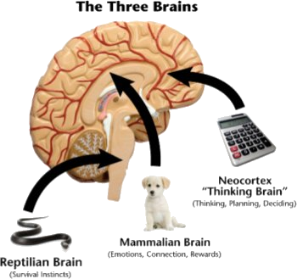
Recap
Attachment is one of the most critical developmental tasks of infancy
(Dr Joy Osofsky)
Every child needs at least one person who is really crazy about him or her (Bronfenbrenner, 1977)
Secure attachments provide:
Safe haven & secure base from which to explore & engage
And encourage development of:
Trust & confidence that adults will help
The ability to manage feelings
Coping & problem-solving skills
Autonomy
Self-efficacy

Slide 9
Nurture Principle One : Children’s Learning Is Understood Developmentally
Review of Attachment and Brain development
Activity: Identify what you learned from the session on attachment theory and how this impacts on children’s development
Identify implications for practice and teaching style
Notes:
10 mins

Slide 10
Brain Scan of 3 year olds

Slide 11
Nurture Principle One : Children’s Learning Is Understood Developmentally
If children live in a chaotic or threatening world, one in which their caregivers respond with abuse or chronically provide no response, their brains may become hyperalert for danger or not fully develop. These neuronal pathways that are developed and strengthened under negative conditions prepare children to cope in that negative environment, and their ability to respond to nurturing and kindness may be impaired (Shonkoff & Phillips, 2000).

Slide 12
Nurture Principle One : Children’s Learning Is Understood Developmentally
The Impact Of Trauma on development
Potential challenges with self monitoring and self –regulation
Impulsivity, inconsequential behaviours, attentional control
Impact on social, emotional and cognitive development
Difficulties engaging with typical reward/sanction models of intervention productively and meaningfully. If rewards are not achieved we as practitioners are in danger of reinforcing the child’s negative representation e.g. “I am bad, I am worthless”
All children need relationships to thrive; traumatised children need relationships to heal (Bowlby & Hughes, 2013)

Slide 13
Nurture Principle One : Children’s Learning Is Understood Developmentally
Role of Key Adults: Dependency
Genetic predisposition to form strong attachments
Neglect or repeated trauma – impacts this ability
Lack of activation of neural connection leads to diminished capacity
Early attachment experiences forms the blueprint of future relationships
Impact on behaviour – research indicates a need to change approach to managing behavior

Slide 14
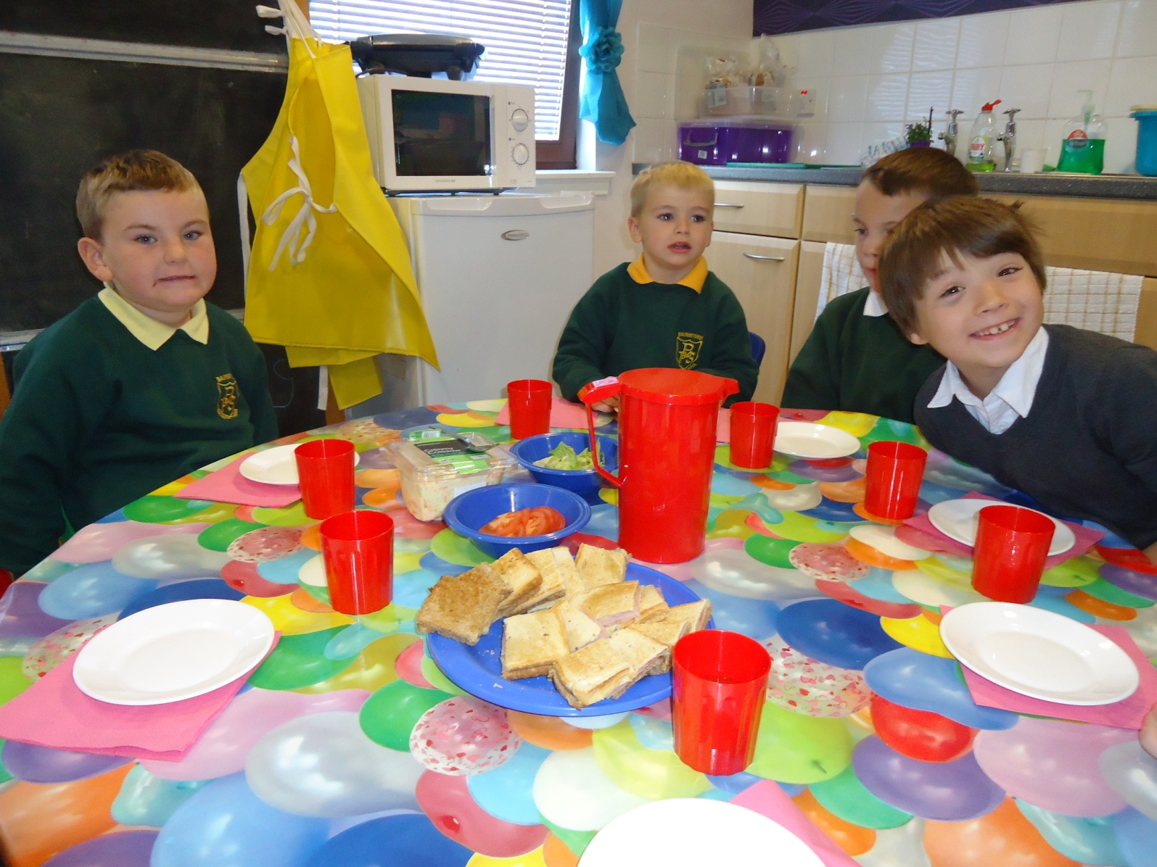
Nurture Principle One : Children’s Learning Is Understood Developmentally
Nurturing relationships can bring about meaningful change – foster a real understanding of development needs and clear differentiated opportunities
Nurturing relationships are modelled by staff through consistent and positive interactions
Expectations are reviewed, appropriate targets are set and shared with all staff

Slide 15
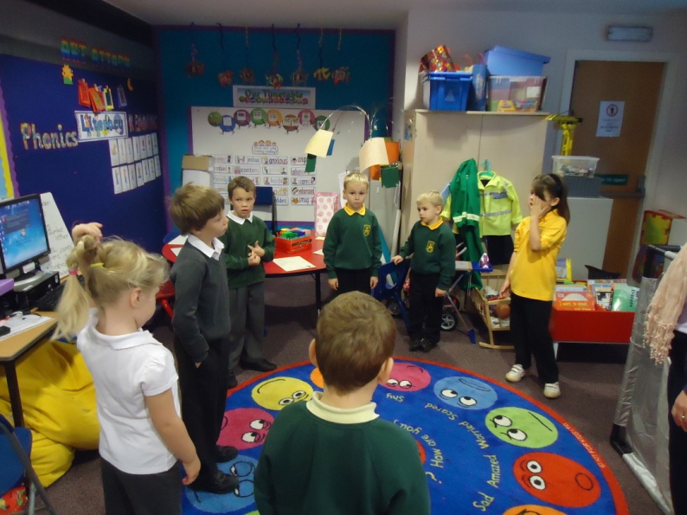
Nurture Principle One : Children’s Learning Is Understood Developmentally
Considering A Relational Or Behaviourist Approach
“If relationships are where things developmentally can go wrong, then relationships are where they are most likely to be put right.”
Howe, 2005

Slide 16
Nurture Principle 2: The Classroom Offers A Safe Base
Activity
Story of Ben– what do you the response may have been and the impact of that response?
If you had a visitor to your class, how would they know that a safe base had been created (what would they see? What would pupils experience?)
What makes you feel safe and that you belong?
In groups using the flip chart paper provided record your thoughts and ideas

Slide 17
Nurture Principle 2: The Classroom Offers A Safe Base
A welcoming and safe environment for everyone which permeates beyond the classroom and is evident in all aspects of the school environment.
The child will be claimed and kept in mind at all times
Set boundaries and predictable routines. Expectations are clearly articulated and delivered. Staff respond to pupils fairly and sensitively providing clear rationale and supportive commentary. Emotional warmth is key even when the message may create conflict or be difficult to process.

Slide 18
Nurture Principle 2: The Classroom Offers A Safe Base
Staff will demonstrate effective attunement. They will be highly sensitive to the child’s need and support potential escalation through use of positive body language and ‘wondering aloud’
Visual support to delineate change and provide structure to the day.
Support, modelling and guidance by key adults
Active promotion of nurturing relationships for all children

Slide 19
Break ☺

Slide 20
Nurture Principle 3: Nurture Is Important For The Development Of Self-Esteem
If you have an envelope on your desk – can you open it, read it and put your hand up
Thank you in advance

Slide 22
Nurture Principle 3: Nurture Is Important For The Development Of Self-esteem
The overall approach should balance the need to support self-esteem and provide challenge and develop resilience as appropriate
Activity
In pairs: Consider a time of personal challenge which you feel comfortable with sharing
Reflect on the social implications and emotions attached to this situation
Which factors were important in resolving this challenge.
What do you notice?

Slide 23
Nurture Principle 3:
Nurture is important for the development of self-esteem
Reinforcement and feedback is clear and consistent with task
A high level of positive attention and commentary. Focus placed on incremental progress : Joint target setting and review
Identifies and shares personal achievements
Celebration of success: Consistent concrete feedback to enhance social and emotional competencies
Build opportunities for success – notebooks
Support is given to gently challenge negative representations to re-frame stories and build skills and strengths.

Slide 24
Nurture Principle 4:
Language is understood as a vital means of communication
In pairs discuss the comment on your desk
Reflect on the impact this communication may have on the young person
How would you re-frame this communication into a nurturing interaction?

Slide 25
Nurture Principle 4:
Language is understood as a vital means of communication
All communication should rooted in nurture. Development of respectful, consistent positive interaction.
Clear articulation of expected behaviours: Careful listening, clarifying, summarising, checking out.
Children and young people are given the appropriate level of support and challenge to develop these behaviours and these opportunities should be noted in planning.
Language is framed to support with the expression of emotions.
Language used is clear, explicit and developmentally appropriate.
Communication should envelope core strands of nurturing communication: Claiming, Attunement, Resilience, Emotional Regulation and Social Skills Development

Slide 26
Nurture Principle 5: All Behaviour is Communication
Personal and group task from Session Two
Initial Reactions to the assessment tools
- e.g. user friendliness, time, relevance, challenges
What were your key findings and how would you relate these findings to the nurture principles and understanding of attachment theory.

Slide 27
Nurture Principle 5:
All Behaviour is Communication
Behaviours can mask true feelings
In state of flux – expectations of different environments
Adult emotional reaction to the behaviour – how this links to our communicative behaviour
Be curious – don’t look at behaviour in isolation
Reflection on contextual factors
Peer support, case conferencing to unpack the function of the behaviour

Slide 28
Nurture Principle 6: Transitions Are Significant In The Lives Of Children
In small groups consider how many transitions our young people may have to negotiate in one day.
Nursery
Primary
Secondary
Consider the impact this has on social, emotional and cognitive development
Consider the impact this may have on a young person with attachment related difficulties

Slide 29
Nurture Principle 6: Transitions Are Significant In The Lives Of Children
There is a high level of awareness of transitions and disruptions in the lives of children and young people, in planning and providing for the meeting of needs
Transition points, internal and external, are well managed.
Appropriate information is shared and, where necessary, there is high quality agency and family work
There are clear welcoming predictable routines at transition points
Where appropriate, there are opportunities to touch base with key staff early in the day and before leaving.
Children and young people are consulted about changes to routines and are supported to cope with these

Slide 30
Learning Outcomes
Practitioners can define the six nurture principles and identify concrete links to practice
Practitioners can apply understanding of attachment theory and link this understanding to the six nurture principles
Practitioners can identify ways in which nurture principles can be integrated into daily classroom practice
Practitioners can identify strategies which link directly to the six nurture principles

Slide 31
Any questions?

Slide 32
Session Three: Learning tasks
Group Task 1
Reflection on key themes from session three: Key themes from today will be collated and forwarded to you next week to support your reflection
Group Task 2
Complete a school audit of how pupils are supported through transitions. Identify three strengths and three areas of development
Individual Task 1
Observe and note 6 verbal interactions. Reframe interactions into nurturing statements. Provide reflection to support why you feel they are examples of nurturing communication
Individual Task 2
Consider the same two pupils from session one. Reflect on nurture principle one and three. Note what do you say and do to ensure that these nurture principles are evident in practice

Slide 33
Support between training sessions
Please e-mail ias@Falkirk.gov.uk and a member of the Psychological Service Nurture Group will contact you.

Slide 34
Suggested reading and references
Settling to Learn Dan Hughes and Louise Bomber
Attachment in the classroom Heather Geddes
Learn the Child: Helping the looked after child to learn Kate Cairns and Chris Stanway
http://www.nurturegroups.org/introducing-nurture/six-principles-nurture

