Slide 1
Child Emotional Development And Attachment Theory
Educational Psychology Service
Educational Psychology Service
Nurture Steering Group
Susan Morrison, Hannah Bertram, Educational Psychologists Nick Balchin, Principal Educational Psychologist
Additional Development by Magda Olejniczak, Gail Hendry and Rhoda Marshall, Educational Psychologists

Slide 2
Level 1 Nurture Course Overview
Pre-training task – consider school readiness
Session one – Introduction to attachment theory
One group and two individual tasks to be completed before training session two
Session two – Assessment for Needs for Nurture
One group and one individual tasks to be completed before training session two
Session three – nurturing principles
Two group tasks and two individual tasks to be completed before training session three
Session four – nurturing schools
Four group tasks and a consultation with your link educational psychologist
Reconnector – October 2016
Meeting with link educational psychologist to discuss Nurture Plan

Slide 3
Course overview
 | Content | Who will attend
1 | Attachment | Wave 2 Project Team
2 | Assessment of Need for Nurture Boxall Profile | Wave 2 Project Team Wave 1 participants who missed Reconnect in November/December
3 | Nurturing Principles | Wave 2 Project Team
4 | Nurturing in Practice. Approaches for whole school: Nurture Classes, Groups Spaces and Nooks, Nurture practices in mainstream classes | Wave 2 Project Team
5. | Reconnector Session - TBC October 2016 | Wave 2 Project Team

Slide 4
Overview of Tonight’s Session
Social and emotional development: early years
Attachment theory & types of attachment behaviour
Brain development
Implications for learning and behaviour

Slide 5
Organisation
House Keeping
Tea and coffee
Break
End of discussion signal

Slide 6
Learning Intentions
At the end of the session participants should be able to understand and define the key areas of attachment theory
Understand what is meant by the ecological framework and how this links with context, child and behaviour
Reflect on attachment theory with regards to school systems and practice
Understand the potential impact of trauma on forming attachment bonds and general development

Slide 7
Activity
What does a child need to develop and thrive ?
In your group, please record your thoughts on sheet 1 (10 minutes)

Slide 8
Ecological Model
The Ecological Model (Bronfenbrenner, 1979)
Bronfenbrenner identified that people exist within five levels of systems with which they interact.
- Individual, microsystem, mesosystem, exosystem, macrosystem
These systems impact on each other and these interactions influence our experiences.

Slide 9
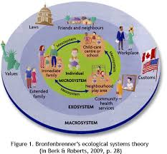
Bronfenbrenner’s Ecological Systems Theory (in Berk and Roberts, 2009, p. 28)

Slide 10
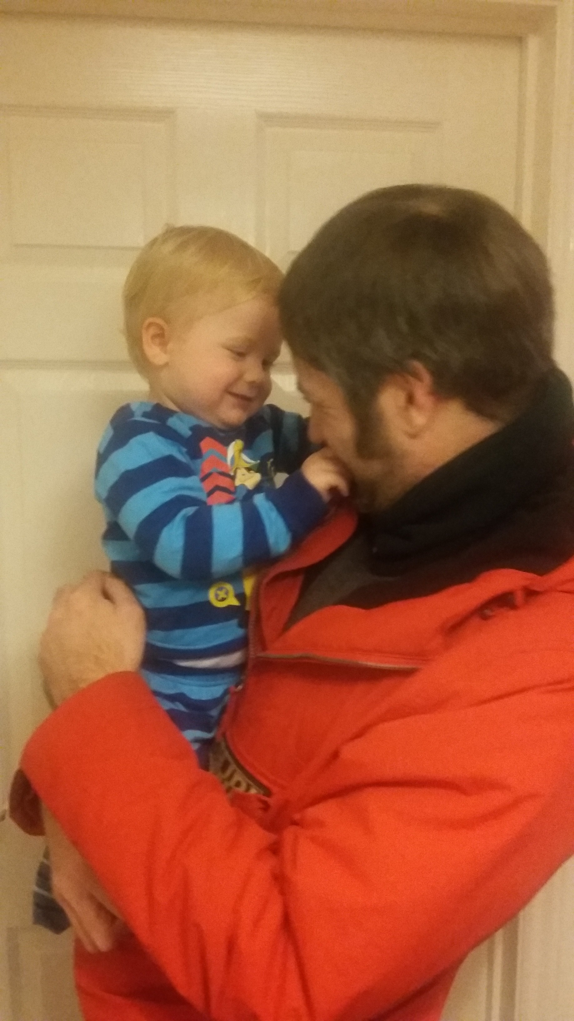
Key life tasks
Attachment is one of the most critical developmental tasks of infancy
Dr Joy Osofsky

Slide 11
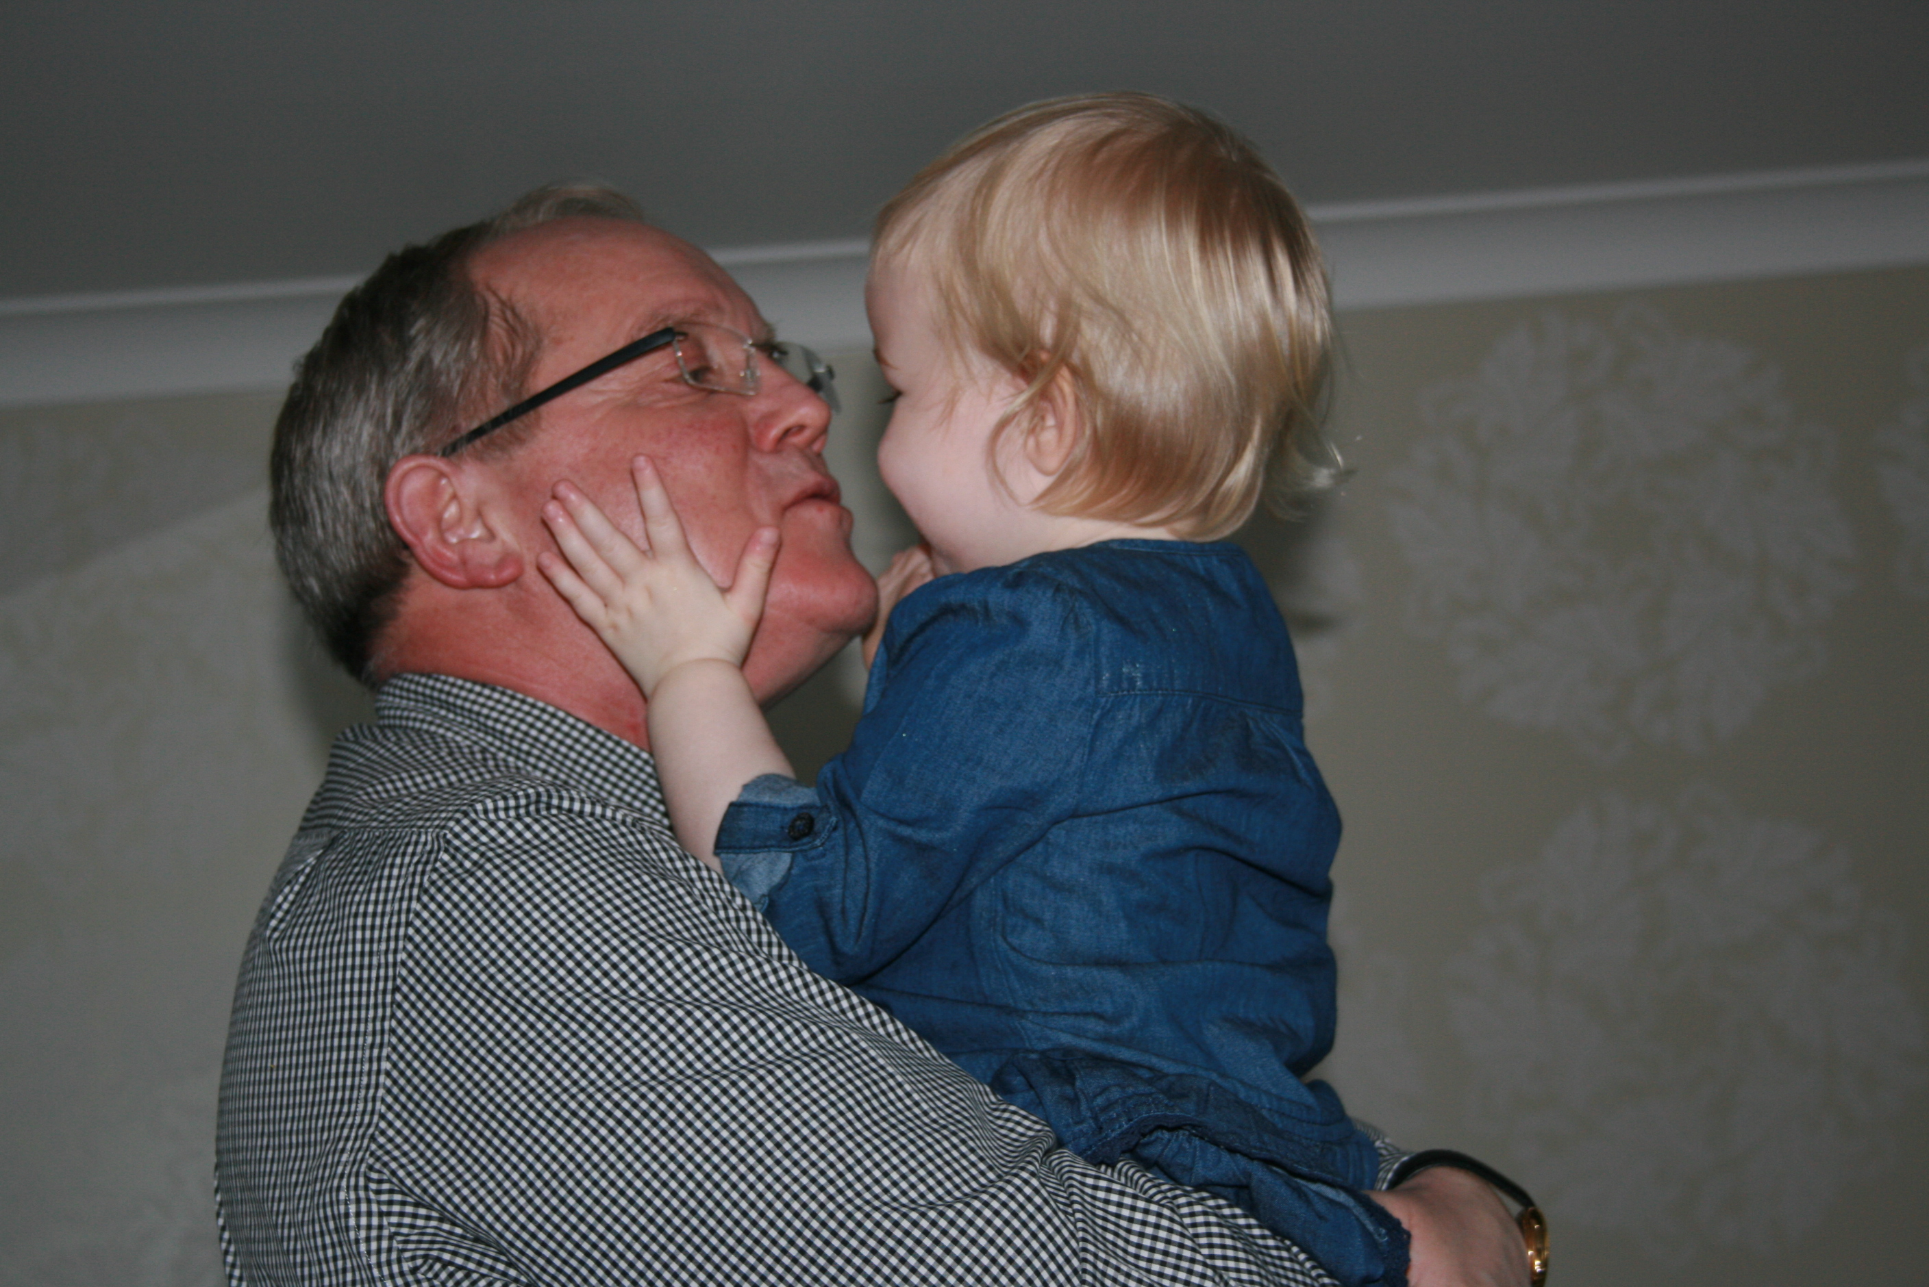
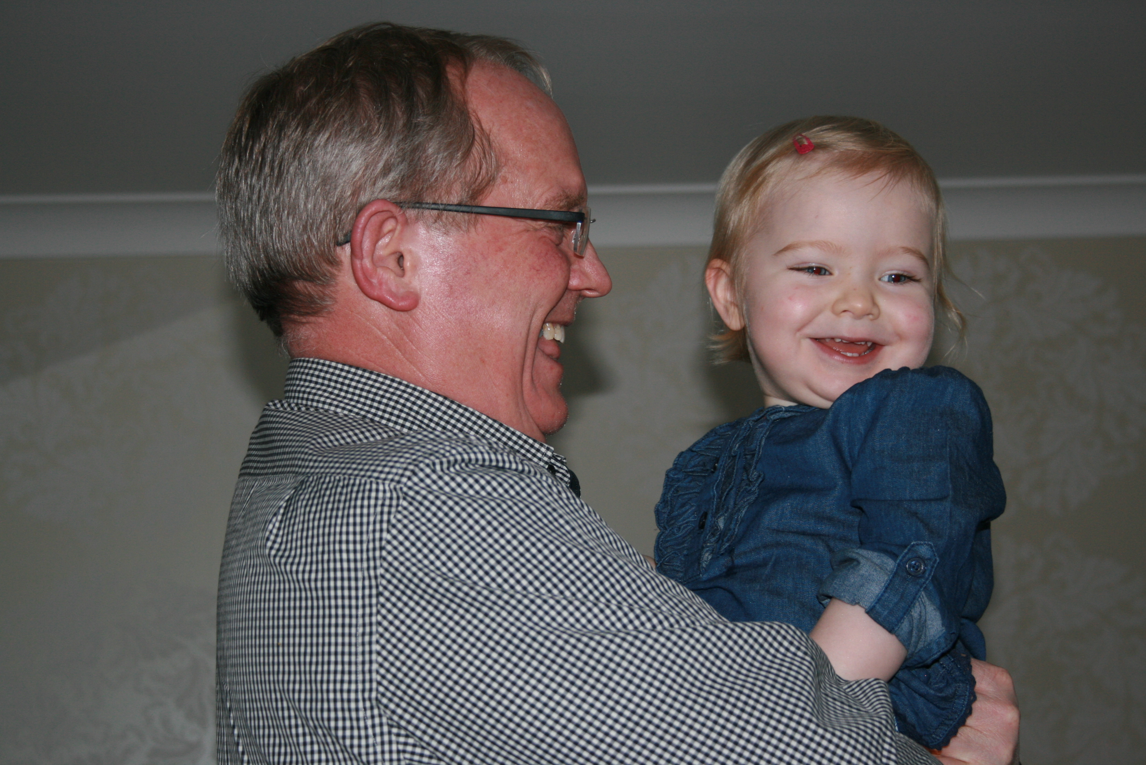
"Every child needs at least one person who is really crazy about him or her" (Bronfenbrenner, 1977).

Slide 12
Why is attachment important?
Most children enjoy life & are successful in school & relationships.
But some struggle from an early stage, especially in adolescence.
These children can be:
Unfocussed
Disruptive
Controlling
Destructive
Withdrawn
Underachieving & often ‘punished’
Research – our ability to form relationships & learn is shaped by early experiences
Understand WHY and HOW some children behave – can find ways to help

Slide 13
What Is Attachment?
‘Human relationships, and the effects of relationships on relationships, are the building blocks of healthy development. From the moment of conception to the finality of death, intimate and caring relationships are the fundamental mediators of successful human adaptation’
(Shonkoff & Philips, 2000)
“lasting psychological connectedness between human beings”
(Bowlby, 1969).

Slide 14
Attachment Formation And Cognitive Development
asocial stage (0-6 weeks)
indiscriminate attachments (6 weeks- 6-7 months)
specific attachments (6-9 months)
multiple attachments (10 months onwards)
Results – responsiveness was key to attachment not time and feeding

Slide 15
Attachment Theory
*John Bowlby
Attachment Figure
Secure Base
Blueprint For Future Social Interactions
Worldview
Secure & Insecure Attachment Styles
Early care-giving has a long-lasting impact on development (Siegel, 2012)

Slide 16
Care-giving And Attachment Types
Ainsworth’s ‘Strange situation studies’
Relationship Style | Parenting behaviour
Secure | Consistently responsive
Avoidant | Rejecting, distant
Ambivalent | Inconsistent, intrusive
Disorganised | Frightening, confusing, unpredictable

Slide 17
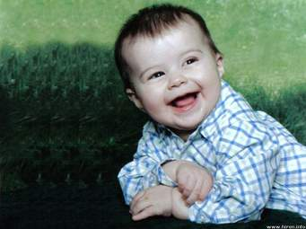
Cycle Of Attachment (Secure)
Feels need or displeasure
Expresses need
Feels relaxed Trust develops
Need met consistently

Slide 18
Secure Attachment
A securely attached child feels confident that should they feel anxious, their parents will respond. Such security is brought on by interactions which are:
Sensitive
Regularly available and reliable
Warm
Responsive
Consistent

Slide 19
What does attachment look like?
Eye contact
Reaching
Smiling
Calling to
Holding, clinging or protesting separation
Following
Sitting with
Verbal engagement

Slide 20
Secure Attachment – Impact On Development
Healthy self-esteem
Independence and autonomy
Curiosity and problem solving
Social – emotional competence
Empathy, compassion and conscience
Capacity for intimacy and close relationships
Positive coping strategies (resilience)
Positive behaviour and academic success

Slide 21
Securely attached Internal model | Insecurely attached Internal model
Adults are predictable, responsive and interested | Adults are unpredictable, unreliable, not interested
I am worthwhile, interesting, lovable and loved | I am worthless, uninteresting, unlovable
Exploration is safe – the adult with keep me safe | Exploration is not safe
Learning is interesting | Learning is risky

Slide 22
Activity
What kind of behaviour might you see from a securely attached child or young person?

Slide 23
Cycle Of Attachment (Insecure)
Feels need or displeasure
Expresses need
Feels shame/stress (increased cortisol)
Trust does not develop
Need not met consistently

Slide 24
Possible Causes Of Breakdown In The Bonding Cycle (risk factors for attachment difficulties)
Physical/ emotional neglect; abuse
Traumatic experiences
Home instability, separation/divorce
Changes in primary caregivers
Poor parenting skills
Paternal illness (pre/post depression, mental illness)
Maternal addiction
Birth trauma
Emotional/physical/sexual abuse

Slide 25
Discussion
What can you observe a child or young person doing when they are not feeling safe?

Slide 26
Insecure Attachment Types
Consistently unresponsive (leading to avoidant attachments)
Inconsistently responsive (leading to ambivalent attachments)
Unsafe and unpredictable (leading to disorganised attachments)

Slide 27
Be careful not to make assumptions!

Slide 28
Avoidant attachment: behaviours which may be observed
High levels of self reliance
Pupils rarely or unable to ask for support
Expresses anger through aggression towards others and or/objects e.g. This is rubbish
Unexpected changes may provoke negative response as it is challenging control and self reliance
Pupils will show preference for focus on the task itself on not on them

Slide 29
Avoidant Attachment:
Responses may be almost mechanical – rote – literal description may lack expansion – emotional content
Pupil will exert control over their environment whenever possible

Slide 30
Resistant/Ambivalent Attachment Pattern Observable Behaviour
In older children – developing pattern of attendance/time-keeping issues
Evidence of needy and controlling behaviours
May demonstrate irritating and intrusive behaviours when you are speaking to others/whole class
Trying at all opportunities to divert attention to themselves
Unable to tolerate if others require the teacher’s attention
May demonstrate frustration in perceived failure and project this in aggressive responses towards you

Slide 31
Resistant/Ambivalent Attachment Pattern Observable Behaviour
May be hostile to key adult
Difficulties in initiation and sustaining peer relationships due to perceived bossy controlling behaviour
Vulnerabilities anxieties particular in transitions to more complex environments e.G. High school

Slide 32
Disorganised Attachment
A mixture of both avoidant and ambivalent behaviours
Generally good attenders
Distracting others from the teacher speaking
May wander around classroom/leave class/school without warning
Lack of empathy
Sensitive to perceived criticism
Hypervigilant – in perpetual fight/flight mode

Slide 33
Disorganised Attachment
Any new situation may be viewed as threat/humiliation
Patterns of rage/violence to others/objects
Highly controlling
Cause disruption in response to anxiety
Anxiety may be triggered by things that others would not see as anxiety provoking e.g. Change of task
Unexpected interruptions
Introduction of new topic
Beginnings and endings in day – challenge however minimal we may view

Slide 34
Brain Development Why Love Matters
Early interactions between babies and their parents have lasting and serious consequences
Positive relationships are vital for brain development and therefore learning
The development of the brain can affect future emotional well being
The primary relationship will govern all relationships thereafter (including their relationship with you!!)
This early bonding and attachment helps children to develop:
Learning
Self-confidence
Social skills
Successful relationships
Empathy

Slide 35
Physiological Effects
When children and young people experience persistent stress they are likely to produce toxic amounts of cortisol which can have a detrimental effect on
Brain development
Hormonal differences
Arousal functioning
Reductions and changes in chemical functioning

Slide 36
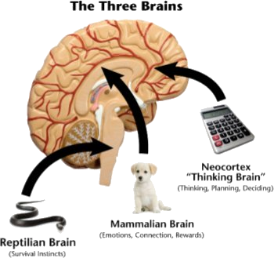
Brain Structure

Slide 37
Fight, flight, freeze
Limbic system – mammalian/emotional bran
Increased rate of limbic abnormalities following abuse
Under threat – limbic system is activated before the thinking brain
Hyper-arousal – impacts capacity to activate thinking brain
Extreme reactions

Slide 38
Brain Scans Of 3 Year Olds

Slide 39
Home atmosphere
May be characterised by
Hostility Abuse
Habitual anger
Ambiguity Discouragement
Tension Fear Inconsistency
Poorly attached child will try
to recreate family environment
Child compulsively repeats own history and experiences.
Re-plays / re-enacts conflicts, assigns roles and expectations
to staff & peers.
Forces them into a negative response
School atmosphere Emotion is contagious, staff need to control the emotional rhythm of the school day ensuring Predictability Respect Clear, calm, firm expectations playfulness fun security love empathy

Slide 40
Brain Systems
Neural systems in brain frequently employed to defend rather than cooperate
Regulatory systems become biased/primed towards arousal and fear rather than relaxed and ready for learning

Slide 41
So this means that…
Teachers and other significant adults in a child’s life can provide important attachments for children
Positive associations are found between quality of teacher- child relationships and achievement
High quality teacher-child relationships help buffer children from the negative effects of insecure attachment on achievement
Emotional resilience and the ability to learn are inextricably linked
Secure attachment relationships correlate strongly with higher academic attainment, better self-regulation and social competence

Slide 42
Why Does…
Nick always explode during maths or spelling?
Kelly get into trouble during lunch time and breaks?
Wesley refuse to be helped with new work?
Sarah constantly ask trivial questions about her work?
Mary frequently tell lies?
Charlie seem to be in the world of his own?
Jodie ignore the teacher’s instructions?

Slide 43
Activity
Case studies
Identify what may be underpinning the observed behaviour?
What further questions may you have?
How would you assess?
What information would you be looking for?
What strategies would you consider ?
How would you implement them?

Slide 44
Learning Outcomes
Practitioners can define the key areas of attachment theory
Practitioners can explain the rationale of the ecological framework and how the framework makes links between context and behaviour
Practitioners can reflect on attachment theory and identify potential implications for school systems, planning and teaching practice
Practitioners can define developmental trauma and identify potential difficulties in forming attachment bonds/developing relationships

Slide 45
Any questions?

Slide 46
Tasks
Group Task
Two Individual tasks
Complete two functional behavioural analysis
Complete the reflective task sheet for both pupils
Tasks to be completed prior to Session Two: Nurturing Principles

Slide 47
Support between training sessions
Please contact your link psychologist and a member of the Psychological Service Nurture Group will contact you.

Slide 48
Useful resources
https://www.youtube.com/watch?v=apzXGEbZht0
Still Face Experiment
http://www.educationscotland.gov.uk/learningandteaching/earlylearningandchildcare/prebirthtothree/nationalguidance/conversations/robinbalbernie.asp
Robin Balbernie – baby brains and relationships

Slide 49
Any questions?

