Slide 1
EIH: LEADERSHIP OF & FOR LEARNING
A PROFESSIONAL LEARNING SERIES FOR HEADTEACHERS
Notes:
Chris
Housekeeping
Welcome

Slide 2
Chris French
Lead Specialist
PLL Directorate
Gordon Bone
Lead Specialist
PLL Directorate
Louise Sanders
Associate
Lead Specialist
PLL Directorate
Andy Travis
Associate
Lead Specialist
PLL Directorate
Notes:
Chris

Slide 3
We live in a complex world with an ever changing landscape
Notes:
Introduction- Talk about changing times, islands of sanity, taking time to stand back and think.
Talk about changing times, islands of sanity, taking time to stand back and think.
Who we are and what we stand for?
https://margaretwheatley.com/wp-content/uploads/2017/10/Margaret-Wheatley-2017-Leader_to_Leader.pdf
Several years ago, in the face of irreversible global problems and the devolution of leadership, I began to challenge every leader I met with these questions: Who do you choose to be for this time? Are you willing to use whatever power and influence you have to create islands of sanity that evoke and rely on our best human qualities to create, relate, and persevere? Will you consciously and bravely choose to reclaim leadership as a noble profession, one that creates possibility and humaneness in the midst of increasing fear and turmoil?
I know it is possible for leaders to use their power and influence, their insight and compassion, to lead people back to an understanding of who we are as human beings, to create the conditions for our basic human qualities of generosity, contribution, community, and love to be evoked no matter what. I know it is possible to experience grace and joy in the midst of tragedy and loss. I know it is possible to create islands of sanity in the midst of wildly disruptive seas.
An island of sanity can be a literally bounded group, such as a team, function, or community. It can also be an interior space bounded by our integrity: we know who we are, what we value, and what we stand for. Sanity is in treating people, as the great activist Grace Lee Boggs said, as human beings
https://collectiveleadershipscotland.com/wp-content/uploads/2018/11/collectiveleadershipreport1.pdf
Collective Leadership: Where Nothing is Clear and Everything Keeps Changing. Kathy Sharp
It is with this immediate context in mind that this paper seeks to offer a complexity-informed and coherent way of thinking about evidence use and generation and tackles

Slide 4
Notes:
Pace
Intentional time and space
Andy

Slide 5
I am the DJ!
Notes:
Talk about getting off the dance floor and onto the balcony
As HT you are often want and are expected to be, in the mix at a range of levels from the playground and classroom to the local authority
At your best, can be on the dance floor and the balcony at the same time?
Reflective and active at the same time --- Reflection in action
Another dancefloor analogy – Will you dance with the untidy dancers? Can you co-labour with those you don’t normally work with?
Hiefitz 1970s
Andy

Slide 6
Connector
Three Musketeers
•Introduce yourself…
•Agree on something you all dislike
•Agree on something you all like
•Exchange an interesting fact about yourself
Notes:
Kerrie

Slide 7
Collaborative and Connected Learning Environment
Holding the ladder
Learning from, with, and on behalf of each other.
What will I do that will help our learning?
Notes:
Louise

Slide 8
Questions
I may have some questions about the programme and what I will be doing.
If I could ask any question now – what would it be?
Write it on a post-it, and put it up on the ‘car park’ flip chart

Slide 9
EiH: Leadership of and for Learning
Part 1

Slide 10
Personal reflection
Reflect on your own best adult learning activity.
Think about the experience and what made it the best.
What made the learning great?
Particular phrase or concept which resonated with you?
Can you note a word or a phrase that highlights this?
Task: Take 5 mins to consider individually then share with your group for the next 10 mins
Notes:
Glaser STEP 1 Focus/on task
Introduce concept of andragogy and the principles underlying it. Emphasis the similarities and difference between andragogy and pedagogy.
Malcolm Knowles 1970’s. There is a PLA on Andragogy at the ES Online learning resources https://professionallearning.education.gov.scot/
Break out room or chat
ACTIVITY 2 Learning as an adult
Reflect on your own best adult learning activity .
A title and/or ONE sentence on what it was about.
What made the learning great? Particular phrase or concept which resonated with you and explains the why to others
Andy

Slide 11
Adults Learn best when...
they understand why they need to learn something
they learn by doing
prior experience is taken into account
learning is approached as problem-solving
learning preferences are taken into account
the learning climate is safe
there is time to reflect
they have the support needed
an-dra-go-gy
man
Andragogy
leading
andr- + (ped)agogy
Notes:
Glaser STEP 1 Focus/on task
Introduce concept of andragogy and the principles underlying it. Emphasis the similarities and difference between andragogy and pedagogy.
Malcolm Knowles 1970’s. There is a PLA on Andragogy at the ES Online learning resources https://professionallearning.education.gov.scot/
Break out room or chat
ACTIVITY 2 Learning as an adult
Reflect on your own best adult learning activity .
A title and/or ONE sentence on what it was about.
What made the learning great? Particular phrase or concept which resonated with you and explains the why to others
Andy

Slide 12
an-dra-go-gy
man
Andragogy
leading
andr- + (ped)agogy

Slide 13
“The job of the teacher is teaching.
The job of the school leader is adult learning.”
McKinsey - How the worlds most improved systems keep getting better, 2010
Notes:
Andy

Slide 14
Three Fields of Knowledge
(NCSL 2003)
“The aim of knowledge animation is creation of new knowledge by learning communities that will help people enhance their practice and policy. This new knowledge takes centre stage and is the outcome of connecting what individuals know and what is known ‘out there’, external research. Knowledge animation provides the collaborative processes for new knowledge creation by ensuring that what is known is connected to what people know through collaborative dialogic processes”
Notes:
Glaser STEP 1
Focus/on task
http://www.leeds.ac.uk/educol/documents/155096.htm
First field – what I know
Second field – what else is out there
Third field – what can we create together, that’s new
Androgogy underpinned by 3 fields
Synergy with Inwards, Outwards, Forwards from HGIOS 4

Slide 15
National Model of Professional Learning
Professional learning must focus on the education professional as a learner and how this is related to and impacts upon the learning of children, young people and adults.
Professional learning should be:
Challenging, and develop thinking, knowledge, skills and understanding
Underpinned by developing skills of enquiry and criticality
Interactive, reflective and involve learning with and from others.
Professional learning is informed and supported by professional standards and education policy. Leadership of and for learning is essential to ensure it is well supported, promoted and sustained.

Slide 16
John West-Burnham Model (2005)
Shallow
Deep
Profound Learning
Notes:
The most powerful means of developing leadership is to create an organisational culture, which values the sorts of learning most likely to enhance the capacity of individuals to lead. In identifying such learning, it is firstly necessary to identify the most appropriate mode of learning. Three modes of learning can be identified: shallow, deep and profound. −
Shallow learning is concerned with the acquisition of information. It is largely demonstrated through memorisation and replication, and it can result in compliance and dependency.
Deep learning, by contrast, is focused on the creation of knowledge through the development of understanding. This means that the knowledge can be applied on the learners own terms.
Profound learning describes the situation where knowledge is converted into wisdom and where understanding becomes intuition.
Deep and profound learning require two specific learning strategies to really make an impact.
Firstly, there has to be the opportunity to reflect to review one’s own practice, to review working with others and to explore how theory and practice interact. Time and space to reflect is an essential component of leadership learning. One of the most significant characteristics of the effective team is the way that it builds in time for individual and shared reflection. Reflection is the means by which we make sense of the world it allows us to clarify, analyse, prioritise and, crucially, to understand.
The second component is coaching, which is probably the most powerful learning strategy for developing leadership potential. Coaching is the essential learning relationship and, at its best, has the following characteristics
http://www.learnersfirst.net/private/wp-content/uploads/Resource-building-leadership-capacity-John-West-Burnham.pdf
Prof John West-Burnham is Professor of Educational Leadership at St Mary’s University, London. He is a key advisor in the development of the Aquinas Centre for Learning Leadership and Innovation

Slide 17
Aligning Definitions to the Professional Standards
“The Standard for Headship recognises that effective leadership depends on the principles of collegiality and that all teachers are leaders of and for learning, who lead learning for, and with, all learners. Headteachers work with, and support the development of, colleagues and other partners. The Standard for Headship includes a focus on leadership of and for learning, teacher leadership, and working collegially to build leadership capacity in others”
GTCS – Professional Standards
Notes:
Glaser Step 2 Experience Update Standard
We’ve looked at our own understanding of leadership. Definitions in the literature. Do we have a moderated understanding of Leadership??
This is our benchmark. It has been agreed for us……..to prevent dubiety……. To allow us to measure ourselves against it. But does it fully capture the aspects of leadership you have discussed this morning?
Discuss in pairs
How does it articulate with your current role?
No feedback will be sought so please be as honest as you feel able.

Slide 18
Aims of this experience
You will not have:
Keynote speakers
1
Every answer to every question you have
2
Lots of handouts and copies of these slides
3
Lots of tasks to do or homework
4
A finished product or certificate
5
Notes:
Individual exercise

Slide 19
EiH Support
Connected and Collaborative Resource
A recent addition to the suite of professional learning resources, based on feedback from school leaders, is the EiH Connected and Collaborative Resource.
This is an online curated space where participants will find EiH Core Learn presentations, recommended reading, podcasts and relevant policy documents. It was developed in response to feedback from headteachers who found navigating and sourcing key professional learning resources and policy documents challenging.
T

Slide 20
An influential figure
Think about somebody who has been an influential figure in your life, who has had a great impact on you.
Why is/was this person influential?
What are/were this person’s main characteristics?
What values do you associate with this person?
Notes:
Chris

Slide 21
Break

Slide 22
EiH: Leadership of and for Learning
Part 2

Slide 23
An influential figure
Think about somebody who has been an influential figure in your life, who has had a great impact on you.
Why is/was this person influential?
What are/were this person’s main characteristics?
What values do you associate with this person?
Notes:
Chris

Slide 24
Personal Values
A personal value is a deeply-held belief in which you have an emotional investment and therefore guides your decisions and actions (Success Intelligence 20), for example:
Love
Honesty
Integrity
Growth
Commitment
Trust
Freedom
Beauty
Wisdom
Learning
Respect
Courage
Risk
Success
Security
Challenge
Authenticity
Fairness
Notes:
Chris

Slide 25
Asking for help
Developing and empowering teams
Self-Awareness
Managing ego
Making public promises
and tuning into context
and acknowledging mistakes
Power and love
Being a restless learner
Developing
future leaders
Internal foundations
External manifestation
Authenticity,
and doing the
right thing
Show up with pragmatic optimism
Professor Steve Mumby
Notes:
Andy
Focus on self awareness, linking to Daniel Goleman's model with the 4 domains
self awareness
self management,
social awareness
relationship management
Andy

Slide 26
Leadership Style
“Leaders need to develop their own leadership style based on their beliefs and values, their expertise and skills and their personality. But context matters so our leadership style has to change as our context changes.”
Steve Munby Imperfect Leadership. 2019
Notes:
Context is key,

Slide 27
Leadership of and for learning…
… is essential to ensure professional learning is well supported, promoted and sustained.
Leaders in the widest sense understand that people are the drivers and enactors of change for improvement. Professional learning and development is the means by which this is put into action. As a priority, leaders commit to and invest in their own professional learning and development, creating the conditions where professional learning can thrive – space, time, culture and trust.
For Scotland's learners, with Scotland's educators
Notes:
Discuss for 10 mins
Reflective questions - next steps
Santiago Slides
Develop the strategic vision to lead and support learning for all
Develop a learning culture and ethos based on trust, honesty, challenge and support; one which supports and promotes the growth of professional capital through professional learning
Support and provide time for meaningful engagement in sustained professional learning and development with opportunities to share
Lead learning conversations underpinned by coaching approaches to stimulate, challenge and support thinking
Have professional courage
Enact collaborative and enquiring approaches to practice
Encourage, challenge and question to ensure development and progress
Are committed to and recognise the importance of developing individual and collective knowledge

Slide 28
Leaders of and for learning…
Develop the strategic vision to lead and support learning for all
Develop a learning culture and ethos based on trust, honesty, challenge and support; one which supports and promotes the growth of professional capital through professional learning
Support and provide time for meaningful engagement in sustained professional learning and development with opportunities to share
Lead learning conversations underpinned by coaching approaches to stimulate, challenge and support thinking
Have professional courage
Enact collaborative and enquiring approaches to practice
Encourage, challenge and question to ensure development and progress
Are committed to and recognise the importance of developing individual and collective knowledge
Notes:
Develop the strategic vision to lead and support learning for all
Develop a learning culture and ethos based on trust, honesty, challenge and support; one which supports and promotes the growth of professional capital through professional learning
Support and provide time for meaningful engagement in sustained professional learning and development with opportunities to share
Lead learning conversations underpinned by coaching approaches to stimulate, challenge and support thinking
Have professional courage
Enact collaborative and enquiring approaches to practice
Encourage, challenge and question to ensure development and progress
Are committed to and recognise the importance of developing individual and collective knowledge

Slide 29
Leadership of and for learning –
values and characteristics
Thinking about yourself as an headteacher and leader of learning, in what ways do you:
Commit to and invest in your own professional learning and development?
Create conditions where learning can thrive?
Create a learning culture for you and your learners?
For Scotland's learners, with Scotland's educators

Slide 30
Leadership characteristics and values –
Diamond 9
Most important
Discuss your Leadership and Learning quotes as a group and agree a diamond shape with the most important statement, that resonates most with your group, at the top.
Using your top 3, agree and write on sticky notes the leadership characteristics and values you associate with each quote. Add these to the leadership characteristics and values wall.
Display your Diamond 9 to share with other groups.
Least important
For Scotland's learners, with Scotland's educators

Slide 31
Self evaluation tool
A gap analysis
A coaching conversation
A plan for future action
A reference point
A reflective tool

Slide 32
Leadership of and for learning
As a leader I...
Develop the strategic vision to lead and support learning for all
Create the conditions where professional learning can thrive - a learning culture and ethos based on trust, honesty, challenge and support; one which supports and promotes growth of professional capital through professional learning
Support and provide time for meaningful engagement in sustained professional learning and development with opportunities to share
10
Lead learning conversations underpinned by coaching approaches to stimulate, challenge and support thinking
0
Have professional courage
Commit to and invest in my professional learning and development, enacting collaborative and enquiring approaches to my practice
Encourage challenge and question to ensure development and progress
Am committed to and recognise importance of developing individual and collective knowledge
Notes:
Individual exercise

Slide 33
Leadership of and for learning
As a leader…
the leadership culture I work in…
Develop the strategic vision to lead and support learning for all
Create the conditions where professional learning can thrive - a learning culture and ethos based on trust, honesty, challenge and support; one which supports and promotes growth of professional capital through professional learning
Support and provide time for meaningful engagement in sustained professional learning and development with opportunities to share
10
Lead learning conversations underpinned by coaching approaches to stimulate, challenge and support thinking
0
Have professional courage
Commit to and invest in my professional learning and development, enacting collaborative and enquiring approaches to my practice
Encourage challenge and question to ensure development and progress
Am committed to and recognise importance of developing individual and collective knowledge

Slide 34
Connect, Extend, Challenge
How does Leadership of and for learning feature of the national model of professional learning connect with you and your professional learning?
Connect – How do these ideas connect with what you already know, believe or do?
Extend - How do these ideas extend, build on, what you already know, believe or do?
Challenge - How do these ideas challenge what you already know, believe or do?

Slide 35
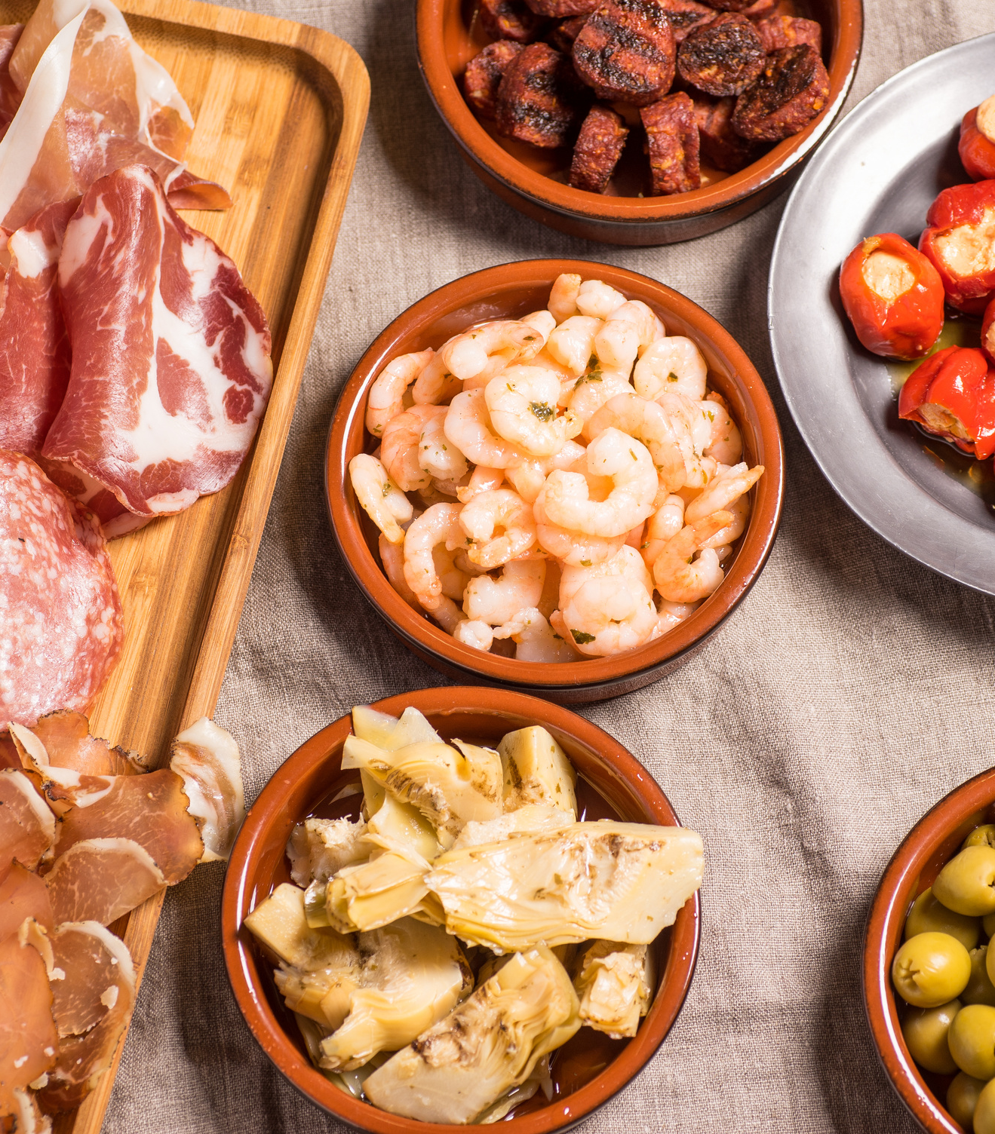
Lunch

Slide 36
Review
Preview
Notes:
Walk

Slide 37
Leadership of and for Learning
Part 3

Slide 38
Just a minute...
It lasts just a minute...
Choose one person from each table to start talking about what you know about Reform for 60 seconds without hesitation, repetition or deviation.

Slide 39
National Educational Policy into Practice
What is my role as a HT in national policy?
Notes:
Step 5 Modifying/Assimilating
Feedback to room 20 minutes

Slide 40
What is my role as a HT in national policy?
The Scottish education system in context| Scotland’s Curriculum for Excellence : Into the Future
Notes:
Step 5 Modifying/Assimilating – Edit Andy T
Facilitator to put up 3 compass point flipcharts once completed- explain what the compass points mean
Reading 20 minutes
Discussion 20 minutes
Sharing learning 20 minutes

Slide 41
Curriculum making as a social activity within and between levels
Site of activity | Examples of activity | Examples of actors
Supra | Transnational curriculum discourse. Curriculum policy lending/borrowing. Policy learning | OECD, EU, World Bank
Macro | Developing policy frameworks. Legislation | National govt., National curriculum agencies
Meso | Developing policy guidance. Leadership and support of curriculum making | National govt., National curriculum agencies. RIC, LA, RIT, subject and sector organisations
Micro | School level curriculum making, curriculum planning, lesson planning | HT, school leadership teams, PT, teachers
Nano | Curriculum making in class and learning spaces. Learning interactions | Teachers and learners
Priestley et al (2021) Curriculum making in Europe
Notes:
Where do you have influence?
Where should you invest your energy
Strengthened middle tier. What is your network for discussing curriculum design?
Some thoughts on Scotland’s education reform agenda; a contribution to the National Discussion on Education – Professor Mark Priestley (wordpress.com)

Slide 42
A National Context for System Leadership
National Discussion (ND)
Stobart
Review
Consultation
Launch
Implementation
Framework V2.0
Women in
Enterprise
Review
Muir
Review
SLF
2022
1ˢᵗ year of
new Gov
New
School
Year
New Agency
High level
Blueprints
OECD
Review
Financial
Year
Implementation
Framework V1.0
M | J | J | A | S | O | N | D | J | F | M | A | M | J | J | A | S | O | N | D | J | F | M | A
2021 | 2021 | 2021 | 2021 | 2021 | 2021 | 2021 | 2021 | 2022 | 2022 | 2022 | 2022 | 2022 | 2022 | 2022 | 2022 | 2022 | 2022 | 2022 | 2022 | 2023 | 2023 | 2023 | 2023

Slide 43
A National Context for System Leadership
Equality,
Opportunity,
Community
Skills
Delivery
Review
New Education Agency & New Inspection Agency?
SG OECD
Papers
Prof
Hayward
Report
Women in
Enterprise
Review
Scottish Government Response?
National
Discussion
Report
LfS Strategy
Purposes &
Principles
J | F | M | A | M | J | J | A | S | O | N | D | J | F | M | A | M | J | J | A | S | O | N | D
School Year 22/23 | School Year 22/23 | School Year 22/23 | School Year 22/23 | School Year 22/23 | School Year 22/23 | School Year 22/23 | School Year 23/24 | School Year 23/24 | School Year 23/24 | School Year 23/24 | School Year 23/24 | School Year 23/24 | School Year 23/24 | School Year 23/24 | School Year 23/24 | School Year 23/24 | School Year 23/24 | School Year 23/24 | School Year 24/25 | School Year 24/25 | School Year 24/25 | School Year 24/25 | School Year 24/25
2023 | 2023 | 2023 | 2023 | 2023 | 2023 | 2023 | 2023 | 2023 | 2023 | 2023 | 2023 | 2024 | 2024 | 2024 | 2024 | 2024 | 2024 | 2024 | 2024 | 2024 | 2024 | 2024 | 2024

Slide 44
‘…a future education system in Scotland would benefit from greater system synergy (that) reflects a coherent, co-ordinated, and interdependent system, involving all key players in an integrated but not overly bureaucratic way.’
‘…the need for the Scottish education system to be much more of a learning system that is able to take risks and to embark upon significant, bold and ambitious reform.’ (P.19)
All Learners in Scotland Matter: Our National Discussion A Summary Report: Scottish Government 2023

Slide 45
‘…for the reform to have personal and professional integrity everyone who has a role to play in making the innovation successful should be involved in its design and development.’ (P.28)
‘In Scotland, a wide range of organisations have to align to support the process of change in any innovation.’ (P.29)
It's Our Future - Independent Review of Qualifications and Assessment: Scottish Government 2023

Slide 46
'Organisations and individuals have, perhaps naturally, tended to focus on their own role in delivery or part of the landscape rather than looking across the system for solutions or opportunities. This approach can be indicative of systems that are fractured or have gaps in the clarity of roles, processes or individual parts.’ (p.5)
Fit for the Future: developing a post-school learning system to fuel economic transformation. Withers, 2023

Slide 47
‘The landscape is complex and will continue to be so. The unique opportunity this Review presents is to make that complexity visible, to establish an agreed baseline for positive action and to prioritise and energise a critical area of public life.’ (P.16)
‘Co-creation and collaboration with children, young people and their families will support more coherent, inclusive and all-encompassing policy making, which improves implementation, impact and experience.’ (P.14)
Support for Learning: All our Children and All their Potential, Scottish Government 2020

Slide 48
Review and
Key Recommendations
Priorities: P.22-24
Overview of
recommendations:
P.69-72
Summary recommendations
P.63-69
Call to Action: P.14-22

Slide 50
The Impact of leadership on student outcomes: Making Sense of the Evidence
What is at the top of your head?
How does it square with your thinking?
What’s still circling around in your mind ?
Notes:
Facilitator to talk through this, questionns about Day 1
Active - Discuss

Slide 51
Leadership of and for Complex Change
Leaders in the widest sense understand that people are the drivers and enactors of change for improvement.
In person option
Date: 7th December 2023 (Thursday)
Time: 09:30 – 16:30
Location: Clayton Hotel, 298 Clyde Street, Glasgow, G1 4NP
Leadership of and for System
This session will provide an opportunity to explore how leaders build relational trust and networks
In person option
Date: 1st February 2024 (Thursday)
Time: 09:30 – 16:30
Location: The Studio, 67 Hope Street, Glasgow, G2 6AE

Slide 52
Evaluation

