Slide 1
CONNECTED AND COLLABORATIVE
SYSTEMS LEADERSHIP
NOVEMBER 2023
Notes:
Chris / Lise
Housekeeping
Welcome

Slide 2
Gordon Bone
Lead Specialist
PLL Directorate
Iain McDermott
Lead Specialist
PLL Directorate
Andy Travis
Associate
Lead Specialist
PLL Directorate
Chris French
Lead Specialist
PLL Directorate
Notes:
Chris / Lise

Slide 3
Aim of the session
By the end of this session I will have:
Further reflected on the area of enquiry that we are considering exploring
Moved to deeper discussions to support our interrogation this theme or focus with colleagues
Started to develop a theory of action
Begin to consider the three fields of knowledge and an Action Research Approach to collaborative enquiry
Started to compose a plan to inform process and next steps
Notes:
Louise?

Slide 4
Collaborative and Connected Learning Environment
Holding the ladder
Learning from, with, and on behalf of each other.
What will I do that will help our learning?
Notes:
Louise

Slide 5
Questions
I may have some questions about the programme and what I will be doing.
If I could ask any question now – what would it be?
Write it on a post-it, and put it up on the ‘car park’ flip chart
Notes:
Louise?

Slide 6
Connector
Same
In what ways might you both have a similarity?
Different
In what ways might you both have a difference?
Connect
In what ways might you both be connected?
Engage
Identify one thing that you are both looking forward to.
Notes:
Kerrie

Slide 7
Three Fields of Knowledge
(NCSL 2003)
“The aim of knowledge animation is creation of new knowledge by learning communities that will help people enhance their practice and policy. This new knowledge takes centre stage and is the outcome of connecting what individuals know and what is known ‘out there’, external research. Knowledge animation provides the collaborative processes for new knowledge creation by ensuring that what is known is connected to what people know through collaborative dialogic processes”
Notes:
Glaser STEP 1
Focus/on task
http://www.leeds.ac.uk/educol/documents/155096.htm
First field – what I know
Second field – what else is out there
Third field – what can we create together, that’s new
Androgogy underpinned by 3 fields
Synergy with Inwards, Outwards, Forwards from HGIOS 4

Slide 8
National Model of Professional Learning
Professional learning must focus on the education professional as a learner and how this is related to and impacts upon the learning of children, young people and adults.
Professional learning should be:
Challenging, and develop thinking, knowledge, skills and understanding
Underpinned by developing skills of enquiry and criticality
Interactive, reflective and involve learning with and from others.
Professional learning is informed and supported by professional standards and education policy. Leadership of and for learning is essential to ensure it is well supported, promoted and sustained.

Slide 9
John West-Burnham Model (2005)
Shallow
Deep
Profound Learning
Notes:
The most powerful means of developing leadership is to create an organisational culture, which values the sorts of learning most likely to enhance the capacity of individuals to lead. In identifying such learning, it is firstly necessary to identify the most appropriate mode of learning. Three modes of learning can be identified: shallow, deep and profound. −
Shallow learning is concerned with the acquisition of information. It is largely demonstrated through memorisation and replication, and it can result in compliance and dependency.
Deep learning, by contrast, is focused on the creation of knowledge through the development of understanding. This means that the knowledge can be applied on the learners own terms.
Profound learning describes the situation where knowledge is converted into wisdom and where understanding becomes intuition.
Deep and profound learning require two specific learning strategies to really make an impact.
Firstly, there has to be the opportunity to reflect to review one’s own practice, to review working with others and to explore how theory and practice interact. Time and space to reflect is an essential component of leadership learning. One of the most significant characteristics of the effective team is the way that it builds in time for individual and shared reflection. Reflection is the means by which we make sense of the world it allows us to clarify, analyse, prioritise and, crucially, to understand.
The second component is coaching, which is probably the most powerful learning strategy for developing leadership potential. Coaching is the essential learning relationship and, at its best, has the following characteristics
http://www.learnersfirst.net/private/wp-content/uploads/Resource-building-leadership-capacity-John-West-Burnham.pdf
Prof John West-Burnham is Professor of Educational Leadership at St Mary’s University, London. He is a key advisor in the development of the Aquinas Centre for Learning Leadership and Innovation

Slide 10
Support
Connected and Collaborative Resource
A recent addition to the suite of professional learning resources, based on feedback from school leaders, is the EiH Connected and Collaborative Resource.
This is an online curated space where participants will find EiH Core Learn presentations, recommended reading, podcasts and relevant policy documents. It was developed in response to feedback from headteachers who found navigating and sourcing key professional learning resources and policy documents challenging.
T

Slide 11
Emerging Areas of Enquiry
Curriculum to engage all learners
Quality of experience between P7 -S1 (Pupil Engagement, Progression in Learning, Process and Systems)
Revolution! (Accountability: Supporting and safeguarding for school leaders, reporting/monitoring what we value)
Tackling the poverty related attainment gap: What improves outcomes for key learners?
‘How do we measure and report what we value?
Curriculum design for the 21st century
Building a future curriculum: Exploring the potential of IDL to meet the needs identified in the National Discussion and ‘Scotland’s Curriculum)
Innovative Practice: Recognition, sharing and upscaling, sourcing expertise in the system
Exploring literacy assessments at First level to ensure equity for ASN pupils
Rights vs Reality
The disconnect between GTCS standards, teacher professionalism development and the impact on the classroom
How do we equip children and young people to become change makers/system leaders and how do we measure and validate the success?

Slide 12
Process and next steps
Collaborative enquiry is a structure in which members of a professional learning community come together to systematically examine their educational practices, to:
Ask questions
Develop a theory of action
Determine action steps
Develop and test hypotheses
Gather and analyse evidence
Assess impact of their actions
Share and celebrate the learning
Debrief the process

Slide 14
Break

Slide 15
Theory of Action

Slide 16
What is a theory of action?
A theory of action is …………..
a set of underlying assumptions about how we will move our organisation from its current state to its desired future.
Aligns intended theory with the realities of work within your context and the ‘system’.
Connects strategy to the actions and relationships critical to achieving improvement.
Identify the mutual dependencies that are required to get the complex work of improvement done
Grounded in research or evidence-based practice.
(City, Elmore, Fiarman and Teitel,2009)

Slide 17
Action Step 1 An﻿alysis of context
This involves generating an overview of the current situation and defining a focus for the enquiry. Teachers involved in the school’s collaborative research will need to think about what they already know about the situation - what their ‘hunches’ are and what evidence is readily available. What further evidence is required to enable them to develop a set of enquiry questions? Many of the proposals focus on this phase of activity.
Adapted from Collaborative Action Research 2015: Education Scotland in collaboration with the University of Glasgow Robert Owen Centre for Educational Change
V
Notes:
Glaser Step 2 Experience Update Standard
We’ve looked at our own understanding of leadership. Definitions in the literature. Do we have a moderated understanding of Leadership??
This is our benchmark. It has been agreed for us……..to prevent dubiety……. To allow us to measure ourselves against it. But does it fully capture the aspects of leadership you have discussed this morning?
Discuss in pairs
How does it articulate with your current role?
No feedback will be sought so please be as honest as you feel able.

Slide 18
Action Step 2 Agreeing Enquiry Question
Strategic questions are crucial in adopting an enquiry based approach. They determine what information is needed and how it should be collected. These questions must be generated by practitioners themselves. This ensures the focus is on ‘real world’ issues and that the findings of the investigations will be meaningful and relevant. This is why it is so helpful to have members involved who have different perspectives. The question should be refined as the group moves through the process
Adapted from Collaborative Action Research 2015: Education Scotland in collaboration with the University of Glasgow Robert Owen Centre for Educational Change
Notes:
Glaser Step 2 Experience Update Standard
We’ve looked at our own understanding of leadership. Definitions in the literature. Do we have a moderated understanding of Leadership??
This is our benchmark. It has been agreed for us……..to prevent dubiety……. To allow us to measure ourselves against it. But does it fully capture the aspects of leadership you have discussed this morning?
Discuss in pairs
How does it articulate with your current role?
No feedback will be sought so please be as honest as you feel able.

Slide 19
Action Step 3 Agreeing Purposes
At this step it is important to clarify the collaborative enquiry team’s shared understanding of the questions and issues in hand before checking them out with a broader group. This involves reflecting on the initial ‘hunches’ and considering what analysis of the existing evidence suggests. Discussions include priorities for action and thinking about who needs to be involved. At this stage the collaborative enquiry team may decide additional evidence is required. This phase is about generating a wider constituency and ensuring the issues the collaborative enquiry team is raising resonate more widely across the system.
Adapted from Collaborative Action Research 2015: Education Scotland in collaboration with the University of Glasgow Robert Owen Centre for Educational Change
Notes:
Glaser Step 2 Experience Update Standard
We’ve looked at our own understanding of leadership. Definitions in the literature. Do we have a moderated understanding of Leadership??
This is our benchmark. It has been agreed for us……..to prevent dubiety……. To allow us to measure ourselves against it. But does it fully capture the aspects of leadership you have discussed this morning?
Discuss in pairs
How does it articulate with your current role?
No feedback will be sought so please be as honest as you feel able.

Slide 20
Action Step 4 Making use of the Expertise
Here the collaborative research team will need to identify what expertise exists within their group, networks, partnerships, the wider programme and beyond. What are the gaps in the expertise? And from where/ how can these gaps be filled? It is at this action step that you are considering the ‘Field One and Field Two‘ in the ‘Three Fields of Knowledge‘ approach.
Adapted from Collaborative Action Research 2015: Education Scotland in collaboration with the
University of Glasgow Robert Owen Centre for Educational Change
Notes:
Glaser Step 2 Experience Update Standard
We’ve looked at our own understanding of leadership. Definitions in the literature. Do we have a moderated understanding of Leadership??
This is our benchmark. It has been agreed for us……..to prevent dubiety……. To allow us to measure ourselves against it. But does it fully capture the aspects of leadership you have discussed this morning?
Discuss in pairs
How does it articulate with your current role?
No feedback will be sought so please be as honest as you feel able.

Slide 21
Action Step 5 Collecting Data
There is a wide range of evidence available to those involved in collaborative enquiry. This may include interviews, focus groups surveys,etc. It is also likely to include statistical material that is readily available within the system. This gives a general picture of what is happening in relation to the issues under consideration.
Adapted from Collaborative Action Research 2015: Education Scotland in collaboration with the University of Glasgow Robert Owen Centre for Educational Change
Notes:
Glaser Step 2 Experience Update Standard
We’ve looked at our own understanding of leadership. Definitions in the literature. Do we have a moderated understanding of Leadership??
This is our benchmark. It has been agreed for us……..to prevent dubiety……. To allow us to measure ourselves against it. But does it fully capture the aspects of leadership you have discussed this morning?
Discuss in pairs
How does it articulate with your current role?
No feedback will be sought so please be as honest as you feel able.

Slide 22
Action Step 6 Making Sense of the Evidence
Each collaborative enquiry team will need to analyse the evidence and orchestrate a widespread discussion within their groups. There are benefits in involving representatives others in these discussions, not least because ‘outsiders’ can helpfully ask questions and spot issues, trends and themes that ‘insiders’ may overlook. Where this is well led, it is a means of drawing people together around a common sense of purpose. Other projects note this process is a particularly effective means of encouraging innovation and experimentation. Clearly, the most important role of the collaborative enquiry team is to coordinate and stimulate this analytical process.
Adapted from Collaborative Action Research 2015: Education Scotland in collaboration with the University of Glasgow Robert Owen Centre for Educational Change
Notes:
Glaser Step 2 Experience Update Standard
We’ve looked at our own understanding of leadership. Definitions in the literature. Do we have a moderated understanding of Leadership??
This is our benchmark. It has been agreed for us……..to prevent dubiety……. To allow us to measure ourselves against it. But does it fully capture the aspects of leadership you have discussed this morning?
Discuss in pairs
How does it articulate with your current role?
No feedback will be sought so please be as honest as you feel able.

Slide 23
Action Step 7 Deciding what to recommend
Having established areas for development and positive examples, it will be necessary for the collaborative enquiry team to formulate strategies and recommendations. Therefore, the logical starting point is with a detailed analysis of existing ways of working. This allows the best practices to be identified and shared, whilst, at the same time, drawing attention to ways of working that may be creating barriers.
One of the most important aspects of formulating recommendations is moving beyond the spreading of accepted best practice by innovating new practices. This requires injecting new ideas, and evidence from other sources. At this point it is helpful to remember the old adage, educational change is technically simple but socially complex. In other words, suggesting the actions that are needed is likely to be relatively straight forward; the challenge for the team is to find ways of getting everybody involved to implement them.
Adapted from Collaborative Action Research 2015: Education Scotland in collaboration with the University of Glasgow Robert Owen Centre for Educational Change
Notes:
Glaser Step 2 Experience Update Standard
We’ve looked at our own understanding of leadership. Definitions in the literature. Do we have a moderated understanding of Leadership??
This is our benchmark. It has been agreed for us……..to prevent dubiety……. To allow us to measure ourselves against it. But does it fully capture the aspects of leadership you have discussed this morning?
Discuss in pairs
How does it articulate with your current role?
No feedback will be sought so please be as honest as you feel able.

Slide 25
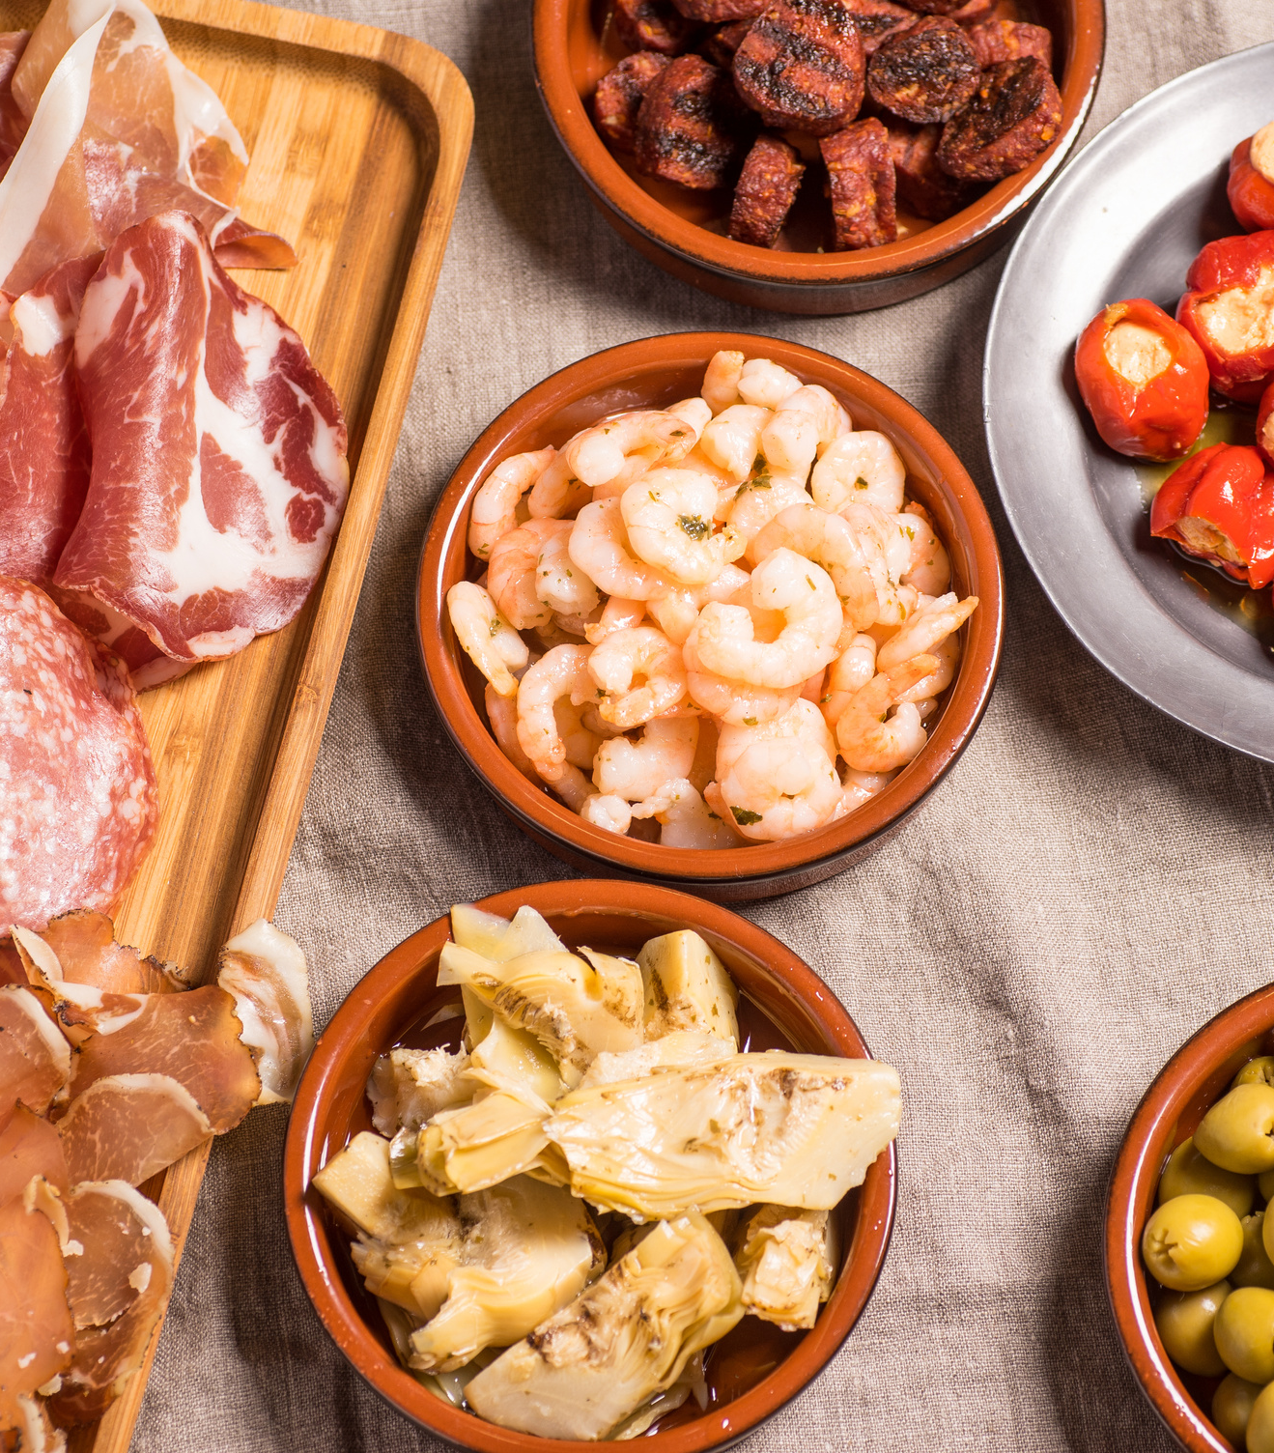
Lunch

Slide 26
Review
Preview

Slide 27
The Plan

Slide 28
Collaborative Enquiry Planning Resource
Collaborative Enquiry Planning Resource
What
How
Who with
By When
Third Field of Knowledge: What does this tell us?
First Field of Knowledge
What
How
Who with
By When
Second Field of Knowledge

Slide 30
Evaluation

Slide 31
Key Dates
System Learn - Learning is Scotland’s Future: Professor Chris Chapman & Professor Graham Donaldson
Tuesday 12th December 2023 - 09:30 - 15:30, Stirling Court Hotel
CCSL Meet Up 2
Thursday 7th March 2024 - 09:30 - 15:30, Stirling Court Hotel

Slide 32
Up coming System Learns
Connected and Collaborative Systems - Dr Simon Breakspear
Liberating Learning - Santiago Rincon Gallardo
System Learn - Learning is Scotland’s Future: Professor Chris Chapman & Professor Graham Donaldson
Systems Thinking - Virtual Staff College (Online)
Generation X - Dr Karen Edge (In Person & Online)
A Public Approach to Learning (Online)
Poverty Related Attainment Gap - Professor Morag Treanor (TBC)
Power and Positionality - Dr Khadija Mohammed (TBC)

