Slide 1


Connected
&
Collaborative
System
Leadership
Residential
6th & 7th September 2023

Slide 2


Connector

Slide 3
Aims of the Session
By the end of this session I will have: ​
​
  Develop an understanding of enquiry
  Reflected on the area of enquiry that I am considering exploring​
  Started to discuss and interrogate this theme or focus with colleagues​
  Started to develop a theory of action​
  Begin to consider the three fields of knowledge

Slide 4

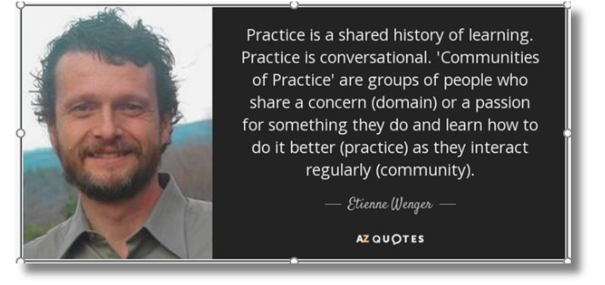
A Culture of Enquiry

Slide 5

Activity
  Introduce yourself, your context
and where you are coming from
today​
​
  Consider your experience of enquiry
and share this with your colleagues

Slide 6

Enquiry
as a
Stance
Enquiry
as a
Project
Notes:
​
What do we mean by 'enquiry as stance'? ​
Marilyn Cochran-Smith and Susan Lytle: "Working from and with an inquiry stance, then, involves a continual process of making current arrangements problematic; questioning the ways knowledge and practice are constructed, evaluated and used; and assuming that part of the work of practitioners individually and collectively is to participate in educational and social change." Cochran-Smith, M. & Lytle, S. L. (2009) Inquiry as Stance. Teachers College Press, New York. ​
What do we mean by 'enquiry as project'?​
How might an enquiring stance inform an enquiry project? How might a project influence stance? ​
Marilyn Cochran-Smith and Susan Lytle: "The essential purposes and functions of inquiry communities are to provide rich and challenging contexts for practitioner learning over the professional life span as well as making available productive locations for linking communities of educators with larger change efforts, both nationally and internationally." Cochran-Smith, M. & Lytle, S. L. (2009) Inquiry as Stance. Teachers College Press, New York. ​
Kate Wall, Anna Beck and Nova Scott: "one of the critiques we would level at the project stance on practitioner enquiry approach is that is seems to imply an on/off model of enquiry; rather it would seem more pragmatic to think about a dialling up and down of the research element depending on the motivation of the enquirer and the qualities required of an answer to any particular enquiry question. " The Nature and Purpose of Practitioner Enquiry | University of Strathclyde​

Slide 7

Thinking Enquiry
Why
What
How

Slide 8

Core Learning Session
The 'Why'

Slide 9

Improving Schools Through Collaborative Enquiry
(2005) ​
D Jackson, J McGrane, H Street, J Temperley ​
The move towards 'authentic school improvement'...
.......collaborative enquiry is a central part of a framework

Slide 10
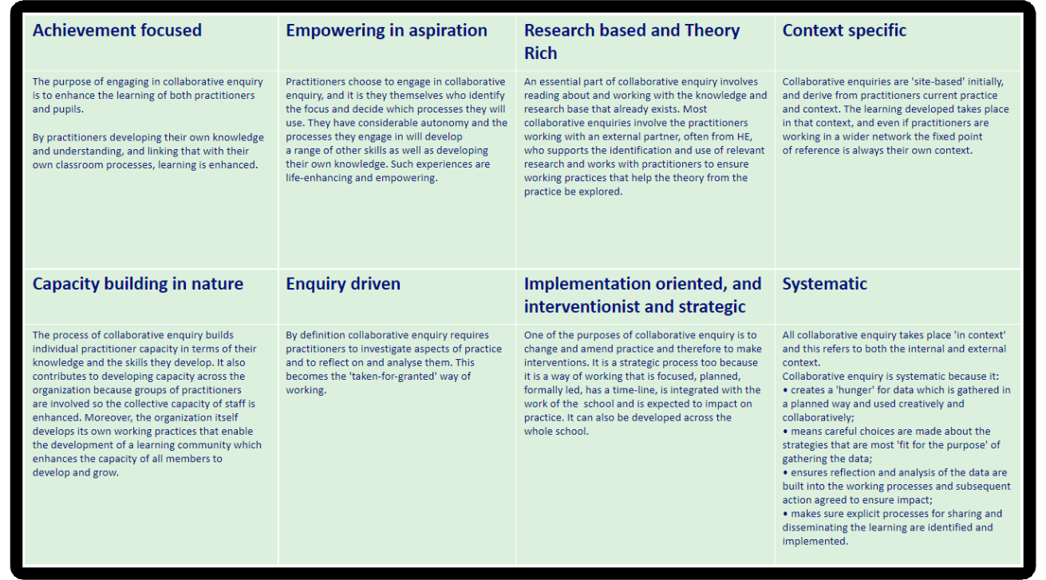
Improving Schools Through Collaborative Enquiry
Notes:
Title: Improving Schools Through Collaborative Enquiry​
Author: David Jackson, Julie McGrane, Hilary Street, Julie Temperley​
Date: 2005​
​
Lise- Drawing focus to the above title which is accessible via the GTCS Research Portal (EBSCO database)​
​
Empowering in aspiration ​
Practitioners choose to engage in collaborative enquiry, and it is they themselves who identify the focus and decide which processes they will use. They have considerable autonomy and the processes they engage in will develop​
a range of other skills as well as developing their own knowledge. Such experiences are life-enhancing and empowering.​
​
Implementation oriented, and interventionist and strategic​
One of the purposes of collaborative enquiry is to change and amend practice and therefore to make interventions. It is a strategic process too because it is a way of working that is focused, planned, formally led, has a time-line, is integrated with the work of the school and is expected to impact on practice. It can also be developed across the​
whole school.​
​
Systematic​
All collaborative enquiry takes place 'in context' and this refers to both the internal and external context.​
Collaborative enquiry is systematic because it:​
• creates a 'hunger' for data which is gathered in a planned way and used creatively and collaboratively;​
• means careful choices are made about the strategies that are most 'fit for the purpose' of gathering the data;​
• ensures reflection and analysis of the data are built into the working processes and subsequent action agreed to ensure impact;​
• makes sure explicit processes for sharing and disseminating the learning are identified and implemented.​
Why Enquiry? ​
Achievement focused ​
The purpose of engaging in collaborative enquiry is to enhance the learning of both practitioners and pupils.​
By practitioners developing their own knowledge and understanding, and linking that with their own classroom processes, learning is enhanced.

Slide 11
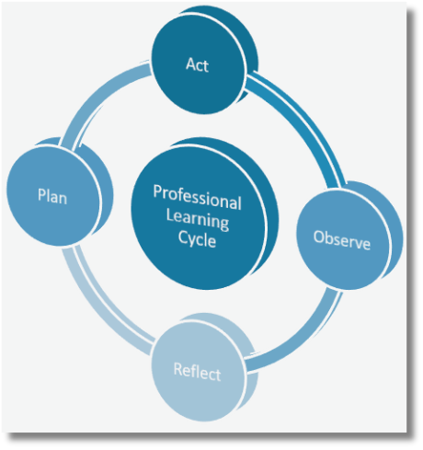
Why Enquiry?
‘By closely examining and reflecting on the results
of their actions, individuals and teams begin to think differently.
They begin to question long-standing beliefs and consider
implications for their professional practices’ (Donohoo, 2016)
Collaborative Enquiry is a process that challenges thinking and practice.
Relational trust has been found to be a particularly strong facilitator of
the kind of professional community that is required for collaborative
inquiry to reach its potential for improved practice (Katz, 2009) ​​
This conception of trust goes beyond that of goodwill and friendship,
though such “companion trust” is certainly essential. It extends to include
respect for each other’s dignity and idea, belief in each other’s competence, and a confidence in each other’s integrity to put students first ​
(Katz, Earl & Jaafar, 2009) ​
Notes:
An enquiry approach has the greatest impact upon those who are undertaking the enquiry by investigating the question, they develop the knowledge and skills around the question. However, by interacting with the collaborative team and others they further develop their professional, attitudes and beliefs.

Slide 12
Coffee Break

Slide 13

Core Learning Session
The 'What'

Slide 14

The capacity of teachers to critically shape their responses to problematic and complex situations, mobilising prior experience to manoeuvre between repertoires for action in the light of reflection on alternative futures.​
Priestley, Biesta, Robinson 2015​
Notes:
We ended our last session having had a lively discussion on empowerment; 'we need to drive the bus' and lack common understanding of empowerment in face of the accountability agenda and a warning of 'be careful what you wish for' (Martin Mc Cusker)​
This view sees agency has having three temporal dimensions. First, agency is rooted in past experience; and individuals with a wide repertoire of experience to draw upon may achieve agency more readily than those with a less rich reservoir of experience. Secondly, agency is always oriented to the future through the setting of goals and the ability to envisage future possibilities; in this case, people who are able to imagine multiple trajectories are likely to achieve agency more readily than those who are limited in their aspirations. Third, agency is always acted on the present. There are two aspects to this dimension: the practical (i.e. what is actually possible given existing resources and in the face of existing constraints); and the evaluative (e.g. judgements about risk – and it is axiomatic in social science that perceived barriers to action can be as real in their effects as actual constraints)

Slide 15

Activity
Think about a time when you did 'agency'(were agentic)
What were the conditions and environment which supported your agency?

Slide 16
Agency
  Agency is dependent on the interplay of the individual (capacity-skills, knowledge, beliefs) and conditions (culture, structures and material resources and constraints)
  Agency is not something that people possess; it is something that people do or, something they achieve.​
  “This concept of agency highlights that actors always act by means of their environment rather than simply in their environment [so that] the achievement of agency will always result from the interplay of individual efforts, available resources and contextual and structural factors as they come together in particular and, in a sense, always unique situations.”
  (Biesta & Tedder, 2007: 137).

Slide 17
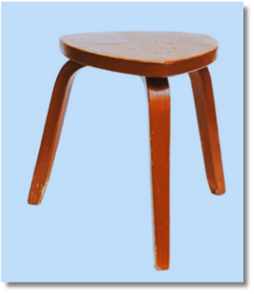


Slide 18



Activity
Time to collaborate
In groups, think of a time when you successfully worked collaboratively:

Slide 19

Collabor-ability​
As a leader​.........
  What am I willing to leave at the door?
​
  What am I able to put into the pot?​
  When am I willing to stay around when there is no immediate gain for me and my organisation?​​
Lynn Sharrat (2018)

Slide 20

A Think Piece
from the
Association of Directors of Education
in Scotland
(2019)
The central tenant of the current reforms is to develop an excellent and equitable education system that can support all children and young people (and lifelong learners?) to succeed irrespective of where they come from. One of the key mechanisms to make this happen is through the empowerment of different parts of the system to encourage more autonomous cultures with (hopefully) increased joint responsibility for decision-making and outcomes across a range of stakeholders.
This requires leaders across the system to reject traditional forms of leadership that is based on positional power and hierarchy and adopt a collaborative stance whereby leaders model the values and practices of collaborative leadership in a range of settings across the system. Put simply, we need a cadre of senior educational leaders who equally value and are equally well-equipped working with small groups of teachers, their peers, ministers and colleagues from other services and sectors.
This will mean that our leaders will need to lead improvement efforts outside their normal operational space, hierarchies and across professional boundaries. Ultimately, this will facilitate the shift in ownership of the reform that will be required to embed and sustain the new ways of working in an empowered system.​

Slide 21

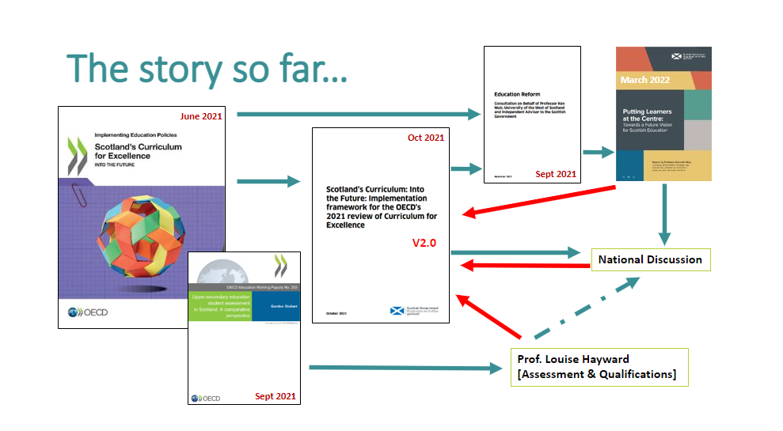
Joining the dots

Slide 22
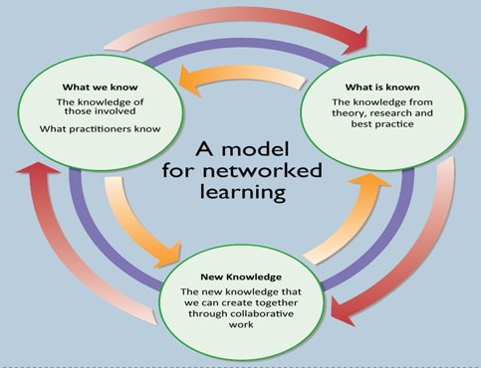
Three Fields of Knowledge
(NCSL, 2006)
“The aim of knowledge animation is creation of new knowledge
by learning communities that will help people enhance their practice
and policy. This new knowledge takes centre stage and is the outcome of connecting what individuals know and what is known ‘out there’, external research. Knowledge animation provides the collaborative processes for new knowledge creation by ensuring that what is known is connected to what people know through collaborative dialogic processes”​

Slide 23
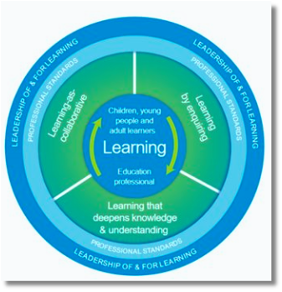
National Model of Professional Learning
  Asking critical questions about self, and learners within your context​
  Reflecting on professional practice, learning and the learning of learners within your context encourages metacognitive knowledge and skills​
  Supporting dispositions around risk-taking, being open to change and ready to innovate​
  Critically examining a wide range of sources of information to inform knowledge and understanding​
  Asking questions about impact, about the progress of learners and their learning​
  Enquiry based professional learning encourages informed decision making and clearer articulation of ‘why’ we are teaching and learning in the way we are, promoting voice around the 'so what?’ and 'what now'?​
  Develops professional agency and voice – educators as leaders of change​

Slide 24

Our Professional Standards
2.2.2 Fully understand and demonstrate self-awareness and inspire and motivate others​
  Regularly challenge your thinking and practice through critical reflection and enquiry;​
​
3.3.1 Co-create and lead a culture which promotes and sustains career-long professional learning across the school and learning ​
  Develop and engage in professional enquiry as a key element of a sustainable professional learning culture;​
​3.4.1 Establish, enable, and sustain a range of inclusive, resilient, and adaptive relationships, processes and practices which engender an ethos and culture of self-evaluation at every level in the school and learning community​
  facilitate an open, honest and critical stance in examining practice through modelling and promoting good practice in self-evaluation at every level.​

Slide 25


Slide 26

Core Learning Session
The 'How'

Slide 27

Collaborative enquiry is a structure in which members of a professional learning community come together to systematically examine their educational practices, to:​
  Ask questions ​
  Develop a theory of action ​
  Determine action steps​
  Develop and test hypotheses​
  Gather and analyse evidence​
  Assess impact of their actions​
  Share and celebrate the learning​
  Debrief the process
Notes:
Facilitator: Andy​
Collaborative inquiry is a powerful design for professional learning that supports teacher leadership. It provides a systematic approach for educators to explore issues and determine resolutions through shared inquiry, reflection, and dialogue. Rather than being merely consumers of research and the professional knowledge that accompanies it, head teachers engaged in collaborative inquiry become producers and disseminators of knowledge.​
Collaborative inquiry should be conceived as a professional learning strategy as opposed to a rigorous research design. It is a powerful strategy for building head teachers' capacity to lead because it provides a structure for them to become authentic leaders and decision makers.​
Jenni Donohoo (ref below)​
CI as a PL approach to resolve Adaptive Challenges​
When individuals and organisations meet adaptive challenges (one for which the necessary knowledge to solve the problem does not yet exist) they themselves become something different- they adapt. Change of this magnitude is hard as people’s ideas about how things work are not easily reconstructed. By focusing on professional learning approaches that challenge mental models and engaging people in learning and working collaboratively, they will be more likely to meet adaptive challenges. (Heifetz, Grashow, Linsky (2009))​
​
https://www.bing.com/ck/a?!&&p=7f603f8c7be21a28JmltdHM9MTY2MzYzMjAwMCZpZ3VpZD0xYzA4YThhNi04MGVlLTY3YmUtMjU2ZS1iODY4ODEyZTY2ZmEmaW5zaWQ9NTM1NQ&ptn=3&hsh=3&fclid=1c08a8a6-80ee-67be-256e-b868812e66fa&u=a1aHR0cHM6Ly93d3cuamVubmlkb25vaG9vLmNvbS9wb3N0L2Zvc3RlcmluZy10ZWFjaGVyLWxlYWRlcnNoaXAtdGhyb3VnaC1jb2xsYWJvcmF0aXZlLWlucXVpcnk&ntb=1​
​
Collaborative inquiry should be conceived as a professional learning strategy as opposed to a rigorous research design. It is a powerful strategy for building teachers' capacity to lead because it provides a structure for teachers to become authentic leaders and decision makers. Leadership opportunities extend beyond merely serving on a committee or acting as a department or grade level chair. Through their collaborative work and learning by doing teachers have the potential to become more meaningfully involved in school- improvement and catalysts for change.​
The four-stage model begins with teachers framing a problem of practice. During this first stage, teachers determine a meaningful focus, develop an inquiry question, and formulate a theory of action. The most effective collaborative inquiry teacher teams keep in mind that their end goal is to increase learning and achieve greater success for all students. Therefore, they begin by identifying current student learning needs in order to ensure that their inquiry is authentic, relevant, and worth the investment. The focus of their inquiry must also be an issue individuals can act upon. Identifying promising approaches and implementing changes in practice are key elements in this process. If the problem the team identifies falls outside their realm of control (Stephen Covey Speres of Influence), there will be little they can do to impact change.​
For What Reason. When formulating a theory of action, teacher teams compose a sequence of 'if - then' statements that illustrate the causality between their actions and expected outcomes. Framing theories in the form of a hypothesis (if - then) compels educators to consider causes (instructional and/or leadership practices) that precede effects (student learning/teacher learning). It helps to uncover relationships between teaching and learning and/or leading and change as teams examine what they think will work against the realities of what is actually happening given their existing culture, specific context, and unique population.​
During stage 2 of the collaborative inquiry process, teachers work together to develop new knowledge and competencies and implement changes in practice. They also identify sources of information that will help answer their inquiry question and collect evidence about how their actions are impacting students. Once teacher teams feel they have gathered enough information to address the question posed, teams engage in analyzing the evidence (stage 3). Teachers make meaning of data by identifying patterns and themes and formulating conclusions. As teams refine their thinking, they revisit their theory of action accordingly.​
During the fourth and final stage, teachers come together to document, share, and celebrate their new understandings. Teams consider next steps by identifying additional student learning needs and reflecting on what they learned through their inquiries. Finally, participants debrief the process by considering how their work was reflective of the characteristics of collaborative inquiry.​
​
​
​

Slide 28
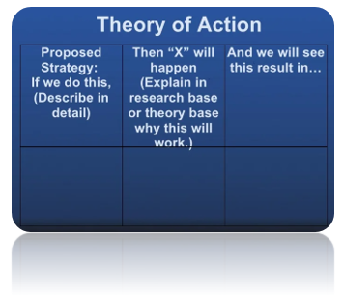
Developing a Theory of Action That Will Travel Well​
A theory of action is …………..​
​
  a set of underlying assumptions about ​
how we will move our organisation from ​
its current state to its desired future.​
​
  Grounded in research or evidence-based practice​
(City, Elmore, Fiarman and Teitel,2009)​

Slide 29
If you are successful, what will the results be:​
What is your preferred future?
Possible future-things that could happen but are unlikely​
Probable future- things that probably will happen unless something is done to turn events around
​
Preferred futures- things that you would prefer to happen and/or that you would definitely like to happen
Notes:
Facilitator: Andy​
Another useful thinking tool​
Focusing on their ‘preferred future’ can tie down ideas into specificity and reach a shared vision​
Facilitator thinking points/discussion:​
Where are we now in relation to preferred future?​
What have we tried so far?​
What factors or obstacles have prevented us from achieving the level of success we desire?​
What is our role in creating this outcome:​
What do we know (that we need to know)? ​
What don’t we know YET (that we need to know)?​
What don’t we know at all?

Slide 30

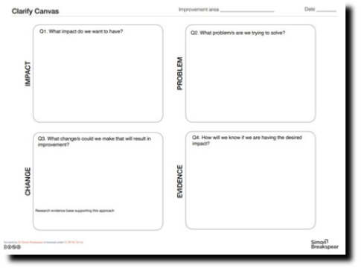
Activity
Think about the area of enquiry that you are considering
and complete your clarify canvas
(30 minutes)

Slide 31
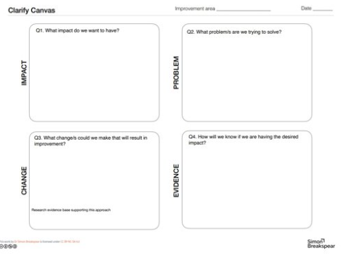

One person at the table talks through their clarify canvas( no more than 5 minutes) with the others listening. After each person has had a chance to share their thinking, identify similarities and differences and be ready to share with the room.

Slide 32
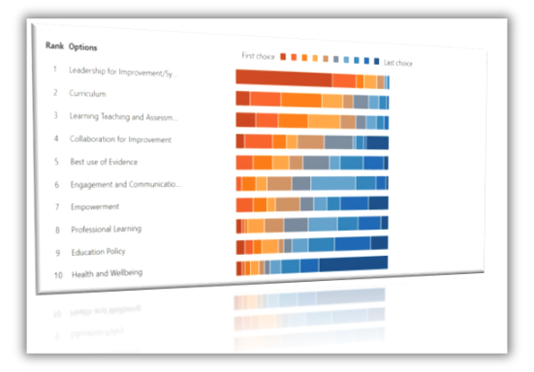

Forming Groups
“Planning requires deliberate and strategic thinking. Before a group begins planning, each group member needs time to think about their own commitment to being a part of a rigorous inquiry.” ​
(Facilitator’s guide to Collaborative Enquiry 2012)​

Slide 33
Forming Groups
Share your ‘why’ for this group (10 minutes each)​
​
​
Feedback to the room – key points from your discussion​

Slide 34

Further Refinement
Notes:
Moving from Trios to Groups to further refine thinking and understanding –​
​
In what ways did the trio exercise clarify your thinking, interrupt your thinking, change your thinking ​
​
Investigate your potential area of enquiry, further with the group ​
​
30mins around 3 mins per person ​
​
Nominate scribe and timekeeper ​
​
Padlet to note feedback and areas ​
​

Slide 35
Where do I begin my research?​
  How do we get from the current state to the desired state?​
​
  What are the vital actions that will improve e.g. teaching and learning?​
  What evidence do we have that these actions will be successful in our local context?​
​
  As a result of these actions, what will happen?​
​
  How will this transform e.g. the teaching-learning experience?​
​
  How will this action impact students?​
​
  What will this action lead to?​
​
  What results will we see?

Slide 36

What is a Theory of Action?​
A theory of action is …………..​
​
a set of underlying assumptions about how we will move our organisation from its current state ​to its desired future.​
​
Aligns intended theory with the realities of work within your context and the ‘system’.​
​
Connects strategy to the actions and relationships critical to achieving improvement.​
​
Identify the mutual dependencies that are required to get the complex work of​
improvement done.​
​Grounded in research or evidence-based practice.​
​
(City, Elmore, Fiarman and Teitel,2009)​
​

Slide 37


