Slide 1
Connected and Collaborative Systems Leadership
Day Two
Iain McDermott - Lead specialist
Chris French - Lead specialist

Slide 2
Session objectives
Explore and sense-make the latest policy landscape through a systems lens
Further develop an understanding of the key elements of what leading collaborative systems looks like
Build relationships and take time to consider the rationale for your enquiry
Provide time and space to consider ways to support capacity to contribute to extending system leadership across a collaborative and connected system

Slide 3
Connector
Notes:
Card task

Slide 4
System Leaders and System Leadership

Slide 5
Notes:
Provocations from Professor Alma Harris, Tri nations Symposium, June 2023
https://youtu.be/ildFx1OXhjI

Slide 6
Defining System Leadership
System leadership should not be associated with any singular formal role
It largely involves connecting parts of the system that were not connected before.
System leadership means working across organisational boundaries
System leadership is creating new conditions, links and capacity for change and improvement
Professor Alma Harris, Tri-Nations Symposium, June 2023
Notes:
Provocations from Professor Alma Harris, Tri nations Symposium, June 2023

Slide 7
Notes:
Taking the four key provocations (slide 6/7), what are our observations?
Using two colours of sticky notes, visit each provocation in turn around the room and annotate flipcharts with barriers and opportunities

Slide 8
Defining System Leadership
'…those willing to improve other schools
and systems in addition to their own.'
‘…see the multiple system components and the inter-related sets of challenges.’
Fullan 2005
‘…tend not to accept business as usual.’
Fullan 2005
‘…collectively charged with the development
of others and the improvement of the system.’
Hopkins et al 2014
Harris, 2020
Notes:
What else does the research say about SL?
System Leaders and System Leadership: Reviewing the Evidence (2020) Professor Alma Harris Swansea University School of Education. Welsh Insight Series.
This review of the international evidence base explored the contemporary literature concerning system leaders and system leadership. It focused on some country examples (including Scotland) to highlight different approaches to system leaders/ship.

Slide 9
How do Alma’s bullet points link with the rationale/aims for CCSL?
Are early connections with possible enquiry themes beginning to emerge?
Notes:
Table discussions:

Slide 10
Break

Slide 11
Public Health approach to Learning
Public Health Scotland and Education Scotland
Eileen Scott

Slide 12
INTRODUCTION
Education plays a pivotal role in promoting public health and well-being.
Healthy development is critical to education.
The Covid-19 pandemic highlighted this interconnectedness.
There is a need for ongoing and deeper connection

Slide 13
SOLUTION
Offer by Education Scotland and Public Health Scotland to work with them to develop a whole system approach to public health and education
PROBLEM
"In what ways can professionals work together to ensure a better future for all?"
Question posed by Headteachers in Excellence in Headship Stretch

Slide 14
Through collaboration, we aim:
To improve health and education outcomes for children and young people in Scotland, and to reduce inequalities in these outcomes

Slide 15
THE WHY?
Education has long been recognised as one of the fundamental social determinants of health.
Accessible and quality education contributes to better health outcomes.
Improved educational attainment is associated with lower rates of chronic diseases and mortality.

Slide 16
Educational Settings are Health Promoting and vital anchor institutions:
Schools have a significant impact on health, playing a crucial role in promoting health among students and the wider community.
Educational institutions can serve as hubs that go beyond education to provide access to health services, extended childcare, adult learning, and community activities.

Slide 17
Collaboration between Education and Health Sectors:
Effective collaboration between the education and health sectors is essential for addressing public health challenges.
Joint efforts can lead to comprehensive school health programs, integrating education and health promotion.
Sharing resources, expertise, and research findings can drive evidence-based interventions and policies.

Slide 19
KEEP MOVING FORWARD, TOGETHER

Slide 20
A National Context for System Leadership
Stobart
Review
Consultation
Launch
National Discussion (ND)
Muir
Review
Implementation
Framework V2.0
Women in
Enterprise
Review
SLF
2022
1st year of
new Gov
New
School
Year
New Agency
High level
Blueprints
OECD
Review
Financial
Year
Implementation
Framework V1.0
M | J | J | A | S | O | N | D | J | F | M | A | M | J | J | A | S | O | N | D | J | F | M | A
2021 |  |  |  |  |  |  |  | 2022 |  |  |  |  |  |  |  |  |  |  |  | 2023

Slide 21
A National Context for System Leadership
Equality,
Opportunity,
Community
Skills
Delivery
Review
SG OECD
Papers
New Education Agency & New Inspection Agency?
Prof
Hayward
Report
Women in
Enterprise
Review
Scottish Government Response?
National
Discussion
Report
LfS Strategy
Purposes &
Principles
J | F | M | A | M | J | J | A | S | O | N | D | J | F | M | A | M | J | J | A | S | O | N | D
School Year 22/23 |  |  |  |  |  |  | School Year 23/24 |  |  |  |  |  |  |  |  |  |  |  | School Year 24/25
2023 |  |  |  |  |  |  |  |  |  |  |  | 2024

Slide 22
‘…a future education system in Scotland would benefit from greater system synergy (that) reflects a coherent, co-ordinated, and interdependent system, involving all key players in an integrated but not overly bureaucratic way.’
‘…the need for the Scottish education system to be much more of a learning system that is able to take risks and to embark upon significant, bold and ambitious reform.’ (P.19)
All Learners in Scotland Matter: Our National Discussion A Summary Report: Scottish Government 2023

Slide 23
‘…for the reform to have personal and professional integrity everyone who has a role to play in making the innovation successful should be involved in its design and development.’ (P.28)
‘In Scotland, a wide range of organisations have to align to support the process of change in any innovation.’ (P.29)
It's Our Future - Independent Review of Qualifications and Assessment: Scottish Government 2023

Slide 24
'Organisations and individuals have, perhaps naturally, tended to focus on their own role in delivery or part of the landscape rather than looking across the system for solutions or opportunities. This approach can be indicative of systems that are fractured or have gaps in the clarity of roles, processes or individual parts.’ (p.5)
Fit for the Future: developing a post-school learning system to fuel economic transformation. Withers, 2023

Slide 25
‘The landscape is complex and will continue to be so. The unique opportunity this Review presents is to make that complexity visible, to establish an agreed baseline for positive action and to prioritise and energise a critical area of public life.’ (P.16)
‘Co-creation and collaboration with children, young people and their families will support more coherent, inclusive and all-encompassing policy making, which improves implementation, impact and experience.’ (P.14)
Support for Learning: All our Children and All their Potential, Scottish Government 2020

Slide 26
Review and
Key Recommendations
Priorities: P.22-24
Overview of
recommendations:
P.69-72
Summary recommendations
P.63-69
Call to Action: P.14-22
Notes:
Sense making of policy (2023 remix)
Sections for initial horizon-scan
Reflective questions - what, so what, now what?
Fishbone – 1 per report (problem identified by group) – click on fishbone icon for short descriptor video

Slide 27
Notes:
https://youtu.be/4eteSMuum6k?si=JvJb0N4vIlt4-Fsm

Slide 28
Lunch

Slide 29
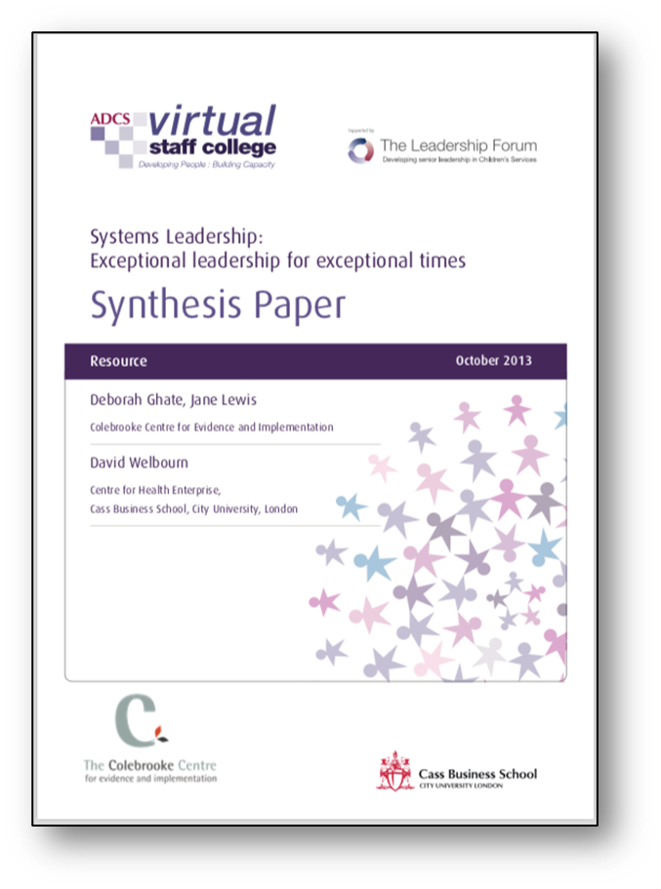
System Leadership:
“Leadership as participation rather than
leadership as performance”
achieved through:
Influence and nudge
Alignment around a common vision or purpose
Focus on outcomes and results not just process
Strong but robust and honest relationships
Mindset rather than specific behaviours and actions
Notes:
Looking back – looking forward.
A revisit to the VSC paper and the starting point of our introductory learning about System Leadership (for some, back to initial MSSL learning)
A reminder of these bullet points:
VSC_Synthesis_exec_complete.pdf (leadershipcentre.org.uk)

Slide 30
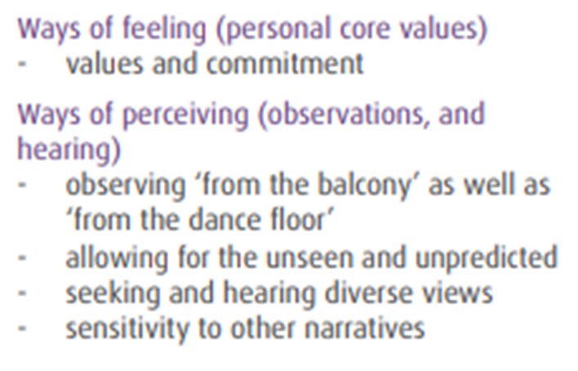
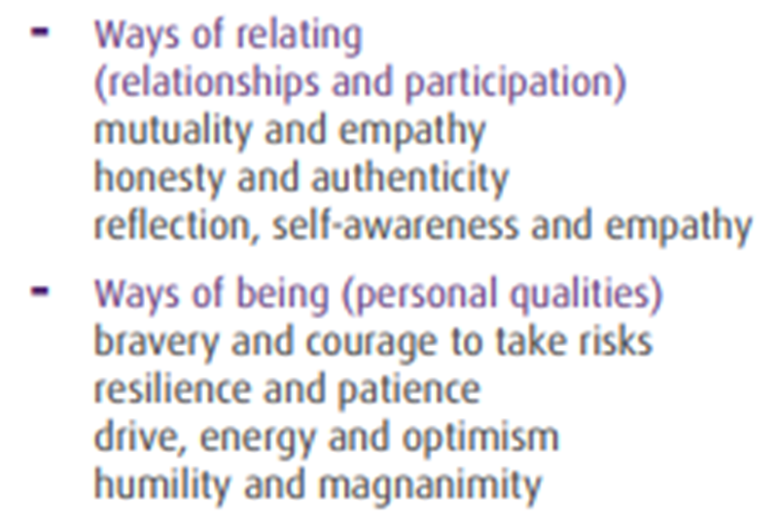
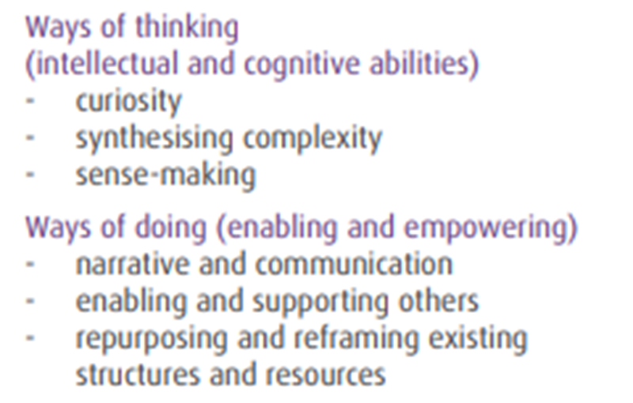
Notes:
The diagram on P.10 and the appendix on P.11 highlight some significant provocations on the way we feel, perceive, relate, be, think and do.

Slide 31
Need to Know
What else do you need to know or find out about this idea?
What additional information would help you
to evaluate things?
Worrisome
What do you find worrisome about this idea?
What’s the downside?
Excited
What excites you about this idea?
What’s the upside?
Stance or Suggestion for Moving Forward
What is your current stance or opinion on the idea?
How might you move forward
in your evaluation of this idea or proposition?
Notes:
Purpose: Why use this routine?
This routine helps participants flesh out an idea or proposition and eventually evaluate it.
Application: When and where can I use it?
This routine works well to explore various sides and facets of a proposition or idea prior to exploring it further.
Launch: What are some tips for starting and using this routine? The routine is generally easiest for participants to begin with what is exciting or positive about the idea and then move to worrisome and need to know. Participants may wish to write down their individual stance or suggestion for moving forward after the initial group discussion.

Slide 32
Collaborative
connections
Notes:
45 min – where are we?
An opportunity for the group to begin sense making from what policy and research is saying and the potential for enquiry.
In table groups, take time to discuss today so far.

Slide 33
Generate a list of ideas and initial thoughts that come to mind when
you think about this particular topic/issue.
Sort your ideas according to how central or tangential they are. Place central ideas near the centre and more tangential ideas toward the outside of the page.
Connect your ideas by drawing connecting lines between ideas that have something in common. Explain and write in a short sentence how the ideas are connected.
Elaborate on any of the ideas/thoughts you have written so far by
adding new ideas that expand, extend, or add to your initial ideas.
Notes:
Purpose: What kind of thinking does this routine encourage?
This routine activates prior knowledge and helps to generate ideas about a topic. It also facilitates making connections among ideas. Concept maps help to uncover mental models of a topic in a non-linear way

Slide 34
‘But education for the future is not about adding more to the pile of things teachers and school leaders are expected to do. It is about pausing to redefine our key priorities, and then learning to do things differently.’
‘Effective school and system leaders manage to tap into their institutional power to support and liberate those they lead, to leverage and partner with those 'above' them in the institutional hierarchy, and to connect and collaborate laterally with their peers in larger community to pursue shared interests.’
‘Social movements, rather than large bureaucracies, have historically been agents of cultural change.’

Slide 36
Tuesday, 19th September 09.30-16:30 - ‘Connected and Collaborative Systems Learn - Developing capabilities to understand and influence the system’ - Dr Simon Breakspear and Professor Steve Munby
Wednesday 27th September 09:30 – 16:30 - Liberating Learning with Santiago Rincon Gallardo – A System Learn in association with the Scottish Learning Festival Conversations programme of events. This session will feature a keynote and Q and A session with the Cabinet Secretary for Education and Skills.

Slide 37
Coming soon!
Public Health Scotland – learning across systems
Dr. Karen Edge
Donaldson and Chapman – Learning is Scotland’s Future

Slide 38
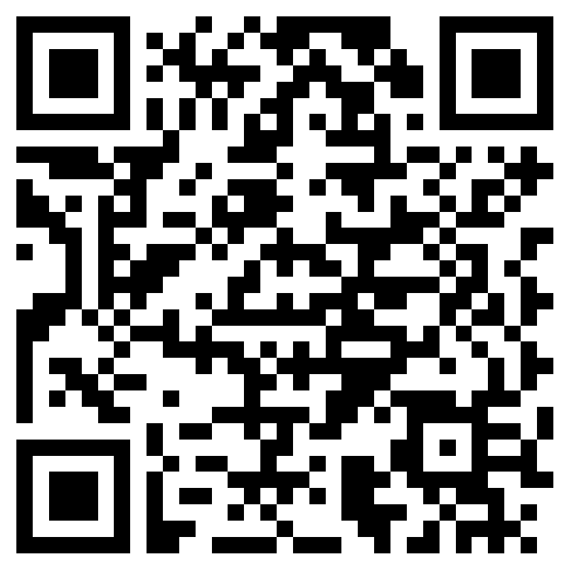
Session objectives
Explore and sense-make the latest policy landscape through a systems lens
Further develop an understanding of the key elements of what leading collaborative systems looks like
Build relationships and take time to consider the rationale for your enquiry
Provide time and space to consider ways to support capacity to contribute to extending system leadership across a collaborative and connected system

