Slide 1


We will be starting shortly
Please add your name and location to the chat pane
What musical joy would you like to share with your colleagues?
This Photo by Unknown author is licensed under CC BY.

Slide 2
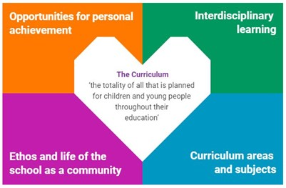
Excellence in Headship Learn
Interdisciplinary Learning - How
For Scotland's learners, with Scotland's educators
For Scotland's learners, with Scotland's educators
Notes:
Feel we should model leading a meeting effectively online – openness, respect, honesty, humour and keep to timings.

Slide 3
Protocols and expectations
Please mute your microphone when you are not speaking- this will prevent any background noise interference.
Cameras are optional- but work well in the small breakout groups.
We will not record this session.
You can use the chat pane function to post a resource link or to make a comment for others in the meeting to see.
You all have something valuable to contribute but you are not expected to be experts. This session is a non-judgemental, collective thinking and sharing space. Everyone is invited to share their experiences, thoughts, ideas, resources, questions and worries.
For Scotland's learners, with Scotland's educators

Slide 4

Learning agenda
Welcome , Introductions, Protocol
Recap of What
Examples of IDL
Break
How? Agency and collaborative enquiry
Close
For Scotland's learners, with Scotland's educators

Slide 5



This Photo by Unknown author is licensed under C BY.
For Scotland's learners, with Scotland's educators
Notes:
“What resonate with you and is at the top of your head?”
Global warming ENVIRONMENT
AI TECHNOLOGY
Pandemic HEALTH and WELLBEING
Issues that are too big for one person or one discipline
WHY
1. Making the case for why; Breakspear –cycle crisis, adaptation and opportunity , meeting the needs of learners eg UNCRC, LEGO Creativity, Skills 4.0, OECD Education 2030 equipping children & young people for 21st century (and the 22nd!) ICEA report. Hayward review.
Resilience planning- IDL worked well in lockdown – part of your contingency planning (resilience)
Building success and confidence through IDL process and output (the product of IDL)
WHAT
2. What's Critical -negotiating exercise
3. Looks like (see), sounds like (hear), feels like (feel)
4. Ambitious learning definition
5. Fruit bowl, salad, smoothie visual metaphor
6. What: looking at underlying principles of IDL. Diamond nine. Generating your own definition

Slide 6
IDL Characteristics
Diamond 9

Slide 7
Deepen learning experience
Be relevant, collaborative and inclusive
Creating understanding and knowledge of the world
Allow for developing transferrable skills
Take account of local context
Elizabeth

Slide 8
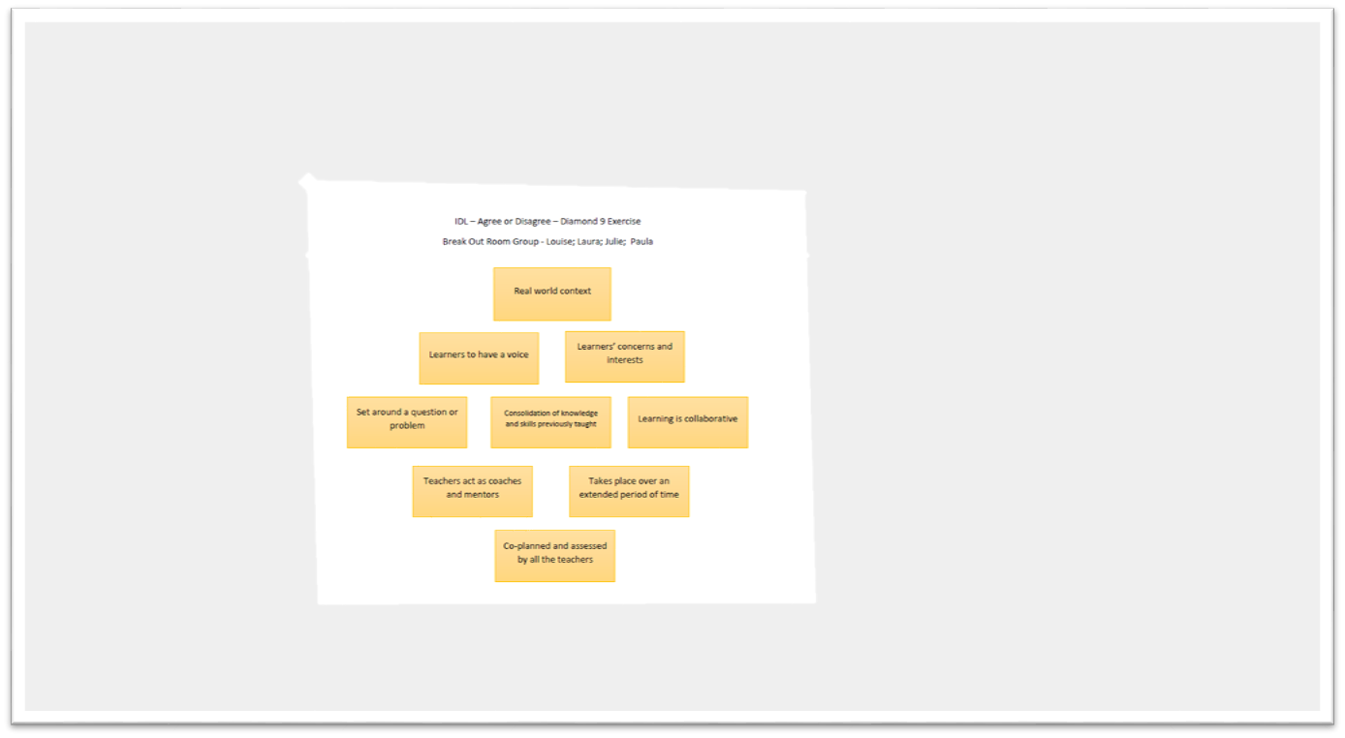

Slide 9
IDL Diamond 9
IDL starts with learners’ concerns and interests
IDL contains student choice in task and or timing
IDL enables learners to have a voice
Teachers act as coaches and mentors
IDL is a catalyst for depth to new learning / application of skills
IDL has genuine / relevant links between curricular areas
IDL is planned around Experiences and Outcomes
IDL has a real-world context / IDL is set around a question or a problem
Learning is collaborative / IDL features an output or product that allows learners to show others what they have learned. Andrew (Falkirk)

Slide 10
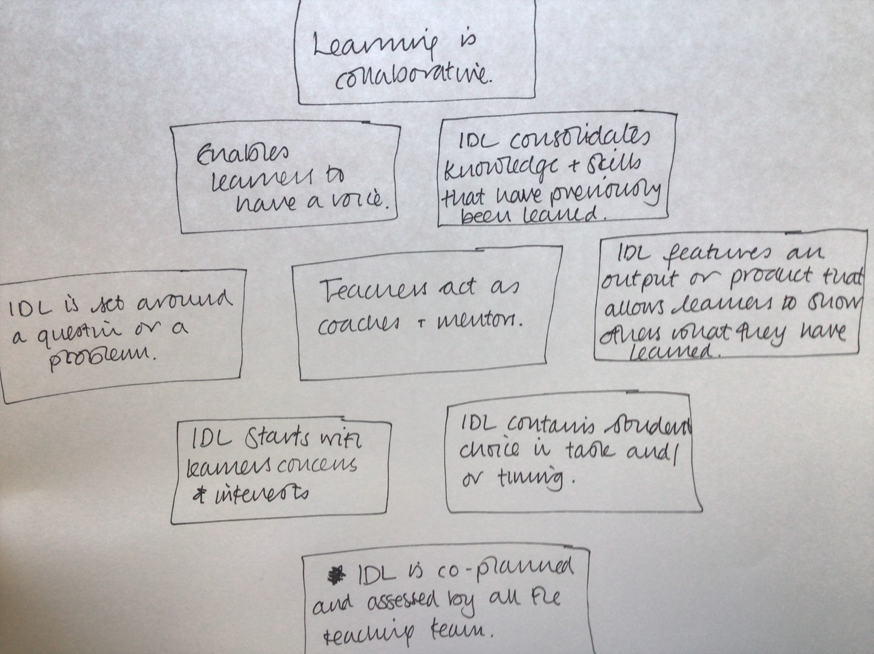
Seonaidh (Glas)

Slide 11
IDL Diamond 9
IDL starts with learners' concerns and interests
Learning is collaborative IDL has a real world context
Enables learners to have a voice IDL features an output etc... Teachers act as coaches/mentors
IDL set around a question/problem Consolidates knowledge and skills previously taught
IDL is planned around subject knowledge
Marie (Fife)

Slide 12
IDL enables learners to have a voice
IDL features and output or product that allows learners to show others what they have learned.
Teachers act as coaches and mentors
IDL starts with learners’ concerns and interests Learning is collaborative IDL has a real-world context
IDL is set around a question or a problem IDL contains student choice in task and/or timing
IDL is planned around subject knowledge

Slide 13
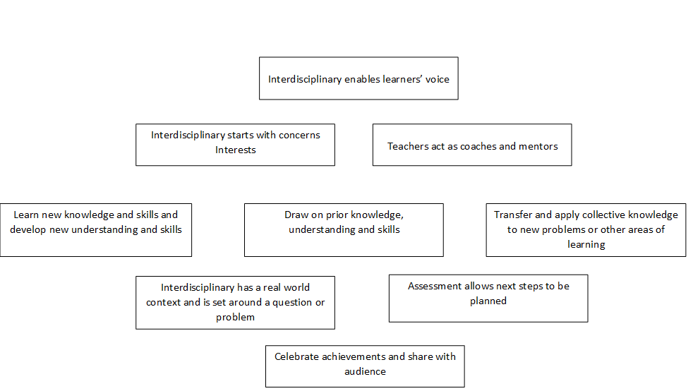

Slide 14
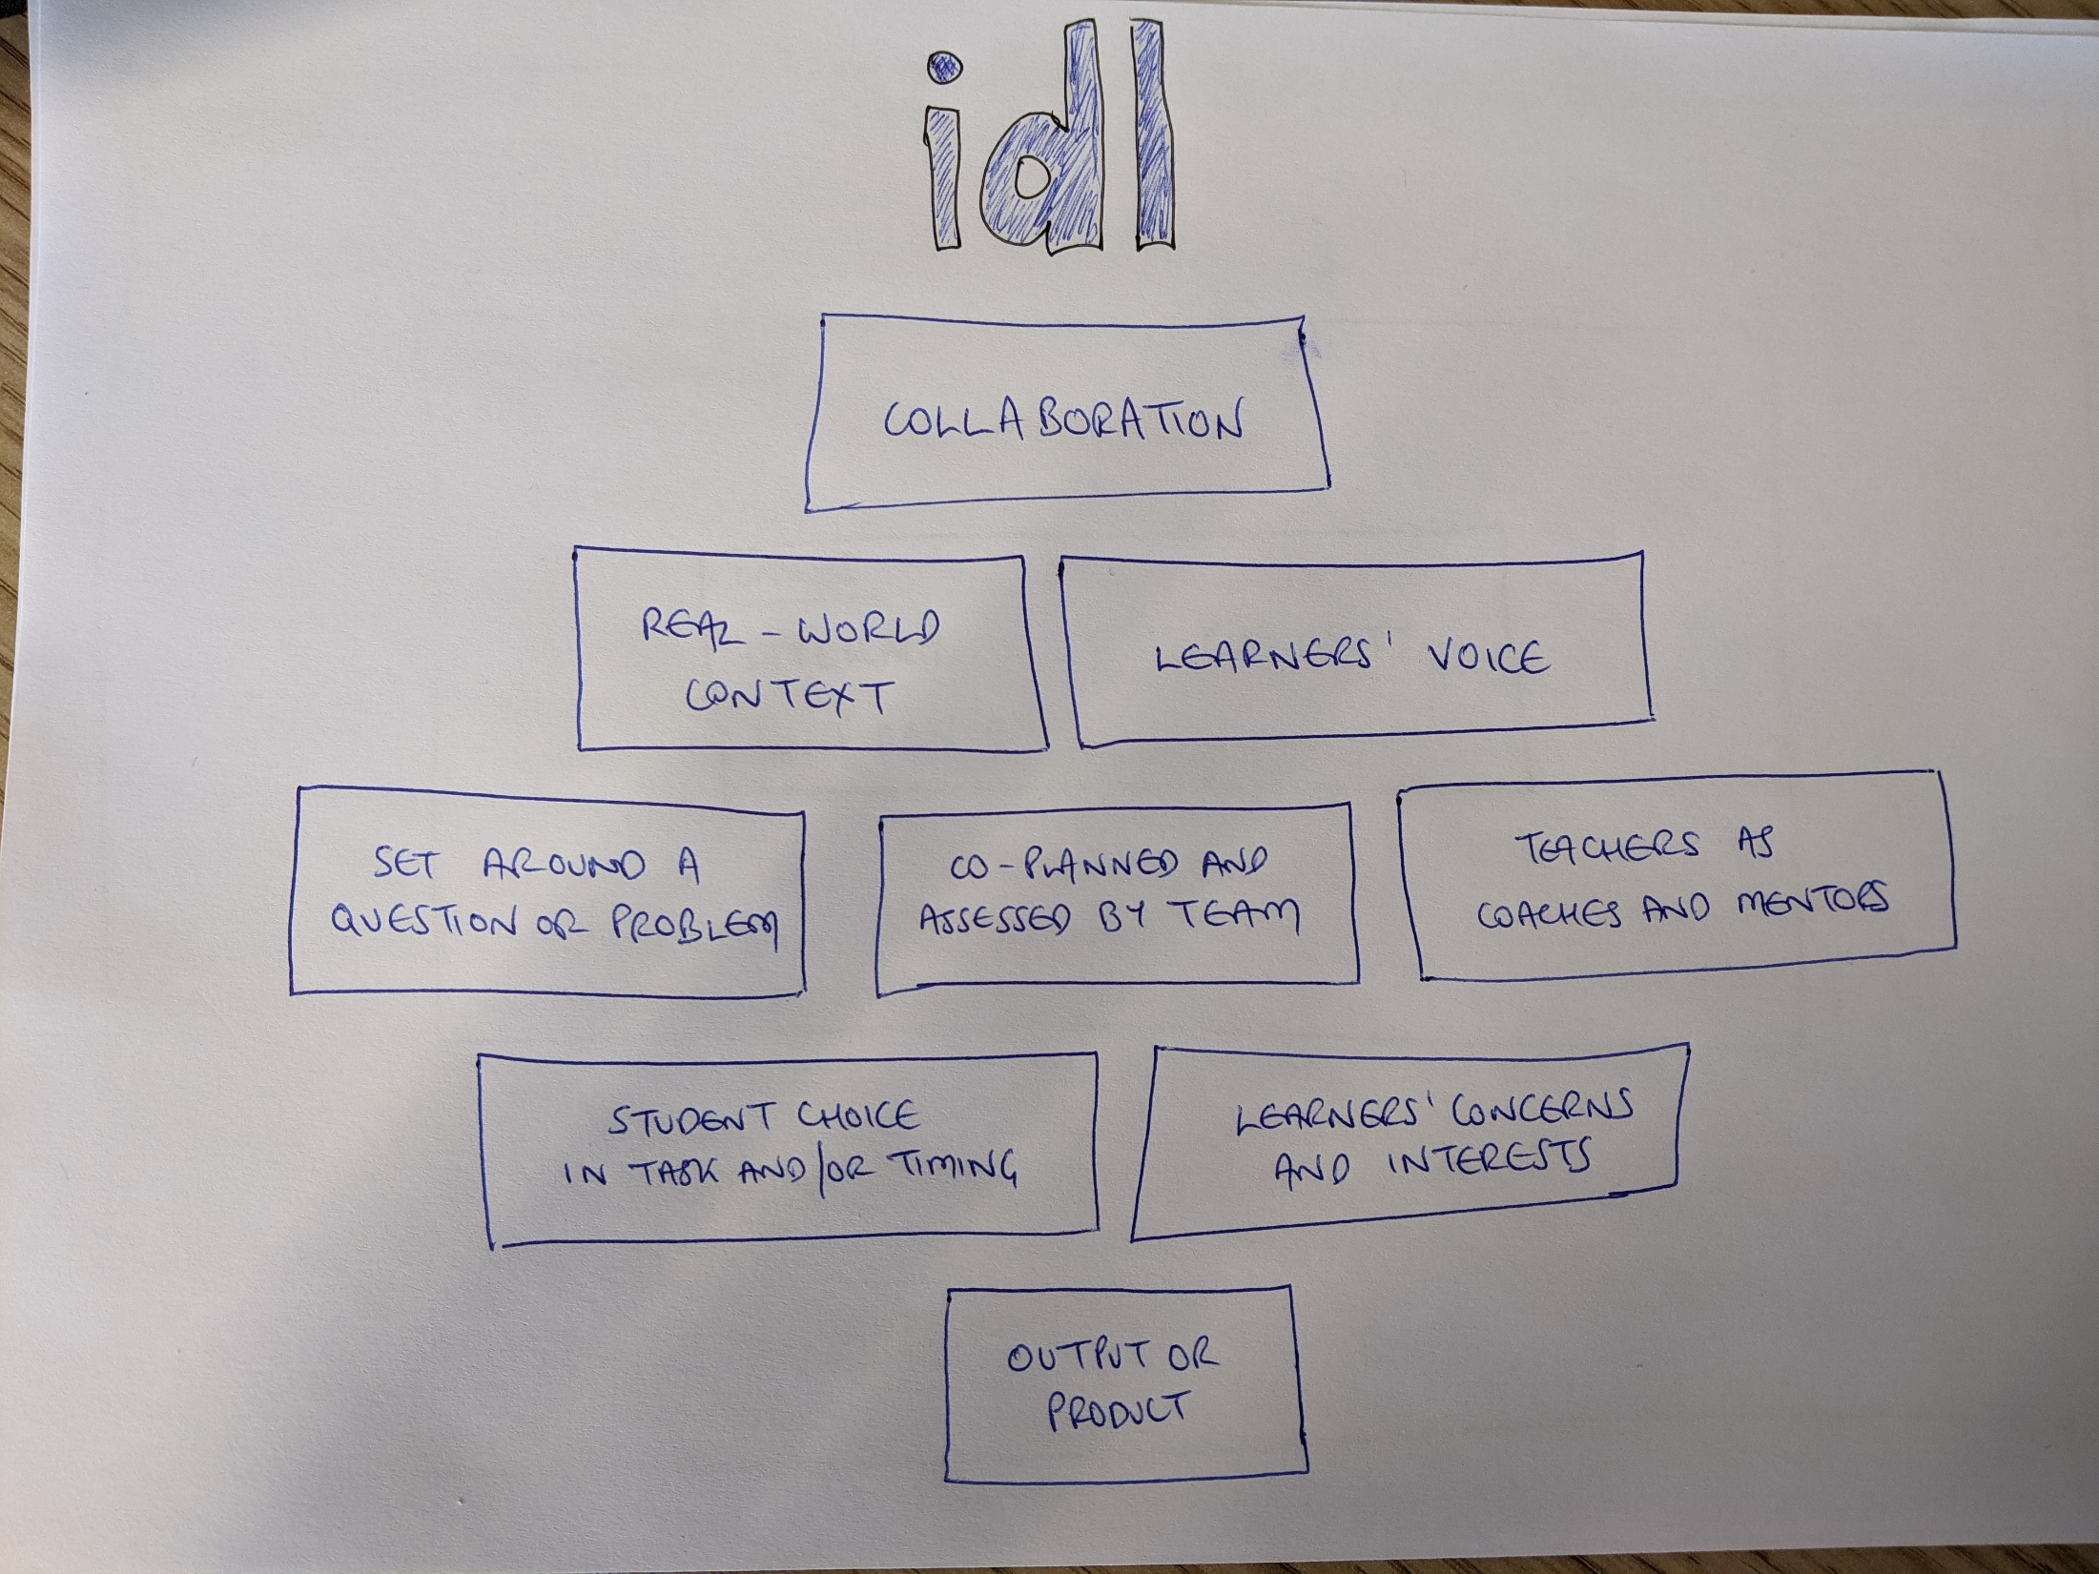

Slide 15
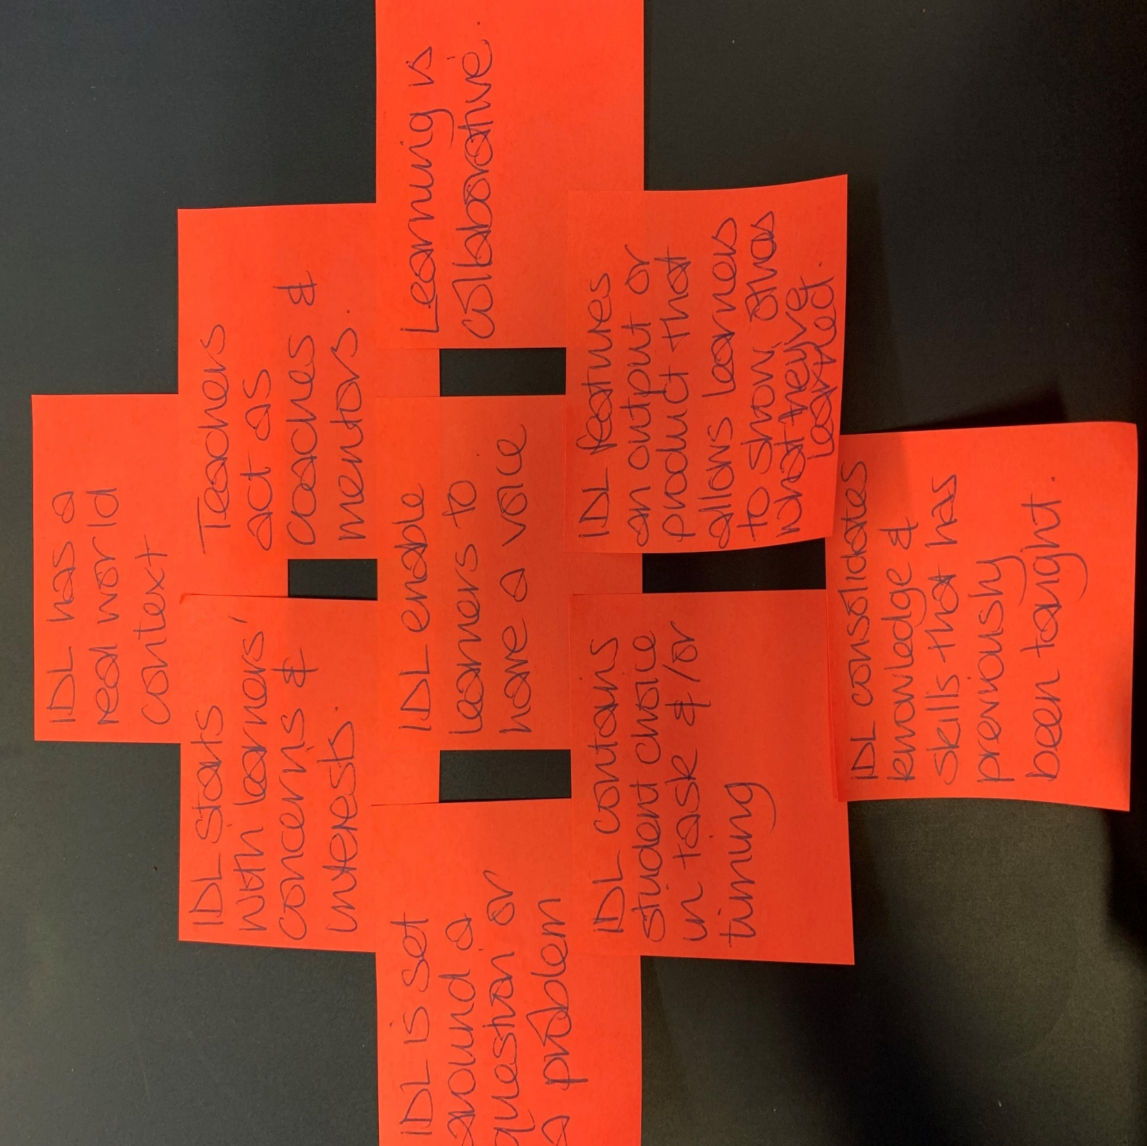

Slide 16
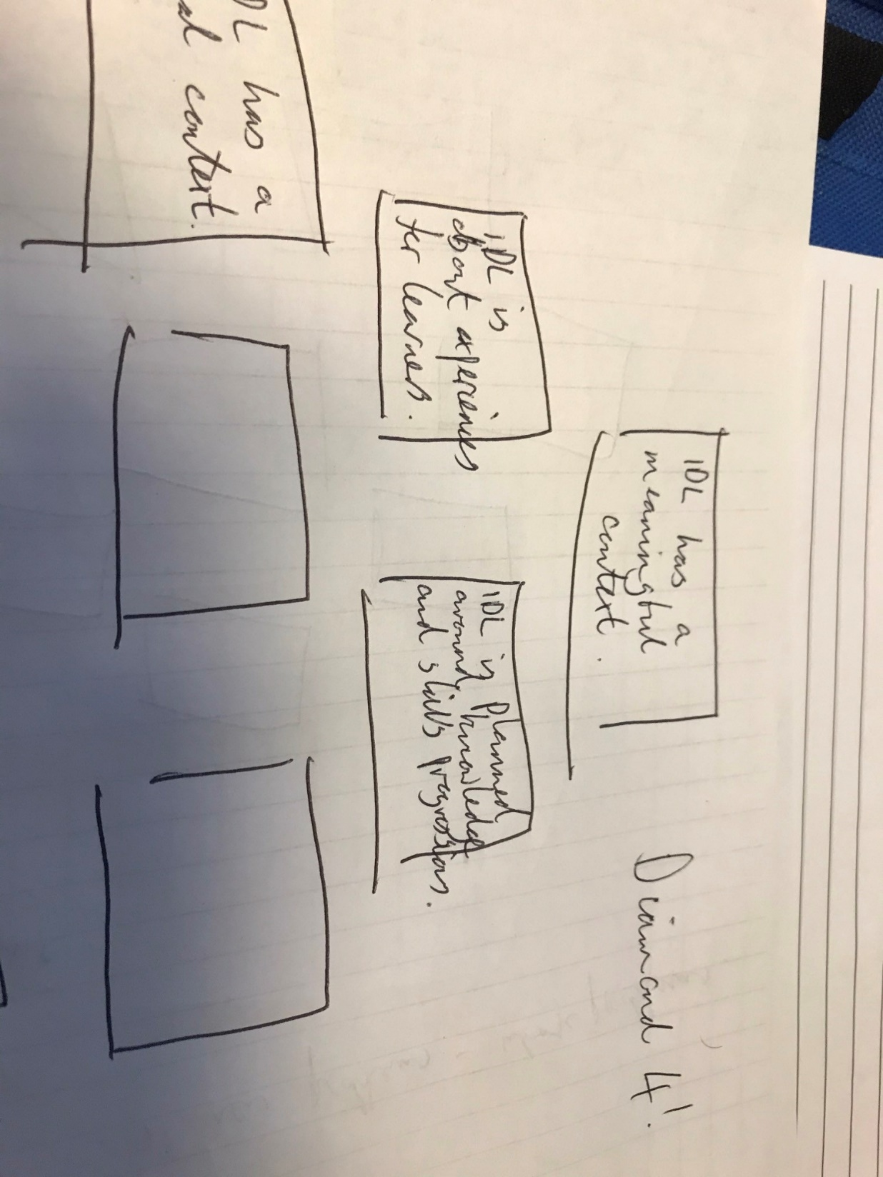

Slide 17
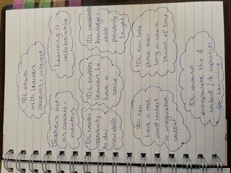

Slide 18
Key features of IDL –
IDL starts with learners concerns and interests
IDL has a
real-world context
IDL is co-planned and assessed by all the teaching team
IDL is set around a question or a problem
IDL consolidates knowledge and skills that has previously been taught
IDL enables learners to have a voice
IDL takes place over an extended period of time
Visible output
IDL is planned around subject knowledge
Teachers as coaches & mentors
Notes:
Leading into breakout activity 1
Lets look at some examples of IDL and see how they measure up against the key features and/or the checklist
Put in file for breakout

Slide 19
PMI
Plus
Minus
Interesting
Plus- What I liked or thought might be useful
Minus – What I didn't like or thought to be unhelpful.
Interesting – Found interesting but was more neutral
Notes:
Use the positive, minus and neutral to think about, makes notes on the next section on
IDL and multidisciplinary
Project based learning PBL
Two Scottish examples; one primary and one secondary

Slide 20
✅: Required ✓ : May include | Interdisciplinary Learning (e.g. several disciplines collaborate on one project) | Multi-disciplinary learning (e.g. several disciplines contribute to a project)
Practitioners from different curricular areas plan together. | ✅ | ✓
Learning is generally framed as projects, and may use Project-Based Learning planning tools and approaches. | ✅ | ✅
Planning connects disciplines and project outcomes across the four contexts. | ✅ | ✓
Discipline knowledge, understanding and skills are necessary and directed towards the project’s outcomes. | ✅
Prior knowledge and skills are transferred and applied to new problems, challenges or contexts. | ✅ | ✓
New knowledge and skills are encountered. | ✅ | ✓
Learners take planned time to reflect on connections between disciplines. | ✅
Learners reach each outcome using several disciplines. | ✅
Assessment of the learning is shared between disciplines. | ✅
(Interdisciplinary Learning: ambitious learning for an increasingly complex world, page 5)
Notes:
Put in file for breakout
About PBLWorks | PBLWorks

Slide 21
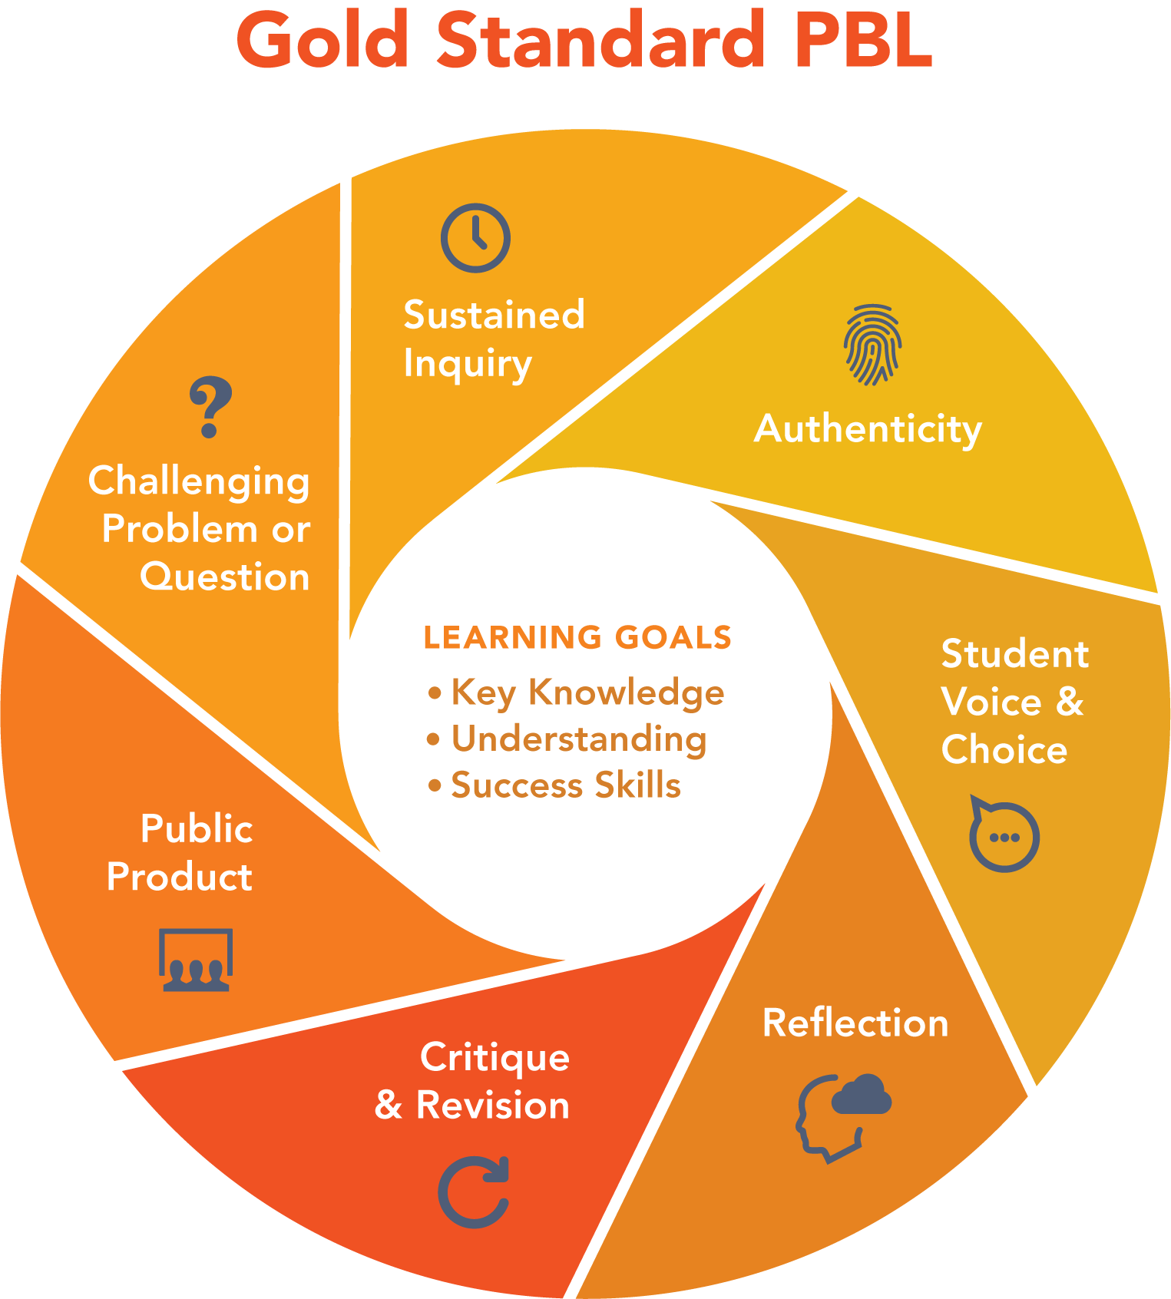
What is Project Based Learning? | PBLWorks
Notes:
What is Project Based Learning? | PBLWorks
About PBLWorks | PBLWorks

Slide 22
4 key ideas
There is no such thing as a bad idea from students in a classroom setting (no matter how creative or ambitious)
Students learn so much when they have to lead, teach, mentor, and support each other (this can’t be left solely up to only to teachers)
Multimedia (ie. videos, websites, articles/blogs) is the base building block, but technology is the enabler not the driver (students are)
There has to be a real, authentic audience beyond your classroom (break down those walls)
PBL works

Slide 23
Planning IDL- Historical walking tours
Consider Your Students
  What do students (and/or their families) already know about the history of their local community?
  How will you make this project meaningful to students who are newer to the community, as well as students whose families may have been in the community longer?
  How can you leverage, build on, and expand the perspectives that students are bringing to this conversation?
Consider the Context
  What specific events would make the most sense to focus on given your community’s history and your state standards?
  What primary and secondary source materials might be available to support student learning about people and events in your local community? What might be missing and how will you fill that gap?
  What local experts (e.g., historians, elders, activists) or institutions (e.g., historical societies, universities, tribal councils, museums) could serve as partners in this project?
Consider the Content & Skills
  What models and examples of historical narratives and markers might you provide to students?
  How will you scaffold students’ research and writing skills throughout this project? What literacy strategies, graphic organizers, and feedback protocols can you use to support students and build their skills?
  How will you support your students in learning to hold and/or take on multiple perspectives? What might be challenging about this?

Slide 24
Evidencing IDL - major products
Individual Products
Individual output –personal response
Personal reflection explaining how the photo from the team essay inspired the creation of the personal response
Reflection on the process of learning
Team/Whole Class Products
Photo essays on hunger in the team’s community
Making It Public
Presentation of the photo essay and gallery to community members from the school, local organizations, or the subjects of the photos

Slide 25
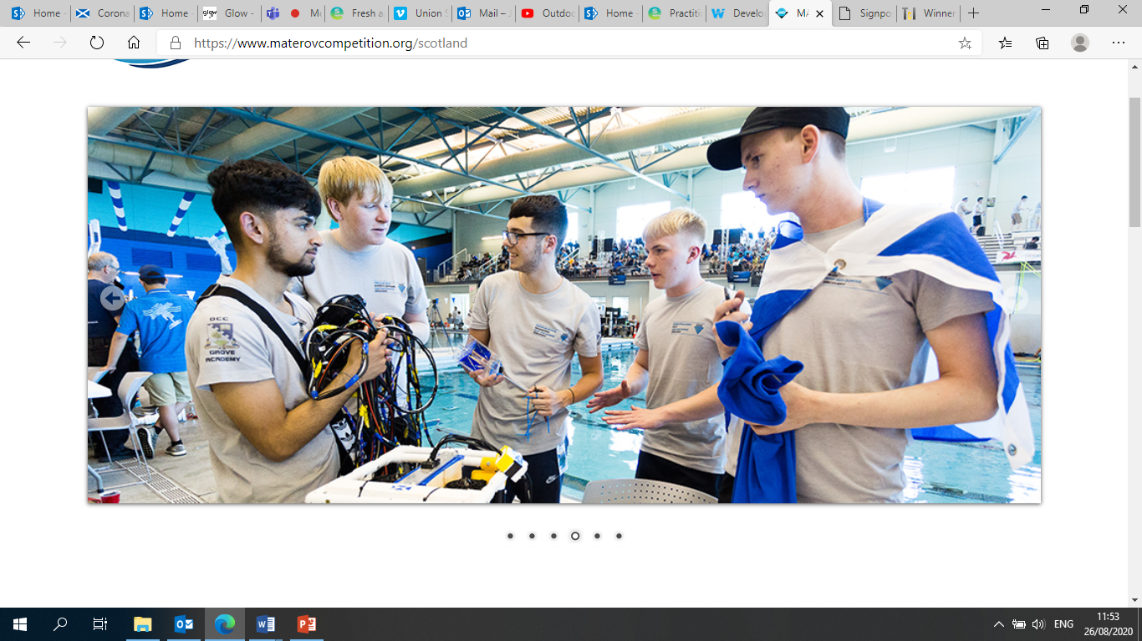
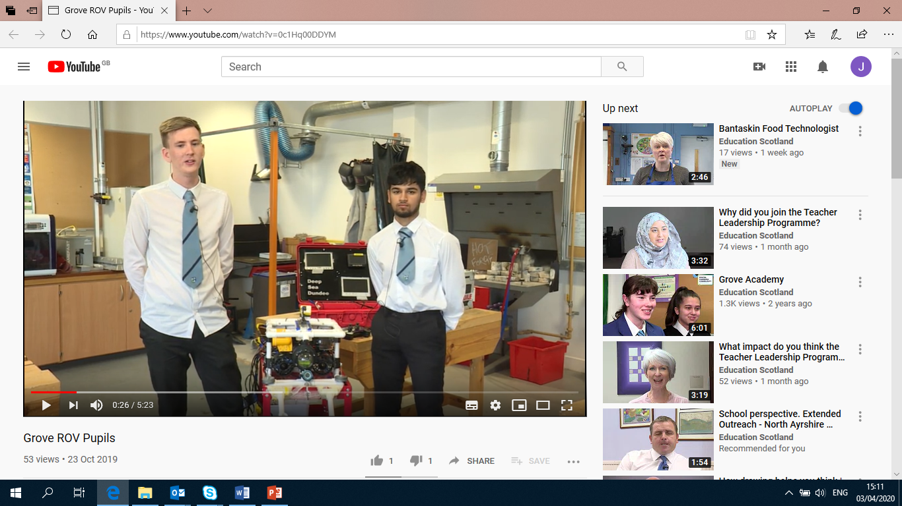
MATE ROV Competition
Senior Phase at Grove Academy
Course developed in response to feedback from Further Education
For Scotland's learners, with Scotland's educators
For Scotland's learners, with Scotland's educators
Notes:
Film can be viewed here
More about IDL at Grove Academy

Slide 26

IDL at Grove Academy – MATE ROV course in 6th year
Opportunities for personal achievement
Interdisciplinary Learning
Developing skills and attributes through leadership roles
Clear links to career paths – wide including engineering, marketing, business studies.
Positive destinations included Universities, Colleges, Apprenticeships
.
Pupils enter the International MATE ROV competition, co-ordinated and hosted by Robert Gordon’s University
The competition challenges students to tackle problems that impact the entire world.
Representing school in locally, national and internationally
Business links with NCR Dundee
Fundraising for travel to USA for international competition
Advanced Engineering Programme
Engineering Science
Graphic Communication
Design and Manufacture
I
Curriculum areas and subjects
Ethos and life of the school as a community
Notes:
Put in file for breakout
For secondary colleagues

Slide 27
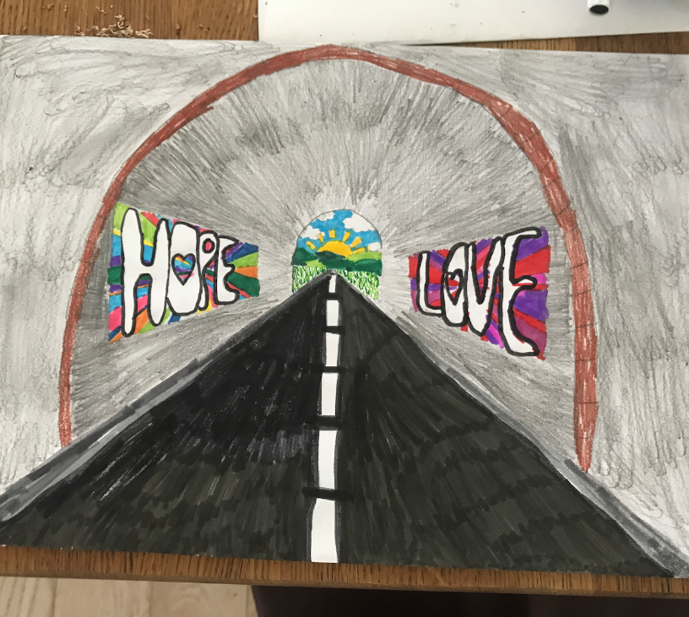
Case Study from Hazlehead School
How to thrive in difficult times
Developed and delivered remotely during Term 4 session 2019-20
Impact
95% engagement from learners
New ways of working – has transformed their curriculum delivery
Enhanced skill set of all staff
https://sites.google.com/ab-ed.org/hazleheads-idl-journey/home
https://education.gov.scot/media/20flphza/idl-case-study_-hazlehead-school-primary.pdf
For Scotland's learners, with Scotland's educators
Notes:
https://sites.google.com/ab-ed.org/hazleheads-idl-journey/home
https://education.gov.scot/media/20flphza/idl-case-study_-hazlehead-school-primary.pdf
Fresh approaches to interdisciplinary learning | Learning resources | National Improvement Hub (education.gov.scot)

Slide 28

IDL at Hazlehead Primary School
Journal
Film
Diary
Artefact
Sculpture ..
Opportunities for personal achievement
Interdisciplinary Learning
Create a product that shares the challenges and opportunities that you have experienced during lockdown. Identify the skills and attributes that have helped you thrive.
Identify and research key figures from the past who have coped well during times of adversity and discuss the skills and attributes they demonstrated Consider resources, scaffolds and activities that might be helpful
Research information about strategies for coping during stressful situations – this might include healthy eating and exercise, relaxation techniques, connecting with others and your community.. Consider resources such as input from practitioners, families, partners and community members.
.
Skills
Knowledge
New Learning
IDL
Key Partners
Business Sector
Community …
Knowledge and skills from prior learning
Exemplifications of strategies and skills from partners
Health and Wellbeing activities
Exhibition of shared learning– virtual and ‘in school’
I am learning skills and strategies which will support me in challenging times, particularly in relation to change and loss. HWB 2-07a
Prior Learning
Resources for learners
I can use primary and secondary sources selectively to research events in the past. SOC 2-01a I can compare and contrast a society in the past with my own and contribute to a discussion of the similarities and differences. SOC 2-04a
Curriculum areas and subjects
Ethos and life of the school as a community
Notes:
Hazlehead started looking at IDL differently using prior learning from the curriculum areas to build on
Looking at opportunities to enhance the ethos and life - e.g. key partners shared strategies they had used to support them during lockdown and exemplified new skills they’d developed
Using the IDL challenge to offer personalisation and choice to support opportunities for personal achievement – and also to use this to support the pupils to articulate the skills.
Different way of looking at four contexts.

Slide 29
7 Stages in Hazelhead PS IDL
Stage 1: How do you inspire? Design a Knowledge Harvest for teaching teams, choose the cross-curricular contexts for an IDL project that makes the most of the local setting.
Stage 2: What do they know? Implement a Knowledge Harvest with learners’ prior knowledge on the context and generate scores of questions.
Stage 3: How do you build on what they know? Plan Rich Experiences Based on what learners already know, and the questions they want to explore. The teacher plans and curates experiences, activities and content that relate to the E&Os
Stage 4: How do you stretch every learner? Co-design Outcomes Further planning kicks in, collaboratively between practitioners within a specific Level and specialist subject areas. Teachers share their Big Questions from class to class.
Notes:
Resources to support the Refreshed Curriculum for Excellence Narrative | Learning resources | National Improvement Hub (education.gov.scot)

Slide 30
7 Stages in Hazelhead PS IDL
Stage 5: How do you build skills and understanding? Plan the experiences. Staff plan the final content, experiences and expected outcomes for learning that involves specialists and other colleagues.
Stage 6: How do you keep momentum? Learn, feedback and document Rich tasks will provide a range of entry points and expectations, and choice so that learners can push themselves into new ground.
Stage 7: How do you involve others? Exhibit. Exhibition is often perceived as something that happens solely at the end of a project. But an IDL project will see learners share early ideas, drafts and iterations of their thinking, as they build one idea on another.
The Listening Teacher. Giving learners more responsibility does not reduce the role of the teacher; it increases it.
Assessment and impact. Ongoing, formative assessment. It’s easier to see when learners are struggling, or when they need to be pushed, when you’ve got “circuit routines” and “thinking recipes” to hand, built up over time.
Notes:
Resources to support the Refreshed Curriculum for Excellence Narrative | Learning resources | National Improvement Hub (education.gov.scot)

Slide 31
In breakout rooms – think about these models of interdisciplinary learning, PBL and multidisciplinary learning and discuss your PMI charts
For Scotland's learners, with Scotland's educators
Notes:
BREAKOUT ACTIVITY 1
30 minutes ½ hour

Slide 32
Feedback

Slide 33

Coffee Break
For Scotland's learners, with Scotland's educators
Notes:
15 minute coffee and comfort

Slide 34
Key considerations from the thought paper
The whole person – knowledge, skills and wellbeing
Lifelong breadth in learning
Learning with purpose, with partners
IDL is learning
More than just ‘engagement’: deep thinking and deep learning
Collaborative learning, teacher coaches
Shared goals, not dictated goals
Realising ambition, embracing opportunities and building confidence
Challenge realises ambitious learning, opens opportunities
Build confidence through a shared language
For Scotland's learners, with Scotland's educators
Notes:
How does this resonate with you
Chat pane or conversation

Slide 35
CfE – modern 'international' curriculum
Emphasis on generic skills. Competencies. But not skills v knowledge!
Learner centred. Student agency. Active learning
Teachers must act as change agents- creating the curriculum.
  Reduced prescription means an intended curriculum that needs to be enacted.
  Sense making, bring the document into action. Curriculum making a living process
Partnerships. In/between schools, community, agency, business partnerships

Slide 36
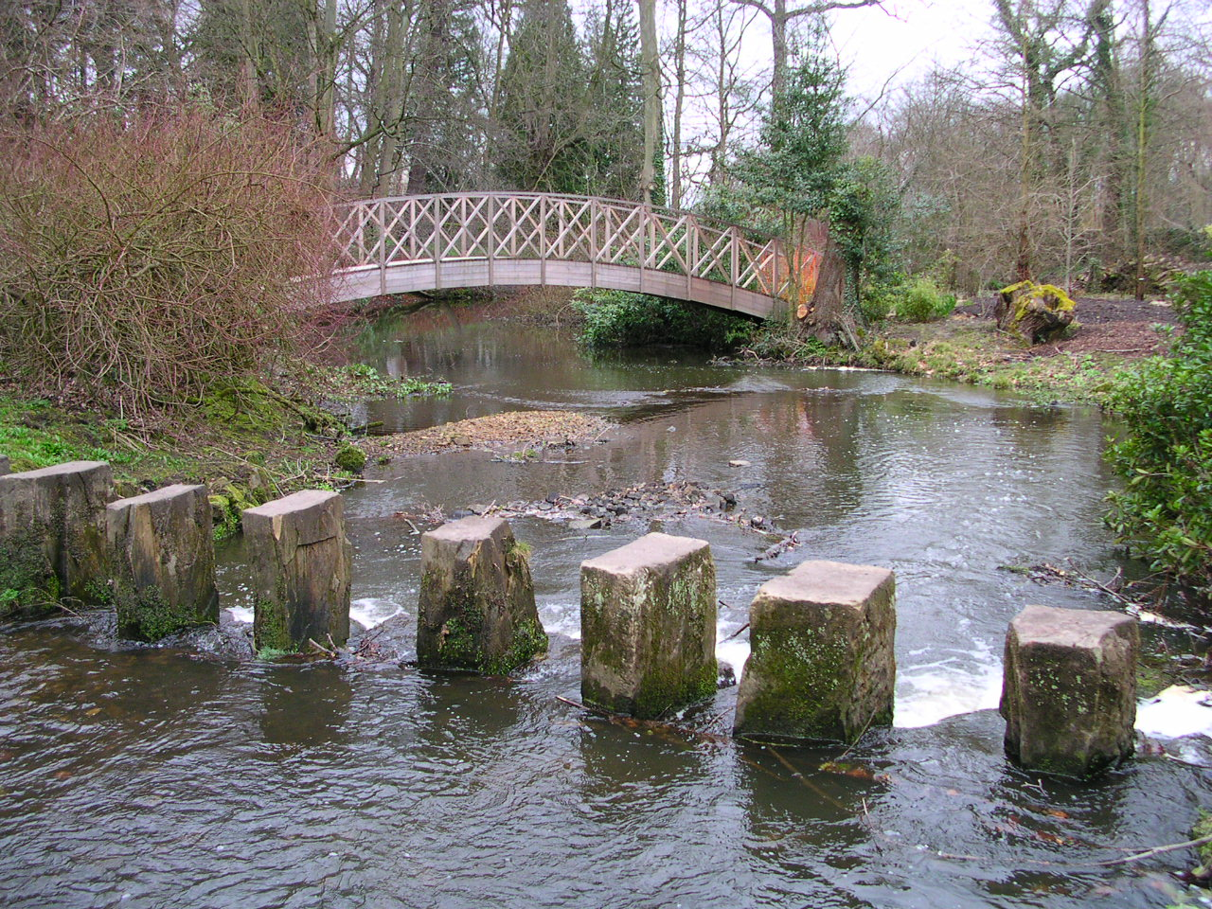
Building your way to IDL in your context.
“While IDL is one of the most distinctive and innovative features of Curriculum for Excellence, it has not yet been widely developed in our schools.” Royal Society of Edinburgh - Interdisciplinary Learning in Schools (Feb 2020)
For what reason has IDL not yet been widely developed in our schools?
This Photo by Unknown author is licensed under CC BY-SA.
For Scotland's learners, with Scotland's educators
Notes:
BREAKOUT ACTIVITY 10'

Slide 37
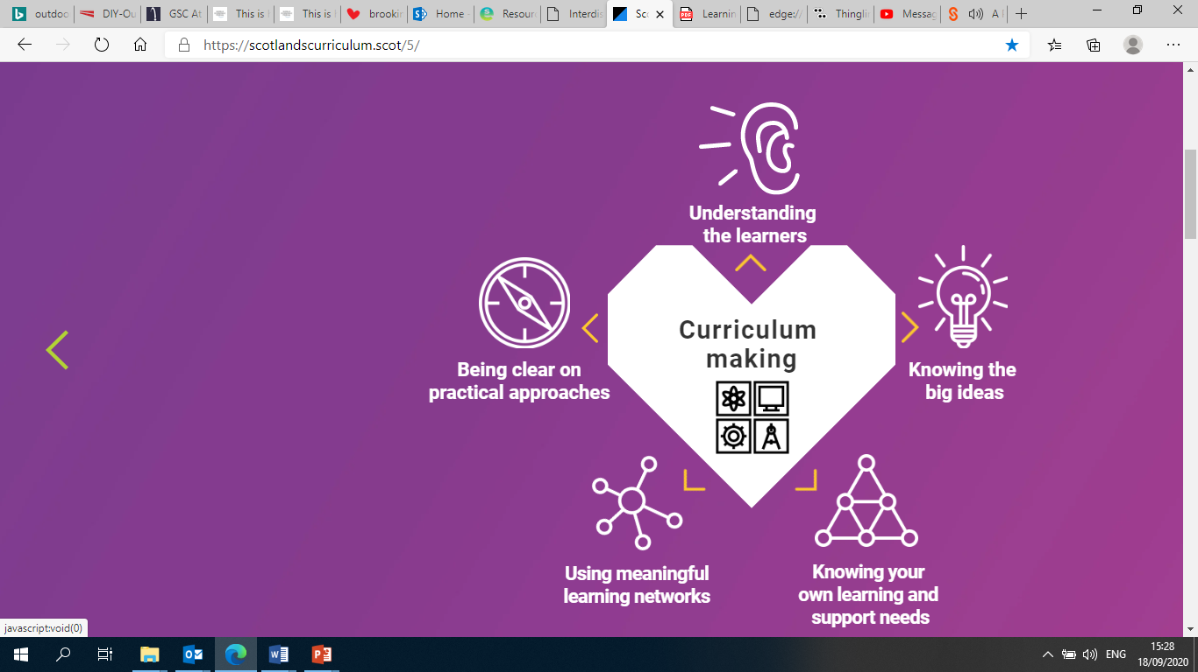
How do we do it?
Where should we be investing our energy?
For Scotland's learners, with Scotland's educators
Notes:
From the documents on the refreshed narrative
Understand the learners, knowing the big ideas, knowing your own learning needs, using meaningful learning networks, being clear on practical approaches

Slide 38
Aspects to consider
Teacher agency- collegiality
Time
Institutional support
For Scotland's learners, with Scotland's educators
For Scotland's learners, with Scotland's educators

Slide 39
Teacher agency
The capacity of teachers to critically shape their responses to problematic and complex situations, mobilising prior experience to manoeuvre between repertoires for action in the light of reflection on alternative futures.
Agency is not something that people possess; it is something that people do or, something they achieve.
  “[T]his concept of agency highlights that actors always act by means of their environment rather than simply in their environment [so that] the achievement of agency will always result from the interplay of individual efforts, available resources and contextual and structural factors as they come together in particular and, in a sense, always unique situations.” (Biesta & Tedder, 2007: 137).

Slide 40
Building teacher agency
The capacity of teachers to critically shape their responses to problematic and complex situations.
Teacher agency strengthened by:
  Material resources
  Cognitive resources
  Relational resources
Developed through:
  Engagement with research
  Engagement with other perspectives – schools, multi-agency, academics
  Collaborative enquiry
Notes:
School leaders
Creating and sustaining a vision
Creating dialogic spaces and communication channels
Provision of external resources – research, visiting speakers, external links
Encouragement of risk-taking and innovation – support, permission, protection
Minimising bureaucracy
Search Results for “teacher agency” – Professor Mark Priestley (wordpress.com)
Professor Mark Priestley – Comment on topical issues relating to the school curriculum (wordpress.com)

Slide 41
How do we do it –Emerging guiding principles in facilitating IDL
Culture and Ethos
??
Local context
Teacher Agency
Whole school commitment
Evidence the Impact
For Scotland's learners, with Scotland's educators

Slide 42
How – Some thoughts on emerging guiding principles in facilitating IDL
No curriculum development without professional development! Sense making, collegiality, curriculum learning and agency
Does the culture and ethos of the school nurture IDL? Learner voice and choice. Risk taking. Teachers as facilitators of learning. Teachers collaborate.
Is the unique local context reflected? Recognise the diversity and uniqueness. Relevant to learners, colleagues and community.
Is there a commitment to IDL? Time, resources and investment from all?
How is the impact on learners evidenced? Knowledge and skills evidenced? Articulate the what and how of IDL? A tangible end point
For Scotland's learners, with Scotland's educators
Notes:
BREAKOUT ACTIVITY 3
Does the culture and ethos of the school nurture IDL? Has consideration been given to the potential to impact positively on the health and wellbeing of the learners? Are the learners at the heart? Are there opportunities for personalisation and choice? Account has been taken that children and young people learn in different ways. Are learners and practitioners encouraged to take risks in the ambition of what they choose to tackle?
Is the unique local context reflected? Are the IDL opportunities relevant for learners? Are opportunities being maximised in the local environment, the community, with partners? Have diverse relationships and partnerships across the community been created to support IDL?
Is there a commitment to IDL? In terms of time, resources and investment from practitioners and learners? Is it regarded as an entitlement 3 – 18? Has space been created in the timetable, for professional learning, planning sessions for practitioners / across faculties, for implementing and giving feedback?
How is the impact on learners evidenced? Are both knowledge and skills being evidenced? Are learners able to articulate the knowledge and skills they have developed? Are there measures of success and milestones? Has consideration been given to tracking progression across levels, stages, sectors? Do learners have increased understanding of career progression pathways? Do learners have opportunities to share, present, have a tangible end goal, to ‘show off’?

Slide 43

So… bringing it all together?
For Scotland's learners, with Scotland's educators
Notes:
Creativity in Leadership and Learning | Practice exemplars | National Improvement Hub (education.gov.scot)
Resources to support the Refreshed Curriculum for Excellence Narrative | Learning resources | National Improvement Hub (education.gov.scot)
PDF file: Interdisciplinary Learning: ambitious learning for a complex world
Interdisciplinary Learning: ambitious learning for an increasingly complex world (education.gov.scot)
home | MyPBLWorks

Slide 44

Key considerations
The whole person – knowledge, skills and wellbeing
Lifelong breadth in learning
Learning with purpose, with partners
IDL is learning
More than just ‘engagement’: deep thinking and deep learning
Collaborative learning, teacher coaches
Shared goals, not dictated goals
Realising ambition, embracing opportunities and building confidence
Challenge realises ambitious learning, opens opportunities
Build confidence through a shared language
PDF file: Interdisciplinary Learning: ambitious learning for a complex world.

Slide 45
Reflect
What...? So what...? Now what...?
What – is at the top of my head?
1
So what - does it mean for my practice?
2
Now what- do I plan to do next?
3

Slide 46

Please fill in the evaluation form following the link in the chat pane
This Photo by Unknown author is licensed under CC BY-SA-NC.
For Scotland's learners, with Scotland's educators

Slide 47
Resources and
Provocations

Slide 48
Session 3
Provocations
Resources

Slide 49
Royal Society of Edinburgh - Interdisciplinary Learning in Schools (Feb 2020)
IDL is crucially important to addressing current and future complex, societal challenges, including climate change. While IDL is one of the most distinctive and innovative features of Curriculum for Excellence, it has not yet been widely developed in our schools.
The RSE has published an advice paper setting out the actions and conditions needed to support the delivery of interdisciplinary learning (IDL) in Scotland’s schools.
SUMMARY
Interdisciplinary learning (IDL) is crucially important to addressing current and future societal challenges, including climate change.
While IDL is a distinctive and innovative feature of Curriculum for Excellence, its development in our schools has been patchy.
Key barriers to embedding IDL include: a lack of understanding as to what it is; its low profile compared to other education priorities; cultural, including a focus on subject specialism, and logistical, including timetabling; and how to assess it.
IDL development can be supported by: building on the refreshed CfE narrative and parallel activity to clarify IDL; providing practical advice, exemplification and guidance to teachers, and supporting teacher collaboration; harnessing the resource and expertise within the Regional Improvement Collaboratives (RICs) to build capacity in IDL; embedding IDL within teachers’ professional review and development and professional update processes; and researching and evaluating IDL approaches.

Slide 50
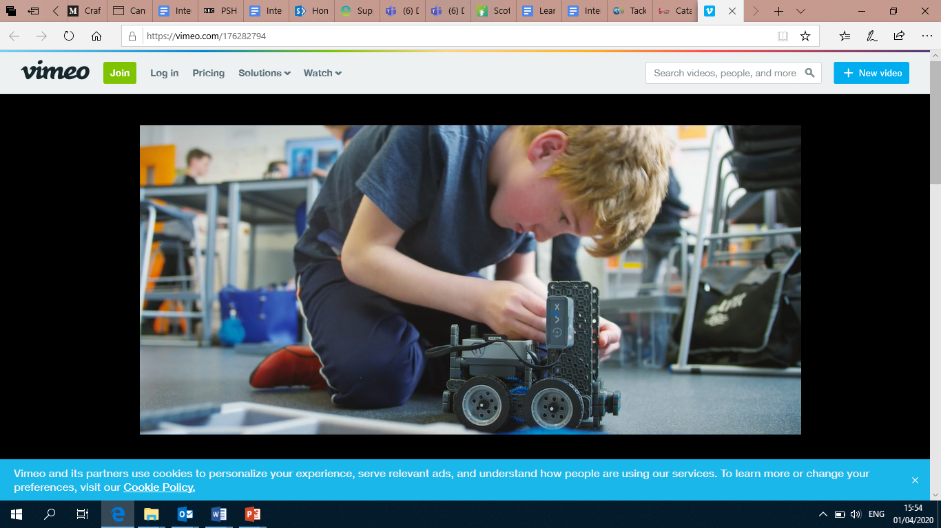
Provocation – XP School
XP is a mainstream 11-19 secondary school in Doncaster, UK. This short film is about how our school came about, what it is all about, how we do things and why. xpschool.org
https://vimeo.com/176282794

Slide 51
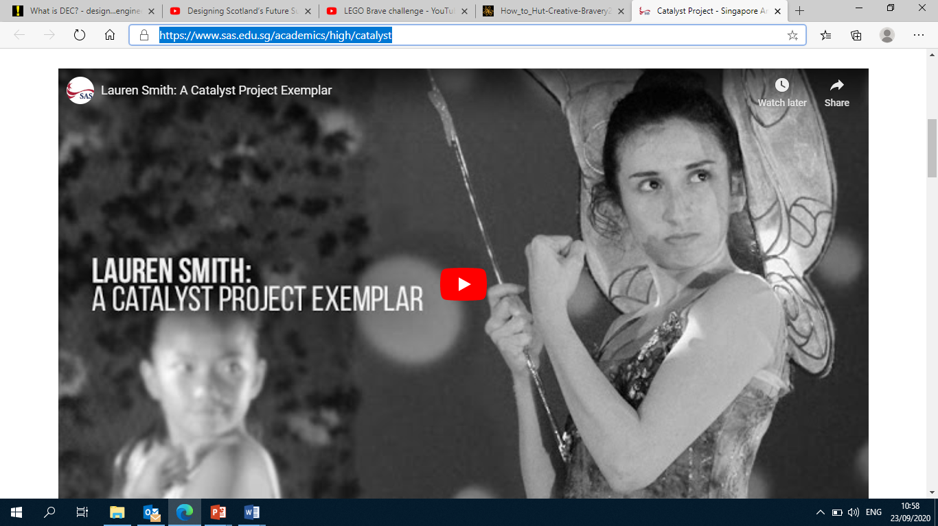
Catalyst project – from Singapore American School
Lauren Smith
https://www.sas.edu.sg/academics/high/catalyst

Slide 52
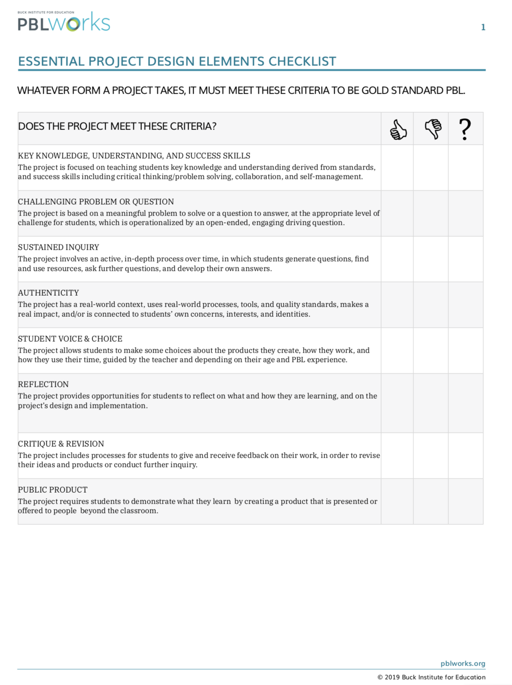

Project Based Learning Works
Essential project design elements checklist
https://my.pblworks.org/

Slide 53
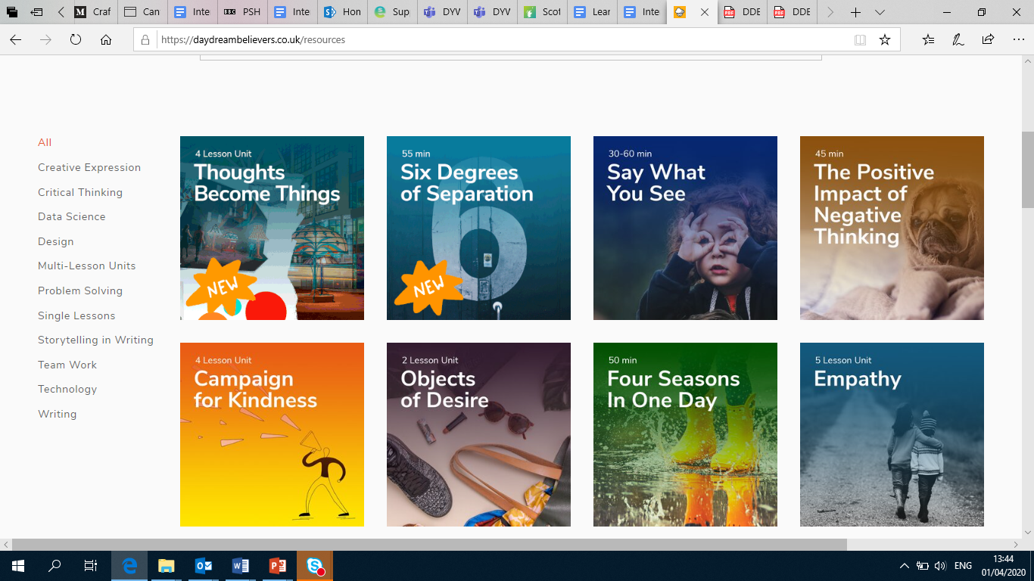

Daydream Believers
https://daydreambelievers.co.uk/resources

Slide 54
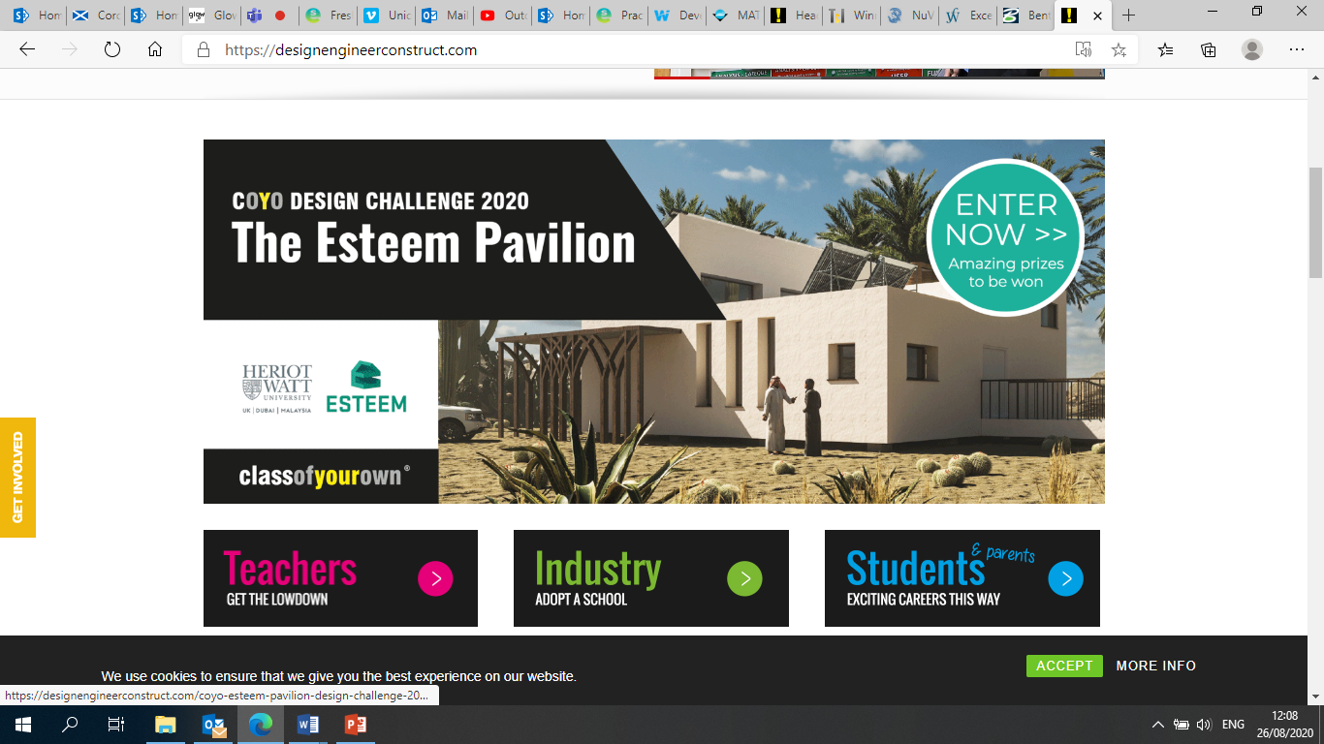
https://designengineerconstruct.com/what-is-dec/

Slide 55
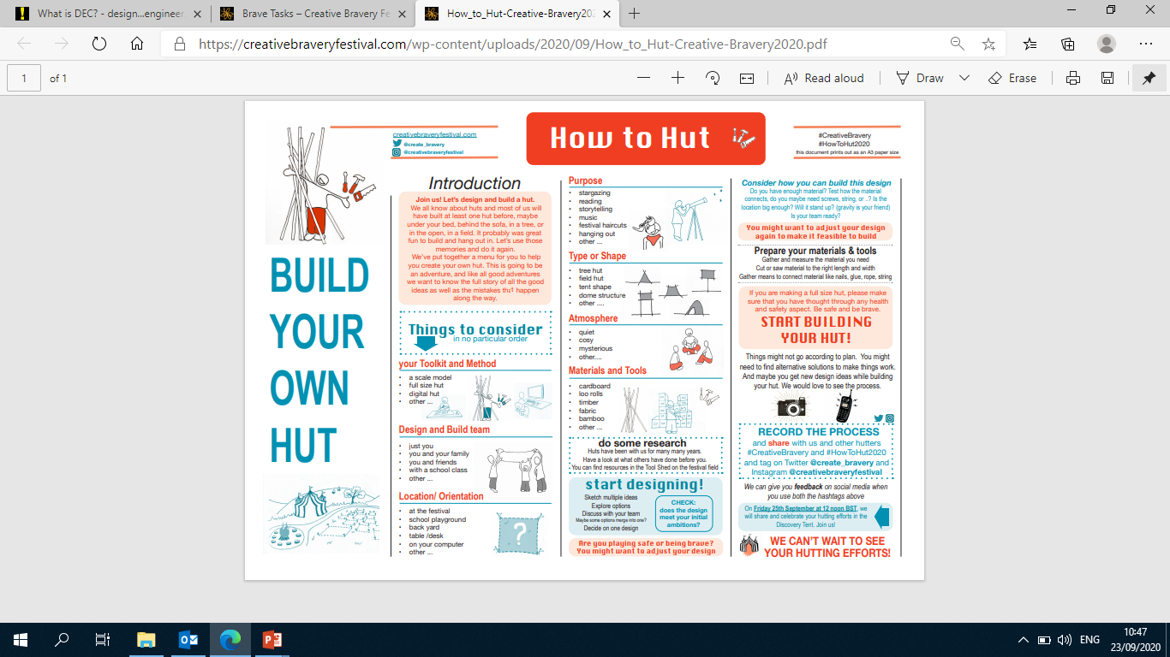
How to HUT
https://creativebraveryfestival.com/wp-content/uploads/2020/09/How_to_Hut-Creative-Bravery2020.pdf

Slide 56
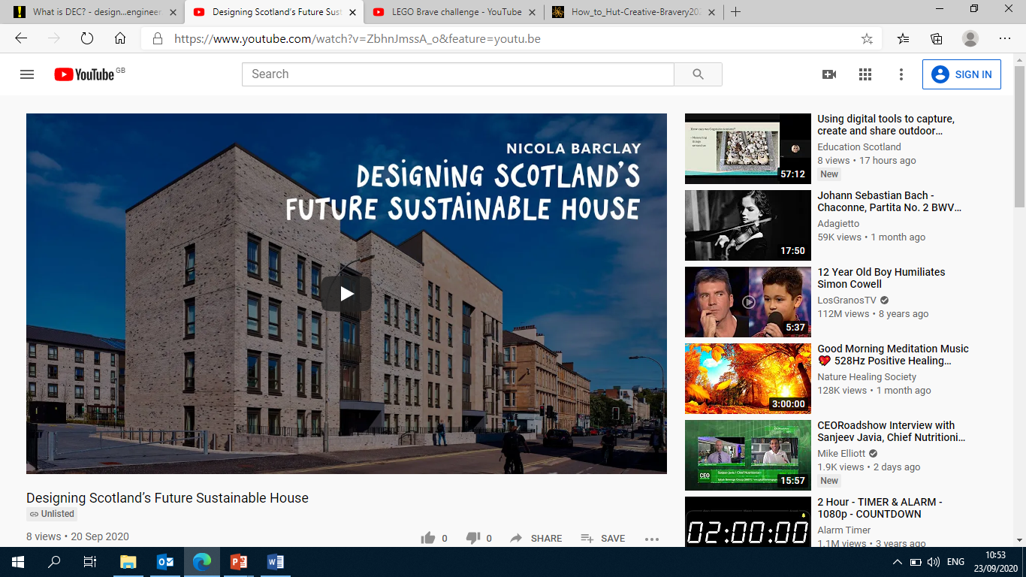
Designing Scotland’s Future Sustainable House – P6 and P7
https://creativebraveryfestival.com/wp-content/uploads/2020/09/Scotlands-Primary-Teachers-P6-and-P7-Project-Briefing-Notes.pdf

Slide 57
A “Genius Hour.” “20% Time.” “An Hour of Code.” These ideas suggest that students should be allotted time during the school week to follow their own interests. But it this really a substantive or sustainable change?
https://modernlearners.com/its-gonna-take-more-than-a-genius-hour/
Keith Cook: Role Models
http://bit.ly/keithcook
School: about memorisation or memorable learning?
http://bit.ly/memorableormemorisation
Data + Joy = Learning [VIDEO]
How do we get data into our students’ hands? Does IDL need a “fitbit of learning”?
http://bit.ly/datajoylearning

