Slide 1


We will be starting shortly
Please add your name and location to the chat pane
This Photo by Unknown author is licensed under CC BY.

Slide 2
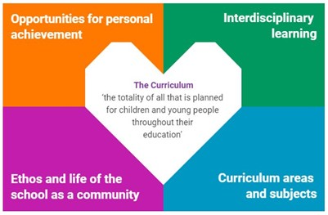
Excellence in Headship Learn
Interdisciplinary Learning
For Scotland's learners, with Scotland's educators
For Scotland's learners, with Scotland's educators
Notes:
Curriculum making series
Refreshed narrative; enacted curriculum
Harvie, Julie (2020) Interdisciplinary Learning: Addressing the Implementation Gap, Scottish Educational Review 52(2), 48-70 227172.pdf (gla.ac.uk)
Interdisciplinary Learning: A cognitive-epistemological foundation1 Veronica Boix Mansilla, Project Zero, Harvard Graduate School of Education The point of integration: (harvard.edu)

Slide 3
Practical Points
Mute your microphone unless you are speaking
(this is to minimise feedback, echo and background noise
Post comments, questions and thoughts into the chat window or use the raise hand function
ES facilitators will bring you into the chat and you can unmute your microphone.
The event will not be recorded
For Scotland's learners, with Scotland's educators

Slide 4
What works in online meetings
The aim today is to be as relaxed and conversational as possible. As such, this event will not be recorded. We want you to be comfortable and to speak as freely as you want to.
You all have something valuable to contribute but you are not expected to be experts. Quite often a conversation can raise more questions than answers, this session is a non-judgemental, collective thinking and sharing space.
Everyone is invited to share their experiences, thoughts, ideas, resources, questions and worries.
We want this event to be owned by you but we are there to help should there be a ‘tumbleweed’ moment.
For Scotland's learners, with Scotland's educators

Slide 5
Facilitation team
Chris French, Lead Specialist Professional Learning and Leadership
Gordon Bone, Lead Specialist Professional Learning and Leadership
Andy Travis, Lead Specialist Professional Learning and Leadership
For Scotland's learners, with Scotland's educators

Slide 6
EiH Learn Interdisciplinary Learning
Day 1 – 21 February 9:30-12:00
Why IDL and why now?
Refreshed narrative and IDL
What is IDL?
Day 2 – 7 March 13:00-15:00
What is IDL?
Guiding principles of IDL
How of IDL
For Scotland's learners, with Scotland's educators
Notes:
Origin of this session- part of our curriculum series
Refresh of Scotland's Curriculum Sept 2019
Learner Pathways
IDL PDF file: Interdisciplinary Learning: ambitious learning for a complex world.

Slide 7
That’s me
I work in a school
For Scotland's learners, with Scotland's educators
Notes:
Use the hands up function to answer these questions. Remind hands down
I work in a school
From where I am sitting I can see a tree
I work north of Stirling
I am a primary head teacher
I own a bike
I am have a pet
I am in a quiet place
I am ready to learn

Slide 8
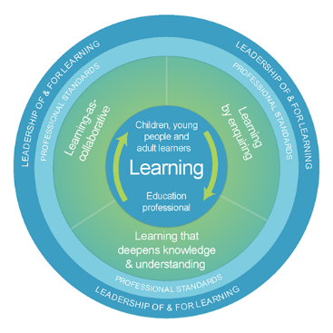
Model of Professional Learning
We are ALL learners and our
learning benefits all of us
Learning by enquiry
Learning as a collaborative
Learning that deepens knowledge
and understanding
For Scotland's learners, with Scotland's educators
For Scotland's learners, with Scotland's educators
Notes:
Guiding principles not another YUFTI

Slide 9

Expectations
For what reason am I here?
Why did I choose this session?
Why is it important to me?
For Scotland's learners, with Scotland's educators
Notes:
Breakout room

Slide 10
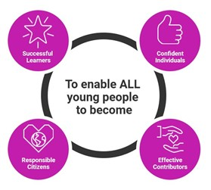
For Scotland's learners, with Scotland's educators
Notes:
Scottish Curriculum
Societal values of social cohesion, justice and equality. Scottish Mace wisdom, justice, integrity and compassion.
Curriculum as a 'poem' to these aspirations. Expressed as 4 capacities that are developed through 4 contexts
Intended v enacted curriculum. Sense making, bring the document into action. Curriculum making a living process
International aspects of a modern curriculum
Emphasis on generic skills. Competencies
Active learning. Learner centred. Student agency
Teacher as change agent. Reduced prescription. Partnerships
Education Scotland - NoTosh - The Four Capacities Version 5 Sept 2022

Slide 11
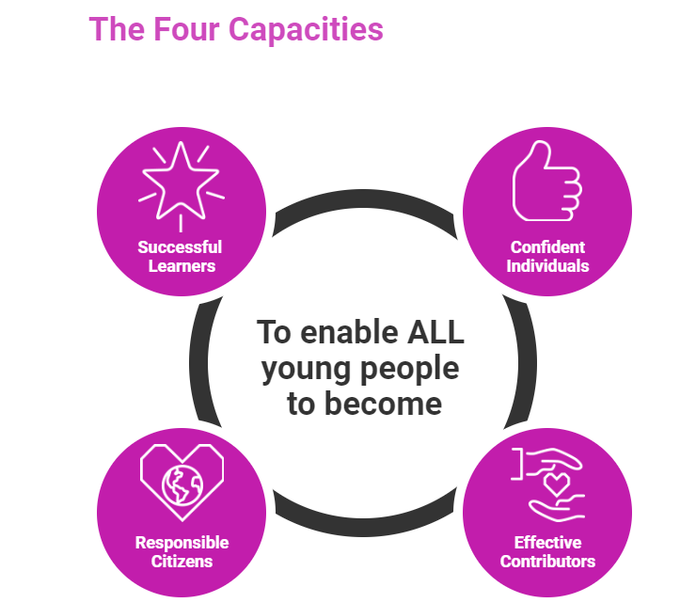
Why? A point to ponder
In recent months
In your context which of the 4 capacities has been a strength?
For Scotland's learners, with Scotland's educators
Notes:
Silent reflection
Chat pane
How have you developed your skills and attributes that underpin the 4 capacities?
Invite to share in the chat pane

Slide 12

Interdisciplinary learning- What does it mean to you?
For Scotland's learners, with Scotland's educators
Notes:
Discussion around this on the chat pane
Or
In breakout rooms

Slide 13
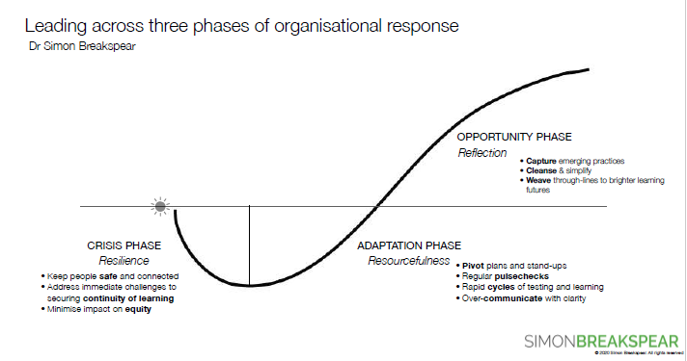
Why now?
Simon Breakspear
Riding the COVICOASTER
CRISIS, ADAPTATION, RENEWAL or REVERSION
For Scotland's learners, with Scotland's educators
Notes:
Simon Breakspear- Stretch COVID as an 'Induced experiment'
Breakspear; crisis, adaptation, renewal or reversion
We learned that:
Things could happen at a big scale across the system
The centre (system) did not have the answers to the complexity at school level.
Does the system know best? E.g. has the system shown it knows best about improving L&T

Slide 14

It is clear that the driving forces for education professionals are not metrics but morals – a sheer determination to do the right thing for those in their charge (Harris & Jones 2020)
This Photo by Unknown author is licensed under CC BY.
Notes:
Post-pandemic: Return or reset? | BERA
Are we only putting back those things that we truly value?
Are we are snapping back to the 'old' practice
Can we remove some things?

Slide 15

Renewal or reversion
‘As the crisis begins to subside, we find ourselves in a crucial period of renewal or reversion, where a choice has to be made between reverting to everything as it was before the crisis, or resetting the agenda to build something new from all that has passed.’
This Photo by Unknown author is licensed under CC BY-NC-ND.
Notes:
Ask yourself "Why did we go through all that to get back here"
What were the key elements of this forced experiment
What were the 'high water marks that were forced by COVID that are opportunities

Slide 16
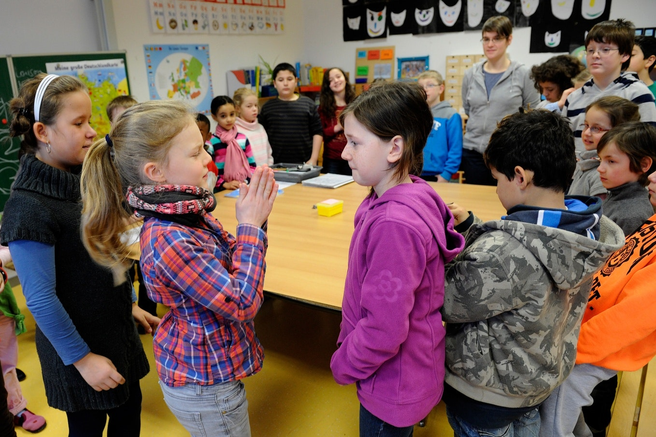
The pandemic has highlighted the value of a rich curriculum and sadly shown how children suffer when schooling is confined to subject-based teaching only.
Post-pandemic there is an opportunity to free up schools to reset the curriculum and develop true breadth and depth in what children learn.
This Photo by Unknown author is licensed under CC BY-NC-ND.

Slide 17
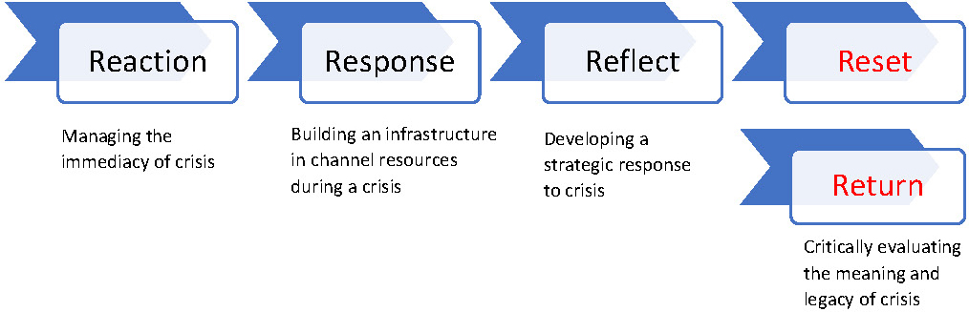

Slide 18

Why IDL …. ? How can IDL contribute to renewal?
Quick 6
Fold a piece of paper into 6 or sketch out 6 rough and ready boxes
What opportunities for learning does IDL offer?
But you only have 20 sec per box
We will call time every 20 seconds
This Photo by Unknown author is licensed under CC BY-SA-NC.
Notes:
30 seconds per response
Breakout room

Slide 19
International Council of Education Advisers Report 2018-2020
How can an educational system operate for all its learners as effectively during a pandemic, or other crisis, as it can under other circumstances? And how can responding to this challenge improve the accessibility and quality of learning and wellbeing for all young people under all circumstances?
“… positive yet prudent use of digital technologies and platforms, expanded engagement with learning outdoors; more self-directed learning and collaborative inquiry; still more collaborative professionalism and distributed leadership; stronger connections to local community organisations and agenda …”
Notes:
International Council of Education Advisers Report 2018-2020 - gov.scot (www.gov.scot)

Slide 20
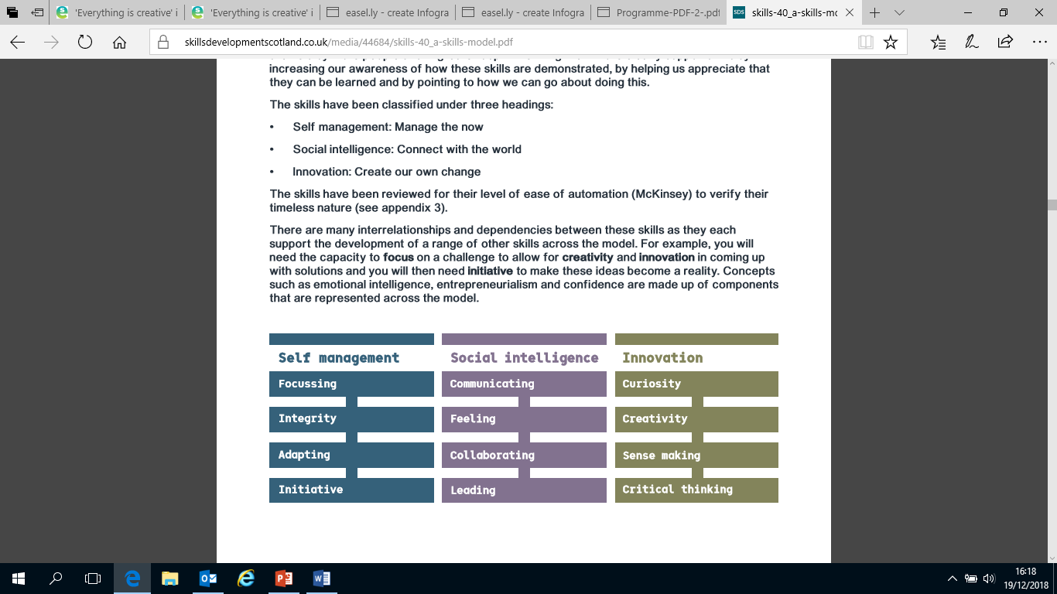
Why? Skills
"Education systems around the world are urgently recalibrating, realizing that they are dangerously outdated. Many are seizing the opportunity to modernize their systems for the 21st century – reimagining learning to equip children with the skills they need to be productive, life-long learners. “
World Economic Forum – 15th September, 2020
https://www.weforum.org/agenda/2020/09/future-of-education-system-covid-19/
Skills for the future – Skills 4.0
For Scotland's learners, with Scotland's educators
For Scotland's learners, with Scotland's educators
Notes:
We think that it is very important to look at the ongoing relevance of the 4 capacities.
Does the quote from the WEF resonate with your. It reinforces the argument for restating the importance of the 4 capacities and the skills and attributes that underpin these which also dovetail with the Skills 4.0
https://www.weforum.org/agenda/2020/09/future-of-education-system-covid-19/
Background on Skills 4.0
https://www.skillsdevelopmentscotland.co.uk/what-we-do/skills-planning/skills4-0/
skills-40_a-skills-model.pdf (skillsdevelopmentscotland.co.uk)
1451_skills-toolkit-phase-1-_guidance-paper_v4-002-final.pdf (skillsdevelopmentscotland.co.uk)

Slide 21
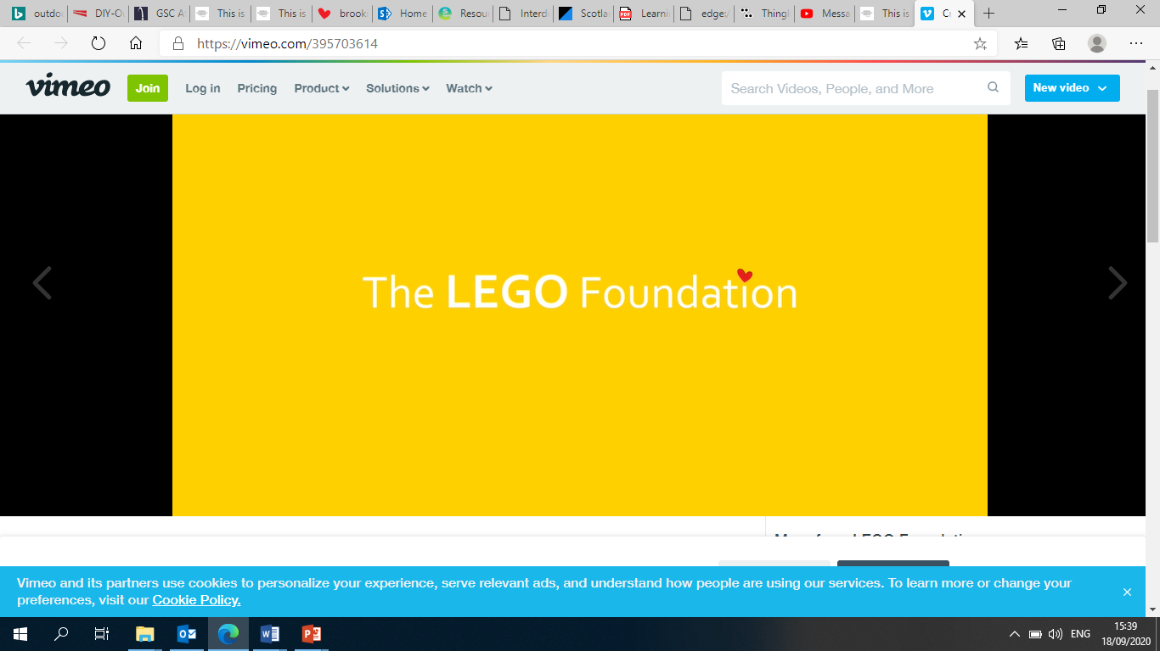
Why? Creativity
Why Creativity Matters (vimeo.com)
For Scotland's learners, with Scotland's educators
Notes:
Post the link to the video in the chat pane
Why Creativity Matters (vimeo.com)
Ken Robinson "Do schools kill creativity"
Pasi-Sahlberg.pdf (greenschool.org)
The three of the most complicated barriers — competition, standardisation and test-based accountability — that commonly prevent schools focusing more on developing students’ creative knowledge, skills and habits of mind.
The three most important enabling factors — collaboration, risk-taking and learning to be wrong — are presented as the general conditions of change
Enablers: Collaboration, risk-taking and learn to be wrong
Barriers: competition, standardisation, test-based accountability

Slide 22
Why? UNCRC
The ‘United Nations Convention on the Rights of the Child’ (UNCRC) states:-
Every child has the right to an education (Article 28)
Education must develop every child’s personality, talents and abilities to the full (Article 29)
Every child has the right to learn and use the customs and religion of their family (Article 30)
Every child has the right to relax, play and take part in a wide range of cultural and artistic activities (Article 31)
For Scotland's learners, with Scotland's educators
Notes:
So where can IDL play a part

Slide 23
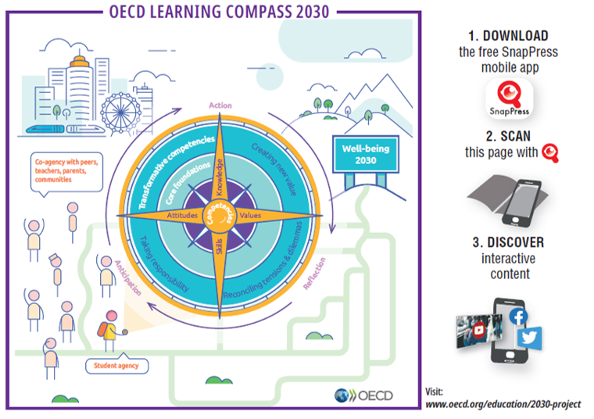

The future of skills and education. Education 2030 OECD
For Scotland's learners, with Scotland's educators
Notes:
On the compass points; Attitudes, Knowledge, Skills, Values
Dark blue circle Transformative competencies, Creating new value, Reconciling tensions and differences, Taking responsibility
Around the circle: Student agency, Co agency – pupils, peers parents community, Wellbeing
About - OECD Future of Education and Skills 2030
Could IDL reduce curriculum overload by focussing on conceptual understanding and 'big ideas'
Curriculum Overload : A Way Forward | OECD iLibrary (oecd-ilibrary.org)
Page 11 digital, personalized cross cutting to reduce inequality
Adapting Curriculum to Bridge Equity Gaps: Towards an Inclusive Curriculum | READ online (oecd-ilibrary.org)

Slide 24
What is the purpose of education.
Curriculum for Excellence – what is critical to reimagine learning and develop in children and young people for the 21st century?
IMPORTANT
VERY IMPORTANT
CRITICAL
For Scotland's learners, with Scotland's educators
Notes:
Breakout rooms –group 3 or 4 (20 minutes if possible)
What is the purpose of education.
Curriculum for Excellence – what is critical to reimagine learning and develop in children and YP the capabilities, attitudes, resilience and skills they need to strive and thrive in the 21st century?
Negotiating exercise
Think – from you own standpoint what is critical
Discuss, negotiate and post it in the section of the group’s choosing choice. (important, very important or critical)
Identify three maximum for the critical section

Slide 25

Coffee Break
For Scotland's learners, with Scotland's educators
Notes:
15 minute coffee and comfort

Slide 26
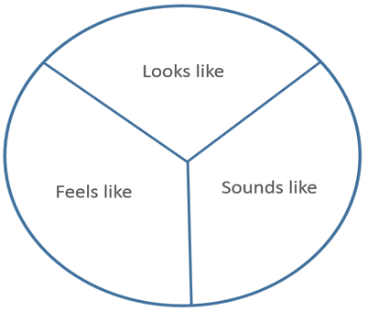
Curriculum for Excellence – IDL can reimagine learning
IDL as learning
What would you see learners doing?
What would you hear learners and teachers saying?
What would learners and teachers be thinking and feeling?
For Scotland's learners, with Scotland's educators
Notes:
Possible breakout rooms –group 3 or 4 (20 minutes if possible)
Curriculum for Excellence – IDL can reimagine learning to equip children and young people with the skills they need to be productive, life-long learners?

Slide 27
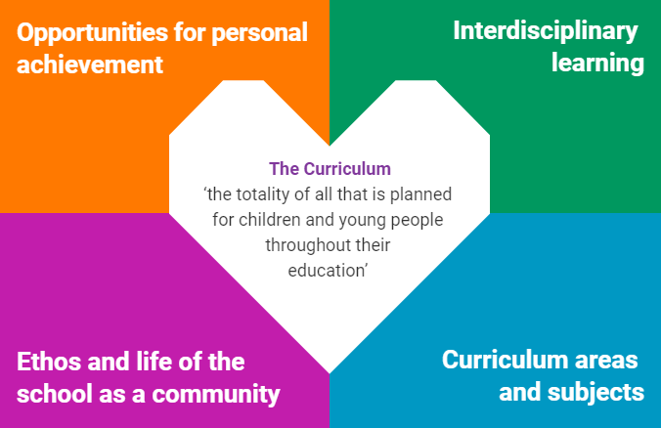
What matters?
Notes:
During the launch of the refreshed narrative in Sept 2019, the above diagram of the 4 contexts was produced it became apparent that the there were a range of understanding and applications of IDL.
IDL is at the heart of CfE but application and quality is inconsistent.
But when done well ….. it is a key way of thinking and learning that has shown high levels learner engagement and performance
Emphasised in the refreshed narrative. Can provide great opportunities for learning. achievement, celebration of success and confidence building for learners, teachers and the system –

Slide 28
What matters?
Think about your school and context
Across the four contexts – where does the learning take place?
Please unmute your mic and give your thoughts
For Scotland's learners, with Scotland's educators

Slide 29
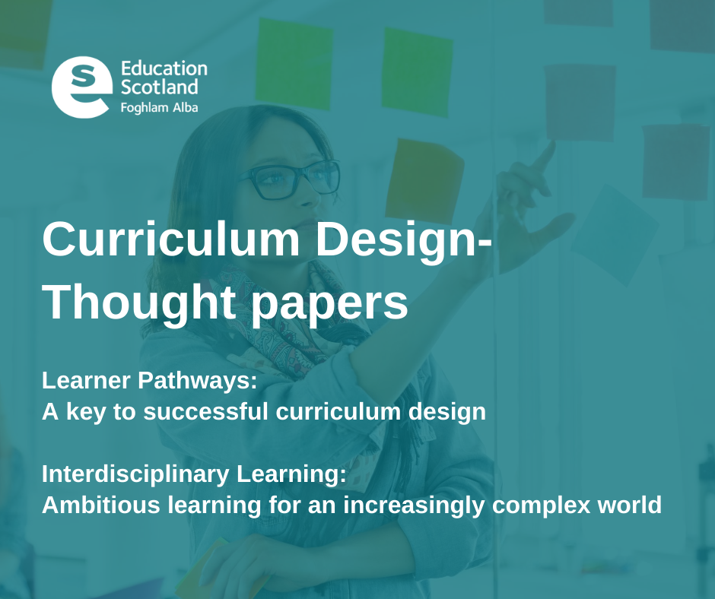
Notes:
Over session 2019/20, Education Scotland has worked with No Tosh, practitioners and partners using a design-thinking process to understand how we can realise our ambitions for IDL.
Download paper: PDF file: Interdisciplinary Learning: ambitious learning for a complex world.
In session 2020/21, we will build on the thinking and suggestions in the paper. This will include co-creating tools, resources and practices that build on the thinking and principles in the paper. We will share examples of how schools and partners are being ambitious through the development of bold IDL experiences.
We want to use this current period as an opportunity to begin the re-focus on IDL and what it can offer our children and young people. Now, maybe more than ever, schools need to be places where young people learn and develop rich knowledge and the skills to thrive in a future which is increasingly unpredictable.

Slide 30
Interdisciplinary learning
The curriculum should include space/opportunities that enable children and young people to make connections between different areas of learning. Interdisciplinary learning should be stimulating, relevant and challenging. Revisiting a concept or skill from different perspectives deepens understanding and can make the curriculum more coherent and meaningful for learners. It can take advantage of opportunities to work with partners who are able to offer and support enriched learning experiences and opportunities for young people’s wider involvement in society.
Effective interdisciplinary learning:
• can take the form of individual one-off projects or longer courses of study
• is planned around clear purposes
• is based upon experiences and outcomes drawn from different curriculum
• areas or subjects within them
• ensures progression in skills and in knowledge and understanding
• can provide opportunities for mixed stage learning which is interest based.
Notes:
This is the long standing definition of IDL from CfE

Slide 31
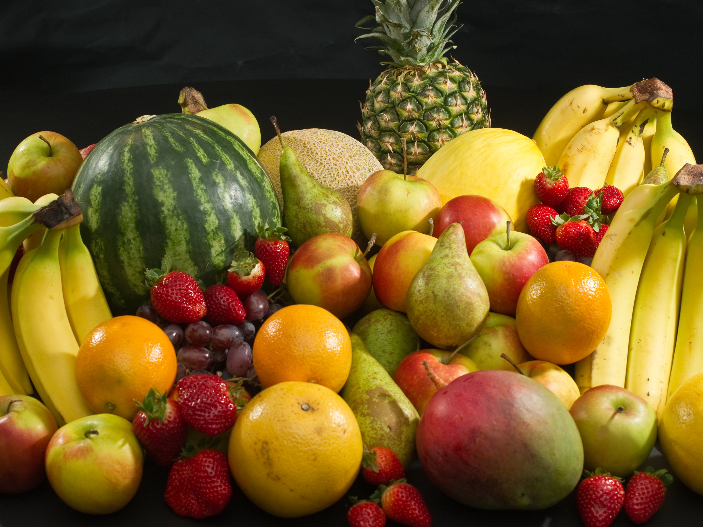


This Photo by Unknown author is licensed under CC BY-SA.
This Photo by Unknown author is licensed under CC BY-NC-ND.
This Photo by Unknown author is licensed under CC BY-NC-ND.
Notes:
A chat pane and on screen discussion
A basket of fruit, fruit salad and the fruit smoothie
Discuss which image represents your view of IDL and how is this differs from the others

Slide 32
What is IDL?
Interdisciplinary Learning is a planned experience that brings disciplines together in one coherent programme or project. The different disciplines plan and execute as one. These disciplines might fall within one curricular area (e.g. languages, the sciences) or between several curricular areas. IDL enables children and young people to:
  ● learn new knowledge or skills, and develop new understanding of concepts;
  ● draw on prior knowledge, understanding and skills;
  ● transfer and apply that collective knowledge to new problems or other areas of learning.
(Interdisciplinary Learning: ambitious learning for an increasingly complex world, page 5)
For Scotland's learners, with Scotland's educators
Notes:
Defining and agreeing what IDL is has been a source of discussion for some time and has an impact on its implementation in practice.

Slide 33
What is IDL?
Defining and agreeing what IDL is has been a source of discussion for some time and has an impact on its implementation in practice. Global influencers such as the OECD, for example, refer to IDL as one form of cross curricular learning. The discussion on definition formed a large part of the work of the co-design group. What follows is the group’s definition of IDL.
Interdisciplinary Learning is a planned experience that brings disciplines together in one coherent programme or project. The different disciplines plan and execute as one. These disciplines might fall within one curricular area (e.g. languages, the sciences) or between several curricular areas. IDL enables children and young people to
  ● learn new knowledge or skills, and develop new understanding of concepts;
  ● draw on prior knowledge, understanding and skills;
  ● transfer and apply that collective knowledge to new problems or other areas of learning.
This is different from learning, for example, which takes place when several disciplines or subjects are linked up through a common theme or topic, but the student’s experience and educator planning is discreet, or separate in each discipline or subject. This can be referred to as multi-disciplinary learning.
(Interdisciplinary Learning: ambitious learning for an increasingly complex world, page 5)
For Scotland's learners, with Scotland's educators
Notes:
Direct lift from the thought paper -

Slide 34
✅: Required ✓ : May include | Interdisciplinary Learning (e.g. several disciplines collaborate on one project) | Multi-disciplinary learning (e.g. several disciplines contribute to a project)
Practitioners from different curricular areas plan together. | ✅ | ✓
Learning is generally framed as projects, and may use Project-Based Learning planning tools and approaches. | ✅ | ✅
Planning connects disciplines and project outcomes across the four contexts. | ✅ | ✓
Discipline knowledge, understanding and skills are necessary and directed towards the project’s outcomes. | ✅
Prior knowledge and skills are transferred and applied to new problems, challenges or contexts. | ✅ | ✓
New knowledge and skills are encountered. | ✅ | ✓
Learners take planned time to reflect on connections between disciplines. | ✅
Learners reach each outcome using several disciplines. | ✅
Assessment of the learning is shared between disciplines. | ✅
(Interdisciplinary Learning: ambitious learning for an increasingly complex world, page 5)

Slide 35
IDL - Do you agree or disagree?
IDL consolidates knowledge and skills that has previously been taught.
IDL has a real-world context.
IDL features an output or product that allows learners to show others what they have learned.
IDL contains student choice in task and/or timing.
IDL enables learners to have a voice
Learning happens before the IDL. IDL is consolidation
IDL is planned around subject knowledge
IDL is co-planned and assessed by all the teaching team
IDL takes place over an extended period of time.
IDL is set around a question or a problem
IDL starts with learners’ concerns and interests
Teachers act as coaches and mentors
Learning is collaborative
For Scotland's learners, with Scotland's educators
Notes:
Use as a provocation for breakout room
Choose a statement
Do you agree, disagree or a bit of both.
Explain your reasoning in the breakout room with colleagues
What are the defining characteristics of IDL – develop your own charcteristics
Record your thoughts a diamond nine

Slide 36
IDL Diamond nine
For Scotland's learners, with Scotland's educators
Notes:
Use as a the statements from the previous slide as your provocation for breakout room
Choose a statement
Do you agree, disagree or a bit of both.
Should it go into your diamond nine
Explain your reasoning in the breakout room with colleagues
What are the defining characteristics of IDL – develop your own charcteristics
Record your thoughts a diamond nine

Slide 37
Reflect
What...? So what...? Now what...?
What – is at the top of my head?
1
So what - does it mean for my practice?
2
Now what- do I plan to do next?
3

Slide 38
Next session
The HOW of IDL
7 March 13:00-15:00
We will send out joining instructions
For Scotland's learners, with Scotland's educators

Slide 39

Please fill in the evaluation form following the link in the chat pane
This Photo by Unknown author is licensed under CC BY-SA-NC.
For Scotland's learners, with Scotland's educators

Slide 40
Provocations for next session

Slide 41
Key considerations
The whole person – knowledge, skills and wellbeing
Lifelong breadth in learning
Learning with purpose, with partners
IDL is learning
More than just ‘engagement’: deep thinking and deep learning
Collaborative learning, teacher coaches
Shared goals, not dictated goals
Realising ambition, embracing opportunities and building confidence
Challenge realises ambitious learning, opens opportunities
Build confidence through a shared language
PDF file: Interdisciplinary Learning: ambitious learning for a complex world.

Slide 42
Royal Society of Edinburgh - Interdisciplinary Learning in Schools (Feb 2020)
IDL is crucially important to addressing current and future complex, societal challenges, including climate change. While IDL is one of the most distinctive and innovative features of Curriculum for Excellence, it has not yet been widely developed in our schools.
The RSE has published an advice paper setting out the actions and conditions needed to support the delivery of interdisciplinary learning (IDL) in Scotland’s schools.
SUMMARY
Interdisciplinary learning (IDL) is crucially important to addressing current and future societal challenges, including climate change.
While IDL is a distinctive and innovative feature of Curriculum for Excellence, its development in our schools has been patchy.
Key barriers to embedding IDL include: a lack of understanding as to what it is; its low profile compared to other education priorities; cultural, including a focus on subject specialism, and logistical, including timetabling; and how to assess it.
IDL development can be supported by: building on the refreshed CfE narrative and parallel activity to clarify IDL; providing practical advice, exemplification and guidance to teachers, and supporting teacher collaboration; harnessing the resource and expertise within the Regional Improvement Collaboratives (RICs) to build capacity in IDL; embedding IDL within teachers’ professional review and development and professional update processes; and researching and evaluating IDL approaches.

Slide 43
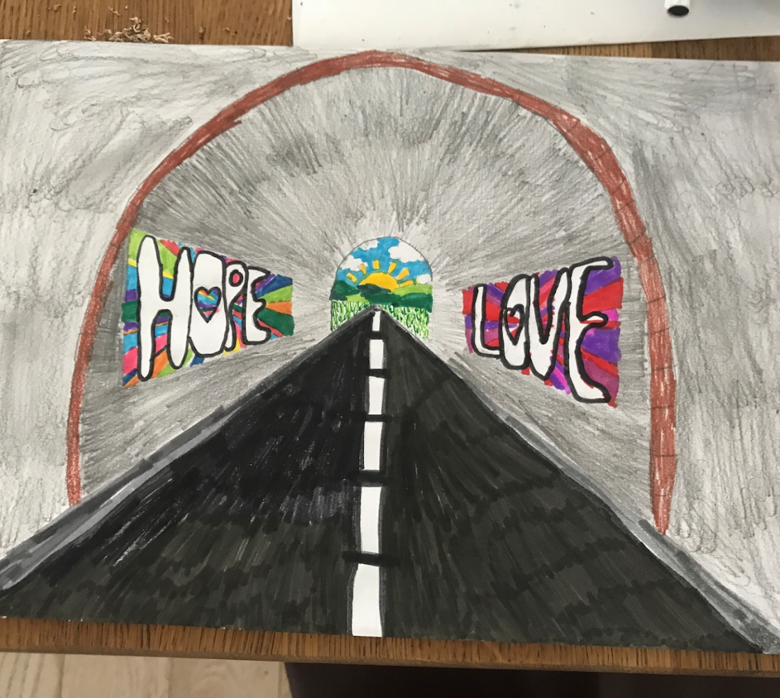
Case Study from Hazlehead School
How to thrive in difficult times
Developed and delivered remotely during Term 4
Impact
95% engagement from learners
New ways of working – has transformed their curriculum delivery
Enhanced skill set of all staff
https://sites.google.com/ab-ed.org/hazleheads-idl-journey/home
For Scotland's learners, with Scotland's educators
Notes:
Hazlehead – once case study is added to hub can add link

Slide 44
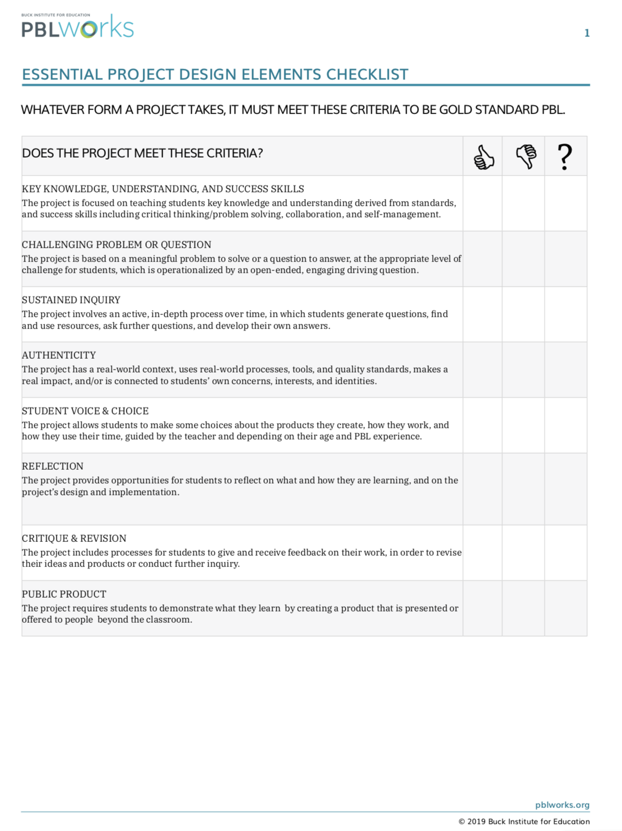

Project Based Learning Works
Essential project design elements checklist
https://my.pblworks.org/

Slide 45
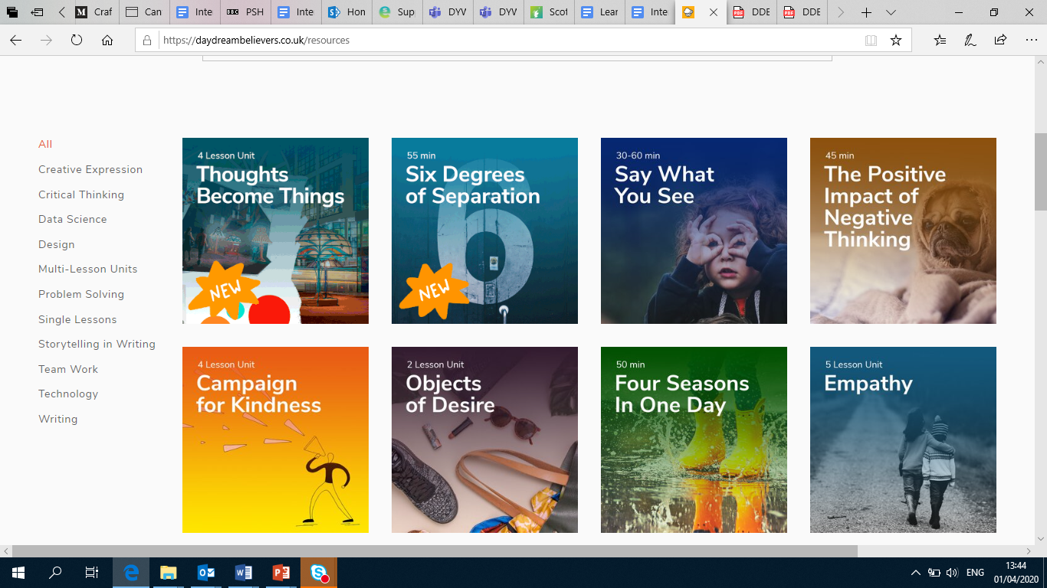

Daydream Believers
https://daydreambelievers.co.uk/resources

Slide 46
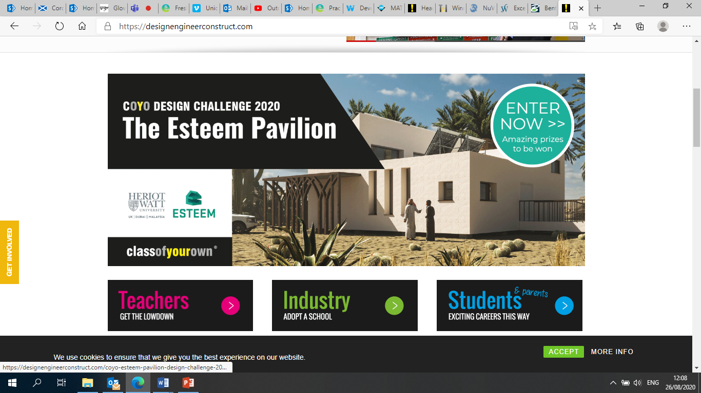
https://designengineerconstruct.com/what-is-dec/

Slide 47
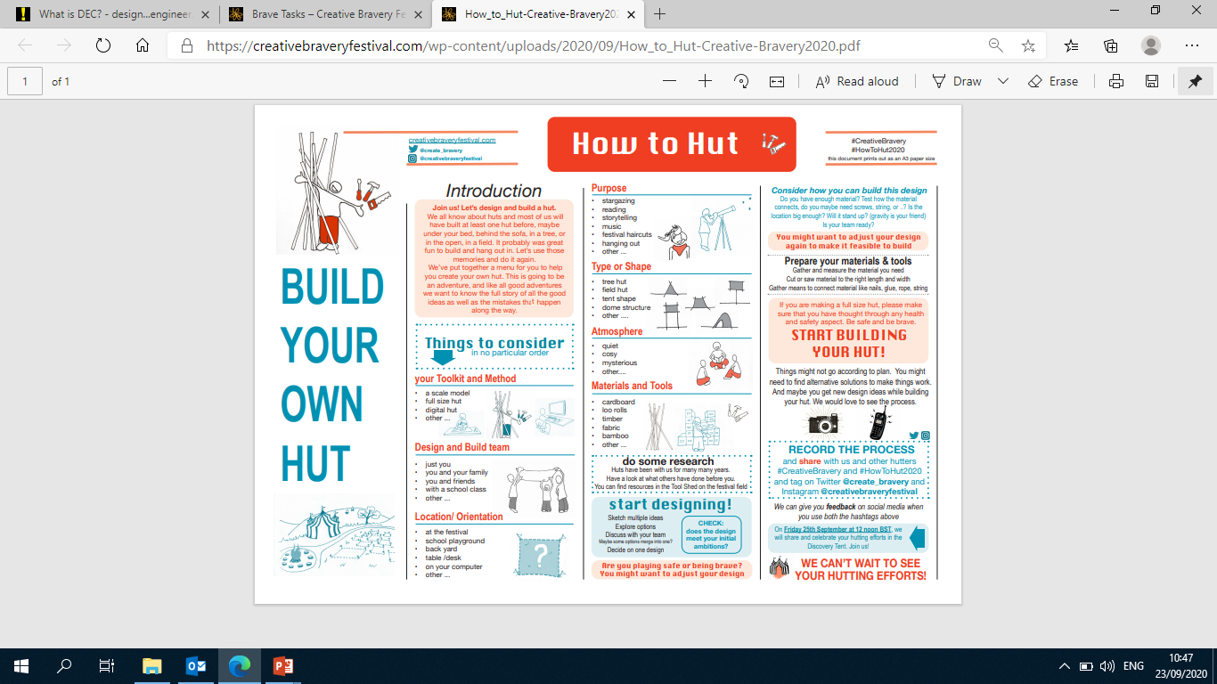
How to HUT
https://creativebraveryfestival.com/wp-content/uploads/2020/09/How_to_Hut-Creative-Bravery2020.pdf

Slide 48
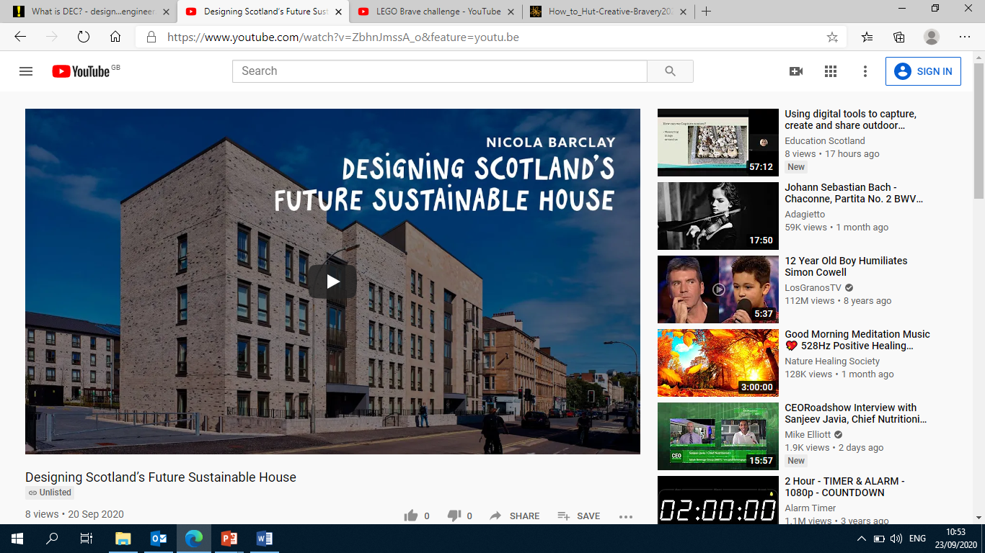
Designing Scotland’s Future Sustainable House – P6 and P7
https://creativebraveryfestival.com/wp-content/uploads/2020/09/Scotlands-Primary-Teachers-P6-and-P7-Project-Briefing-Notes.pdf

Slide 49
A “Genius Hour.” “20% Time.” “An Hour of Code.” These ideas suggest that students should be allotted time during the school week to follow their own interests. But it this really a substantive or sustainable change?
https://modernlearners.com/its-gonna-take-more-than-a-genius-hour/
Keith Cook: Role Models
http://bit.ly/keithcook
School: about memorisation or memorable learning?
http://bit.ly/memorableormemorisation
Data + Joy = Learning [VIDEO]
How do we get data into our students’ hands? Does IDL need a “fitbit of learning”?
http://bit.ly/datajoylearning

Slide 50
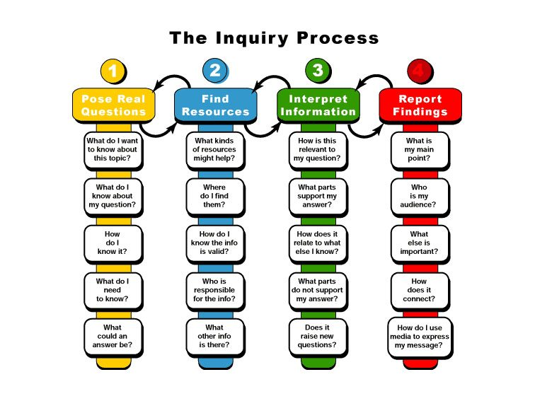
Notes:
Kuhlthau, C., Maniotes, L., & Caspari, A. (2007). Guided Inquiry: Learning in the 21st Century. London: Libraries Unlimited

