Slide 1



Thanks for your patience… the session is about to begin…
Please put your name and location in the chat pane.
This Photo by Unknown author is licensed under CC BY.
For Scotland's learners, with Scotland's educators
For Scotland's learners, with Scotland's educators

Slide 2
Excellence in Headship
Developing a Curriculum Rationale
Online
For Scotland's learners, with Scotland's educators

Slide 3
Facilitators
Gordon Bone Lead Specialist EiH
Chris French Lead Specialist EiH
Andy Travis Lead Specialist EiH
For Scotland's learners, with Scotland's educators

Slide 4
What works in online meetings
The aim today is to be as relaxed and conversational as possible. As such, this event will not be recorded. We want you to be comfortable and to speak as freely as you want to.
You all have something valuable to contribute but you are not expected to be experts. Quite often a conversation can raise more questions than answers, this session is a non-judgemental, collective thinking and sharing space.
Everyone is invited to share their experiences, thoughts, ideas, resources, questions and worries.
For Scotland's learners, with Scotland's educators

Slide 5
Expectations
Think – ‘For what reason am I here?’
Post it in the chat pane- first thoughts as to reason for being here today.
For Scotland's learners, with Scotland's educators

Slide 6
Developing your school curriculum rationale
Purpose of this session to:
Give time to reflect on the Refreshed Narrative on Scotland’s Curriculum.
Discuss and network with colleagues.
Review a range of tools that will assist in the process of developing your school curriculum rationale
For Scotland's learners, with Scotland's educators
Notes:
We hope that you will discuss practice with your colleagues and some of you may want to exchange emails and swap/meet to discuss rationale
Tools to undertake curriculum co-design
Because of the last point: we look at exercises through three lenses CONTENT, PROCESS, LEADERSHIP ACTION
Curriculum making is organised and planned BUT
Curriculum making is a social process; interactive, non-linear and iterative, strongly contextual and happens within and across sites in the system.
As a school leader you can engage or distance people from the process
This is a quote from an HMI report (2019) – emphasises the process again.
‘In recent years, the headteacher has led effectively a process to reflect on the uniqueness of the school in order to develop a dynamic and ambitious curriculum rationale’. 2019

Slide 7
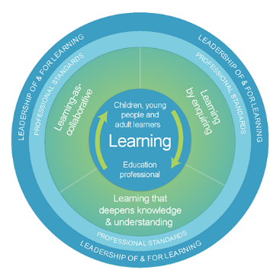
Model of Professional Learning
We are ALL learners and our
learning benefits all of us
Learning by enquiry
Learning as a collaborative
Learning that deepens knowledge
and understanding
For Scotland's learners, with Scotland's educators
For Scotland's learners, with Scotland's educators
Notes:
As education professionals you engage in professional learning to stimulate your thinking and to ensure your practice is critically informed and up-to-date.
Professional learning must focus on the education professional as a learner and how this is related to and impacts upon the learning of children, young people and adults.
Professional learning should be:
● Challenging, and develop thinking, knowledge, skills and understanding
● Underpinned by developing skills of enquiry and criticality
● Interactive, reflective and involve learning with and from others.
Professional learning is informed and supported by professional standards and education policy.
Leadership of and for learning is essential to ensure it is well supported, promoted and sustained.

Slide 8
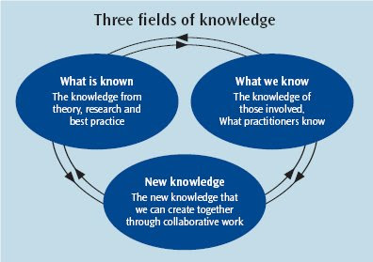
Three fields of knowledge
For Scotland's learners, with Scotland's educators
Notes:
Explicitly emphasise the importance of drawing equally upon three fields of knowledge. These are:
Practitioner knowledge (we start from what people know, the knowledge that people bring to the learning table).
Publicly available knowledge (the theory and research publicly available to be drawn in to learning environments).
The new knowledge that we are able to create together through collaborative working and enquiry.
A key dimension of the model, as indicated, is the inter-relationship of the three knowledge fields through network-based activity– represented by the connecting ring of the model. The model is consistent with what we know about knowledge use in networks.
This emphasis on the three fields of knowledge also echoes the need that Senge highlights of identifying new ways of learning that involve leveraging diverse perspectives into collective or shared group intelligence and integrating theory, new capacities, and practice with one another (Senge, 1994).

Slide 9

Curriculum- What does it mean to you?
Put your initial thought in the chat pane
By working around the meeting adding a ‘scoop’ of information we will build up our group knowledge
For Scotland's learners, with Scotland's educators
Notes:
Purpose of this session
To give time to reflect on the Refreshed Narrative on Scotland’s Curriculum.
To discuss and network with colleagues
To review a range of tools that will assist in developing your school curriculum rationale
The ‘rationale’ that story around the why of the school curriculum may be ‘lost’ as people have moved on.
Who can tell the story.
How has the context changed since that rationale was developed. Has it been refreshed or has the attention and energy been elsewhere?

Slide 10
“No curriculum development without professional development”
"by virtue of their meaningfulness curricula are not simply instructional means to improve teaching but are expressions of ideas to improve teachers“ p68
(Stenhouse 1975)
For Scotland's learners, with Scotland's educators
For Scotland's learners, with Scotland's educators
Notes:
Lawrence Stenhouse proclaims: "No curriculum development without teacher development".
Stenhouse (1975) pointed out that this did not mean "we must train teachers in order to produce a world fit for curricula to live in" (p. 68).
The message was that we needed to develop curricula fit for teachers to grow in, because the quality of children's education depends on the quality of the people teaching them. Stenhouse argued that when designing a curriculum is not simply instructional means to improve teaching but are “expressions of ideas to improve teachers" (p. 68). At odds with the notion of the ‘teacher proof curriculum’
Capacity building, Climate, Culture, Professional trust
John Elliott (1994) The Teacher's Role in Curriculum Development: an unresolved issue in English attempts at curriculum reform, Curriculum Studies, 2:1, 43-69, DOI: 10.1080/0965975940020103
Stenhouse, L. (1975) An Introduction to Curriculum Research and Development. London: Heinemann

Slide 11
CfE – modern 'international' curriculum
Emphasis on generic skills. Competencies. But not skills v knowledge!
Learner centred. Student agency. Active learning
Teachers must act as change agents- creating the curriculum.
  Reduced prescription means an intended curriculum that needs to be enacted.
  Sense making, bring the document into action. Curriculum making a living process
  Context
Partnerships. In/between schools, community, agency, business partnerships
Notes:
Knowledge v skills Dr Joe Smith ‘The Ethics of Knowldege’ on GTCS Ethics Provocation Video Ethics provocation videos and roundtables - The General Teaching Council for Scotland (gtcs.org.uk)
Powerful Knowledge (Essential Knowledge) Professor Michael Young
Ethics provocation videos and roundtables - The General Teaching Council for Scotland (gtcs.org.uk)
Ethics of Knowledge in Curriculum Design. Dr Joe Smith
Sense making, capacity building
Strengthened ‘middle tier’
Climate
Culture
Trust

Slide 12
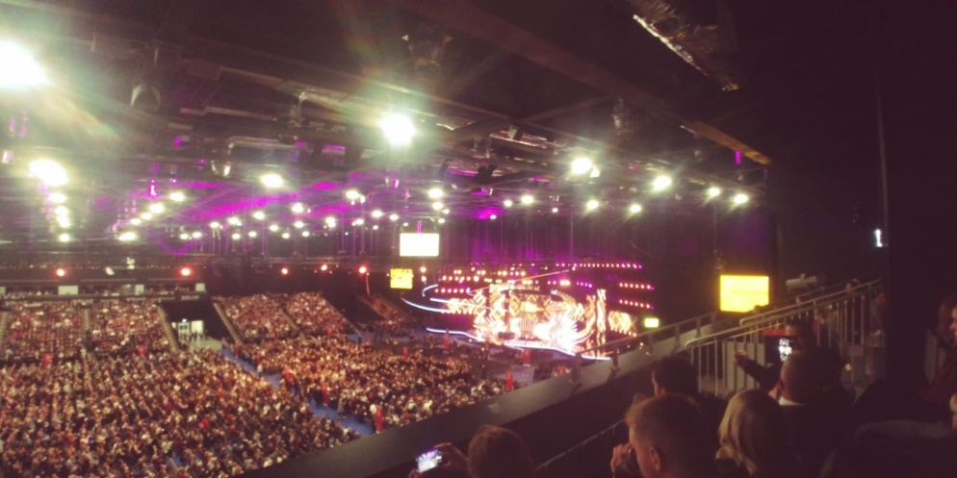
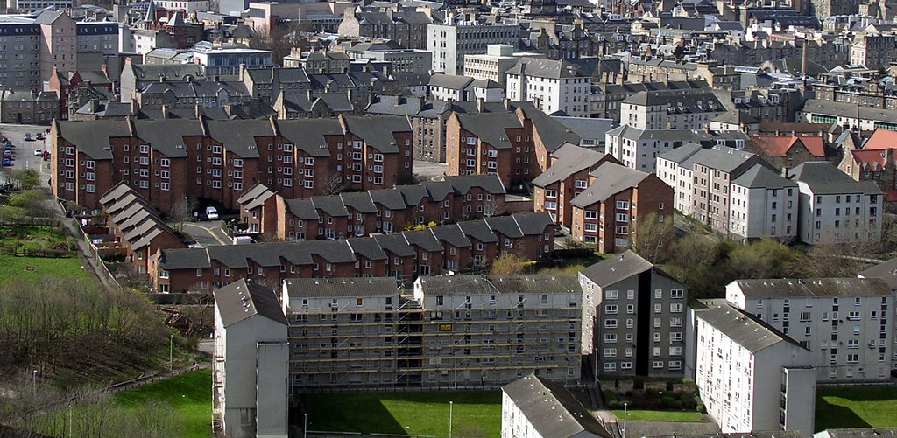
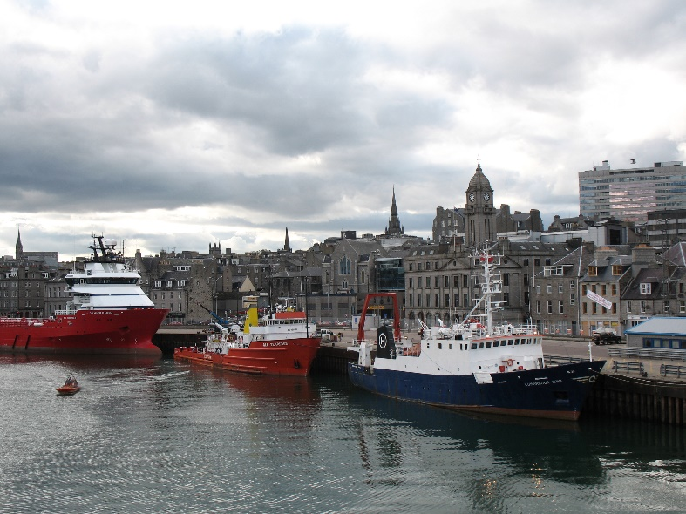
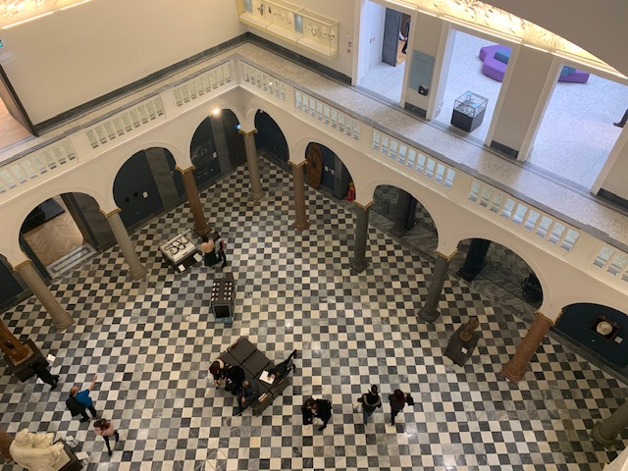
Aberdeen 2022 – where are the learning opportunities?
What is your context?
Where are the learning opportunities?
Notes:
Example for Aberdeen –
P&J Live (15,000 venue), oil, gas & green transition, refurbished city centre, your own community (community capital)
if you wanted to, participants could add ideas to a post it and collate and put on a wall – visual to remind importance of own contexts and the opportunities within it.

Slide 13

The Organisation for Economic Co-operation and Development (OECD) Review 2015
CfE is the right approach for Scotland in the 21st Century
Requirement for a strong, fresh narrative
Aim: to ‘powerfully help to galvanise activity and enthusiasm’
For Scotland's learners, with Scotland's educators
For Scotland's learners, with Scotland's educators
Notes:
Background to the Refreshed narrative on Scotland’s Curriculum – advice from the OECD http://www.oecd.org/education/school/Improving-Schools-in-Scotland-An-OECD-Perspective.pdf
“CfE is at a “watershed” moment. There has been a decade of patient work to put in place the full curriculum programme. That programme implementation process is nearing completion and this represents a prime opportunity boldly to enter a new phase.
The curriculum in Scotland has traditionally been implemented through consensus.
There has been coordination with other organisations to build system alignment and coherence, fitted to implementing CfE as a Scotland-wide curriculum programme.
There is need now for a bold approach that moves beyond system management in a new dynamic nearer to teaching and learning.”
Recommendations
Develop metrics that do justice to the full range of CfE capacities informing a bold understanding of quality and equity.
Create a new narrative for the Curriculum for Excellence.
Strengthen the professional leadership of CfE and the “middle”. •
Simplify and clarify core guidance, including in the definitions of what constitutes the Curriculum for Excellence.
Focus on the quality of implementation
CfE and the approach taken is widely admired by other systems across the world. There is great interest shown in the notions of curriculum flexibility from systems that do not have this
The Organisation for Economic Co-operation and Development (OECD) is an international organisation that works to build better policies for better lives. Our goal is to shape policies that foster prosperity, equality, opportunity and well-being for all. We draw on almost 60 years of experience and insights to better prepare the world of tomorrow.

Slide 14
OECD (2021)Recommendations for next steps: Focus on student learning progress
1.1 Re-assess Curriculum for Excellence’s (CfE) aspirational vision against emerging trends in education
1.2 Find a better balance between breadth and depth of learning throughout CfE to deliver Scotland’s commitment to providing all learners with a rich learning experience throughout school education
1.3. Adapt the Senior Phase to match the vision of CfE Scotland
1.4. Continue building curricular capacity at various levels of the system using research
Notes:
1.1 Re-assess Curriculum for Excellence’s (CfE) aspirational vision against emerging trends in education to take account of evolutions in education and society: Scotland should consider updates to some of its vision’s core elements and their implications for practice, in particular the role of knowledge in CfE; and define indicators aligned to the vision to help understand students’ progress across all four capacities set out in CfE.
1.2 Find a better balance between breadth and depth of learning throughout CfE to deliver Scotland’s commitment to providing all learners with a rich learning experience throughout school education: Scotland could consider how the design of CfE can better help learners consolidate a common base of knowledge, skills and attitudes by the end of BGE, and nurture and hone this base for them to progress seamlessly through Senior Phase and the choices its offers
1.3. Adapt the Senior Phase to match the vision of CfE Scotland could consider adapting the pedagogical and assessment practices and the structure of learning pathways in the Senior Phase to enhance learners’ experience of upper-secondary education and help them develop CfE’s four capacities continuously.
1.4. Continue building curricular capacity at various levels of the system using research By developing the environment of curriculum design support around schools, including in supporting exchange and collaboration between practitioners for curriculum design and experimentation within and across schools; and collaboration between schools and universities.
SG Response
1.1 Initial SG response
ACCEPT: We will work with Education Scotland, SQA, the teaching profession, learners, parents and other key partners to build on the work undertaken in 2019 to refresh Scotland’s curriculum narrative. This will include re-examining core elements of its vision to take account of 20 years of curriculum design and delivery, and wider educational developments.
We will work with stakeholders to ensure the role of knowledge, skills and attitudes are more explicit and better integrated in the capabilities and attributes of the four capacities, to help understand learners progress.
1.2 Initial SG response
ACCEPT: We will work with partners including teachers, parents, young people, academics, and all parts of the system to find the point of balance between breadth and depth, considering how this evolves through the learner journey from the broad general education towards more knowledge and discipline based courses in the senior phase. We will provide guidance which supports schools to develop an approach which will work in their context.
1.3 Initial SG response
ACCEPT: The Scottish Government will build on the work undertaken in 2018 on the Learner Journey and subsequent discussions at the Education and Skills Committee in 2019/20. Specifically it will update senior phase approaches and learner pathways in order to enhance learners’ experiences across the four capacities of Scotland’s curriculum. This will include reviewing and updating guidance on learning and teaching and assessment practices where appropriate.
1.4 Initial SG response
ACCEPT: Teachers should be supported to take innovative decisions about the curriculum, based on the findings of relevant research and methods such as professional enquiry. Actions to support this will include reducing class contact time (see Recommendation 3.1), supporting ever greater collaboration between teachers and schools through regional improvement collaboratives and intensifying school empowerment.
We will also consider whether existing professional learning in terms of curriculum can be enhanced while exploring how we can expand colleges and universities’ interaction with schools.

Slide 15
Policy tension
A shifting policy discourse (excellence, equity, collaboration, empowerment, attainment, leadership) and the persistence of tensions resulting from accountability mechanisms have made the enactment of CfE challenging for many teachers.”
(Humes and Priestley (2021)
Curriculum Making in Europe: Policy and Practice within and Across Diverse Contexts by Professor Walter Humes and Professor Mark Priestley (2021) – https://www.emerald.com/insight/publication/doi/10.1108/9781838677350
For Scotland's learners, with Scotland's educators
Notes:
CFE is an intended rather than an ENACTED curriculum- Andreas Schleicher OECD
Putting Learners at the Centre: Towards a Future Vision for Scottish Education ‘Muir Report’ Putting Learners at the Centre: Towards a Future Vision for Scottish Education (www.gov.scot)
Ethics provocation videos and roundtables - The General Teaching Council for Scotland (gtcs.org.uk)
Ethics of Knowledge in Curriculum Design. Dr Joe Smith

Slide 16
Curriculum making as a social activity within and between levels
Site of activity | Examples of activity | Examples of actors
SUPRA | Transnational curriculum discourse. Curriculum policy lending/borrowing. Policy learning | OECD, EU, World Bank
MACRO | Developing policy frameworks. Legislation | National govt., National curriculum agencies
MESO | Developing policy guidance. Leadership and support of curriculum making | National govt., National curriculum agencies. RIC, LA, RIT, subject and sector organisations
MICRO | School level curriculum making, curriculum planning, lesson planning | HT, school leadership teams, PT, teachers
NANO | Curriculum making in class and learning spaces. Learning interactions | Teachers and learners
Priestley et al (2021) Curriculum making in Europe
Notes:
Where do you have influence?
Where should you invest your energy
Strengthened middle tier. What is your network for discussing curriculum design?
Some thoughts on Scotland’s education reform agenda; a contribution to the National Discussion on Education – Professor Mark Priestley (wordpress.com)

Slide 17

Refreshed Narrative on Scotland’s Curriculum
https://scotlandscurriculum.scot
For Scotland's learners, with Scotland's educators
Notes:
Individual time to review this on their mobile devices.
https://scotlandscurriculum.scot
Response in the chat pane
Take some feedback
“Underwhelming, not much has changed” agree and that was how it meant to be. Did the system require more radical change? Did the profession request another major overhaul?
Importance of a restatement of key principles
Some subtle changes/emphasis e.g.
Sustainability
Digital learning
The ‘rationale’ that story around the why of the school curriculum may be ‘lost’ as people have moved on.
Who can tell the story.
How has the context changed since that rationale was developed. Has it been refreshed or has the attention and energy been elsewhere?

Slide 18

Common purpose – endorsed across leadership
For Scotland's learners, with Scotland's educators
For Scotland's learners, with Scotland's educators
Notes:
Following the advice from OECD, the Curriculum and Assessment Board (CAB) set up a sub-group to create the refreshed narrative for Scotland’s Curriculum. The brief is above. The sub-group had representatives including practitioners, academics, Education Scotland, Scottish Government, Unions, GTCS. The refreshed narrative has been endorsed widely across education leaders in Scotland (logos are all on microsite)
Brief for the refresh:
practitioners as the principal audience
single framework that is clear to follow
succinct and in plain English
an update to reflect the contemporary context
Additional information about CAB – for reference Curriculum and Assessment Board
CAB – the board is joint shared by Gayle Gorman and Graeme Logan and meets every three months. It provides advice and guidance to the Scottish Government. It has a wide range of representatives across Scottish Education.
https://www.gov.scot/groups/curriculum-and-assessment-board/

Slide 19
Key Messages
A resource to:
celebrate the successes of CfE and build confidence for future development
maximise and develop opportunities to meet the aspirations of our learners
stimulate fresh thinking about Scotland’s curriculum
engage in professional dialogue in curriculum design and inspire, share and nurture innovation.
For Scotland's learners, with Scotland's educators
Notes:
Intended to an enacted curriculum
Curriculum making/teacher agency
Collective efficacy and Collaborative enquiry

Slide 20
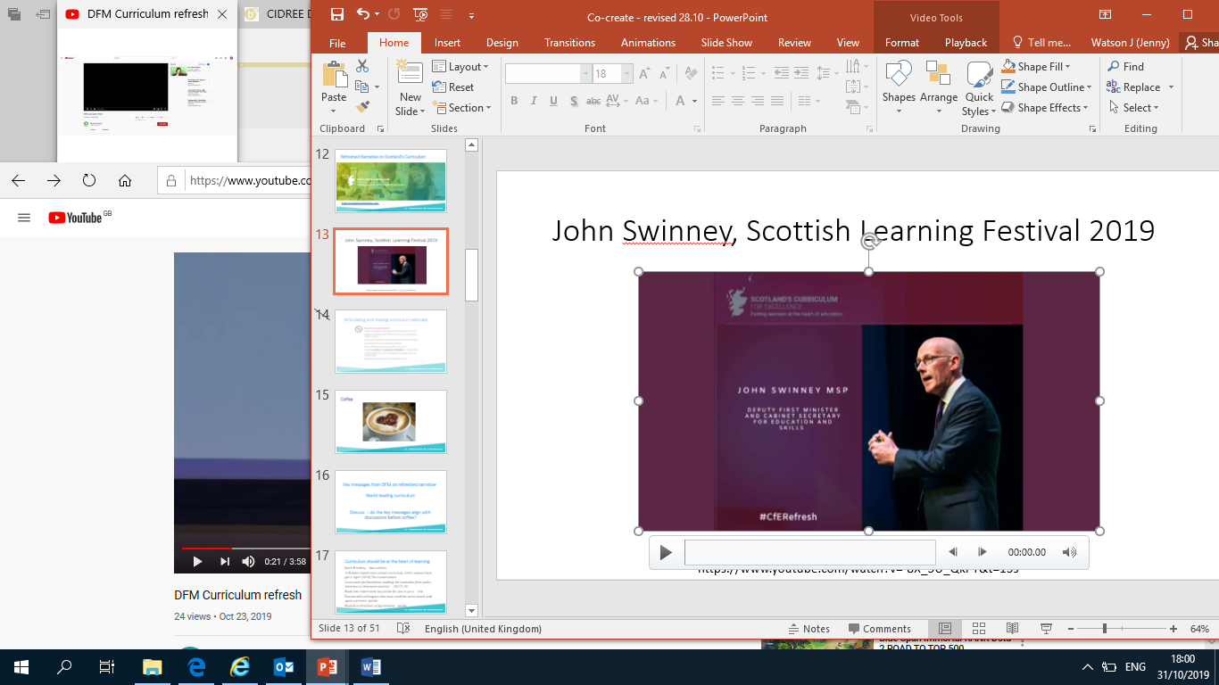
John Swinney, Scottish Learning Festival 2019
https://www.youtube.com/watch?v=-8X_5U_QkPY&t=15s
Notes:
Get this downloaded onto PC and memory stick to overcome connectivity issues 4 min video
https://www.youtube.com/watch?v=-8X_5U_QkPY&t=15s

Slide 21
Key messages from DFM on refreshed narrative
World leading curriculum
Discuss - do the key messages align with your reflections?
For Scotland's learners, with Scotland's educators
Notes:
Take feedback, support discussion across the floor

Slide 22
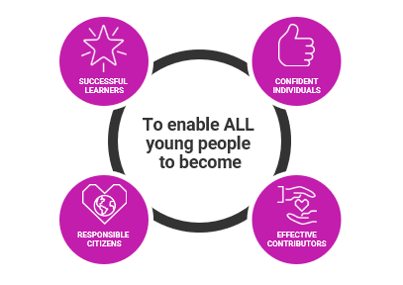
Scotland’s Approach - four capacities
Choose one of the capacities that is well developed in you.
Notes:
Resources to support the Refreshed Curriculum for Excellence Narrative | Learning resources | National Improvement Hub (education.gov.scot)
Personalise by asking “Choose one of the capacities that you feel is well developed in YOU”
“Choose one of the capacities that you feel is a development area for YOU”
Take feedback, the applicability of the 4 capacities
Can the develop further “Choose one capacities that you feel is well developed in your school or context”

Slide 23






Scotland’s approach - the four capacities
with:
> enthusiasm and motivation for learning
> determination to reach high standards
of achievement
> openness to new thinking and ideas
and able to:
> use literacy, communication and
numeracy skills
> use technology for learning
> think creatively and independently
> learn independently and as part
of a group
> make reasoned evaluations
> link and apply different kinds of
learning in new situations
with:
> self respect
> a sense of physical, mental and
emotional wellbeing
> secure values and beliefs
and able to:
> relate to others and manage themselves
> pursue a healthy and active lifestyle
> be self aware
> develop and communicate their own
beliefs and view of the world
> live as independently as they can
> assess risk and take informed decisions
> achieve success in different areas
of activity
with:
> respect for others
> commitment to participate responsibly
in political, economic, social and
cultural life
and able to:
> develop knowledge and understanding
of the world and Scotland’s place in it
> understand different beliefs
and cultures
> make informed choices and decisions
> evaluate environmental, scientific and
technological issues
> develop informed, ethical views of
complex issues
with:
> an enterprising attitude
> resilience
> self-reliance
and able to:
> communicate in different ways
and in different settings
> make informed choices and decisions
> work in partnership and in teams
> take the initiative and lead
> apply critical thinking in new contexts
> create and develop
> solve problems
Ethos and life of the school as a community
Notes:
In school have these printed off

Slide 24
Numeracy and Mathematics – example of using four capacities to articulate skills and attributes in a curricular area
Demonstrate new skills
Persistence and effort
Positive Mindset in Mathematics
Challenges/Puzzles etc.
Demonstrate creativity
Work independently
Practise new learning
Use numeracy and mathematics skills/knowledge/understanding in a real life context
Solve problems
Discuss learning
Apply thinking skills
Teach someone else a maths concept
Explain how a solution was reached
Show different ways of solving a calculation
Apply skills in different contexts
Opportunities to celebrate personal successes
Critical thinking
Ask questions
Make informed decisions
Interpret information
Draw conclusions
Can see relevance in learning
View yourself as a learner
Can ‘see’ learning in lots of activities, not just work set by teacher/school
Communicate solutions
Work independently on challenges/puzzles/homework
Work as part of a team to reach solutions
Offer your own opinions
Demonstrate critical thinking
Apply mathematical skills to design/create/improve etc.
Ethos and life of the school as a community
Notes:
Ask colleagues to consider the learners. In their classroom/sector/subject - find examples to populate this

Slide 25
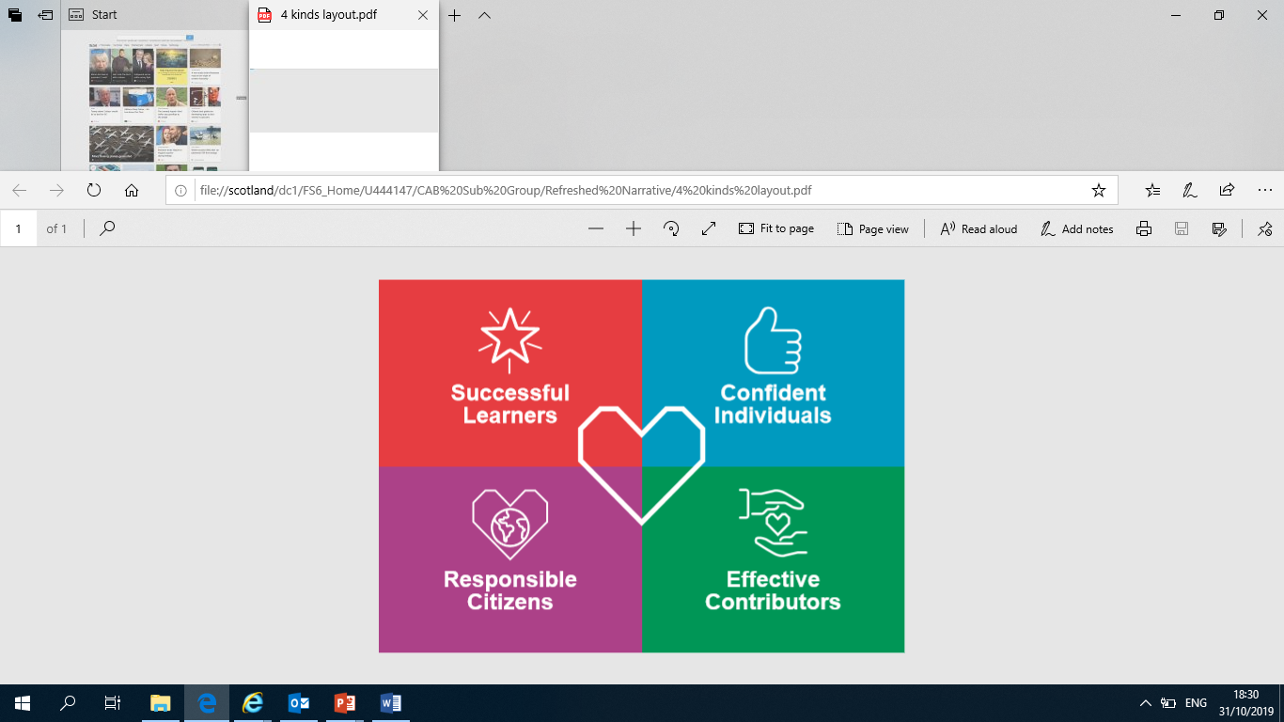
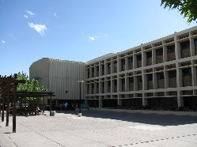
Your unique setting
Your school
Your community
Where are the opportunities that build the four capacities in your school and across your community?
Your school
Your community
Notes:
BREAK OUT 20 mins.
Optional exercise following from the previous one – four capacities
Emphasis on the centrality of the 4 capacities

Slide 26

Where do you think the most effective learning
takes place in your context?
Think
Pair
Share
For Scotland's learners, with Scotland's educators
Notes:
Take feedback, discussion. Feeedback chat pane

Slide 27
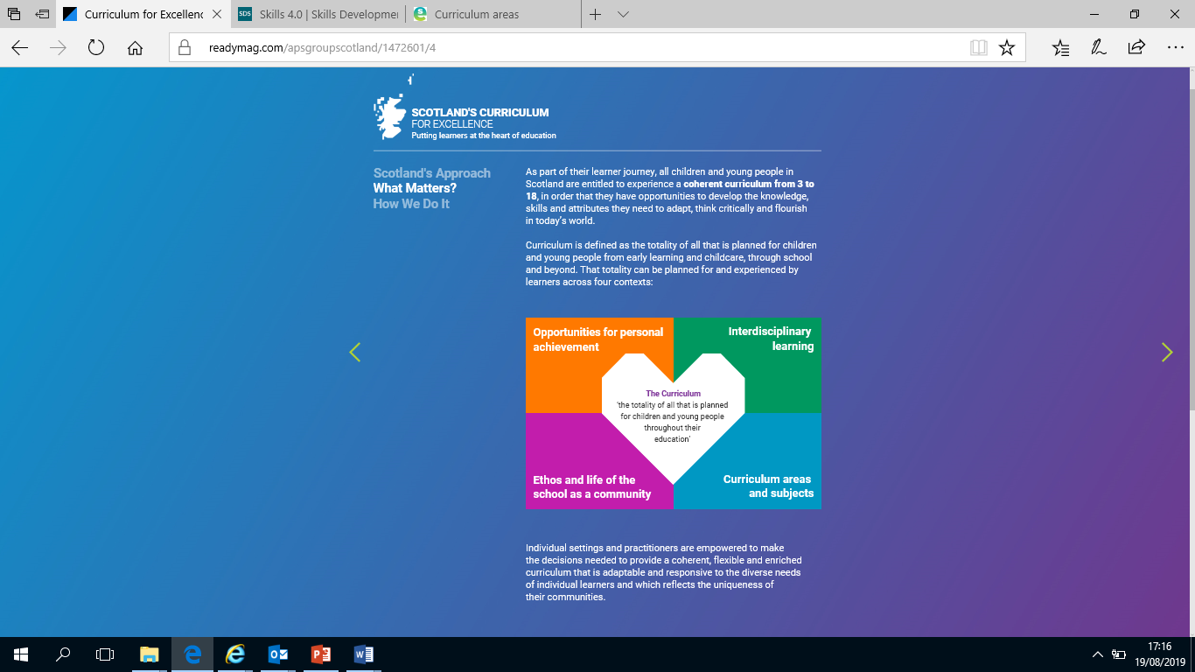
Maths / Numeracy Team – Four Contexts
STEM projects
Enterprise Activities
School credit union
STEM ambassador inputs
Employer engagements
Financial Education
Digital / technology skills
Social Studies
Home economics. Family food
Maths competitions
Online weekly puzzles (Sumdog contests
Numeracy Leaders
Maths ambassadors within schools
Cross stage working
National events
Parental Engagement
Celebration days
Numeracy across learning
Partnership working
Community learning
Homework support initiative
Transitions – possible use of Beeslack project (Improvement Hub)
Closing the gap
Early foundations in numeracy ,
Numeracy frameworks
Use of application of maths and the new Higher
Pedagogical approaches
Outdoor learning ideas, creativity ideas
Teacher forums, online resource sharing
Current research – link to usable collection
For Scotland's learners, with Scotland's educators
Notes:
Issue examples – indicating coverage around 4 contexts may be more than thought

Slide 28

Coffee
For Scotland's learners, with Scotland's educators

Slide 29
Exploring the 4 capacities- a thought paper (Oct 22)
"I can't believe we're still talking about this."
Out of 600 learners 50% of upper primary school learners had heard of the four capacities. 74% of S1-3 learners and 68% of Senior Phase learners have never heard of/entirely forgotten, them.
Educators strongly supported the 4 capacities but did not think that they should be measured. But what about the 4 values?
The learners were asked how they understood the purpose of school. 80 educators asked to anticipate their answers. The top three responses for both were jobs, education/learning and friendship.
The value of qualifications was further down the order.
No educators anticipated that the learners would highlight the importance of their parents (or the law) in compelling them to go to school
For Scotland's learners, with Scotland's educators
Notes:
Education Scotland - NoTosh - The Four Capacities Version 5 Sept 2022
Wisdom, justice, compassion and integrity define the values for Scottish society

Slide 30
Exploring the 4 capacities- a thought paper (Oct 22)
Superpowers
‘Superpowers’ are those unique and essential skills and personal attributes you recognise in yourself. And as young people talk about their superpowers, they also tend to reveal their own definition of the purpose of going to school and why it matters,
Wide ranging responses. Developed in/out of formal education.
Learners identified their need for successful learning habits such as critical thinking, communication skills, curiosity, creativity and teamwork. All stages noted the importance of leadership skills.
For Scotland's learners, with Scotland's educators
Notes:
Education Scotland - NoTosh - The Four Capacities Version 5 Sept 2022

Slide 31
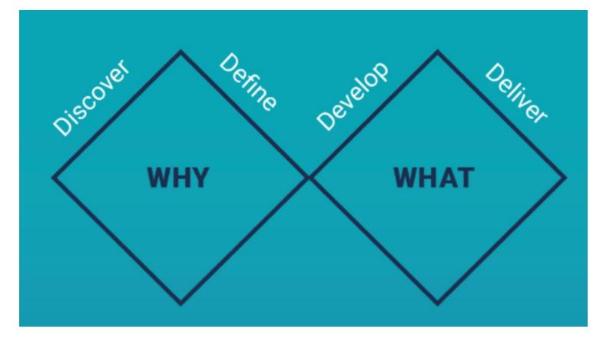
Notes:
Service Design
Curriculum Design Toolkit | Learning resources | National Improvement Hub (education.gov.scot)
Understanding the Learners
Curriculum Design Toolkit (education.gov.scot)
Essential Tools
Curriculum Design Toolkit (education.gov.scot)

Slide 32
Developing your curriculum rationale
Start with WHY.
Getting the ideas out
Imagine if …
Understanding your learners
Empathy maps
Personas
Data driven design
For Scotland's learners, with Scotland's educators

Slide 33
Alice and The Cheshire Cat
"Would you tell me which way to go from here?“ asked Alice
"That depends a good deal on where you want to get to“ said The Cheshire Cat
"I don't much care where -“ replied Alice
"Then it doesn't matter which way you go“ retorted the grinning cat
For Scotland's learners, with Scotland's educators
Notes:
Exploring your why

Slide 34
What matters in education
“We each need to take the time to decide what it is that we believe education is for; not because someone tells us, or the rules dictate, but because we believe it is right and just. Once we have an image of the future we prefer, getting there is possible. It may be difficult; we may have to change, to learn, to live in dissonance, and to stand firm in our beliefs. But it is possible”
(Earl, 2003, p.4).
For Scotland's learners, with Scotland's educators
Notes:
What matters in education

Slide 35
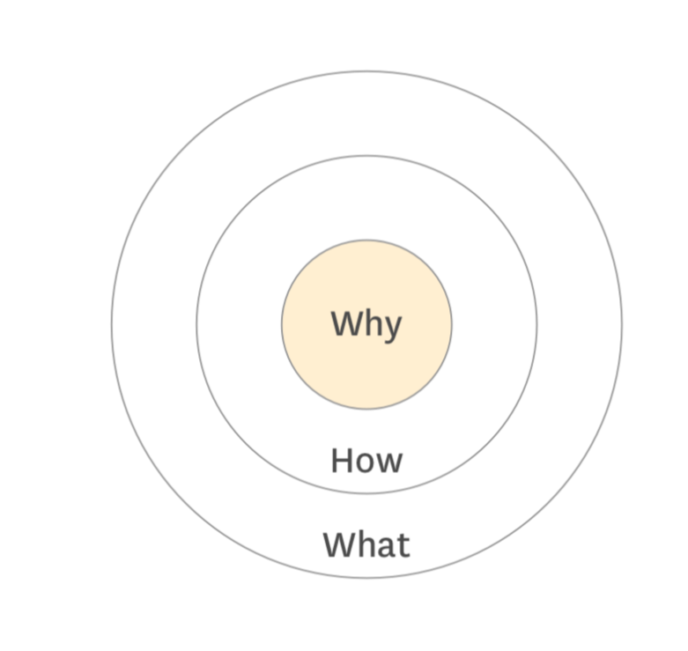
Why?
Why. What is your cause? What do you believe?
How. What are you strategies, partnerships and underlying processes?
What. What will you do? What will your visible outputs be?
For Scotland's learners, with Scotland's educators
Notes:
Why:. Why is all about your purpose. Why does your school exist? Why do you do what you do? And why should anyone care? Moral compass
How: Some people and schools know how they do what they do. HOWs are often given to explain how something is different or better.
What: Every single organisation on the planet knows what they do. This is true no matter how big or small it is, or no matter what sector they belong to. Everyone can easily describe the products or services their company sells or the job function they have within the company.
When we start with “Why”, we go from the inside out of the circle. “Why” is the reason to care and the “Whats” merely represent the tangible products as a proof of that belief. “Whats” are the visible outputs.
The advantage of explaining why over how and what. Why gives a purpose, it provides flexibility to change and adapt the how and what while maintaining the direction; the moral compass.
Simon Sinek “Starts with Why”

Slide 36
Curriculum for Excellence- The children and young people in your community can thrive and strive in the 21st century
IMPORTANT
VERY IMPORTANT
CRITICAL
For Scotland's learners, with Scotland's educators
Notes:
BREAK OUT 20 mins
Negotiating exercise
Think – from you own standpoint what is critical. On individual post its, write three. As a group, examine the sticky notes.
Discuss, negotiate and post it in the section of the group’s choosing choice. (important, very important or critical)
Feedback. Why- in the context of a changing agenda
60 years ago – job for life, stay local, know your place, obedience and virtue
Today - Diversity, inclusion, social justice, climate change, sustainability ?
When developing a rationale what is critical and what is very important?

Slide 37
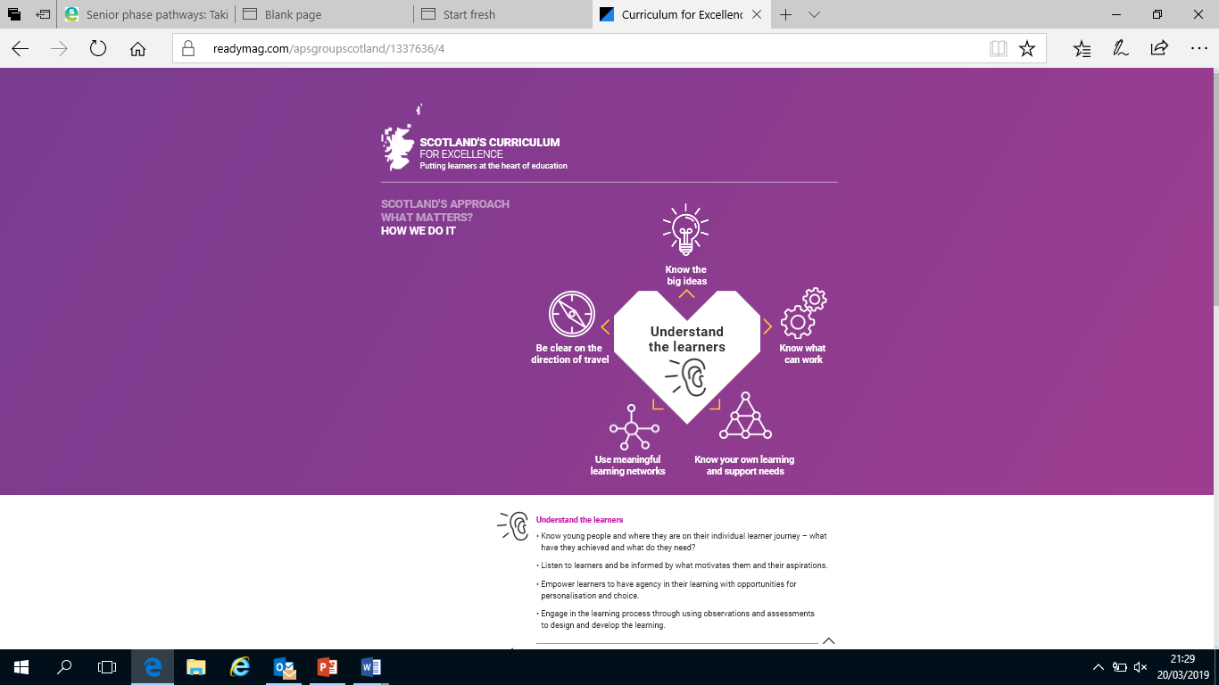
Understand the learners
Knowing young people and where they are on their individual learner journeys.
Listening to learners and be informed by their motivations and aspirations.
Empowering learners to have agency in their learning with opportunities for personalisation and choice.
Using observations, assessments and feedback to design and develop the learning.
For Scotland's learners, with Scotland's educators
Notes:
One of the pages on the refreshed narrative site

Slide 38
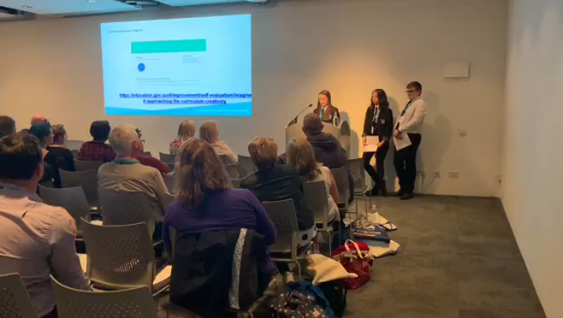

Understand the learners – Imagine if ….
Creative approach to capturing the needs and wishes of learners
All ages and stages. 45-60 minute workshop used with class-sized groups.
The Imagine If… statements generated can inform rich discussion around improving the curriculum that your school, establishment or learning environment offers founded on the voices of learners.
For Scotland's learners, with Scotland's educators
For Scotland's learners, with Scotland's educators
Notes:
Imagine if… approaching the curriculum creatively | Self-evaluation | National Improvement Hub (education.gov.scot)
LOGO is hyperlinked to NIF site.
Opportunity to ask if anyone in the room has used it.
Could provide time to view the resource
This approach offers a creative approach to capturing the needs and wishes of learners using Imagine If… questions and creativity skills activities.
The process can be done with learners across all ages and stages and takes the form of a 45-60 minute workshop that can be used with class-sized groups.
The Imagine If… statements that the process generates can then be used to inform rich discussion around improving the curriculum that your school, establishment or learning environment offers founded on the voices of learners.
The process can be used individually to support a single planning session, or collectively as part of a broader process.
You can also download examples of the Imagine if… statements created by learners from: primary and secondary school in 2019/20.

Slide 39
Imagine if ….
Imagine if maths and English were not the most important subjects.
Imagine if school was not as technologically advanced and would do things the old-fashioned way – with paper.
Imagine if school was a camp.
Imagine if school was a drop-in.
Imagine if hours were more flexible.
Imagine if classes were more open – you could take whatever classes you want.
Imagine if you could choose your teachers.
Imagine if school wasn’t all about the grades you leave with.
Less stress and more opportunities to do your own research/studying
We rewarded working together collaboratively more than individual achievement
For Scotland's learners, with Scotland's educators
For Scotland's learners, with Scotland's educators
Notes:
These are examples of statements from the Imagine if … website

Slide 40
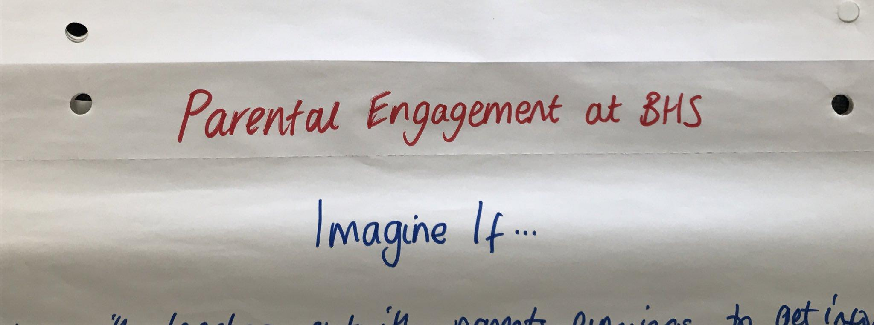
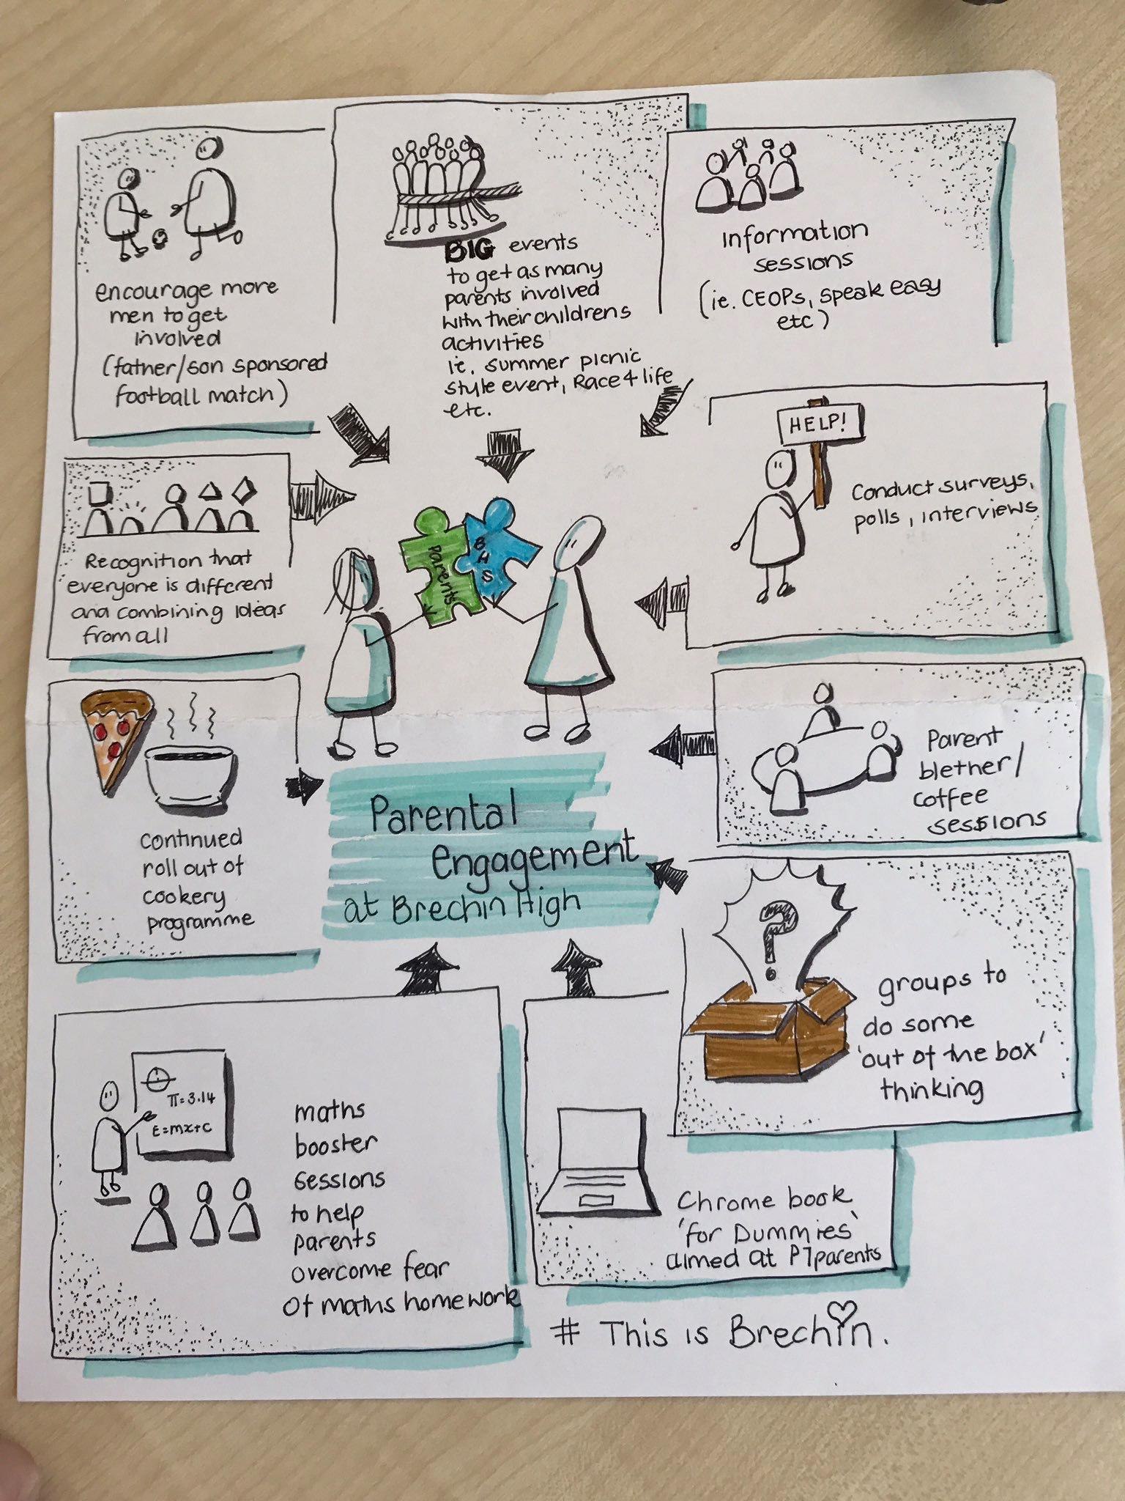
Imagine if … points to ponder
How could you use Imagine if .. to listen to learners and understand their motivations and aspirations?
Could it be used with other stakeholders to help shape the curriculum offer?
For Scotland's learners, with Scotland's educators
Notes:
Teacher from Brechin HS attended a service design programme in Dundee and Angus College and set up an Imagine if … exercise for the Parent Council meeting. One of the parents who was an artist then summarised the points on this poster

Slide 42
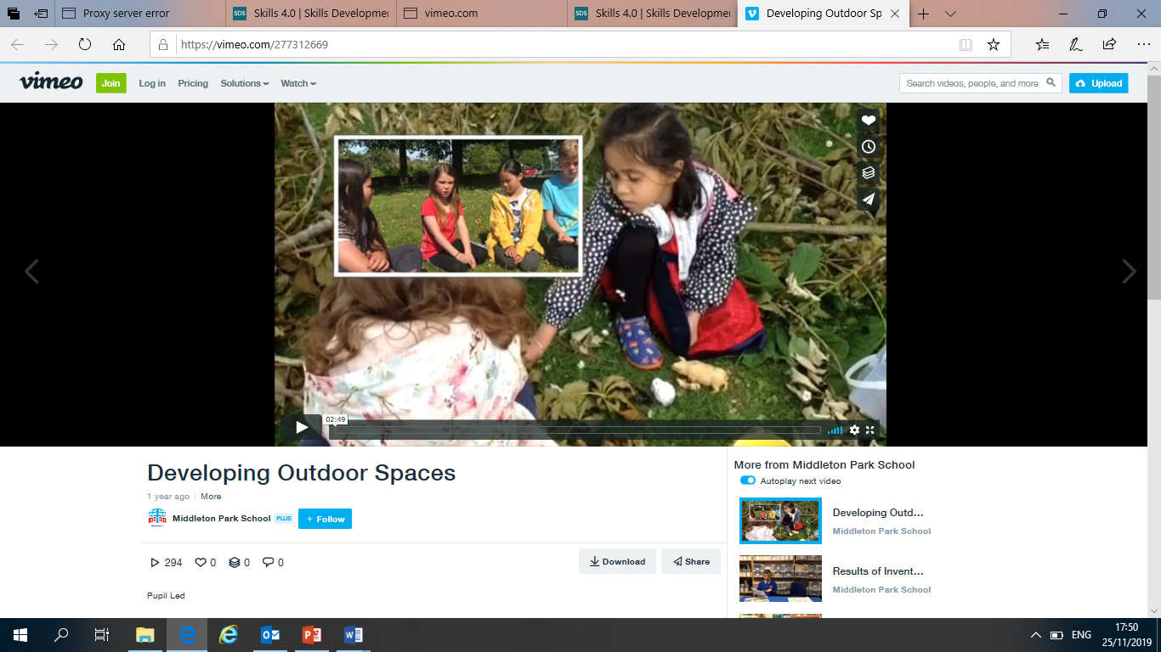
Pupil researchers
How could this tool be used?
What impact could it have?
Who would you use it with?
Pupils as the researchers to inform the school planning process.
This film shows the impact of involving pupils in observing younger children and using their findings to transform a play space.
https://vimeo.com/277312669
For Scotland's learners, with Scotland's educators

Slide 43
Empathy map
Empathy Mapping
‘Walking in someone else’s shoes’
Valuable tool to use voice to shape the curriculum and to ensure that our learners are active shapers of their future world
For Scotland's learners, with Scotland's educators

Slide 44
Empathy Map
Situation
Say and do | Feels
 | Thinks
Pain (obstacles, needs) | Gain (hopes, aspirations)

Slide 45
Empathy Map
HEARING
NAME
SEEING
What does this person hear from authority figures,
the media, the public and family/friends?
What does the person see around them?
DOING
SAYING
What does the person spend their time doing?
What is the person’s attitude in public?
What causes them?
What makes them?
WORRIES
HAPPY
PAIN
GAIN
What are their fears and frustrations?
What do they want and need?
What is the person’s attitude in public?

Slide 46
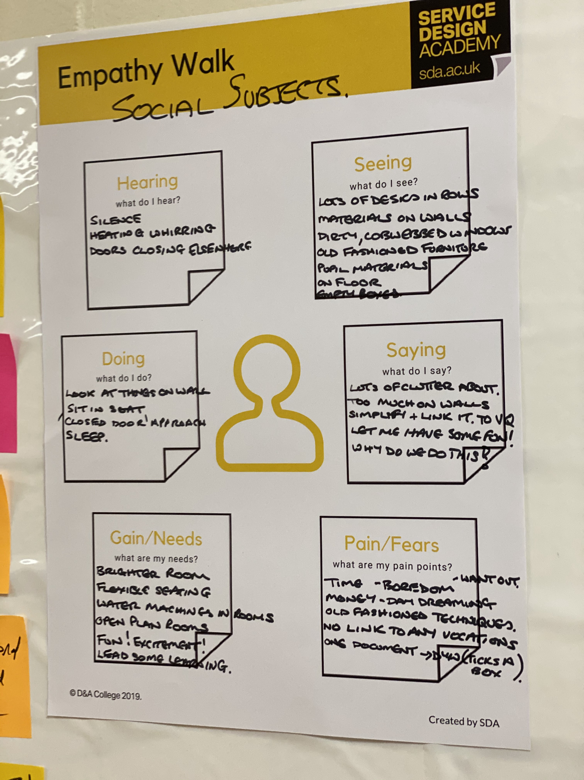
Notes:
Hearing: silence
Seeing: Lots of desks in rows, dirty windows, condensation
Doing: sitting apart, sleeping
Saying: Why do we do this. Let’s have fun
Pain/fears: Boredom, old fashioned teaching, want out
Gains: Brightness, excitement, flexible furniture, link to future
Context = Motivation

Slide 47
Persona
Personas are fictitious characters created to represent different groups of people based on the views and experiences of the group. Personas are developed to represent young people and help practitioners to see how these young people will interact with their service.
Personas encourage people to focus on the needs of the persona, rather than revert to their own personal opinions/biases. Personas provide an anonymous but believable character to focus on and design your service around.
For Scotland's learners, with Scotland's educators

Slide 48
Saying…..?
Persona
Name:
What are their Interests
Background:
Age:
Career/Work life:
What is important to them?
Draw your person:
Personal life: What is their home life like?
What causes them major worries?
Notes:
Examples
Used to engage partners –making concrete the issues facing groups of children and young people.
Use with staff to look at curricular provision
To make cases for shift in resources when working with parents

Slide 49

Persona
Saying…..?
Don’t know where I am
Name:
What are their Interests
Eva
Background:
What is their home life like?
Construction
Wants to work as a joiner
Likes to work on practical tasks
Age:
Stage/Year:
16
S5
Mum works PT and unsociable hours
Can struggle in classes due to dyslexia
1 younger sister
1 older brother
Not around when they come home.
Eva looks after her sister and her brother
Makes breakfast and dinner for them
Organises the house
Needs to travel on bus for FA course
Learner Journey
What is important to them?
Broad General Education Subjects
Working and earning money
Wants to travel
Wants a good job
Doing well in the Foundation Apprenticeship course
English
Maths
Spanish
French
Science
Humanities
ICT
Technologies
Expressive Arts
PE
Work Placement
Hoping to be placed in the construction sector during her FA course
What causes them major worries?
Senior Phase Subjects
What are her options after school?
No help from school on her career path
Not sure about staying on
Unclear about subject choices
English
Maths
Physics
Woodwork
Design Technology
Foundation Apprenticeship
Career Aspiration:
Construction
Wants to work as a joiner
Modern Apprenticeship
Intervention Timeline
EY-Primary | Primary-Secondary | BGE-Senior Phase | Work Placement | Initial Destination
Attendance issues in Early Years Late start to Early Years | Attendance issues in Primary Missed parental meetings Did not attend Primary-Sec Days Dyslexia diagnosis | Attendance issues Issues with subject choices Lack of engagement with ASN | Looking to work with local builder Placement to be self-found Paperwork still not complete

Slide 50
Imagine If, Pupil Researchers, Empathy Maps, Personas
Discuss the tools above and start to think about the young people that you work with.
How could you use these tools to support greater engagement and progression?
What other engagement tools have you used?
For Scotland's learners, with Scotland's educators
Notes:
Break out

Slide 51
Data driven design
Information, data and knowledge
Information becomes knowledge when it is shaped, organised, and embedded in a context that gives it meaning and connectedness. The implications for leaders are vast.
Data is information that is collected and organized in a systematic way and can be used to make instructional or organisational decisions.
Earl and Katz 2006
For Scotland's learners, with Scotland's educators
Notes:
Reflection
Think about a time that you used data to make a change in your life
Seeking the data
Choosing the data
Accepting the data
Mobilizing the data- own actions and support from people

Slide 52
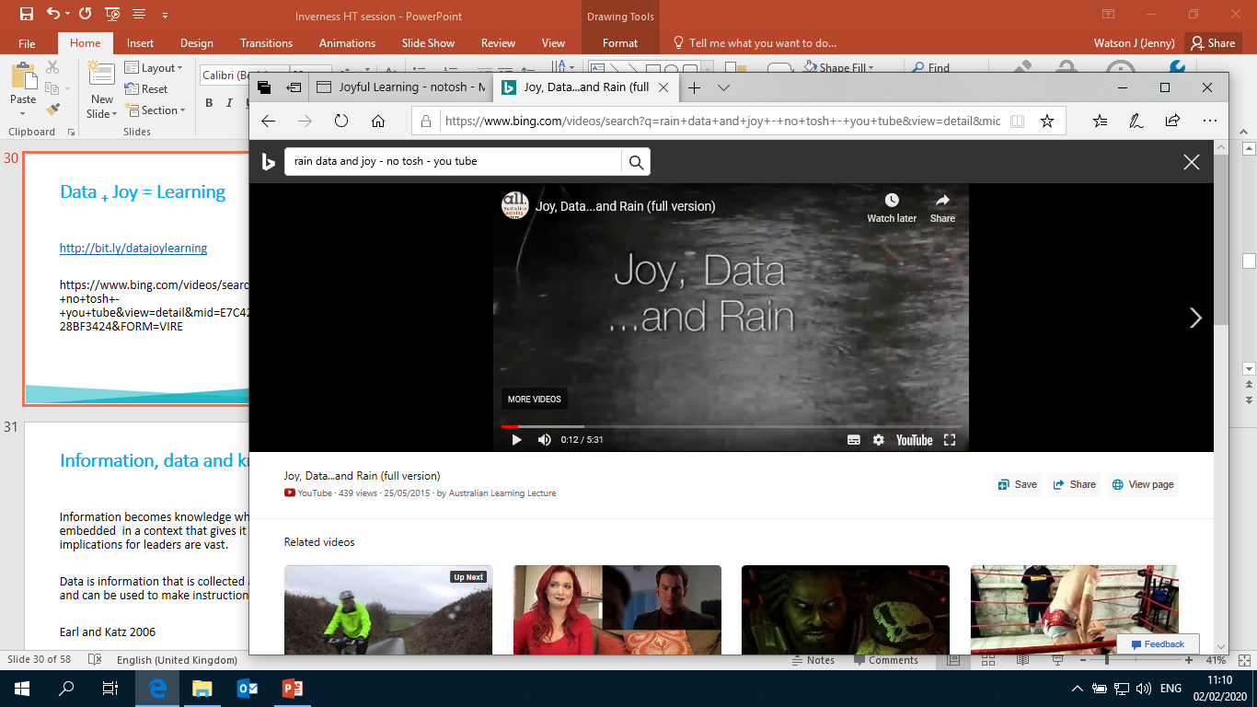
Data driven design - Data + Joy = Learning
Joy, Data...and Rain (full version) - YouTube
For Scotland's learners, with Scotland's educators
Notes:
There is data all around you, when does it become useful?
In pairs- Take something from you wallet and tell a story
Joy, Data...and Rain (full version) - YouTube

Slide 53
What is our data?
Who are our learners? What are their contexts?
What is the learning?
How are our learners’ doing?
How do we do, from other viewpoints?
For Scotland's learners, with Scotland's educators
Notes:
Dump as many data sources as you can in 90 seconds onto post its
Discuss and arrange these in groupings under these headings
Some will fit under two or more headings
Are we a short of data?

Slide 54
What is our data?
Data – both quantitative and qualitative – take many forms, including:
Who are our learners? What is their context? Demographic data. Census data, EAL, learner needs, SIMD, community capital Labour market intelligence
How are our learners’ doing? Achievement Data. Tracking data, report cards, multi agency action plans, CfE levels, Insight data, self-evaluation and external evaluation, leaver destination data. Personas
What is the learning? Programme data. Courses, programmes, evaluation, FE/HE and business partnerships, community capital, learner pathways and maps, self-evaluation and external evaluation. Empathy maps
How do we do? Perceptual data. Learner, parent, community and teacher feedback. Observational data, and surveys. Imagine if …,
(Adapted from the K-12 Board Improvement Planning for Student Achievement (BIPSA) Assessment Tool, Student Achievement Division, 2011)
For Scotland's learners, with Scotland's educators

Slide 55
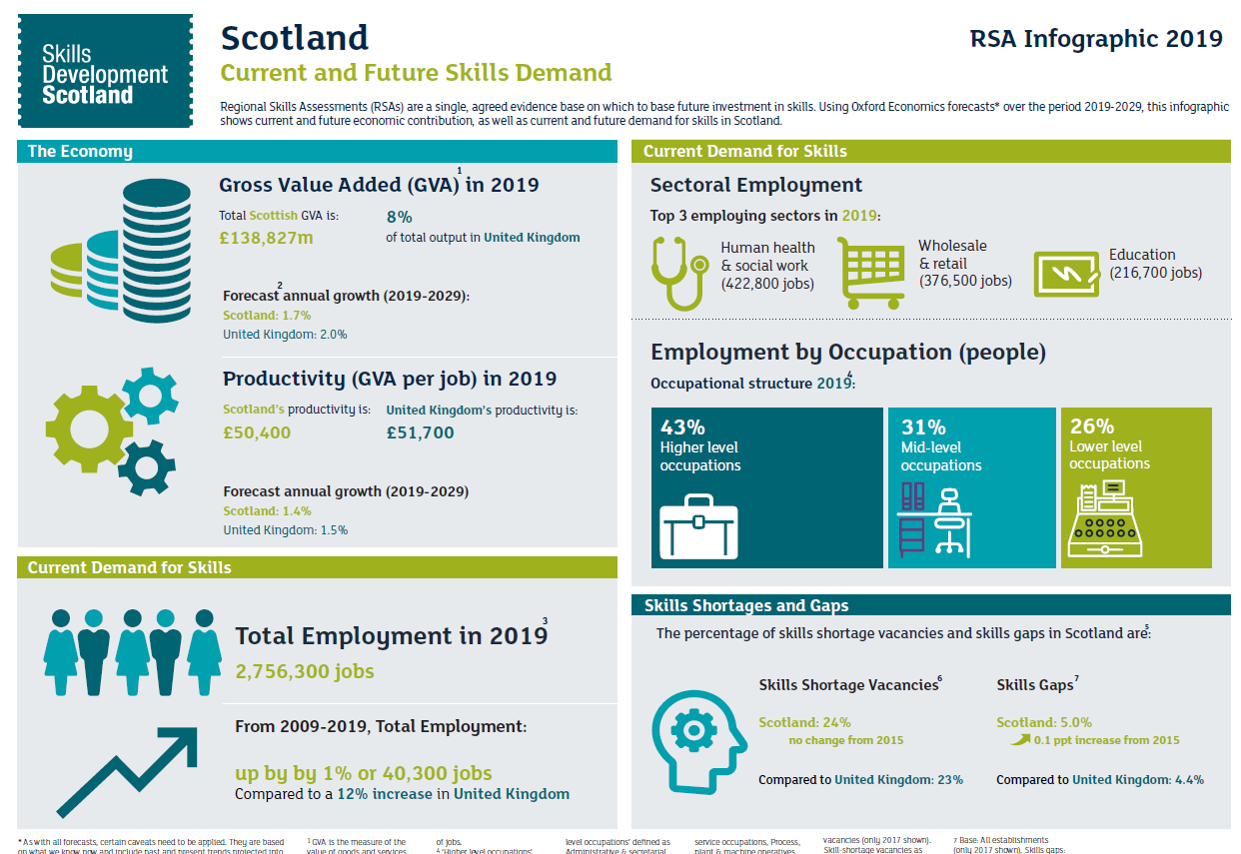
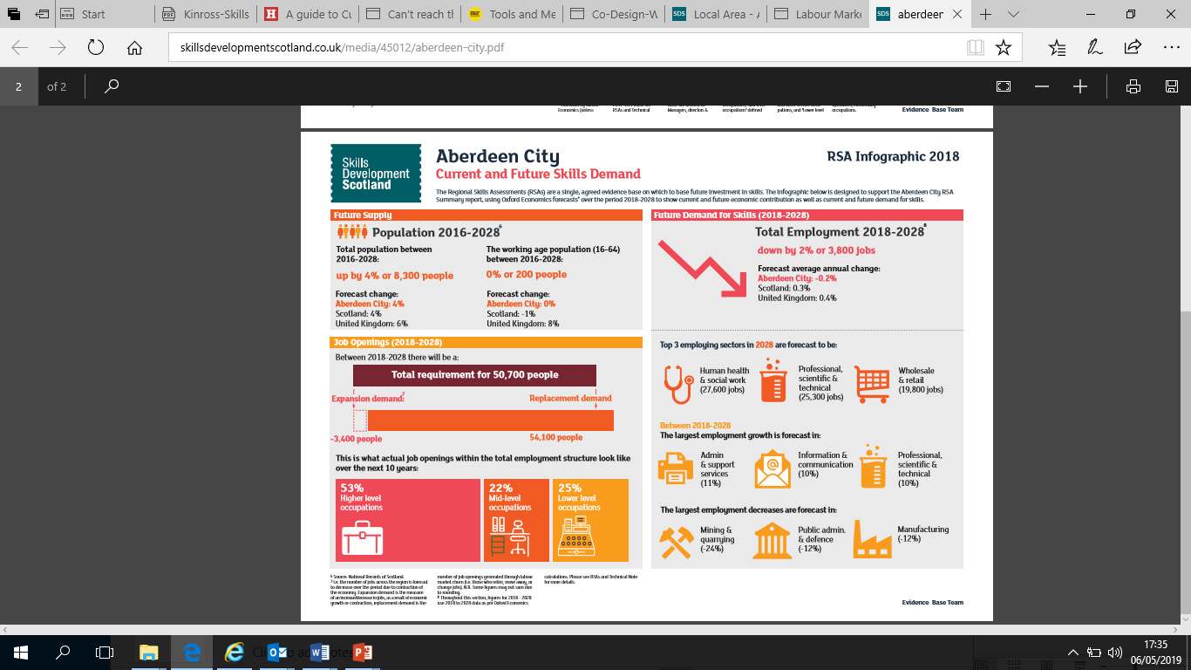
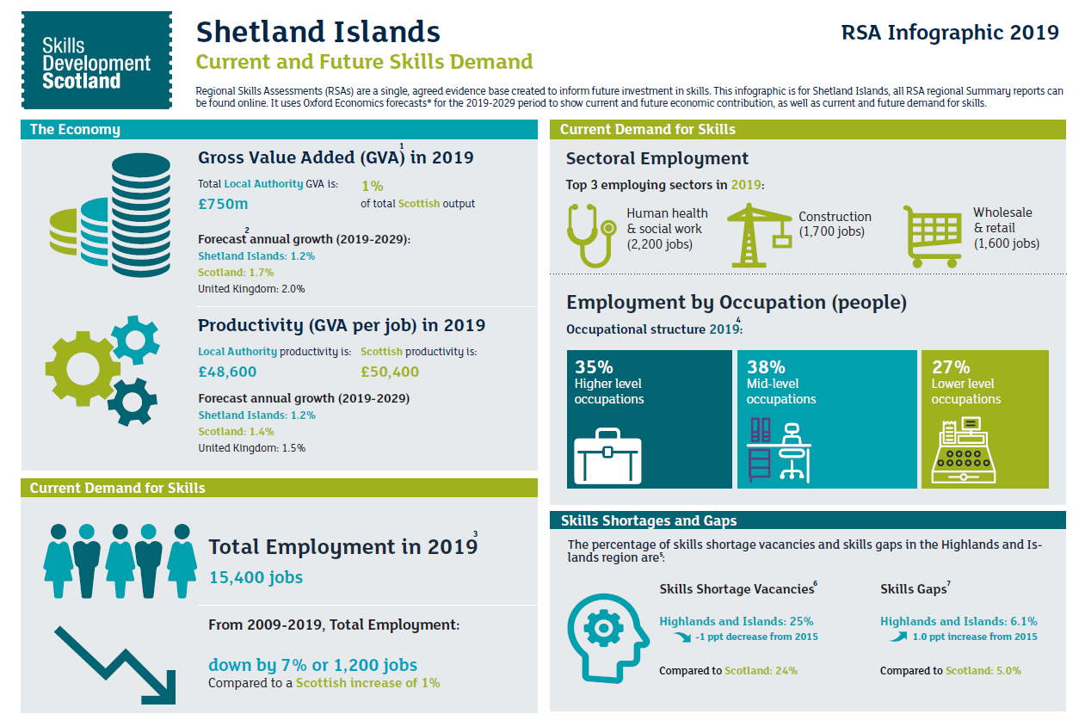
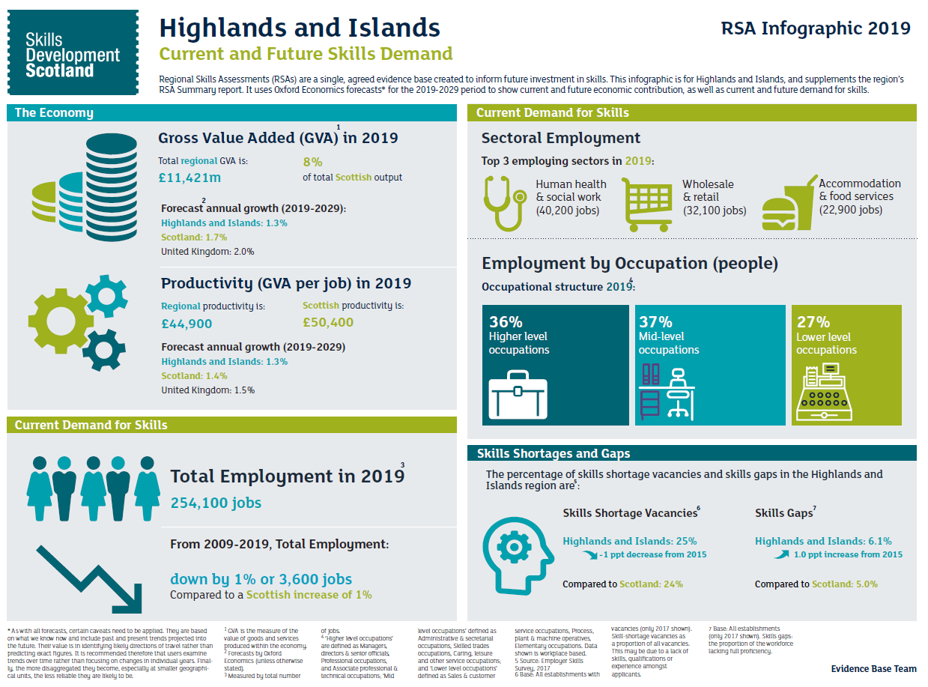

Local Context
How does this shape our curriculum offer?
Notes:
Regional Skills Assessment SDS
Regional Skills Assessments | Skills Development Scotland
All LA, Regions, City Region Deals, Economic Development Zones
New data each July?

Slide 56


#EdScotEiH
For Scotland's learners, with Scotland's educators
Notes:
Link to MS Form in chat pane

Slide 57

So… bringing it all together?
For Scotland's learners, with Scotland's educators

Slide 58

This Photo by Unknown author is licensed under CC BY-NC-ND.

Slide 59
OECD Recommendations for next steps: Focus on student learning progress
1.1 Re-assess Curriculum for Excellence’s (CfE) aspirational vision against emerging trends in education to take account of evolutions in education and society: Scotland should consider updates to some of its vision’s core elements and their implications for practice, in particular the role of knowledge in CfE; and define indicators aligned to the vision to help understand students’ progress across all four capacities set out in CfE.

Slide 60
Scottish Government response
Initial SG response
ACCEPT: We will work with Education Scotland, SQA, the teaching profession, learners, parents and other key partners to build on the work undertaken in 2019 to refresh Scotland’s curriculum narrative. This will include re-examining core elements of its vision to take account of 20 years of curriculum design and delivery, and wider educational developments.
We will work with stakeholders to ensure the role of knowledge, skills and attitudes are more explicit and better integrated in the capabilities and attributes of the four capacities, to help understand learners progress.

Slide 61
What? So What? Now what?
What … does it mean?
So what … are the implications in my context
Now what … does this mean for me as a strategic leader

Slide 62
OECD Recommendations for next steps: Focus on student learning progress
1.2 Find a better balance between breadth and depth of learning throughout CfE to deliver Scotland’s commitment to providing all learners with a rich learning experience throughout school education: Scotland could consider how the design of CfE can better help learners consolidate a common base of knowledge, skills and attitudes by the end of BGE, and nurture and hone this base for them to progress seamlessly through Senior Phase and the choices its offers

Slide 63
Scottish Government response
Initial SG response
ACCEPT: We will work with partners including teachers, parents, young people, academics, and all parts of the system to find the point of balance between breadth and depth, considering how this evolves through the learner journey from the broad general education towards more knowledge and discipline based courses in the senior phase. We will provide guidance which supports schools to develop an approach which will work in their context.

Slide 64
OECD Recommendations for next steps: Focus on student learning progress​
1.3. Adapt the Senior Phase to match the vision of CfE Scotland could consider adapting the pedagogical and assessment practices and the structure of learning pathways in the Senior Phase to enhance learners’ experience of upper-secondary education and help them develop CfE’s four capacities continuously.

Slide 65
Scottish Government response
Initial SG response
ACCEPT: The Scottish Government will build on the work undertaken in 2018 on the Learner Journey and subsequent discussions at the Education and Skills Committee in 2019/20. Specifically it will update senior phase approaches and learner pathways in order to enhance learners’ experiences across the four capacities of Scotland’s curriculum. This will include reviewing and updating guidance on learning and teaching and assessment practices where appropriate.

