Slide 1



Excellence in Headship Stretch 2022-23
Headteacher agency for system change
Gordon Bone & Christopher French, Alison Weatherston, Iain McDermott & Lesley Archibald Education Scotland
For Scotland's learners, with Scotland's educators

Slide 2
Getting the best experience from our online meeting..
Please mute your microphone unless you are speaking ​(this is to minimise feedback, echo and background noise)
Post comments, questions and thoughts into the chat window
If you wish your comment to be fed directly into the discussion, use the raise your hand button. ES facilitators will bring you into the chat and you can unmute your microphone.
The event will not be recorded and we ask that no recordings or photos are taken.
If you can please keep your camera on as it is nice to see you.
For Scotland's learners, with Scotland's educators

Slide 3
Structure of the Session
Introductions
Connector
For what reason am I here
EiH Stretch 2020 – A reflection
Break
What to Expect – Programme overview and timeline
Exploring my itch
Feedback
Close
For Scotland's learners, with Scotland's educators

Slide 4
Aim of the Session
The aim of the session is to welcome you to the Excellence in Headship Stretch Programme and provide you with key information prior to the professional learning starting proper in September 2022.
We will communicate timelines, set expectations and provide an opportunity for you to start to build relationships with fellow school leaders on the programme
For Scotland's learners, with Scotland's educators

Slide 5

Connector
My Professional Learning Journey
For Scotland's learners, with Scotland's educators

Slide 6


Think – ‘For what reason am I here?’
1358 9302
For Scotland's learners, with Scotland's educators

Slide 7
EiH Stretch 2020 - A Reflection
Kirsty Ayed
Headteacher King’s Park Secondary School
Glasgow City Council
For Scotland's learners, with Scotland's educators

Slide 8
Break – 5mins
For Scotland's learners, with Scotland's educators

Slide 9
Excellence in Headship Stretch
Designed to stretch and challenge headteachers, who are seeking opportunities to create positive movement in the Scottish education system.
HTs who have significant experience, as a headteacher and who wish to
develop their leadership across organisational boundaries;
build upon shared values and trust;
draw upon on a wide range of perspectives and resources across national and international systems
to share local, regional and potentially national solutions, which could influence and local, regional and/or national policy
support and encourage headteachers to enquire, experiment, “nudge”, innovate, shape and ultimately improve the system.
Engage and contribute in systems leadership approach
For Scotland's learners, with Scotland's educators
Notes:
The origins of this professional learning sit with Teaching Scotland's Future, Donaldson 2010, its 50 recommendations were accepted one of which was that there should be professional learning for experienced headteachers. The other, more recent, policy drivers come through school empowerment, head teacher agency and a greater role for head teachers as system leaders.
Thus, this professional leaning was under development pre-COVID but the launch, enrolement and learning took place from September 2020
The key features of the EiH Stretch programme develop agency and empowerment, collaborative working and providing safe spaces for headteachers.
Two themes emerged during our work. The HT participants were seeking personal and professional learning in strategic issues ; the headteachers did not wish to become 'COVID' headteacher
And did not wish to see the system snap back to what had gone before
Headteacher Agency and Empowerment

Slide 10
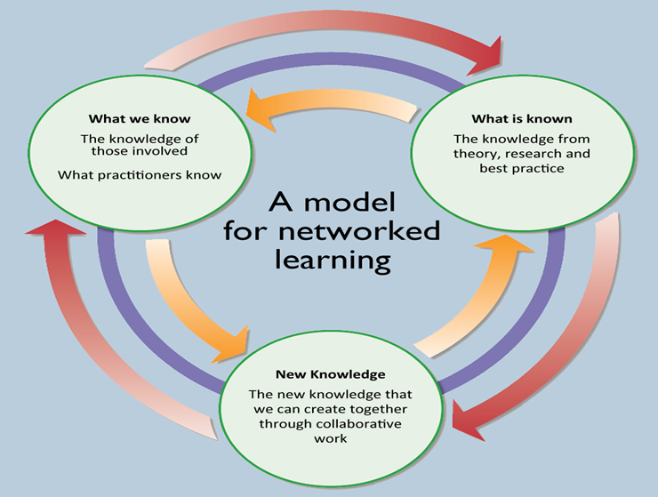
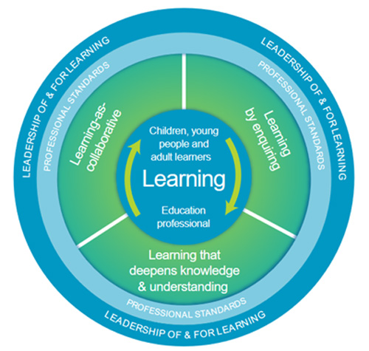
Three Fields of Knowledge
Three Fields of Knowledge NCSL, 2006.
For Scotland's learners, with Scotland's educators
Notes:
Reference
Collaborative Enquiry
EiH Stretch Induction facilitated by Education Scotland
Collaborative enquiry- Support understanding of approach and methodology of CE
What we know
Experienced HTs were encouraged to look inwards and explore their own context and experience in relation to the big questions in education at the time. Predating the recent Scotland’s Curriculum for Excellence : Into the Future by the OECD, HT teachers formed groups and examined areas that report examined.
Collaborative enquiry themes relate to some of the following themes:
What is needed to implement play pedagogy successfully and sustainably across the Scottish Education System?
In what ways can HTs be empowered to work collegiately and efficiently to proactively contribute to decision-making locally and nationally?
What system changes need to take place for headteachers to enact their empowerment in a collaborative manner?
How can our assessment system be revised to be fit for purpose for 21st Century?
How can digital learning positively impact pedagogy and attainment?
What lessons have been learned from the global pandemic in order to ‘build back better’ for everyone?
To what extent does amplifying BME voices increase racial literacy within a school community?
What is Known
Coaching
EiH Stretch participants were offered places on the CollectivEd Knowledge Exchange (Leeds Beckett University) Collaborative conversations which create powerful professional learning programme.
Big ideas
EiH Stretch sessions on the ‘big ideas’ by leading academics
The Myth of Poverty of Ambition, Professor Morag Traenor, Heriot Watt University
Curriculum Making, Professor Mark Priestley, University of Stirling
Headteacher Health and Wellbeing, Dr Karen Edge, University College London and Louka Parry, The Learning Future.
International links
EiH Stretch participants were automatically given a place on the Education Scotland 20-21 International series of blethers and the majority of participants have taken up this opportunity. International and ICoEA partners including Paul Bloomberg and Peter de Witt from America, Simon Breakspear from Australia, Tri Nations colleagues from Scotland, Ireland and Wales, Jeni Donohoo and Carol Campbell from Canada, Alma Harris from Wales, Pasi Sahlberg from Finland, Steve Mumby from England, Avis Glaze and Andy Hargreaves from Canada and Kathryn McEwan and Fleur Johnston from Australia.
CE groups are meeting with headteachers in Slovenia. This has been facilitated by Education Scotland and National School of Leadership in Education (NSLE).
New Knowledge
The culmination of the first two fields will inform the think pieces that the enquiry groups develop.

Slide 11
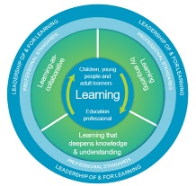
EiH
Stretch
Structure
Core Learning
Stretch Sessions
Thinking Systems Leadership
A culture of enquiry
EiH Resource
Targeted EiH Learns
EiH Perspectives
Stretch Connect Sessions
Recommended Research and Reading
Inclusion, equity and equality
Professional Learning Activities
Interactive Support Pack
International Learning Exchanges
EiH Stretch Coaches
EiH Stretch Supporters
Collaborative Enquiry Groups
For Scotland's learners, with Scotland's educators

Slide 12
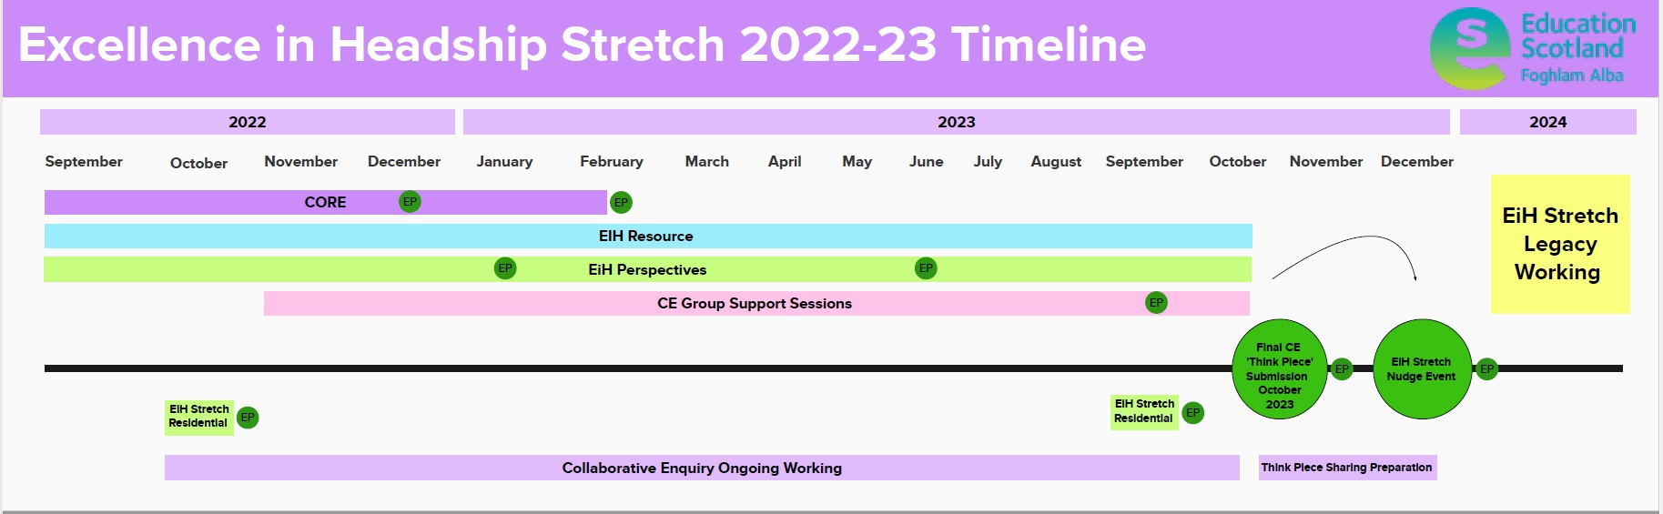
EiH Stretch 2 – Proposed Timeline
Stretch Thursdays – 1:15-3:15
For Scotland's learners, with Scotland's educators

Slide 13
EiH Stretch – Headteacher Agency for System Change
The International Congress for School Effectiveness and Improvement 2021
Scottish Learning Festival
National Congress for Rural Education Canada
Illuminating Leadership Festival – Collective Leadership Scotland
1:1 Digital Device Rollout
Independent Review of Qualifications and Assessment – Professor Louise Hayward
Learning with Public Health Scotland – A systems leadership approach
Empowerment – Where are we now? – Leading renewal of an Empowered System national discussions
In Headship Conference
Building Racial Literacy Programme
Local system leadership roles
For Scotland's learners, with Scotland's educators

Slide 14
Our commitment to you
EiH Lead Specialists will act as facilitators and connectors; signposting you to relevant contacts, resources and networks, related to your area of collaborative enquiry
We will source and provide high quality professional learning and introduce perspectives that interrupt, challenge and enrich your experience, both from a national and international context
Throughout the exploration of your collaborative enquiry we will support you in developing a shared understanding of collaborative professionalism and system leadership as process that aims to support headteacher agency for system change
Provide a platform and audience of system actors to interact with your professional learning journey, enquiry observations and Think Piece Recommendations. In addition to supporting the legacy of your work by connecting you with organisations or individuals that can advance your learning and help you to ‘nudge the system’
Ensure clear communication, provide structured session dates and times with advanced notice, set clear expectations of programme milestones and evaluation
For Scotland's learners, with Scotland's educators

Slide 15
Your commitment to your learning
As professionals we will engage in the process which will ensure a culture of professional trust, respect, courtesy and collaboration
Sessions and connections will be safe spaces for discussion, discourse and the exploration of ideas
Engage and participate in the process to the best of your ability
Complete the evaluations when requested via the method of your choosing
Challenge yourself
For Scotland's learners, with Scotland's educators

Slide 16
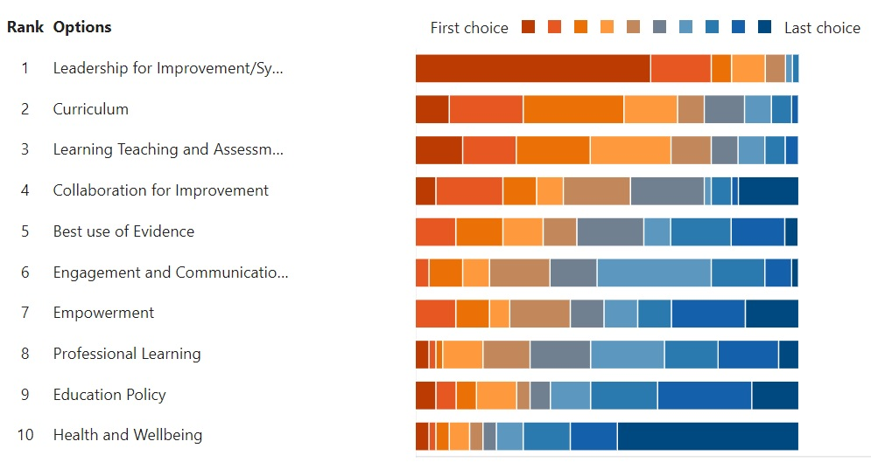
Exploring your itch
For Scotland's learners, with Scotland's educators

Slide 17
Breakout Rooms
In breakout rooms -15 mins
One thing you all like
One thing you all dislike
An area that you thinking that you might like to explore
For Scotland's learners, with Scotland's educators

Slide 18


#EdScotEiHS
For Scotland's learners, with Scotland's educators

Slide 19

Questions
For Scotland's learners, with Scotland's educators

Slide 20

Feedback
43039731
For Scotland's learners, with Scotland's educators

Slide 21

National Conversation
For Scotland's learners, with Scotland's educators
Notes:
Work is progressing on the National Discussion with a focus on our national vision for Curriculum for Excellence which was recommended by Professor Ken Muir and the OECD. The National Discussion will be facilitated by Professor Alma Harris and Professor Carol Campbell and Education Scotland will be supporting the Scottish Government throughout this work. We have provided some advice to SG colleagues about the timescales (which are tight) and have stressed the importance of the approach to the National Discussion being co-created and co-constructed with practitioners at all levels within the Scottish Education system. We realise that the well-deserved summer holidays are approaching but given the tight timescales we are looking to gauge whether there are colleagues who would be interested in meeting in early August to be part of the initial conversations around shaping the approach to the National Discussion so that we can prototype and genuinely co-create with the system. With our existing networks the PLL team volunteered to reach out to colleagues and identify those who may be interested in meeting for an afternoon in early August to be part of this initial conversation. As an organisation ES believes that it is vital that this work is shaped by you. If you are interested and may be available in early August then please let us know and also provide an email address where we will be able to contact you over the holiday period. We completely understand if you are not able to be involved at this stage, please rest assured that we will continue to share progress and there will be further opportunities to engage as we progress the work.

