Slide 1


Excellence in Headship Stretch 2022-23
Headteacher agency for system change
Stretch Core Learning Session
Enquiry – ‘The Why’
For Scotland's learners, with Scotland's educators
Notes:
Chris

Slide 2
Welcome….
We welcome each and everyone of you who have joined our online learning space today. Thank you for protecting this time and committing to your own and each other's professional learning. This will be a safe space to reflect on your experience of enquiry and collaboration and explore the range of the experience in the room.
We welcome interaction and your ideas. We would encourage your questions and your thoughts. Please come into the conversation or post directly into the chat pane. Keep your camera on if you can as it is nice to see you.
For Scotland's learners, with Scotland's educators
Notes:
Chris

Slide 3

Supporting our Session today
Fearghal Kelly Senior Lead Specialist
Lise Mccaffery Senior Lead Specialist
Gordon Bone Lead Specialist
Chris French Lead Specialist
Iain McDermott Lead Specialist
Stephanie Peat Lead Specialist
For Scotland's learners, with Scotland's educators
Notes:
Chris

Slide 4

Spread the word!
@EdScotPLL
@EducationScot
#EdScotEiHStretch
For Scotland's learners, with Scotland's educators
Notes:
Hiding this Slide

Slide 5
Structure of the Series
Why
How
What
For Scotland's learners, with Scotland's educators
Notes:
Chris – Describe the approach to the series

Slide 6
Structure of the Session
Enquiry
Collaboration
Being a Headteacher
Moving to the ‘What’
For Scotland's learners, with Scotland's educators
Notes:
Chris - Welcome and Introduction
Enquiry
Setting the Scene –
Connector – Enquiry in an everyday Breakout Room Activity
Feedback
Why Enquiry?
Enquiry as a Stance/Project
Collaboration
Collaboration Looks Like, Feels Like, Sounds Like Breakout Room Activity
Break
Tenants of Collaborative Enquiry
Feedback
Being a Headteacher
Policy Landscape – Empowerment and your agency - Stretch 1
Model of Professional Learning/Professional Standards/ HGIOS4
The Power of Stretch
Evaluation

Slide 7
Aim of the Session
By the end of this session I will have:
Reflected on the ways in which enquiry is embedded in my daily practice
Considered my experience of purposeful collaboration that has resulted in successful action and the factors that supported this
Made connections to the ways in which this professional learning links to my role as a headteacher
For Scotland's learners, with Scotland's educators
Notes:
Chris

Slide 8
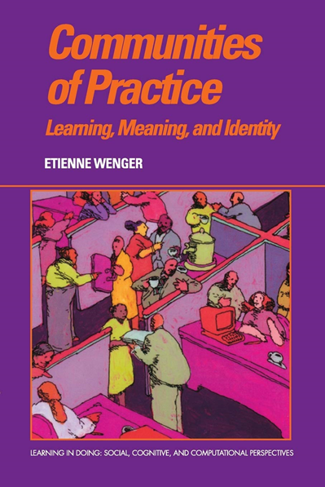
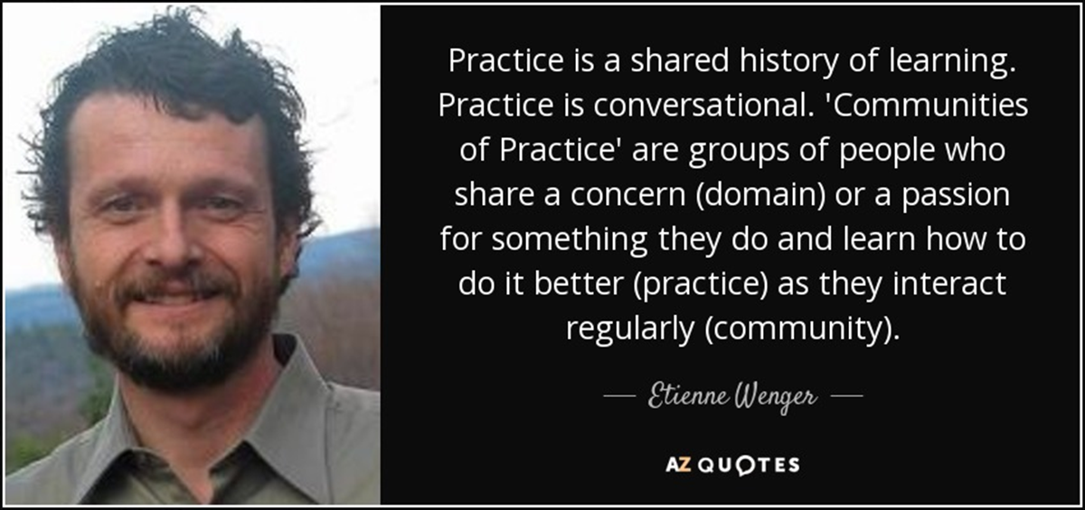
Culture of Enquiry
For Scotland's learners, with Scotland's educators
Notes:
Setting the scene – Culture of Enquiry – Steph

Slide 9
Enquiry as a Stance, Enquiry as a project
Stance
Project
For Scotland's learners, with Scotland's educators
Notes:
Steph
What do we mean by 'enquiry as stance'?
Marilyn Cochran-Smith and Susan Lytle: "Working from and with an inquiry stance, then, involves a continual process of making current arrangements problematic; questioning the ways knowledge and practice are constructed, evaluated and used; and assuming that part of the work of practitioners individually and collectively is to participate in educational and social change." Cochran-Smith, M. & Lytle, S. L. (2009) Inquiry as Stance. Teachers College Press, New York.
What do we mean by 'enquiry as project'?
How might an enquiring stance inform an enquiry project? How might a project influence stance?
Marilyn Cochran-Smith and Susan Lytle: "The essential purposes and functions of inquiry communities are to provide rich and challenging contexts for practitioner learning over the professional life span as well as making available productive locations for linking communities of educators with larger change efforts, both nationally and internationally." Cochran-Smith, M. & Lytle, S. L. (2009) Inquiry as Stance. Teachers College Press, New York.
Kate Wall, Anna Beck and Nova Scott: "one of the critiques we would level at the project stance on practitioner enquiry approach is that is seems to imply an on/off model of enquiry; rather it would seem more pragmatic to think about a dialling up and down of the research element depending on the motivation of the enquirer and the qualities required of an answer to any particular enquiry question. " The Nature and Purpose of Practitioner Enquiry | University of Strathclyde

Slide 10
Connector
In breakout rooms
Introduce yourself, your context and where you are coming from today
Consider your experience of enquiry and share this with your colleagues
For Scotland's learners, with Scotland's educators
Notes:
Chris
Breakout Activity - Consider your experience of enquiry and share this with your colleagues

Slide 11

For Scotland's learners, with Scotland's educators
Notes:
Chris

Slide 12
Why Enquiry?
Professional Learning Cycle
Act
Observe
Reflect
Plan
‘By closely examining and reflecting on the results of their actions, individuals and teams begin to think differently. They begin to question long-standing beliefs and consider implications for their professional practices’ (Donohoo, 2016)
Collaborative Enquiry is a process that challenges thinking and practice. Relational trust has been found to be a particularly strong facilitator of the kind of professional community that is required for collaborative inquiry to reach its potential for improved practice (Katz, 2009). ​
This conception of trust goes beyond that of goodwill and friendship, though such “companion trust” is certainly essential. It extends to include respect for each other’s dignity and idea, belief in each other’s competence, and a confidence in each other’s integrity to put students first (Katz, Earl & Jaafar, 2009, p. 40)
For Scotland's learners, with Scotland's educators
Notes:
Lise – Introduction to the associated Knowledge, specific to enquiry. Which then leads into next slide.
Highlighting the Plan, Act, Observe, Reflect approach to Professional Learning.

Slide 13
Improving Schools Through Collaborative Enquiry (2005) David Jackson, Julie McGrane, Hilary Street, Julie Temperley ​
​
‘
Achievement focused
Empowering in aspiration
Research-based and Theory Rich
Context specifc
Capacity building in nature
Enquiry driven
Implementation oriented, and interventionist and strategic
Systematic
For Scotland's learners, with Scotland's educators
Notes:
Title: Improving Schools Through Collaborative Enquiry
Author: David Jackson, Julie McGrane, Hilary Street, Julie Temperley
Date: 2005
Lise- Drawing focus to the above title which is accessible via the GTCS Research Portal (EBSCO database)
Empowering in aspiration
Practitioners choose to engage in collaborative enquiry, and it is they themselves who identify the focus and decide which processes they will use. They have considerable autonomy and the processes they engage in will develop
a range of other skills as well as developing their own knowledge. Such experiences are life-enhancing and empowering.
Implementation oriented, and interventionist and strategic
One of the purposes of collaborative enquiry is to change and amend practice and therefore to make interventions. It is a strategic process too because it is a way of working that is focused, planned, formally led, has a time-line, is integrated with the work of the school and is expected to impact on practice. It can also be developed across the
whole school.
Systematic
All collaborative enquiry takes place 'in context' and this refers to both the internal and external context.
Collaborative enquiry is systematic because it:
• creates a 'hunger' for data which is gathered in a planned way and used creatively and collaboratively;
• means careful choices are made about the strategies that are most 'fit for the purpose' of gathering the data;
• ensures reflection and analysis of the data are built into the working processes and subsequent action agreed to ensure impact;
• makes sure explicit processes for sharing and disseminating the learning are identified and implemented.
Why Enquiry?
Achievement focused
The purpose of engaging in collaborative enquiry is to enhance the learning of both practitioners and pupils.
By practitioners developing their own knowledge and understanding, and linking that with their own classroom processes, learning is enhanced.
Empowering in aspiration
Practitioners choose to engage in collaborative enquiry, and it is they themselves who identify the focus and decide which processes they will use. They have considerable autonomy and the processes they engage in will develop
a range of other skills as well as developing their own knowledge. Such experiences are life-enhancing and empowering. The quotes from practitioners in this book demonstrate this
Research based and Theory Rich
An essential part of collaborative enquiry involves reading about and working with the knowledge and research base that already exists. Most collaborative enquiries involve the practitioners working with an external partner, often from HE, who supports the identification and use of relevant research and works with practitioners to ensure working practices that help the theory from the practice be explored
Context specific
Collaborative enquiries are 'site-based' initially, and derive from practitioners current practice and context. The learning developed takes place in that context, and even if practitioners are working in a wider network the fixed point
of reference is always their own context.
Capacity building in nature
The process of collaborative enquiry builds individual practitioner capacity in terms of their knowledge and the skills they develop. It also contributes to developing capacity across the organization because groups of practitioners
are involved so the collective capacity of staff is enhanced. Moreover, the organization itself develops its own working practices that enable the development of a learning community which enhances the capacity of all members to
develop and grow.
Enquiry driven
By definition collaborative enquiry requires practitioners to investigate aspects of practice and to reflect on and analyse them. This becomes the 'taken-for-granted' way of
working.
Implementation oriented, and interventionist and strategic
One of the purposes of collaborative enquiry is to change and amend practice and therefore to make interventions. It is a strategic process too because it is a way of working that is focused, planned, formally led, has a time-line, is integrated with the work of the school and is expected to impact on practice. It can also be developed across the
whole school.
Systematic
All collaborative enquiry takes place 'in context' and this refers to both the internal and external context.
Collaborative enquiry is systematic because it:
• creates a 'hunger' for data which is gathered in a planned way and used creatively and collaboratively;
• means careful choices are made about the strategies that are most 'fit for the purpose' of gathering the data;
• ensures reflection and analysis of the data are built into the working processes and subsequent action agreed to ensure impact;
• makes sure explicit processes for sharing and disseminating the learning are identified and implemented.

Slide 14
Achievement focused | Empowering in aspiration | Research based and Theory Rich | Context specific
The purpose of engaging in collaborative enquiry is to enhance the learning of both practitioners and pupils. By practitioners developing their own knowledge and understanding, and linking that with their own classroom processes, learning is enhanced. | Practitioners choose to engage in collaborative enquiry, and it is they themselves who identify the focus and decide which processes they will use. They have considerable autonomy and the processes they engage in will develop a range of other skills as well as developing their own knowledge. Such experiences are life-enhancing and empowering. | An essential part of collaborative enquiry involves reading about and working with the knowledge and research base that already exists. Most collaborative enquiries involve the practitioners working with an external partner, often from HE, who supports the identification and use of relevant research and works with practitioners to ensure working practices that help the theory from the practice be explored. | Collaborative enquiries are 'site-based' initially, and derive from practitioners current practice and context. The learning developed takes place in that context, and even if practitioners are working in a wider network the fixed point of reference is always their own context.
Capacity building in nature | Enquiry driven | Implementation oriented, and interventionist and strategic | Systematic
The process of collaborative enquiry builds individual practitioner capacity in terms of their knowledge and the skills they develop. It also contributes to developing capacity across the organization because groups of practitioners are involved so the collective capacity of staff is enhanced. Moreover, the organization itself develops its own working practices that enable the development of a learning community which enhances the capacity of all members to develop and grow. | By definition collaborative enquiry requires practitioners to investigate aspects of practice and to reflect on and analyse them. This becomes the 'taken-for-granted' way of working. | One of the purposes of collaborative enquiry is to change and amend practice and therefore to make interventions. It is a strategic process too because it is a way of working that is focused, planned, formally led, has a time-line, is integrated with the work of the school and is expected to impact on practice. It can also be developed across the whole school. | All collaborative enquiry takes place 'in context' and this refers to both the internal and external context. Collaborative enquiry is systematic because it: • creates a 'hunger' for data which is gathered in a planned way and used creatively and collaboratively; • means careful choices are made about the strategies that are most 'fit for the purpose' of gathering the data; • ensures reflection and analysis of the data are built into the working processes and subsequent action agreed to ensure impact; • makes sure explicit processes for sharing and disseminating the learning are identified and implemented.
‘
For Scotland's learners, with Scotland's educators
Notes:
Title: Improving Schools Through Collaborative Enquiry
Author: David Jackson, Julie McGrane, Hilary Street, Julie Temperley
Date: 2005
Lise- Drawing focus to the above title which is accessible via the GTCS Research Portal (EBSCO database)
Empowering in aspiration
Practitioners choose to engage in collaborative enquiry, and it is they themselves who identify the focus and decide which processes they will use. They have considerable autonomy and the processes they engage in will develop
a range of other skills as well as developing their own knowledge. Such experiences are life-enhancing and empowering.
Implementation oriented, and interventionist and strategic
One of the purposes of collaborative enquiry is to change and amend practice and therefore to make interventions. It is a strategic process too because it is a way of working that is focused, planned, formally led, has a time-line, is integrated with the work of the school and is expected to impact on practice. It can also be developed across the
whole school.
Systematic
All collaborative enquiry takes place 'in context' and this refers to both the internal and external context.
Collaborative enquiry is systematic because it:
• creates a 'hunger' for data which is gathered in a planned way and used creatively and collaboratively;
• means careful choices are made about the strategies that are most 'fit for the purpose' of gathering the data;
• ensures reflection and analysis of the data are built into the working processes and subsequent action agreed to ensure impact;
• makes sure explicit processes for sharing and disseminating the learning are identified and implemented.
Why Enquiry?
Achievement focused
The purpose of engaging in collaborative enquiry is to enhance the learning of both practitioners and pupils.
By practitioners developing their own knowledge and understanding, and linking that with their own classroom processes, learning is enhanced.
Empowering in aspiration
Practitioners choose to engage in collaborative enquiry, and it is they themselves who identify the focus and decide which processes they will use. They have considerable autonomy and the processes they engage in will develop
a range of other skills as well as developing their own knowledge. Such experiences are life-enhancing and empowering. The quotes from practitioners in this book demonstrate this
Research based and Theory Rich
An essential part of collaborative enquiry involves reading about and working with the knowledge and research base that already exists. Most collaborative enquiries involve the practitioners working with an external partner, often from HE, who supports the identification and use of relevant research and works with practitioners to ensure working practices that help the theory from the practice be explored
Context specific
Collaborative enquiries are 'site-based' initially, and derive from practitioners current practice and context. The learning developed takes place in that context, and even if practitioners are working in a wider network the fixed point
of reference is always their own context.
Capacity building in nature
The process of collaborative enquiry builds individual practitioner capacity in terms of their knowledge and the skills they develop. It also contributes to developing capacity across the organization because groups of practitioners
are involved so the collective capacity of staff is enhanced. Moreover, the organization itself develops its own working practices that enable the development of a learning community which enhances the capacity of all members to
develop and grow.
Enquiry driven
By definition collaborative enquiry requires practitioners to investigate aspects of practice and to reflect on and analyse them. This becomes the 'taken-for-granted' way of
working.
Implementation oriented, and interventionist and strategic
One of the purposes of collaborative enquiry is to change and amend practice and therefore to make interventions. It is a strategic process too because it is a way of working that is focused, planned, formally led, has a time-line, is integrated with the work of the school and is expected to impact on practice. It can also be developed across the
whole school.
Systematic
All collaborative enquiry takes place 'in context' and this refers to both the internal and external context.
Collaborative enquiry is systematic because it:
• creates a 'hunger' for data which is gathered in a planned way and used creatively and collaboratively;
• means careful choices are made about the strategies that are most 'fit for the purpose' of gathering the data;
• ensures reflection and analysis of the data are built into the working processes and subsequent action agreed to ensure impact;
• makes sure explicit processes for sharing and disseminating the learning are identified and implemented.

Slide 15

Break – 5mins
For Scotland's learners, with Scotland's educators

Slide 16

Time to collaborate
In breakout rooms, think of a time when you successfully worked collaboratively:
Feel
Like?
Sound Like?
Look
Like?
For Scotland's learners, with Scotland's educators
Notes:
Breakout- Gordon Room Activity
https://padlet.com/edspll/mgc7h9t8en7svebu

Slide 17
For Scotland's learners, with Scotland's educators
Notes:
Gordon

Slide 18
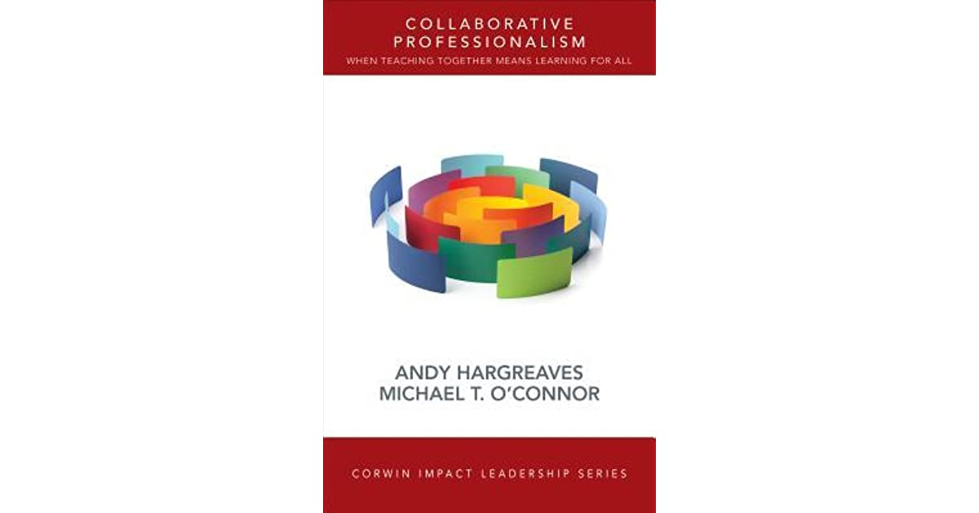
Collaborative Professionalism
Collective Autonomy
Collaborative Enquiry
Collective Initiative
Mutual Dialogue
Common Meaning and Purpose
Hargreaves, Andy & O’Connor, Michael. (2018). Collaborative Professionalism.
Notes:
Gordon
1. Collective Autonomy. Educators have more independence from top-down bureaucratic authority, but less independence from each other. Teachers are given or take authority.
2. Collective Efficacy. The belief that, together, we can make a difference to the students we teach, no matter what.
3. Collaborative Inquiry {CI). Teachers routinely explore problems, issues, or differences of practice together in order to improve or transform what they are doing. CI is embedded in the everyday work of teaching. Teachers inquire into problems before rushing into solving them.
4. Collective Responsibility. People have a mutual obligation to help each other and to serve the students they have in common. Collective responsibility is about our students, rather than my students.
5. Collective Initiative. In collaborative professionalism: there are fewer initiatives, but there is more initiative. Teachers step forward, and the system encourages it. Collaborative professionalism is about communities of strong individuals who are committed to helping and earning from each other.
6. Mutual Dialogue. Difficult conversations can be had and are actively instigated among educators. Feedback is honest. There is a genuine dialogue about valued differences of opinion about ideas, curriculum materials, or the challenging behaviour of students. Participants are often protected by protocols that insist on clarification and listening before any disagreement is brought forth.
7. Joint Work. Joint work exists in team teaching, collaborative planning, collaborative action research, providing structured feedback, undertaking peer reviews, discussing examples of student work, and so forth. Joint work involves actions and sometimes products or artifacts (such as a lesson, curriculum, or feedback report) and is often facilitated by structures, tools, and protocols.
8. Common Meaning and Purpose. Collaborative professionalism aspires to, articulates, and advances a common purpose that is greater than test scores or even academic achievement on its own. It addresses and engages with goals of education that enable and encourage young people to grow and flourish as whole human beings who can live lives and find work that has meaning and purpose for themselves and for society.
9. Collaborating With Students. In the deepest forms of collaborative professionalism, students are actively engaged with their teachers in constructing change together.
10. Big-Picture Thinking for All. In collaborative professionalism, everyone gets the big picture. They see it, live it, and create it together.

Slide 19
Collaborative Leadership for Improvement
The central tenant of the current reforms is to develop an excellent and equitable education system that can support all children and young people (and lifelong learners?) to succeed irrespective of where they come from. One of the key mechanisms to make this happen is through the empowerment of different parts of the system to encourage more autonomous cultures with (hopefully) increased joint responsibility for decision-making and outcomes across a range of stakeholders.
This requires leaders across the system to reject traditional forms of leadership that is based on positional power and hierarchy and adopt a collaborative stance whereby leaders model the values and practices of collaborative leadership in a range of settings across the system. Put simply, we need a cadre of senior educational leaders who equally value and are equally well-equipped working with small groups of teachers, their peers, ministers and colleagues from other services and sectors. This will mean that our leaders will need to lead improvement efforts outside their normal operational space, hierarchies and across professional boundaries. Ultimately, this will facilitate the shift in ownership of the reform that will be required to embed and sustain the new ways of working in an empowered system.
Making sense of reform: where next for Scottish education?
A think piece from the Association of Directors of Education in Scotland, 2019
Notes:
Gordon

Slide 20
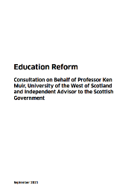




The story so far…
March 2022
June 2021
Oct 2021
Sept 2021
V2.0
National Discussion
Prof. Louise Hayward
[Assessment & Qualifications]
Sept 2021
Notes:
Fearghal or Gordon

Slide 21

Our Professional Standards
2.2.2 Fully understand and demonstrate self-awareness and inspire and motivate others
Regularly challenge your thinking and practice through critical reflection and enquiry;
3.3.1 Co-create and lead a culture which promotes and sustains career-long professional learning across the school and learning
Develop and engage in professional enquiry as a key element of a sustainable professional learning culture;
3.4.1 Establish, enable, and sustain a range of inclusive, resilient, and adaptive relationships, processes and practices which engender an ethos and culture of self-evaluation at every level in the school and learning community
facilitate an open, honest and critical stance in examining practice through modelling and promoting good practice in self-evaluation at every level.
For Scotland's learners, with Scotland's educators
Notes:
Fearghal or Chris

Slide 22
How Good is Our School (4th Edition)
1.2 LEADERSHIP OF LEARNING
Our school has a collegiate learning culture demonstrated through, for example, collaborative practitioner enquiry, peer learning, constructive feedback, professional dialogue and debate. All staff work collaboratively with colleagues, learners, partners and parents to take forward improvement priorities and learn with and from each other.
For Scotland's learners, with Scotland's educators
Notes:
Fearghal or Chris

Slide 23
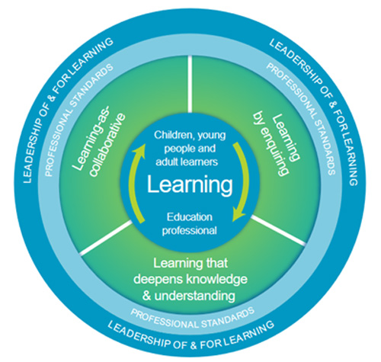
National Model of Professional Learning
Asking critical questions about self, and learners within your context
Reflecting on professional practice, learning and the learning of learners within your context encourages metacognitive knowledge and skills
Supporting dispositions around risk-taking, being open to change and ready to innovate
Critically examining a wide range of sources of information to inform knowledge and understanding
Asking questions about impact, about the progress of learners and their learning
Enquiry based professional learning encourages informed decision making and clearer articulation of ‘why’ we are teaching and learning in the way we are, promoting voice around the 'so what?’ and 'what now'?
Develops professional agency and voice – educators as leaders of change
For Scotland's learners, with Scotland's educators
Notes:
Iain

Slide 24
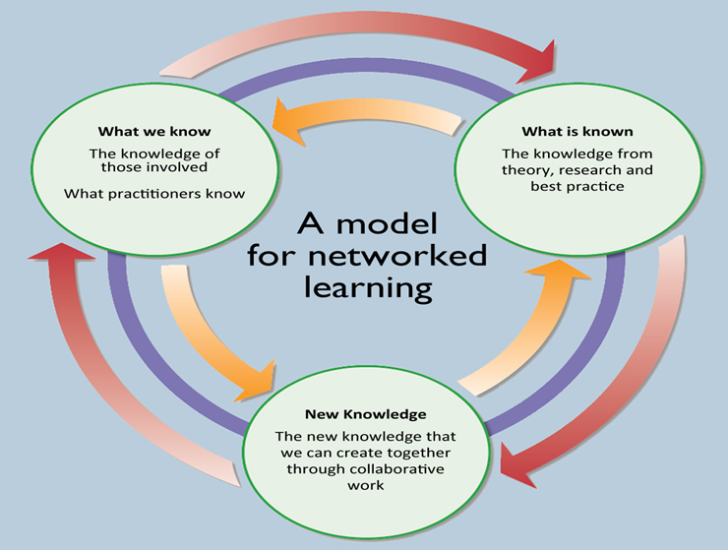
Three Fields of Knowledge
“The aim of knowledge animation is creation of new knowledge by learning communities that will help people enhance their practice and policy. This new knowledge takes centre stage and is the outcome of connecting what individuals know and what is known ‘out there’, external research. Knowledge animation provides the collaborative processes for new knowledge creation by ensuring that what is known is connected to what people know through collaborative dialogic processes”
Three Fields of Knowledge NCSL, 2006.
For Scotland's learners, with Scotland's educators
Notes:
Iain

Slide 25
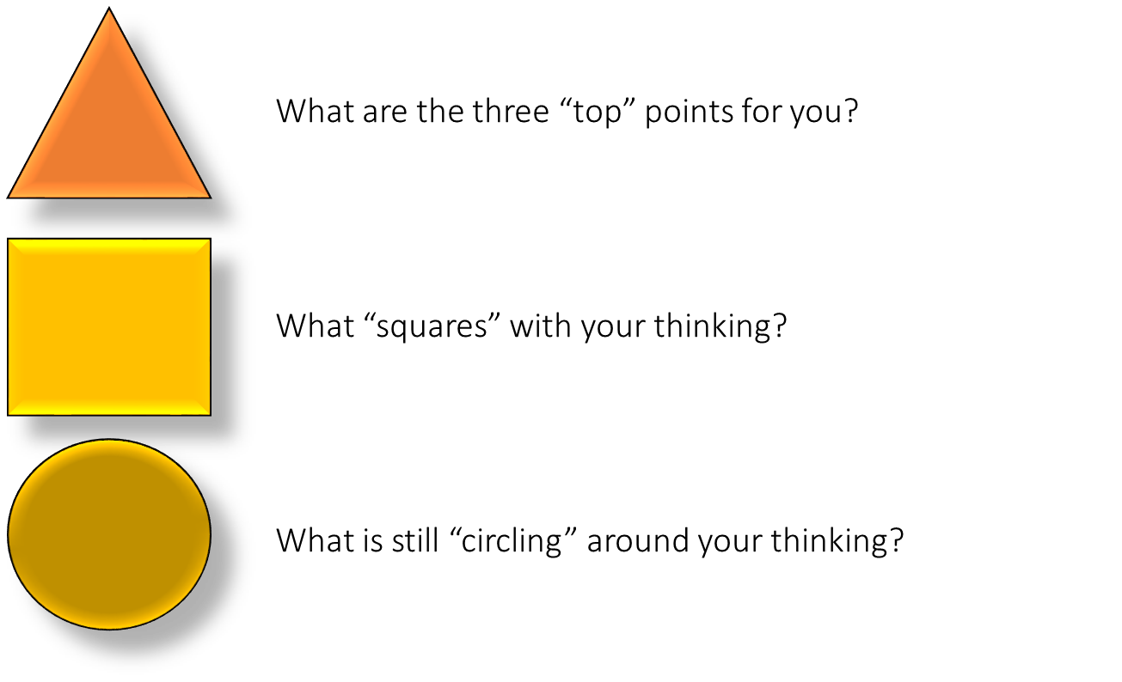
Aim of the Session
By the end of this session I will have:
Reflected on the ways in which enquiry is embedded in my daily practice
Considered my experience of purposeful collaboration that has resulted in successful action and the factors that supported this
Made connections to the ways in which this professional learning links to my role as a headteacher
For Scotland's learners, with Scotland's educators
Notes:
Iain – Breakout

Slide 26
EiH Stretch – Headteacher Agency for System Change
The International Congress for School Effectiveness and Improvement 2021
Scottish Learning Festival
National Congress for Rural Education Canada
Illuminating Leadership Festival – Collective Leadership Scotland
1:1 Digital Device Rollout
Independent Review of Qualifications and Assessment – Professor Louise Hayward
Learning with Public Health Scotland – A systems leadership approach
Empowerment – Where are we now? – Leading renewal of an Empowered System national discussions
In Headship Conference
Building Racial Literacy Programme
Local system leadership roles
For Scotland's learners, with Scotland's educators
Notes:
Chris

Slide 27

Questions
For Scotland's learners, with Scotland's educators

Slide 28


Feedback
Menti Code
2545 8145
For Scotland's learners, with Scotland's educators
Notes:
Chris

Slide 29
Upcoming Learning
Scottish Learning Festival – Empowerment - 'Where are we now?' Wednesday 21st of September 10:00- 10:45
International Blether: Leading Enquiry and Professional Learning in Schools Thursday 29 September 16:15-17:15
EiH Stretch Core Learning Enquiry 'The What to the How' Thursday 6th October 13:30 – 16:00
For Scotland's learners, with Scotland's educators
Notes:
Chris

Slide 30
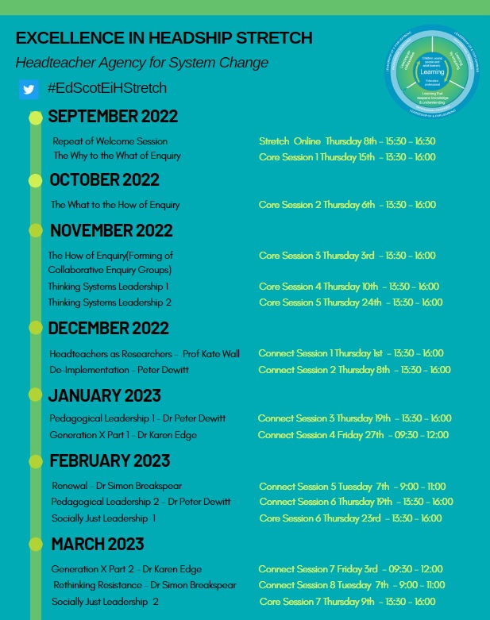
Draft Programme
For Scotland's learners, with Scotland's educators
Notes:
Chris – Will share screen

