Slide 1
Health & Wellbeing
West Partnership EP Practitioner Network

Slide 2
Overview
Overview of the work being undertaken in North Lanarkshire and East Renfrewshire
Group Discussion
Group Feedback

Slide 3


Strengths and Difficulties Questionnaire (SDQ)
North Lanarkshire 2023
next steps for schools
&
how the EPS can support
Notes:
Many establishments have been exploring ways to better understand the health and wellbeing needs of their pupils during these difficult times. In order to support this, Education and Families intends to gather this information through the use of a robust, universal health and wellbeing screener in the form of the Strengths & Difficulties Questionnaire (SDQ)
This piece of work has been commissioned by Derek Brown, Executive Director
Concerns over the impact of COVID on children have made it a priority this year
It follows on from the Realigning Children’s Services questionnaire for all Secondary children which was administered a few years ago
The results will be useful a an individual, school and Authority level
Gerard McLaughlin (Head of Education, North) has responsibility for health and Wellbeing and these results will feed into the Authority strategy.
We will provide more information about next steps at the end of the training.
Introduce Jake and Janice ..

Slide 4

Overview:
The SDQ survey in North Lanarkshire – Background & Purpose
Key Results from SDQ Data
Next steps - using the Data at Different Levels:
    Large group – cluster/area/whole school
    Small group – class/group
    Individual

Slide 5
Rationale for using the SDQ
In response to the COVID-19 Pandemic – there was a significant increase in risk factors associated with wellbeing.
NLC is using the SDQ as a universal screening tool – to provide an initial insight into the H&WB of all pupils.
The SDQ data will be used to support:
individual level assessment and planning
planning and intervention at group and whole school levels
Strategic level planning and reporting.
This is a snapshot of pupil wellbeing at the point you completed the assessment

Slide 6
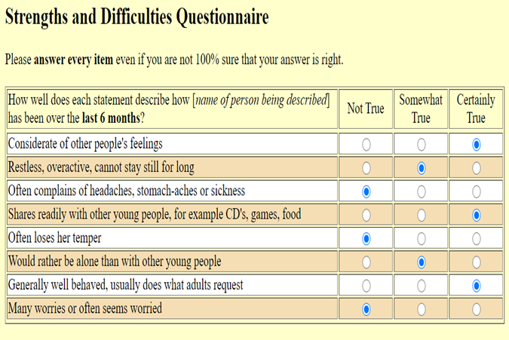
SDQ - Background
SDQ survey was initially
carried out in 2021.
This built on the health
and wellbeing survey
carried out in 2017 as part
of the Realigning
Children’s Services.
SDQ is a mental health &
wellbeing screener/
assessment tool for use
with children and young
adults (aged 2-17+).
Notes:
Since 1998, over 4500 clinical and academic studies and over 5 million assessments (via their site alone)
Used globally, across six continents & in 83 languages (8 currently for online version)
SDQ has been used in NL to provide an insight into the H&WB of pupils.
The SDQ data will be used to support:
Strategic level planning & intervention and reporting and planning at authority, cluster and whole school levels
individual level assessment and planning.
This is a snapshot of pupil wellbeing at the point the assessment is completed.

Slide 7
Strength and Difficulties Survey
25 questions across 5 sub-sections: Emotion, Conduct,
Hyperactivity, Peer relationships & Prosocial
Sub-sections are group under the following subscales:
Secondary Schools – self report
Primary Schools – teacher report
Externalising
Conduct
Hyperactivity
Internalising
Emotion
Peer
Prosocial
Notes:
All versions of the SDQ provide scores on the following five subscales:
Emotion (items related to somatic complaints, worries, fears, happiness)
Conduct (items related to temper, obedience, fighting, lying, stealing)
Hyperactivity/inattention (items related to restlessness, fidgeting, distractibility, reflectiveness, attentiveness)
Peer relationships (items related to friendships, popularity, bullying, relationships with adults, being solitary)
Prosocial (items related to being considerate, kind, sharing, caring, helpful)

Slide 8
SDQ – Key messages from 2021 and 2023
  Overall, a positive picture – not much change from ’21 to ‘23.
  Mean total difficulties scores were slightly higher in ‘23 – remained in same score categories.
Notes:
Total difficulties score – this is the key score from the SDQ – it is the total of the subscale scores (conduct, emotion, hyperactivity, peer relationships)
Primary pupils – (completed by teachers)
2021 – 23,238 responses
2023 – 24,311 responses (94% response rate)
Secondary pupils – (completed by pupils)
2021 – 14,599
2023 – 11,611 (56% response rate – which doesn’t sound as good, but a response of over 1 in 2 is very good given it was pupils themselves asked to do the SDQ)
TD scores change – e.g., Mean TD for primary was 5.7 in 21, 6 in ’23 – slight increase, but still in ‘close to average range’
Mean TD for secondary was 13.1 in 21, 13.4 in ’23 – slight increase, but still in ‘close to average range’

Slide 9

Planning
New or different Health & Wellbeing supports could be put in place at a whole school, small group and / or at an individual pupil level depending on what the data tells us.
Information sessions for schools:
Range of resources to support:
  Excel template, guides, resources and support available on MS Teams channel

Slide 10
SDQ 2023:
Primary pupils
24,311 teacher completed SDQs
Majority of pupils scored in the ‘close to average range’ across SDQ subscales.
Male pupils showed higher scores across all areas than females
Notes:
94% return rate (% SDQ return for whole primary school population)
the proportion of pupils scoring in the ‘close to average’ category in SDQ areas ranged from 78% to 87%. This indicates that most pupils were rated by their teachers as being ‘close to average’ across the key SDQ scales
In looking at gender differences across all the key SDQ scales, the mean scores are within the ‘close to average’ score category. Male pupils show higher scores across all areas in comparison to female pupils
With respect to total difficulties for primary school pupils, there is a greater proportion of female pupils rated in the ‘close to average’ score category (88%) compared to male (76%) pupils

Slide 11
SDQ 2023:
Secondary pupils
11,611 self-reported SDQs
Majority of pupils scored in the ‘close to average range’ across SDQ subscales.
Female pupils showed higher scores across all areas compared to males (except prosocial)
Notes:
56% return rate (% SDQ return for whole secondary school population)
he proportion of pupils scoring in the ‘close to average’ category in SDQ areas ranged from 56% to 66%. average’
For Total Difficulties, 59% of pupils rated themselves in the ‘close to average’ category
· In looking at gender differences across all the key SDQ scales, the mean scores for total difficulties are within the ‘close to average’ score category. Female pupils scored higher across all SDQ subscales (except prosocial) compared to male pupils. Female pupils fell in the ‘slightly raised’ score category for Impact and Internalising difficulties
· With respect to total difficulties for secondary school pupils, there is a greater proportion of male pupils rated in the ‘close to average’ score category (67%) compared to female (51%) pupils (refer to figures 8 & 9 of the technical report).

Slide 12
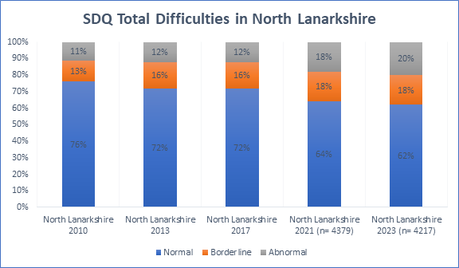
SDQ trends
Biggest downward shift is between 2017-2021
Need to consider impact of:
- COVID19
- Lockdown
- School closures
Notes:
Notes on Gerry’s slide:
When looking in more detail to specific groups…
- S2 and S4 pupil groups over long-term
Gerry’s notes
The RCS data highlighted there was an emerging trend that the proportion of pupils with ‘very high’ scores in SDQ areas was increasing. A similar pattern is observed when including the 2021 and 2023 data and can be seen over a period of time from initial data collection from 2010 in North Lanarkshire.
Need to be cautious – when looking at the whole population – things are relatively stable, when looking in more detail to smaller population’s there is a longer term trend – downwards trajectory of wellbeing.

Slide 13
Whole-School Analysis & Planning

Slide 14
Whole-School Analysis & Planning

Slide 15
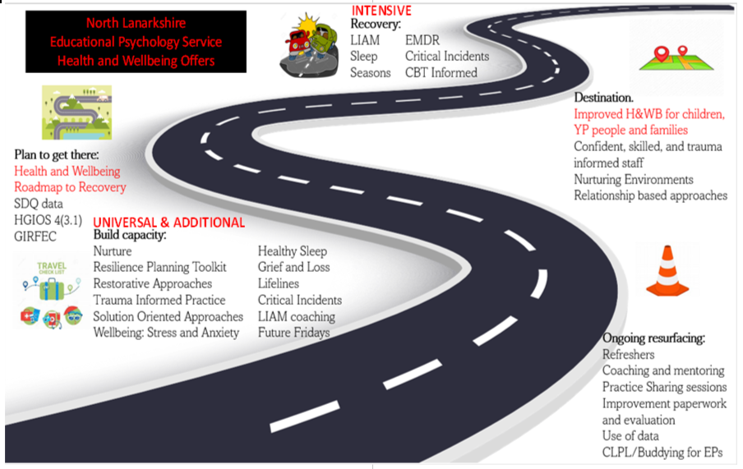
Health and Wellbeing
Services that can support you (Ed Psy)
Notes:
There are a number for service that can support you in the area of health and wellbeing.
Educational Psychology can help you to analyses your health and wellbeing data. The Educational Psychology menu of offers outline how the Service can support you at the Universal, Additional and Intensive Level. On this slide you will find an extract from the Health and Wellbeing menu of offers. Educational Psychologists can tailor their support to meet your needs. Psychologists will be undertaking Practice Level Agreements with you this term.

Slide 16
Summary
SDQ data can be used to compare over time
Data can help identify potential trends re HWB?
Data can be explored at different levels:
  Large group – school / cluster
  Small group – classes, class groups, predefined groups (e.g., nurture group pupils)
  Individual level
What next? NLC considering doing survey again

Slide 17
Be Well Survey
Developed with Barrhead High School

Slide 18
Rationale
All schools have been tasked with tracking and reporting on the wellbeing of children and young people.
The survey does not ‘measure’ wellbeing, as it is not a scale, but it does offer insight into how children and young people feel about their wellbeing, how resilient they are likely to be, and whether they feel a sense of belonging in their school.
These insights are helpful as wellbeing, resilience and belonging are connected to how included, engaged and involved children and young people are, and can predict how likely they are to achieve their potential during the school years and beyond.
This survey was developed so that practitioners within schools can explore the views of their students and analyse the results to understand how they can respond at a whole school and individual level.

Slide 19
Background
School Aims:
Need to look at how to track health and wellbeing at a whole school level.
Looking to find out key information about the school population by year group and as a collective
Areas of interest established as SHANARRI, resilience, school connectedness
So what? What can the school do to respond across levels – Universal, Targeted and Intensive

Slide 20
What we looked at
Glasgow Wellbeing Profile
Resiliency Scale for Children and Adolescents
Spence Anxiety Scales
Strengths and Difficulties Questionnaire
Basic healthy lifestyle questions

Slide 21
Psychological Wellbeing (Ryff, 2007)
Created a scale for adults using six constructs relating to self-actualisation:
  Autonomy
  Personal growth
  Purpose in life
  Self acceptance
  Mastery
  Positive connections to others

Slide 22
Glasgow Motivation and Wellbeing Profile
1. I like this school
2. I work hard in this school
3. I am good at working with others
4. I like being chosen to do things in school
5. Other pupils look out for me in school / make sure I am feeling ok
6. I have friends in this school
7. I am proud of the work I do in school / my work is good
8. I wait my turn
9. I can stand up for myself in school
10. Adults look out for me in school / make sure I am feeling ok
11. People help me if I am upset in school
12. People tell me what I am good at
13. I follow the school rules
14. People listen to me in school **rights are respected
15. I feel safe in school
16. I belong to this school / I feel important to this school
17. I keep trying even if the work is hard
18. I stay calm when I am told ‘no’ **can cope with being upset / manage emotions
19. I would complain if I felt picked on by anyone in school
20. I feel good about myself in school

Slide 23
Self Determination Theory (Ryan and Deci 2017)
Autonomy (having a choice, and being able to be yourself)
Competence (feeling effective at one’s activities)
Relatedness (feeling connected to others, a sense of belonging)
These three areas contribute to an individuals’ motivation and engagement
In turn, leading to enhanced performance and well-being
(Informs the Glasgow Motivation and Wellbeing Profile)

Slide 24
Hedonic v Eudaimonic Happiness
Hedonic
Enjoyment
Relaxation
Comfort
Pleasure
Fun
Eudaimonic
Meaning
Purpose
Personal Growth
Expressiveness
Self Actualization

Slide 25
7 Teachable Skills of Resilience (Karen Reivich)
Emotion Awareness and Control
Impulse Control
Realistic Optimism
Flexible Thinking
Self-efficacy
Reaching Out
Empathy
https://www.cnbc.com/2008/06/30/karen-reivich-the-resilience-ingredient-list.html

Slide 26
 | PRIMARY Questions (Revised) | SECONDARY Questions (Revised) | SHANARRI Indicator | School Belonging | PT Follow Up | Resilience Indicator | Resilience Skill
1 | I enjoy learning new things. | I enjoy learning new things. | Achieving | a
2 | My school celebrates my successes. | My school celebrates my successes. | Included | a
3 | I take part in a group or club in school. | I take part in extra-curricular activities / clubs within the school. | Active | a
4 | I get the help I need to learn. | I have everything I really need to learn. | Achieving | a
5 | I work hard and try my best in school. | I work hard and try my best in school. | Responsible | a |  | a | Self Efficacy
6 | I am doing well in school. | I am achieving and reaching my potential in school. | Achieving | a |  | a | Self Efficacy
7 | I feel good when I am in school. | I feel good about myself in school most of the time | Respected | a
8 | I enjoy coming to school. | I enjoy coming to school. | Respected | a |  | a | Realistic Optimism
9 | I behave well in school. | I behave responsibly and follow the school values. | Responsible | a |  | a | Impulse Control
10 | I work well with others in school. | I work well with others in school. | Responsible | a |  | a | Self Efficacy
11 | If I am upset or worried I can talk to an adult in school. | If I am upset or worried I have a key adult I can go to in school. | Nurtured | a | a | a | Reaching Out
12 | I have a friend in school. | I have a friend in school. | Included | a | a
13 | I feel part of the school. | I feel I belong in my school. | Included | a | a
14 | I feel safe in school. | I feel safe in school. | Safe | a | a
15 | If I am upset or worried I can keep myself and others safe. | If I am upset or worried I can keep myself and others safe. | Safe |  | a | a | Impulse Control
16 | If I am upset or worried I can talk to someone at home. | If I am upset or worried I can talk to someone at home. | Nurtured |  | a | a | Reaching Out
17 | I feel loved and cared about at home. | I feel loved and cared about at home. | Nurtured |  | a
18 | I feel safe at home. | I feel safe at home. | Safe |  | a

Slide 27
19 | I am happy most of the time. | I am happy with my mental wellbeing most of the time. |  |  | a | a | Emotional Awareness and Control
20 | I learn from my mistakes and try again. | I learn from my mistakes and try again. | Responsible |  |  | a | Flexible Thinking
21 | I can make good choices even if I am sad, worried or angry. | I can manage my emotions well when things are challenging/difficult. |  |  |  | a | Impulse Control
22 | I eat healthy food most days. | I have a balanced, healthy diet. | Healthy
23 | I get at least 9 hours sleep every night. | I sleep between 7 and 9 hours most nights. | Healthy
24 | I get enough exercise. | I am physically active. | Active
25 | I take part in a group or club outside of school. | I take part in extra-curricular activities / clubs out-with school. | Active
26 | My rights are respected in school. | My rights are respected in school | Respected | a
27 | I feel healthy and well most of the time | I feel healthy and well most of the time | Healthy
28 | If I am upset or worried I have a friend I can talk to. | If I am upset or worried I have a friend I can talk to. |  |  |  | a | Reaching Out
29 | I think good things are going to happen in my future | I am hopeful about my future |  |  |  | a | Realistic Optimism
30 | Most of the time things work out for the best | Most of the time things work out for the best |  |  |  | a | Realistic Optimism
31 | I can tell what my emotions are most of the time | I am aware of my emotions most of the time |  |  |  | a | Emotional Awareness and Control
32 | I can think of different ways to manage strong emotions | I can think of different ways to manage strong emotions |  |  |  | a | Emotional Awareness and Control / Flexible Thinking
33 | If someone I know is upset or worried I will try to help them | If someone I know is upset or worried I will try to help them |  |  |  | a | Empathy
34 | I think about how my actions might affect other people | I think about how my actions might affect other people |  |  |  | a | Empathy
35 | I can usually tell what people might be thinking and feeling | I can usually tell what people might be thinking and feeling |  |  |  | a | Empathy
36 | I can usually think of different ways to solve a problem | I can usually think of different ways to solve a problem |  |  |  | a | Flexible Thinking

Slide 28
SHANARRI indicators – 3 statements
Resilience – 19 statements
School connection – 15 statements
PT FOLLOW UP – 9 STATEMENTS:
I have a key adult in school I can go to if I am upset or worried about something.
I have at least one friend in school.
I feel a sense of belonging to school.
I feel safe in school.
I can cope with being upset without hurting myself or others.
There are people to support me when I'm upset, angry or worried.
I have someone who loves and cares about me at home.
I feel safe at home.
I am happy with my mental wellbeing at this time.

Slide 29
Link to Primary Form
https://forms.office.com/Pages/DesignPageV2.aspx?subpage=design&token=fe9fff4c3d3f466c8c74e8821e2a2910&id=oyzTzM4Wj0KVQTctawUZKRaFwFTqwy1Ir_uKQWYw_d1UODZBWVpYMDJKU0lYR0c2VklZTENCQlZZMy4u

Slide 30
Next Steps…
GDPR / Consent Statement
Implementation – P3-S6
Development – ELC, P1 and P2, ASN.

Slide 31
Group Discussion
What is your service doing in this area?
Is there anything that you can share with each other?
Are there ways in which services can work together to share practice?
What are your first / next steps going to be in this area?

