Slide 1

Learner Skills Profile
South Lanarkshire Psychological Service

Slide 2
What is the Learner Skills Profile?
A solution-oriented framework which can be used to identify support for neurodivergent learners which focuses on a young person’s strengths and barriers to learning.
Devised as a response to a gap in available assessments and interventions in the service.
Noted the increase in conversations with education staff regarding children with neurodivergent presentations and co-morbidity.
Acknowledgement that not all children have a diagnosis, and for some families this is not a route they are pursuing.
Awareness that within Scottish education, the focus is on meeting the needs of the child rather than providing a label.

Slide 3
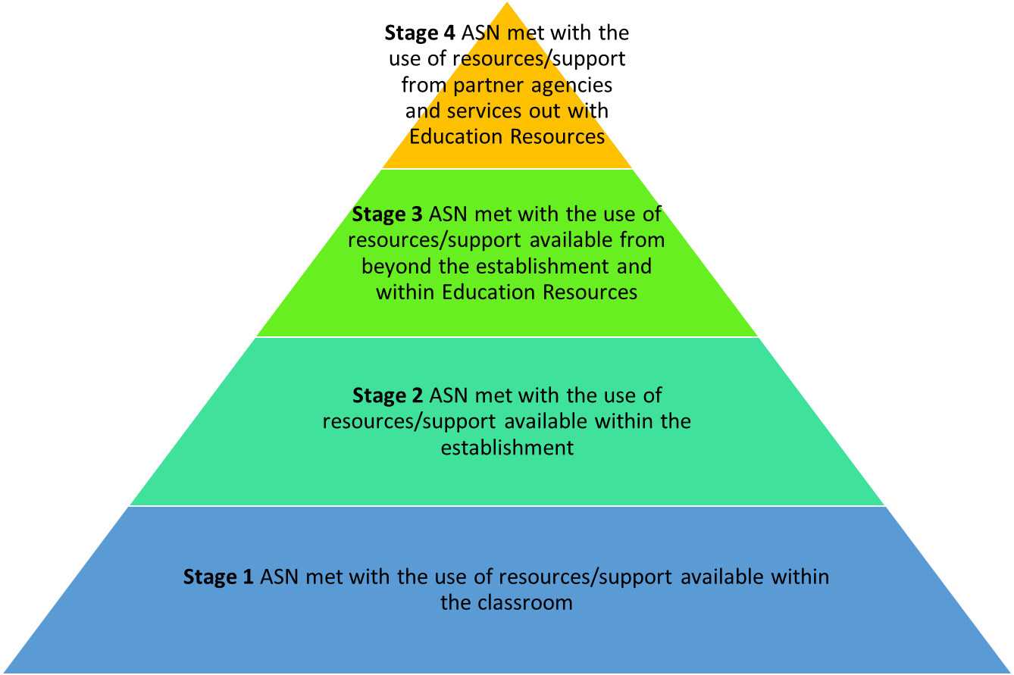
The Learner Skills Profile as part of Staged Intervention
Learner Skills Profile
Use of environmental audit tools such as SCERTS or CIRCLE framework

Slide 4
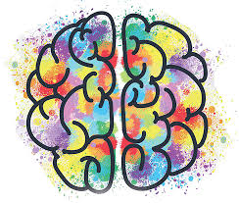
What is neuro-affirming practice?
Being neuro-affirming means that you believe in a strengths and rights-based approach to developmental differences and aim to provide support and adaptations that affirm the child's neurodivergent identity.
(NAIT, 2023)

Slide 5
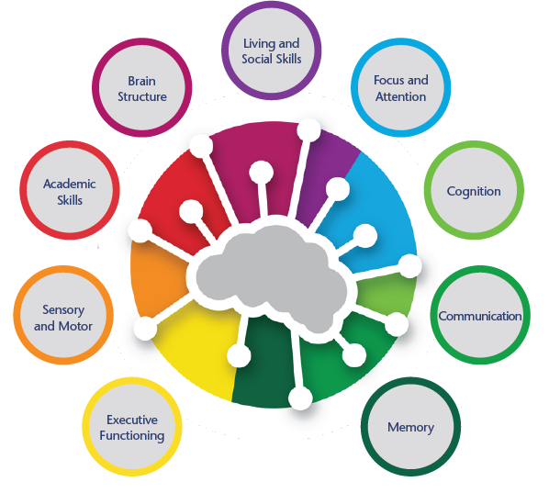
Development of the Learner Skills Profile
Use of a solution-oriented framework consistent with service delivery
Ayrshire and Arran FASD document: 9 brain domains – collapsed into 7 – removing brain structure and combined academic and cognitive skills
Consistent with ESSENCE model (Gilbert, 2011) which Health is moving towards
Addition of guidance booklet with suggested interventions
Taken from: Ayrshire and Arran Understanding Foetal Alcohol Spectrum Disorder: What Educators Need to Know (2019)

Slide 6
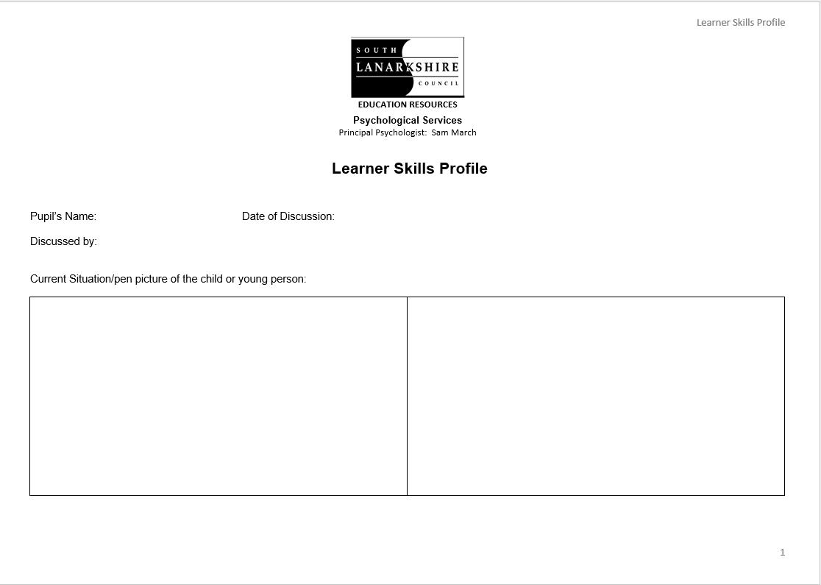
Where to start…

Slide 7
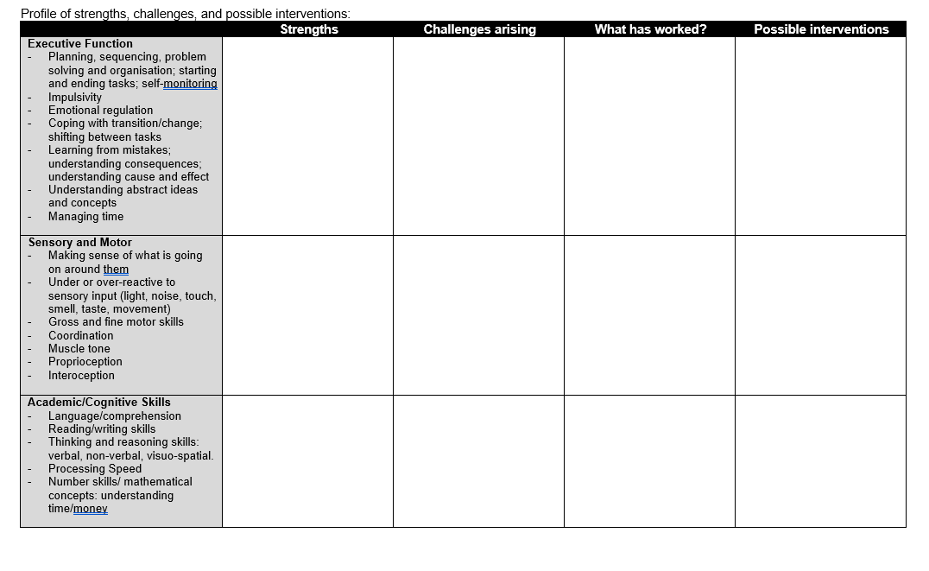
Start filling in the boxes…
1
2
3
4

Slide 8
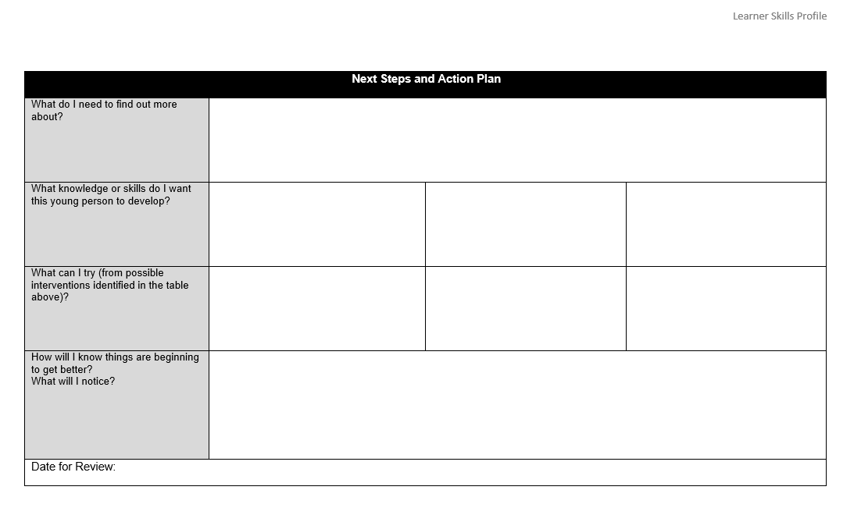
The last page…

Slide 9
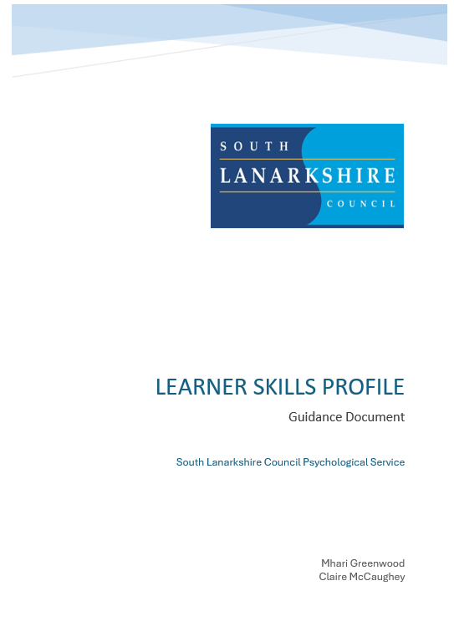
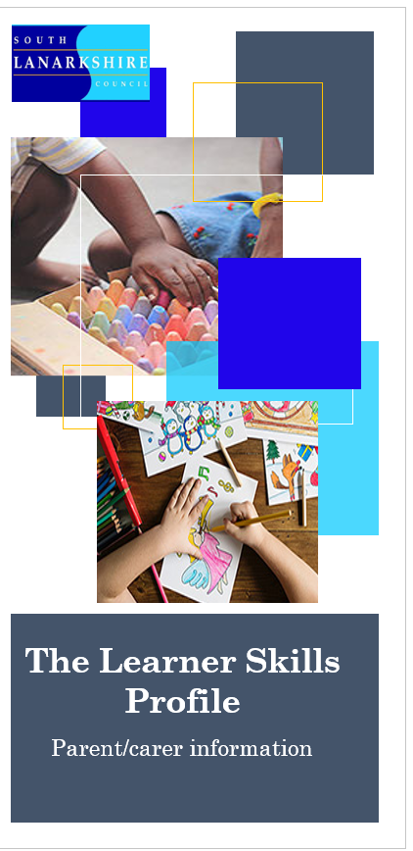
Supporting Documents

Slide 10
Discussion
What is happening in your service to support neurodivergent learners?

Slide 11
Thank you for listening & contributing

