Slide 1
EDC Promoting attendance
West Partnership
East Dunbartonshire EPS

Slide 2
Context in EDC
The numbers:
  In 2020, average attendance in EDC was 95.3% (89.8–97.7%)
  Current rates of attendance:
    90.8% Secondary
    94.8% Primary
In 2022:
  Increased requests to the EPS for support with attendance
  Sample of secondary PSG discussions: 39-56% of young people discussed have reported school attendance problems.
  Guidance and policies not been updated
Notes:
In 2020, average attendance in EDC was 95.3% with schools ranging from 89.8–97.7%. Unauthorised absence had been increasing year on year pre-covid. There have been increased requests to the EPS for support with attendance, both for individual casework and for development work with staff.
In a sample of secondary PSG discussions, 39-56% of young people discussed have reported school attendance problems.
Guidance and policies had not been updated to match current context, processes and IEL

Slide 3
EDC Targeted Supports: Examples
LifeLink Counselling
Lets Introduce Anxiety Management (LIAM)
Wellbeing Bases
Lego Therapy
Nurture groups
Talking Mats
Support for Learning

Slide 4
EDC Outreach and Specialist Supports
Language and Communication Outreach
Wellbeing Outreach
Home Tuition
Outdoor Education
Secondary Wellbeing Outreach
Local Area Coordinators
Primary Wellbeing Support Service
Secondary Wellbeing Support Service
Enhanced Learning Resources
Positive Achievements

Slide 5

Training

Slide 6
Attendance Working Group
Formed in September 2022
Membership: HLO, ISO, QIO ASN, EP, LAC, School Reps
Focus:
  review attendance within EDC, with a focus on school attendance problems;
  Establish what good practice there is within and outwith the authority;
  Provide a needs analysis to support development of new up-to-date guidance for schools.

Slide 7
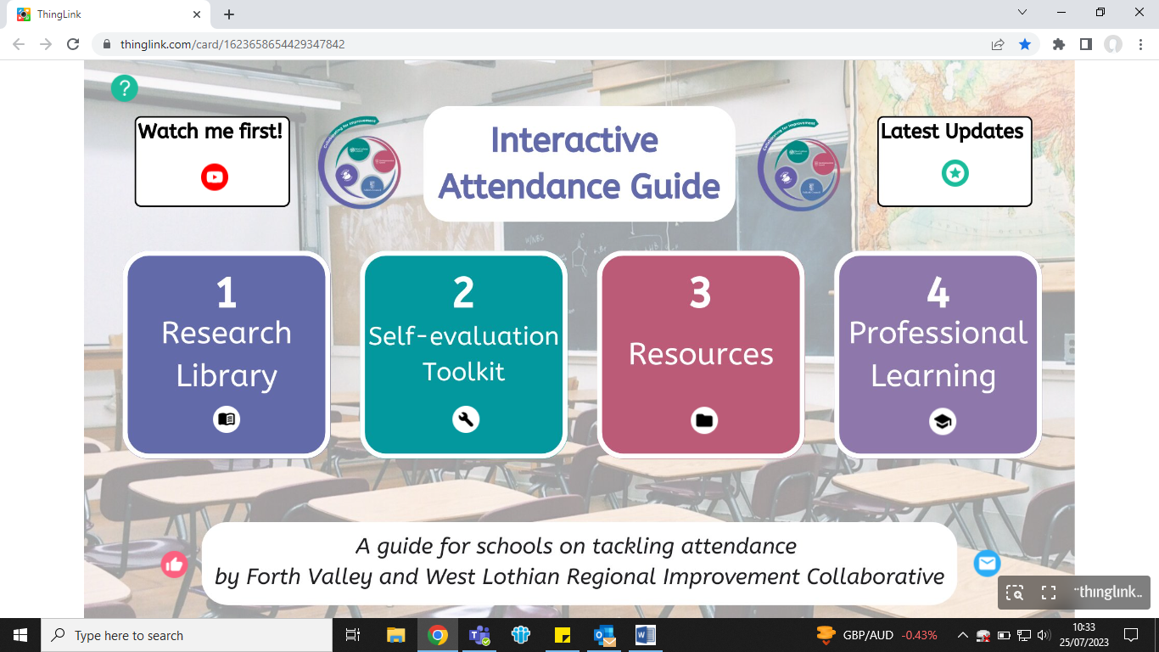
Pilot FVWL Toolkit

Slide 8
Promoting Attendance Guidance for Education Professionals
Four main aspects
Promoting Attendance: Guidance for Education Professionals
Procedure Manuals
  PM 3/39
  PM 3/08
Attendance Letters
Implementation Plan

Slide 9
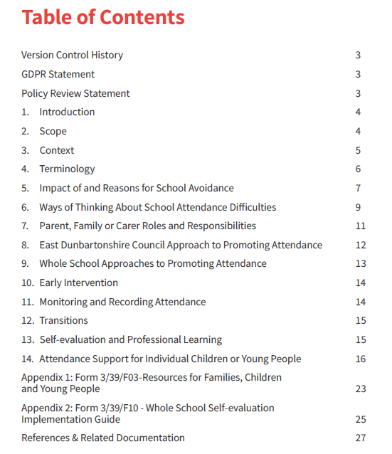
Notes:
Overview of new policy contents

Slide 10
Key Messages in Guidance
EDC approaches to support attendance e.g. nurture, mental health strategy, language and communication friendly establishments
Terminology changes
Emotionally based school avoidance
Reasons for school avoidance
Early intervention- action when attendance falls below 90%

Slide 11
Promoting Attendance: Guidance for Education Staff
Interventions to promote attendance – universal, targeted (support and intervention) and enhanced levels
Universal – 85-90% over a 6 week period or other meaning loss of half to a full day a week
Targeted Support – 71-84%
Targeted Intervention – 50-70% or 14 days in a 4 week period
Enhanced Support < 50% - likely to need multi-agency and consideration of referral to Reporter
Appendix 1 Resources for Parents/Carers
Appendix 2 Supporting attendance leaflets and attendance letters
Appendix 3 Whole school self-evaluation implementation guide

Slide 12
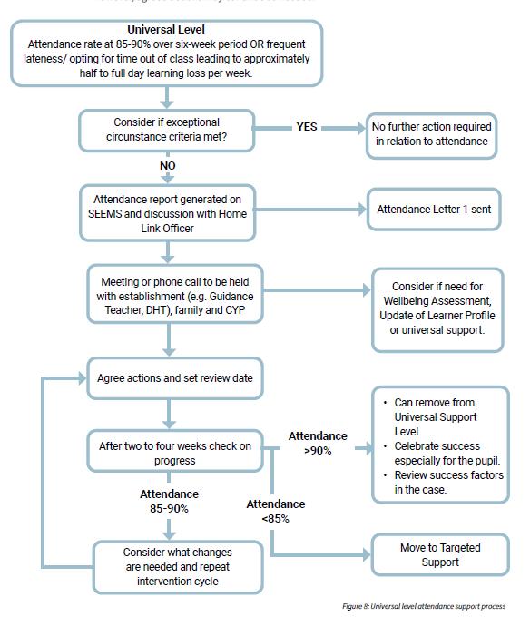

Slide 13
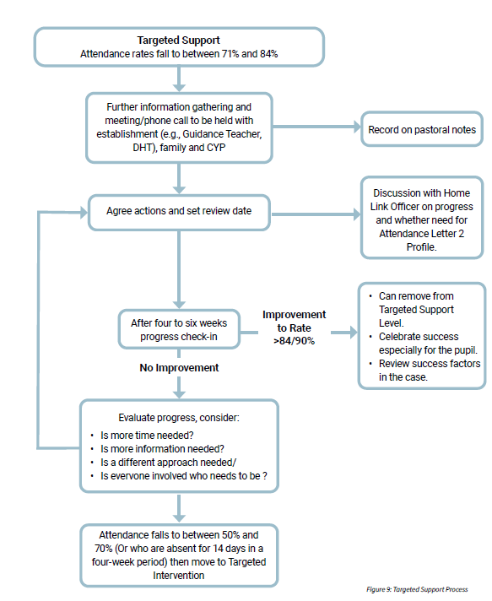

Slide 14
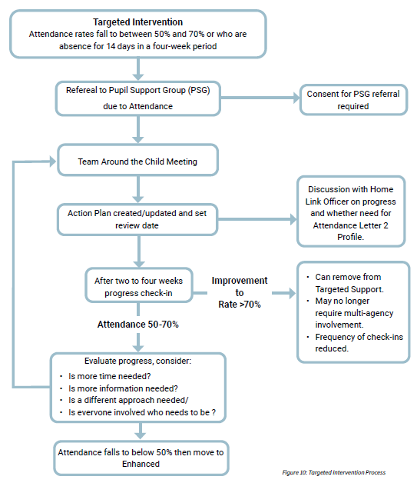

Slide 15
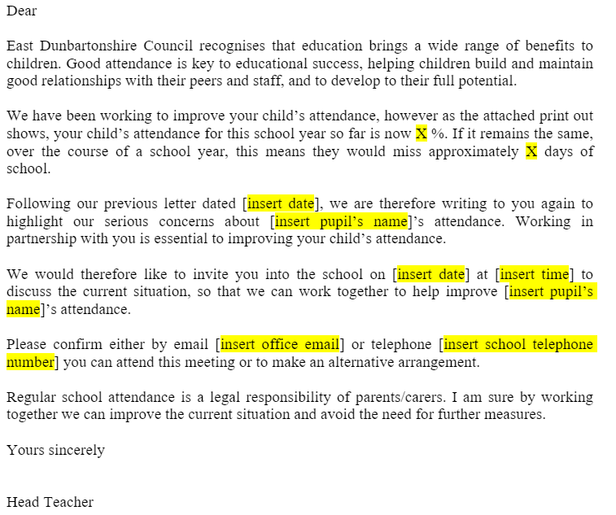
New Attendance Letters

Slide 16
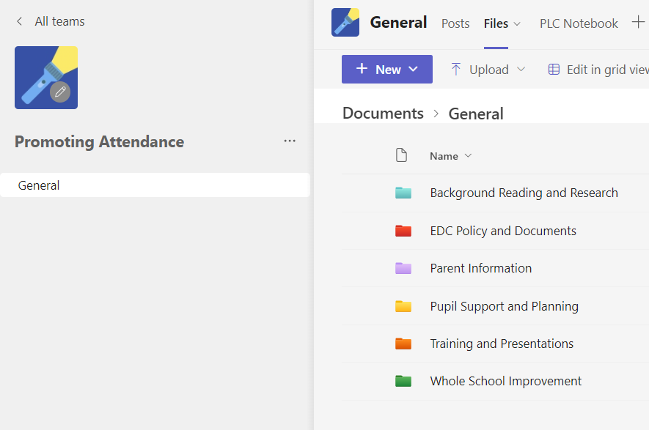
Promoting Attendance – Teams Page

Slide 17
Cluster Pilot
Two clusters identified based on secondary and primary attendance data and local knowledge of readiness factors
May 2024: Launch and initial engagement with self-evaluation framework
September 2024: Supported self-evaluation analysis and improvement planning to agree on action plan
February 2025: Review of implementation of action plan and intermediate measures
May 2025: Practice sharing within group and across authority with end of year evaluations
June 2025: Review of impact of cluster work to inform next stage of support in EDC

Slide 18
Next Steps
Continue to implement planned cluster pilot work
Individual school SIPs
Support with training
Continue updating Teams page resources
Aligning with other EDC initiatives
Sharing of good practice
Continued link with West Partnership and Education Scotland

Slide 19
Small Group Discussion
What role do you and your EPS have in supporting EBSA?
Reviewing current practice in your own context, what is currently working?
What are the strengths?
What's an example of where you’ve had success?
What resources have you found useful?
What big or small change could you implement to move forward supporting attendance in your work today?
At the WP Network event in 2023 there was a workshop on EBSA- as a profession are we collaborating more on this topic? How can we work better together to share practice more in this area?

Slide 20
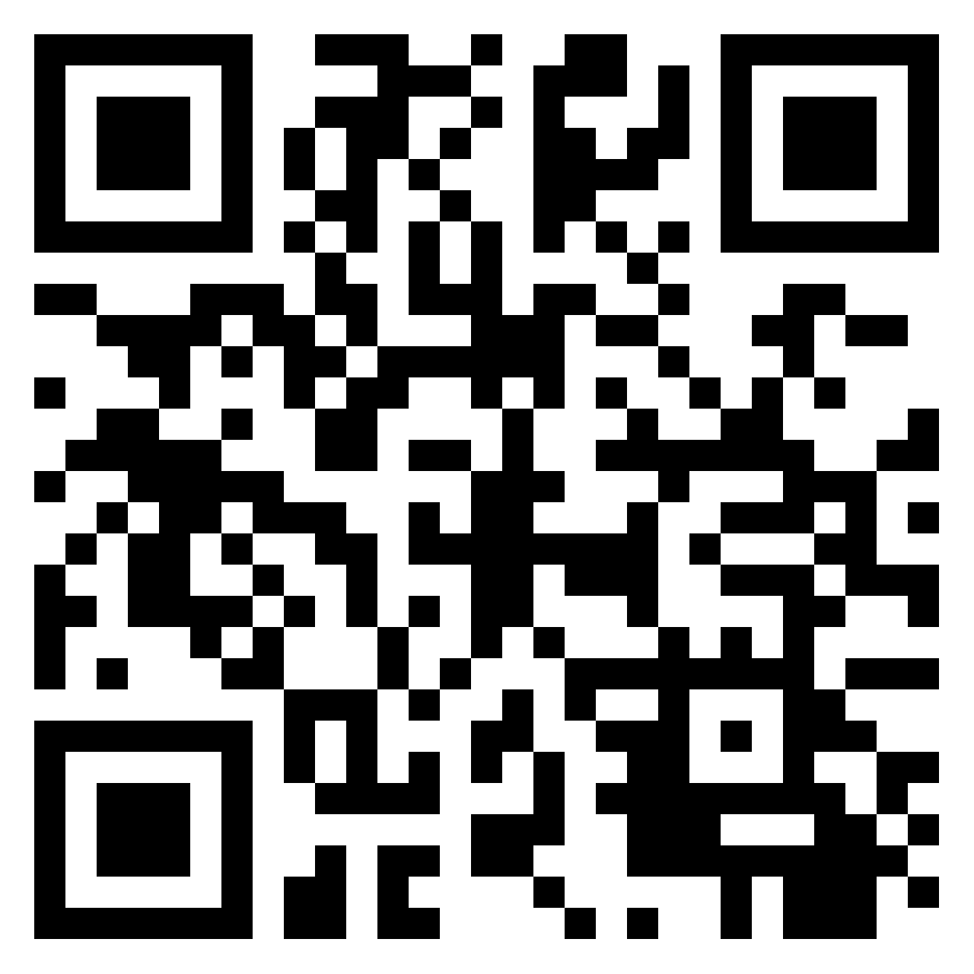
Padlet QR code
Password: WhiwYLZz

