Slide 1
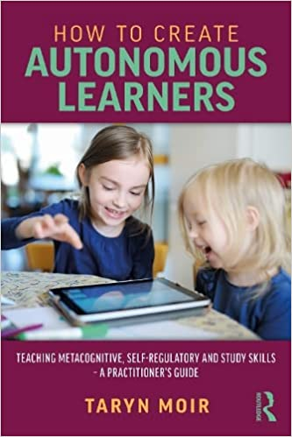
How to create
autonomous learners

Slide 2

Programme for the session
Theory
Practice
Implementation
Notes:
Based upon my book which is:
The book is divided into three parts with:
• Part 1 THEORY. This is concerned with the theory and evidence that supports the assertions and approaches outlined in the book.
• Part 2 PRACTICE. This is concerned with understanding strategies, which ones to teach and how to teach them.
• Part 3 IMPLEMENTATION. This is concerned with implementation and how to successfully embed these approaches at an entire school or authority level.

Slide 3


Catchphrase
Notes:
To get going: ice breaker

Slide 4


Notes:
Brain box
The point of this is that the more information you have the more you can make sense of the world. When only one square was removed. You could not determine the catchphrase. The more information (or experience you have) the more you can make problem solve, infer or understand.

Slide 5

PART 1: Theory
Chapter 2: Theoretical models
Chapter 3: Research into strategy instruction
Chapter 4: UK research

Slide 6

The Reader
Notes:
To illustrate we can interpret things differently (beautiful lady or old lady)
NAME A BIRD THAT CAN’T FLY- CHILDREN’S ANSWER a ROAST CHICKEN- WOULD YOU MARK THIS WRONG?
The Reader
The learner has experiences of the world which have shaped their knowledge, understanding, and beliefs. This unique information can be subdivided into affective conditions which include attitude, motivation, and sociocultural beliefs and values and their cognitive conditions which include declarative (knowledge of “what”), procedural (knowledge of “how”) and conditional (knowledge of “when” and “why”). Together, they provide knowledge of language, text decoding strategies, metacognitive strategies, knowledge of the classroom, social interaction, and person/world knowledge. These reader characteristics influence how they interpret the information on the page and the meaning that they make of text in a process called “knowledge use and control”. The meaning is shaped by how they construct this information based on their reading goals and purpose. This is an exclusive process, for what one reader brings to the experience will be different from others. During the reading process, the reader allocates their comprehension and monitoring skills based on their prior knowledge, values, and beliefs. They predict and guess what the text means based upon the synthesis of all the information they have to hand to come to conclusions around meaning. Sometimes these conclusions will be in line with the author’s while other times there will be differences. Upon finishing the reading, the reader may then update their beliefs, attitudes, values, or knowledge. If the reader does not understand the text, they may attribute the breakdown in understanding to their own reader skills or alternatively attribute it to a fault of the text.
Throughout the reading process, tracking understanding of the text is key. These skills are called comprehension monitoring skills. If comprehension fails, the reader will have to employ some sort of fix-up strategies, for example, rereading to help repair the breakdown in comprehension. However, sometimes a reader will fail to recognise that comprehension has broken down and continues to decode text. Yet, the metacognitive reader will recognise when comprehension has failed and will try to regain meaning (Moore, 1983). However, much research has shown that developing or early readers tend not to employ fix-up strategies as they are overly concerned with decoding text (Baker, 1994; García-Rodicio & Sánchez, 2014).
The young reader’s metacognitive skills develop. Real reading is about more than just decoding; it relies on the ability to think about what is being read, make a decision to take action, and employ that action. Without the use of these metacognitive strategies, coherent reading would be impossible ( Ahmadi, Ismail & Abdullah, 2013). However, the phenomenon becomes more complex as we recognise that comprehension monitoring or “fix-up” strategies are needed for effective reading (Dabarera, Renandya, & Zhang, 2014). The fact that the reader has learned such a strategy and notices that text meaning is lost does not necessarily mean that the fix-up strategy will be employed (García-Rodicio & Sánchez, 2014). A reader will not search for meaning if they have no motivation to do so. Therefore, comprehension monitoring and metacognitive strategies more generally are closely linked with self-regulation and motivation (Souvignier & Mokhlesgerami, 2006). This link is reciprocal, as developing comprehension monitoring skills also enhances motivation for reading.

Slide 7

The mediator
Notes:
Teachers are mediators. But they are all different.
PHYSICALLY TEACHERS TURN UP BUT WHAT ABOUT COGNITIVELY? EMOTIONALLY?
The teacher is similarly unique and will have their own philosophies, values, beliefs, and understandings of effective teaching practices. Every teacher will have their own style, what they regard as important to teach and it is teachers’ prior understanding of the world which will inform what teaching should look like in practice, what activities are important, what are the aspects of a task which need to be more carefully explained. Similar to the reader, it is the teacher’s “executive and monitor” which dictates what they will give attention to and to mediate within an optimum learning environment. Feedback that the teacher gets within a plenary session or their ongoing assessment of learning situations will inform the teacher’s ever growing knowledge, beliefs, and values. To teach anything, it is necessary for the teacher to have knowledge of the subject, interest in the subject, and self-efficacy in teaching the subject.
The teacher is responsible for supporting the learner to make meaning, and this requires the creation of the optimum socially mediated environment (Gersten, Fuchs, Williams, & Baker, 2001). If the teacher is in tune with the pupil’s attributes and adapts their instruction to suit the child, being in tune with the child’s stance, this will enhance their levels of motivation and comprehension. It is also essential to create a safe environment where children can discuss texts without fear of failure, creating a culture where it is good to seek verification and unique understandings instead of conforming to one teacher’s perceptions of the “correct” answer.
The teacher would know the individual reader brings their own knowledge, beliefs, values, and attitudes to the reading process. Topic exploration with the teacher through collaborative discussion prior to reading will have a profound impact on the ease and depth of understanding, as well as motivation for engagement (Dowhower & Speidel, 1988). Greater engagement, in turn, leads to better memory retention of the information read. Conversation develops meaning and enables the development of metacognitive strategies (Pressley, Johnson, Symons, McGoldrick, & Kurita, 1989b) such as rereading (Haller et al., 1988) and comprehension monitoring (Dabarera, Renandya, & Zhang, 2014; Payne & Manning, 1992). Class/teacher discussions support all to update and re-evaluate meaning and recognise the various rich interpretations, creating an inclusive classroom. The skills of questioning, cognitive challenging, re-evaluation, and creating meaning can transcend the contexts of literacy instruction, allowing construction of meaning across learning contexts. The outcomes for the reflective teacher (or metacognitively aware teacher) in this dialogical approach include a variety of thoughts of their teaching practices, or new knowledge or values (Gillies, Nichols, & Burgh, 2011). This, in turn, will inform their ongoing practice.
With all this in mind, it is interesting that Swanson’s (2008) synthesis of 26 studies of classroom observations of teacher behaviour concluded that little comprehension instruction takes place. This was further explored by Ness (2009), who stated that this was influenced by a lack of teacher confidence in strategy instruction. Even now, some teacher training courses allow for little time to consider how to directly teach the skills needed to understand. The importance of teaching strategies needs to be highlighted and support provided to teachers to ensure they feel effective at doing so.

Slide 8
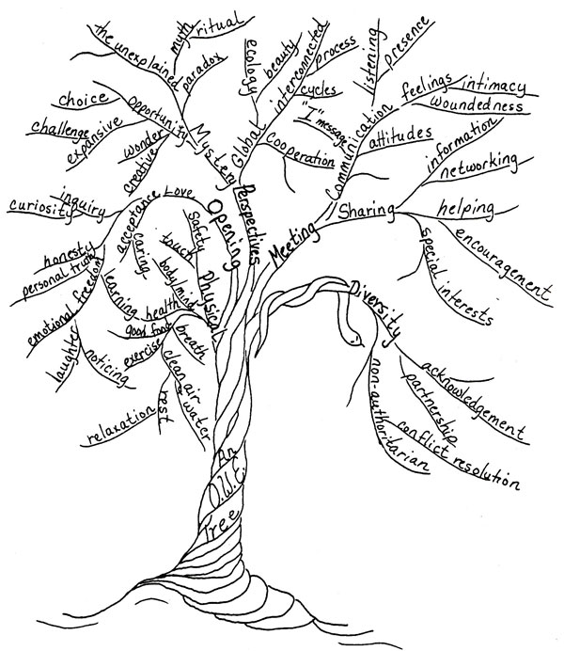
The Learning Environment
Notes:
The third component is the text/environment. Independent of ability, a child who has been exposed to reading will greatly influence their level of reading skill. So too will the number of different authors that a person is familiar with (Britton & Graesser, 1996). Choice of reading material, with an emphasis placed on reading for pleasure, is highly important. To get children motivated to read, they need to be reading something that interests them (Brooks, 2013). Furthermore, social opportunities like book discussions that enable joint engagement through interactions with others to discuss and explore interesting texts create an exciting curriculum (Ellis, Denton & Bond, 2014).
The unique relationships between the three components of teacher, environment, and student ultimately come together to determine the quality of the learning experience. When the three aspects align the learner’s motivation and the teacher’s work satisfaction, both accelerate and learning is a positive experience for all. This model builds upon previous models and acknowledges the potential impact of the quality of the teacher’s lesson, which bears on individuals’ motivation (Ruddell & Unrau, 2004). Also, the structure of the classroom or learning environment influences the developing reader’s sense of ownership of their learning process. In turn, learning conversations and class discussions develop pupil/teacher relationships, enhancing trust and leading to a negotiation of meaning (Davies et al., 2013; Ruddell & Unrau, 2004)

Slide 9

The Learning Triangle
Reader
Mediator analyses learner’s potential
Learner requires mediation
Learner brings cog. fn. to task
Task requires cog fn. of learner
© Copyright: Ruth M Deutsch
Mediator
Mediator analyses task
Task determines mediation
Task/environment
Notes:
The reader based factors are the learner’s cognitive abilities, concepts of intelligence, dispositions to learn
The text based factors are related to the task
And the mediator is teacher/parent who shares the strategies which help the child the comprehend in reading

Slide 10
How to create
autonomous learners
Notes:
Before moving into the comprehension aspect, what about some reading research info….

Slide 11

Notes:
Based upon

Slide 12
Systematic teaching of phonics/decoding is necessary for reading but it is not enough

Slide 13
“The act of teaching requires deliberate interventions to ensure that there is cognitive change in the student”
Notes:
Hattie 2009

Slide 14
Togerson et al (2006) found evidence for phonics “first” but not “fast” and not “only”

Slide 15
Becoming an effective transactional strategies instruction teacher is a difficult skill(Brown et al., 1996).

Slide 16
Readers bring their knowledge of a range of texts and genres to bear when reading something new

Slide 17
“The data suggests that students at all skill levels would benefit from being taught strategies”(Rosenshine, Meister, & Chapman, 1996, p. 201).

Slide 18
“The best way to pursue meaning is through conscious, controlled use of strategies” (Duffy, 1993, p. 223).

Slide 19
Notes:
One of the largest literature review of reading practices was conducted by the Eunice Kennedy Shriver, National Institute of Child Health and Human Development (NICHD) (2000), comprising 100,000 studies looking at each of the five components of reading: phonemic awareness, phonics, fluency, vocabulary, and reading comprehension. While these components were considered separately, it was clear from their conclusions that reading is a complex task requiring interactivity between all five components – the sum of which is greater than its constituent parts. While the NICHD did not undertake a meta-analysis of reading comprehension approaches (because of the small number of studies), they could conclude that for comprehension to develop, the following was true:
• Linking phonemic awareness to letters makes learning more efficient.
• Fluency was a factor required for comprehension and learners benefited from guided instruction.
• Vocabulary needed to be taught explicitly.
• Comprehension needed to be taught explicitly and six strategies were identified as effective:
• Twenty-two studies explored comprehension monitoring, the ability to recognise when the reader understands the text.
• Ten studies reported on cooperative learning, that is, when readers need to learn to work in groups, listen, and understand their peers as they read, and help one another to use strategies that promote effective reading comprehension and readers learn to focus and discuss reading materials.
• Reported within 11 studies was the use of graphic and semantic organisers, including story maps which externally systematise information, aiding understanding.
• Question-answering strategies were reported by 17 studies to help readers develop skills in answering questions and making inferences.
• Question generation was reported in 27 studies as a strategy for readers to develop their ability to generate questions or inferences.
• Summarisation was reported within 18 studies as a strategy to develop the reader’s understanding of key points within text.
• In addition, many of these strategies have also been effectively used in the category of “multiple strategy” or Multiple Comprehension Strategy Instruction (MSCI) where readers and teachers interact with texts. Thirty-eight studies reported on various ways to coordinate several processes to construct meaning from texts. How instruction of a multiple strategy approach could be employed for the highest impact was an area for further research.
This led to a load of glossy packages that promised to improve comprehension.
The US Department of Education commissioned the large- scale James-Burdumy et al. (2010) study. Given that the evidence had previously cited multiple strategy reading comprehension approaches to yield bigger learning gains than when strategies were taught in isolation, their study was to assess which of four multiple strategy supplementary reading comprehension curricula interventions would show the largest gains. Data from children attending over 200 schools and 10 American districts were analysed. Using a variety of different measures, including observational, teacher, implementation, and test data, they evaluated four multiple strategy interventions. Surprisingly, the results showed that none of the interventions had a significant positive impact on student’s reading comprehension.
What was even more surprising was that one approach had a statistically significant negative impact. Therefore, the mere act of putting together a package of strategies would not be enough to see a positive change. There needed to be other factors that, if in place, brought about increased reading comprehension. To find out, they undertook secondary analysis of the observational data. What they found was that when there was a positive impact on children’s comprehension, there was explicit instruction, effective teacher management and responsiveness, and student engagement.
My study became knows as SHORS Strathclyde Higher order Reaching skills project:
The SHORS programme takes its research principles from two studies: James-Burdumy et al. (2010 ) and Shanahan et al. (2010). Which both came to similar conclusions.
The SHORS intervention used in the McCartney et al. (2015) study took these underlying principles and designed the intervention around these aspects and showed that they had an impact on reading outcomes. The approach encourages a shift in practice instead of new curriculums or prescriptive lesson plans. It is a methodology that allows teachers to blend the approach with their teaching resources in entire class and group settings. McCartney et al. (2015) facilitated the training of teachers where they are encouraged to discuss its application within the classroom. This involvement creates ownership and potentially increased effectiveness (Moir, 2018).
When improvement in reading comprehension for the SHORS group was compared with that of the control group (using the WIAT-II (Wechsler, 2005)), the results showed a large effect size d = 0.81. Analysis showed that the level of this effect size could only be attributed to the intervention and not measurement error.

Slide 20
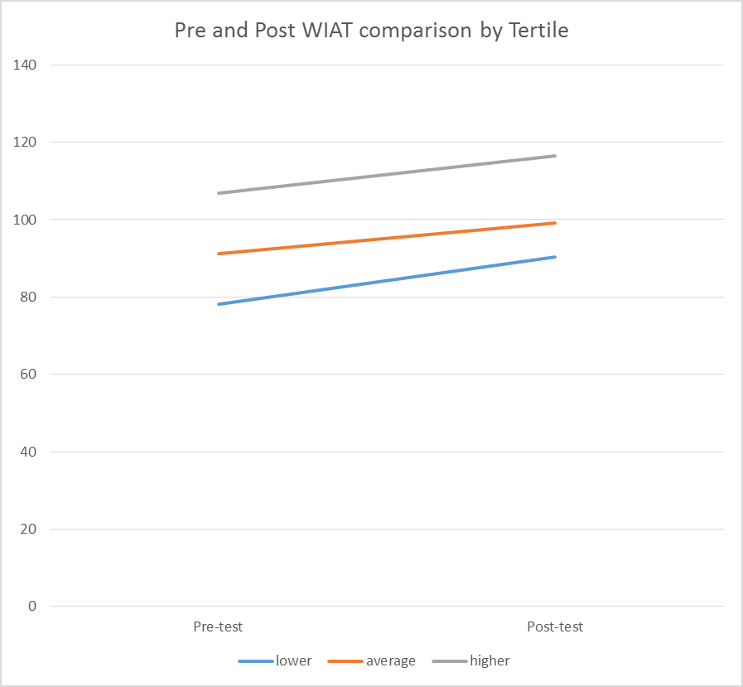
Notes:
Of the children within the experimental condition, there will be no difference between the tertiles’ change scores of children of lower, average and higher reading ability and as such the intervention can be described as a universal approach.
Above illustrates equivalence between the tertiles in regard to pre- versus post-intervention scores and the equity of impact of the intervention across ability sub-groups.

Slide 21
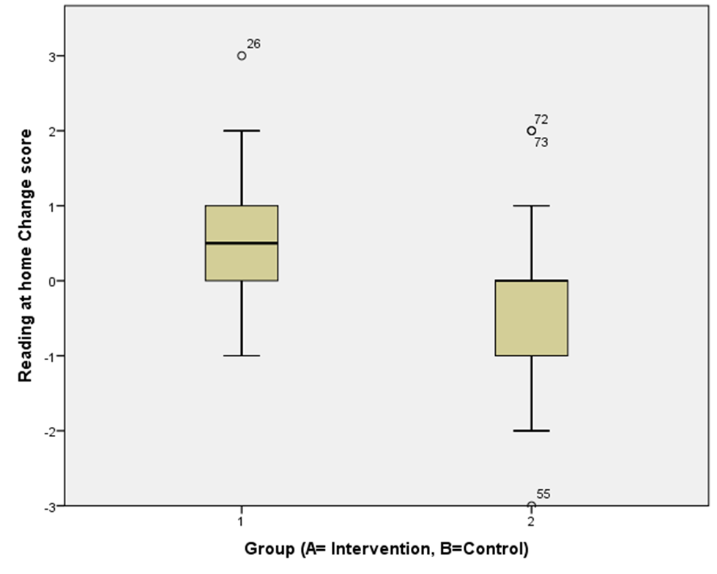
Reading habits…..
Notes:
The “fourth-grade slump”, a phenomenon which occurs in upper primary/elementary schools whereby reading comprehension skill decreases (Chall, Jacobs & Baldwin, 2009). This was evident in the study’s control group, who reported reading at home for pleasure less as they got older. However, those children within the intervention group not only were resilient to the slump, but their amount of reading at home statistically significantly increased (Moir, Boyle & Woolfson, 2020). Taking part in the study had had a positive impact on children’s reading habits. As children read more, it is likely this additional practice led to an increase in reading skill (Davis, 2010). This then perpetuates a positive cycle, where reading more increases skill, which increases self-efficacy, which leads to more reading, and so on.

Slide 22
Intervention Teacher feedback
 | % of Quotes
Codes | Higher Fidelity teachers | Lower Fidelity teachers
SHORS could be used across CfE | 13 | 0
Pupils were more empowered | 7 | 8
SHORS Enjoyable for all | 7 | 0
Allowed for teacher reflection | 7 | 0
Teacher/ staff felt upskilled | 27 | 23
Additional resources not needed | 10 | 0
Quality training and good support given. | 7 | 15
Flexibility | 7 | 0
There was more visible learning | 17 | 0
The literacy knowledge was not new to me | 0 | 38
Evidence of use of alternative teaching methods to that within the intervention | 0 | 8
Time a challenge | 0 | 8
Notes:
The feedback from the teachers who had implemented the intervention to a higher
“The approach was different in that it was a methodology rather than something that was bought in, another resource”.
“It is more explicit in the use of strategies and I found myself asking questions that I wouldn’t otherwise have asked”.
“It was very child friendly”.
“Children throughout the school were better at articulating what they imagined”.
“It enabled children to really get in a text where they had never had the opportunities to do that before”.
“Also the strategies for vocabulary were very useful, far better than just putting the word in a sentence”.
degree elicited quotes regarding SHORS, which were 100% positive.

Slide 23
Comparison with other approaches….
MCSI | Effect size using standardised measures | Statistical Significance | Out-with Measurement error
Strathclyde Higher Order Reading Skills Approach | 0.81 | YES | YES
Informed Strategies for Learning | 0.81 | NO | NO
Transactional Strategies Instruction | 0.67 | YES | Insufficient data
Concept-Oriented Reading Instruction | 0.62 | NO | NO
Peer-Assisted Learning Strategies | 0.43 | NO | NO
Think Aloud Instruction | 0.37 | YES | Insufficient data
Reciprocal Teaching | 0.32 | YES | Insufficient data
Collaborative Strategic Reading | 0.28 | YES | Insufficient data
Notes:
The effect size of the SHORS intervention within my current study and can be compared to other multiple comprehension strategy interventions. It can be seen:
• SHORS has yielded the largest effect size
220
SHORS can be compared favourably in terms of statistical significance
SHORS can be compared favourably in terms of measurement error.
Furthermore, SHORS has proved to be more desirable regarding intervention implementation ease, accessibility and capacity to bring about positive outcomes for children of all abilities.

Slide 24

PART 2: Practice and pedagogy
Chapter 5: Metacognition and Mindset
Chapter 6: Metacognition and Motivation
Chapter 7: How should I teach a strategy?
Chapter 8: Metacognitive strategies and how to teach them
Chapter 9: What cognitive strategies should I teach?
Chapter 10: Successful study skills

Slide 25
The 6 core components...
1. Teach children some/all of the 12 reading comprehension strategies using:
Direct teaching- provide a range of examples during initial teaching and practice through modelling, thinking aloud, application and guided practice
Keep it visual (posters anchor charts)
Use kinaesthetic hand gestures indicating the use of a strategy
Refer to strategies
Encouragement of active involvement and conscious use of strategies
2. Use visual organisation aids
3. Guide students through high focused, high quality discussion about the text
4. Provide interesting, appropriate and varied reading materials
5. Establish an engaging motivational context and reading opportunities
6. Support vocabulary
Notes:
The intervention highlights 12 text comprehension strategies and illustrative ‘key messages’ (in italics) were emphasised similarly to McCartney et al., (2015):
• Children would actively engage in reading comprehension by consciously accessing their prior knowledge; ‘Prepare your mind. What is this about?’
• Children would develop and answer questions about important ideas in the text; ‘Wonder to yourself. Does this seem likely?’
• Children would visualise what a text means; ‘If this was a film, what would I see?’
• Children would clarify points of misunderstanding; ‘If I don’t understand, stop, re-read. If I still don’t understand, find the problem word. Does it remind me of other words? If necessary, look it up.’
• Children would make inferences around the text; ‘How does this relate to what I already know? What was new?’
• Children would summarise; ‘What do I know so far? What do I need to know?’
• Children would retell the main points of the text; ‘In my own words, that means . . . .’
In addition, and again in line with the McCartney et al.,’s (2015) research, the awareness of the use of the strategies was increased with the use of hand gestures when strategies were being used (Courtney & Gleeson, 2010). Use of hand gestures allows young readers to take a more interactive role in reading rather than in previous lesson formats where children read silently before being asked a series of questions about the text (Pressley, et al., 1998). This raised awareness of strategy use and maximises retention of information via a variety of neural processing pathways (Baker, Zeliger-Kandasamy, & DeWyngaert, 2014). Using a series of hand gestures also allows the teacher to see when children are using strategies and shows children how each of these strategies interact with each other (Raphael & Au, 2005). It has also been argued that gestures can give clarity to the teacher in how to better facilitate reading comprehension instruction (Block, Paris, & Whiteley, 2008). Given that a one-off modelled lesson of a reading comprehension strategy is insufficient in systematically using the strategy, the use of hand gestures allows the development of the skill, while teachers can be aware of when and where strategies are/are not being used and can therefore scaffold appropriately. Gardner (1999) summarises this by stating that activity and action are both important for primary children's learning allowing them to transcend the role of passive recipients to become more participatory, whereby recall and learning have a greater lasting impact.
An additional signal was encouraged for when children hear a voice ‘reading aloud’ in their head and post reading reflection was encouraged by asking children how the story could have ended differently (‘crunch points’). Furthermore, the intervention used McCartney et al.’s (2015) targeted approach to develop the vocabulary. Handouts with intervention information and strategies were provided, as were classroom reminders including a classroom poster. Children were also encouraged to use text organisational structures and to be given opportunities to participate in direct teacher/children discussion. Finally reading texts were to be carefully selected jointly by children and teachers to be of high interest to promote maximum motivational engagement.
After training was given to the teachers and discussion had taken place around the interventions core components, they were asked to sign a pre-intervention questionnaire/contract to ensure readiness to invest in the intervention.

Slide 26
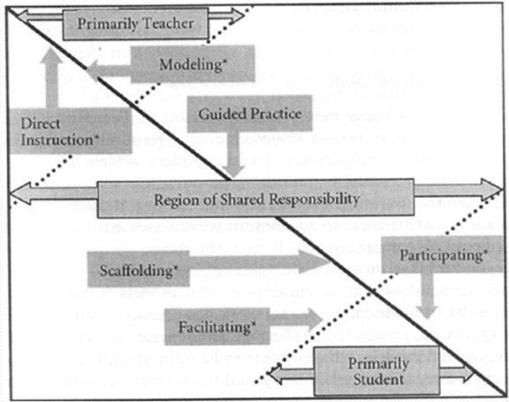
Gradual release of responsibility
Notes:
These strategies had to be taught explicitly. There are various models of the stages involved in the teaching of strategies. Duke and Pearson (2009) described a four-stage process of direct teaching, modelling/think aloud, guided practice and application. However, these have become increasingly more detailed with the Education Endowment Foundation (2020) (EEF), outlining a seven-stage process, these being activating prior knowledge, explicit strategy instruction, modelling of a learning strategy, guided practice, independent practice, and structured reflection. These models all show a gradual transfer of responsibility for the application of the skill from the teacher (who initially has 95% – 100% responsibility but their proportion reduces towards 0% responsibility) to the learner (who initially has 0% responsibility but their proportion grows towards 95% – 100% responsibility;

Slide 27
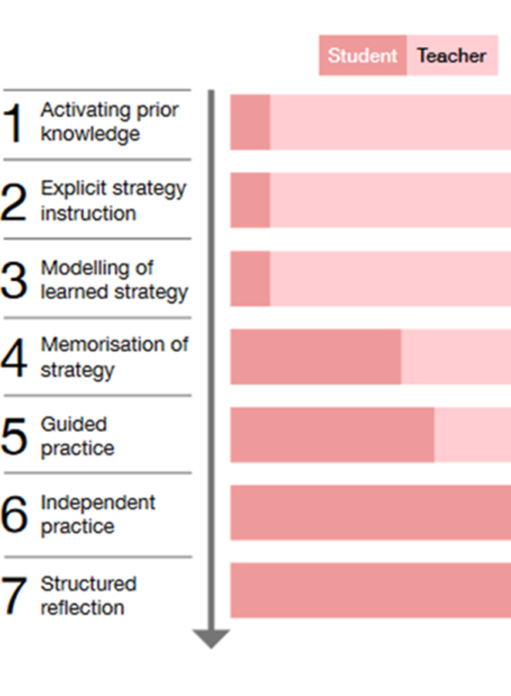

Lets find your strengths
Notes:
Within session 2 there was a lot of time given to the gradual release of responsibility, in which the teacher first introduces that strategy, explains how to use the strategy and then gives students more and more independence in practicing and applying the strategy over time.
ultimately releasing the student to use the strategy independently. When releasing responsibility to students, however, teachers should be mindful that students differ in the extent of modeling or support they need from teachers in order to use strategies effectively.
Give out the self-reflection questionnaire and get them to complete section 1 on activating prior knowledge.

Slide 28
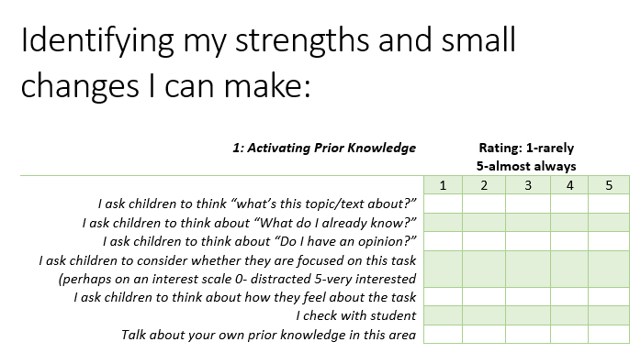
Notes:
This is section 1: After they have completed this section get them to reflect with a peer their strengths and something they want to concentrate on getting better on.
Ask the group if they want to feed back anything to the wider group before continuing on to the next section.
Step 1: Activate your prior knowledge
We all have good days and less good days. Sometimes our minds are so busy that we find it hard to engage in anything. Pushing forward with a task without acknowledging this can waste time and be a frustrating experience. The mere fact that we attune to our bodies and think about whether we are focused on what we are doing is great for realigning ourselves. Noticing that we are motivated will increase our motivation. Alternatively, if we realise we do not want to do the task, we may talk ourselves into it. “I’ll do this for 15 minutes and then I will allow myself to do something else.” Or “I don’t really want to do this but the benefits of engaging in it will be X, Y, and Z”. Consciously recognising our learning disposition enables us to get into the learning zone.
Whenever we are starting a new task or new learning, getting the class together to initially think about what they already know will help prime and support additional learning. The discussion helps all individuals to delve into their long-term memory and remember anything related. If we are learning a new strategy, we may begin by asking what we already know about strategies. Which strategies are particularly useful? When should I use strategies? Revisiting this existing knowledge will provide a solid foundation for the new learning. We may identify certain pieces of vocabulary that perhaps we should cover before moving on. The more we can remember, the more the learner will have to draw on, and it will be easier to internalise new concepts. The teacher is the facilitator of the discussion. The teacher is the one who asks. The teacher is prompting the class, encouraging them to talk and share ideas. The better the quality of discussion, the more memories, thoughts, and ideas will be activated.

Slide 29
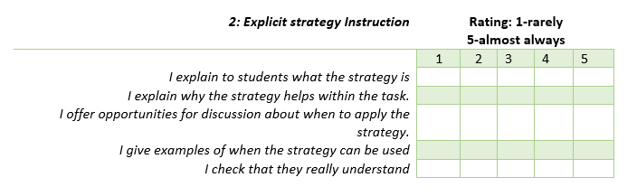
Notes:
This is section 2: After they have completed this section get them to reflect with a peer their strengths and something they want to concentrate on getting better on.
Ask the group if they want to feed back anything to the wider group before continuing on to the next section.
Step 2: Explicit strategy instruction
Within this stage, the teacher will lead a discussion about the new strategy that they are introducing. They will name the strategy and discuss why it might be a useful strategy and when it could be used.

Slide 30
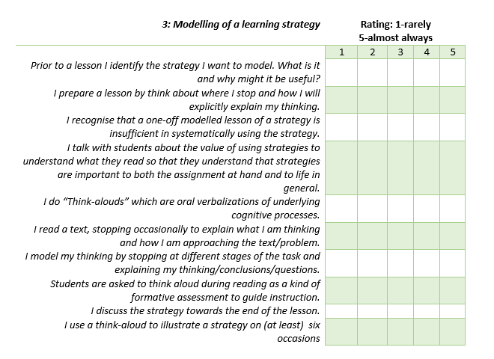
Notes:
This is section 3: After they have completed this section get them to reflect with a peer their strengths and something they want to concentrate on getting better on.
Ask the group if they want to feed back anything to the wider group before continuing on to the next section.
Step 3: Modelling of a learning strategy
Within this stage, the teacher is showing or modelling to the students how to apply the strategy. The teacher may have a book that they read aloud. The teacher will stop throughout the reading the say to the class what she is thinking. The technique “think aloud” is very useful here and is where the teacher verbalises to the class what she is thinking to ensure that the process is as transparent as possible (Bereiter & Bird, 1985). In so doing, this overt approach to the use of a controlled mental process is revealed so that learners can gradually use it automatically. The teacher will recount to the class what thoughts, feelings, expectations, or questions the text raises for them. It will be necessary to repeat this process several times for any new strategy that is being introduced. The transfer of the skill is gradual and modelling a “think aloud” process once will be inadequate in equipping children to systematically use the approach themselves. It is recommended that the think aloud process be demonstrated at least six times for each strategy before this type of scaffolding is withdrawn.
Once the learners are familiar with the use of “think alouds”, they could be asked to model to the teacher what they are thinking as they read, thereby providing a valuable formative assessment that can shape future instruction. A well-prepared teacher will be familiar with the text they are planning to read to the class, will have identified whether it lends itself to the strategy that they are teaching, will have planned when they are going to stop for demonstration of the “think aloud” process, and will have some ideas to develop a discussion about the strategy’s usefulness.

Slide 31
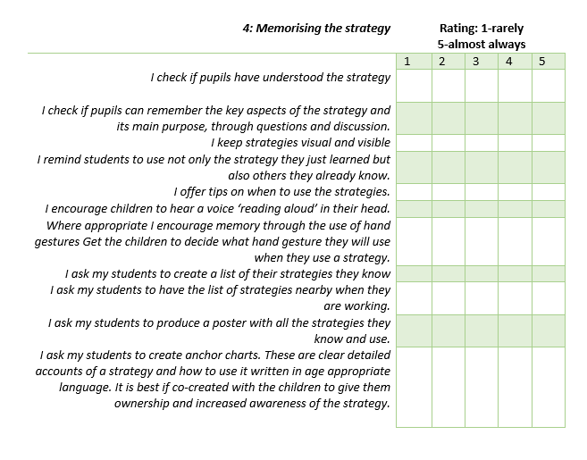
Notes:
This is section 4: After they have completed this section get them to reflect with a peer their strengths and something they want to concentrate on getting better on.
Ask the group if they want to feed back anything to the wider group before continuing on to the next section.
Step 4: Memorising the strategy
Here, the teacher is doing what they can to support the transmission of the new strategy from short-term memory to long-term memory. They may provide some visual tools as reminders. These can be in the form of anchor charts (see Figure 7.5) and lists of strategies. These visual tools have the greatest impact when the children have designed and created them for themselves. The teacher will facilitate discussion to see whether the learners are really grasping how to use the strategy and the benefits of doing so. It is also helpful to discuss when this strategy might be more or less useful than other strategies that they have previously learned. Continue to encourage children to be conscious of the narrative of their thinking by hearing a voice “reading aloud” in their heads. In order to make the use of the strategy even more evident, ascribe a hand gesture to the strategy and boost strategy awareness by doing the hand gesture in tandem with the strategy use (Raphael & Au, 2005; Parrish, 2010; Courtney & Gleeson, 2010; Baker, Zeliger-Kandasamy, & DeWyngaert, 2014). Children are more empowered to learn when the learning is personalised to them and therefore it is better to get the pupils to decide what the hand gesture should be. Take photographs of the children doing the hand gesture and display them. All humans have a memory bias for material that can be processed with a reference to the self. For example, putting a word in a sentence regarding the individual increases spelling accuracy by 20%.

Slide 32
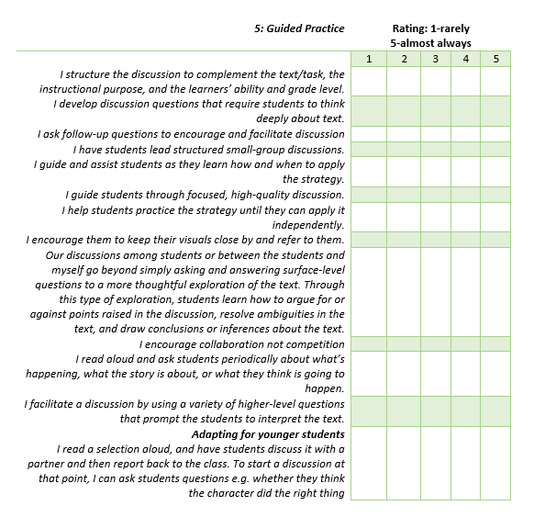
Notes:
This is section 5: After they have completed this section get them to reflect with a peer their strengths and something they want to concentrate on getting better on.
Ask the group if they want to feed back anything to the wider group before continuing on to the next section.
Step 5: Guided practice
Within a crammed curriculum, the temptation could be to move on to a different strategy. However, without giving the learners sufficient time to practise, the use of the strategy could undo some of the hard work done. Guiding children as they practise using the strategy will build confidence and also help them decide for themselves when it is the best time to use what strategy. There is still a role for the teacher, assisting and guiding where necessary. It is like learning to ride a bike. Initially, the learner needs a lot of support, but eventually they will be able to stay fairly steady. However, unless this period is followed with opportunities to ride a bike, it is unlikely the learner will have sufficient skill and confidence to be considered a bike rider. Also, many car drivers believe it is only after having passed your driving test that you really learn the skill. It is the practice of driving that makes you develop the skill of driving – not getting your license.
Engaging with the learners and encouraging quality discussion enables depth of understanding and increases their ability to use the strategy co-dependently before independently. Allow time for peer discussions (Davies, Jindal – Snape, Collier, Digby, Hay, & Howe, 2013). When children are asked to take part in quality discussion, teachers often believe that they can go off topic. Therefore, do not expect all children to know how to have productive discussions. This is another skill that may need to be taught. To avoid this, provide clear guidance on what should be discussed and model how this guidance can be used.

Slide 33
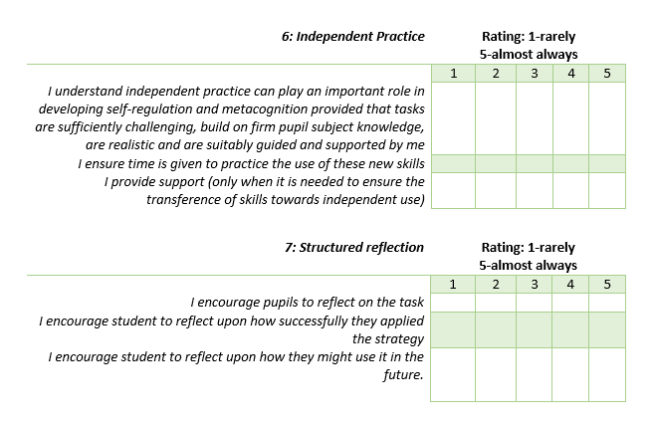
Notes:
These are sections 6 and 7: After they have completed this section get them to reflect with a peer their strengths and something they want to concentrate on getting better on.
Ask the group if they want to feed back anything to the wider group before continuing on to the next section.
This task should help inform their own personal action plan
Step 6: Independent practice
Here, the teacher has created an autonomous learner. All the scaffolding support has enabled them to know what strategies should be used when and how. They have a knowledge of themselves as learners and are conscious of the task and the process of learning. Again, the learner needs the opportunity to use the strategy independently.
Step 7: Structured reflection
Unfortunately, few students will stop and reflect on their learning unless encouraged to do so. Questions or quizzes could encourage children to think about how and when they have used strategies and what ones may be more successful in the future for different tasks. This develops the individual’s knowledge of themselves as learners and promotes their more general metacognitive skills (Moir, Boyle, & Woolfson, 2020).
The transfer
Although this is considered step 7, the reflective skills are essentially what makes a strategy a metacognitive strategy and therefore the whole 7 step process requires reflective thought throughout.

Slide 34

Corridor stop
Has this exercise thrown up anything unexpected?
Reflect on these ideas with a partner

Slide 35
Some metacogntive skills
Metacognitive skills
Managing distractions
Questioning
Making links
Visualising
Noticing
Reflecting
Notes:
Here are some examples of metacogntive skills- you can say that these continue to be redefined be people much smarter than us. The difference between a cognitive skill and a metacognitive skills is how you reflect on your use of it- whether you are concentrating upon the process.

Slide 36
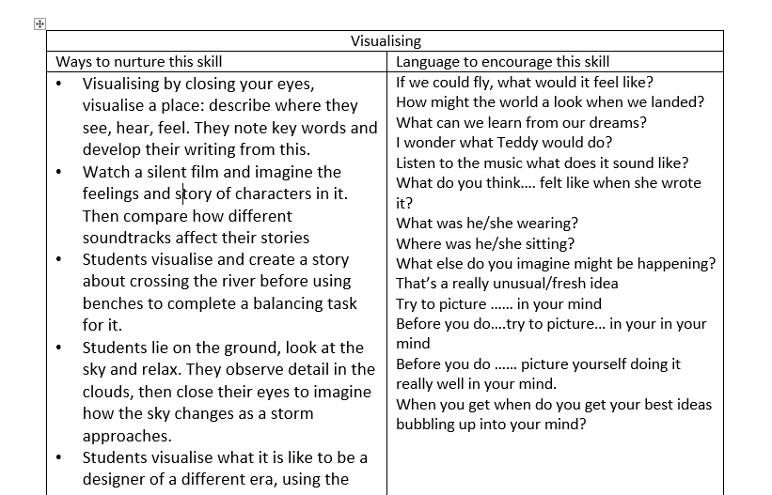
Notes:
There are 4 sheets with examples of how a skills can be taught within the book. Give out 1 visualising and and a blank worksheets.
In pairs get the participants to choose one skill and complete the blank worksheets, ask participants to think about ideas around how they can nurture this skill and what language they could use to do this.

Slide 37
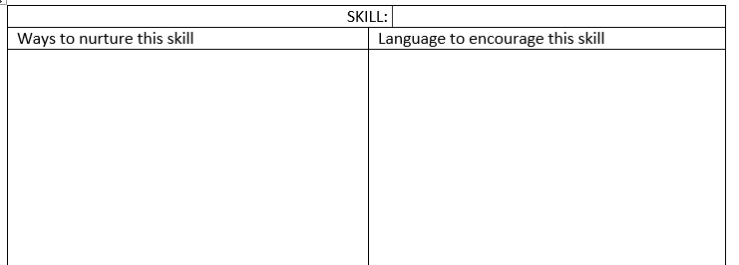
Notes:
Once complete ask the pairs to share 1 which skill they were working on, ways to nurture this skill and language to encourage this skill
Once this activity is completed give out the other examples.
Depending upon time pairs could be asked to do the same for another skill.

Slide 38
Corridor stop
A colleague stops you in the corridor and asks about the course you have been on.
You say that you have
thought of a few small changes that you want to try.
“Tell me more?” your
colleague asks.
You reply…..

Slide 39

Simple things you can do right away
Display learning progression on walls – not just finished work
Model how it feels to be stuck – brainstorm strategies to get unstuck
Reward good questions as well as good answers
Explain how learning is a lifelong skill – show how you are still learning
Discuss how others overcame difficulties
Dual-objectives in class
Acknowledge mistakes – and how important they are in learning
Notes:
Here are some things that participants may have already thought of that they could do.
Also – support children in developing how to work in groups
And think about measuring the impact . . .
For teachers – peer learning – journal, peer coaching
Focus on – questioning – learning walls, learning talk, class environment
Measure – progress, attainment – but also – asking for help less, working better together, asking more questions, asking for help less.
Pupils and teachers focusing and engaging in learning

Slide 40


Simple things I can do right away
Notes:
Ask participants what their take home things are , small changed that they can do right away.
When they are feeding back- make a note on flipchart of simple things they can do right away.

Slide 41

Please complete My evaluation
By scanning this QR code
Or following this link:
https://forms.office.com/Pages/ResponsePage.aspx?id=oyzTzM4Wj0KVQTctawUZKSy2svrkRwxMm5wnuRwI3PpUNENEU0IxQkdZRUVNVDVNVjhaMlZVUFVVNC4u
Notes:
If participants have completed all activities but not the evaluation then they can do so now.
Your feedback is very important. Please complete our evaluation and this will inform how we can continue to support school in implementing these ideas.

Slide 42

PART 3: Implementation at the whole school or authority level
Chapter 11: Whole school implementation
Chapter 12: Pupil participation
Chapter 13: Parental Engagement
Chapter 14: Professional collaboration and a shout out for Educational Psychologists
Chapter 15: Some Final Thoughts

Slide 43


Questions/Feedback
Link to purchase book
Notes:
CE

