Slide 1
Play pedagogy: implementation and evaluation documents
Educational Psychology Service

Slide 2
Key Documents
EDC’s Play Pedagogy Strategy (2023-2024)
Play Pedagogy Audit Toolkit (2023)
Collaborative Practitioner Enquiry
Notes:
Copies of these 2, plus the October feedback report which you don’t need at the moment

Slide 3
EDC’s Play Pedagogy Strategy 2023-2024
Updated by the Play Pedagogy Steering Group in April 2023
Outlines the aims for this session
Explains the role of the Play Pedagogy Steering Group
Outlines the key principles of EDC’s Play Pedagogy approach
Highlights the Professional Learning Programme (including Professional Learning Community (PLC) sessions)

Slide 4
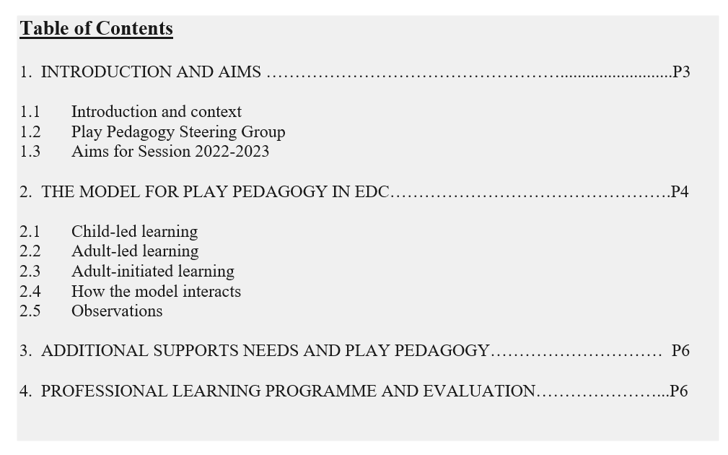

Slide 5
Aims for Session 2023-2024 include:
To continue to provide high quality ‘in person’ Professional Learning Community sessions, including peer support visits and practice sharing.
To work towards all School Senior Management and staff teams being knowledgeable of the principles and understanding the value of play pedagogy.
To continue to empower children to be active participants in their own learning, make decisions and choices involved in planning their learning.
To continue to support practitioners to undertake clear planning, self-evaluation and to gather and analyse data for improvement; using a range of tools including observations.

Slide 6
Play Pedagogy Audit Toolkit
Updated by the Steering Group for Session 2023-2024
A practical document with ideas and prompts to support the development of play pedagogy (indoors and outdoors)
A consultation framework for schools to use to self-evaluate as a baseline
A framework to identity targets for change
A framework to measure change in terms of the outcome and impact of any changes - if revisited post intervention.
The most recent addition includes sections on playful literacy and playful numeracy and maths, developed by the ELST team.

Slide 7
Structure of Audit Toolkit
The Audit Toolkit has been divided into 9 areas which focus on:
Child-led learning
Adult-led learning
Adult-initiated learning
Outdoor learning
Classroom environment
Materials and resources
Reflection and evaluation: teachers, children and parents
Playful literacy
Playful numeracy and maths development

Slide 8
9 checklists/prompts
There are 9 tables which highlight possible strategies and ideas, and provide space to make notes about the following:
The extent to which this strategy is currently developed
Whether this strategy is a priority
Any actions/next steps
Evaluations/evidence

Slide 9
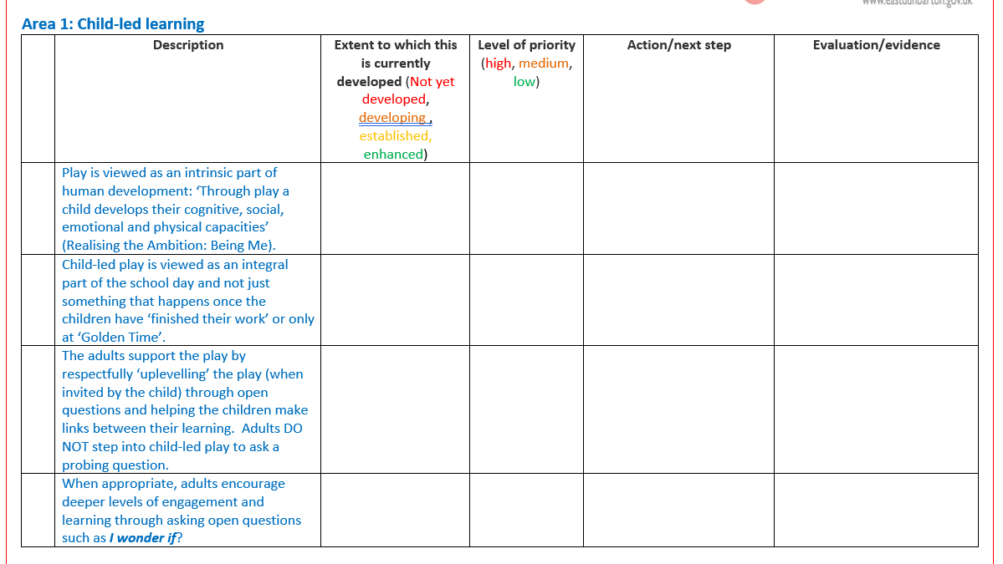

Slide 10
Summary of priorities
Area | Priority | Next steps | Timescale
Child-led play
Adult-led learning
Adult-initiated learning
Outdoor learning
Classroom environment
Materials and resources
Reflection and evaluation: teachers, children and parents

Slide 11
Play Pedagogy: Collaborative Practitioner Enquiry
Implementation approach which involves at least two people working collaboratively to:
identify an issue to be addressed
look at other resources and/or research literature to identify possible reasons and solutions
identify a strategy to attempt to improve the issue
evaluate the changes made.
i.e. study, plan, do, review

Slide 12
Collaborative Practitioner Enquiry (CPE)
CPE has been used to support other EDC education initiatives e.g. Language and Communication Friendly Establishments, NQTs, PATHS and Autism Advisers
In line with the recommendations of the General Teaching Council of Scotland (GTCS): “Teachers engaging in practitioner enquiry offer a number of benefits to the teacher as an individual, the school and wider educational community.”

Slide 13
CPE and Play Pedagogy
Schools develop their play pedagogy approach, based on the EDC principles, at their own pace and according to their own specific context.
CPE supports the implementation and evaluation of play pedagogy within a set time frame (e.g. one term). There is a comprehensive guide which explains the process in detail, and a working document for practitioners to note down their plans on.

Slide 14
Using the Collaborative Practitioner Enquiry (CPE) document
4 steps:
Step 1: identify the issue or area of change (study)
Step 2: identify possible solutions (plan)
Step 3: identify new practice or change (do)
Step 4: evaluate what worked (review)

Slide 15
Study, plan, do, review
Collaborative Practitioner Enquiry
Evaluate what worked
Identify the issue or area of change
Identify possible solutions
Introduce new practice or change

Slide 16
Using CPE and the Audit Toolkit together
The CPE documents guide you through the process of planning, implementing and evaluating an aspect of play pedagogy from start to finish and the Audit Toolkit can help provide practical strategies and a means of tracking your use of these strategies (pre and post).
The documents make reference to each other at every step in the process.
Start small and make your changes achievable! Small changes can make a significant difference to children’s learning and wellbeing.
You can speak to your school’s link Educational Psychologist about research techniques and ask for support in designing and carrying out Collaborative Practitioner Enquiry. There is a Research Peer Support Group run by the EPS that all practitioners in EDC can access – contact Kate for more details.

