Slide 1
Play Pedagogy in Primary Schools
Led by East Dunbartonshire Educational Psychology Service
Structure of practice sharing workshop:
The national context
East Dunbartonshire’s play pedagogy journey in the Primary School context
The role of the Educational Psychologist
Sharing of practice and resources across the West Partnership
Next steps

Slide 2
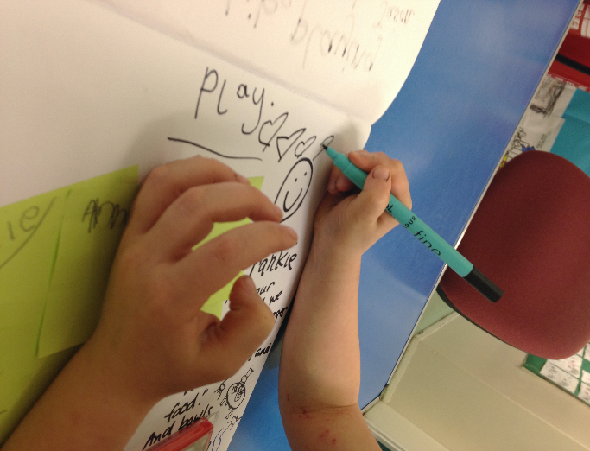
Why is play pedagogy important?
‘Play is an intrinsic part of human development.
Through play a child develops their cognitive, social, emotional and physical capacities’
Realising the Ambition: Being Me
p44
Notes:
Why is play pedagogy so important?
When we welcome our children into settings and schools it will be important for children to have opportunities to play.
‘Play is an intrinsic part of human development. Through play a child develops their cognitive, social, emotional and physical capacities’ Realising the Ambition (RTA) p44.
Through play children can act out real life experiences. Play offers a space for children to cope with matters that may impinge on their lives and now more than ever we need to be minded of the value of play.
Playing in spaces that offer similarities, that connect them to home and with their peers will mend broken bridges and pave the way for new beginnings. ‘Curriculum for Excellence (2007) gives prominence to play, particularly across the early level and the transition between ELC and primary school. This transition will likely be smoother for the child if the play remains and continues as the main vehicle for their early learning in P1 and beyond’ RTA p45
We don’t have all the answers, but we can take comfort from our own instincts, we know children should be at the centre of everything we do, whether at home or in settings and schools. We can find solutions and be responsive to the changing transitions landscape.

Slide 3
Early Level
In Scotland we benefit from a curriculum model that spans the ELC and the early years of Primary School.
The Early Level of Curriculum for Excellence is intended to support the implementation of a responsive, continuous, play-based curriculum for children aged 3 – 6.
The learning environment in the early stage of primary school should not look or feel starkly different from a motivating ELC environment. The level of provocation might be greater, the interaction might be more challenging, and the experiences on offer might be different, but the school environment should be conducive to learning through play (Realising the Ambition, 2020)
Notes:
In reality, many children move from child centred world of early level to adult directed P1. The children who find this most difficult are the youngest children, the children with ASN and those from more disadvanted backgrounds

Slide 4
Building the Curriculum 2 (2007) talks about active learning in the early years in terms of……
Spontaneous play
Planned and purposeful play
Investigating and exploring
Events and life experiences
Focused learning and teaching
Notes:
Is of course our guidance paper for active learning in the early years of education. It covers pre school settings and the early years of primary school education. For the first time in Scotland, the curriculum for pre school and P1 children are presented together as one level. Fantastic for transitions!
So the go ahead from the Scottish Government to use play pedagogy is right here! It’s 15 years old

Slide 5
Time line of implementation in EDC 2016-2018
2016-2017 – Play pedagogy Pilot (Play2Learn) in 4 schools supported by QIO, Educational Psychologist Kate Spalding, the Early Years’ Team and the Early Level Support Teachers’ team. Deirdre Grogan (University of Strathclyde) acted as consultant.
The Play2Learn pilot (2016-2017) won a Quality Improvement award in the category of ‘most inspiring or innovative project’ from the Scottish Government and Healthcare Improvement Scotland Awards (2017).
2017-2018 – Half of EDC’s primary schools introduced play pedagogy over this session, supported by a series of Professional Learning Community sessions and school visits. Audit Toolkit and Collaborative Practitioner Enquiry processes were embedded to support implementation.
In Session 2017-2018 there were statistically significant differences between the achievement of Early Level for children who had experienced Play2Learn, compared to those who hadn’t, in reading, writing and talking and listening.
Notes:
Bearsden, Hillhead, Colquhoun Park and Baljaffray Primaries

Slide 7
Time line of implementation in EDC (2018-2019)
2018-2019– 90% of primary schools had introduced play pedagogy and many had taken this practice into Primary 2 and Primary 3.
2019: EDC were asked to present at the West Partnership Head Teachers’ conferences (March 2019) and our presentation was shared by Education Scotland on the Hub
The good practice from 2 of our schools was published on Education Scotland’s National Improvement Hub: https://education.gov.scot/improvement/research/sac86-play2learn-in-bearsden-primary-and-st-matthews-primary-school

Slide 8
Time line of implementation in EDC (2019-2021)
2019-2020 – all EDC primary schools had implemented play pedagogy. The PLC calendar continued with the establishment of experienced Play mentors to support the implementation and evaluation process.
Bespoke training was provided to Support Staff across EDC in play pedagogy with a high level of turnout (February 2020)
Covid-related school closures (March 2020) resulted in the PLC calendar being moved to Microsoft Teams
The play strategy and PLC programme were adapted to take account Covid Restrictions

Slide 9
Time line of implementation in EDC (2022-2023)
EP and an EY QIO colleague presented to First Year EP Trainees (University of Dundee) re: play pedagogy in 2022 and 2023
A working group was set up focussing on developing play pedagogy for children with additional support needs. Accreditation by the GTC for work carried out in Additional Support Needs school.
August 2022 - session on play pedagogy for all EDC probationer primary teachers
The PLC calendar for Session 2022-2023 was delivered via face to face sessions with presentations saved on Teams
Links made with several West Partnership local authorities, who attended our Play Forum in May 2023

Slide 10
Key context/roles for Educational Psychology
Supporting the National Improvement Framework – raising attainment (particularly in literacy and numeracy)
The Future of EPs in Scotland (April 2019) – empowering teachers in the classroom, supporting professional learning of teachers, collaborative research with teachers
Muir Report (2022) - Curriculum for Excellence – repeated support for retaining the increasing focus being given to outdoor learning and to active, play-based, relationship-centred learning in the early years and early primary.
National Discussion on Education (All Learners in Scotland Matter, 2023) - ‘joy and love of learning including importance of play and outdoor learning for all ages’
Translating research into practice
Child development
Inclusive practices
Implementation and evaluation
Quality assurance of pedagogy

Slide 11

Documents for sharing from East Dunbartonshire EPS
Play Pedagogy Audit Toolkit (2023)
Collaborative Practitioner Enquiry documentation (Guidance and practitioner documentation)
An introduction session to Play Pedagogy for school practitioners
Play Pedagogy Strategy (2023-2024)

Slide 12
Padlet: sharing practice and collaboration across the West Partnership
In what ways are your service involved in supporting play based pedagogy?
Are there areas of practice you would share with this group?
What would you like to find out more about?
WP Play pedagogy (padlet.com)

Slide 13


Slide 14
Key texts
Bottrill, G. (2018). Can I go and play now? Rethinking the early years. London: Sage Publications.
Education Scotland: Play Pedaggy toolkit https://www.thinglink.com/card/1609461484272746499
Ephgrave, A. (2018). Planning in the moment with young children.
Fisher, J. (2016). Interacting or interfering: improving interactions in the early years. Berkshire: Open University Press.
Scottish Executive. (2007). A curriculum for excellence, building the curriculum (2): Active learning in the early years. Edinburgh: Scottish Executive. http://www.ltscotland.org.uk/curriculumforexcellence/publications/Buildingthecurriculum2/index.asp
The work of Alistair Bryce-Clegg https://abcdoes.com/

