Slide 1
Bereavement
West dunbartonshire

Slide 2
West Dunbartonshire
Bereavement Policy
    Motion at Council for ‘Universal Bereavement Support’
    “The current support that is in place varies significantly across schools in the area and is not holistic enough to fully support grieving children and young people throughout their school careers.”
    “The motion is based on the National Childhood Bereavement Project's “Growing Up Grieving” report which was delivered by Includem which looks at this issue on a national level.
    “Council requests the Chief Education Officer to address the lack of universality of bereavement support provided in schools across West Dunbartonshire through a bereavement policy that takes at a whole school approach to death, dying and bereavement to support all children and young people who are experiencing grief.”

Slide 3
What are we doing?
Area | Action
Data gathering from: Trained companions Schools and early years centres Parents and carers CYP Out of Authority | Focus groups Questionnaire Individual and small group
Staff training and development | Options appraisal of current approaches and those being used by colleagues across West Partnership
Establish reference group to inform policy | Identify participants and agree terms of reference
Bereavement policy | Draft bereavement policy for consultation

Slide 4
Survey/Focus Group
All schools and Seasons for Growth Companions in WDC (plus focus group with 20 Seasons for Growth Companions at reconnector)
Responses from 30 schools
Split into Support for Young People, Parents and School Staff

Slide 5
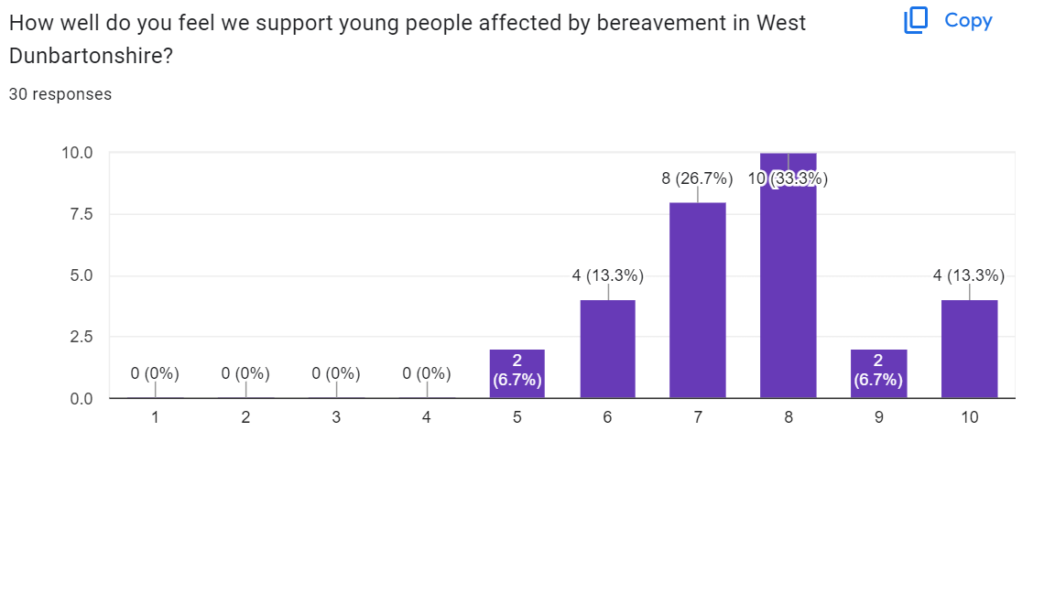
Young People

Slide 6
Young People
Average 7.6 out of 10
Any other supports not currently on offer, or do more of?
  More knowledge of what is on offer in authority at the moment
  Support/Counselling outside of school
  More staff trained in S4G/ ability to free up staff to deliver
  Part of Universal Curriculum to all pupils
  More input, support and advice from Ed Psych

Slide 7
Reflective Questions
Is this what you would expect to see?
What would you like to see in the policy to support all young people with bereavement? Particularly in your sector

Slide 8
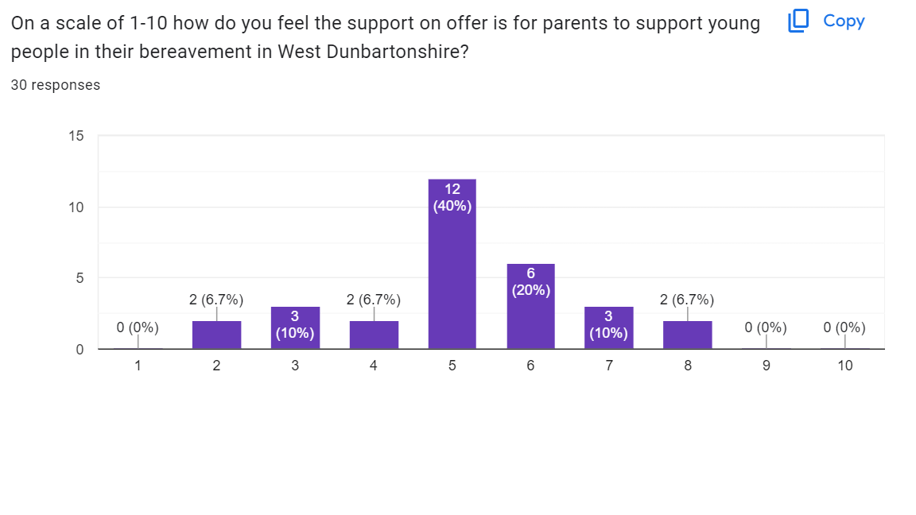
Parents

Slide 9
paRENTS
Average 5.13 out of 10
Any other supports not currently on offer, or do more of?
  Parents unaware of supports
  Policy clearly signposting parents to supports
  More Seasons for Growth opportunities for Adults/Parents
  Group opportunities to meet with other parents affected by grief to develop strategies.

Slide 10
Reflective Questions
Is this what you would expect to see?
What would you like to see in the policy to support parents with bereavement?

Slide 11
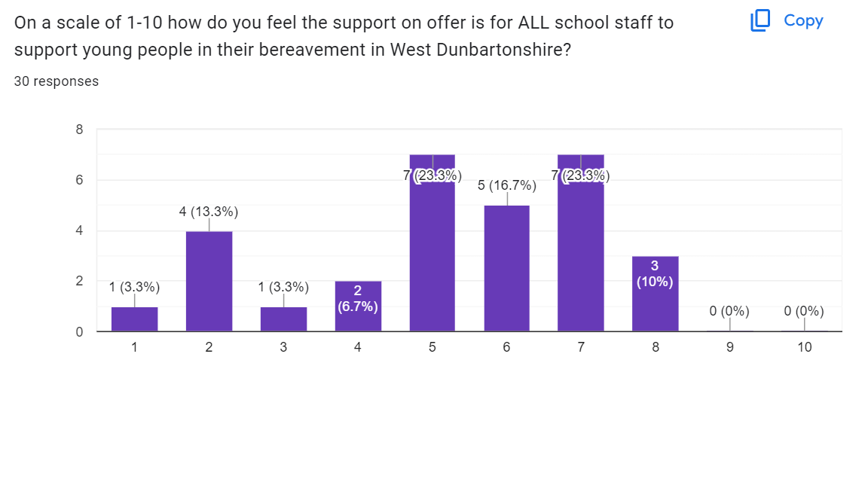
School staff/ELCC Staff

Slide 12
School staff
Average 5.26 out of 10
Any other supports not currently on offer, or do more of?
  Universal training for all staff
  Generic bereavement training for all school staff offered as standard, not as an 'opt-in' as may take a back seat with conflicting priorities.
  More sessions with Educational Psychology to support bereavement - face-to-face training

Slide 13
Reflective Questions
Is this what you would expect to see?
What would you like to see in the policy to support school staff with bereavement?

Slide 14
Bereavement Working Group
Consisting of staff from EY, Primary, ASN and Secondary
7 key gaps found
  Early Years
  ASN provisions
  Support for Parents
  Universal Training for all staff
  Universal curriculum offer for pupils
  Cultural Differences – accessibility
  LAAC/OOA pupils

Slide 15
Thanks!

