Slide 1

Supporting families, including those experiencing violence
East Renfrewshire & Inverclyde
Educational Psychology Services
West Partnership Event
September 2025

Slide 2
Overview
East Renfrewshire Context
Inverclyde Context
Q/A – Question Formulation

Slide 3
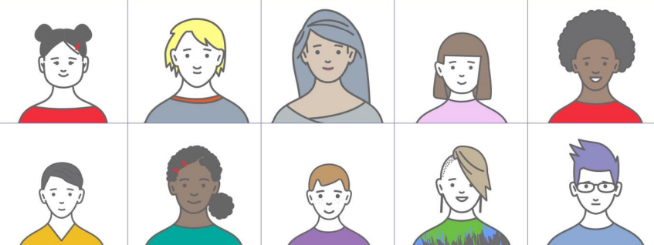
Healthier Minds Framework
Vision/aims
Capacity-building in family
Increased independence in decision making
Upskilling on nurture/trauma informed parenting strategies
Strengths-based
Support at individual C/YP / family level
Recent developments:
Whole Family Support Worker (WFSW) employed through EPS team
Healthier Minds Support Worker
Learn Well Service (home/school/community link)
Family wellbeing scale (research project 24-25)
Introduction of self-referrals
EP role:
Consultation (strategic level through HM Hub, multiagency planning meetings, individual C/YP work e.g. EMDR)
Data collection to inform content of framework / CLPL offers
CLPL training offers based on data analysis (Self-Harm, ASIST, restorative approaches, problematic eating)
Supporting sustainability through evaluation
Strategic interagency framework for supporting mental health and wellbeing (systemic level)
Close partnership working (Social Work, Education, CAMHS, Educational Psychology, RAMH, Children First, CLD, Family First)
Sits within staged intervention model (universal, targeted, intensive)
I
T
U
Notes:
2 inputs
Looking at support C/YP and families more generally – multi-agency structures and, frameworks and approaches that the EPS is involved in or has supported initial implementation.
Inverclyde have a discrete piece of work

Slide 4
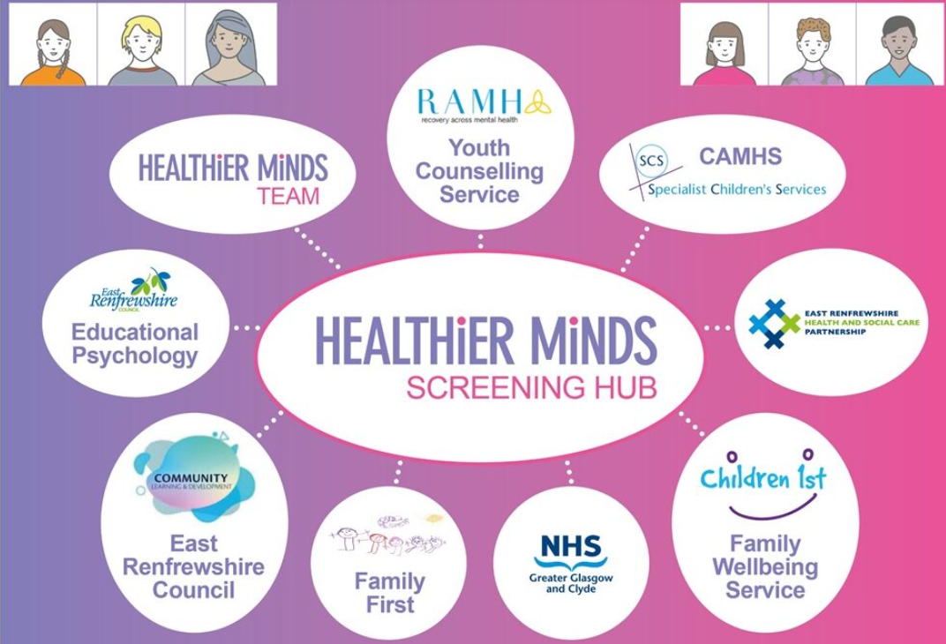
Multi-agency forums
HM Hub
Reviewing HM referrals- identifying appropriate support, self-referrals made easier
Data collection from HM referrals to inform strategic planning, CLPL offers etc.
MARAC
Attended by PEP – support to develop a coordinated action plan – safety for most vulnerable families – liaison and information sharing with schools to support safeguarding and mitigation of risk
Recent data indicates domestic abuse as primary reason for child protection measures in ERC
Notes:
HM Hub:
EP role in working systemically alongside multiple agencies
MARAC:
Domestic abuse data
Ages of offenders getting younger
Changing social context: Social media, violence against women and girls
How safety planning is integrated at school/family level- PEP’s role in linking with establishments /EPs to ensure they are informed and attuned to needs (responsive to preventative support)

Slide 5

Signs of Safety
Whole systems model to guide multi-agency assessment and planning
Family-centred – relationship-based practice, strength and safety focused, but also rigorously explore harm and complicating factors
Emphasises the need to define harm, and outline danger and identify safety goals
EP involvement in initial implementation i.e. needs analysis, training etc.
East Renfrewshire Health and Social Care Partnership inspection 2022
Feedback from families and C/YP indicated increased parental engagement and involvement in decision making, and more effective safety planning
Assessment tools
Harm matrix
Scaling questions
Genograms
Danger or worry statements
3 houses
Establishing clear safety and wellbeing goals (shared, specific and jargon free)
Notes:
Whole systems approach led by SW- used when supporting most vulnerable families
2021-2022 EP role in initial implementation
Connects to EP approaches/frameworks (SOA)- assessment approaches useful when working systemically /complex cases , vulnerable backgrounds

Slide 6
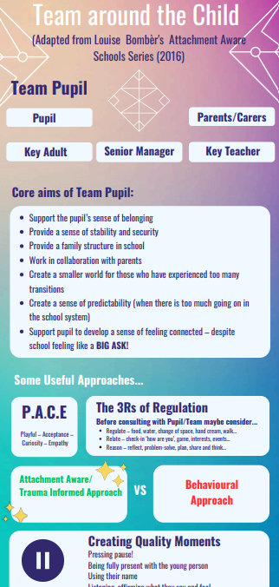
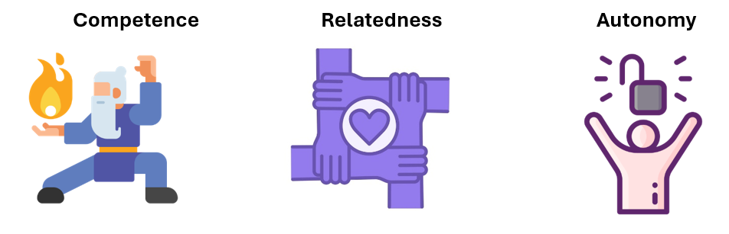
GIRFEC Refresh 2025
An initiative to include more progressive, person-centred approaches to supporting health & wellbeing, and working with C/YP and their families
Guidance shared with ASN coordinators:
Self-Determination Theory (application as an assessment and planning tool)
Team Around the Child Approach (planning tool adapted from Louise Bomber, 2016)
C/YP Plan review (gathering C/YP / family voice, digitalisation of plans, alternative methods of capturing views)
Be Well Survey (capturing wellbeing data
across authority)
Notes:
GIRFEC Refresh - rolling out 2 resources (SDT/TAC)
SDT guidance in the application of three basic psychological needs/core needs when working with C/YP and families: psychological nutrients needed for growth
Competence: self-belief when engaging in tasks.
Relatedness: sense of belonging and connectedness to others.
Autonomy: independence in their thoughts and actions.
Used as assessment / planning tool - supporting wellbeing and any potential barriers to wellbeing or areas for development, supports the use of SDT as a lens through which the child’s/family wellbeing can be understood – inform intervention planning
TAC:
Consultation planning tool - how to set up the Team Around the Child Approach (adapted from Louise Bombèr’s Attachment Aware Schools Series (2016).
Supporting collaboration C/YP and families at centre - shared responsibility for the inclusion and wellbeing of the C/YP (establishing relational safety through emotionally and physically safe, predictable, and consistent support network).
Roles and responsibilities of team members
How to introduce TAC to C/YP
Connection to nurturing approaches (universal, targeted, intensive)
Sits along other local authority initiatives:
Review of CWPs (content - processes of gathering C/YP and family views- is it relevant/meaningful/useful, (how effectively do we involve C/YP in planning- how we identify meaningful wellbeing targets), are we accessing all voices? Digitalisation of CWPs/)
Be Well survey- adapted from Glasgow Motivation and Wellbeing Profile (GMWP), Stirling, Spence anxiety scale, Stirling Wellbeing scale (rolled out across LA Primary/Secondary Schools to monitor wellbeing /gather data)

Slide 7
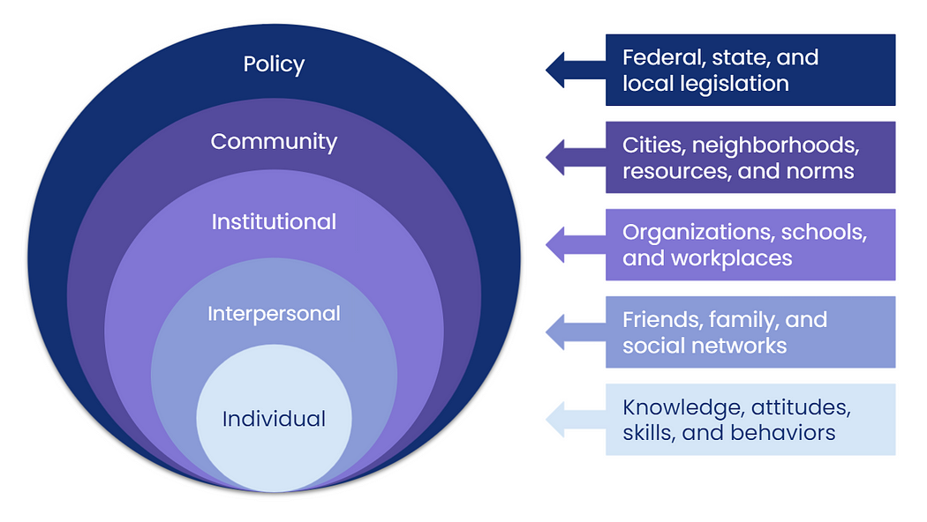
Context
Increasing complexity of case working
COVID
Issues can be entrenched,
Competing agendas,
Lack of buy-in from key partners and CYPF,
Low engagement,
Support Plans that look good on paper but don’t make a difference,
But what support to provide?
Identified a need to provide support beyond the school environment:
Supporting collaboration at TACs,
Collaborating more closely with CYPF,
Increase in direct work,
Increase cohesion within team and ‘unique contribution’ related to psychological theory/practice

Slide 8
Team response
The context of our own service
Prior to covid had started exploring systemic practice CPD as a team to support with these increasing issues as it aligned with our practice
2020 - Staff training in Systemic Practice delivered by Association of Family Therapy (AFT) – Whole Team completed Foundational Training
2020-2024 – Applying learning across EP working – improved collaborations, shared understanding and reflection. Reflective teams was main aspect we applied to practice (and created our own structure) – but only piecemeal – need to further explore and expand
2024-25 – six practitioners completed intermediate level + new EP completed introductory course. Opportunity to get some funding to complete from whole family wellbeing hub (justification was to support early intervention work via hub and upskill our service long term)
2024/25: EPS establish Whole Family Wellbeing Hub (WFWH) – WFW Fund and EP Pilot team established to look at how to apply systemic practice out with a therapeutic context.
2025/26: Whole Team enhanced training and Service Improvement to deliver Systemic Practice more ‘systematically’. How as a service can we use this to enhance current practice.

Slide 9

What is Systemic Practice?
Systemic practice is a relational and context aware approach that explores patterns of interaction and meaning making within systems, using curiosity and collaboration to support understanding and change.
Systemic practice is rooted in systems theory, cybernetics, family therapy, and social constructionism, drawing on ideas about interconnectedness, relational patterns, feedback loops, and the co construction of meaning in context.
It is a broad approach that applies systems thinking to various professional practices, not just therapy. It looks at patterns, relationships, and feedback loops in any kind of system (families, teams, organisations, communities).

Slide 10
A systemic disposition
Feature | Description
Relational Awareness | Seeing individuals as part of broader relational and social systems. Problems are not located just in an individual but are patterns of relating to others – zooming out to understand the wider system
Context Sensitivity | Attending to culture, history, power, and social context in shaping experiences. Consider social graces
Curiosity | Approaching situations with an open, questioning stance, rather than assuming and seeing others are the experts of their own lives, this leaves space to co construct meaning. (formulation)
Not-Knowing Position | Resisting expert authority and staying open to clients’ meanings and perspectives. Respects family's resilience and autonomy
Comfort with Complexity | Accepting that people and systems are messy, dynamic, and not easily reduced to cause-effect explanations. Understanding that families are complex systems and can’t be fully understood or ‘fixed’
Reflexivity | Being aware of your own influence on the system and the meanings being co-created (use of self) . Considering how you are contributing to a system (e.g. presence, language and tone) and how you are shaping interactions
A systemic disposition is a practitioner’s attitude or orientation that emphasises relationships, context, patterns, and curiosity, rather than focusing solely on individuals or linear causes.

Slide 11
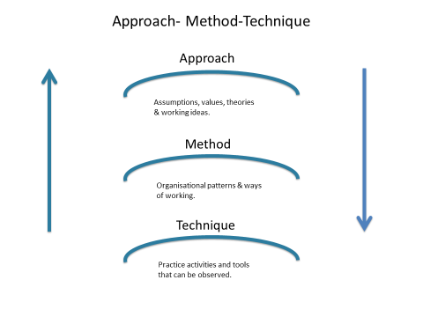
Approach
Method Technique
Systemic Family Therapy
Examples:
Genograms
Sculpts
Reflective Teams
Formulation
Circular Questions
Narrative Approaches
Notes:
Key approaches, methods, techniques:
Neutrality, partiality and multi-partiality,
Narrative,
Formulation,
Reflective teams,
Circularity,
Social GRACES,
Internalised other,
Externalising,
Perspective,
Positionality,
Polarities,
Not knowing position,
Sculpts,
Genograms,
Scaling questions,
Role play,
Deconstruction,
Family life cycle,
Coordinated management of meaning (CMM),
(Un)safe (un)certainty,
Power dynamics,
Social dynamics,
Naming,
Eco-maps,
Seven-eyed model,
Bells that ring,
Hypothesising,
Prescribe the problem,
Curiosity
(un)said, (un)seen

Slide 12

Systemic Practice within our Team
Whole Family Wellbeing Hub
Within Team Pilot
Whole Team
Via Peer Support Reflective Triads
Wider team to use this for consultation/case work?
Rethinking meetings we already attend (using some systemic tools)
Using the tools at a case level
Consultation Support/Case work with schools (e.g. formulation, systemic tools such as genograms, circular questions, narrative approaches e.g. externalising
Whole family therapeutic work
Reflective Practice to support case work
Group of EPs looking at how to use systemic practice within EP practice
At an establishment level
Reflective Practice support via reflective Teams
They have been sharing feedback with wider team (currently gathering data)
Upskilling whole EP team
Reflective teams
Sharing articles/podcast
Year plan to explore different systemic themes via workshops
Sharing and development of resources on shared drive.
Integrating Systemic into development work
solution oriented approaches (how do we make this and other development work more systemic).
Create our own ‘shared understanding meetings’ e.g. using Formulation, circular questions, reflective teams
Notes:
Emphasis on how we have moved it beyond the hub.
Rethinking meetings we already attend – use of self; positionality; social graces; reframing, power dynamics; eliciting hopes/strengths; SO approaches e.g. scaling questions
Case level – sculpts’, life story work, narrative approaches, reflective conversations; circularity; genograms.
SAFE service
Quotes from shared understanding and reflective teams – ask Karen

Slide 13
Impact and Learning
Readiness, timing and referral process matters: 80% CYPF engage when completing referral alongside, 20% if done on behalf of
No CYPF progressed to care-experience
CYPF like it: 100% retention from session 3+
CYPF achieve acceptance (prevention) or transformative change (improvement)

Slide 14

Discussion
In your groups
Solution-focussed discussion
What is working well in your EPS? What strategies/ initiatives/resources do you use when supporting families?
What barriers/challenges do you face?
What helps?
2) Question formulation Technique
Generate 2-3 questions that arise from what you have discussed e.g., current context (social, political, future predictions), individual EP role, today’s input) etc.

