Slide 1



Supporting LGBTQIA+ Colleagues, Children, Young People and Families in Glasgow
Notes:
GEPS logo to add – pride one? Could ask Iona/Sophie for this

Slide 2
Topics to be covered
Why focus on LGBT as an EPS?
Our LGBT Youth Scotland Charter Journey- what did we do?
What’s next?
Limitations and Barriers
Supporting the Trans Community

Slide 3
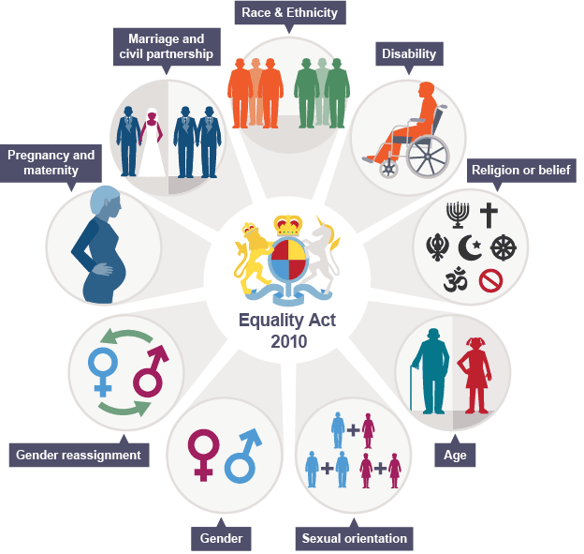
The why?
Equality Act 2010
The Act protects individuals from discrimination based on the following nine protected characteristics:
Age: Protection against age discrimination in various contexts, including employment and services.
Disability: Provisions requiring reasonable adjustments to be made for disabled individuals.
Gender Reassignment: Protection for individuals undergoing gender transition.
Marriage and Civil Partnership: Protection against discrimination for those who are married or in a civil partnership.
Pregnancy and Maternity: Protection for women during pregnancy and maternity leave.
Race: Protection against discrimination based on race, ethnicity, or nationality.
Religion or Belief: Protection against discrimination based on religious beliefs or lack thereof.
Sex: Protection against discrimination based on gender.
Sexual Orientation: Protection against discrimination based on sexual orientation.
Notes:
Public Sector Equality Duty
Public bodies must consider the needs of all individuals when carrying out their functions, ensuring that they promote equality and eliminate discrimination.

Slide 4
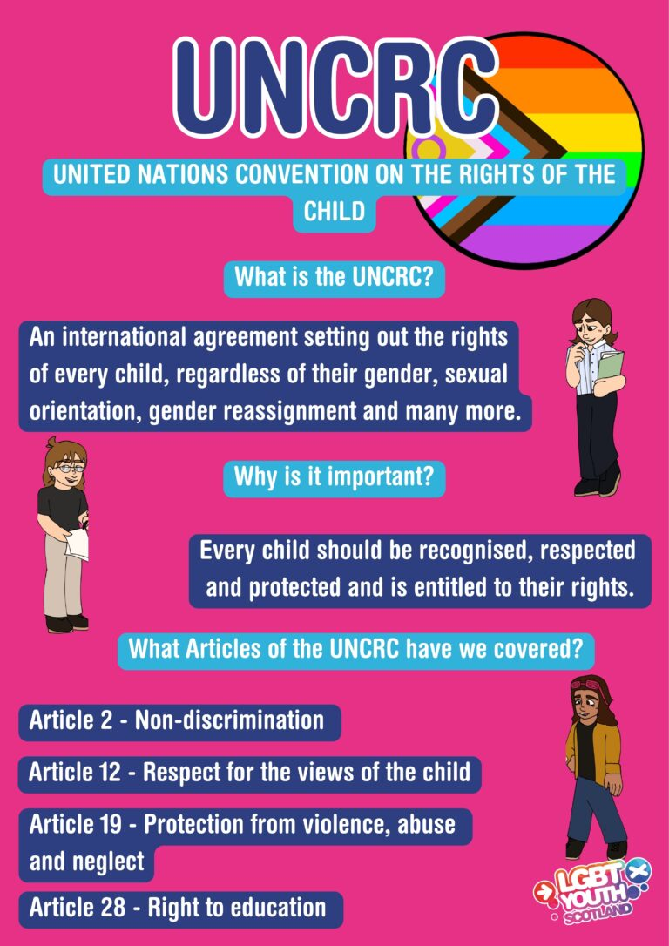
United Nations Convention on the Rights of the Child (UNCRC) – Incorporation into Scots Law (July 2024)
Article 2: Non-discrimination
Article 12: Respect for the views of the child
Article 19: Protection from violence, abuse and neglect
Article 28: Right to education

Slide 5
HCPC Standards of Conduct, Performance and Ethics (2024): Challenge Discrimination
1.5 You must treat people fairly and be aware of the potential impact that your personal values, biases and beliefs may have on the care, treatment or other services that you provide to service users and carers, and in your interactions with colleagues.
1.6 You must take action to ensure that your personal values, biases and beliefs do not lead you to discriminate against service users, carers or colleagues. Your personal values, biases and beliefs must not detrimentally impact the care, treatment or other services that you provide.
1.7 You must raise concerns about colleagues if you think that they are treating people unfairly, that their personal values, biases and beliefs have led them to discriminate against service users, carers or colleagues, or if they have detrimentally impacted the care, treatment or other services that they provide. This should be done following the relevant procedures within your practice and should maintain the safety of all involved.

Slide 6
BPS: Code of Ethics and Conduct (2021)
3.1 Respect: Members value the dignity and worth of all persons, with sensitivity to the dynamics of perceived authority or influence over persons and peoples and with particular regard to people’s rights.
3.3 Responsibility: Members value their responsibilities to persons and peoples, to the general public, and to the profession and science of psychology, including the avoidance of harm and the prevention of misuse or abuse of their contribution to society.
3.4 Integrity: Members value honesty, probity, accuracy, clarity and fairness in their interactions with all persons and peoples, and seek to promote integrity in all facets of their scientific and professional endeavours.

Slide 7
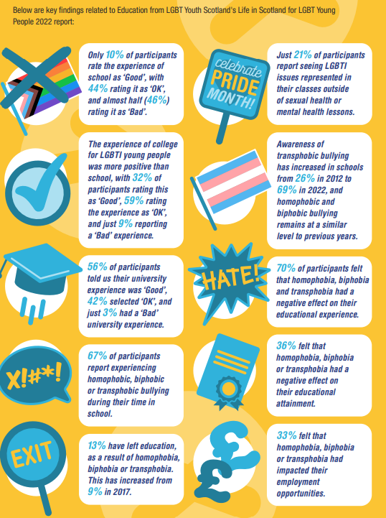
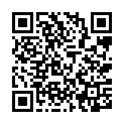
Our ‘why’
Key Findings from the LGBT Youth Scotland’s ‘Life in Scotland for LGBT Young People’ 2022 Report
Findings from Glasgow-based research: The Views of LGBT Young People in Glasgow Schools
Notes:
Key findings from our research – in line with the LGBT Youth Scotland report?
In regards to the ‘13% have left education as a result of homophobia, biphobia or transphobia’, reflect on how we say that staying in school is a protective factor, and how that will impact on their wider life chances in terms of health, housing, further education, employment, wellbeing.
From the LGBT Youth Scotland Health Report 2023:
LGBTQ+ people experience poorer mental health than the heterosexual/cisgender population (Saunders, 2022).
Just Like Us’s 2022 Growing Up LGBT+ research found that 68% of LGBT+ young people reported that their mental health had got worse since the pandemic, as compared to 49% of non-LGBT+ young people (Cibyl, 2021).
The current average waiting time for a first appointment with a Gender Identity Clinic in Scotland varies by location from around two to almost five years (Scottish Trans, n.d.).
Trans participants report experiencing suicidal thoughts/ actions at almost DOUBLE the rate of cisgender participants 66% vs 34%.

Slide 8

LGBT Youth Scotland: Charter Mark Journey
Already achieved Bronze Schools Charter Mark 2017
August 2022 started our Silver Charter Mark process
Champion Group identified and completed focus group and action planning session
LGBT training for all staff
Champion Group taking action plan forward, completing tasks in line with the standards and development areas identified and ongoing mentoring from our LGBT Youth Scotland mentor
Submitted evidence for all standards October 2023, with some amendments suggested, and achieved Silver Charter Mark status February 2024.
Notes:
Flesh out a wee bit in terms of more specifics related to the journey? e.g. buy-in from SMT?
Charter Mark status valid for 3 years

Slide 9
LGBT Youth Scotland Charter Mark-
6 key areas
Leadership
Training
Policy
Visibility
Monitoring and Evaluation
Practice
Notes:
Leadership and monitoring and evaluation – examples to add from our review document??

Slide 10
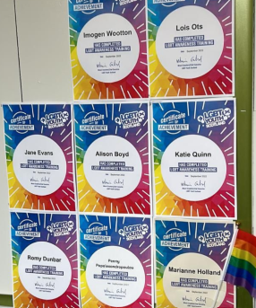
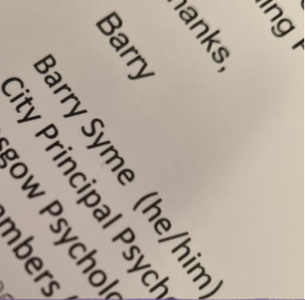
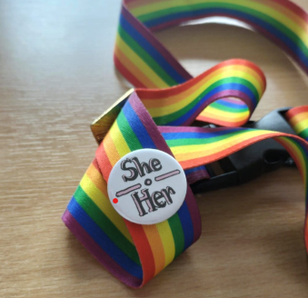
Input at development days on assessment methods
Champion group set up with members of SMT Linked
Policy
Leadership
Training
Key GCC Policy was included as evidence and a statement was put on our website
90% of staff complete online awareness training
Focus groups held with staff and action plan created addressing barriers
Pronouns on emails
Pronouns on emails
Practice

Slide 11
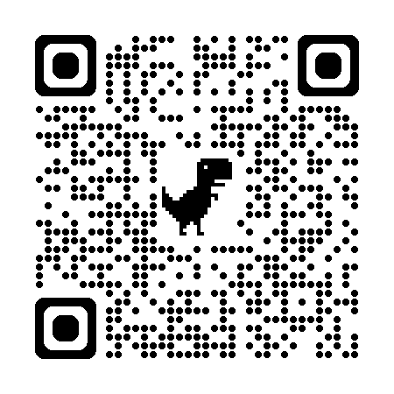
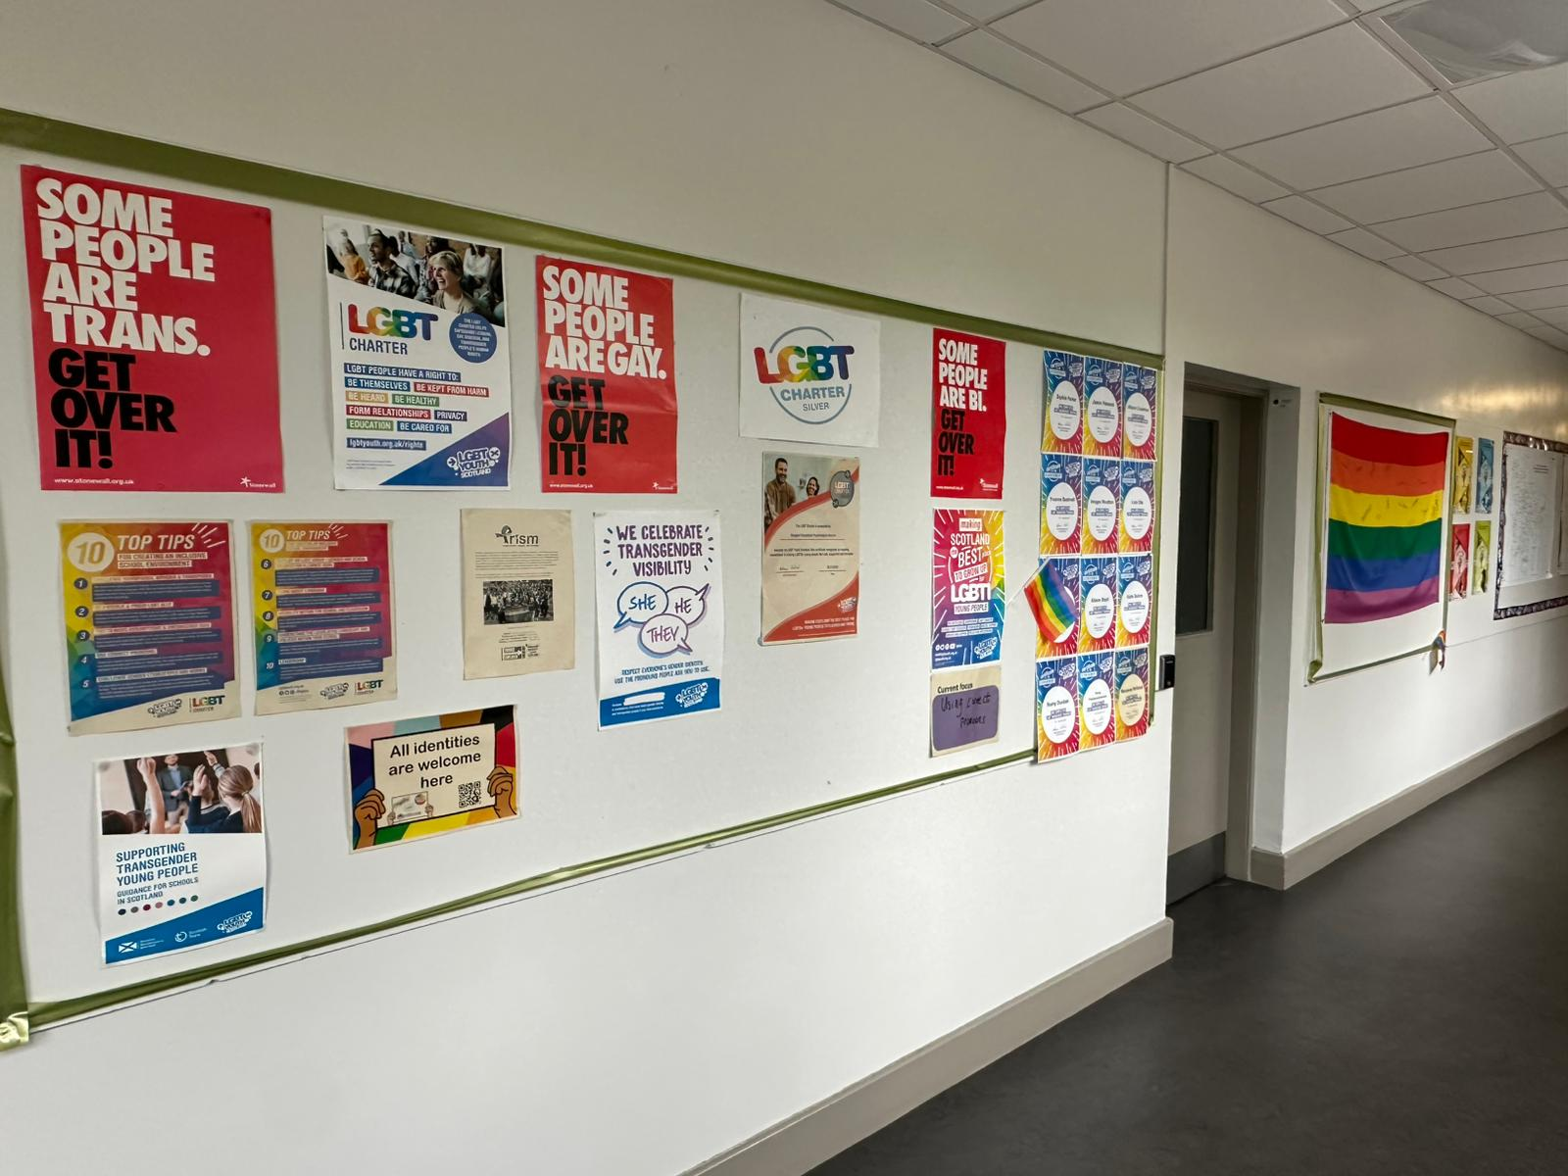
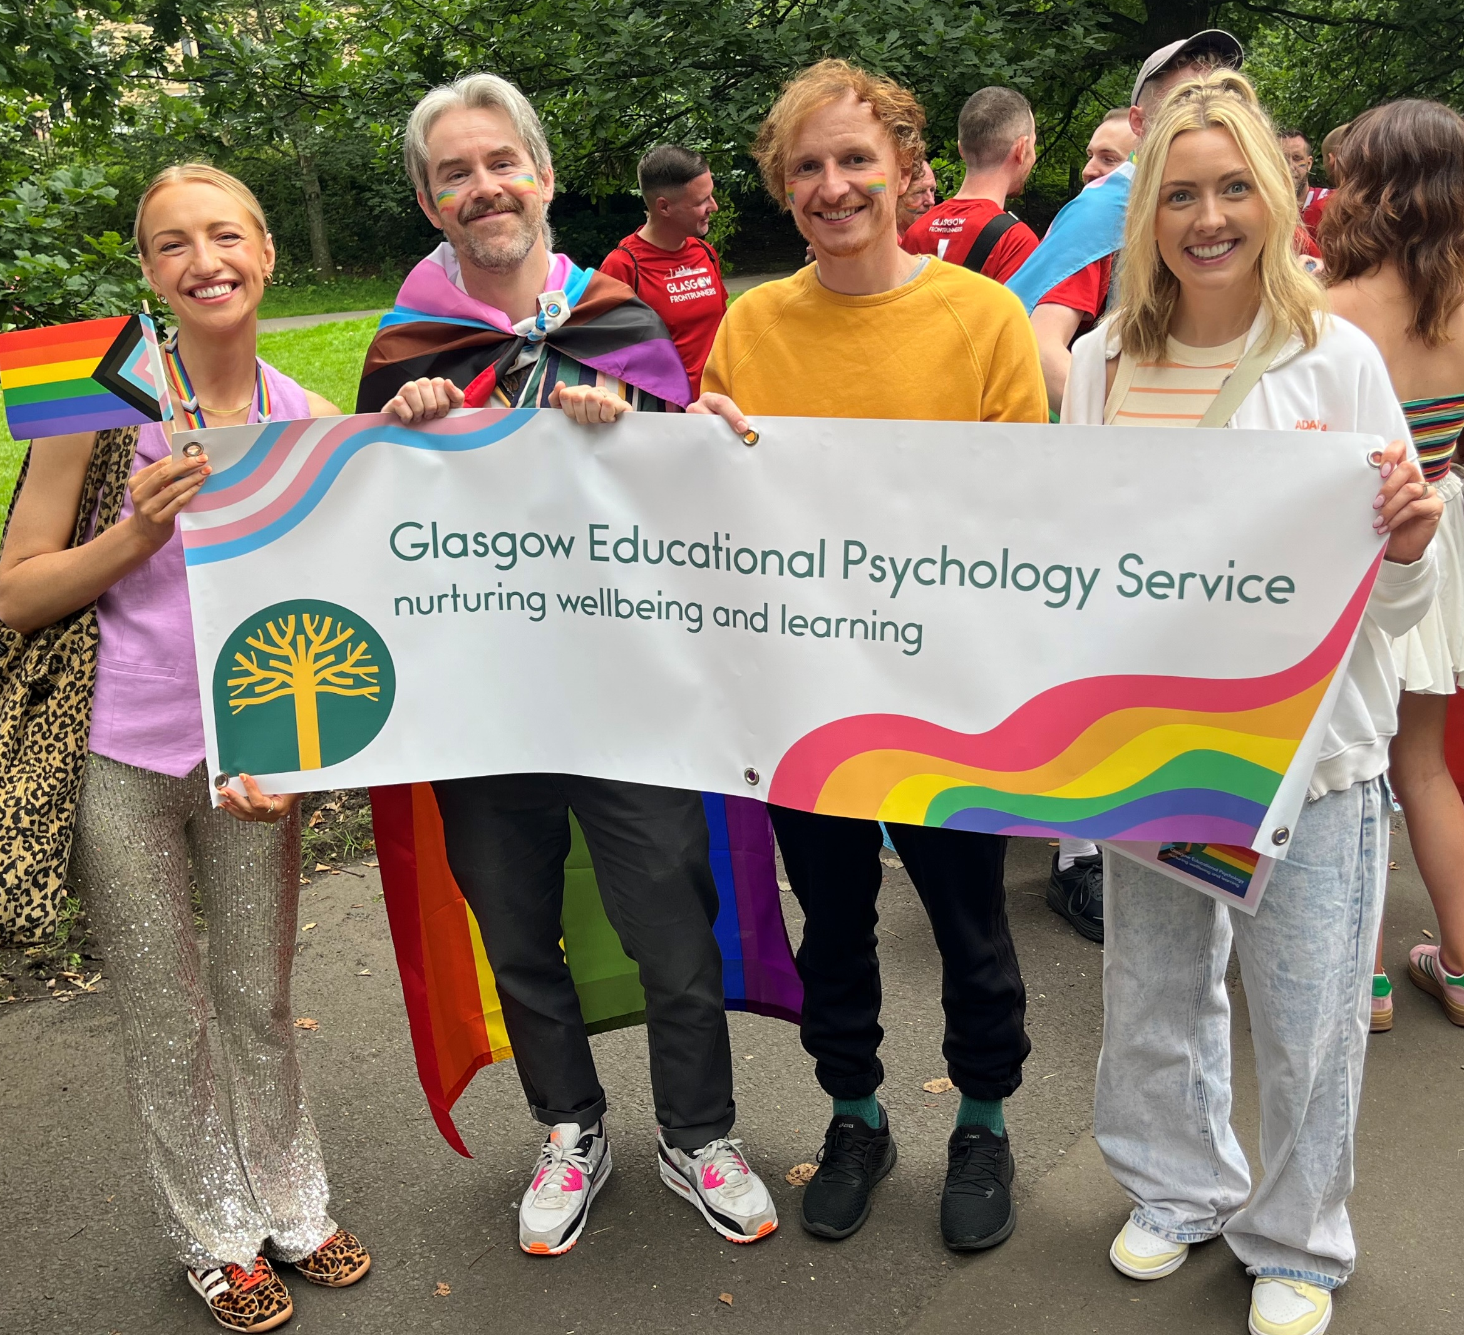
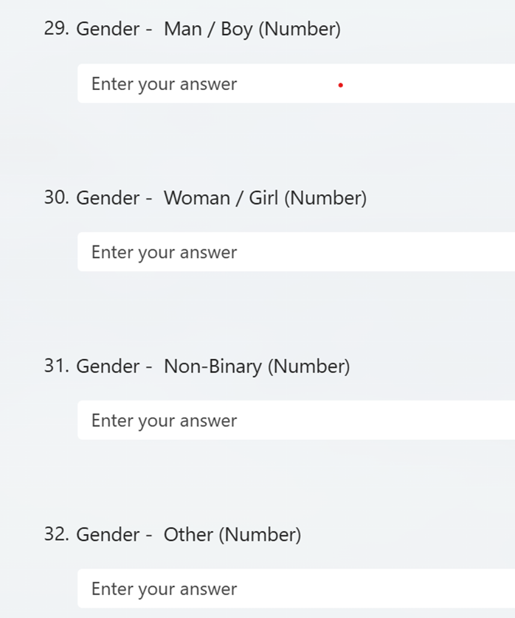
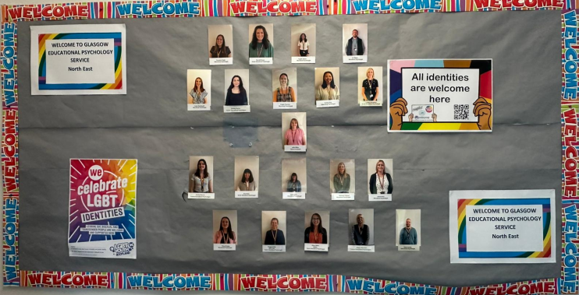
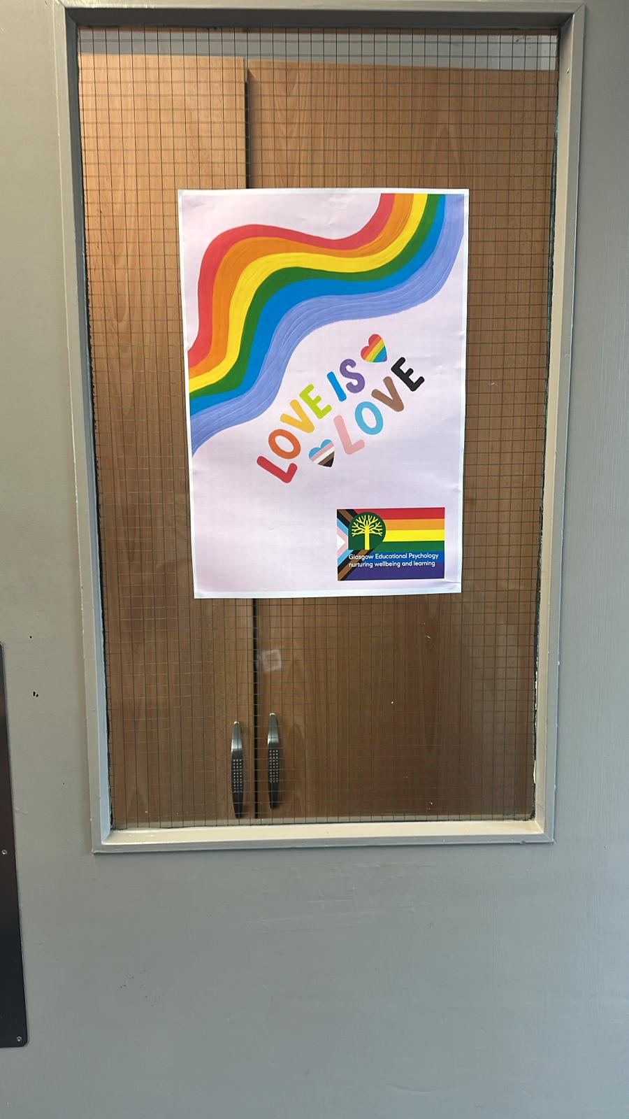
A number of online ‘campaigns’ were completed
Glasgow City Council equalities data analysed. Recruitment processes reviewed for bias
Visibility
Monitoring and Evaluation
SIIM/JST/ Referral forms changed to be more inclusive
Pride
Wall Displays

Slide 12

Notes:
Examples:
Animoto pride video – to embed? Pride and Pronouns – Animoto
Photos of display from North East – toilet sign? (too controversial lol?)
https://blogs.glowscotland.org.uk/glowblogs/glasgowpsychologicalservice/lgbtqi-statement/ - could QR code link to this (done in tandem with our Anti-Racism statement from SDEP)

Slide 13
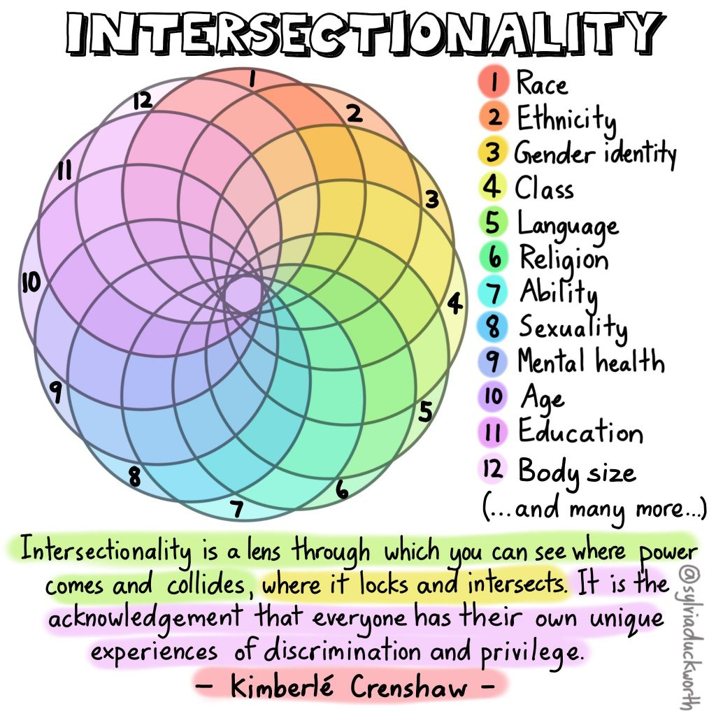
Reflection on assessment materials activity
Whole Service Development Day activity: reflect and discuss assessment materials that you currently use when working with children, young people and families.
Notes:
Further info re the development day activity and some of the padlet feedback ?
Activity for attendees: think of assessment materials you are using, what are the gender stereotypes at play? Are there any obvious ones (examples of Boys brigade etc)? Are there any other stereotypes – think with regards to intersectionality
When using more unstructured materials, such as strength cards, talking mats etc. how are you using questioning to ensure inclusivity? E.g. “do you live at home with your mum and/or dad?”
What about CE children, kinship/foster care, single parent and same-sex parent families? How do we bring up discussions around experiences of racism, sexism, homophobia and transphobia in our discussions/work with young people and families?
15/20 minutes for activity and feedback?

Slide 14

Limitations and barriers
Tackling discrimination (in all forms) is our duty as EPs and not just tied to our charter mark achievement (or similar other process)
Equalities across all workstreams
Be wary of tokenism and performative activism
Toilets, pronouns and complaints!
Notes:
Thinking about tokenism and ongoing self-reflection and evaluation
Stonewall has similar standard/charter
As noted by Dr. Charlotte Walker-Said, scholar and activist, performative allyship ‘focuses on how things look rather than making meaningful change, often benefiting the ally more than the community they claim to support.’ You can often see this in workplaces, where posting on social media during a trendy moment is seen as more impactful than any real internal changes. This shifts and undermines significant progress in implementing a more equitable workplace, and instead leans towards a desire to be seen as an ally. (associate professor in the Department of Political Science at John Jay College of Criminal Justice-City University of New York.)
Genuine allyship is focused on learning and empathy. It’s a proactive effort to better understand and acknowledge the experiences of marginalised communities. D&I expert Janice Gassam Asare stresses that ‘true allyship involves showing up consistently, speaking out even when it's uncomfortable, and actively working to dismantle systems that perpetuate inequality.’
Practicing genuine allyship means advocating for equitable policies, amplifying underrepresented voices, and nurturing an inclusive workplace culture.
(https://www.trinnovogroup.com/blog/performative-allyship-vs-genuine-allyship-building-an-inclusive-workplace)
Anymore to add?

Slide 15

What Next?
Area Team Meeting discussions around supporting transgender children and young people in our establishments
CLPL opportunities, including planning for Equalities and Inclusion whole service development day
Laying the groundwork this session to begin our LGBT Gold Charter Mark journey, with a greater focus on supporting transgender, non-binary and gender exploring/questioning colleagues, children and young people, and their families.

Slide 16
Our ongoing commitment to supporting transgender, non-binary and gender exploring/questioning CYP
Supreme Court Judgement: Women Scotland LTD vs Scottish Ministers (April 2025)
EIS Statement:
“The EIS’s overarching position is the principle that all young people have the right to learn, and teachers and lecturers have the right to work, in an educational environment that is free from discrimination, where the rights of all are equally upheld…
Understanding, inclusion, and safety are all essential factors to ensure every colleague, pupil and student, including those who are transgender, can be visible in our educational establishments and our workplaces. The recent Supreme Court judgement does not negate the spirit and intent of the Equality Act which provides that the rights of all minoritised groups are equally protected – with no hierarchy of order...
We will be vigilant to this and continue to advocate strongly for, and stand in unequivocal support and solidarity with, transgender people in our schools, colleges, universities and unions, just as we will continue to press for further progress on gender equality for women and girls.”
Notes:
https://www.eis.org.uk/latest-news/supremecourtstatement
According to the 2021 Trans Lives Survey, 40% of participating trans people reported having experienced transphobia when seeking housing.
On public transport, 67% of trans women, 63% of non-binary people, and 60% of trans men have experienced transphobia.
99% of trans people participating had experienced transphobia when using social media, and 97% had seen transphobic content in digital and/or print media. 93% reported that their experiences of transphobia from strangers on the street had been affected by transphobia in the media.
85% reported being treated differently by their family due to transphobic content in the media, 81% said this was true of their colleagues, and 70% for friends.
(cited in LGBT Youth Scotland, Trans Report 2024)
Almost 1 in 5 trans participants (19%) have left education as a result of homophobia, biphobia, or transphobia. This compares to just 6% of cisgender participants. (Trans n = 529, cisgender n = 489)
80% of trans participants feel that homophobia, biphobia, or transphobia has had a negative impact on their educational experience, as compared to 58% of cisgender participants. (Trans n = 513, cisgender n = 439)
64% of cisgender participants feel safe to be their authentic self at work/in training however just 44% of trans participants responded in this way. (Cisgender n = 302, trans n = 271)
https://www.scottishtrans.org/supreme-court-ruling-on-sex-in-the-equality-act/some-thoughts-and-updates-on-the-supreme-court-ruling/:
It dealt with the meaning of the words “sex”, “man” and “woman” for the purposes of the Equality Act 2010. The Supreme Court decided that in the Equality Act, all of those words have a “biological” meaning (although the Judges did not really define what that means).
As far as we can tell, this ruling has had two main effects:
It removes legal gender recognition from trans women and trans men who have gender recognition certificates (GRCs), for the purposes of equality law. Previously, governments across the UK, and the Equality and Human Rights Commission, said that getting a GRC meant you were recognised under the Equality Act 2010 as the sex you’d transitioned to. Indeed it seems very clear that the intention of Parliament was that this would be one of the effects of getting a GRC.
It has created significant uncertainty about how all trans people, whether they have a GRC or not, should be treated in a huge range of services and spaces – all of the ones that are provided separately for women and men. Currently, there is a great deal of disagreement about how trans people can and should be able to use these, as a result of the ruling.

Slide 17
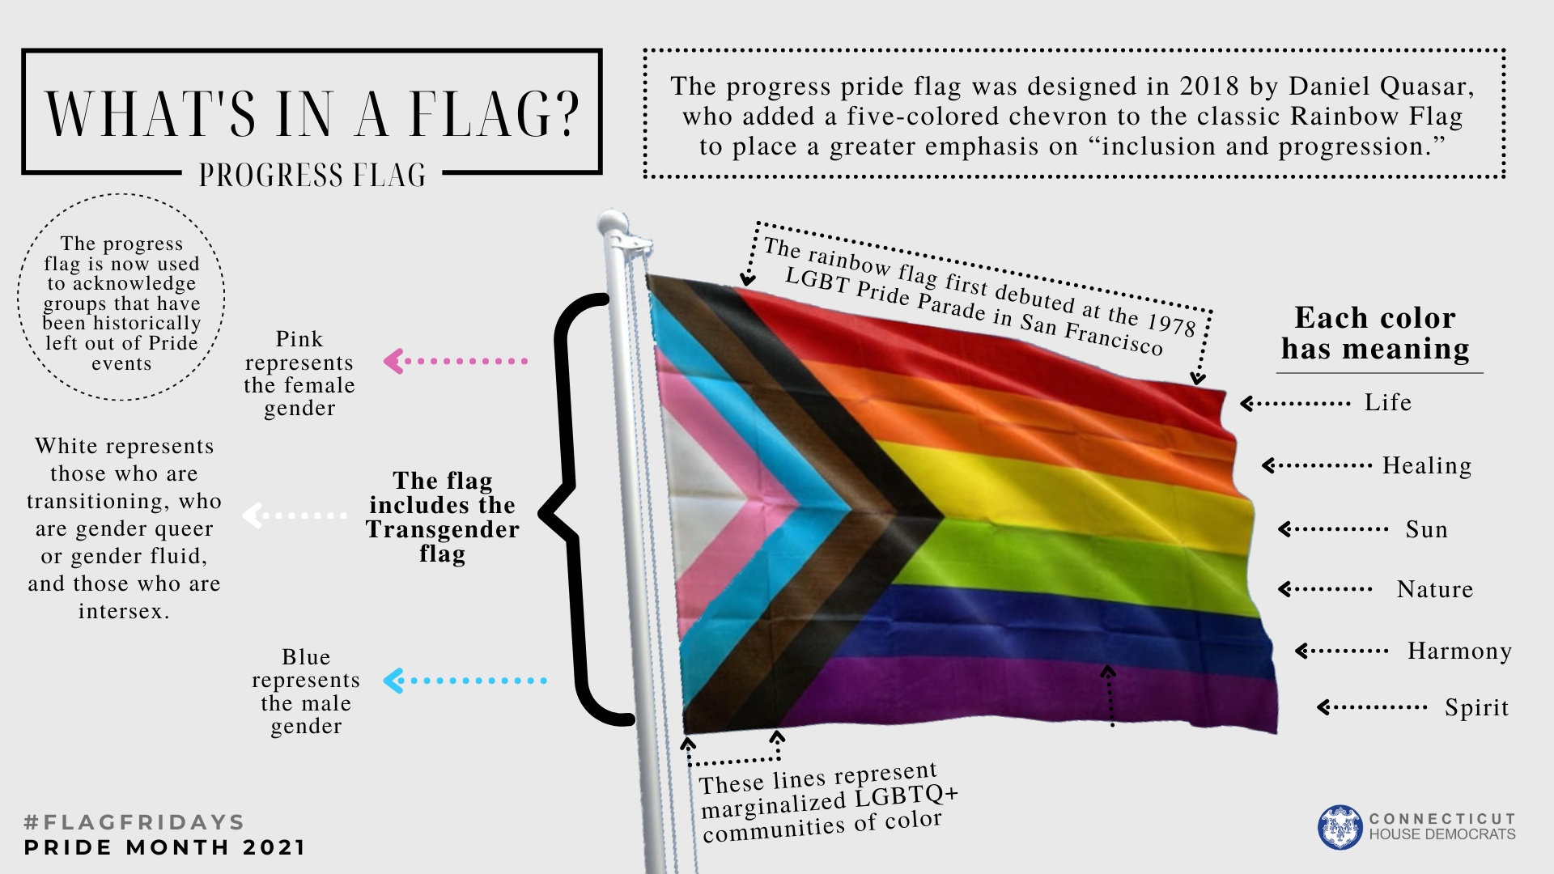
Reflections and Questions

