Slide 1

West Partnership
Practice Sharing Event 2025
Eastwood House
Notes:
Housekeeping

Slide 2

EP Wellbeing
Notes:
73 responses across 8 authorities in 2021 Vs. 52 responses across 8 authorities in 2025
Uneven spread so far in 2025, so data is a WIP. This means all feedback today is a little more broadstroke than might be preferred, and is presented just to give rough ideas of data before fuller analysis.
Also note June/July data-gathering in 2021, July-August in 2025. Not significantly different timings but may have an impact.

Slide 3

1. Resilience
Empathy
Emotional Awareness & Control
Realistic optimism
Reaching out
MOST WELL-USED SKILLS LEAST WELL-USED SKILLS
Notes:
Results indicate that EPs made use of Karen Reivich’s seven skills of resilience to support their own resilience during this time of adversity. Across the RIC, EP scores suggested they mostly felt they used their skills ‘well enough’ to ‘extremely well’. Empathy and Emotional Awareness & Control were considered to be the most effectively used of the seven skills. This is a change from 2021, where Flexible thinking was one of the most well-used skills. This may have been required more then!
Realistic optimism and Reaching out remained least well-used skills.
All scores had taken some decrease since 2021 survey, apart from Emotional Awareness & Control, which had increased. Although this may sound like a bad thing…

Slide 4
2. Wellbeing
Productivity
Stress
Relationships
Self-care
Positive impact
Notes:
…Wellbeing scores tell another story.
When comparing 2021 Vs 2025, nearly all wellbeing measures have increased, some just by small amounts, some signficiantly, (ie. Ability to bounce back gone from 45 to 85%; Ability to switch off and focus on self-care increased 48 to 78%; feeling able to be productive at work increased from 77 to 89%)
Only one measure has gone down: the feeling that the work we do has a positive impact on children and YP, down from 74 to 68%. Speculate this may relate to level of need in schools now.
Note irony that Resilience skills seems to have gone down, Wellbeing seems to be up. Is it possible that this difference is explained by not having to use those resilience skills as frequently now?

Slide 5
3. Post-Covid Working
Positives Negatives
Online options
Flexible working
Expectations & Demands
Connection
Notes:
Positives:
Online options meaning online meetings and CLPL offers, which can have practical and pragmatic benefits and allow more to access. Particularly in out-of-authority work or multi-agency work.
Flexible working so reduced expectations of constant office attendance, especially home starts. Practically positive and good for work-life balance.
Negatives:
Schools expect replies much quicker, expect us to be more accessible, and means our diaries end up busier. Demands exacerbated by pupils with greater need but reduction in EP numbers,
Reduction in connection with team, meaning less peer support, less modelling for less experienced/new staff, and informal info gathering about schools etc
IT issues ie. Access to online filing systems

Slide 6
4. Additional
Blended models universally well-received
Ongoing focus on staff wellbeing & workload
Importance of peer support & supervision; formal & informal
Social events
Notes:
Some other parts that had emerged in data, briefly summarised!
In the wellbeing scales, the factor with most STRONGLY AGREE (and infact 100% agreement in total) is about informal support from EP colleagues, suggesting our strongest resource at present is ourselves. Leads us neatly on to today’s input.

Slide 7
Practice Sharing

Slide 8
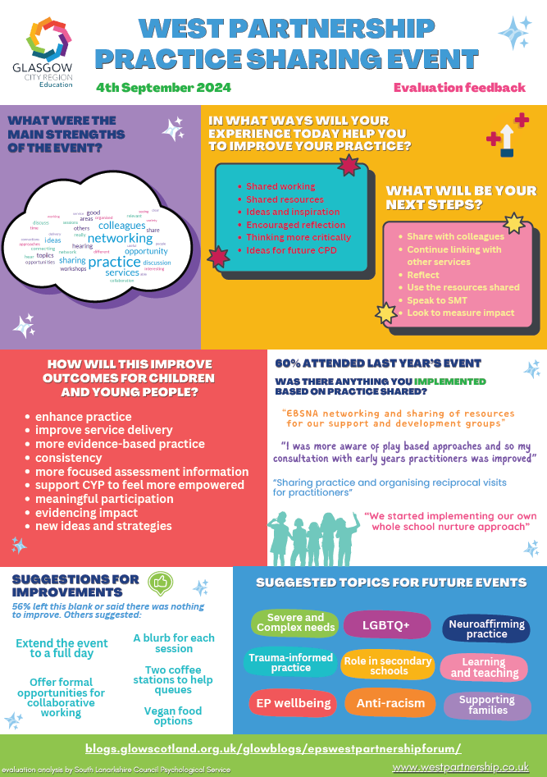
Practice Sharing Event 2024 Feedback
Notes:
You said…we did approach

Slide 9
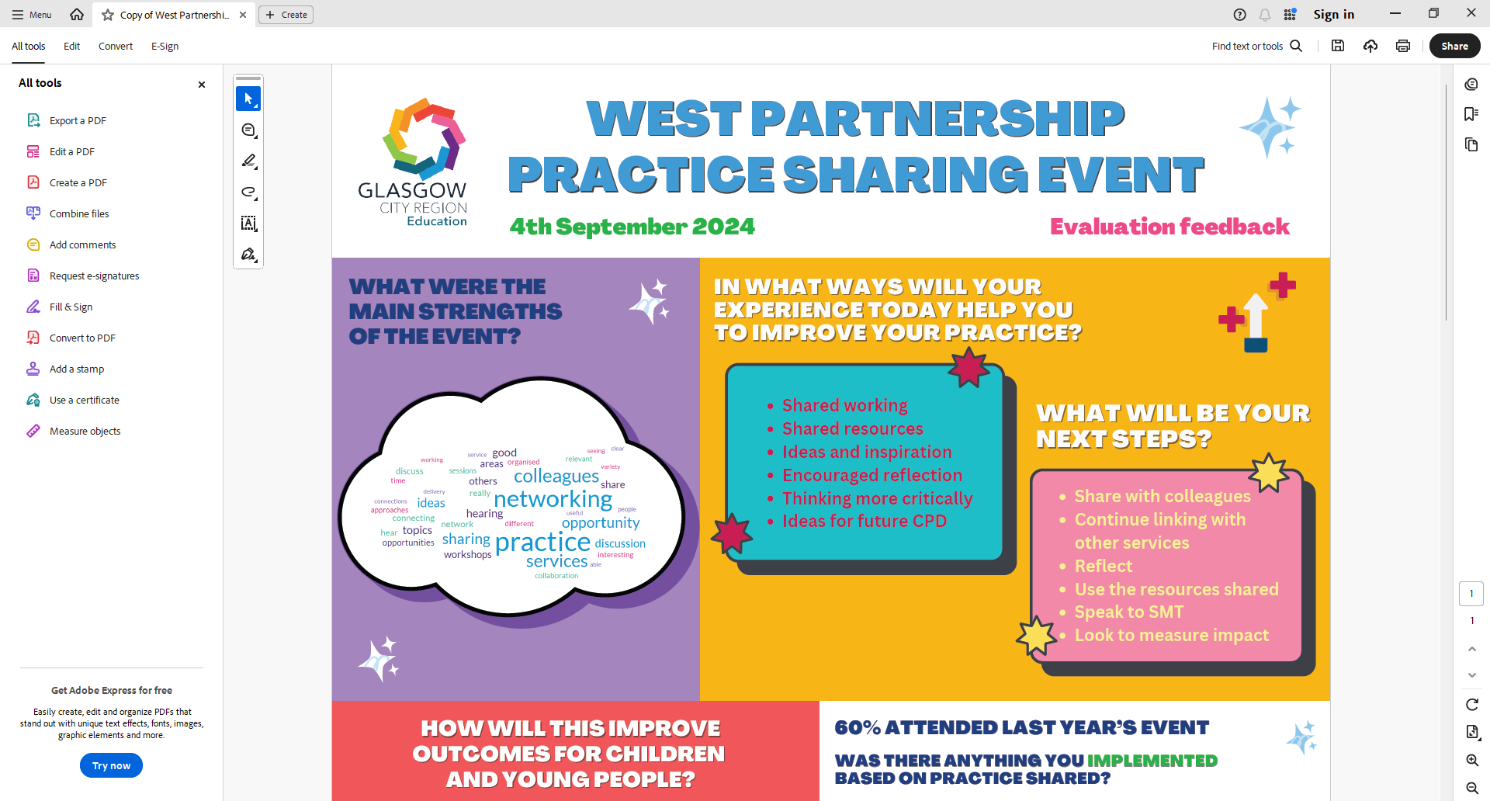
You said…
Notes:
These will continue to be the aims of today: connection, collaboration, discussion. Sharing of work, focus on implementation.
In spirit of the WP plans dating back to its inception.

Slide 10
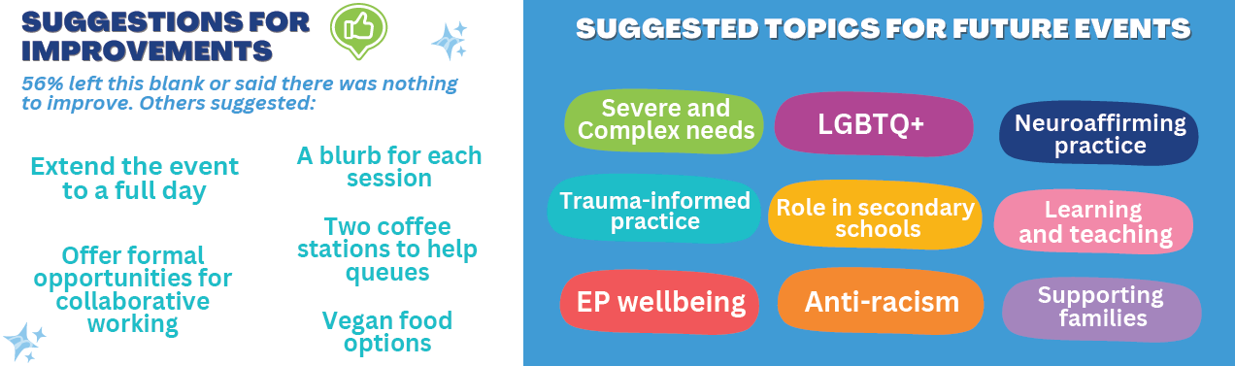
You said…
Notes:
Note how we have responded to these
Topics for today informed by this and suggestions for further topics from ‘expression of interest form’ from earlier this year.

Slide 11
Today’s event - Schedule
TIME | CONTENT
9-9.30 | Arrival
9.30 | Welcome
9.45 | Session 1
10.35 | BREAK
11.05 | Session 2
11.55 | Plenary / Evaluation

Slide 12
Today’s event - Workshops
Nurturing boundaries: supporting learners who display dysregulated behaviours
Inclusive, Neuro-affirmative Practice
Severe and Complex Needs*
Supporting Parents and Families, Including Those Who Have Experienced Violence *
LGBTQI+*
Learning and Teaching – Autonomous Learners *
Attendance and EBSA *
*sessions running once

Slide 13
Today’s event - Workshops
SESSION 1
Nurturing boundaries (Ballroom)
Inclusive, Neuro-affirmative Practice (Bar/Lounge)
Severe & Complex Needs (Room 4)
Supported Parents & Families (Room 1)
SESSION 2
Nurturing boundaries (Ballroom)
Inclusive, Neuro-affirmative Practice (Bar/Lounge)
LGBTQI+ (Room 4 )
Learning & Teaching – Autonomous Learners (Room 3)
Attendance & EBSNA (Room 1)

Slide 14

Plenary

Slide 15
SDEP Anti-Racist Network
* Open to anyone who is an EP, TEP or EPIT in Scotland (Do not need to be an SDEP member)
* Open to anyone interested in Anti-racism
* Aim to create a safe space for discussion and action around anti-racism within the profession
* Meet approx. 4 times in the academic year, dates set at the beginning of the academic session
* Each session focuses on both CLPL input and reflective activity
* Serves as a function for consultation for wide strategic strands
* Hosted in Glasgow South (Govan High) but we do run a hybrid option and have an online link for colleagues further away
* Anyone interested in joining: Scan QR Code
Dates for Session 25/26
18/09/24 – Network Day 1
29/01/25 – Network Day 2
26/03/25 – Network Day 3
28/05/25 – Network Day 4
9.30am – 12.30pm

Slide 16
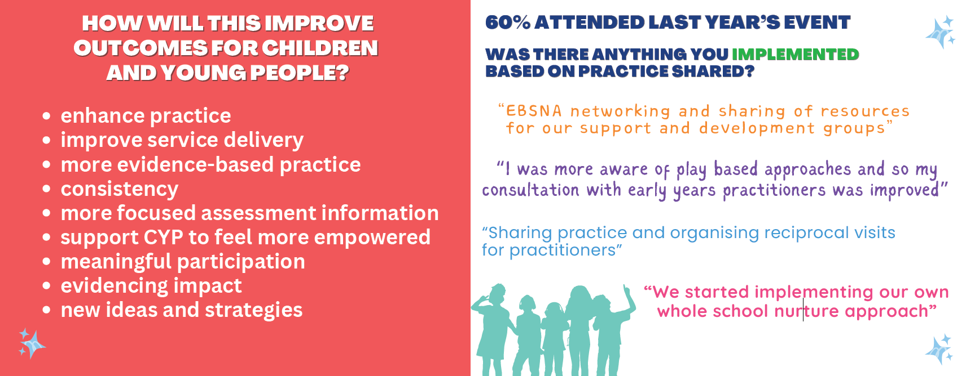
Evaluations
Notes:
Walk through 2024 responses, to frame thoughts for this eval.

Slide 17
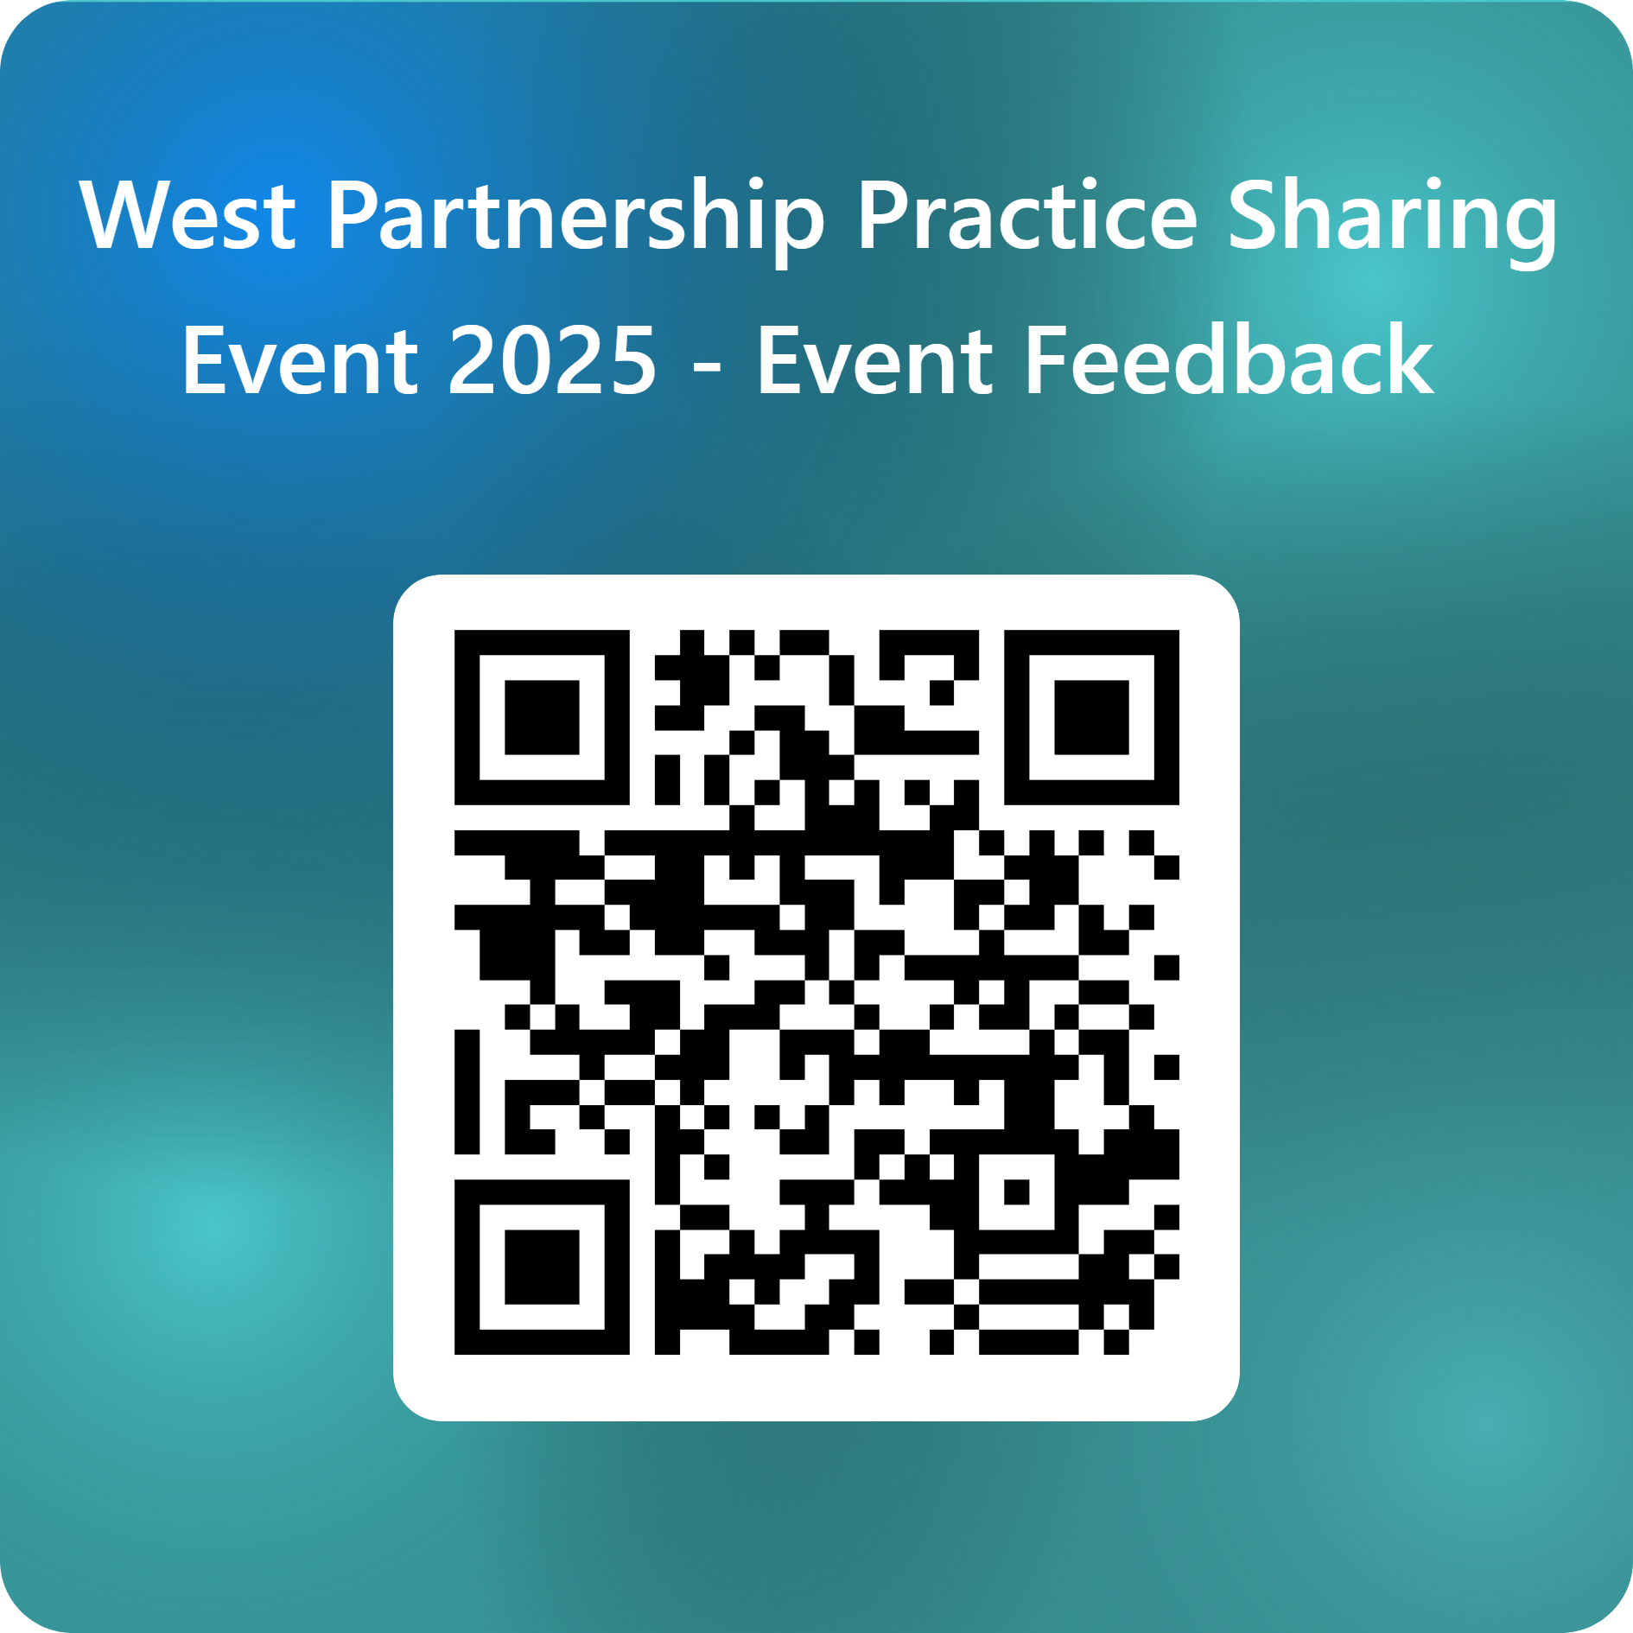
Thank you for coming!
Notes:
Same qs as before.
Also thanks to all presenters (especially our volunteers, other members of the WP.)

