Slide 1

West Partnership Practice Sharing Event 2024
Eastwood House
Notes:
Housekeeping

Slide 2
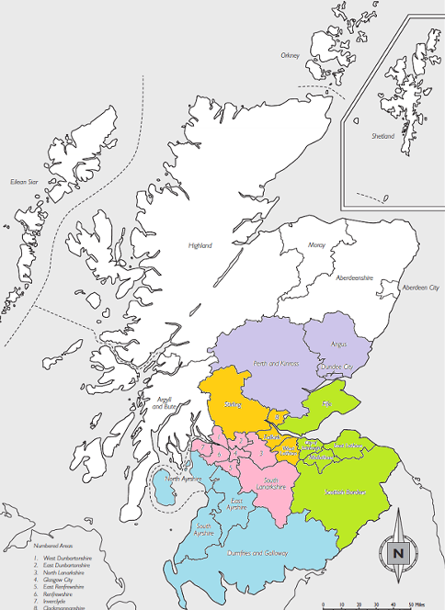
History of West Partnership
2017 - Creation of RICs
2018 – Initial regional improvement plans
submitted
2019 - RIC interim reviews published
2020-23 - Workplan shared
2023 - Funding tapering off…
2024 - …but the WP persists!
Notes:
In 2017 the Scottish Government announced plans to get councils to co-operate more closely, so the councils organised themselves into RICs. The RICs are listed below.
The RICs are ‘virtual’ bodies, formed with the purpose of improving education and closing the poverty-related attainment gap in the schools in their areas – this is the gap in achievement of children from poorer homes compared to more affluent areas. The intention is that they will do this by working together to give advice and support to schools, and to share examples of good work across local authority borders.
In response, 6 were formed, including West Partnership: biggest in terms of population (over 1.8m people), & number of councils involved (8).
35% of Scotland’s school population attends a West Partnership school, and this covers over 1000 establishments.
Should note that in the initial phases it was envisioned as being entwined with Education Scotland.
In 2018, the first of these were submitted, with WP’s being described as having “a more minimalist approach”. These were reflective of national priorities, within local/regional needs also. Broadly aimed at improving leadership, collaborative practice and teaching and learning.
2019 Interim reviews published by SG. Which suggested positive early steps although noted challenges in terms of timing and lack of funding.
Key factors to enable success: buy in from Senior leaders, links between all partners, and focus on clear intended outcomes.
Plans worked well where there was: informed by data & research, clear understanding of priorities, focus on enhancing activity not just duplicating.
Early impact: networking, sharing practice & skills development across RICs.
Was also 2019 when the WP EP Practitioner network first came together.
2020 workstreams created to compliment the core vision of Equity, Excellence & Empowerment. These were reviewed and updated annually until 2023
2023 late in the year the SG announced plans to ‘taper off’ funding to RICs. Although, around this time OECD report came out praising their strengths and benefits.
2024 Now without additional funding, but known to be beneficial, the WP continues, based on:
The aspiration to build a networked learning system remains a shared priority across the West Partnership, thereby adding value to the work of individual Local Authorities; • There is continued buy-in to maintain a strong collective focus on pedagogy; and • There is support and scope for a flexible approach, to enable the participation of teachers, middle and senior leaders to shape and drive the work of the West Partnership more directly.
Effectively, continuing without the government oversight but also without the additional resources.

Slide 3
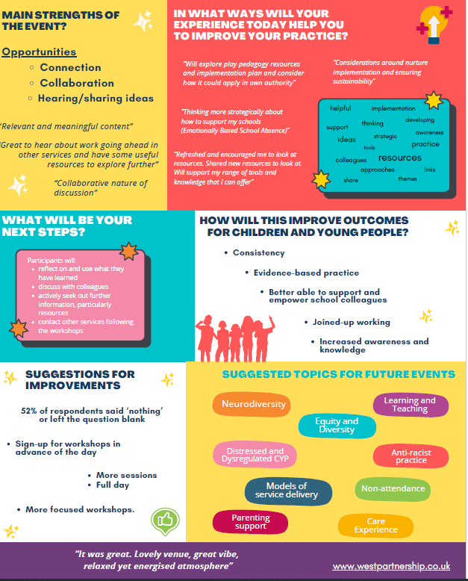
Practice Sharing Event 2023 Feedback
Notes:
You said…we did approach

Slide 4
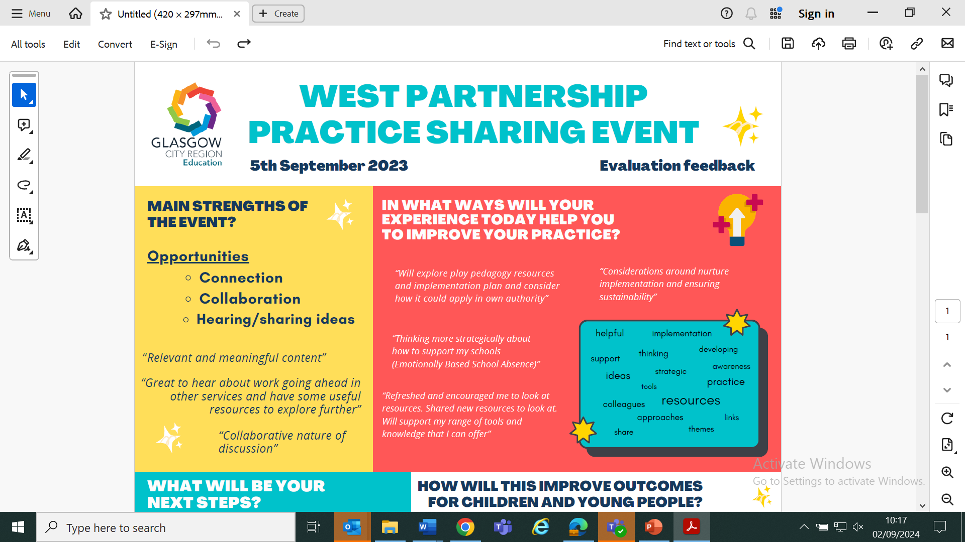
You said…
Notes:
These will continue to be the aims of today: connection, collaboration, discussion. Sharing of work, focus on implementation.
In spirit of the WP plans dating back to its inception.

Slide 5
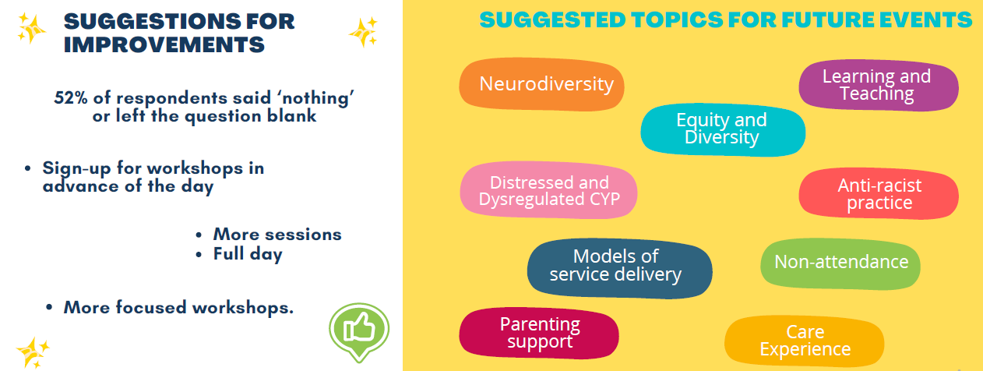
You said…
Notes:
Note how we have responded to these
Topics for today informed by this and suggestions for further topics from ‘expression of interest form’ from earlier this year.

Slide 6
Today’s event - Schedule
TIME | CONTENT
9-9.30 | Arrival
9.30 | Welcome
9.45 | Session 1
10.35 | BREAK
11.05 | Session 2
11.55 | Plenary / Evaluation

Slide 7
Today’s event - Workshops
Neurodiversity
Health & Wellbeing Data tracking
Service delivery
Attendance & EBSNA*
CYP Voice*
Learning & Teaching*
Managing distressed behaviour*
*sessions running once
Notes:
Note Antiracism session was on schedule but had to be removed.
Excellence, equity, empowerment runs throughout these.

Slide 8
Today’s event - Workshops
SESSION 1
Neurodiversity (Room 1 - Eglinton Suite)
Attendance/EBSA (Room 4)
Learning & Teaching (Ballroom)
Health & Wellbeing Data Tracking (Bar / Lounge)
Service Delivery (Winton Suite - Room 3)
SESSION 2
Neurodiversity (Room 1 – Eglinton Suite)
CYP Voice (Room 4)
Managing Distressed Behaviour (Ballroom)
Health & Wellbeing Data Tracking (Bar / Lounge)
Service Delivery (Winton Suite - Room 3)

Slide 9

Plenary

Slide 10
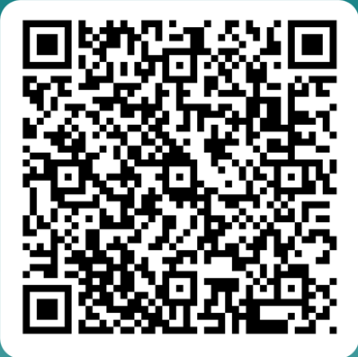
SDEP Anti-Racist Network
* Open to anyone who is an EP, TEP or EPIT in Scotland (Do not need to be an SDEP member)
* Open to anyone interested in Anti-racism
* Aim to create a safe space for discussion and action around anti-racism within the profession
* Meet approx. 4 times in the academic year, dates set at the beginning of the academic session
* Each session focuses on both CLPL input and reflective activity
* Serves as a function for consultation for wide strategic strands
* Hosted in Glasgow South (Govan High) but we do run a hybrid option and have an online link for colleagues further away
* Anyone interested in joining: Scan QR Code
Dates for Session 24/25
17/09/24 – Network Day 1
29/01/25 – Network Day 2
27/03/25 – Network Day 3
27/05/25 – Network Day 4

Slide 11
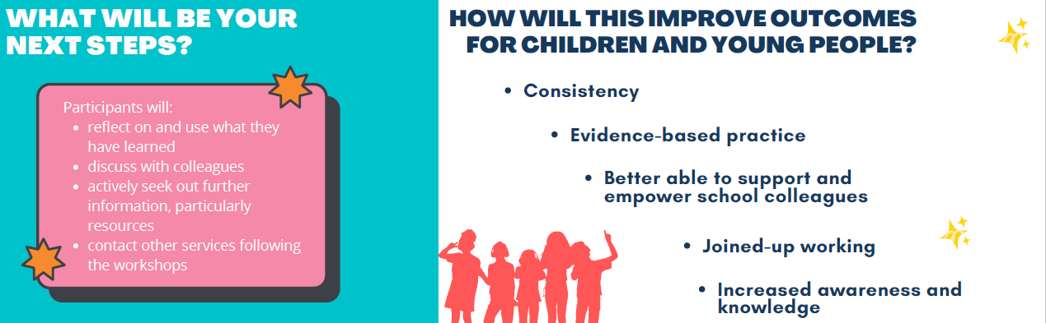
Evaluations
Notes:
Walk through 2023 responses, to frame thoughts for this eval.

Slide 12
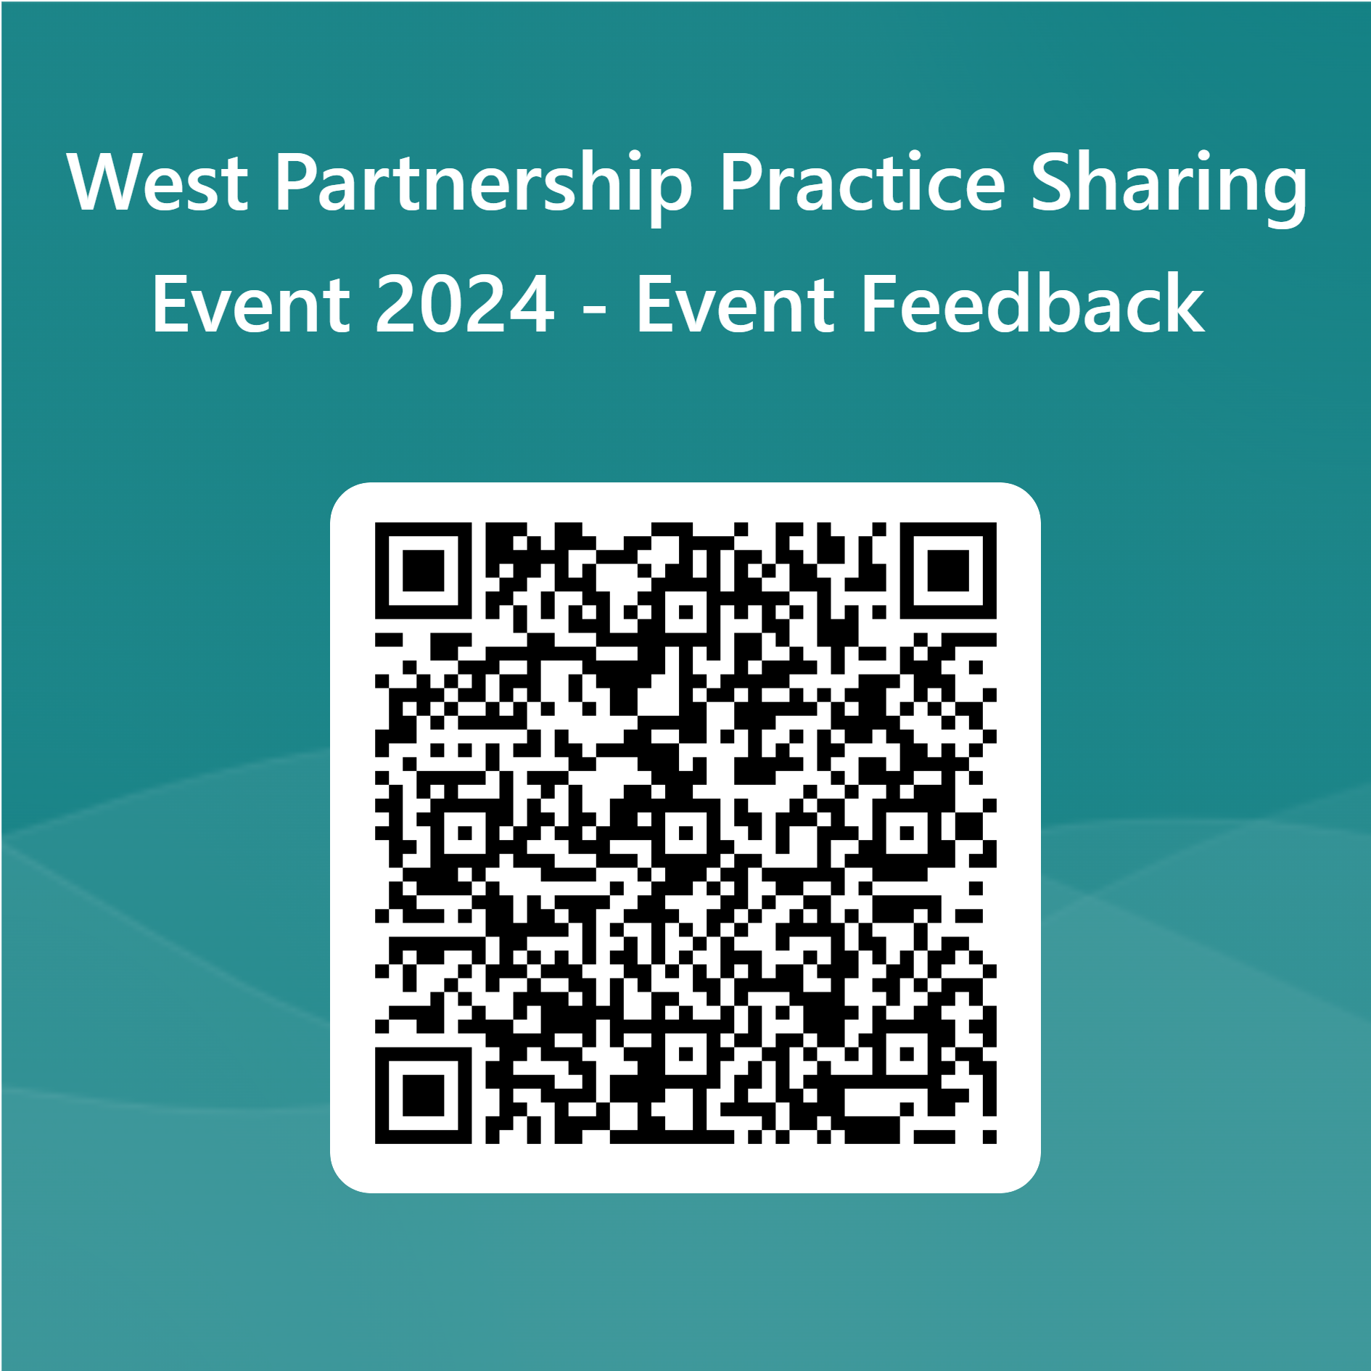
Thank you for coming!
Notes:
Same qs as last year, with addition of follow-up q for those who attended the 2023 event, around impact.
Also thanks to all presenters (especially our volunteers, other members of the WP.)

