Slide 1
Welcome!
West Partnership Educational Psychology Practice Sharing Event
5th September 2023 – Eastwood House

Slide 2
Agenda for the morning
9.30am – Welcome
9.45-10.35am – Workshop Session 1
10.35-11.05am – Break
11.05-11.55am - Workshop Session 2
11.55am – Plenary, evaluation and close

Slide 3
Session 1 (9.45-10.35) / Session 2 (11.05-11.55)
Workshop 1 – Autism (Windsor Suite) Led by Glasgow and South Lanarkshire EP
Workshop 2 – Bereavement & Loss (The Lounge Bar) Led by West Dunbartonshire
Workshop 3 – Mental Wellbeing and Emotionally Based School Absence (Room 1) Led by East Renfrewshire EPS and Inverclyde EPS
Workshop 4 – Nurture and Attachment (Room 2) Led by Renfrewshire EPS
Workshop 5 – Playful Pedagogy (Room 3) Led by East Dunbartonshire EPS
Workshop 6 – Suicide and Self Harm (Room 4) Led by North Lan and South Lan EPS

Slide 4
Housekeeping!

Slide 5
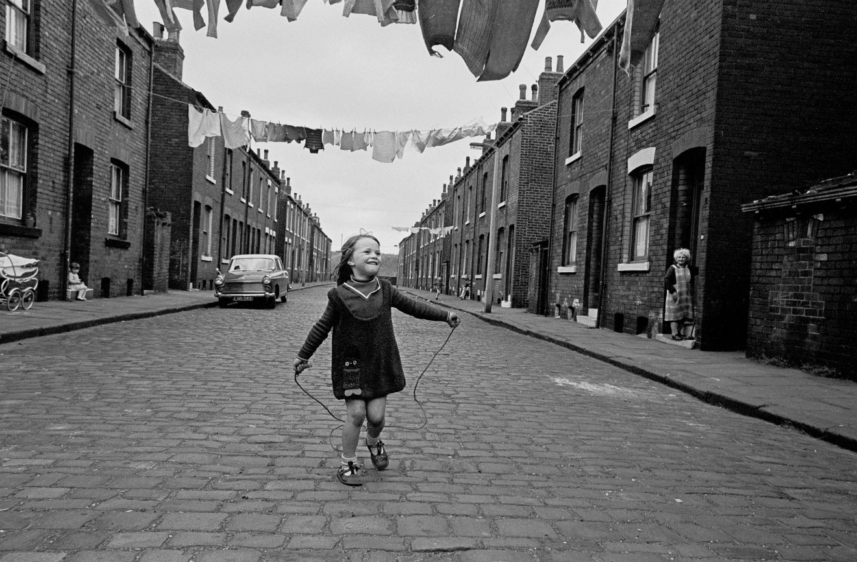
Glasgow Life in the 20th Century

Slide 6
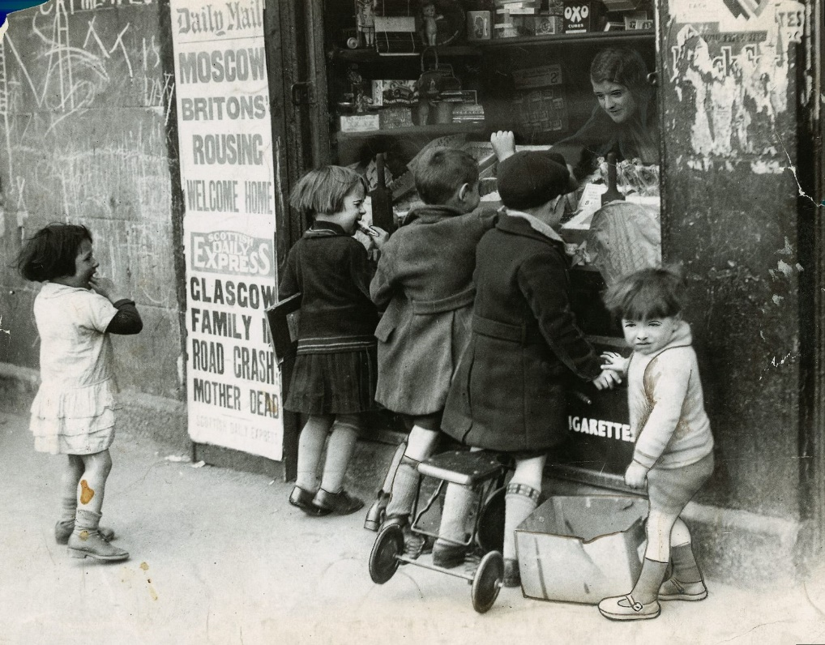
c1933

Slide 7
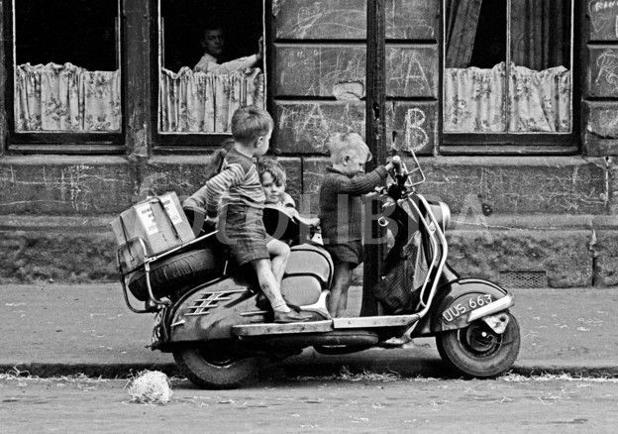
How about a bike ride?

Slide 8
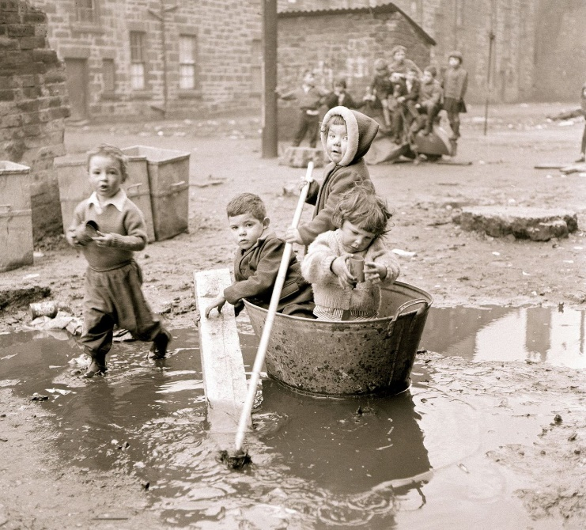
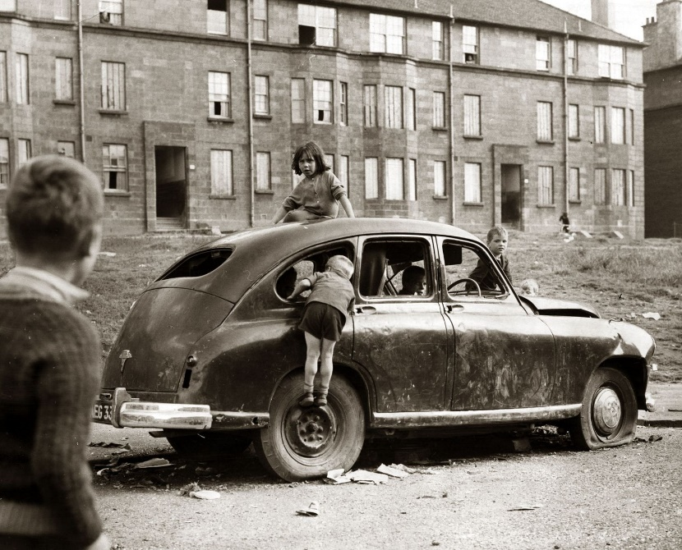
We Are Sailing
1966
We Are Hijacking
1969

Slide 9
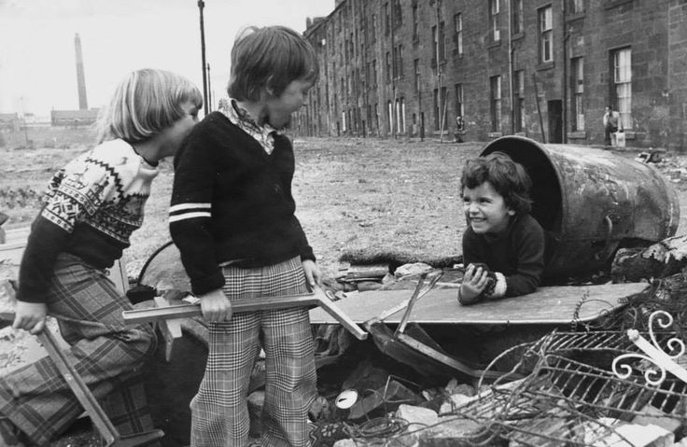
Another Great Escape
1970s

Slide 10
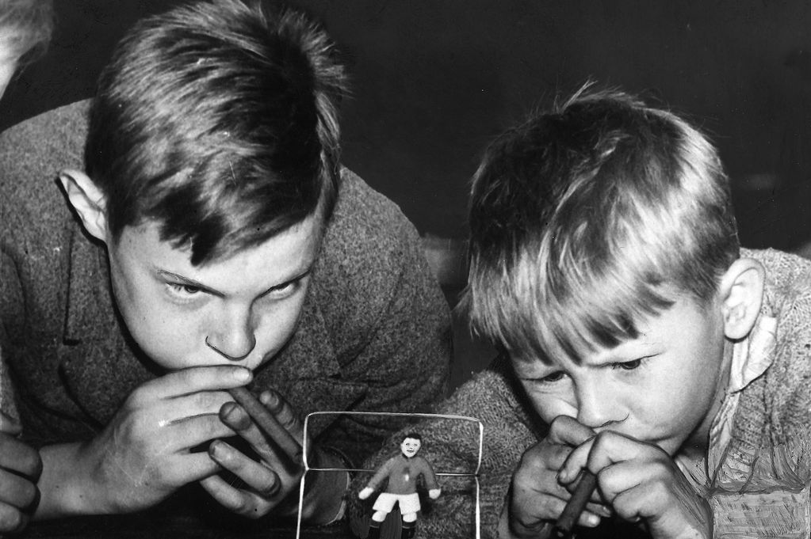
Blow Football?
Anyone?

Slide 11
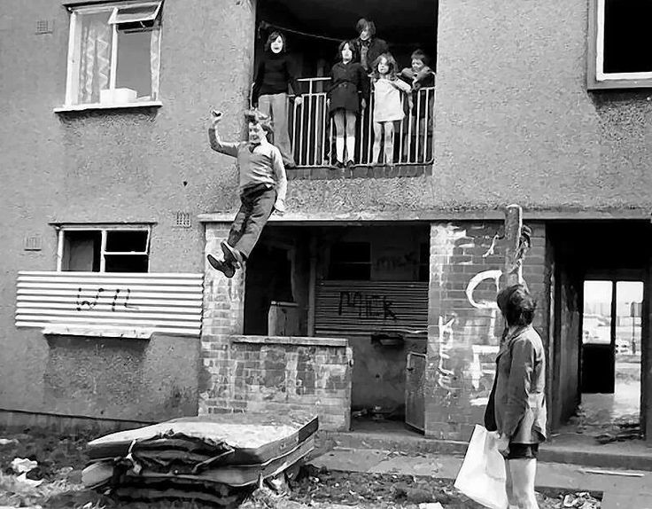
Anything you can do…

Slide 12
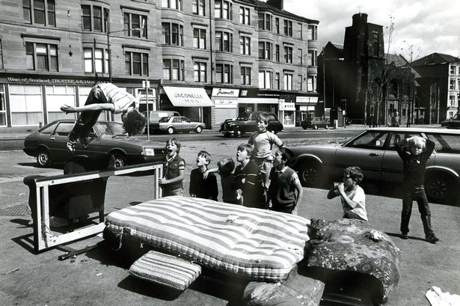
I can do better

Slide 13

One channel, together or not at all

Slide 14
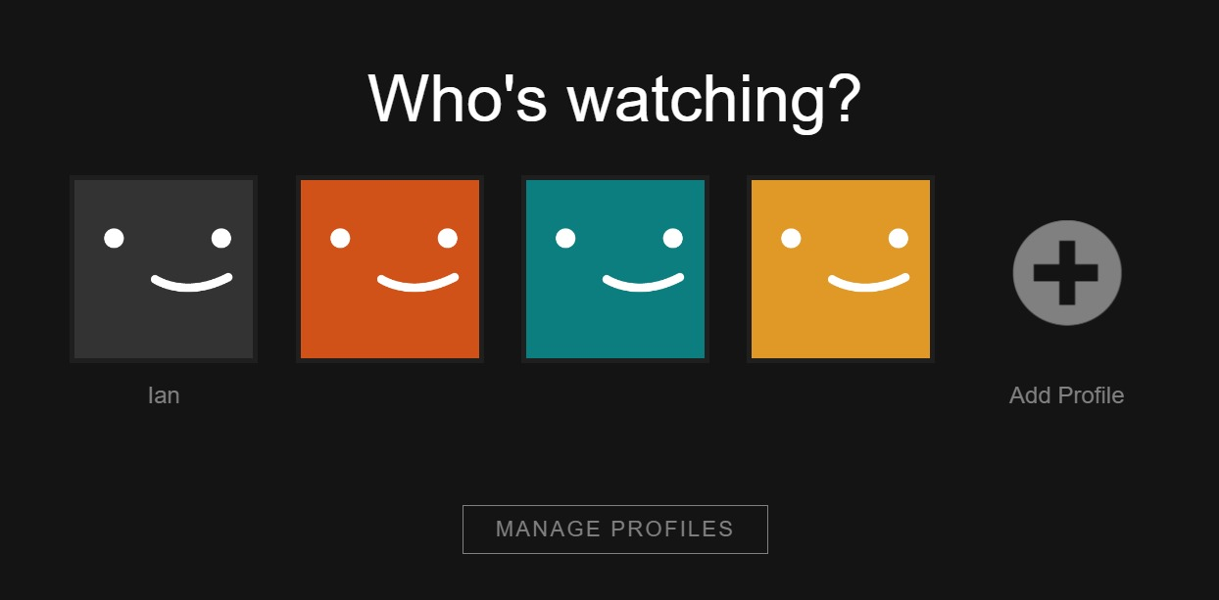
Limitless options, for each individual

Slide 15

One neighbour-hood, one phone…one child, one phone
Notes:
(over 50% of 10 year olds, 2020, BBC)

Slide 16

Access to every possible truth and lie
Exposure to every possible human act

Slide 17


Pressure to cultivate an ideal self that reflects unattainable & deceitful standards
Vulnerable to unkind acts 24/7
Every action / every mistake potentially captured… forever

Slide 18




What are we seeing?
Rising numbers of children and young people identified with additional support needs
Rising numbers of children and young people absent from school
More mental health needs
More self harm
More suicidal ideation
A rise in poverty

Slide 19
How can we help break these cycles of vulnerability?

Slide 20
Session 1 (9.45-10.35) / Session 2 (11.05-11.55)
Workshop 1 – Autism (Windsor Suite) Led by Glasgow and South Lanarkshire EP
Workshop 2 – Bereavement & Loss (The Lounge Bar) Led by West Dunbartonshire
Workshop 3 – Mental Wellbeing and Emotionally Based School Absence (Room 1) Led by East Renfrewshire EPS and Inverclyde EPS
Workshop 4 – Nurture and Attachment (Room 2) Led by Renfrewshire EPS
Workshop 5 – Playful Pedagogy (Room 3) Led by East Dunbartonshire EPS
Workshop 6 – Suicide and Self Harm (Room 4) Led by North Lan and South Lan EPS

Slide 21
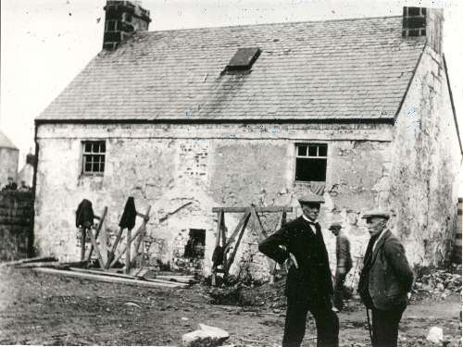
Levern Mill School House

Slide 22
West Partnership EPS Forum Glow Blog

Slide 23
Thanks to…
Ian Walker – West Dun
Graeme McLeary – Glasgow
Kate Spalding – East Dun
Kirsty Forrest – Renfrewshire
Mhairi Greenwood – South Lan
Taryn Moir – Inverclyde
Pamela Bell– North Lan
Laura McDonald – East Dun
All the Facilitators

Slide 24
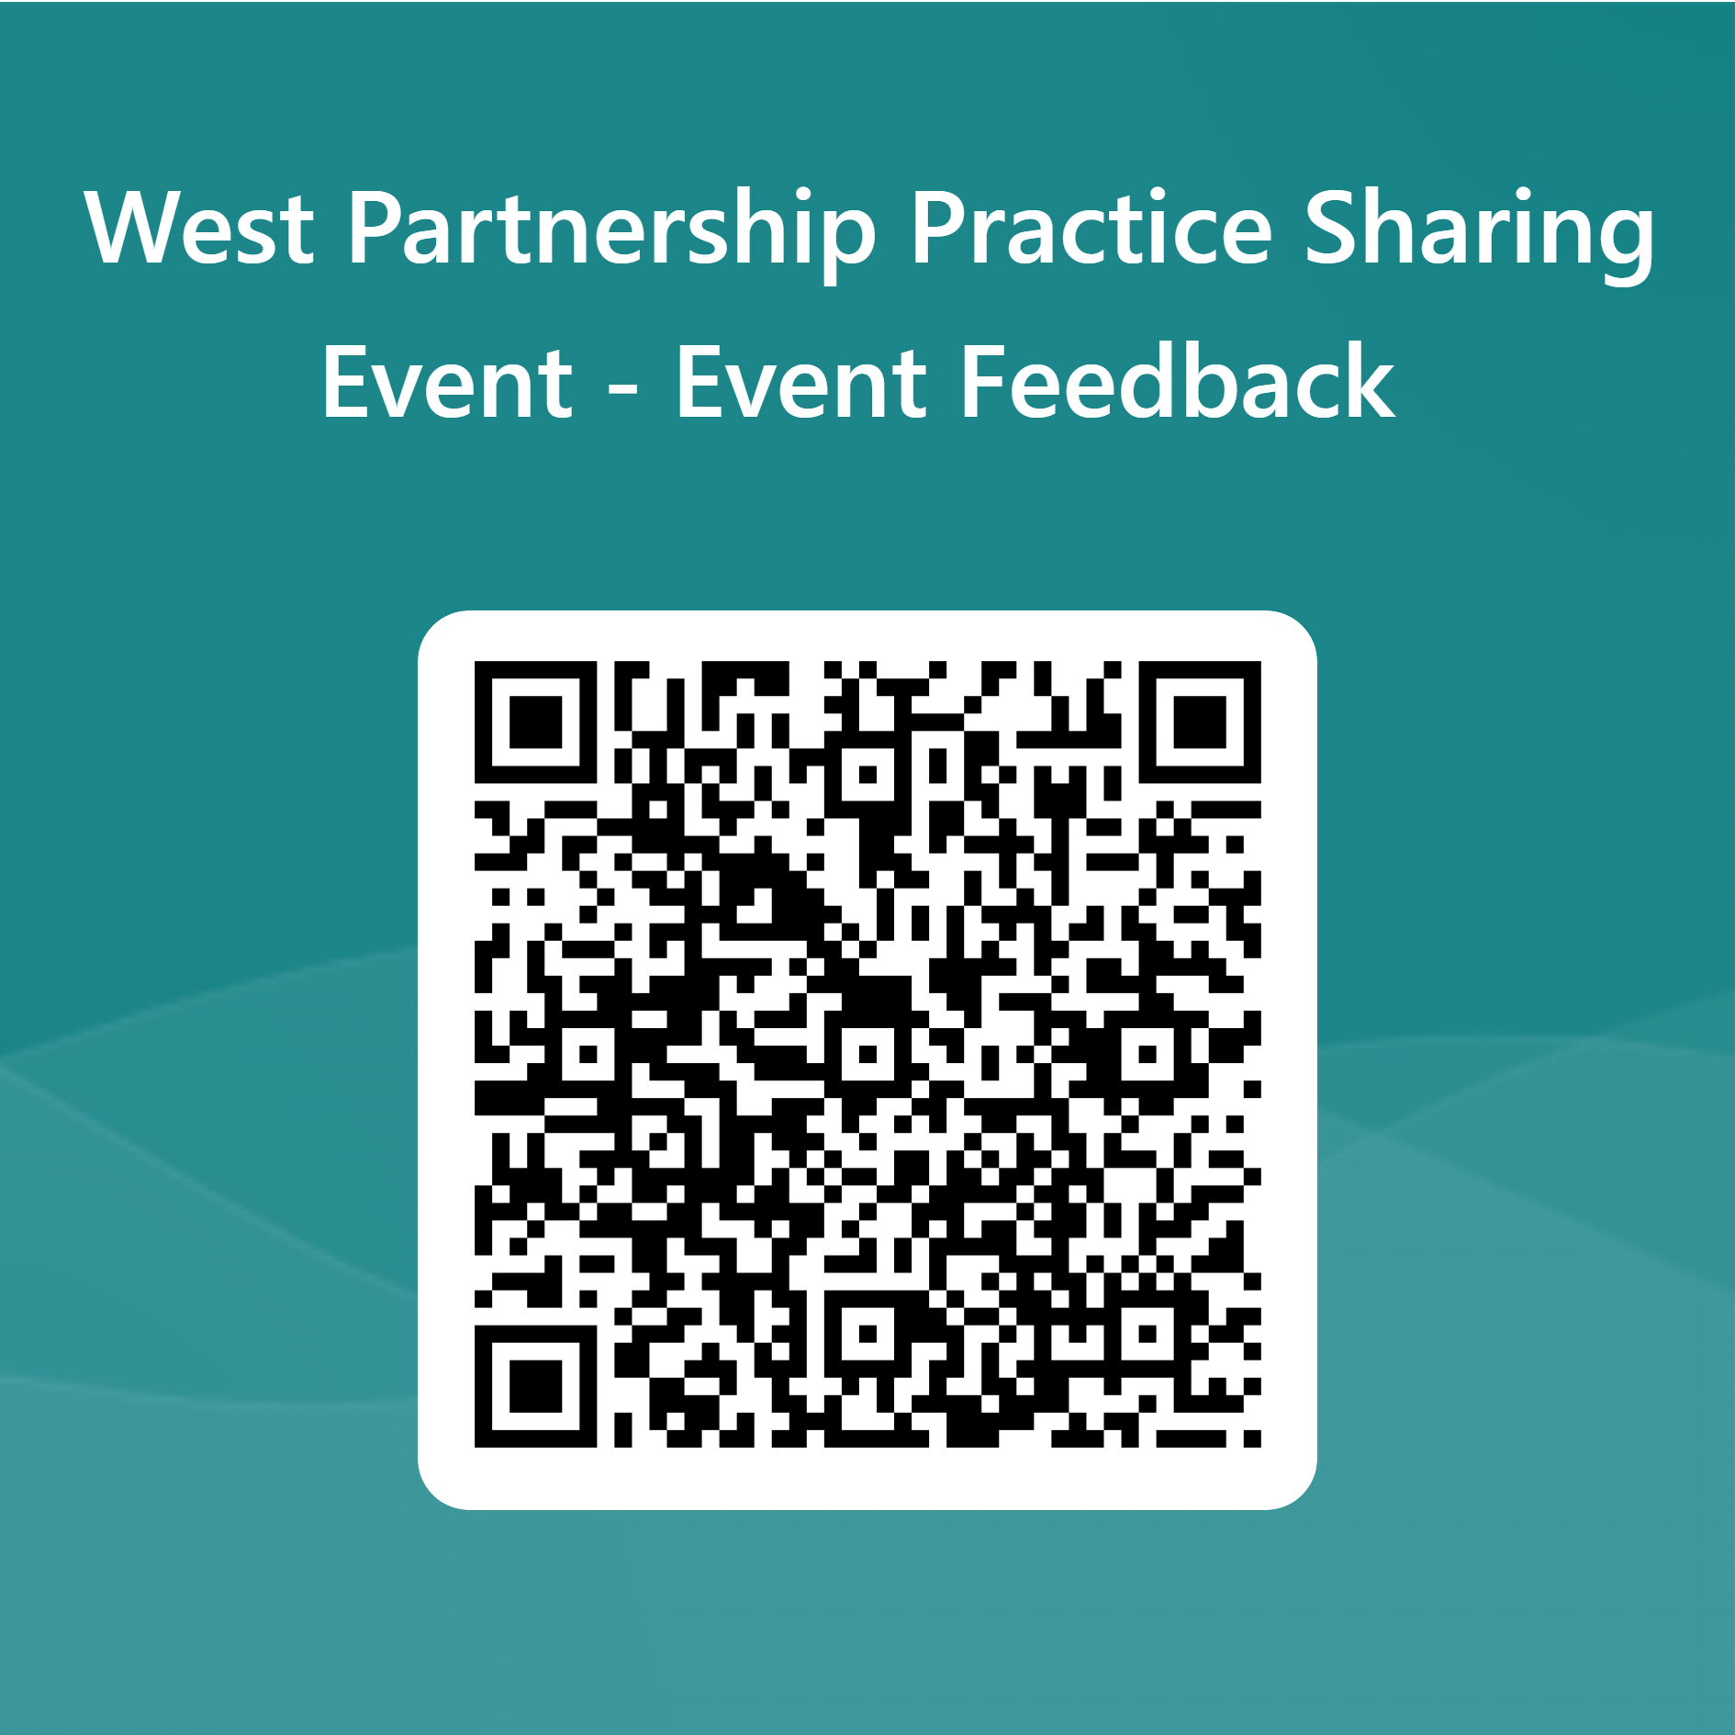

Slide 25
Thanks to you!
That’s all folks…for now…

