Slide 1
Simpsons Feedback Inventors Challenge
27th & 29th April

Slide 2
Describe your day in one word

Slide 3
What did you learn?

Slide 4
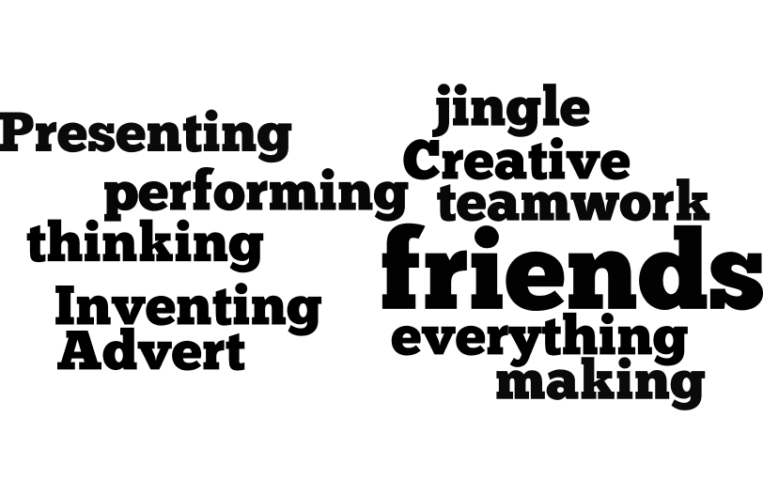
What did you enjoy?

Slide 5
Arkleston Feedback Inventors Challenge
11th & 13th April

Slide 6
Describe your day in one word

Slide 7
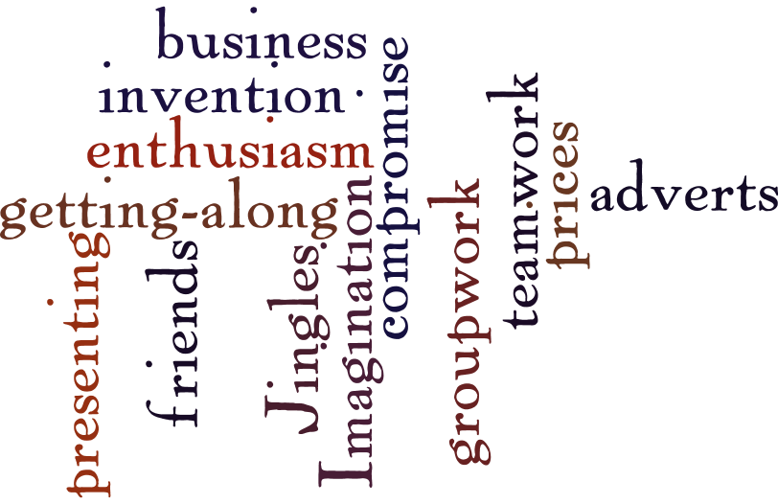
What did you learn?

Slide 8
What did you enjoy?

