Slide 1
Enterprise Masterclass
In enterprise we discussed what makes an entrepreneur?
The qualities and skills that you need to run a good business and to be successful.
We brainstormed ideas to make our own business and worked in teams.
Looked at entrepreneurs, looked at how they became who they are now and what they have achieved.

Slide 2
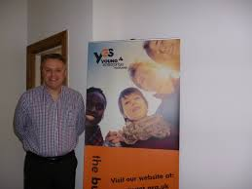
Young Enterprise Scotland
We were lucky to have Rab McDonald from Young Enterprise Scotland to assist us with our learning.
Young Enterprise Scotland supports people from a young age in enterprise
They provide training and practical learning experiences to young people like US!

Slide 3
What is an Entrepreneur?
An entrepreneur is a person who comes up with an idea and makes it into a business
They can make a business of different kind eg Beauty, Clothes, Food, Music and loads more!
They should have lots of skills and qualities like… communication, creativity, presentation skills, responsible, wise, determined, team working
They should know what they are selling and where, when, what, how and who!
They should also know if their product is good and will be successful

Slide 4
In our master class we have learnt about the qualities, values and skills to be an entrepreneur.
We learnt about different types of entrepreneurs and how they got their businesses started.
We looked at companies and looked at how they treat their customers as well as their products.

Slide 5
An Entrepreneurs Mind Set
Passion
Creativity
Communication
Confident
Intelligent

Slide 6
What have we learned?
To develop our own business ideas
We have developed skills like communication skills, creativity, being independent, being responsible and many more
We have used creativity the most because we having been thinking of business ideas and made decisions
We have made a food van and made prices and we had to see who would mainly buy our food

Slide 7
Skills we have developed
Team work
Creating
Listening
Presenting
ICT skills
Decision Making
Confidence

Slide 8
Our own business ideas
We put forward our ideas and as a group we picked the best ideas and we designed and gave our product a name. There
Here are some of our suggestions.
Ice cream fountain
Sun changing nail polish

Slide 9
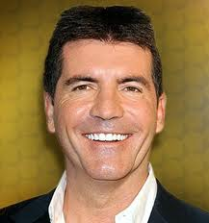
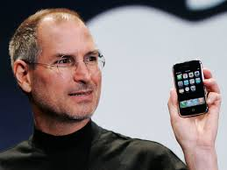
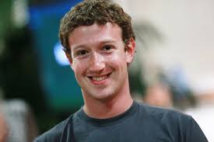
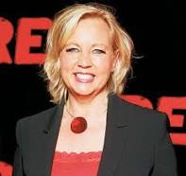
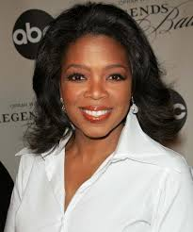
Famous Entrepreneurs

Slide 10
Our Journey
In the last 13 weeks we have learned about Qualities , Skills and Characteristics of an Successful Entrepreneur. We made mind maps , posters , we looked online for Famous Entrepreneurs .
We had to make ideas for our snack van this was really fun because we were using our imagination .

Slide 11
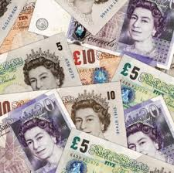
We learned how to work as a team
We learned that entrepreneurs have to have lots of skills and values to have a successful business
We also have to be able to afford and keep our business running

Slide 12
THANK YOU FOR LISTENING AND WE HOPE YOU JOIN ENTERPRISE!
Conclusion

