Slide 1
Floods
Sustainable Development
Nicole Grant, Hollie Seaton, Kelsie Dunlop, Dionne Barrie and Rebecca Hamilton

Slide 2
Learning Intentions
I am learning to describe what a disaster is
I am learning about what causes floods
I am learning about what happens after a flood or disaster

Slide 3
What is a disaster?
“A disaster is a sudden, calamitous event that seriously disrupts the functioning of a community or society and causes human, material, and economic or environmental losses that exceed the community’s or society’s ability to cope using its own resources. Though often caused by nature, disasters can have human origins.” (International Federation of Red Cross and Red Crescent Societies)
(IFRC accessed 2017)

Slide 4
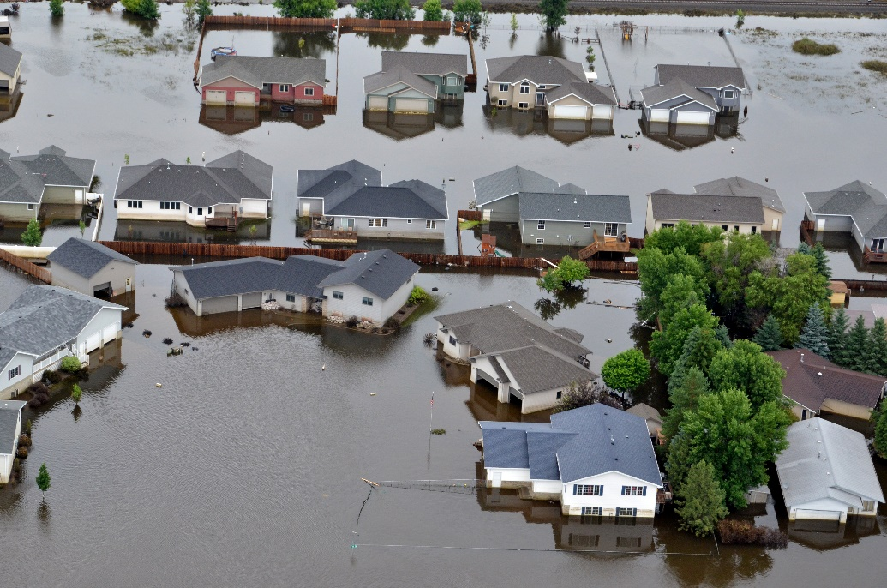
What is a flood and what causes them?
A flood is an overflow of water.
Heavy rail fall/burst banks
Melting snow and ice
Waterlogged land
Lack of land
This Photo by Unknown Author is licensed under CC BY-SA

Slide 5
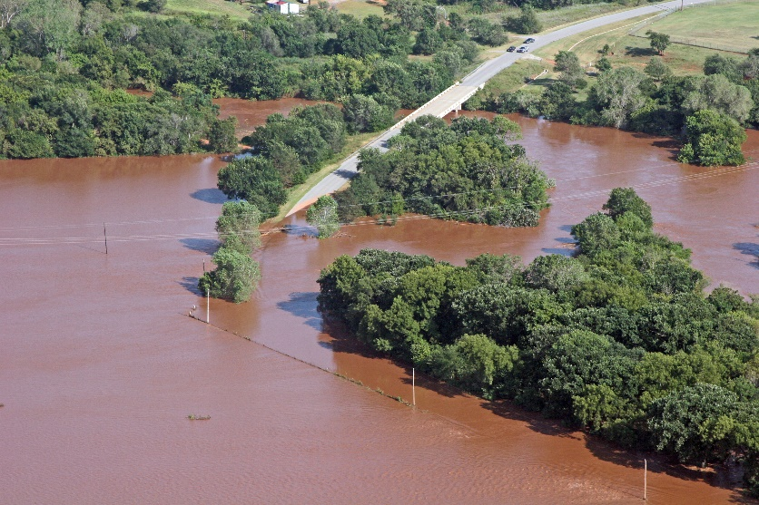
Disadvantages of flooding.
Destroy people’s livelihoods and people may not survive due to drowning
Flood water may carry raw sewage, oil or chemical waste which can cause diseases. Two diseases associated with water are Cholera and Malaria which can lead to death.
Destroy land and crops which means food could be scarce
Destroy buildings leaving people homeless and jobless meaning government will have to contribute more in the costs of the disaster.
This Photo by Unknown Author is licensed under CC BY-SA

Slide 6
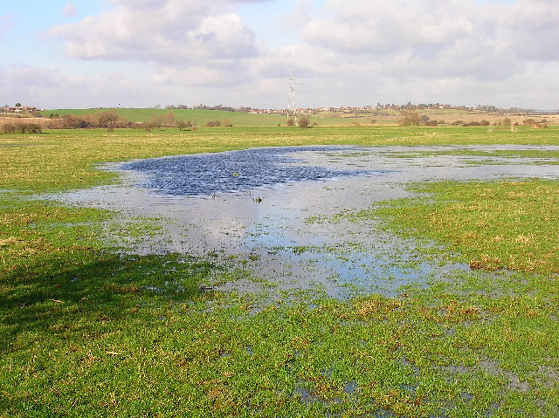
Benefits of flooding.
In some cases, flooding can be beneficial for agricultural purposes.
For example, Bengali where seasonal floods (barsha) are beneficial in enhancing crop production.
Watering paddy fields and enhancing soil fertility.
This gives Bangladeshi villagers food and income.
This Photo by Unknown Author is licensed under CC BY-SA

Slide 7
Short-Term Effects of Flooding
Declines in tourism
Delayed harvests due to waterlogged soil
- increase in food prices
This Photo by Unknown Author is licensed under CC BY

Slide 8
Long-Term Effects of Flooding
Public Health
Effects on physical and mental health
Children suffer emotional health problems.
Wider Community
Public spaces damaged
Unemployment
Breakdown of sanitation system
This Photo by Unknown Author is licensed under CC BY

Slide 9
Facts and figures.
In the UK there are currently 2 million homes within a flood risk area.
There are an additional 2 million homes within 100 metres of a flood risk area.
There is an estimate 250, 000 new homes with planning approval within flood plain areas.
Flash flooding caused more than £1 million worth of damage to a Cornish village following torrential downpours.
“My school, Riverside, in Hebden Bridge, flooded, so term started late and our class had to be moved upstairs! My mum and lots of other people went into town with wellies and shovels to help clean up all the mud.” Noa Baldwin, age 7 on the Boxing day floods 2015.
This Photo by Unknown Author is licensed under CC BY-NC-SA

Slide 10
Curriculum for Excellence Experiences and Outcomes
I can describe the physical processes of a natural disaster and discuss its impact on people and the landscape. SOC 2-07b
I can explain how the physical environment influences the ways in which people use land by comparing my local area with a contrasting area. SOC 2-13a
Inspired by a range of stimuli and working on my own and or with others, I can express and communicate my ideas thoughts and feelings through musical activities. EXA 1-18a

Slide 11
I can display in a clear way using a suitable scale by choosing appropriately from an extended range of tables, charts, diagrams & graphs. MTH 2-21q
I can extend and enhance my knowledge of digital technologies to collect, analyse ideas, relevant information and organise these in an appropriate way. TCH 2-01a
By considering the type of text I am creating, I can select ideas and relevant information, organise these in an appropriate way for my purpose and use suitable vocabulary for my audience. LIT 2-26a

Slide 12
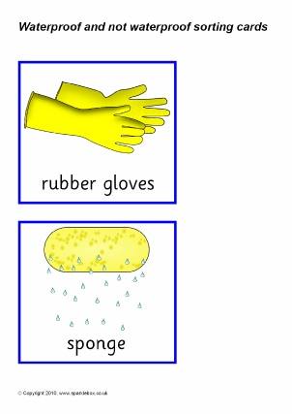
Science
Waterproof/ Non waterproof
(Based on level 1)
Each child is given a worksheet and some materials and must test whether each item is waterproof or non-waterproof. This could lead onto discussion with younger children around what people might lose in a flood and how that would make them feel.
Materials: - Sponge
- Waterproof Jacket
- Cardboard Box
- Gloves
- Basin
- Kitchen Roll
- Sheet
- shoe

Slide 13
Science Continued
(Based on level 2)
Children are split into small groups and given a basin, some play doh and paper. The children must make a house out of the paper and place it in the middle of the basin. They then must fill the basin with some water to see the effects of a flood on houses. Children are then asked to build flood barriers using the play doh around their house and try filling the basin with water again.
Materials: - Basin
- Play doh
- Sink
- Jug
- A4 Paper
I can describe the physical processes of a natural disaster and discuss its impact on people and the landscape. SOC 2-07b

Slide 14
Technology
(Based on level 2)
Research task
Split the children into groups and give them a specific country such as India or the UK. Get them to research floods and all the information behind them in that country and then get them to present this back to the class.
I can extend and enhance my knowledge of digital technologies to collect, analyse ideas, relevant information and organise these in an appropriate way. TCH 2-01a

Slide 15
Mathematics
(Based on level 2)
Following up from technology lesson, look at the figures from different countries and compare the numbers.
Probability from looking at statistics, for example, what is the likelihood of Britain having a flood within the next year?
Creating tables of information and putting into different graphs
I can display in a clear way using a suitable scale by choosing appropriately from an extended range of tables, charts, diagrams & graphs. MTH 2-21q

Slide 16
Literacy
(Based on level 2)
A town near you has flooded due to heavy rain and the river has now burst its banks. You are going to interview the local people and write a news article on how the community have been affected.
Some things to consider:
- Houses/public spaces
- Employment
- Families
- Transport
By considering the type of text I am creating, I can select ideas and relevant information, organise these in an appropriate way for my purpose and use suitable vocabulary for my audience. LIT 2-26a

Slide 17
Arts
(Based on level 1)
Make their own instruments to create a whole class rainstorm.
Inspired by a range of stimuli and working on my own and or with others, I can express and communicate my ideas thoughts and feelings through musical activities. EXA 1-18a

Slide 18
References
BBC Bitesize (2014) River flooding and Management Issues [Online] Available: http://www.bbc.co.uk/schools/gcsebitesize/geography/water_rivers/river_flooding_management_rev1.shtml [Accessed: 1 November 2017]
Education.gov.scot. (2017). Available at: https://www.education.gov.scot/Documents/all-experiences-and-outcomes.pdf [Accessed 1 Nov. 2017].
Flooding – Facts and Figures. (n.d.) [Online] https://www.timberwise.co.uk/2005/10/flooding-facts-and-figures/ Available: 1 November 2017].
International Federation of Red Cross and Red Crescent Societies.(n.d.) Available at http://www.ifrc.org/en/what-we-do/disaster-management/about-disasters/what-is-a-disaster/ [Accessed 1 Nov. 2017]
Gray, S. (2008) Long-term health effects of flooding. Journal of Public Health. [Online] Vol.30(4), pp. 353–354. Available: https://academic.oup.com/jpubhealth/article/30/4/353/1513480/Long-term-health-effects-of-flooding/ [Accessed: 31 October 2017].
Middleton, N. (2013) The Global Casino (5th Edition). London: Hodder Arnold.
Queensland Government (n.d.) What are the consequences of floods?.[Online] Available: http://www.chiefscientist.qld.gov.au/publications/understanding-floods/flood-consequences [Accessed: 31 October 2017].
William, R.G (2015) Floods, Be Aware and Prepare. Minnesota: Capstone Press

Slide 19
Thank you so much for listening
This Photo by Unknown Author is licensed under CC BY-SA

