Slide 1

Developing a Digital Toolkit for Numeracy and Mathematics
Meg Brough

Slide 2
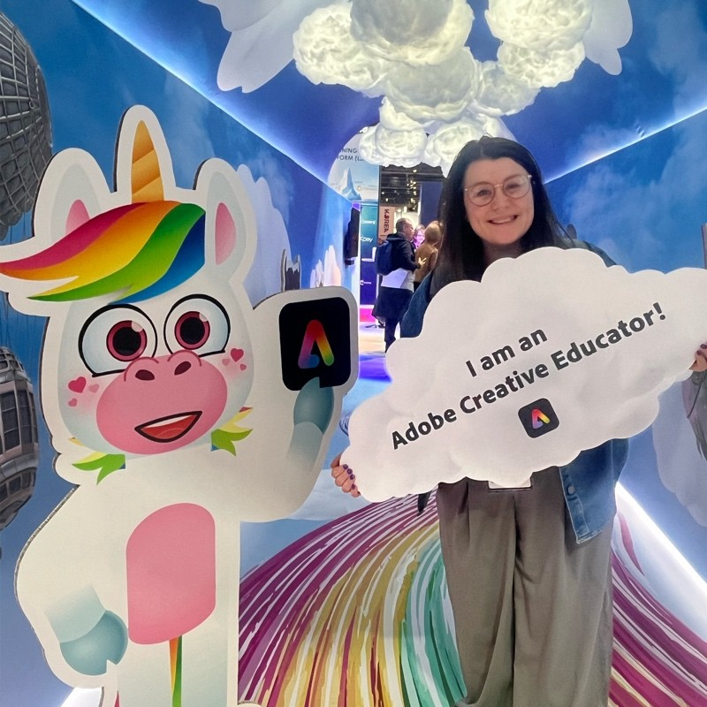

Who am I?
Meg Brough
ESO Digital Learning
Here to support you with all aspects of Digital Learning and Teaching.
*disclaimer* I am not IT!

Slide 3
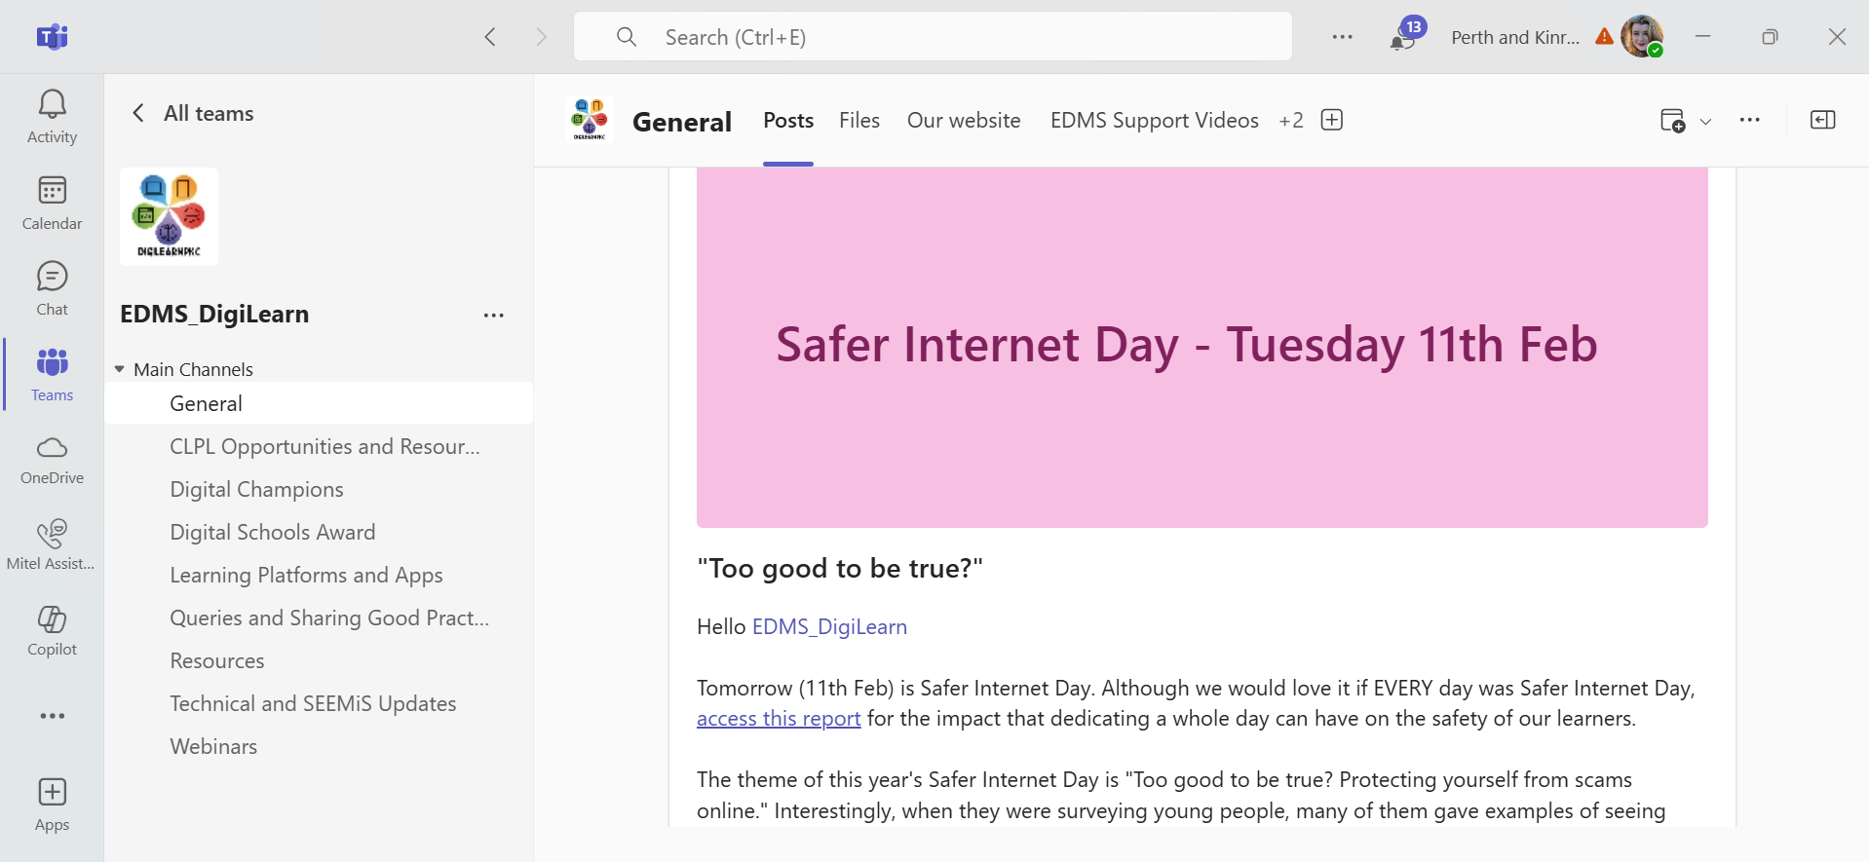
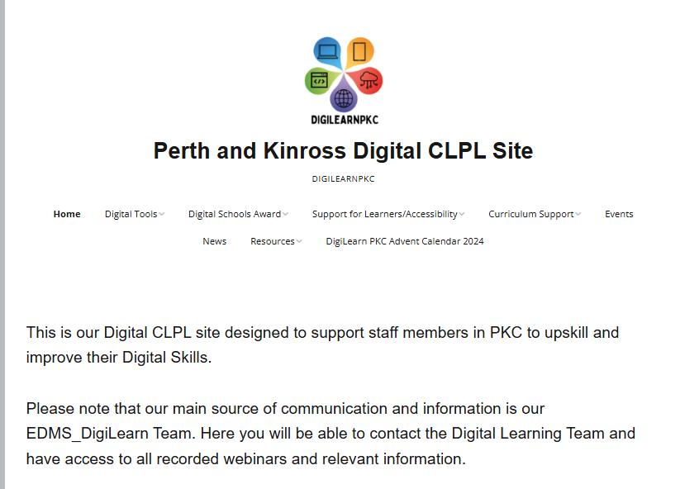
Where to find support

Slide 4
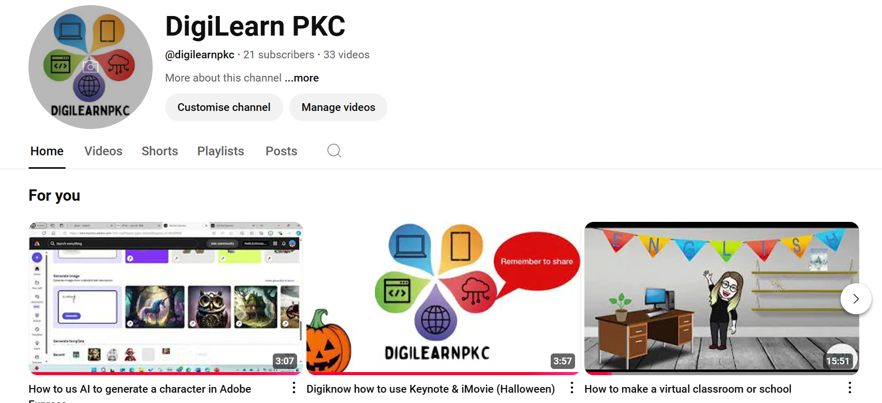
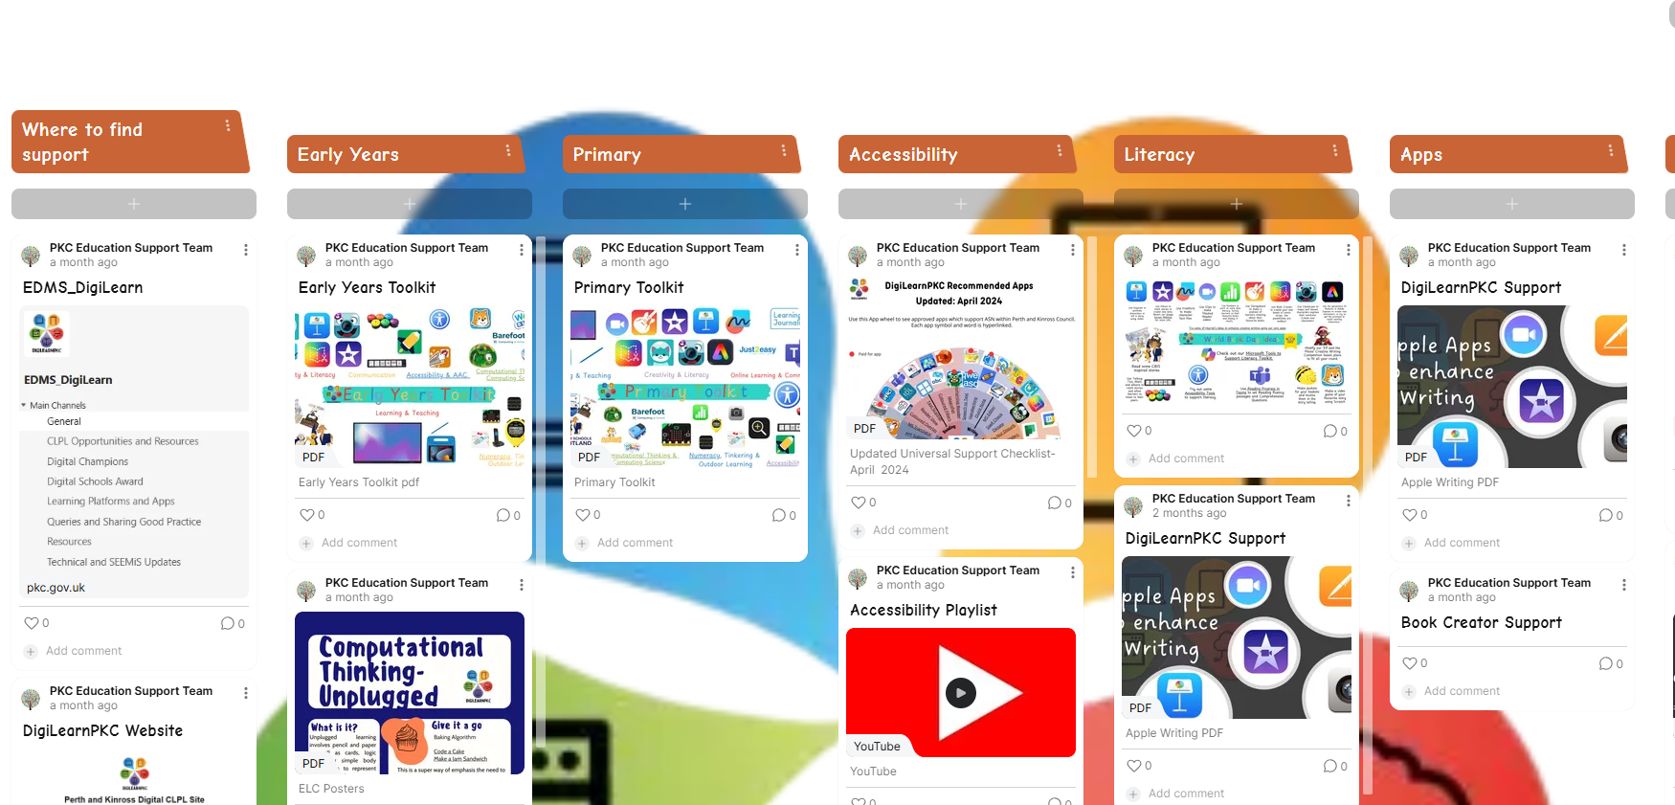
DigiLearn PKC - YouTube
Padlet

Slide 5

What will we cover today
Where to find digital support
Primary Toolkit
Moving from using digital as a substitution to redefining learning using technology (SAMR Model)
Examples of tools you already have access to which can enhance maths and numeracy lessons

Slide 6
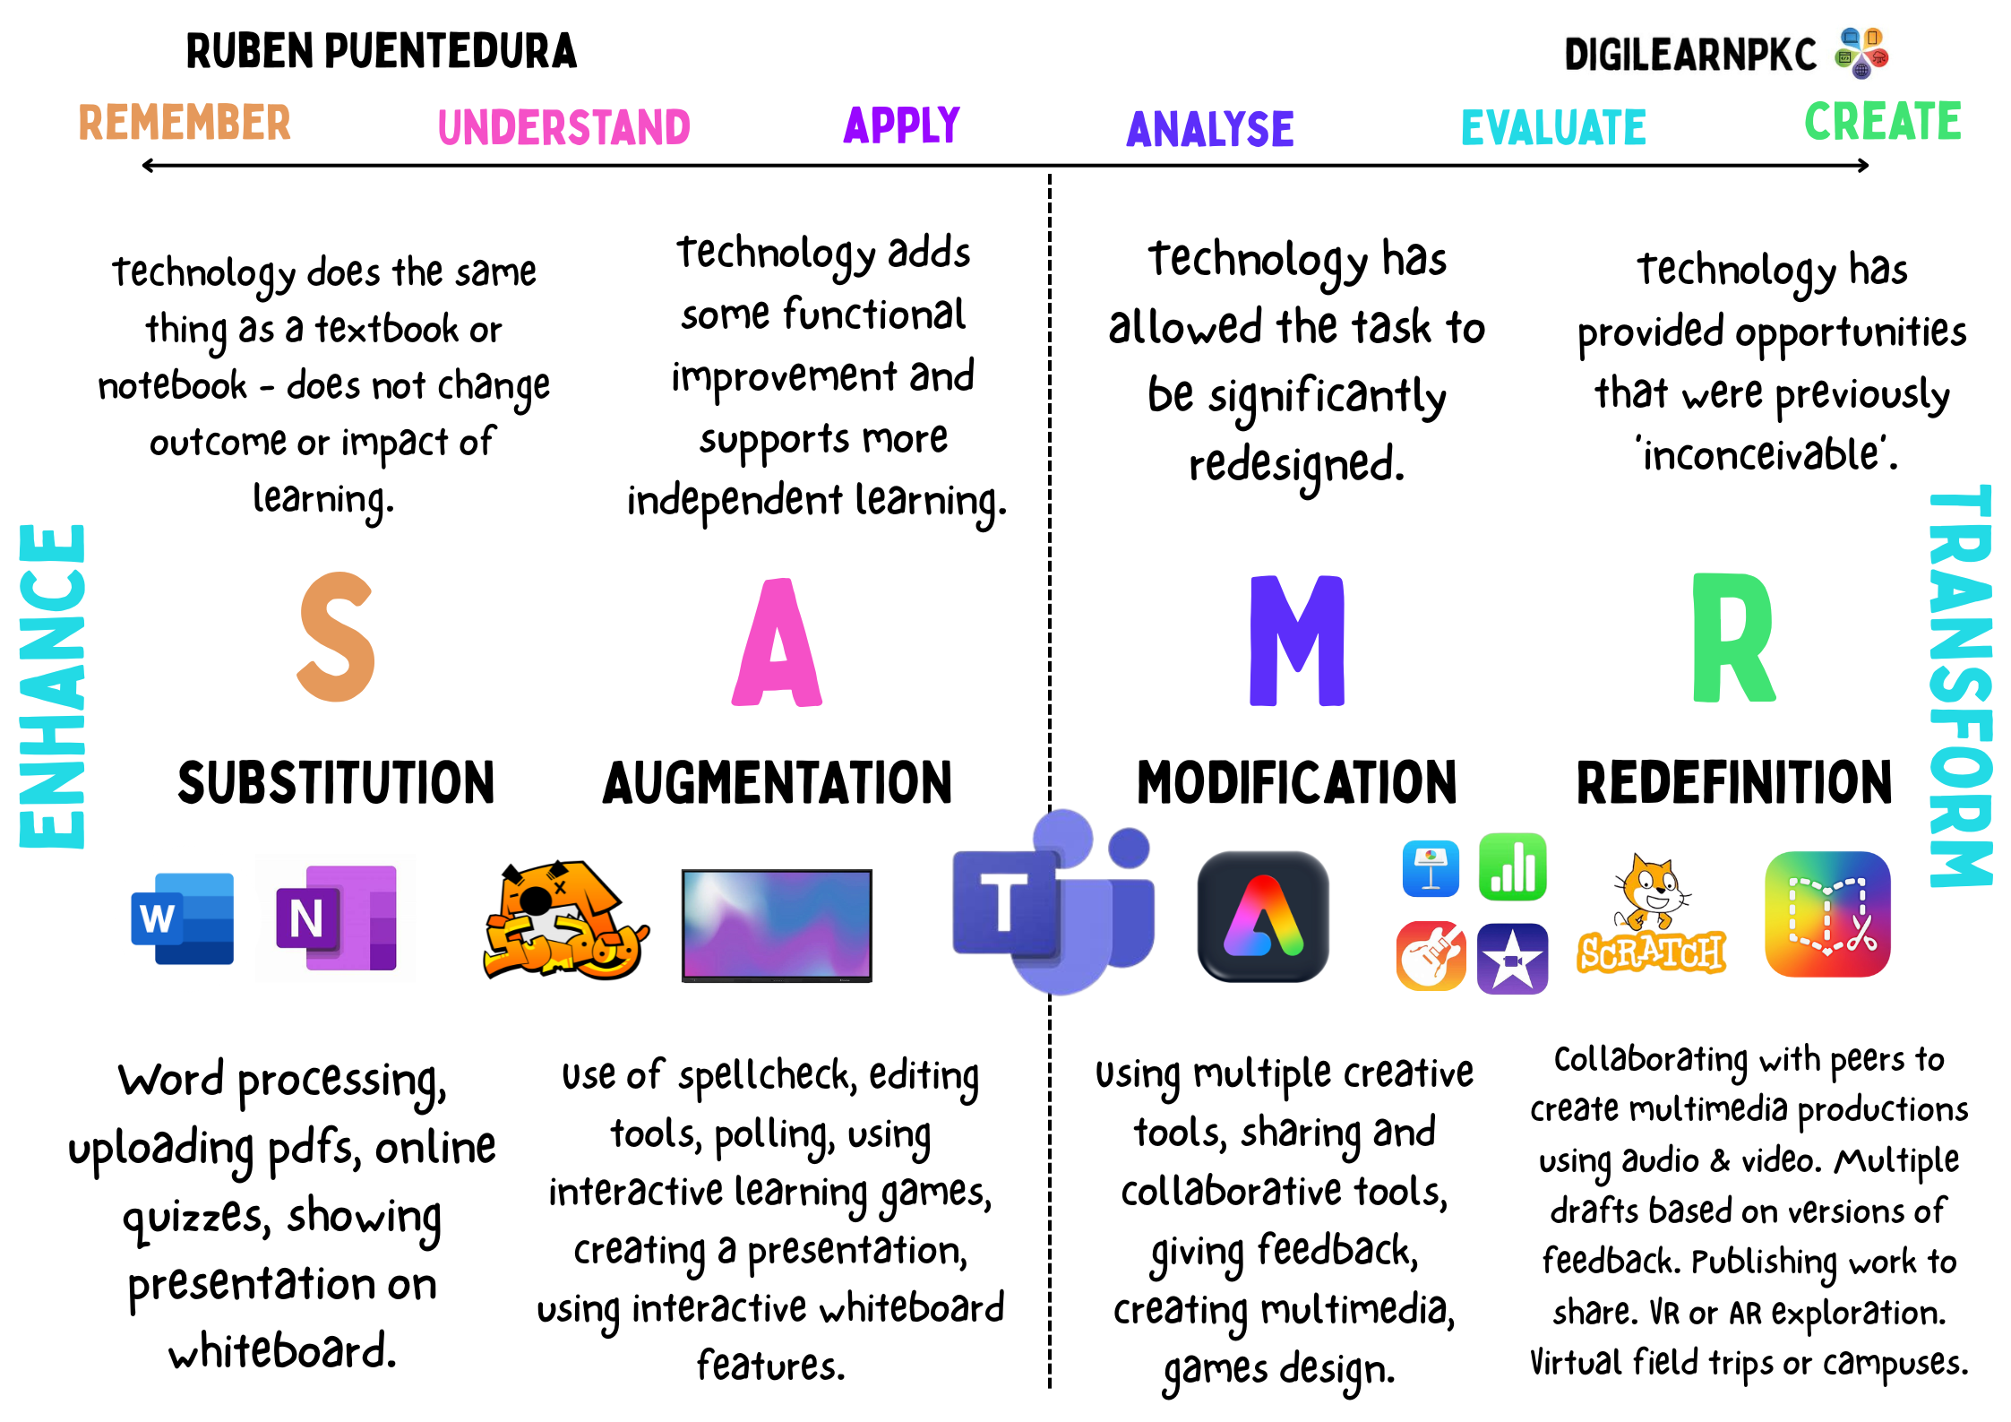

Slide 7

Chat to the person next to you and consider where you think you might be on this scale.
What might be the reasons for this?

Slide 8
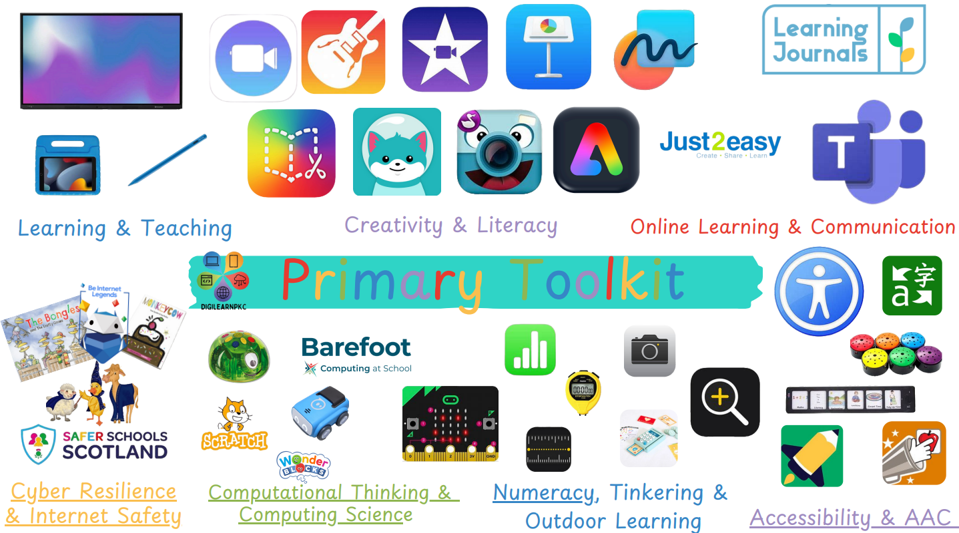

Slide 9

ActivInspire Tools
Using ActivInspire in the Mathematics Classroom - Learn Promethean
MATHEMATICS RESOURCE CONTENT IN ACTIVINSPIRE
The ActivInspire Main Resource Pack has a large number of resources that are relevant for creating lesson content for the mathematics classroom.
Under Shared Resources – Activities and Templates – Activities you can find pages related to:
using an abacus
fraction and decimal equivalence
counting
coordinates
fraction wall
Download here if not already installed - ActivInspire Resource Pack

Slide 10
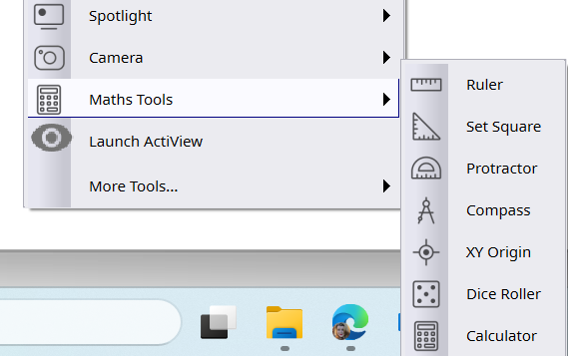
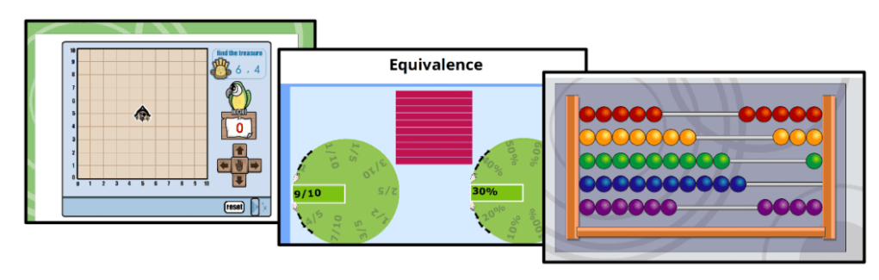
Tools > Maths Tools
Resource Browser> Shared Resources – Activities and Templates – Activities

Slide 11
Apple Resources
Apple Teacher/ Education Community
Everyone Can Create: Projects – Apple Education Community

Slide 12
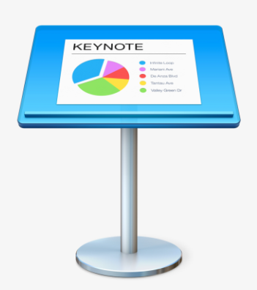



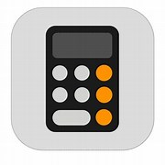
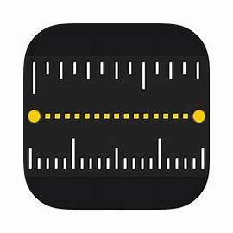
Keynote
Numbers
Mark Up
Freeform
Data Handling
Graphs
Premade tables, pie-charts
Animate data to display in a creative way e.g. infographics
Apple’s Excel
Create tables, charts and graphs
Tap Markup and use the Markup tools to annotate the types of shapes and angles you find in your photo.
combining text, images, and drawings, students can create personalized and engaging study materials. Maths notes included.
Calculator
Measure
Measure
Convert measurement/ switch between units of measurement

Slide 13

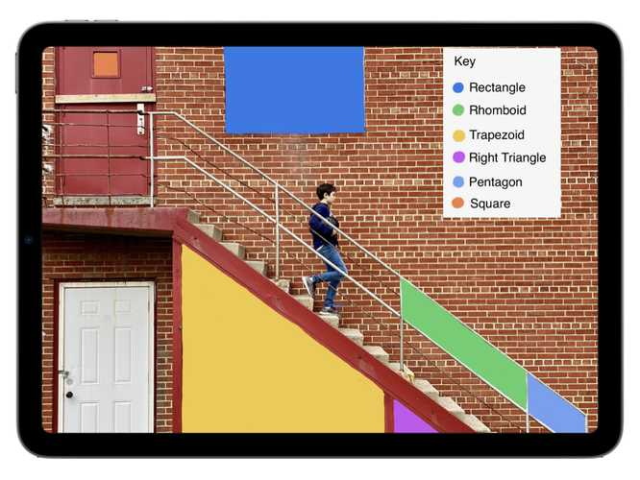
Mark Up
Markup Mathematics
Marking up photos is a great way to connect mathematics concepts to real world settings.
Have a look around your environment and take a photo of something that captures your interest.
Open Camera
Tap the Shutter button to take a photo
Open Photos to find the image you just captured
Tap Edit
Tap Markup and use the Markup tools to annotate the types of shapes and angles you find in your photo.

Slide 14
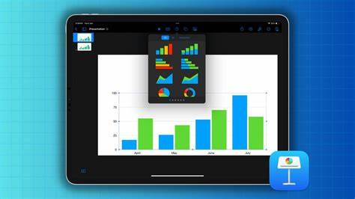
Create charts and infographics in Keynote
Create Presentation > Start an Outline
New blank slide (delete text)
Charts button along top and choose 2d/3d/interactive
Insert chart > press for option ‘edit data’
Insert data into chart (regions can be deleted)
Go to paintbrush to edit appearance and information e.g. add title/caption/legend
You can also change the type of chart at any time to compare the most appropriate type

Slide 15
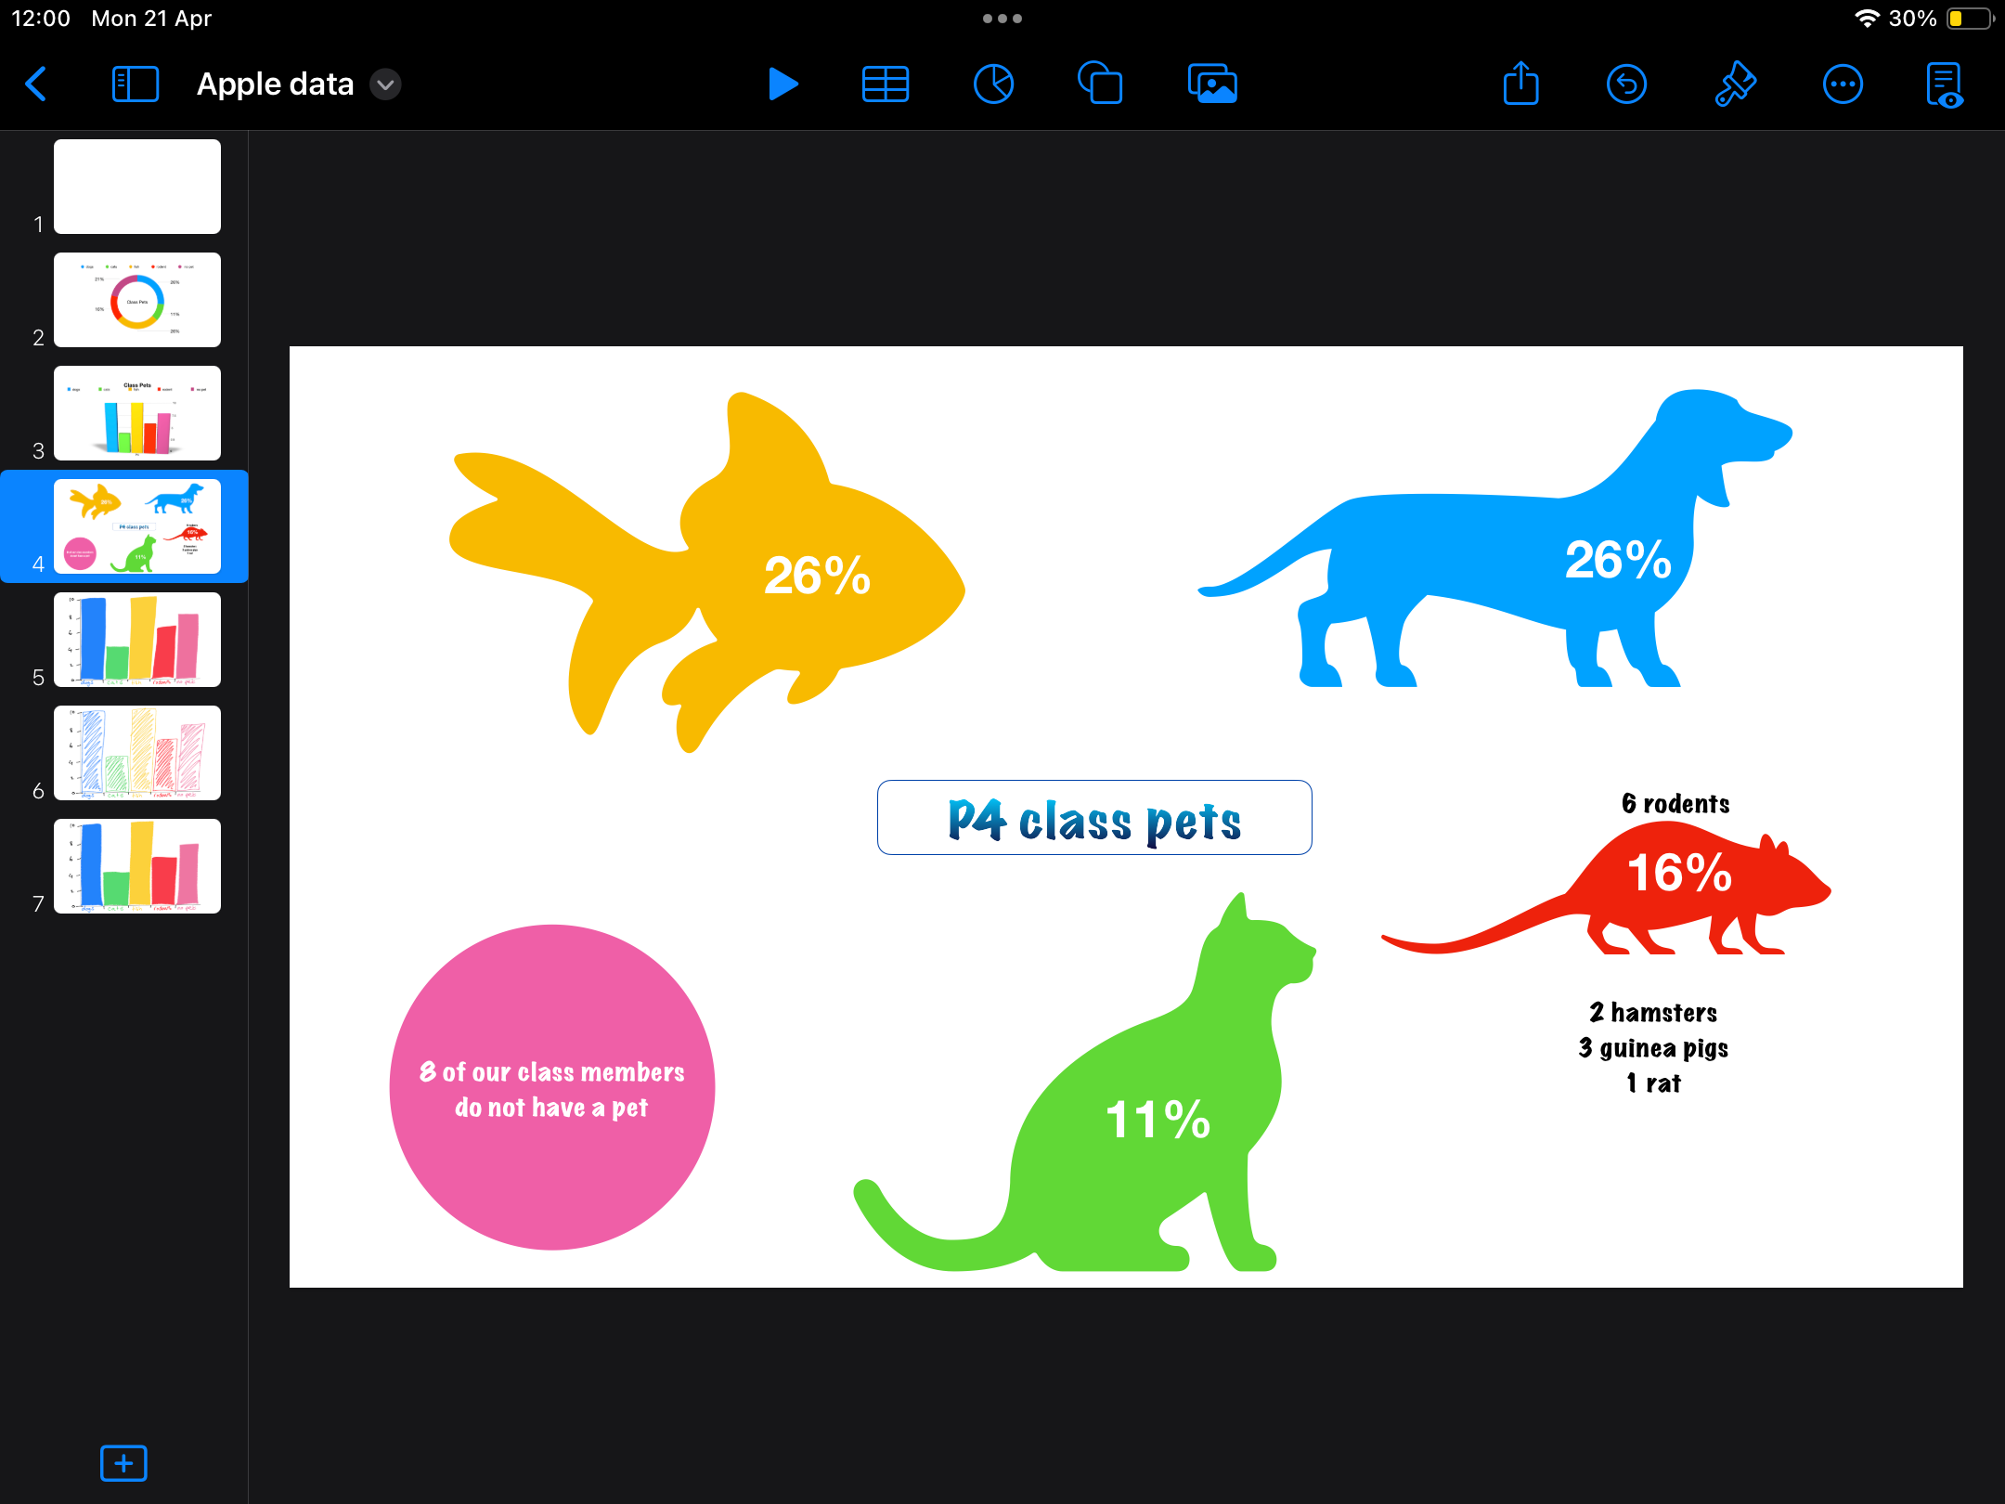

Slide 16

Infographics with shapes
New slide
Navigate to shapes icon
Insert images relevant to data
Size and edit colour/appearance with paintbrush tool
Add text (also in shapes under basic)
Change text to same colour as background
Select Objects and ‘group’
Keynote for iPad: Shapes – Apple Education Community

Slide 17
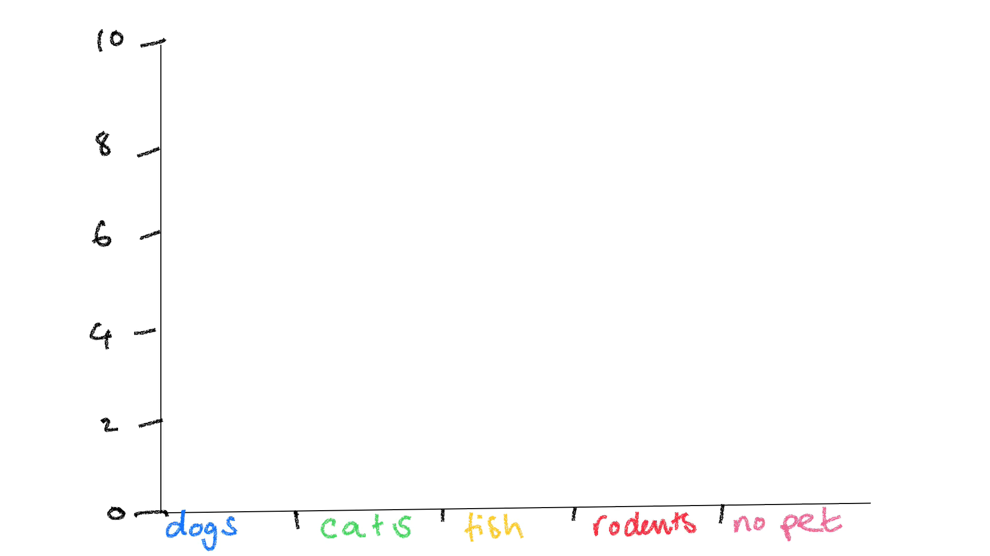

Slide 18
Create an interactive infographic animation
Optional differentiation– airdrop learners template of squared paper (this could have the optional x and y axis on this already)
1. Open new slide and go to image icon
2. Create drawing of an x and y axis and labels – go to paintbrush and ***LOCK IMAGE***
3. Add a new drawing of one bar of information. Click done. Tap this drawing and animate this. Choose ‘add build in’ and s.croll to find *WIPE*. Assign this.
4. Click again on ‘Wipe’ and change ‘from left’ to ‘from bottom’. Click play to check animation.
5. Click done in left hand corner. Ensuring you have only selected this particular bar, navigate to paintbrush and LOCK IMAGE. This allows all bars to be animated separately.
6. Repeat steps 3-5 for the remaining data
7. Press the play button to check animations are in order.
8. To edit animation order or duration, click on any object, click animate and look for the icon with three dots and three lines. This will allow you to change the build order.

Slide 19
To add to the challenge
Add audio to the presentation and export as a video or gif
When you have finished animating go to the image icon
Tap ‘record Audio’
Record audio to match the animation. You can edit this or click ‘insert’
If you need to go back and slow down the animation to match your voice over, select an object, click ‘animate’ and head back to the icon with 3 dots and 3 lines.
Here you can choose to move your audio recording to the start of the build order ‘on tap.’ Then you can ensure all of the subsequent animations happen automatically by tapping ‘after build’ for each one

Slide 20
How to export
1. Navigate to you keynote homepage
Click ‘select’ at the top and select your presentation
At the bottom of the screen click ‘share’ and then ‘export’
Choose a format
If you do not want to export the whole presentation, you must edit ‘slide range’ to only export the appropriate files
When your slides have exported, click ‘share’ and choose ‘save image/video’ to ensure this saves to your camera roll

Slide 21
Sketch & Solve with Math Notes
Sketch & Solve with Math Notes
iPad has a new calculator feature called Maths Notes that lets you type or write math expressions and see them solved instantly in your own handwriting. Math Notes are automatically accessible in the Notes app in the new Math Notes folder.
1. Open Calculator.
2. Tap the calculator symbol in the bottom left corner, then Math Notes. Add a title.
3. Tap the Markup button. Write variables and an equation.
4. Add a graph and drawings to visualise the math equation.
5. Update one or more of the variable values.
6. Explore Math Results options. Share your note.
This can also be accessed and used in Freeform by clicking the down arrow and going to ‘maths notes’.

Slide 22
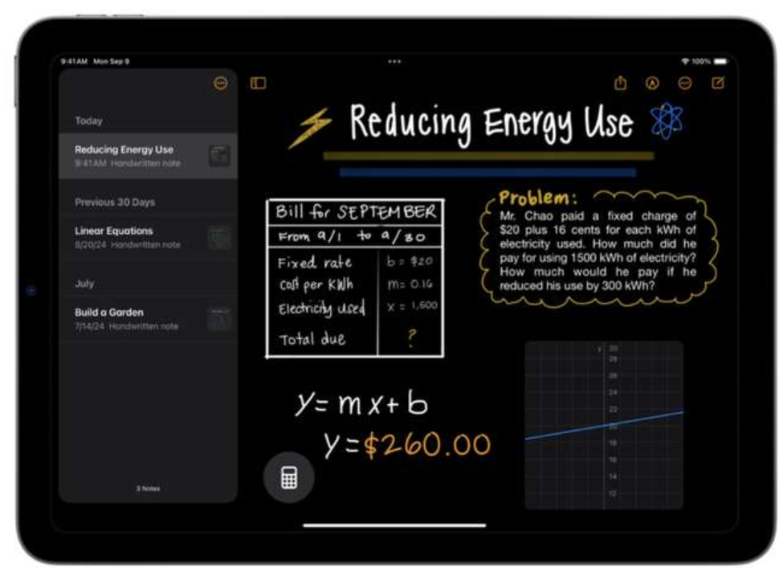
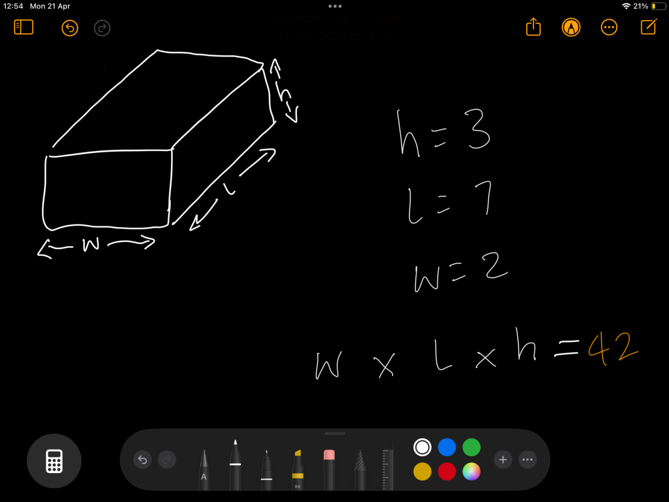

Slide 23
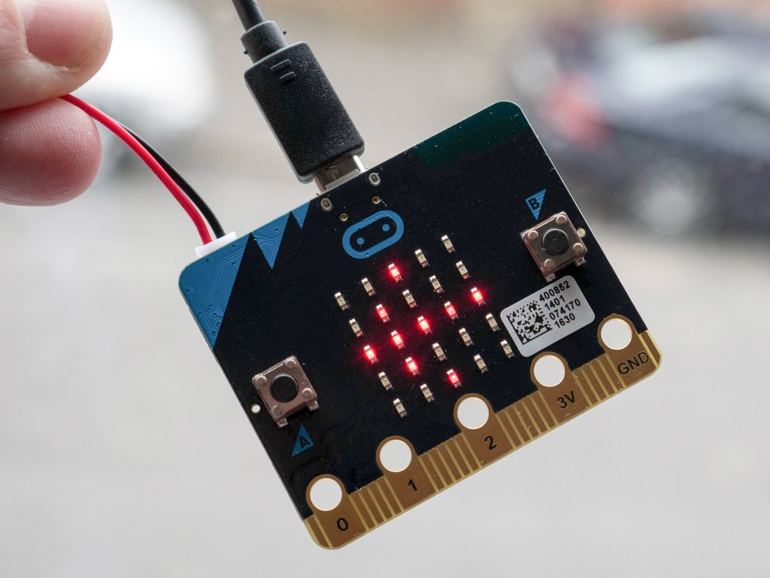
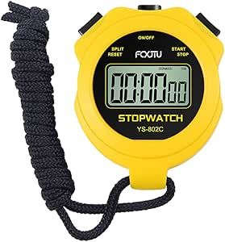
Data Gathering & Handling

Slide 24
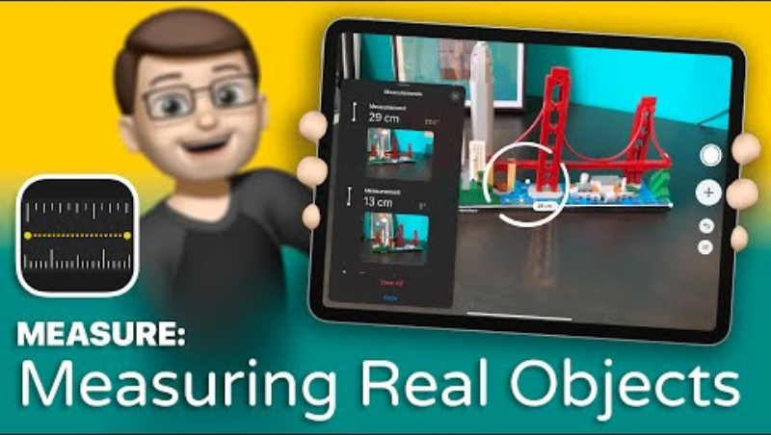
Measure App

Slide 25
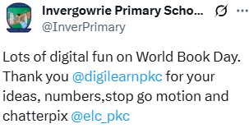
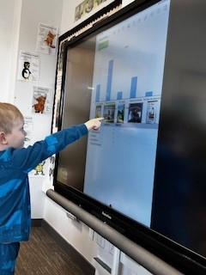
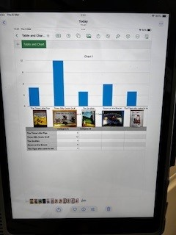

Slide 26
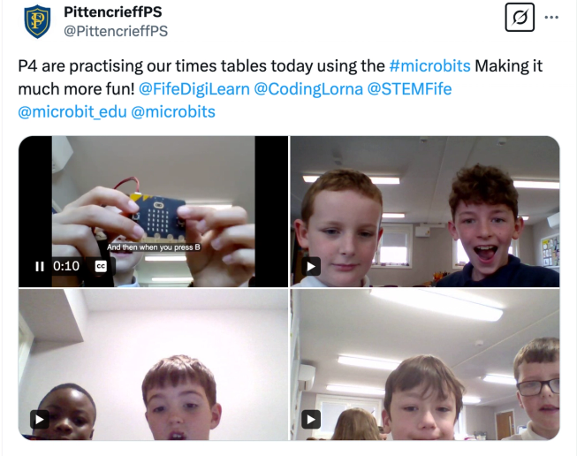
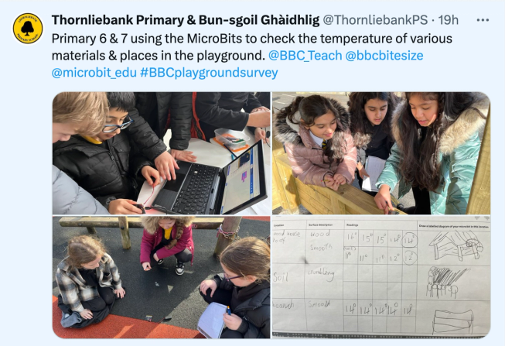
Micro:bit
The micro:bit can be used in the following ways:
Algebra: Solve for unknowns, explore patterns and sequences
Arithmetic: Perform basic operations, build counters, test multiplication
Geometry: Work with angles, distances, and coordinates
Handling data: Collect data using the micro:bits sensors to analyse and make predictions or solve problems
Measurement: Code step counters, record temperatures, measure distance
Number and place value: Create dice, test odd / even and prime numbers
Probability and statistics: Generate random numbers, track frequency, and visualise data
Enhance mathematics lessons with coding and the BBC micro:bit | micro:bit

Slide 27
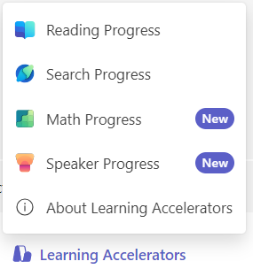
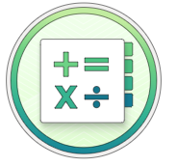

Maths Progress from Microsoft
In Maths Progress, students complete maths problems and receive customised feedback. Maths Progress helps educators:
Generate practice problems for their class
Differentiate to match students' understanding
Track student progress and identify focus areas for support
Build data-informed, targeted lessons
Support building mathematics skills with Math Progress - Training | Microsoft Learn

Slide 28
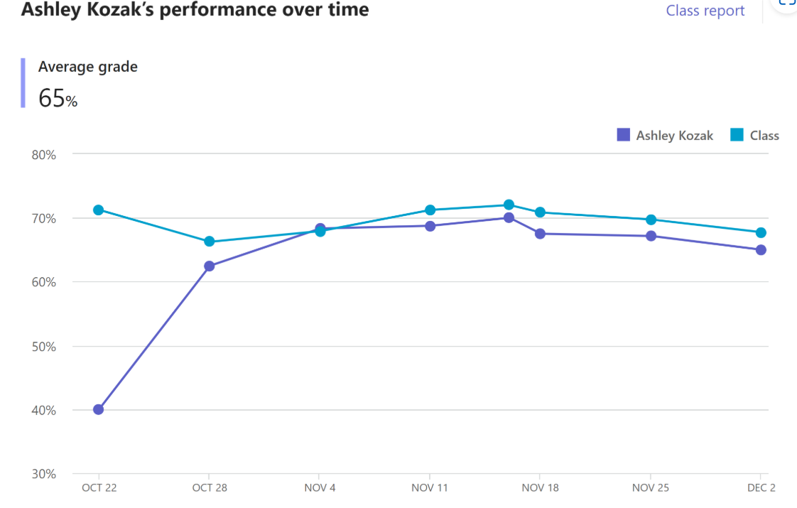

Slide 29
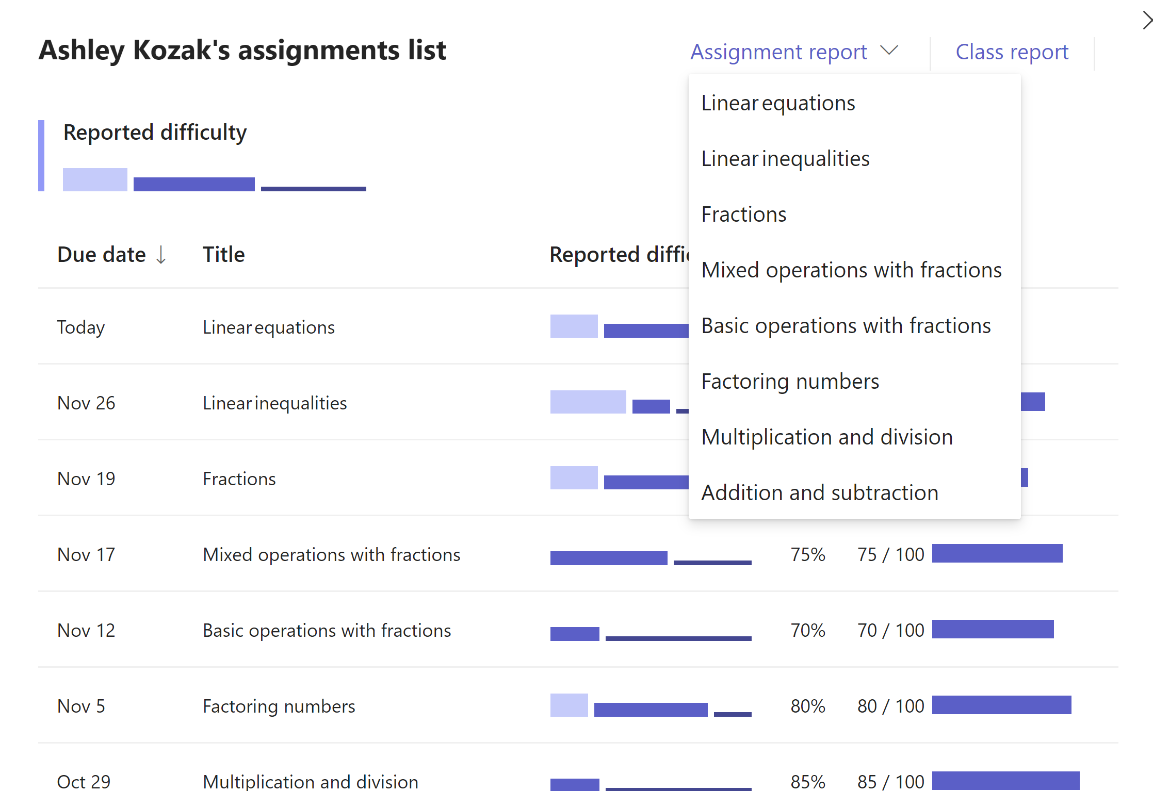

Slide 30
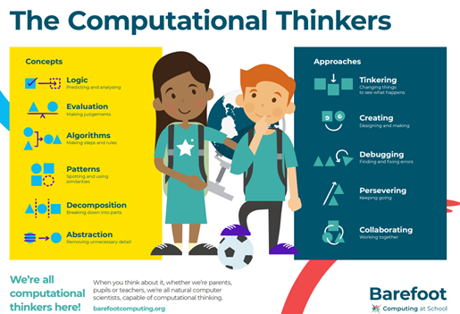
Computational Thinking

Slide 31
Barefoot
Barefoot Computational Thinking Resources
Links to-
patterns
sequences
directional language

Slide 32
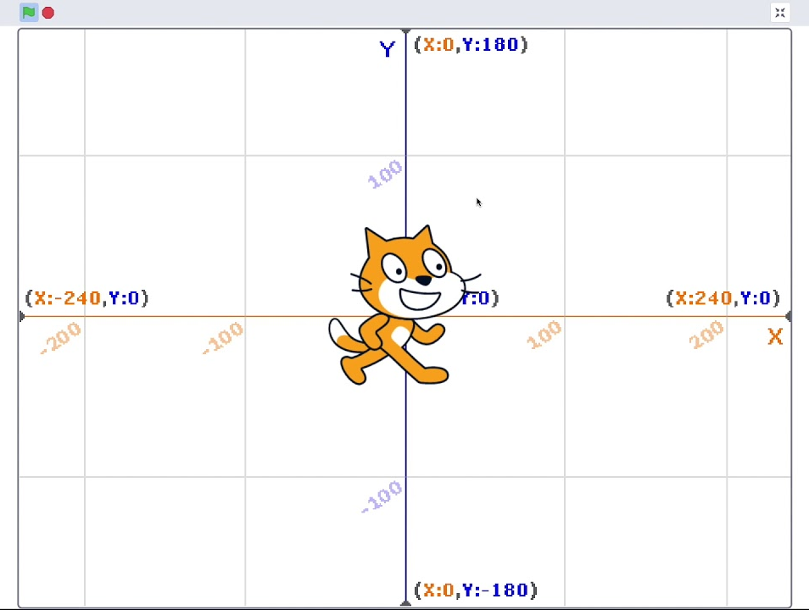
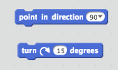
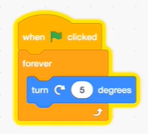
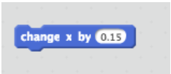
Scratch
Making Maths Meaningful Using Coding and Scratch | Fractus Learning |
Degrees of Turn
Working with Scratch requires students to experiment with the size of a turn and use them to control objects.
Negative Numbers
Coding with Scratch has provided a meaningful use for negative numbers which makes them less abstract. The background stage in Scratch is a basic XY grid. Anything placed to the left of, or below the centre will require positioning using negative numbers.
Cartesian Coordinates
It is almost impossible to do anything in Scratch without using X and Y coordinates. They are required to define the exact position of any object, and to allow objects to move either vertically nor horizontally.
https://youtu.be/vM-4ux6-7q0?si=EX527h1XubqJ9y9V
Decimals
Understanding and ordering decimals is usually challenging for primary school students. In Scratch, students use decimals to perform various functions such as adjusting the speed of an object. If they want to move an object to the right, they can change X by 1. But to slow that movement down, they need to start using smaller numbers.
Primary Lesson Plans

Slide 33
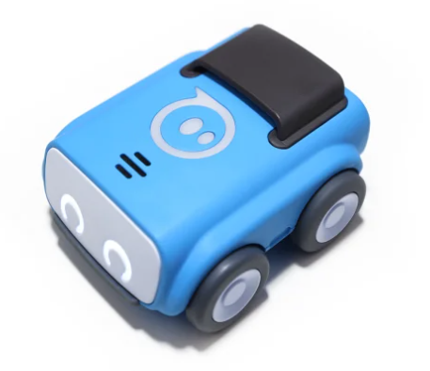
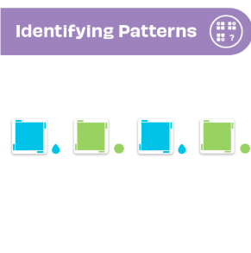
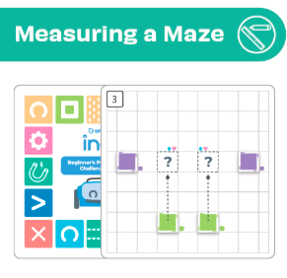
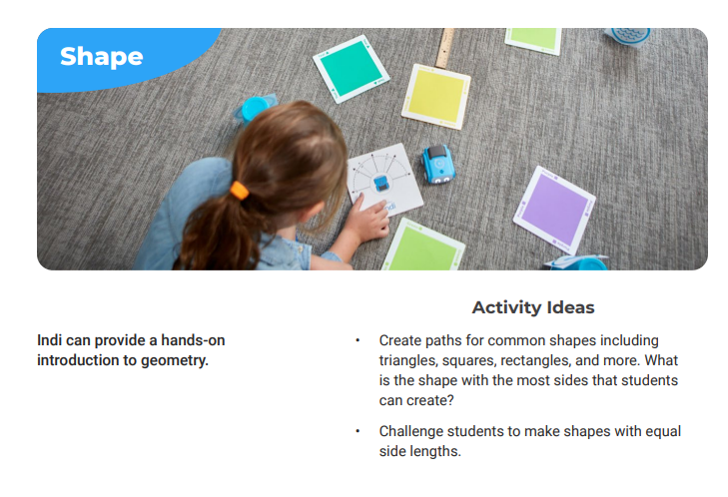
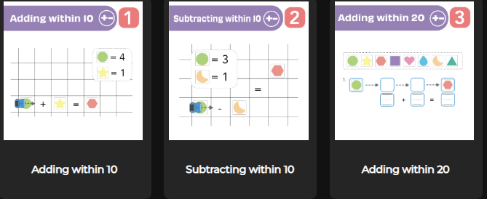
Sphero Indi
indi_literacy-math_support_02.pdf
Sphero Central: Edu Lessons & Resources for Coding Robots & STEM Kits

Slide 34
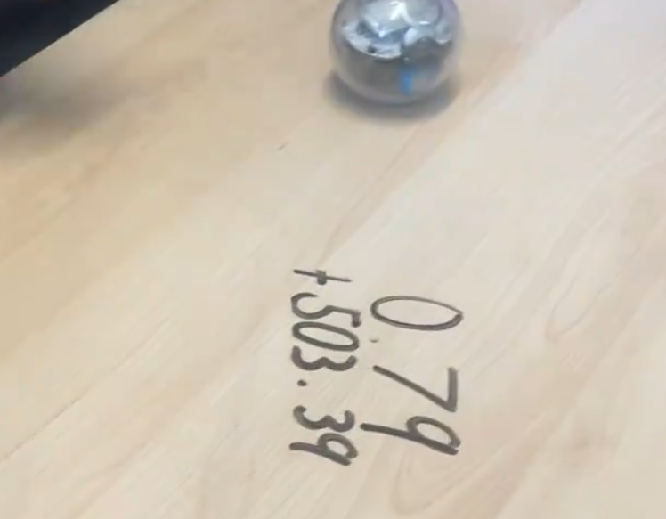
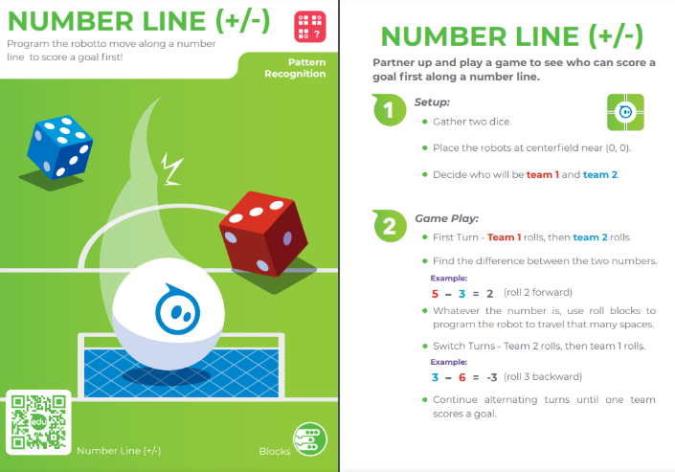
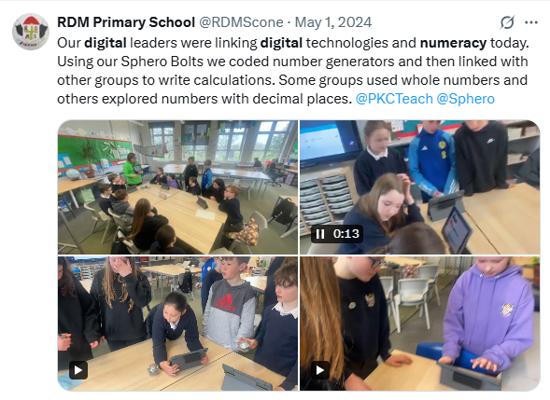
Sphero Bolt
Coding Robot for Kids & Teens | Sphero BOLT Resources & Activities
https://x.com/RDMScone/status/1785731783092244832

Slide 35

Sumdog

Slide 36
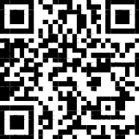
Tasks
Take a post it and write a short summary of 1 thing you will try from today and the impact you hope it will have.
Think about the maths topic(s) you are delivering this term. How can you use technology to redefine or modify this learning?
https://tinyurl.com
/whiteboardnumeracy

Slide 37
Example:
Work with learners to use the thermometer on the micro:bit. Take temperature readings in various locations or a different times of the day – Science. (Similar projects with using Micro:bit as pedometer - PE) Challenge – get the learners to send a temp reading to another thermometer using radio.
Work with learners to log data. Write down information on digital platform of their choice (pages/notes/OneNote)
Log this data in a spreadsheet. Challenge – discuss formula and filtering.
How to create a chart on Excel or Numbers to visualise data. Illustrate data using drawing tools on iPad.
Record Audio or Voice to describe trends and conclusions about temperature. (Numbers in iPad or import graph to Powerpoint). Challenge – Use Keynote animations to create interactive infographics
Add this to a whole class webpage using Adobe Express/Glow Blogs. Share or publish this.

Slide 38
Additional Resources
Recording Maths Lessons Using OneNote on the iPad

