Slide 1
Using Microsoft & Windows tools to Support Learners

Slide 2
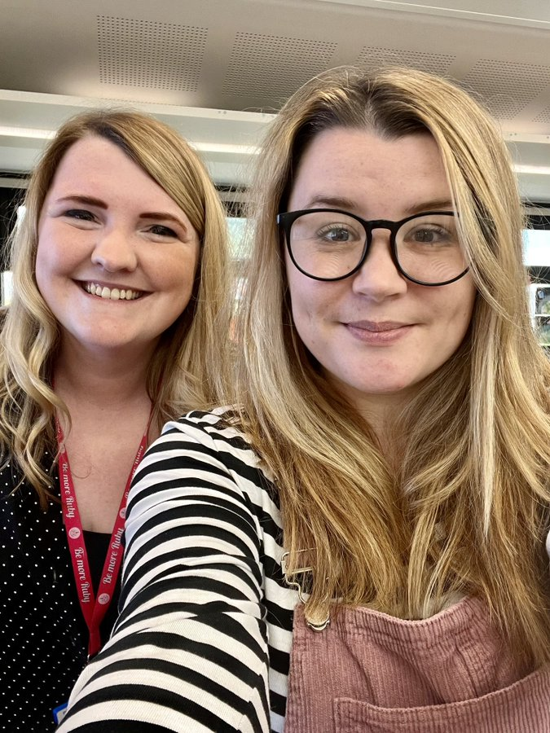
Who we are
Meg Brough
(FT ESO)
mbrough@pkc.gov.uk
Harriet Brownlee
(ESO + Primary Teacher)
hjbrownlee@pkc.gov.uk
What is our role?
To support you with all aspects of Digital Learning and Teaching.

Slide 3
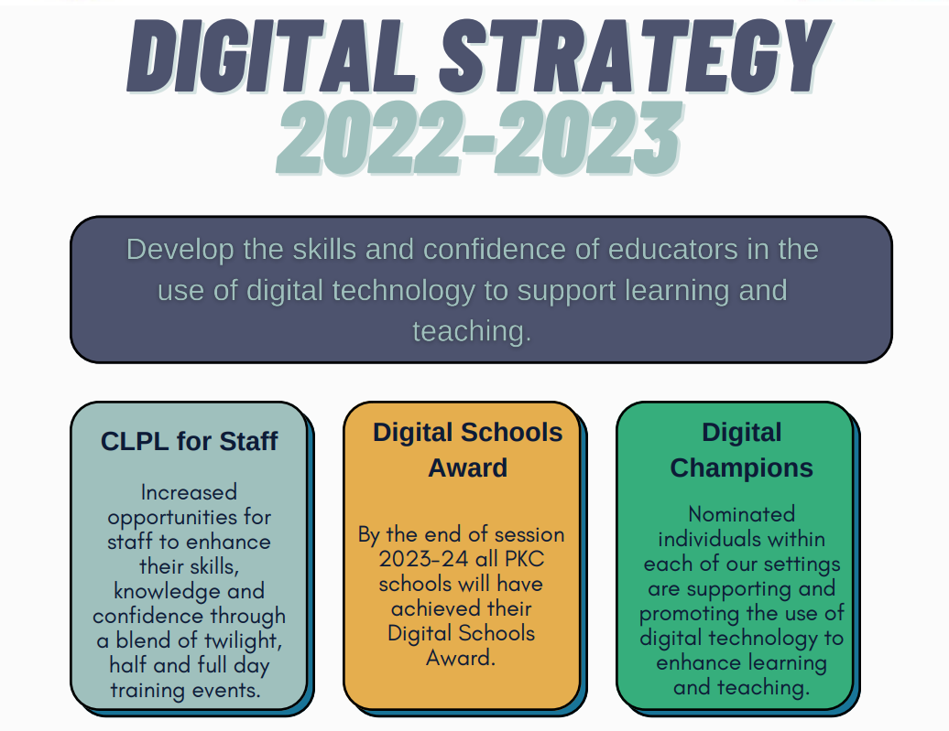
PKC Goals

Slide 4
A Digital Teacher- Your personal journey
Click here to view the Framework
Teachers should be able to:
create, modify, store and share resources for learning and teaching using local and cloud based services
communicate with peers using digital platforms including email, chat and virtual meetings
create and manage classes within a digital learning environment
share and distribute resources for learners within that environment
use and share accessibility tools available to them and their learners via digital devices in order to meet the needs of learners

Slide 5
Reflective questions…
Do you know how technologies can support learners with Additional Support needs?
Are you confident in your own abilities using technology to help raise attainment?
Do you embed technology in your classroom to ensure you provide a fully inclusive learning environment?
Do your computers/ devices in school meet the Scottish Government guidance on computer accessibility which is required for some pupils to access learning effectively and independently?
CALL Scotland: The use of inclusive digital technologies to raise attainment for learners who require additional support (Additional Support Needs) | Learning resources | National Improvement Hub (education.gov.scot)

Slide 6



What we will cover today:
Accessibility features on Windows devices
Additional apps
Learning tools
Learning Accelerators
Tools to support literacy

Slide 7
Promoting independent learning
Learning
Visual
Hearing
Mobility
Neurodiversity
Mental Health
Dyslexia
Dysgraphia
Dyscalculia
Cerebral Palsy
Muscle Dystrophy
Amputation
Autism
ADD/ADHD
Seizure
Anxiety
Depression
OCD
Social/Emotional Wellbeing
Low vision
Blind
Colorblind
Deaf
Hard of Hearing
Accessible technologies help students with disabilities unlock their full potential by addressing a diversity of needs:
See Microsoft Accessibility features for every classroom: http://aka.ms/AccessibilitySway

Slide 8


Windows Accessibility

Slide 9
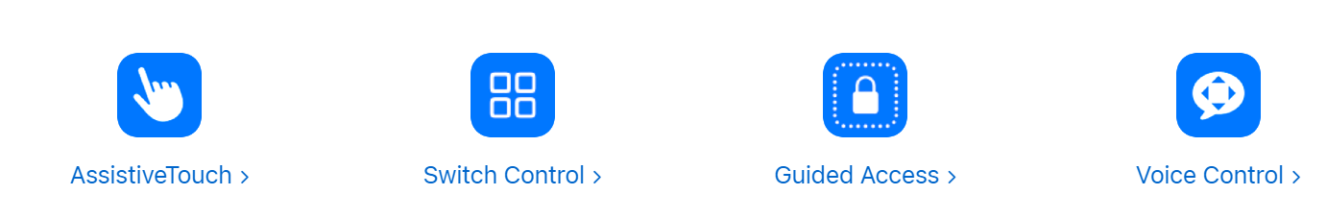
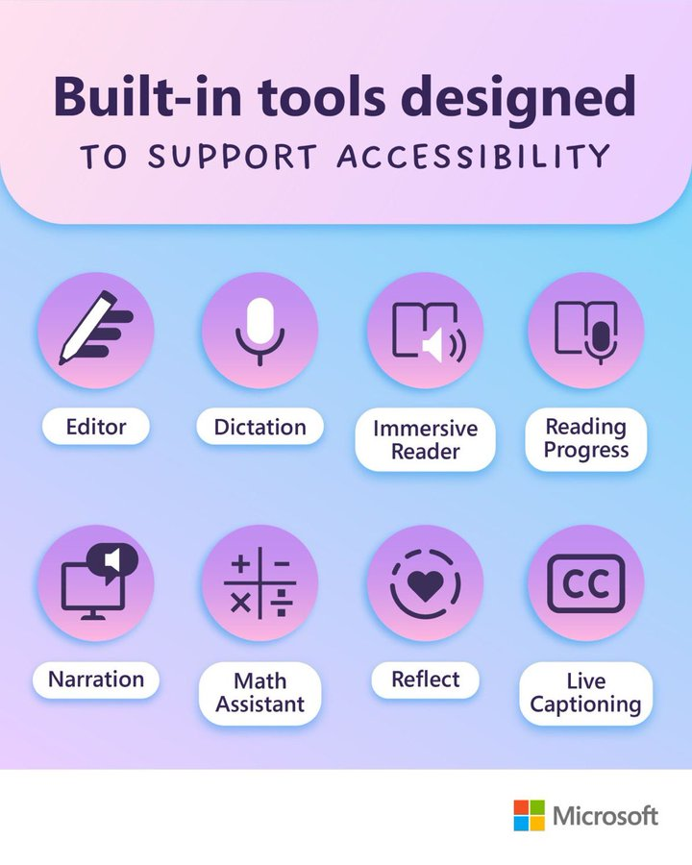

Recommended Accessibility Tools
Windows Ease of Access
Office 365 Accessibility tools
https://sway.office.com/voJZKilvVKZQrsOw?ref=Link

Slide 10
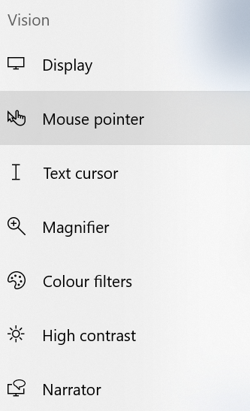
Ease of Access/Accessibility
Settings: Depending what version of Windows you have-
Either- “Ease of Access Centre” or “Accessibility”
Both are designed to create an independent computing experience that is tailored to the exact needs of the learner
Vision- Hearing- Interaction

Slide 11

Narrator
Screen reader which describes aloud what is on the screen
You can change settings – voices, what is read etc.
You can choose specific keyboard shortcuts
Sometimes easier to use ‘Read Aloud’ function in browser or 0365

Slide 12

Some other tools-
Some tools may need “turned on” by IT on pupil devices.
E.g. Dictate.
These can be turned on for particular pupils.

Slide 13

Magnifier
Magnifier enables you to zoom in on parts of your display. By default, it opens in full screen and will follow your mouse pointer, keyboard entry, text cursor, and narrator cursor.
On your PC:
Select Start (or press the Windows logo key on your keyboard), then select Settings > Ease of Access .
From the Vision menu select Magnifier .
Turn on Magnifier by switching the Off button to On.

Slide 14
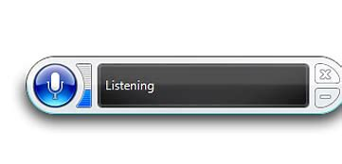
Speech Recognition
Go to Start , then select Settings > Ease of Access > Speech Recognition
Windows Speech Recognition commands - Microsoft Support

Slide 15
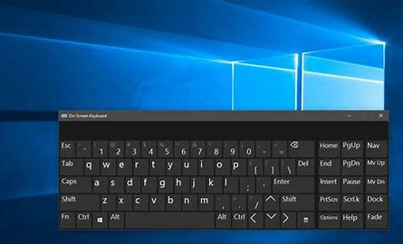
On Screen Keyboard
Go to Start , then select Settings > Ease of Access > Keyboard, and turn on the toggle under Use the On-Screen Keyboard. A keyboard that can be used to move around the screen and enter text will appear on the screen. The keyboard will remain on the screen until you close it.
There are several different kinds of keyboards for PCs. The most common type is a physical, external keyboard that plugs into your PC. But Windows has a built-in Accessibility tool called the On-Screen Keyboard (OSK) that can be used instead of a physical keyboard.
You don’t need a touchscreen to use the OSK. It displays a visual keyboard with all the standard keys, so you can use your mouse or another pointing device to select keys, or use a physical single key or group of keys to cycle through the keys on the screen.

Slide 16
Additional Apps

Slide 17

Translator
  Smartphone apps for in-person, multi-device translation for two or more participants, speech or text
  10 speech languages and 63 text languages
  Up to 100 participants at the same time
  Free Apps on iOS, Android, Windows UWP, PowerPoint and web.
  aka.ms/translatoredu

Slide 18

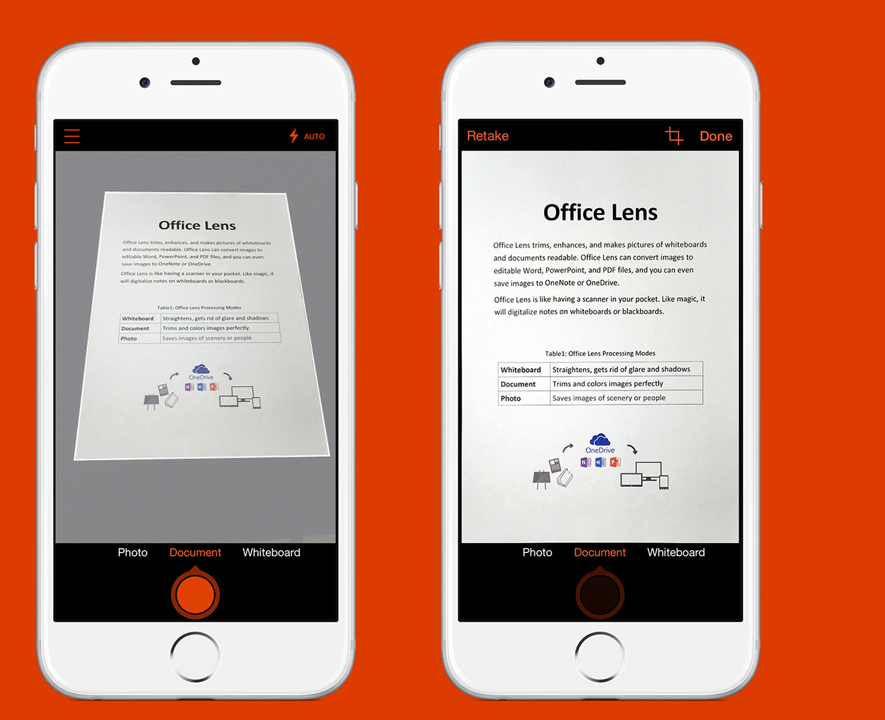
Office Lens
Office Lens supports reading inside and beyond the classroom!
Microsoft Office Lens is a great way to capture information from documents, whiteboards, homework assignments, or anything else containing text that you want to import so that it can be accessed digitally or read using Immersive Reader.
Images taken through Office Lens can be uploaded to Microsoft OneNote, Word, PowerPoint, or OneDrive, saved as PDF files or sent in email.

Slide 19









Seeing AI slide
Seeing AI
Talking Camera App for Blind Community
Real Time Text
People
Scenes
Handwriting
Documents
Products
Currency
Light
http://SeeingAI.com
Using on-device AI + Cloud

Slide 20
Learning Tools
Learning tools are tools which are built into Microsoft programmes which can help learners both universally and with additional support needs.
These include the use of features such as dictation (speech to text), read aloud (text to speech), translation etc

Slide 21
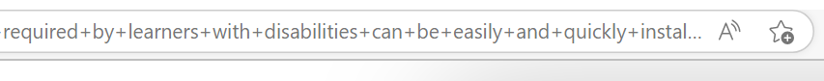


Read aloud
Ctrl + Shift + U
Highlight words and right click then select “Read Aloud”
Or
View- Immersive Reader- Read Aloud

Slide 22
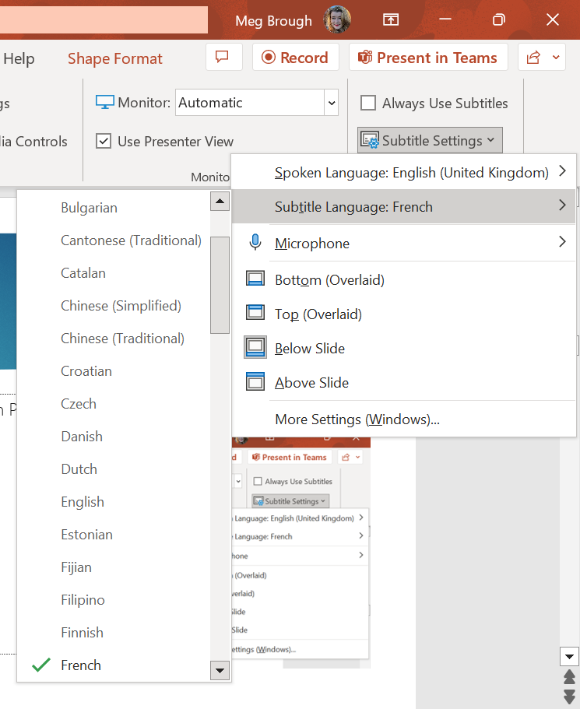
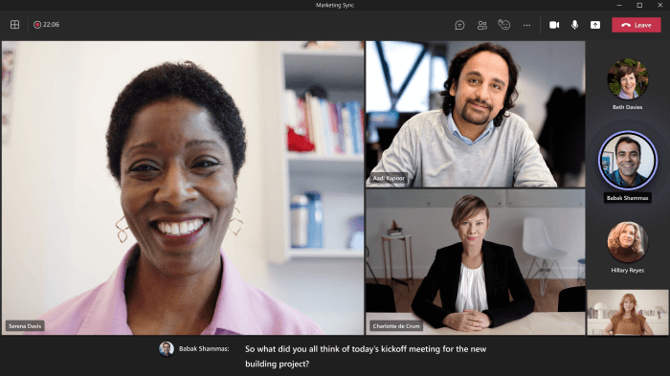
Subtitles and Captions
Present with real-time, automatic captions or subtitles in PowerPoint and Teams
Powerpoint > Slideshow > Subtitle Settings > Subtitle language
Teams > More Options > Turn on live captions > Captions Settings > Change Caption language

Slide 23
Powerpoint Live
Assembly – If you have Powerpoint live running, you can put up a QR code for a student to join. This means that they can join on their device to watch the presentation and have this downloaded free onto a different device. (This is not turned on in PKC, but should work if you are logged into Glow)
This also works on the translator app.
Students can watch captioning and access it in real time. This means you can include learners who speak many different languages.

Slide 24
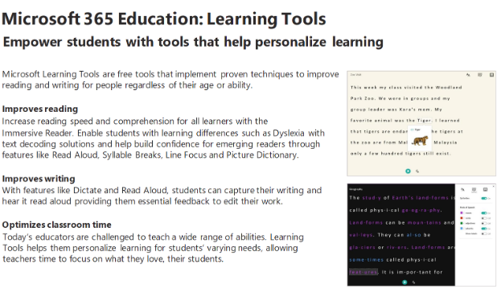

Slide 25
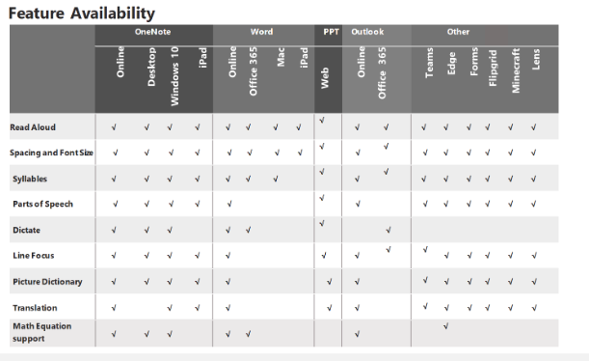
Digital Learning Tools | Microsoft Education

Slide 26
Learning Accelerators
Learning Accelerators are seamlessly integrated into products you already know and love like Microsoft Teams, OneNote, PowerPoint, Word, and more. With these powerful tools, students can start practicing right away, and you can start gathering data to help them get ahead.

Slide 27
Digital Learning Tools, Immersive Reader | Microsoft Education
Improve reading
Increase reading speed and comprehension for all learners with the
Immersive Reader. Enable students with learning differences such as Dyslexia with text decoding solutions and help build confidence for emerging readers through features like Read Aloud, Syllable Breaks, Line Focus and Picture Dictionary.
Improve writing
With features like Dictate and Read Aloud, students can capture their writing and hear it read aloud providing them essential feedback to edit their work.
Optimise classroom time
Today’s educators are challenged to teach a wide range of abilities. Learning Tools helps them personalize learning for students’ varying needs, allowing teachers time to focus on what they love, their students.

Slide 28
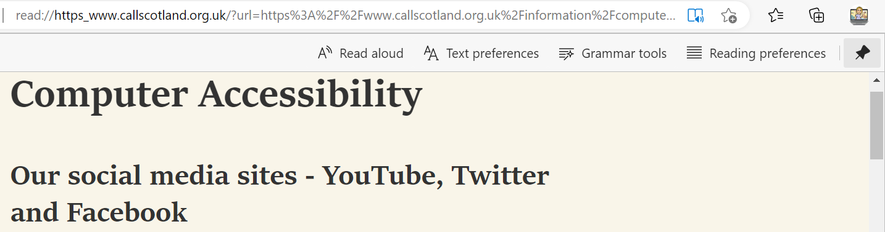
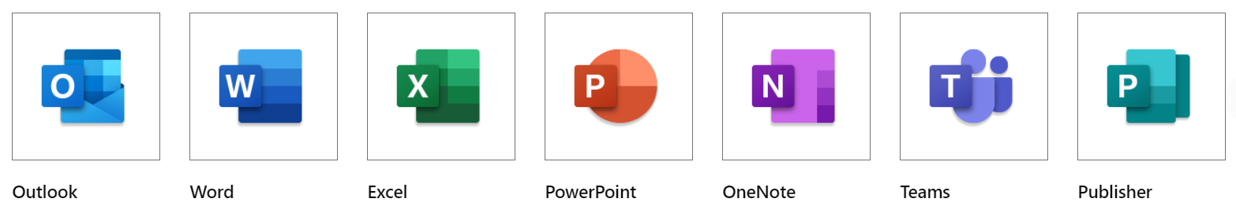

Immersive Reader in Microsoft Edge

Slide 29
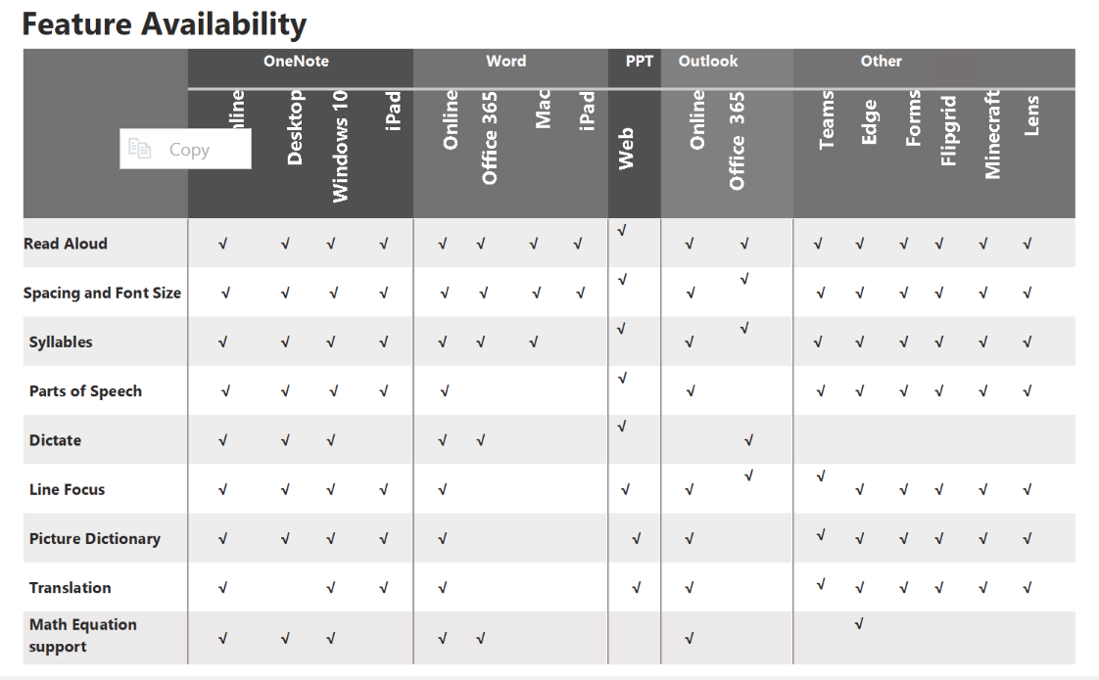
M365 Education - Learning Tools one pager.docx - Microsoft Word Online (live.com)

Slide 30
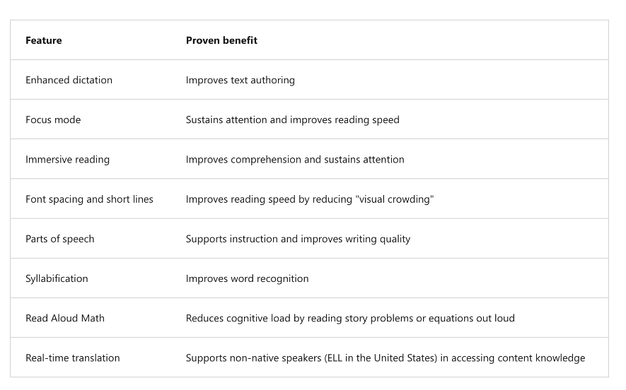
Immersive Reader
Microsoft's Immersive Reader is a free tool, built into Word, OneNote, Outlook, Office Lens, Microsoft Teams, Reading Progress, Forms, Flipgrid, Minecraft Education Edition and the Edge browser, that implements proven techniques to improve reading and writing for people regardless of their age or ability.

Slide 31
Learning Accelerators
Learning Accelerators are
Most of these tools are designed to work alongside Teams and/or Class Notebook

Slide 32

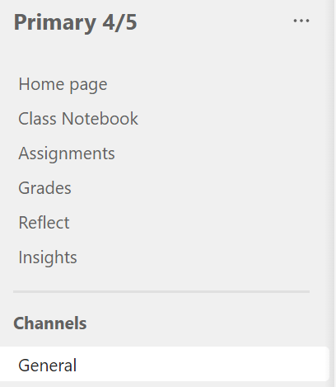
Setting up a class on Teams-
Use your Glow log in
Create a team
Select “class” and name your class
Add all the members of your class using the search bar
Now your Team is set up

Slide 33
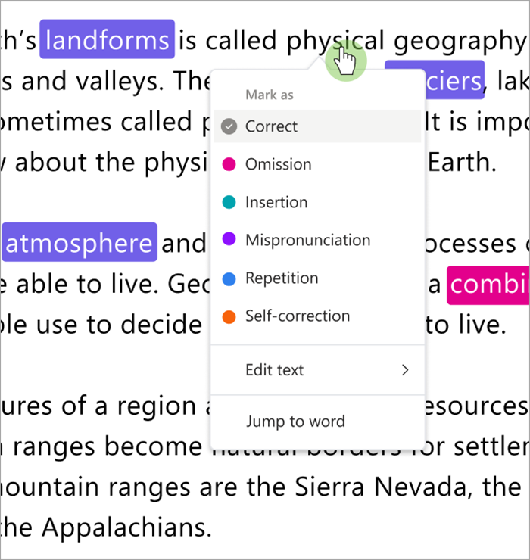
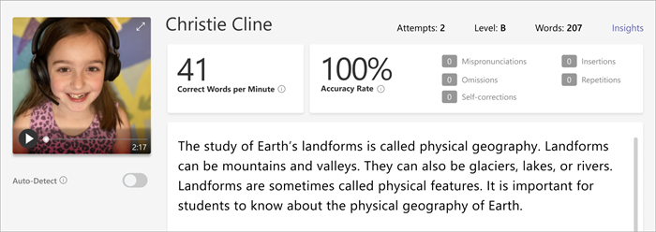
Reading Progress
Reading Progress is a free tool built into Microsoft Teams designed to support and track reading fluency in your class.
Students record their reading on camera and submit it to you. As you mark and return their work, data is automatically collected and organized in Insights, helping you spend more time with students and less time analysing data.

Slide 34
How to use Reading Progress
Navigate to the desired class, then select Assignments.
Select Create>Assignment.
Enter a title for this assignment – this is required.
Select Attach. Then select Reading Progress from the dropdown menu.
To select a passage for your students:
Choose Upload Word or PDF to use your own files, including files from Class Notebook, your Teams files, or OneDrive.
Select Browse sample library to use passages provided by ReadWorks.
6. Complete the additional fields to create more data sorting opportunities when reviewing student work.
7. Edit additional aspects of your assignment by adding Instructions, changing the Points or extending the Date due
8. Select which student's you'd like to have complete this assignment, then select Assign. Your students will be notified of their new assignment, and it will appear in your assignments list.​​​​​​

Slide 35
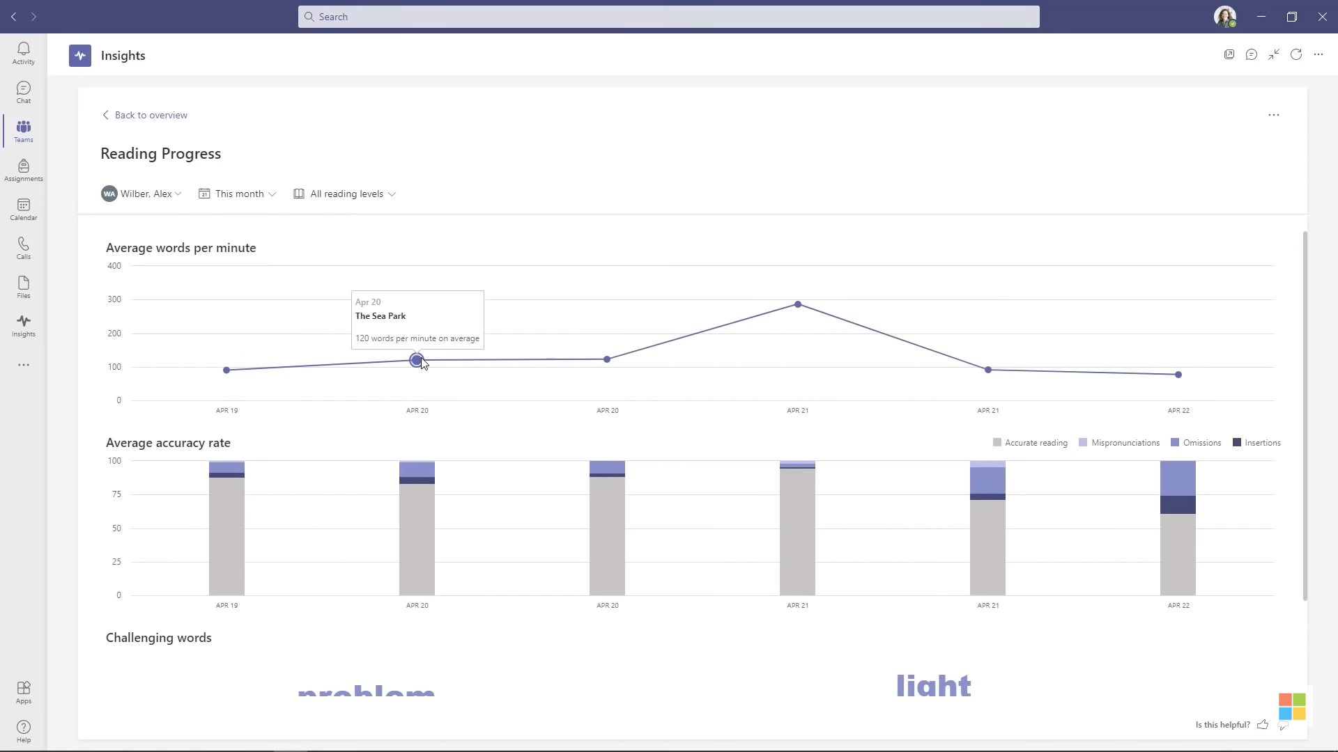

Slide 36

Full Reading Progress Webinar

Slide 37
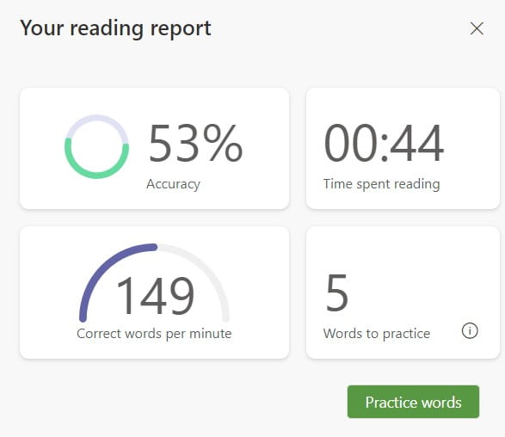
Reading Coach in Immersive Reader
Microsoft has recently added a new reading fluency practice feature to Immersive Reader called Reading Coach. Using a tool that has Immersive Reader such as Microsoft Word, a learner reads a passage aloud. Reading Coach then analyzes the audio to provide specific, personalized feedback to the individual including five target words to practice.

Slide 38
Literacy One Page Guides

Slide 39


Supporting and improving literacy with Microsoft Tools
Reading
Writing
Talking
Listening
Reading Progress
Immersive Reader
Read aloud
Dictation
Editor
Word Prediction
Educators should use the ‘Accessibility Checker’ tool to ensure their content is accessible to all learners
Immersive Reader
Captions and subtitles
Read Aloud
Slide record
PowerPoint ‘Rehearse with Coach’
Text to Speech
Translator app supports EAL
students to access
all aspects of the
curriculum.

Slide 40


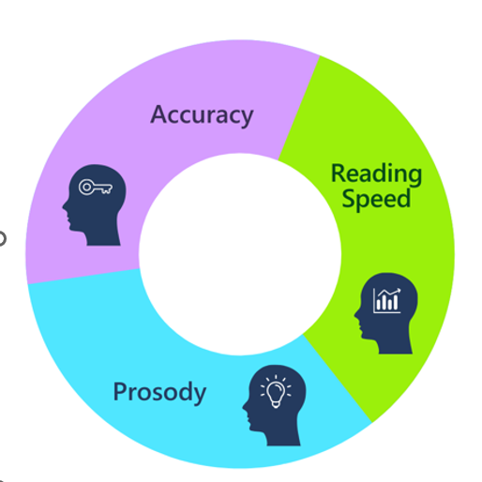


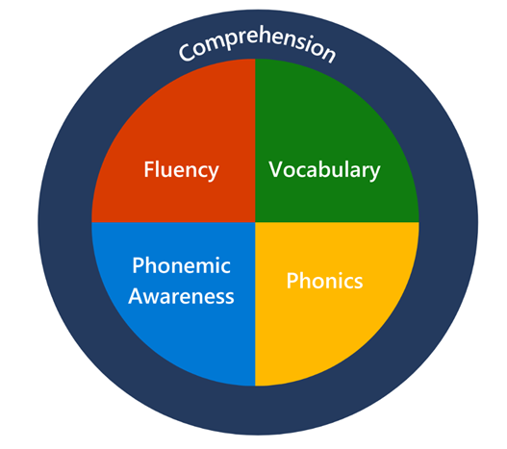


Supporting and improving reading with Microsoft Tools
Although you might want to use PowerPoint features to make learning sounds more interactive!
Decoding
Phonemic Awareness through school/authority recommended reading programme
Reading Coach
Reinforces Phonemic awareness
based on insights
Comprehension
Fluency
Immersive Reader
Reading Progress in Microsoft Teams

Slide 41
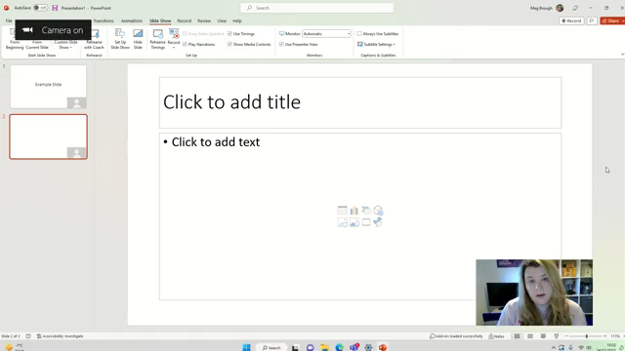
Speaker Coach
How to use Speaker Coach in Microsoft Teams meetings - YouTube
How to use 'Rehearse with Coach' in Powerpoint -

Slide 42
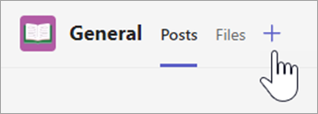
Search Coach
Search Coach is designed to teach students how to compose efficient search queries and evaluate their results. The patterns taught in Search Coach can be applied in traditional search engines like Bing and Google, as well as academic search engines.
From the general channel of any class, select +.
Search for and select Search Coach.
Select Add then select Save.
Digital literacy lesson plans - Microsoft Learn Educator Center | Microsoft Learn

Slide 43
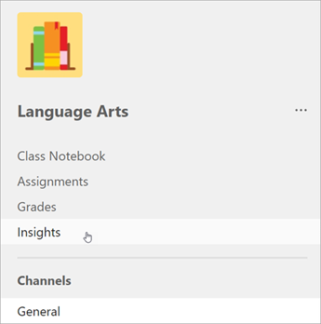
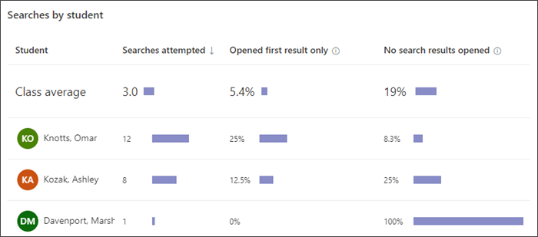
Search Coach Insights
Search Coach outcomes will appear in Insights
How many searches each student attempted
How often each student opened only the top site on the results page
How often each student performed searches without opening any results
A class average of all the above

Slide 44

Full Search Coach Guide

Slide 45
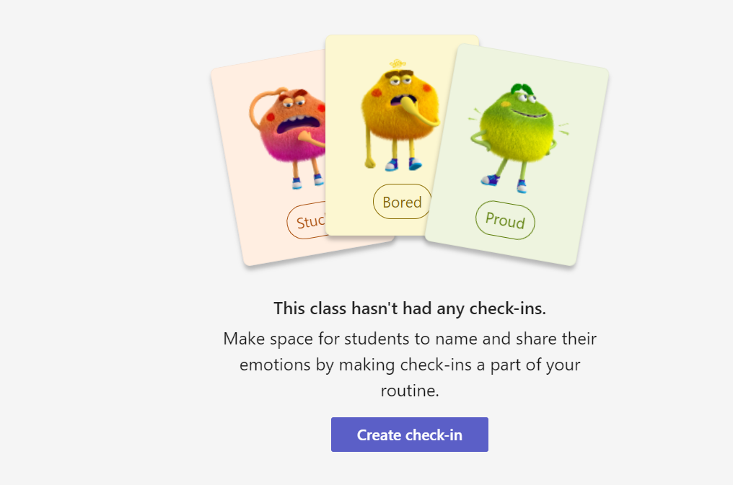
Microsoft Reflect – Social and Emotional Wellbeing
Gives learners the words to express their emotions
Improves Social and Emotional Wellbeing

Slide 46
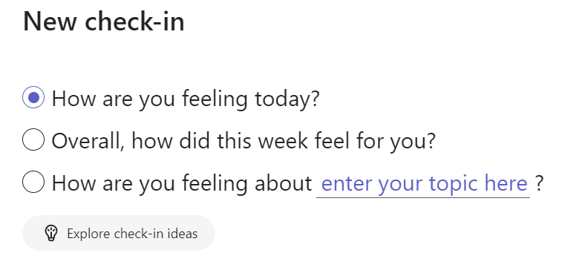
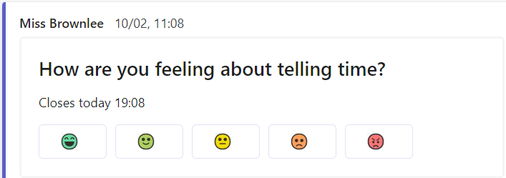
Microsoft Reflect

Slide 47
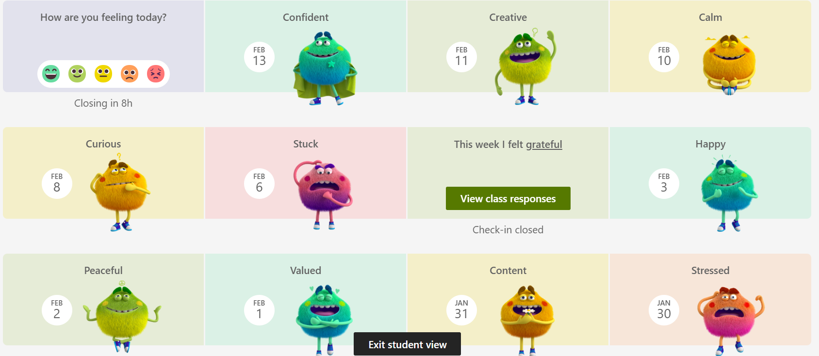

Slide 48

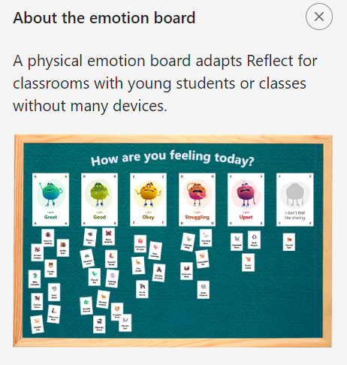
Click here to find out more about the new features within Microsoft Reflect:

Slide 49
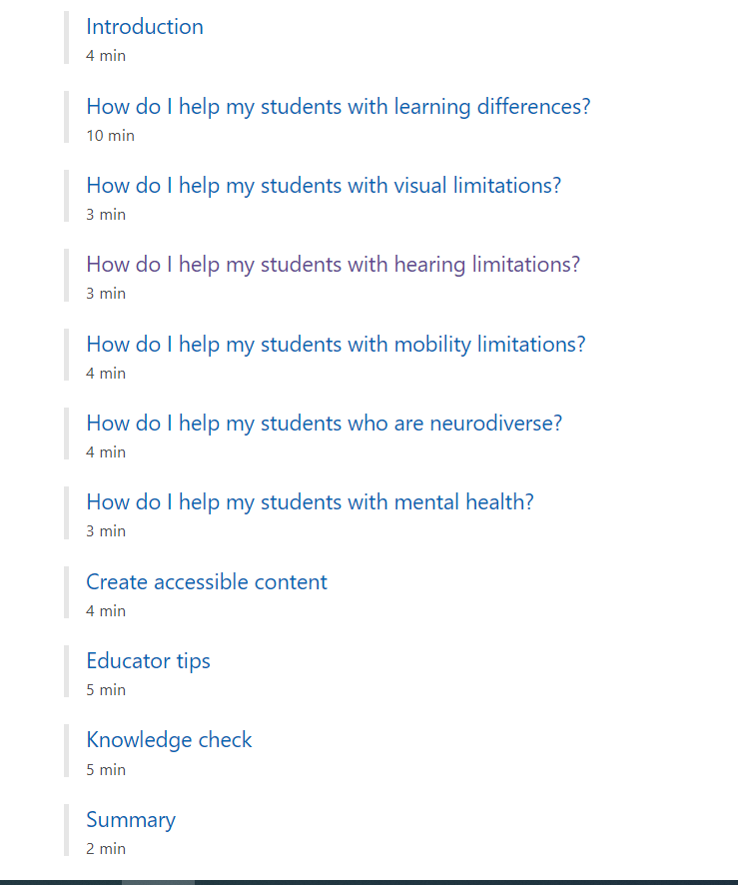
Self Guided Learning-
Microsoft Learn Educator Pathways
https://learn.microsoft.com/en-us/training/educator-center/topics/accessibility

Slide 50

Accreditation on Microsoft Learn
To redeem your code from today, go to Microsoft Learn > Profile > Achievements and 'redeem your code now.'
Today's code : PKCACCESSIBILITY23

Slide 51

https://forms.office.com/e/xpGxNqY4zP

Slide 52
Useful Digital Documents
Features of Highly Effective Digital Learning, Teaching and Assessment in Schools (education.gov.scot)
Contents - Enhancing learning and teaching through the use of digital technology - gov.scot (www.gov.scot
Planning improvements for disabled pupils' access to education: guidance for education authorities, independent and grant-aided schools - gov.scot (www.gov.scot)
CALL Scotland: The use of inclusive digital technologies to raise attainment for learners who require additional support (Additional Support Needs) | Learning resources | National Improvement Hub (education.gov.scot)

Slide 53


Get in touch
@DigiLearnPKC
mbrough@pkc.gov.uk – Meg Brough
hjbrownlee@pkc.gov.uk – Harriet Brownlee
Perth and Kinross Digital CLPL Site – DigiLearnPKC (glowscotland.org.uk)

Slide 54
Important links
Contents - Enhancing learning and teaching through the use of digital technology - gov.scot (www.gov.scot)
Digital Vision – DigiLearn (glowscotland.org.uk)
https://education.gov.scot/media/uh2jebbs/nih158-what-digital-learning-might-look-like.pdf
https://education.gov.scot/media/cxwnqrma/nih312-features-of-highly-effective-digital-learning-and-teaching-01-22.pdf

