Slide 1
Supporting and improving literacy with Microsoft Tools
Reading
Writing
Talking
Listening
Reading Progress
Immersive Reader
Read aloud
Dictation
Editor
Word Prediction
Educators should use the ‘Accessibility Checker’ tool to ensure their content is accessible to all learners
Immersive Reader
Captions and subtitles
Read Aloud
Slide record
PowerPoint ‘Rehearse with Coach’
Text to Speech
Translator app supports EAL
students to access
all aspects of the
curriculum.
Improving Lives Together Ambition | Compassion | Integrity

Slide 2
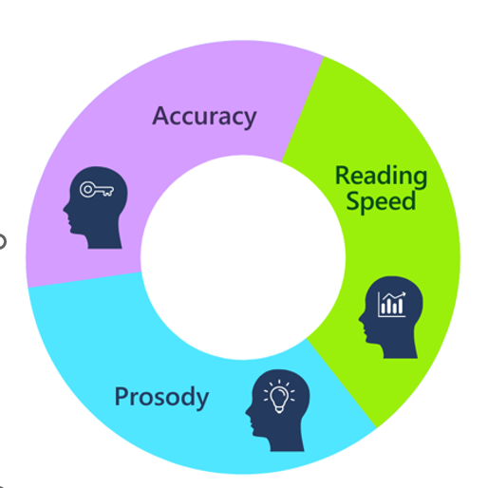
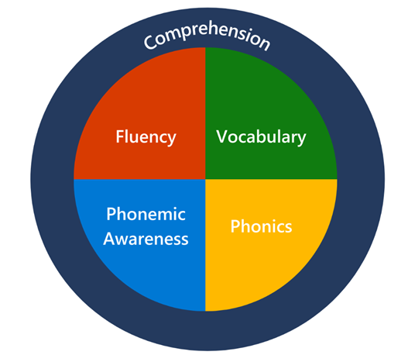
Supporting and improving reading with Microsoft Tools
Although you might want to use PowerPoint features to make learning sounds more interactive!
Decoding
Phonemic Awareness through school/authority recommended reading programme
Reading Coach
Reinforces Phonemic awareness
based on insights
Comprehension
Fluency
Immersive Reader
Reading Progress in Microsoft Teams

Slide 3
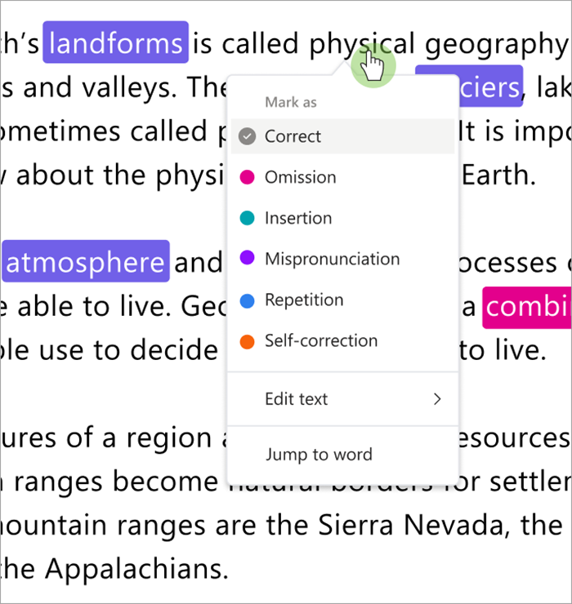
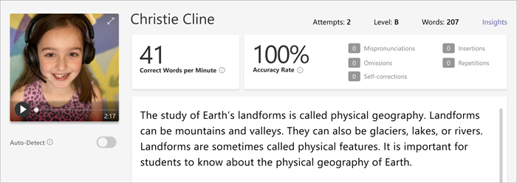
Reading Progress is a free tool built into Microsoft Teams designed to support and track reading fluency in your class.
Students record their reading on camera and submit it to you. As you mark and return their work, data is automatically collected and organized in Insights, helping you spend more time with students and less time analysing data.

Slide 4
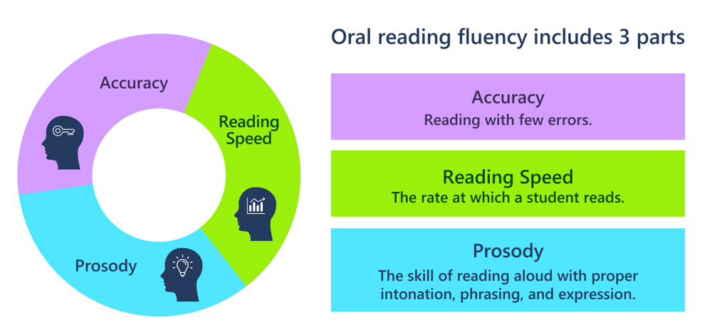
What is reading fluency?
Notes:
Say: Reading fluency is a reader’s ability to read text with accuracy, speed, and expression. When fluent readers read, they first read words (surface level) and secondly derive meaning from text (deeper level). A fluent reader focuses on three characteristics:
Accuracy: Reading with few errors.
Speed: The rate at which a reader reads.
Prosody: Reading aloud with proper intonation, phrasing, and expression.
Do: Advance to the next slide.

Slide 5
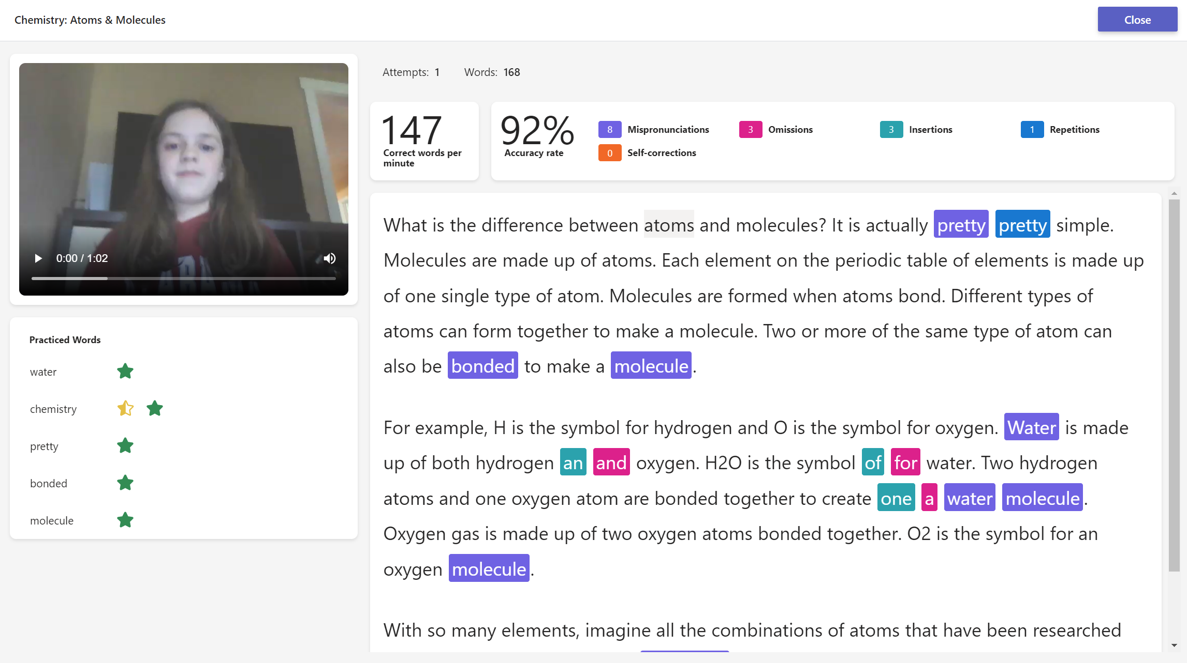
Teacher View
Notes:
Say: Reading fluency is a reader’s ability to read text with accuracy, speed, and expression. When fluent readers read, they first read words (surface level) and secondly derive meaning from text (deeper level). A fluent reader focuses on three characteristics:
Accuracy: Reading with few errors.
Speed: The rate at which a reader reads.
Prosody: Reading aloud with proper intonation, phrasing, and expression.
Do: Advance to the next slide.

Slide 6
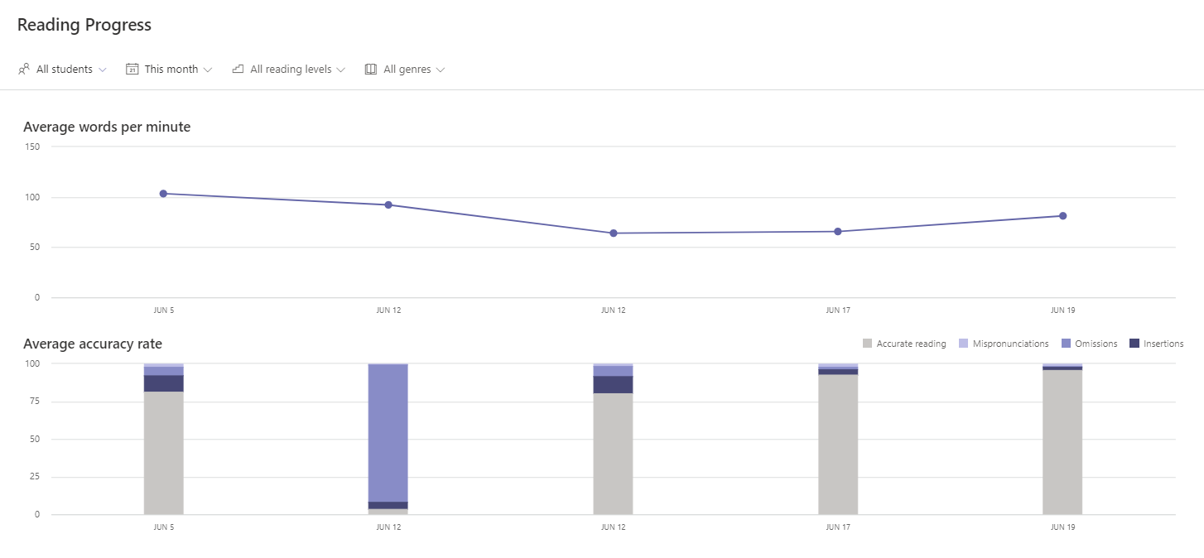
Insights and Analytics
Notes:
Say: Reading Progress in Teams allows educators and districts to view data on both accuracy, errors, and overall trends in fluency data. The data can be viewed by school, class, or educator. Let’s take a look at what this data looks like.
Do: Advance to the next slide.

Slide 7
Insights and Analytics
Notes:
Say: The first screen that you see when opening Reading Progress is the overall trend in fluency data for the whole class.
You can click on each circle in the line graph to view the assignment name and the correct words read per minute.
You can also click down below on each individual assignment to find more information for omissions, insertions, mispronunciation, and accuracy for the assignment.
The dashboard tracks class and individual student data over time for each assignment completed in reading progress.
Information from the dashboard can also be exported to Excel.
Do: Advance to the next slide.

Slide 8
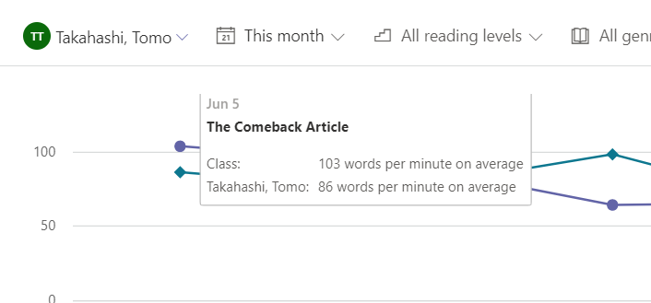
The dashboard automatically displays class fluency information.
You can isolate specific student, reading level or assignment by changing the selection box above the line graph.
When you isolate the data, it displays information about all completed fluency assignments for that student or reading level. From there, you can hover over the circles in the line graph or click on the bar graphs to get additional information.

Slide 9
Notes:
Say: Reading Progress also provides information about the most mispronounced words in a fluency assignment.
A word cloud is created, and the size of the word indicates how often it was mispronounced. The larger the words, the more times the word was mispronounced.
This information can help drive word study or be used to create a center for reading rotations. Educators can also create Reading Progress assignments based on these words, for the entire class or individual students. Hovering over each word displays how many times each word is mispronounced. Educators create a new challenge assignment for students straight from this dashboard. The Challenge Assignment is created automatically, and learners completing the assignment will practice the selected challenge words through the Reading Progress activity.
Schools can subscribe to Education Insights Premium and gain access to system-wide data and analytics.

Slide 10
The student experience in Reading Coach
Notes:
Do: Log in to a student account in your sample class (Slide 17).

Slide 12
Immersive Reader
Microsoft's Immersive Reader is a free tool, built into Word, OneNote, Outlook, Office Lens, Microsoft Teams, Reading Progress, Forms, Flipgrid, Minecraft Education Edition and the Edge browser, that implements proven techniques to improve reading and writing for people regardless of their age or ability.

Slide 14
Writing efficiency: Dictation, Editor, and Word Prediction
Word Prediction: Windows 10 Word Prediction (also known as text suggestions) offers suggestions for words as the user types.
Editor: An enhanced spell checker, Editor takes natural language capabilities, focus and attention, and read-aloud, and combines them into one easy-to-use interface.
Dictation: Some students really struggle with getting their ideas on paper. Using the Dictate feature within Microsoft Word and OneNote enables students to use technology without the frightening burden of typing things perfectly.

Slide 15
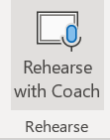
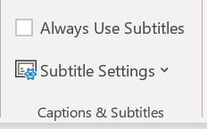
Tools for Listening and Talking
Powerpoint: Present in real time, screen record and ‘Rehearse with Coach’
Read Aloud
Microsoft Translator App: Allow ESOL learners to engage in meaningful conversations and translate written documents
Microsoft Captions and Subtitles: Live subtitles in many languages
Text to Speech – Dictate feature
“Speak”
Read Aloud

Slide 16
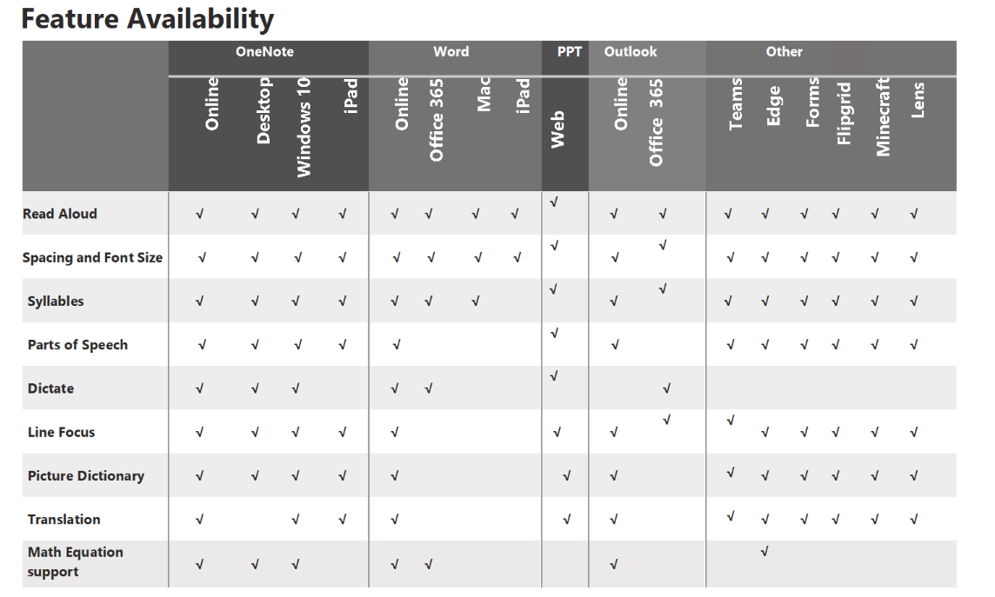
“Learning Tools One Pager”
https://onedrive.live.com/view.aspx?resid=53C617FAC1BF5355!66541

Slide 17
Success stories and Case Studies
New research shows Learning Tools improved reading comprehension in diverse student groups RTi Research
Learning Tools are a game changer for my special education students Lauren Pittman, special education teacher at Holly Springs Elementary School in Georgia
Learning Tools For Microsoft OneNote May Be One Of The Most Disruptive Education Technologies Yet Jordan Shapiro, Forbes Magazine
Struggling 1st grade readers improve with the help of OneNote Learning Tools Jeanne Caudill, 1st Grade Teacher and MIEE, Mullins School, Kentucky
Learning Tools and Immersive Reader updated for OneNote, Word and Outlook Microsoft Education Blog

Slide 18
Call Scotland Support
Blogs
Immersive Reader (callscotland.org.uk)
Immersive Reader in Powerpoint (callscotland.org.uk)
Getting Immersive Reader in Edge to Work (callscotland.org.uk)
How to Read Maths with Immersive Reader (callscotland.org.uk)
Using Immersive Reader with the Edge Browser App and Chrome Extension (callscotland.org.uk)
Using Immersive Reader with Teams (callscotland.org.uk)

Slide 19
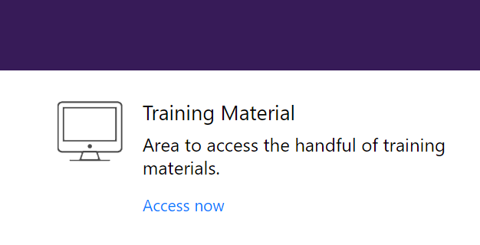
Training Resources
“Support fluency with Reading Progress” > MS Learn Module
Immersive Reader product guide - Microsoft Learn Educator Center | Microsoft Learn
Accessibility, special education, and online learning: Supporting equity in a remote learning environment - Training | Microsoft Learn
Empower every student with an inclusive classroom - Training | Microsoft Learn

