Slide 1

Learning about land use: A. Deforestation and health Geography Second Level
Notes:
Answers:
C
D
B
A
Our world is a delicate resource and also under threat if we don’t look after it.

Slide 2
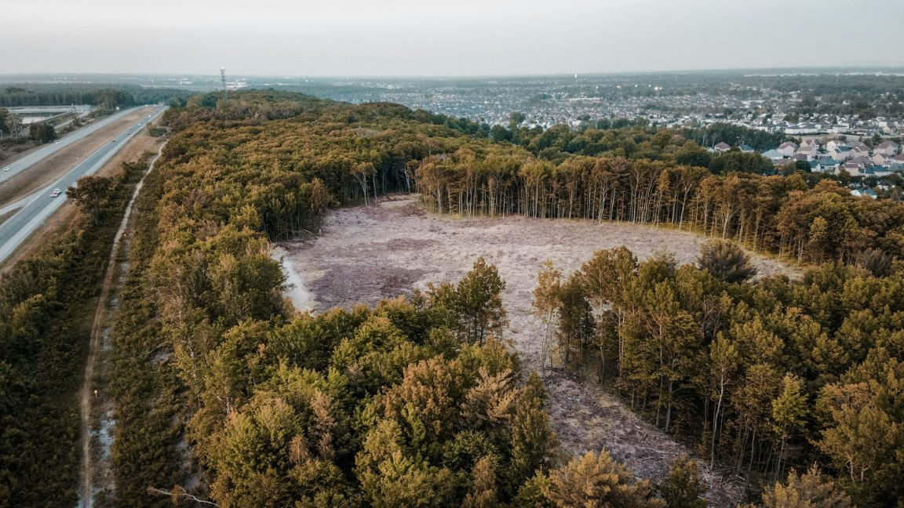
Starter
I see...
I think...
I wonder...
Notes:
Starter:
Give pupils this stimulus and ask them to discuss with a partner and write down what the see, what the think about the picture (aiming to tease out deforestation and the likelihood these trees have been cleared b humans – road nearb. Mabe for logging?). Could do this as a silent task first then ask pupils to go around and find someone else who had a similar idea to them and at least 2 other pupils that had different ideas – the can note these down 'cops and robbers'.

Slide 3
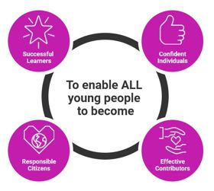
Learning intention and success criteria
(add your own)
Success Criteria:
(add your own)
Notes:
Answers:
C
D
B
A
Our world is a delicate resource and also under threat if we don’t look after it.

Slide 4
Learning intention and success criteria
We are learning about the harm caused by deforestation and exploring ways to improve our use of trees and forests
SCs could be:
I can state what deforestation is
I can describe at least two negative effects of deforestation on people or nature
I can imagine solutions to reduce the impact of deforestation
Notes:
Answers:
C
D
B
A
Our world is a delicate resource and also under threat if we don’t look after it.

Slide 5
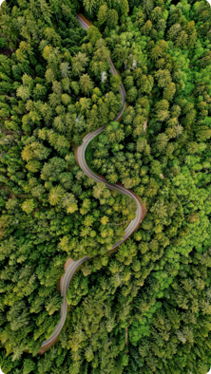
Starter: Why are forests important?
THINK
take a moment to think about this yourself first...
PAIR
talk to your shoulder partner about your ideas...
SHARE
ready to share an idea or two with the class?
Notes:
Starter:
Give pupils this stimulus and ask them to discuss with a partner and write down what the see, what the think about the picture (aiming to tease out deforestation and the likelihood these trees have been cleared b humans – road nearb. Mabe for logging?). Could do this as a silent task first then ask pupils to go around and find someone else who had a similar idea to them and at least 2 other pupils that had different ideas – the can note these down 'cops and robbers'.

Slide 6
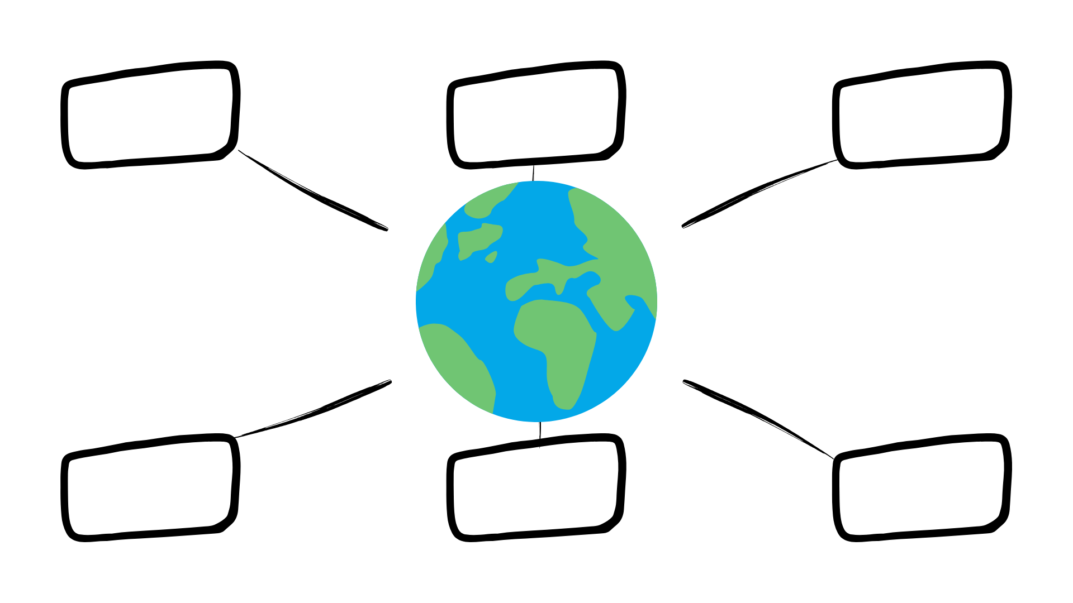
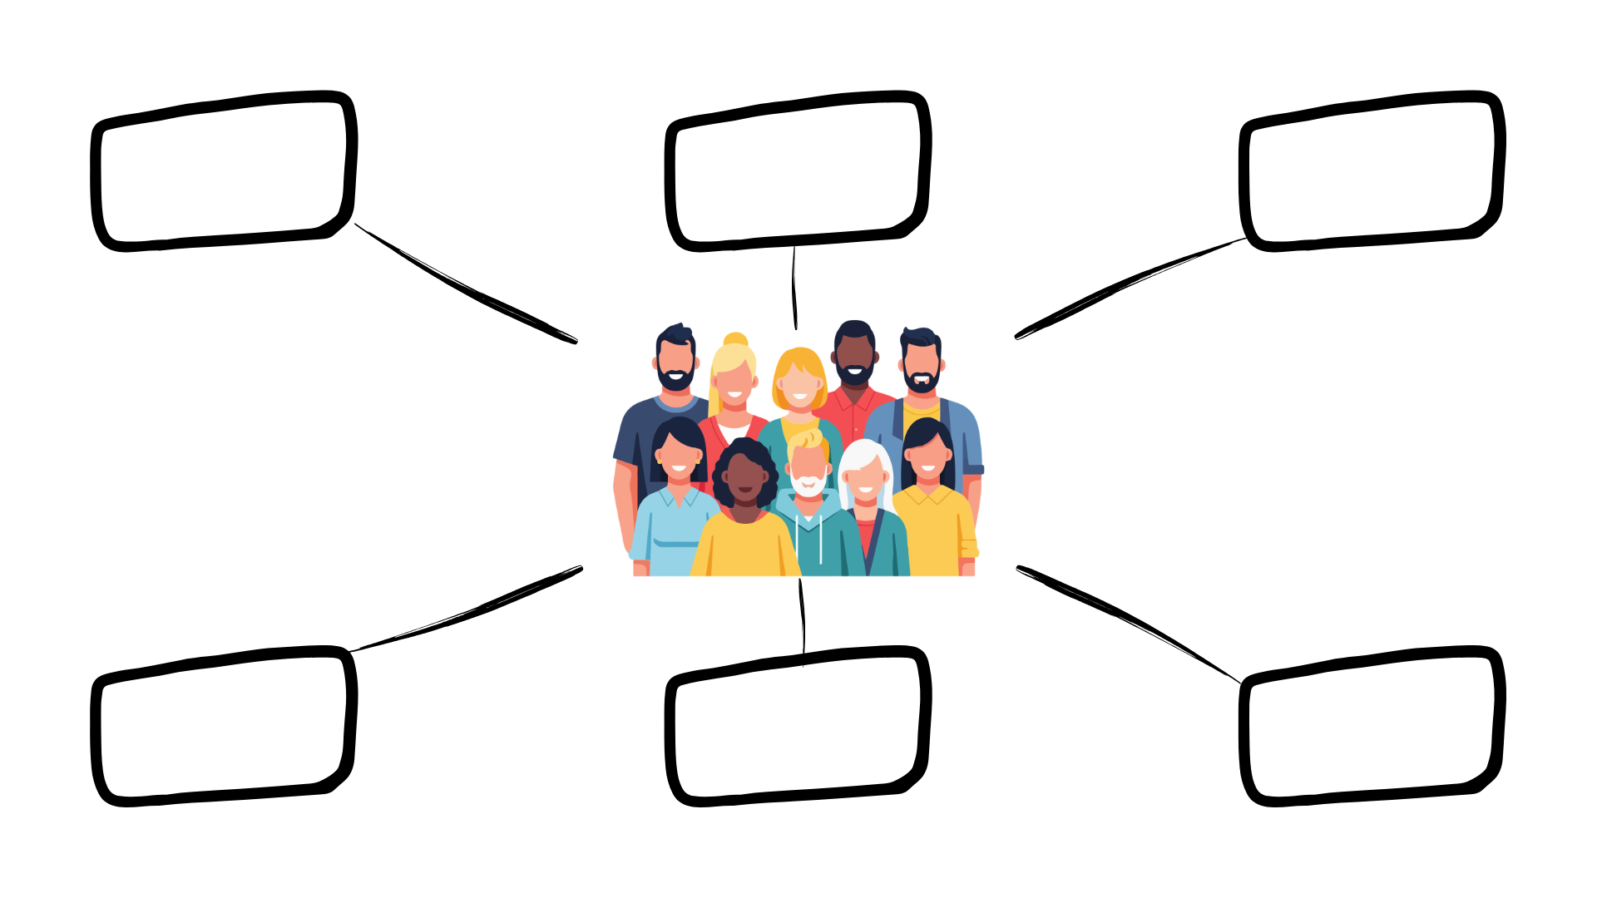
Activity 1: Ways trees can be good
for the planet
for people
Notes:
Use this space or similar to record ideas from discussion as a class – you will need this later
PLANET: Habitat / water cycle / pupils may struggle to come up with more than this...
PEOPLE: paper / fuel / building materials / to produce food … THE LIST GOES ON

Slide 7
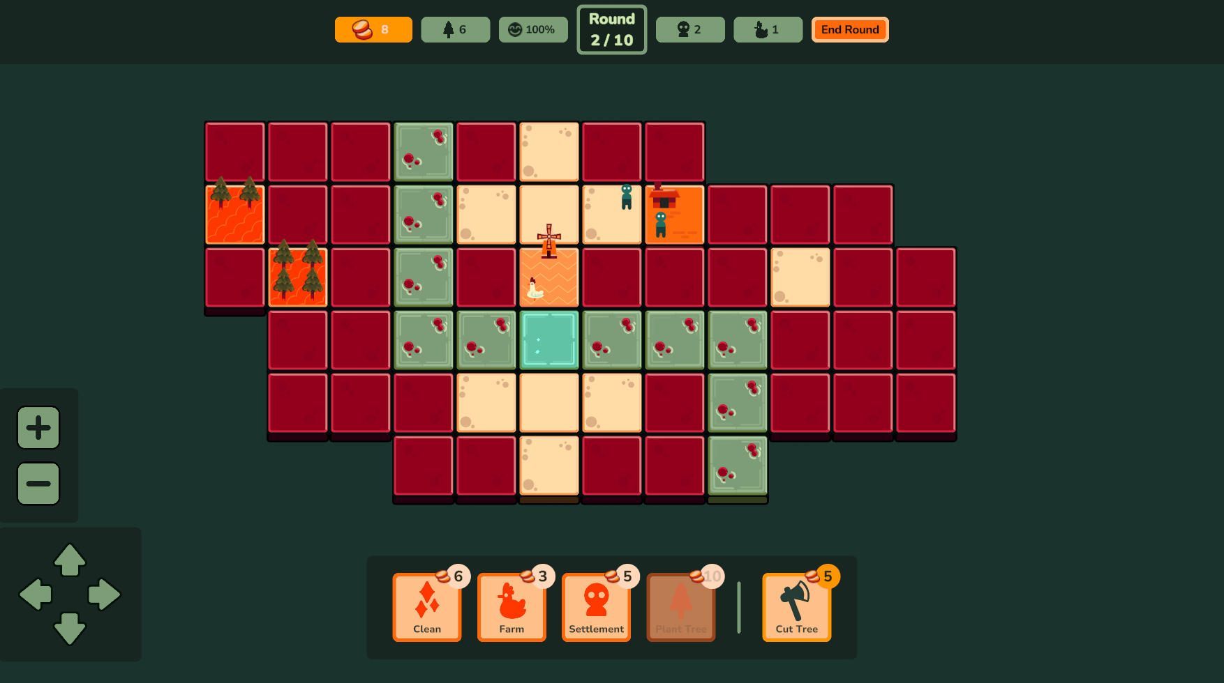
Activity 2: Let's play a game
Restore is a Scottish game developed by GLITCHERS and the University of Stirling.
You will pick a map and then choose how to use the land:
Clean and ready the soil for use
Found new settlements to increase your tax revenue
Manage the forests by planting trees or chop them down for extra cash
Prioritise building homes or expanding the woodlands
Establish chicken farms to feed the ever-hungry populace
Play Restore
Notes:
Play in the VALLEY mode to begin with.
Focus on planting trees and cutting down trees – as immature forestry is planted near people or as forestry is changed near people disease will begin to spread – try to aim to get pupils to notice this while coaching them during game play as this is essential for the rest of the lesson.

Slide 8
During the game
You don’t need to write answers but THINK about:
What happens when there is mature (not brand new) forest?
What happens when there is young (just planted) forest?
What happens when there is forestry close to people?
Notes:
Have this slide on the board as pupils are playing the game – or potentially a printed version of this for pupils to note down ideas in pairs as they play

Slide 9
What happened during the game?
Can we add anything else to the planet one?
2. What have you noticed anything about most of the things on the human side?
Notes:
Pupils should notice that the benefits of trees to people largely need the trees to be cut down...
Mature forest generally is healthy and does not spawn disease
Young forest does tend to spawn disease
Forest near to people tends to spread disease into livestock and into the food chain for people (lots of deaths). ASK PUPILS WHY THEY THINK THIS MIGHT BE? (increased animal and human interactions means diseases otherwise confined to animals may transfer to people – zoonotic diseases – e.g. Ebola and potentially Covid).

Slide 10
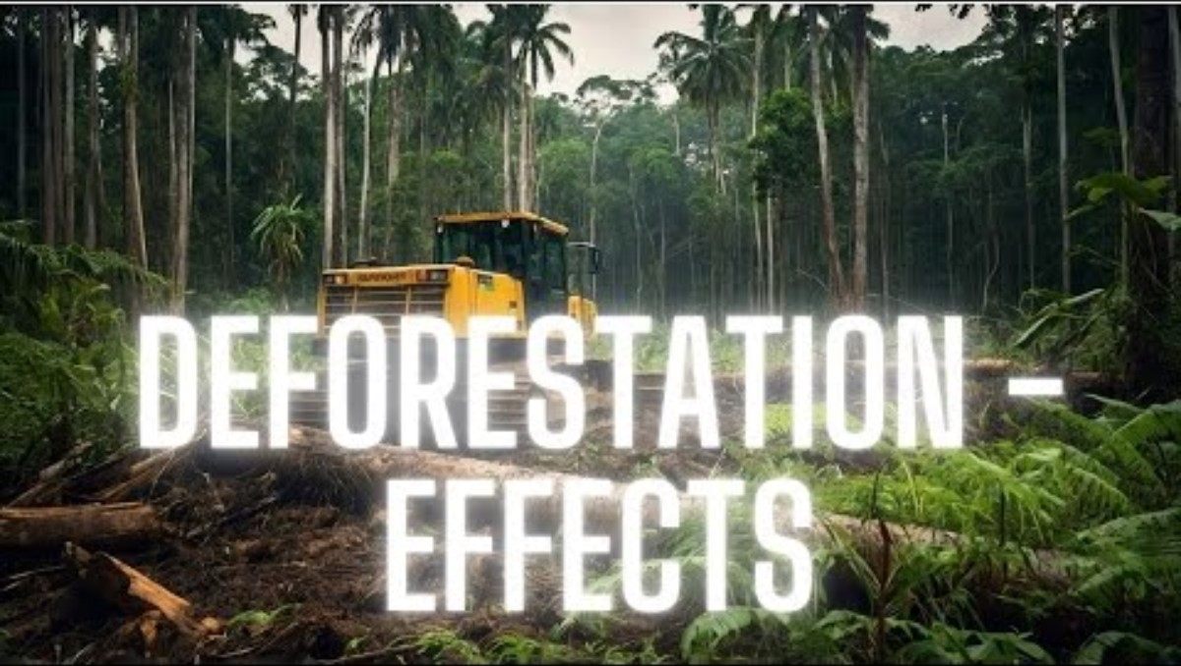
ACTIVITY 3: Deforestation video
Before we watch – let's predict:
Why do we cut down trees?
What could consequences be from cutting down trees?
What could we do to lessen the impact of cutting down trees?
After watching – let's clarify
Rainforest Deforestation: Basics for kids
Notes:
Answers:
What is a zoonotic disease? A zoonotic disease is a disease that spreads from animals to humans.
Give an example of a zoonotic disease. An example is malaria (spread by mosquitoes) or rabies.
If people live closer to forestry, does this increase or decrease the chance of zoonotic diseases? It increases the chance.
Why? Because people are closer to wild animals and insects, so germs can spread more easily from animals to humans.

Slide 11
Notes:
Answers:
What is a zoonotic disease? A zoonotic disease is a disease that spreads from animals to humans.
Give an example of a zoonotic disease. An example is malaria (spread by mosquitoes) or rabies.
If people live closer to forestry, does this increase or decrease the chance of zoonotic diseases? It increases the chance.
Why? Because people are closer to wild animals and insects, so germs can spread more easily from animals to humans.

Slide 12
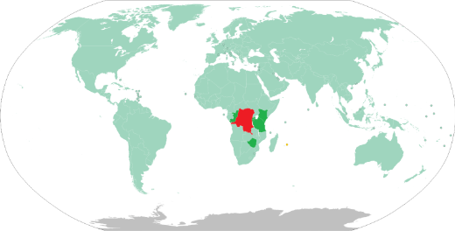
ACTIVITY 4: A real-life example
Where is Democratic Republic of Congo?
It is home to a HUGE rainforest but this is being cut down.
How many football pitches of forest do you think are cut down there in the last 5 years?
It is a country in Africa
4.7 million pitches worth of trees in the last 5 years
Notes:
Answers:
What is a zoonotic disease? A zoonotic disease is a disease that spreads from animals to humans.
Give an example of a zoonotic disease. An example is malaria (spread by mosquitoes) or rabies.
If people live closer to forestry, does this increase or decrease the chance of zoonotic diseases? It increases the chance.
Why? Because people are closer to wild animals and insects, so germs can spread more easily from animals to humans.

Slide 13
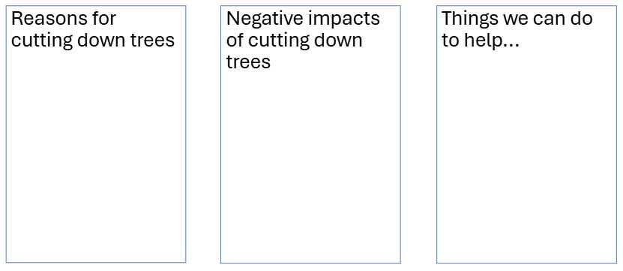
ACTIVITY 4: A real-life example
Investigate
Find out more facts about Democratic Republic of Congo and answer these questions
Deforestation in the Democratic Republic of the Congo - Wikipedia
Congo Deforestation
5 Cool Facts About the Congo Basin - Earth.Org Kids
On Earth Day, learn how UNICEF’s child reporters are advocating for better protection of our planet | UNICEF
Notes:
Answers:
What is a zoonotic disease? A zoonotic disease is a disease that spreads from animals to humans.
Give an example of a zoonotic disease. An example is malaria (spread by mosquitoes) or rabies.
If people live closer to forestry, does this increase or decrease the chance of zoonotic diseases? It increases the chance.
Why? Because people are closer to wild animals and insects, so germs can spread more easily from animals to humans.

Slide 14
ACTIVITY 3:
CHALLENGE 1
The Writer
Write your responseto this brief as afactual newspaperreport.
CHALLENGE 2
The Broadcaster
Record yourresponse to thisbrief as a newsbulletin.
CHALLENGE 3
The Artist
Produce aneducational posterto respond to thisbrief.
THE BRIEF​
Deforestation is increasing around the world. As a Geographer it's your job toeducate the public on why deforestation is increasing and the impacts it ishaving on people and the environment. All good public education itemsinclude a 'call to action' - find a way to inspire your audience to take action toreduce deforestation and its impacts. It's key you include information aboutthe Democratic Republic of the Congo too.​
Notes:
Answers:
What is a zoonotic disease? A zoonotic disease is a disease that spreads from animals to humans.
Give an example of a zoonotic disease. An example is malaria (spread by mosquitoes) or rabies.
If people live closer to forestry, does this increase or decrease the chance of zoonotic diseases? It increases the chance.
Why? Because people are closer to wild animals and insects, so germs can spread more easily from animals to humans.

Slide 15
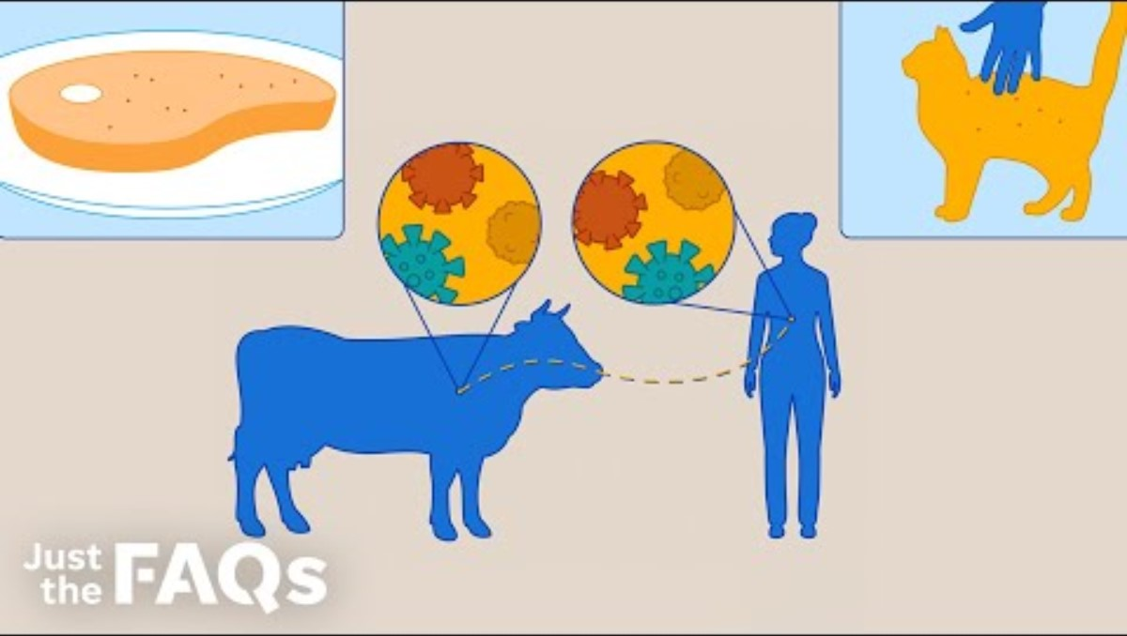
ACTIVITY 3: Zoonotic disease video
Before you watch:
What do you think zoonotic means?
Is living near forests a good thing or not?
After watching, clarify: ​
What is a zoonotic disease? ​
Name a zoonotic disease​
Does living close to forestry increase the risk of zoonotic diseases – why?
​ ​ https://youtu.be/Ss5y_ii796o
Notes:
Answers:
What is a zoonotic disease? A zoonotic disease is a disease that spreads from animals to humans.
Give an example of a zoonotic disease. An example is malaria (spread by mosquitoes) or rabies.
If people live closer to forestry, does this increase or decrease the chance of zoonotic diseases? It increases the chance.
Why? Because people are closer to wild animals and insects, so germs can spread more easily from animals to humans.

Slide 16
Notes:
Answers:
What is a zoonotic disease? A zoonotic disease is a disease that spreads from animals to humans.
Give an example of a zoonotic disease. An example is malaria (spread by mosquitoes) or rabies.
If people live closer to forestry, does this increase or decrease the chance of zoonotic diseases? It increases the chance.
Why? Because people are closer to wild animals and insects, so germs can spread more easily from animals to humans.

Slide 17
Learning intention and success criteria
(add your own)
Success Criteria:
(add your own)
Notes:
Answers:
C
D
B
A
Our world is a delicate resource and also under threat if we don’t look after it.

Slide 18
Learning intention and success criteria
We are learning about the harm caused by deforestation and exploring ways to improve our use of trees and forests
SCs could be:
I can state what deforestation is
I can describe at least two negative effects of deforestation on people or nature
I can imagine solutions to reduce the impact of deforestation
Notes:
Answers:
C
D
B
A
Our world is a delicate resource and also under threat if we don’t look after it.

