Slide 1
Computing Science in Scotland
Brian Clark

Slide 4
What Is Computing Science?

Slide 5
Computer science is considered as part of a family of five separate yet interrelated disciplines: computer engineering, computer science, information systems, information technology, and software engineering. This family has come to be known collectively as the discipline of computing. These five disciplines are interrelated in the sense that computing is their object of study, but they are separate since each has its own research perspective and curricular focus.

Slide 6
Computer science is the study of computers and how they work, including software, hardware, and algorithms. In computer science, an algorithm tells the computer what to do and how to do it. Computer science is an umbrella term that covers everything from artificial intelligence and data science to robotics, game development, cybersecurity, and more

Slide 7
Computing science is wide-ranging: from programming and engineering large software systems, to the design and evaluation of human-computer interfaces, algorithms, computer and network systems, artificial intelligence, information retrieval and big data systems.

Slide 8
Computing Science encourages people to become successful, responsible and creative in using technologies, and to develop a range of qualities including flexibility, perseverance, confidence, and enterprise. People should learn of concepts which underpin the study of computing science and explores the role and impact of contemporary computing technologies.

Slide 9
What does Computing Science mean to you?

Slide 12
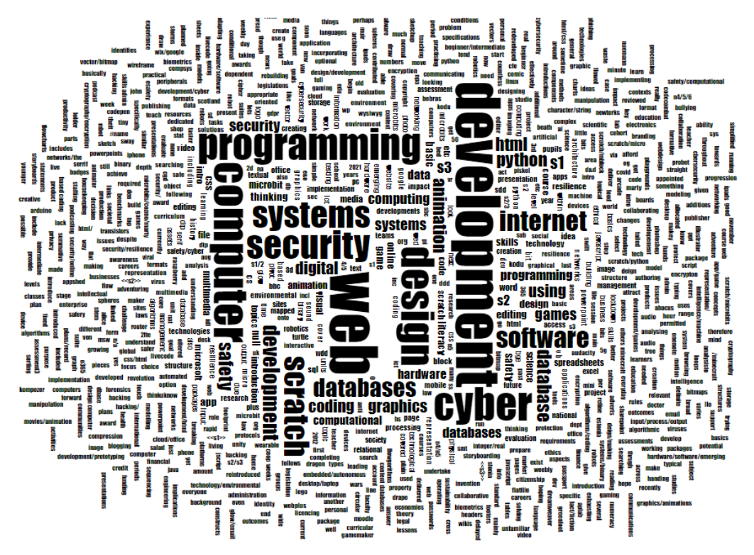
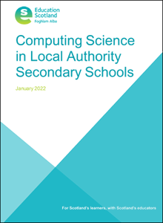
Computing Science in local authority secondary schools | Resources | National Improvement Hub (education.gov.scot)

Slide 13
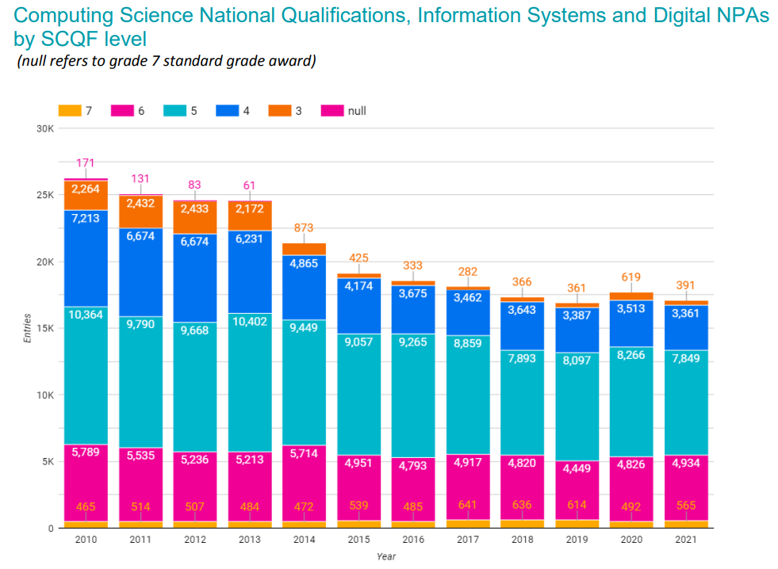
Computing Science in local authority secondary schools | Resources | National Improvement Hub (education.gov.scot)

Slide 14
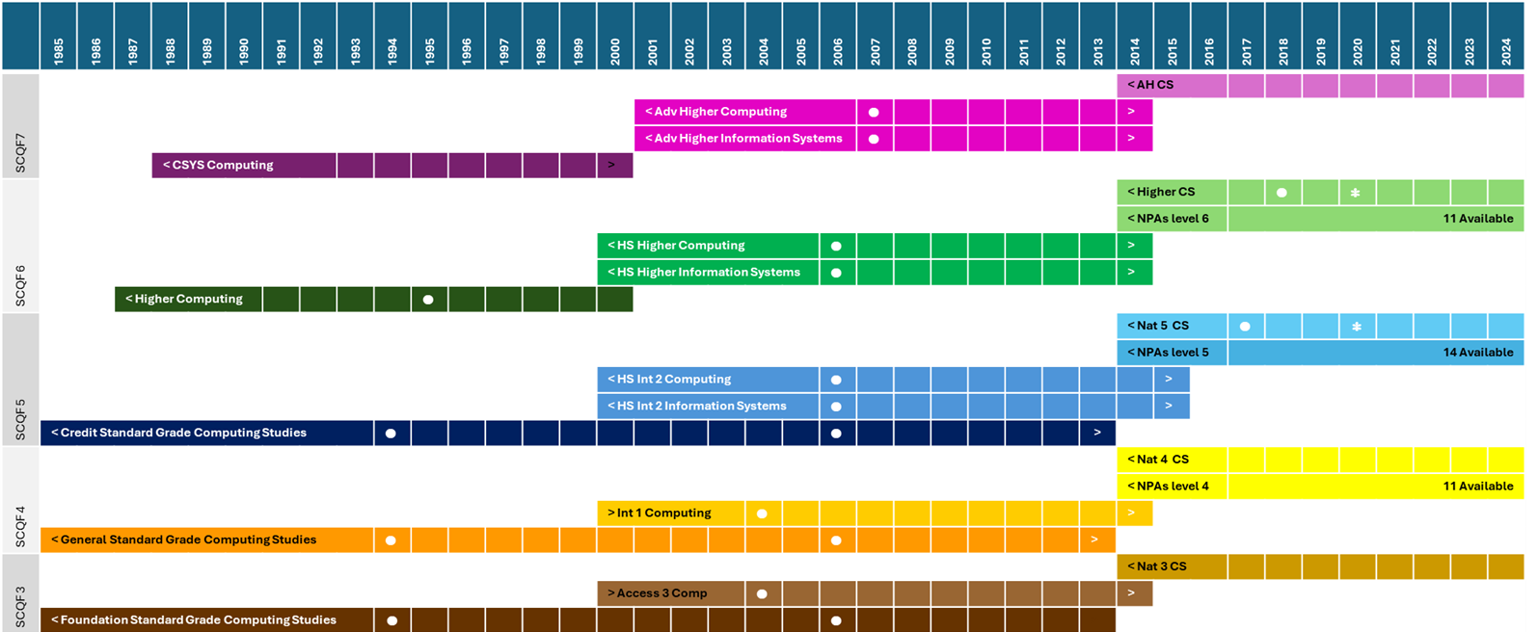

Slide 15
SCQF Level 4
Standard Grade Computing Studies (General) | Intermediate 1 Computing Studies
Computer Applications (60 hours); Computer Systems(20 hours); Computer Programming(40 hours); Project Work (30 hours); Flexibility (10 hours) | Computer Application Software (40 hours); Computer Systems (40 hours); Optional Unit [Software Development; Information Systems; The Internet] (40 hours)
 | 2004 Update
2006 Update | Computer Applications (40 hours); Multimedia Applications (40 hours); Optional Unit [Computers and the Internet; Information and the Internet] (40 hours)
Computer Applications (60 hours); Computer Systems(20 hours); Computer Programming(40 hours); Project Work (30 hours); Flexibility (10 hours)
2014 National 4 Computing Science Course Specification
Software Design and Development; Information Systems Design and Development Added Value Unit

Slide 16
SCQF Level 5
Standard Grade Computing Studies (Credit) | Intermediate 2 Computing | Intermediate 2 Information Systems
1999 Arrangements
Computer Applications (60 hours); Computer Systems(20 hours); Computer Programming(40 hours); Project Work (30 hours); Flexibility (10 hours) | Computer Systems - including applications (40 hours); Software Development (40 hours); Computing Project (40 hours); | Database Systems (40 hours); Information Organisation (40 hours); Optional Unit [Computer Application Software; Expert Systems; Hypermedia] (40 hours)
2006 update
Computer Applications (60 hours); Computer Systems(20 hours); Computer Programming(40 hours); Project Work (30 hours); Flexibility (10 hours) | Computer Systems (40 hours); Software Development (40 hours); Optional Unit [Artificial Intelligence; Computer Networking; Multimedia Technology] (40 hours) | Using Information (40 hours); Database Systems (40 hours); Optional Unit [Expert Systems; Applied Multimedia; The Internet] 40 hours)
2013 END | 2014 END
2014 National 5 Computing Science Course Specification
Software Design and Development; Information Systems Design and Development
2017 Update
Software Design and Development; Database Design and Development; Web Design and Development; Computer Systems

Slide 17
SCQF Level 6
Higher Computing | Higher Information Systems
Computer Systems (40 hours); Software Development (40 hours); Optional Unit [Artificial Intelligence; Computer Programming; Computer Networking; Multimedia Technology] (40 hours) | Database Systems (40 hours); Information Organisation (40 hours); Optional Unit [Computer Application Software; Expert Systems; Hypermedia] (40 hours)
2006 Update
Computer Systems (40 hours); Software Development (40 hours); Optional Unit [Artificial Intelligence; Computer Networking; Multimedia Technology] (40 hours) | Using Information (40 hours); Relational Database Systems (40 hours); Optional Unit [Expert Systems; Applied Multimedia; The Internet] 40 hours)
2014 END
2014 Higher Computing Science Course Specification
Software Design and Development; Information Systems Design and Development
2018 Update
Software Design and Development; Database Design and Development; Web Design and Development; Computer Systems

Slide 18
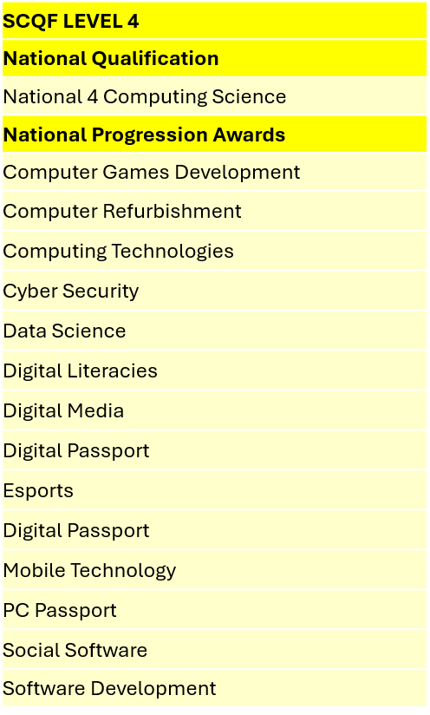
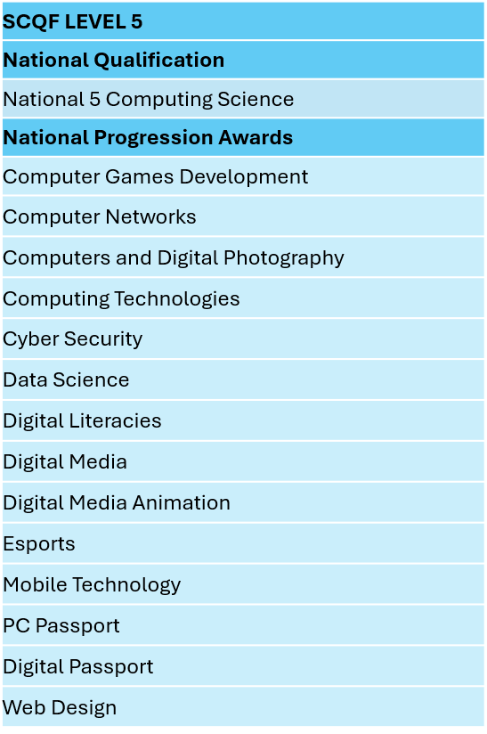
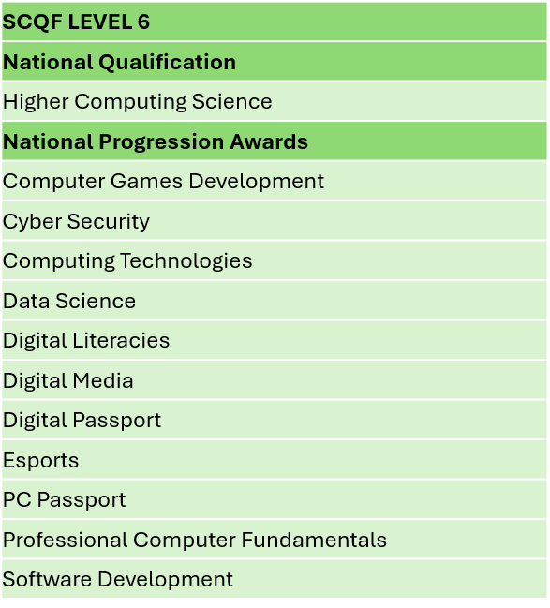

Slide 20
Nat 5 CS by Year Group (LA)

Slide 22
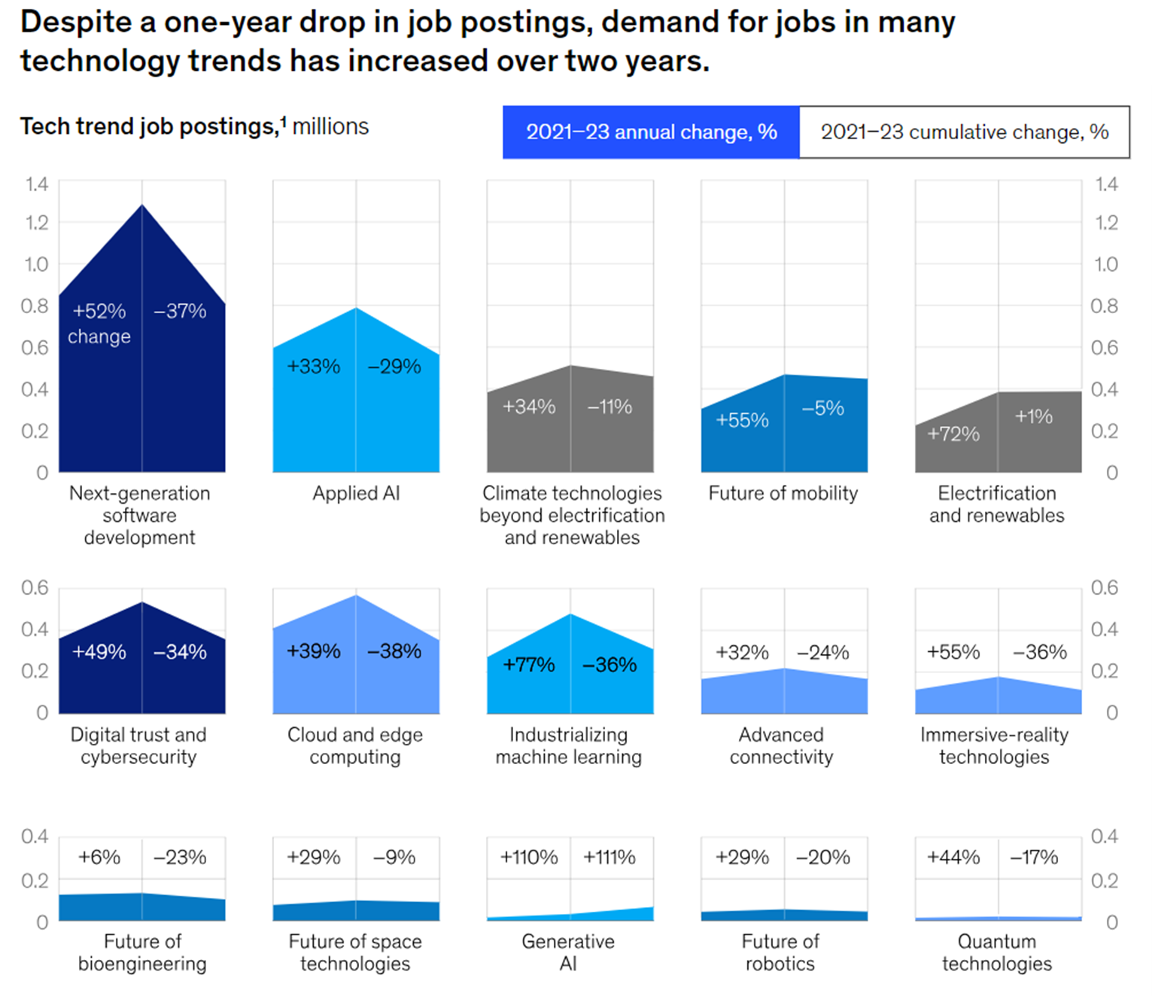

Slide 23
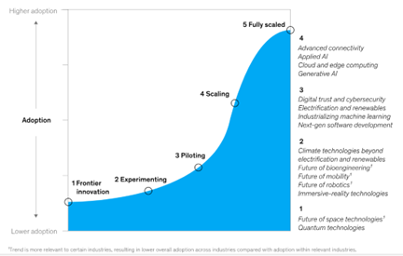

Slide 24
Piaget 4 Stages of Cognitive Development

Slide 25
Sensorimotor stage: Birth to 2 years Preoperational stage: Ages 2 to 7 Concrete operational stage: Ages 7 to 11 Formal operational stage: Ages 12 and up

Slide 26
Sensorimotor stage: Birth to 2 years Major characteristics and developmental changes during this stage: Know the world through movements and sensations Learn about the world through basic actions such as sucking, grasping, looking, and listening Learn that things continue to exist even when they cannot be seen (object permanence) Realise that they are separate beings from the people and objects around them Realise that their actions can cause things to happen in the world around them

Slide 27
Preoperational stage: Ages 2 to 7 Major characteristics and developmental changes during this stage: Begin to think symbolically and learn to use words and pictures to represent objects Tend to be egocentric and struggle to see things from the perspective of others Getting better with language and thinking, but still tend to think in very concrete terms

Slide 28
Concrete operational stage: Ages 7 to 11 Major characteristics and developmental changes during this stage: Begin to think logically about concrete events Begin to understand the concept of conservation; that the amount of liquid in a short, wide cup is equal to that in a tall, skinny glass, for example Thinking becomes more logical and organized, but still very concrete Begin using inductive logic, or reasoning from specific information to a general principle

Slide 29
Formal operational stage: Ages 12 and up Major characteristics and developmental changes during this time: Begins to think abstractly and reason about hypothetical problems Begins to think more about moral, philosophical, ethical, social, and political issues that require theoretical and abstract reasoning Begins to use deductive logic, or reasoning from a general principle to specific information

Slide 30
Future industries
FE / HE
Senior Phase Courses
What does this look like?
What attributes need to be developed in learners?
Pre school / out of school

