Slide 1
The Curriculum Improvement Cycle
Andrew Creamer
Head of Learning, Teaching and Assessment
Education Scotland

Slide 2
Why?
OECD
Review
M | J | J | A | S | O | N | D | J | F | M | A | M | J | J | A | S | O | N | D | J | F | M | A
2021 |  |  |  |  |  |  |  | 2022 |  |  |  |  |  |  |  |  |  |  |  | 2023

Slide 3
Why?
3.4 Develop a systematic approach to curriculum review: Scotland could consider establishing a systematic curriculum review cycle with a planned timeframe and specific review agenda, led by the specialist stand-alone agency.
OECD
Review
M | J | J | A | S | O | N | D | J | F | M | A | M | J | J | A | S | O | N | D | J | F | M | A
2021 |  |  |  |  |  |  |  | 2022 |  |  |  |  |  |  |  |  |  |  |  | 2023

Slide 4
Key events since June 2021
OECD
Review
M | J | J | A | S | O | N | D | J | F | M | A | M | J | J | A | S | O | N | D | J | F | M | A
2021 |  |  |  |  |  |  |  | 2022 |  |  |  |  |  |  |  |  |  |  |  | 2023

Slide 5
Key events since June 2021
Stobart
Review
Consultation
Launch
National Discussion (ND)
Muir
Review
Implementation
Framework V2.0
Pathways:
Women in
Enterprise
Review
SLF
2022
1st year of
new Gov
New
School
Year
OECD
Review
Implementation
Framework V1.0
M | J | J | A | S | O | N | D | J | F | M | A | M | J | J | A | S | O | N | D | J | F | M | A
2021 |  |  |  |  |  |  |  | 2022 |  |  |  |  |  |  |  |  |  |  |  | 2023

Slide 6
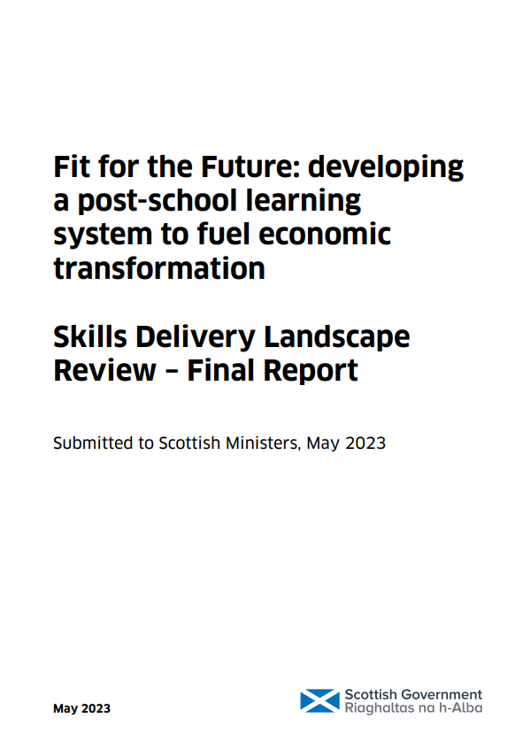
Skills
Delivery
Review
Key events since June 2021
SG OECD
Papers
Prof
Hayward
Report
Women in
Enterprise
Review
National
Discussion
Report
LfS Strategy
Purposes &
Principles
J | F | M | A | M | J | J | A | S | O | N | D | J | F | M | A | M | J | J | A | S | O | N | D
School Year 22/23 |  |  |  |  |  |  | School Year 23/24 |  |  |  |  |  |  |  |  |  |  |  | School Year 24/25
2023 |  |  |  |  |  |  |  |  |  |  |  | 2024

Slide 7
Skills
Delivery
Review
CIC Key dates 2023 / 2024
SG OECD
Papers
Curriculum – Call to Action:
A regular curriculum review process should be established to ensure that the curriculum remains fit for purpose, reflects contemporary learner needs, and can be effectively delivered in ways to ensure that all learners in Scotland have high quality curricular linked learning experiences.
As part of the review of the curriculum the technical framework of the BGE (including the Experiences and Outcomes) needs to be re-visited to ensure it is still fit for purpose and aligns with emerging recommendations about the Senior Phase from the ‘Hayward Review'.
Prof
Hayward
Report
Women in
Enterprise
Review
National
Discussion
Report
LfS Strategy
Purposes &
Principles
J | F | M | A | M | J | J | A | S | O | N | D | J | F | M | A | M | J | J | A | S | O | N | D
School Year 22/23 |  |  |  |  |  |  | School Year 23/24 |  |  |  |  |  |  |  |  |  |  |  | School Year 24/25
2023 |  |  |  |  |  |  |  |  |  |  |  | 2024

Slide 8
Skills
Delivery
Review
CIC Key dates 2023 / 2024
SG OECD
Papers
Prof
Hayward
Report
Women in
Enterprise
Review
National
Discussion
Report
LfS Strategy
Purposes &
Principles
J | F | M | A | M | J | J | A | S | O | N | D | J | F | M | A | M | J | J | A | S | O | N | D
School Year 22/23 |  |  |  |  |  |  | School Year 23/24 |  |  |  |  |  |  |  |  |  |  |  | School Year 24/25
2023 |  |  |  |  |  |  |  |  |  |  |  | 2024

Slide 9
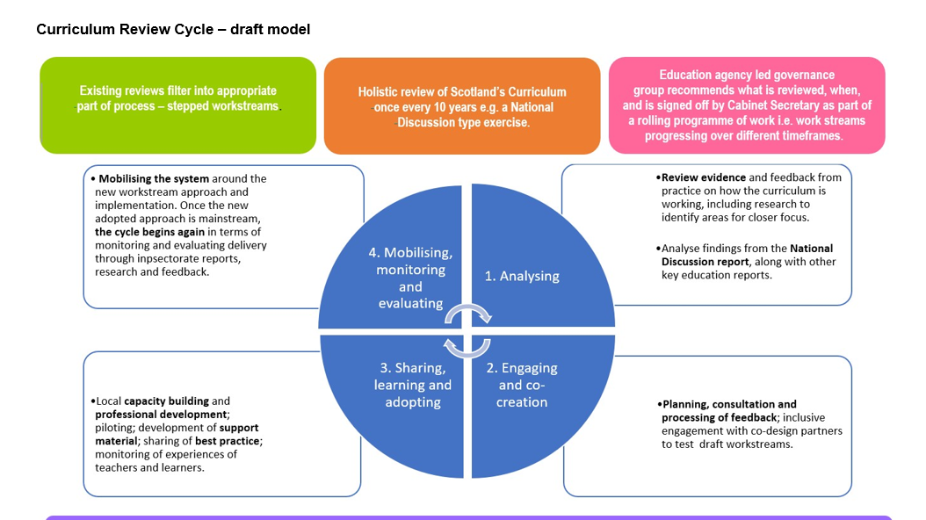
Skills
Delivery
Review
CIC Key dates 2023 / 2024
SG OECD
Papers
Prof
Hayward
Report
Women in
Enterprise
Review
National
Discussion
Report
LfS Strategy
Purposes &
Principles
J | F | M | A | M | J | J | A | S | O | N | D | J | F | M | A | M | J | J | A | S | O | N | D
School Year 22/23 |  |  |  |  |  |  | School Year 23/24 |  |  |  |  |  |  |  |  |  |  |  | School Year 24/25
2023 |  |  |  |  |  |  |  |  |  |  |  | 2024
Curriculum Review
Cycle Developed and then tested with CAB

Slide 11
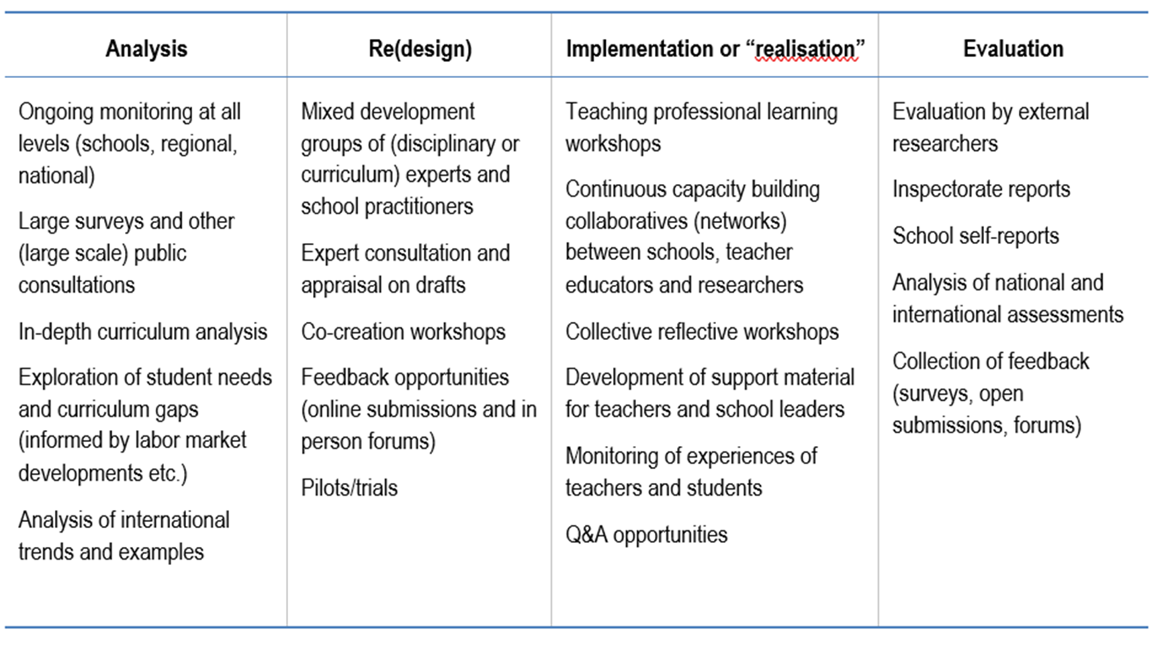

Slide 17
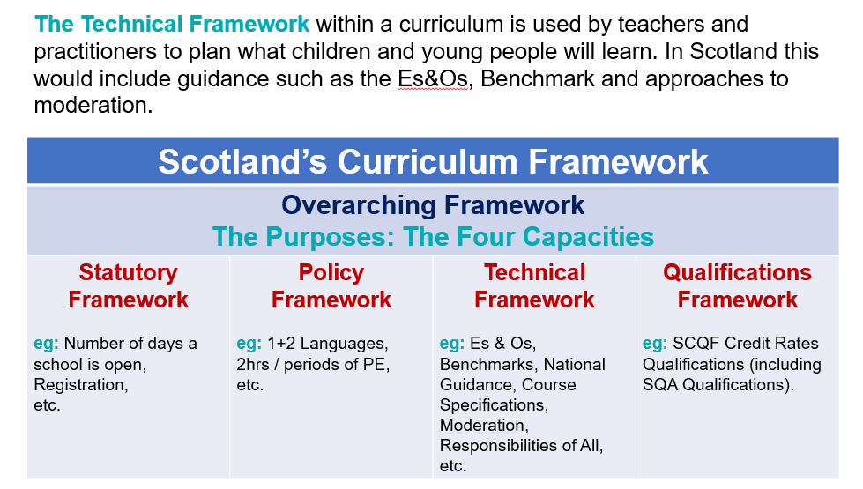

Slide 18
Skills
Delivery
Review
CIC Key dates 2023 / 2024
High Level Maths Framework
Government Response to Hayward, et. al ?
SG OECD
Papers
Review
Assessment &
Qualifications
Women in
Enterprise
Review
ES Commission from SG to start work
Curriculum Review
Cycle Announced
National
Discussion
Report
Maths
English
Work Begins on:
Overarching Framework
Core Competencies
Present clear plan to the system (Autumn)
LfS Strategy
Purposes &
Principles
J | F | M | A | M | J | J | A | S | O | N | D | J | F | M | A | M | J | J | A | S | O | N | D
School Year 22/23 |  |  |  |  |  |  | School Year 23/24 |  |  |  |  |  |  |  |  |  |  |  | School Year 24/25
2023 |  |  |  |  |  |  |  |  |  |  |  | 2024
Curriculum Review
Cycle Developed and then tested with CAB
Creation of long-term education reform strategic plan?

Slide 19
Core Competencies
HWB
Literacy
Numeracy
Learning for Sustainability (LfS)
Careers Education
Creativity
Digital Literacy
Entrepreneurship
Financial Education
Political Literacy
Social Justice

Slide 20
Key Stakeholders
Academics
ELC
Primary
ASN
Secondary
The mix of the experience is the important thing

Slide 22
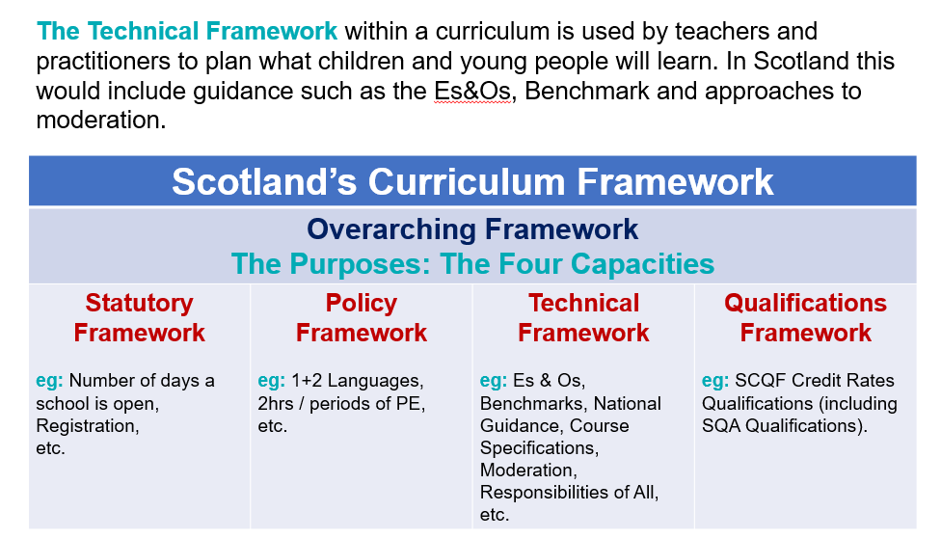

Slide 23
Scotland’s Curriculum Framework
why | what | how
 | + entitlements
…
…
www.scotlandscurriculum.scot

Slide 24
Explore – Define – Exemplify – Empower
(Tools)

Slide 25
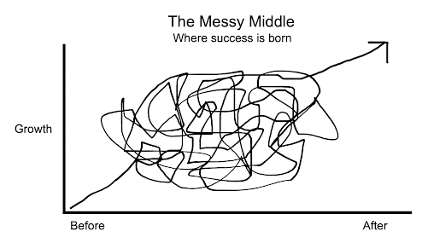
You are about to enter the Messy Middle
[Trust the Process]
A plan of action
Clarity
Development
After
Disagreement
Ideas
NOW
September

Slide 26
Face-to-face Workshop Blueprints
#1 – examine the evidence
#2 – why, what & how: knowledge, skills & attributes
#3 – consolidation and refining

